Slide 1
Advertisement auctions analysis
EDA + Hypothesis testing
Jakub Hofman

Slide 2
203 unique publishers,
on Wednesday, 24/06/2020
offered
999 994 auctions in total.
Only 78 300 / 7.8% of them were successful.

Slide 3
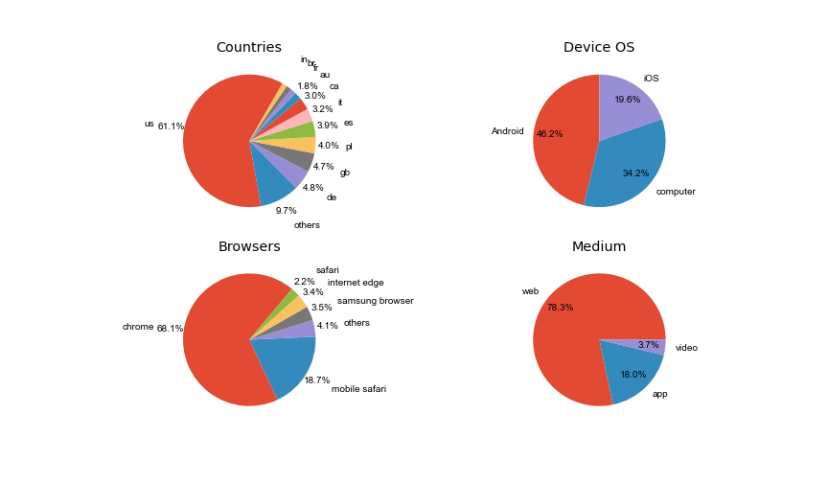

Slide 4
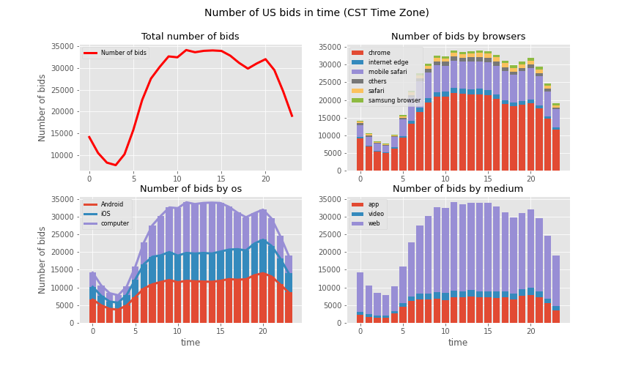

Slide 5
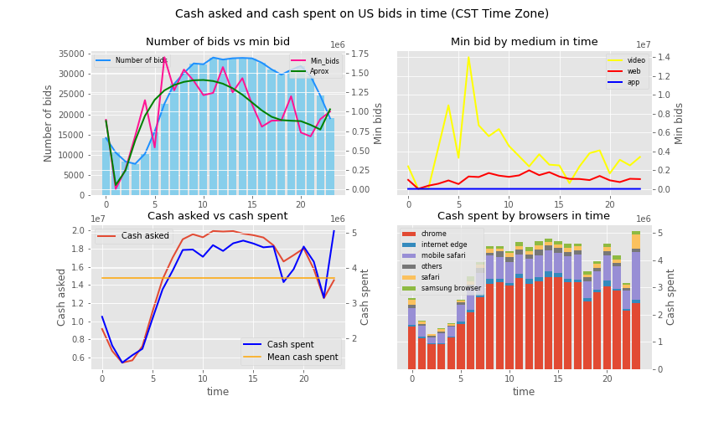

Slide 6
Conclusion:
92.2% of publishers ads are not sold on COMPANY’s auctions.
US is dominant market with 61% of total bids and together with DE,GB,PL,ES,IT stands for 82% of COMPANY business.
Minimal bid to win is correlated with numbers of bids and its strong fluctuations are due to other factors - publishers pricing strategy?
The web is the dominant medium and video is the most expensive.
Advertiser spendings follow the number of bids with the exception of late evening peak (Apple users increase).

