Slide 1
Capstone project – air pollution Krakow (Poland)

Slide 2
Input data
Csv file with sensors location (longitude and latitude)
Csv file with parameters of pm10, pm2.5, teperature, humidity for each sensor for each day of 2017 year (recording every one hour)

Slide 3
Data processing and preparing
Writing data from csv file from Kaggle to dataframe.
Preparing dataframe including only data about pm10 and pm2.5 parameters (other parameters were ignored because of the huge amount of data)
Preparing dataframe only fo December and July to show the difference of air stage depending of the season.
Merging information about sensors location and pm10 and pm2.5 parameters.
Cosmetic – removing duplicats and NaN rows.

Slide 4
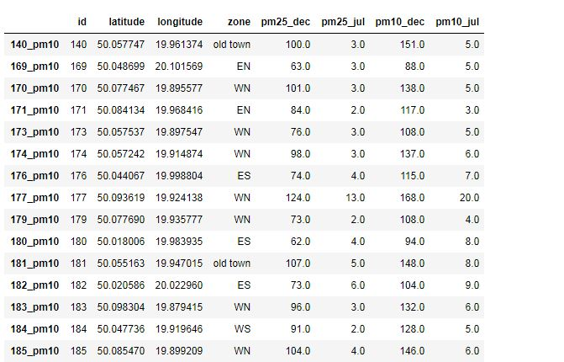
Dataframe after preparing and processing

Slide 5
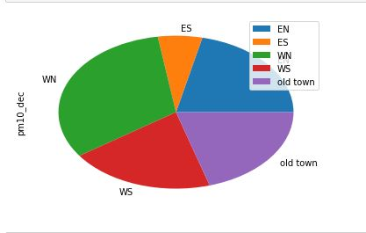
Sensors assigned to the zones (5 zones for all area)

Slide 6
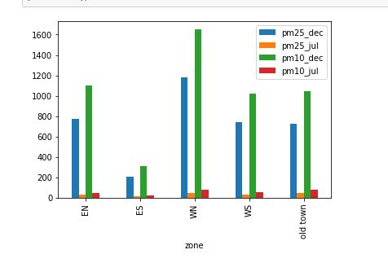
Air pollution depending on the season – much worse is in December than in July

Slide 7
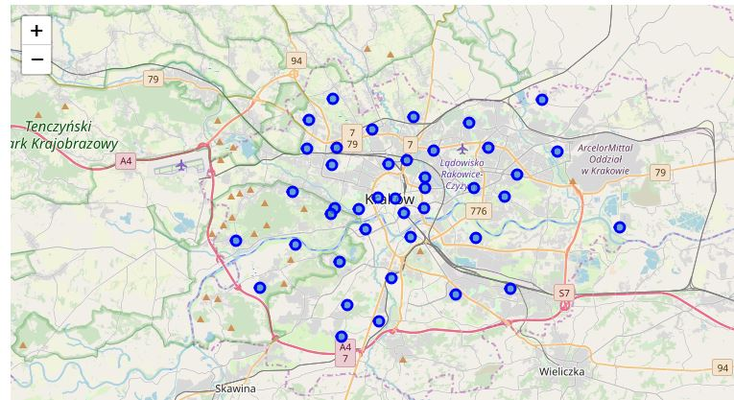
Krakow map with sensors location

Slide 8
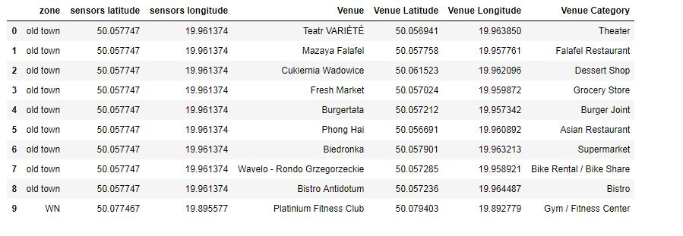
Using Foursquere choosing venues nearby and merging it with existing data

Slide 9
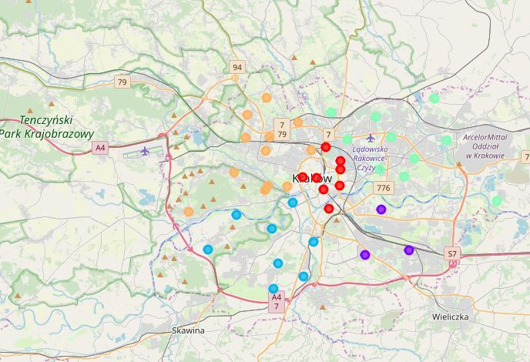
Clusterization (sensors in different clusters depending of zone)

Slide 10
Clusterization
Each cluster was tested and checked by top 10 most popular venues

