Slide 1
Design Patterns
Szkółka website 2017

Slide 2
Very simple introduction
Modern mobile and web applications need to talk to each other
How they do it?
How to make them talk with each other?

Slide 3
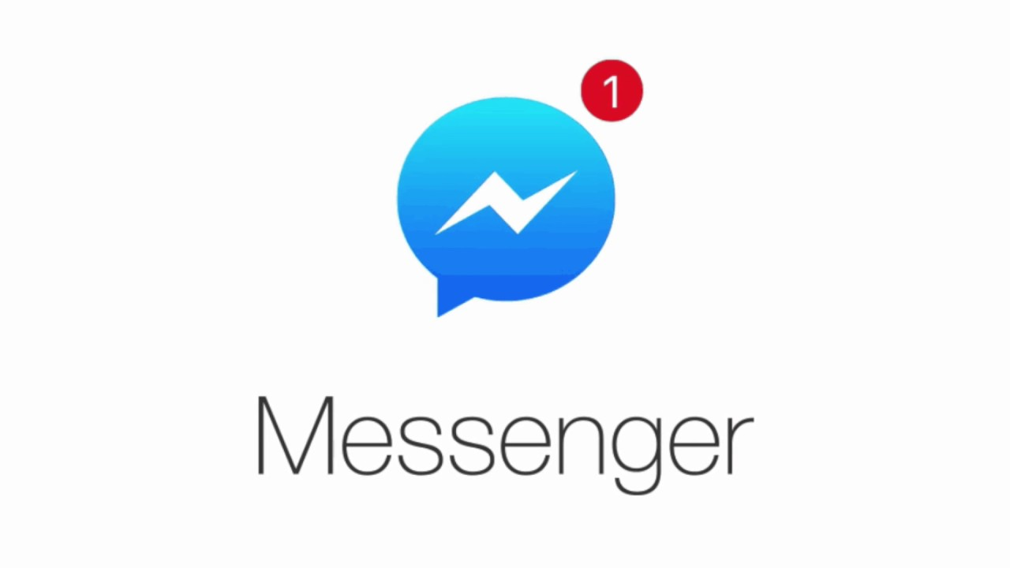
Modern mobile and web applications need to talk to each other

Slide 4
How they do it?

Slide 5

How to make them talk with each other?

Slide 6
Clone the repository and create your branch
branching strategy: [domain_alias]/day-1 np. ksikora/day-1
https://github.com/needcash/asp-net-core-api-training

