Slide 1
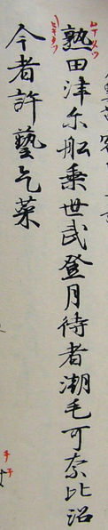


Manyoushuu (万葉集)
Jakub Levý jakub.levy15@gmail.com NDBI042 2021/2022 Faculty of Mathematics and Physics Charles University
unless otherwise stated
i

Slide 2
Contents
Japanese 101
Writing System
Mora
Waka
Haiku
Manyoushuu
About
Poem in detail
Project
Visualization Goals
Overview
Technologies
Look at the Code
(Live) Examples
Conclusion
References

Slide 3
Japanese 101

Slide 4

Japanese Writing System (1)
No script existed until ~ AD 285
Chinese symbols not perfect due to language differences
Sino-Japanese (音読) texts unintelligible
Japanese reading of Chinese characters invented (訓読)
How to capture the exact sound (of Japanese names)?
Use an arbitrary Chinese symbol with the correct 音読 reading
Ex. no could be written as 能, 乃, 農, 濃, 迺, …
The list was then reduced and partially defined
Manyougana (万葉仮名)
Notes:
According to a tradition, Wani, the legendary Korean scholar, introduced Chinese symbols to Japan.
ワニ (wani) is also a word in Japanese meaning crocodile

Slide 5
Japanese Writing System (2)
Manyoushuu is written in Manyougana
Grammatical forms are captured by certain Manyougana characters
Characters are complicated, but often used
Simplification
In 10th century, shortcuts defined as Katakana (片仮名)
First Japanese syllabic alphabet
Considered less aesthetic than Manyougana

Slide 6
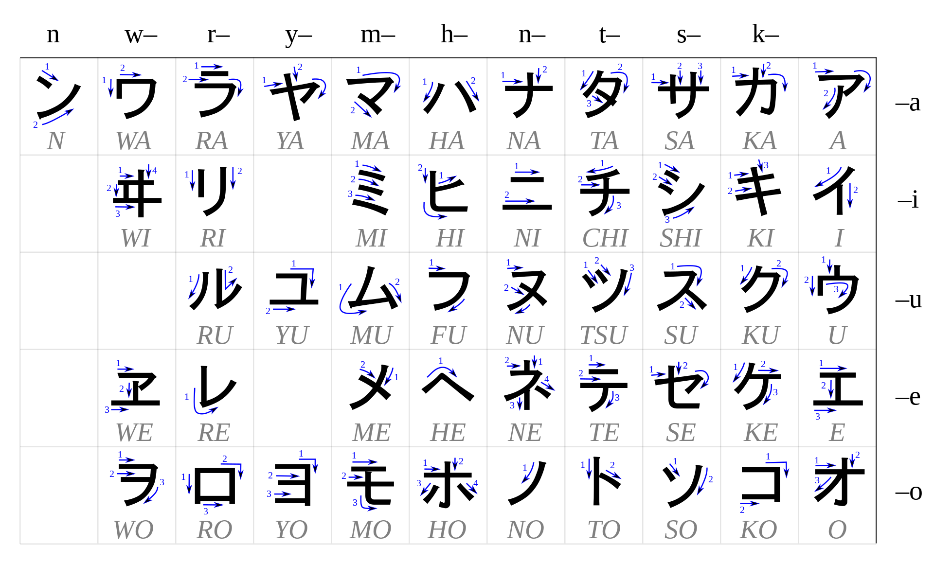

Slide 7
Japanese Writing System (3)
In parallel, Sougana (草仮名) was used in private correspondences
Few selected Manyougana characters written in highly cursive style (草書体)
Generally for woman
Not expected to know Chinese characters
Sougana was called onnade (女手)
Becomes popular in 10th century
Contains “woman gracefulness”
Slightly transformed and called Hiragana (平仮名) nowdays
hand
woman

Slide 8
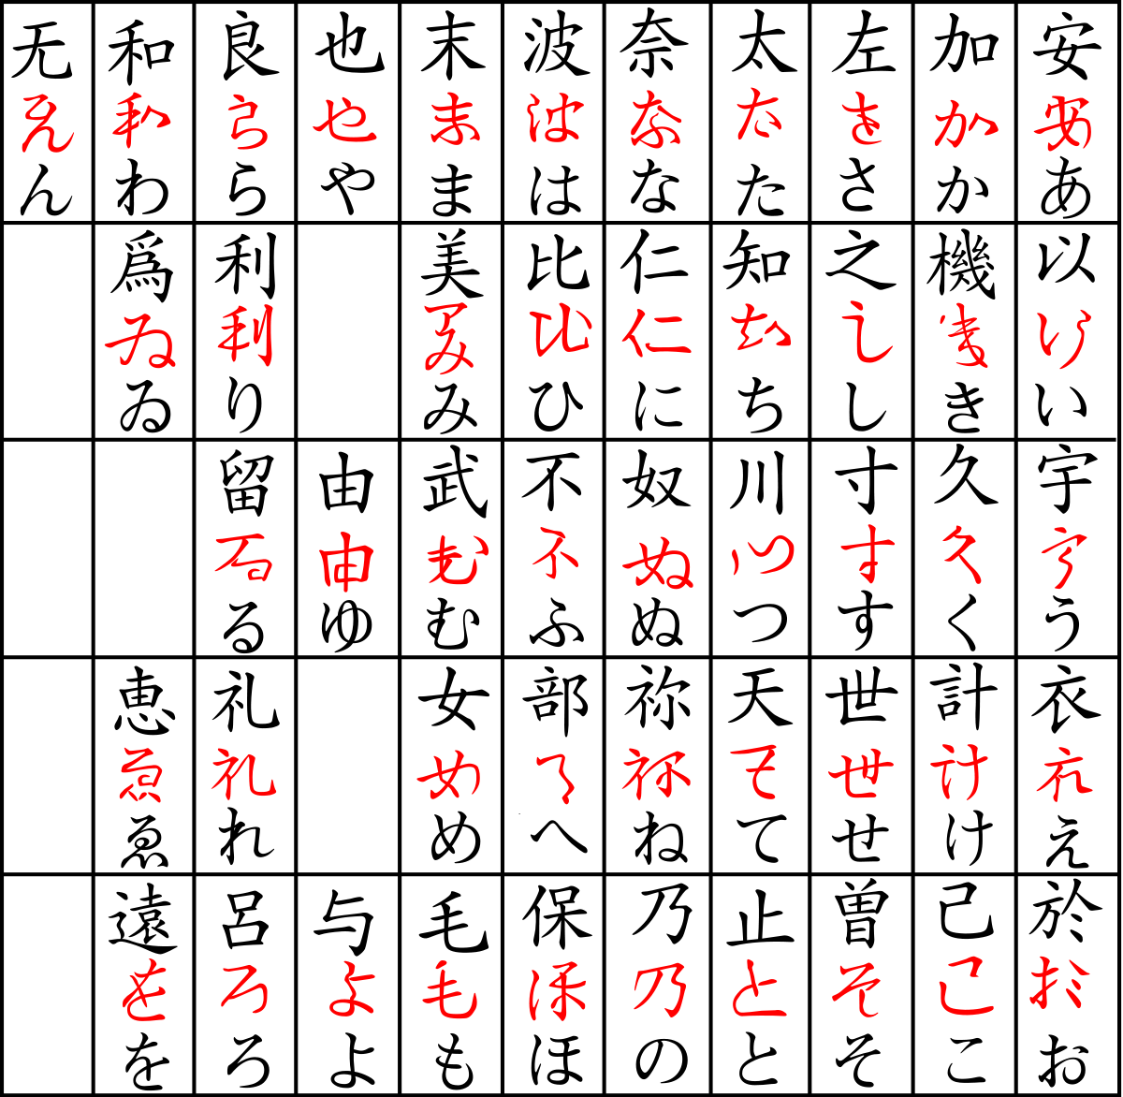
Chinese character
Sougana
Hiragana

Slide 9
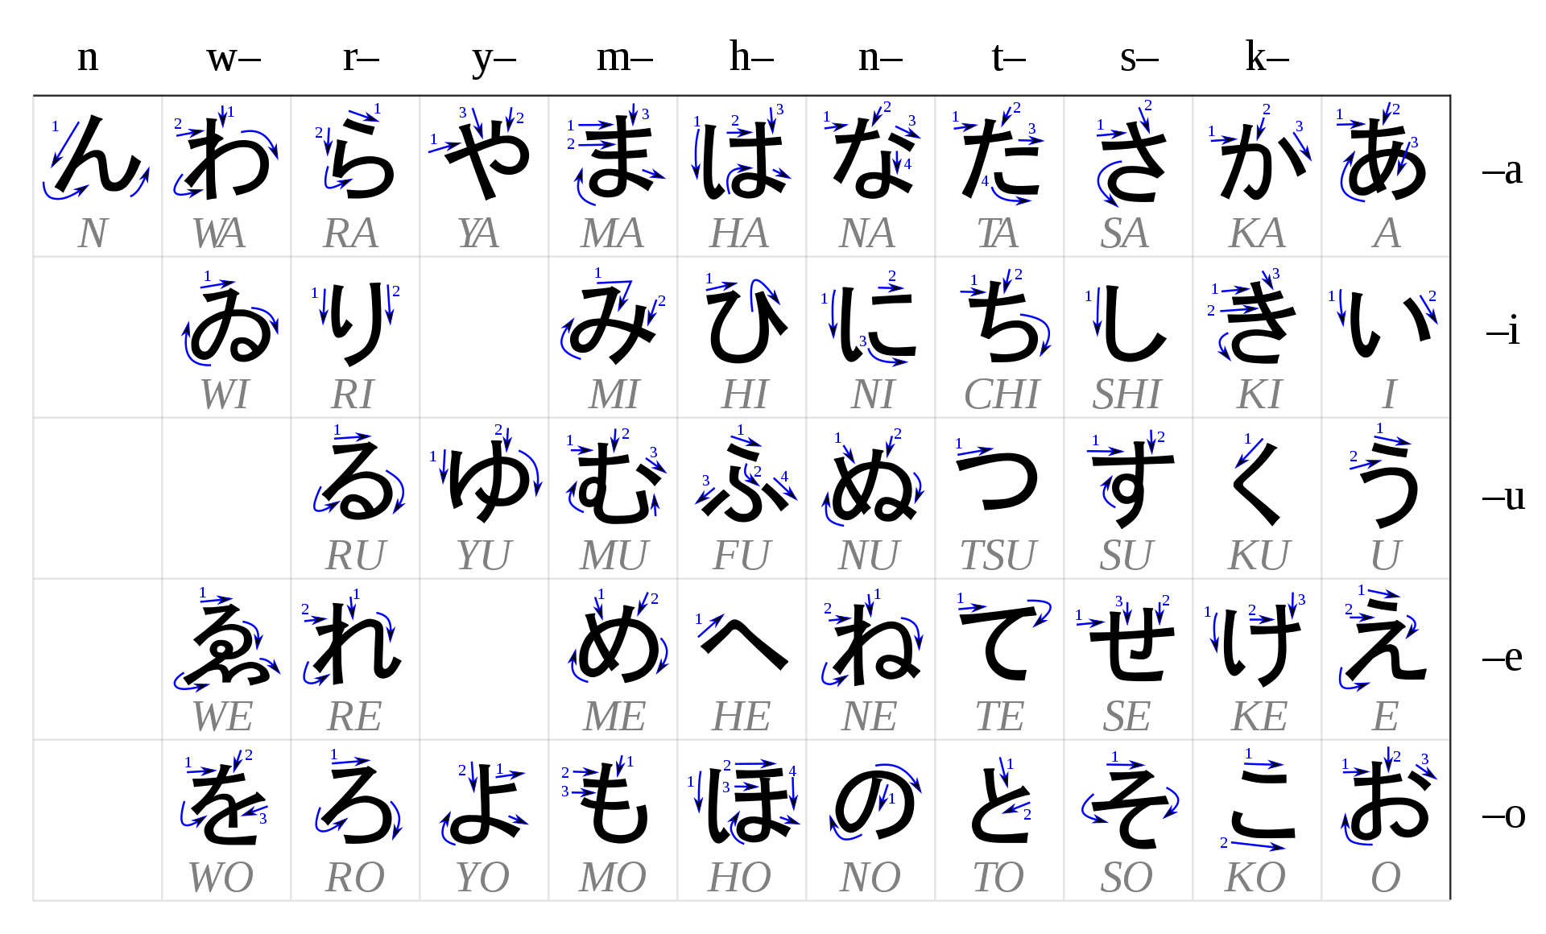

Slide 10
Japanese Writing System (4)
Modern Japanese use
Hiragana, Katakana, Kanji (Chinese characters), Latin, Arabic numerals
CD１枚、Tシャツ２枚、リンゴ３個を買いたいと思います。
I want to buy 1 CD, 2 T-shirts, and 3 apples so much.
一歩でも動いたり 妙 なマネをすればこのガキの 首 を掻き切る。
SHII DII ICHI MAI TI SHA TSU NI MAI RI N GO SAN KO O KA I TA I TO OMO I MA SU
IP PO DE MO UGO I TA RI MYOU NA MA NE O SU RE BA KO NO GA KI NO KUBI O KA KI KI RU
Take even one step or make a funny move and I’ll slit this brat’s throat.
Notice SOV (subject-object-verb) word order

Slide 11


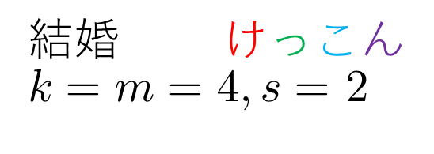
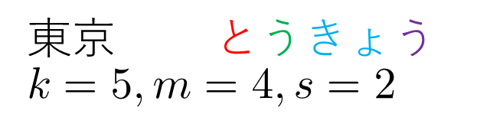
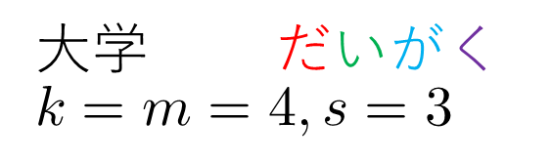
Mora
One mora is the length of time it takes to pronounce one kana (Hiragana or Katakana) character
Generally $k≠m≠s$
BA KA
KE K KO N
馬鹿 ばか $$k=m=s=2$$
結婚 けっこん
$k=m=4,s=$ 2
DA I GA KU
TO U KYO U
大学 だいがく
$$k=m=4,s=3$$
東京 とうきょう $$k=5,m=4,s=2$$
kana
morae
syllables

Slide 12
Waka (和歌 or 倭歌)
Poetry in classical Japanese literature
Many forms
Differ by the number of morae
Tanka (短歌)
Major genre
5-7-5-7-7
Chouka (長歌)
5-7 repeated at least twice
Concluded with 5-7-7 ending
Katauta (片歌)
Shortest form of Waka
5-7-7
Sedouka (旋頭歌)
Katauta twice
5-7-7-5-7-7
Bussokusekika (仏足石歌)
Tanka with an extra 7 phrase at the end
5-7-5-7-7-7

Slide 13
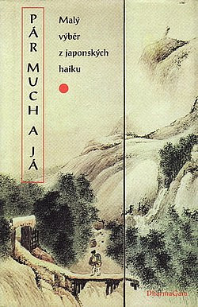

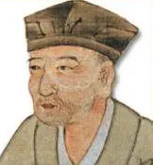

Why is Haiku (俳句) missing?
First emerged in 17th century
Much younger than all forms of Waka
5-7-5
Not relevant for us
古池や 蛙飛び込む 水の音
Notes:
Do staré tůně
skočila žába
žbluňk
(Translated by Antonín Líman)

Slide 14
Manyoushuu (万葉集)

Slide 15
Manyoushuu (万葉集) (1)
万葉集 ~ “collection of ten thousand leaves”
Oldest collection of Waka poetry
Written in Manyougana
More than 4000 Waka poems
561 authors
70 woman
People of various statuses: emperors, aristocrats, peasants, street performers, …
Over 2100 poems by unknown authors

Slide 16
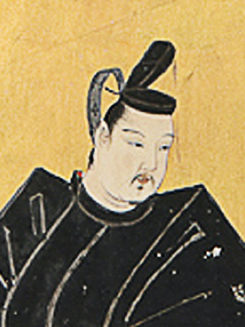
Manyoushuu (万葉集) (2)
First poem by emperor Nintoku (313-399)
Last poem from AD 759
Most poems probably from 7th and 8th century
Probably compiled by Ootomo no Yakamochi (大伴 家持) in 8th century

Slide 17
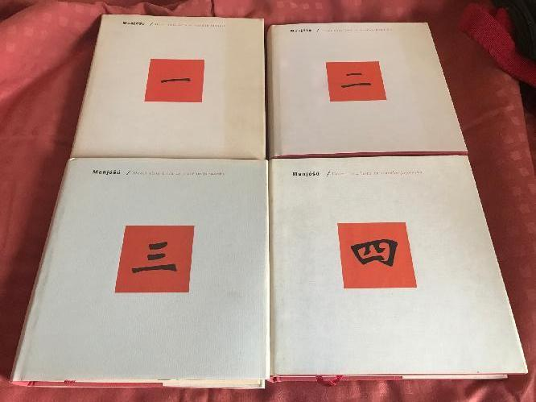
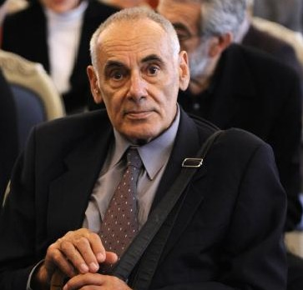
Manyoushuu (万葉集) (3)
Complete translation of the whole anthology available only in
French
Czech (by Antonín Líman)

Slide 18
Uta 8 (Princess Nutaka’s Poem)
Original
Modern
Hiragana only
NIGI TA TSU NI
NI GI TA TSU NI
熟田津尓
船乗世武登
月待者
潮毛可奈比沼
今者許藝乞菜
熟田津に
船乗りせむと
月待てば
潮もかなひぬ
今は漕ぎ出でな
にぎたつに
ふなのりせむと
つきまてば
しほもかなひぬ
いまはこぎいでな
5
5
FUNA NO RI SE MU TO
FU NA NO RI SE MU TO
7
7
TSUKI MA TE BA
TSU KI MA TE BA
5
5
SHIHO MO KA NA HI NU
SHI HO MO KA NA HI NU
7
7
IMA WA KO GI I DE NA
I MA WA KO GI I DE NA
7
8
U loďky v zálivu Nikita
čekáme na měsíc…
Příliv nám přeje,
nuže, k veslům, k veslům!
(Translated by Antonín Líman)

Slide 19
Project

Slide 20
Visualization Goals
Word cloud of the most used words
Frequency of a kanji vs the number of different words the kanji is used in
And be able to somehow quickly see JLPT level of the kanji
Calculate the number of poems for every Waka form
Check the compliance of the form of a poem in modern Japanese
Show the occurrence of a kanji/word across all poems
Different forms of a word must be handled correctly 持たず and 持ち are a form of 持つ

Slide 21
Overview
https://jti.lib.virginia.edu/japanese/manyoshu/AnoMany.html
Puppeteer
data/manyoushuu.csv
Matplotlib, wordcloud,
mplcursors
nlcst-parse-japanese,
japanese-moji
Python scripts in plot/ directory
JSON files in
data/ directory

Slide 22

Puppeteer
Node.js library providing API to control Chrome/Chromium
Uses DevTools Protocol

Slide 23
nlcst-parse-japanese (1)
Parser for Japanese text
Output format is NLCST
Natural Language Concrete Syntax Tree format

Slide 24
nlcst-parse-japanese (2)
MO CHI
Parser output for 持ち (boilerplate nodes omitted)
{
"type": "TextNode",
"value": "持ち",
"position": {
"start": {
"line": 1,
"column": 8,
"offset": 7
},
"end": {
"line": 1,
"column": 10,
"offset": 9
}
},
"data": {
"word_id": 3144310,
"word_type": "KNOWN",
"surface_form": "持ち",
"pos": "動詞",
"pos_detail_1": "自立",
"pos_detail_2": "*",
"pos_detail_3": "*",
"conjugated_type": "五段・タ行",
"conjugated_form": "連用形",
"basic_form": "持つ",
"reading": "モチ",
"pronunciation": "モチ"
}
}

Slide 25
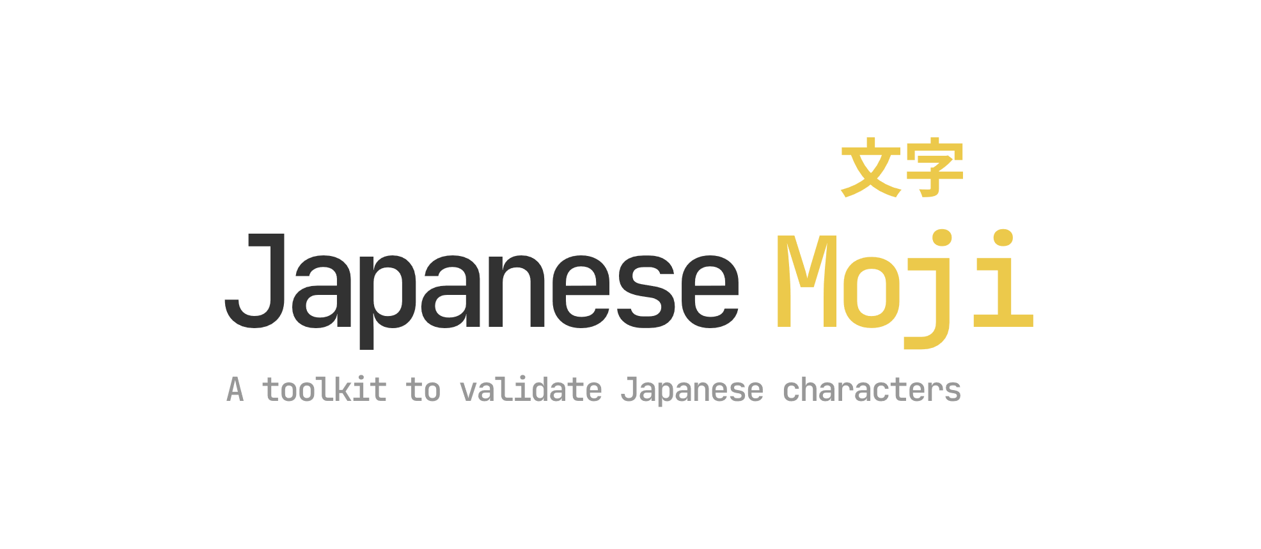
japanese-moji
Handy functions for lazy people
isValidKanji
Supports creation of custom validators
kanaValidatorOptions = {
characterSets : [
CharacterSet.Katakana,
CharacterSet.KatakanaPhoneticExtension,
CharacterSet.HalfWidthKatakana,
CharacterSet.Hiragana
]
}
isValidKana = createStrictValidator(kanaValidatorOptions)

Slide 26
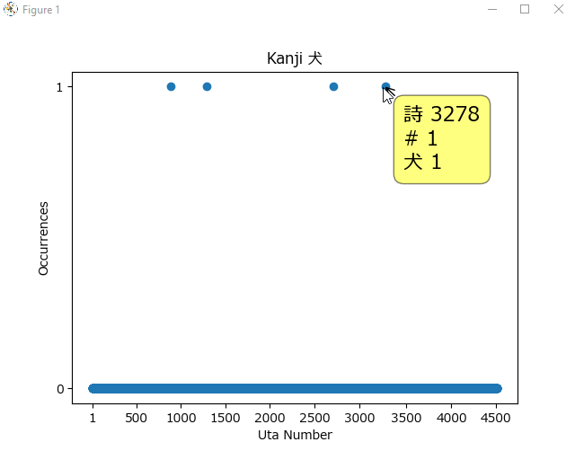
mplcursors
Interactive data selection tooltips for Matplotlib

Slide 27
Look at the Code

Slide 28
(Live) Examples

Slide 29
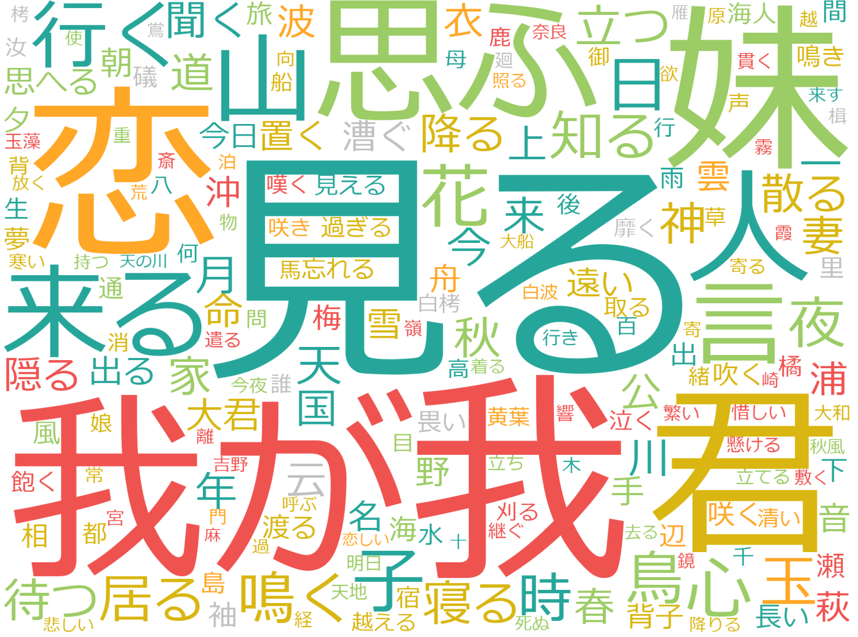
Other
JLPT N1
JLPT N2
JLPT N3
JLPT N4
JLPT N5

Slide 30
freq-count.py
Frequency of a kanji vs the number of different words the kanji is used in.
In 97% of cases, 我 is used in 我 or 我が
君 is virtually always used in 君 or 大君
君 used to mean either “you” or “ruler”
Kanji connected with nature are generally used in many different words
山, 木, 田, 花, 草, 野, 鳥, 春, 夜, …
WARE
WA GA
KIMI
OO KIMI
large, big
YAMA
KI
TA
HANA
KUSA
NO
TORI
HARU
YORU
night
mountain
tree
rice field
flower
grass
field
bird
spring
Notes:
In uta 10, 君 is used to mean “you”.
In uta 47, 君 is used to mean “ruler”.

Slide 31
Words containing 山
#occurrences
YAMA
SHIMA YAMA
山 (497)
山辺 (31)
山川 (28)
山道 (23)
秋山 (19)
山吹 (18)
奥山 (17)
山菅 (13)
高山 (17)
島山 (11)
山下 (10)
春山 (9)
二上山 (9)
山の端 (9)
春日山 (8)
山越え (7)
青山 (7)
山彦 (7)
YAMA BE
(SAN KA)|(YAMA SHITA)|(SAN GE)
Common word
(SAN SEN)|(YAMA KAWA)
(HARU YAMA)|(SHUN ZAN)
YAMA MICHI
(NI JOU ZAN)|(FUTA KAMI SAN)|(FUTA GAMI YAMA)
AKI YAMA
YAMA NO HA
and more …
(115 different words in total)
YAMA BUKI
KASUGA YAMA
OKU YAMA
YAMA GO E
YAMA(SHIGE|SUGA|SUGE)
(SEI ZAN)|(AO YAMA)
KOU ZAN
YAMA BIKO

Slide 32
distance-rank.py
Order the kanji by the Euclidian distance
Associate an integer called rank with every kanji such that
The most distant kanji has rank 1, the second most 2, …
Plot the rank and the Euclidian distance

Slide 33
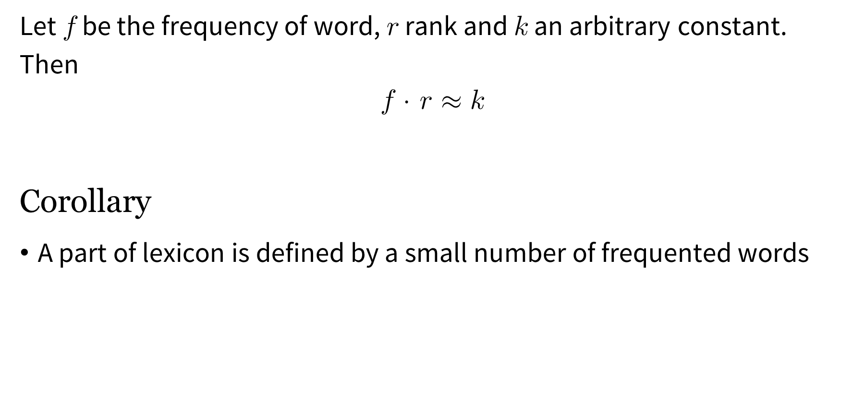
The First Zipf’s Law
Let $f$ be the frequency of word, $r$ rank and $k$ an arbitrary constant. Then
$$f \text{⋅} r≈k$$
Corollary
A part of lexicon is defined by a small number of frequented words

Slide 34
kanji-word-occ.py
Plots the occurrence across the whole anthology
Accepts one positional argument (word/kanji)
In case of a kanji, add an optional parameter –k
python kanji-word-occ.py -k "神"
python kanji-word-occ.py "犬"
python kanji-word-occ.py -k "雪"
god
dog
snow

Slide 35
Uta 886
Abych došel do paláce,
tonoucího v záři slunce,
musel jsem opustit náruč matky,
paní plných ňader, a brát se
do krajů, jež jsem v životě neviděl,
překročit sterou hradbu strmých hor.
Kdy už spatříme hlavní město,
ptám se denně svých druhů,
ale pak bolest láme mé tělo
a já klesám u cesty, která se
táhne do dáli jako kopí z nefritu.
U cesty prostřeli mi narychlo
lože z trávy a zelených větviček
a já vzdychám, jak tu v žalostné bídě ležím.
Být v rodné zemi, pečoval by o mě otec,
být doma, objímala by mě matka.
Že to tak na světě chodí?
Mám snad zajít u cesty jako toulavý pes?
(Translated by Antonín Líman)
Notes:
Composed by Ootomo no Kumakori

Slide 36
uta-types.py
Calculate the number of poems for every Waka form
Overwhelming majority (92%) of poems are of type Tanka (5-7-5-7-7)
Even a Bussokusekika poem is present
Poems inscribed on the Buddha's footprints at Yakushi-ji (薬師寺)

Slide 37
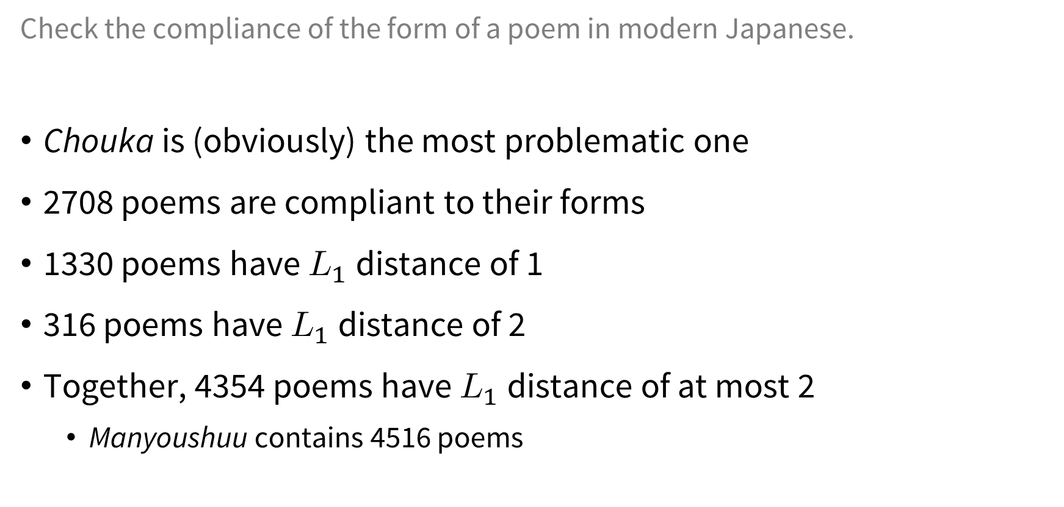
morae-dist.py
Check the compliance of the form of a poem in modern Japanese.
Chouka is (obviously) the most problematic one
2708 poems are compliant to their forms
1330 poems have $L_{1}$ distance of 1
316 poems have $L_{1}$ distance of 2
Together, 4354 poems have $L_{1}$ distance of at most 2
Manyoushuu contains 4516 poems

Slide 38
verse-count.py
Between poems 3221 and 3346, there are 67 poems of type Chouka
25% of all Chouka poems
There are other smaller clusters of Chouka poems

Slide 39
これで終わり

Slide 40
Conclusion
We have learned a bit
About how is/was Japanese written
Old Japanese poetry
The visualization project
We have seen
Examples (writing, sentences, poetry, code)
Visualizations
Results

Slide 41
Code & Slides
https://gitlab.mff.cuni.cz/levyjak/ visualization-project

Slide 42
References (1)
Japonsko-český studijní znakový slovník, druhé vydání
Manjóšú – Deset tisíc listů ze starého Japonska, díl první
Manjóšú – Deset tisíc listů ze starého Japonska, díl druhý
Pár much a já: malý výběr z japonských haiku
https://www.japanesewithanime.com/2019/11/mora.html
https://www.japanesewithanime.com/2017/12/compound-kana.html
https://ja.wikipedia.org/wiki/%E5%92%8C%E6%AD%8C
https://www.britannica.com/art/haiku

Slide 43
References (2)
https://ja.wikipedia.org/wiki/%E4%B8%87%E8%91%89%E9%9B%86
https://en.wikipedia.org/wiki/Man%27y%C5%8Dsh%C5%AB
https://cs.wikipedia.org/wiki/Manj%C3%B3%C5%A1%C3%BA
https://github.com/puppeteer/puppeteer
https://github.com/azu/nlp-pattern-match/tree/master/packages/nlcst-parse-japanese
https://github.com/arjunvegda/japanese-moji
https://wikisofia.cz/wiki/Zipfovy_z%C3%A1kony

Slide 44
References (Pictures) (1)
https://www.iconfinder.com/icons/6900234/alligator_crocodile_crocodile_icon_predator_icon
https://en.wikipedia.org/wiki/Katakana#/media/File:Table_katakana.svg
https://en.wikipedia.org/wiki/S%C5%8Dgana#/media/File:Sogana.png
https://en.wikipedia.org/wiki/Hiragana#/media/File:Table_hiragana.svg

Slide 45
References (Pictures) (2)
https://www.japanpowered.com/japan-culture/the-life-and-impact-of-matsuo-basho
https://www.databazeknih.cz/img/books/13_/13545/big_par-much-a-ja-yD0-13545.jpg
https://www.istockphoto.com/cs/vektor/%C5%BEab%C3%AD-sk%C3%A1k%C3%A1n%C3%AD-izolovan%C3%A1-%C5%BE%C3%A1ba-sk%C3%A1%C4%8De-na-b%C3%ADl%C3%A9m-pozad%C3%AD-gm1130502836-299008045
https://www.stockio.com/free-icon/nature-icons-blue-fish

Slide 46
References (Pictures) (3)
https://www.historyofcreativity.com/content/6/s_creator.001_1589061380.jpg
http://www.c-d-f.cz/media/images/authors/antonin-liman.jpg
https://cdn.aukro.cz/images/sk1622082133201/730x548/manjosu-dil-i-az-iv-komplet-101033023.jpeg
https://user-images.githubusercontent.com/10379601/29446482-04f7036a-841f-11e7-9872-91d1fc2ea683.png

Slide 47
References (Miscellaneous)
Template
https://www.slideegg.com/japan-theme-presentation
https://www.shutterstock.com/cs/image-vector/set-handdrawn-traditional-japanese-symbols-red-418482400
Speech bubbles
https://www.elearningdesigner.co.uk/freebies

