Slide 1
My work with the ECAL DCS software and a Non-invasive isolation damage system for the preshower detector
Jakub Wieczorek
02/12/2019

Slide 2
Presentation plan
A few words about ECAL DCS
What is that
My participation
Isolation damages detection project
Problem definition
Solution proposal
Constructed systems
Outcome

Slide 3
ECAL Detector Control System

Slide 4
ECAL DCS
Detector Control System
ECAL DCS one of the nodes of CMS DCS
SCADA systems which allows controling and operating the detector
My participation:
Panel development
Integration test for interlocks with final report
Parts of technical documentation

Slide 5
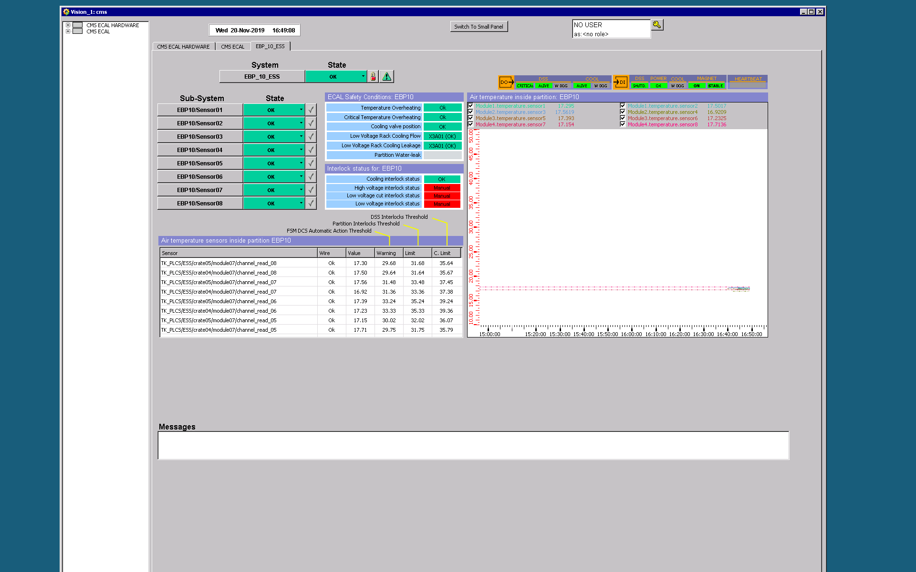
One panel for each partition
1 water leakage sensor per endcap
36 barel partitions, 8 endcaps partitions
8 temperature sensors
per partition
352 temperature sensors

Slide 6
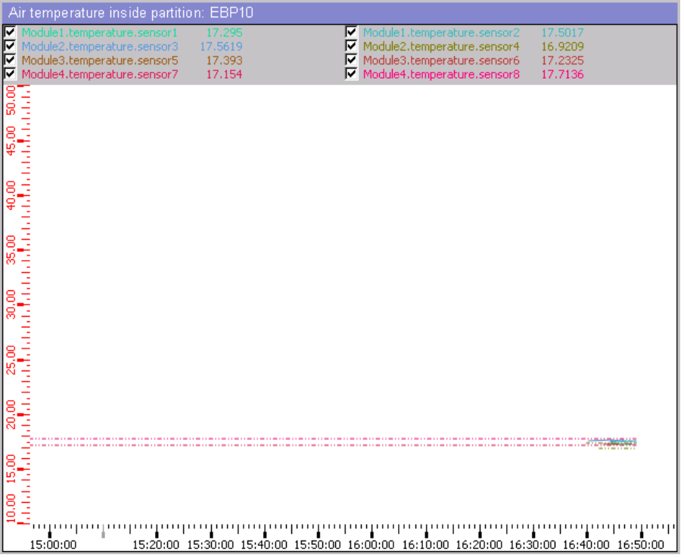
Temperature sensors plot widget
Shows readouts from temperature sensors in real time
Plot can be checked and unchecked by user
When sensor is disabled there is no plot available for that sensor

Slide 7
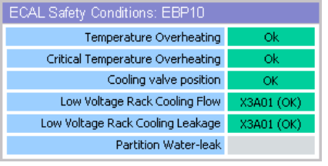
Conditions monitoring widget
Partition conditions in real time
When one of the temperature sensors exceeds threshold, then alarm and suitable automatic actions for the partition is perfomed
Cooling status
Water leakage available only for endcap partitions

Slide 8
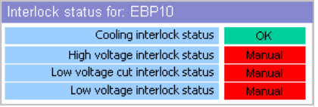
Interlock status widget
Interlocks for current partition
Temperature sensor exceeds limit, then high voltage, low voltage and low voltage cut interlocks are set
Cooling interlock for water leakage sensors in endcaps
Interlocks can be set manually

Slide 9
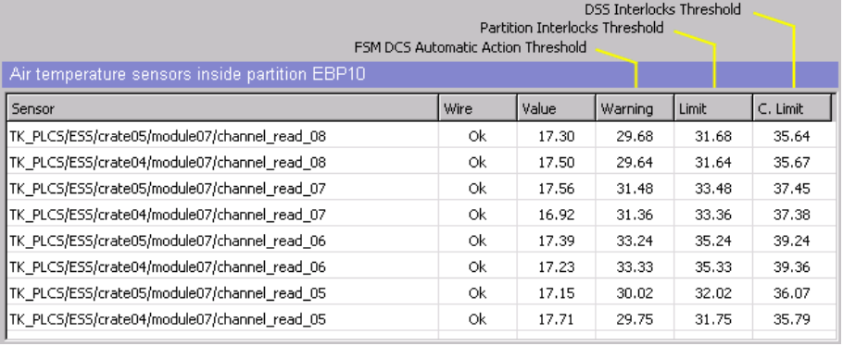
Interlock status widget
Crucial values for every sensor
Wire connection
Current value
Warning status if value two degrees lower than overheating limit
Crossing overheating limit causes partition interlocks
Crossing critical overheating causes general DSS interlock, which turns off the detector

Slide 10
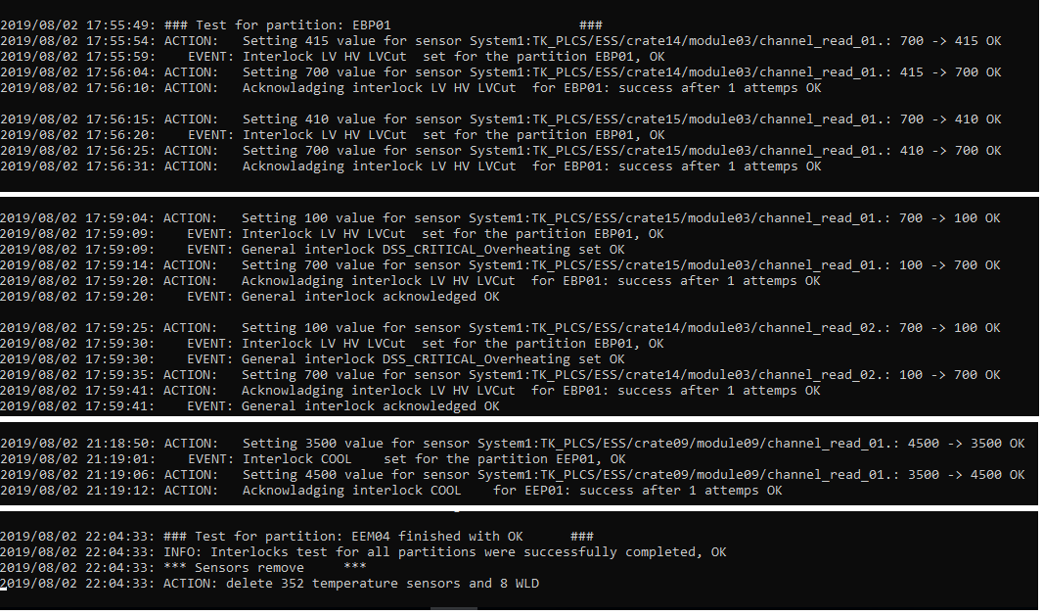
Integration test for interlocks
Test for every partition – 352 temp + 8 WLD
2) Check if interlocks is set
1) Set value to fake sensor – exceed threshold
3) Come back to the normal state and acknowledge interlocks
5) Check if DSS interlock set
4) Exceed critical threshold
6) Exceed WLD threshold
7) Check if COOL interlock set
Problems with 2 sensors detected!

Slide 11
Isolation damages detection project

Slide 12
Introduction and problem definition
The CMS Preshower detector is cooled down to -20°C by C6F14 based liquid
Pipes are isolated using Armaflex
Armaflex is subjected to ageing and damage
Air gets inside an isolation and condensates on the pipes
Energy dissipation

Slide 13
Solution proposal #1
Cut the isolation
Mount humidity and temperature sensors
Connect sensors to PLC
Build SCADA system
Detect isolation damages
Replace damaged isolation
What are the problems?

Slide 14
Solution proposal #2
Use simple sensors, radiation resistant – pair of needles
Stick them into isolation and measure resistance
Measuring infinite resistance – isolation not broken
Measuring something else – potential isolation damage
What are the problems?

Slide 15
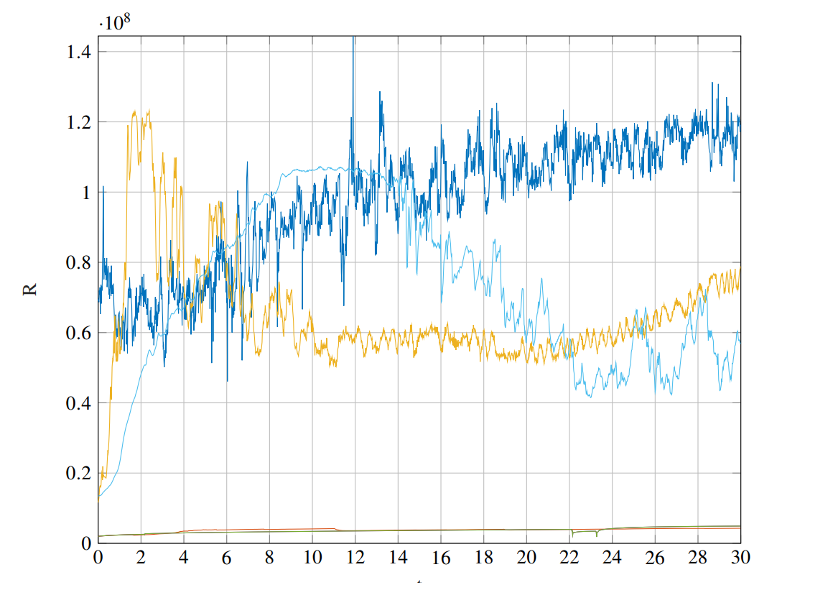
Few words about measurements
It matters where needles are stuck
Really difficult to measure something between no water and water
Water typically several hundreds of kΩ
Dry isolation typically dozen MΩ

Slide 16
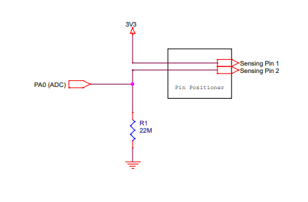
Hardware and electronics
Pair of needles
100% radiation resistant
Potentially subject to rust
High valued resistor
Voltage divider

Slide 17
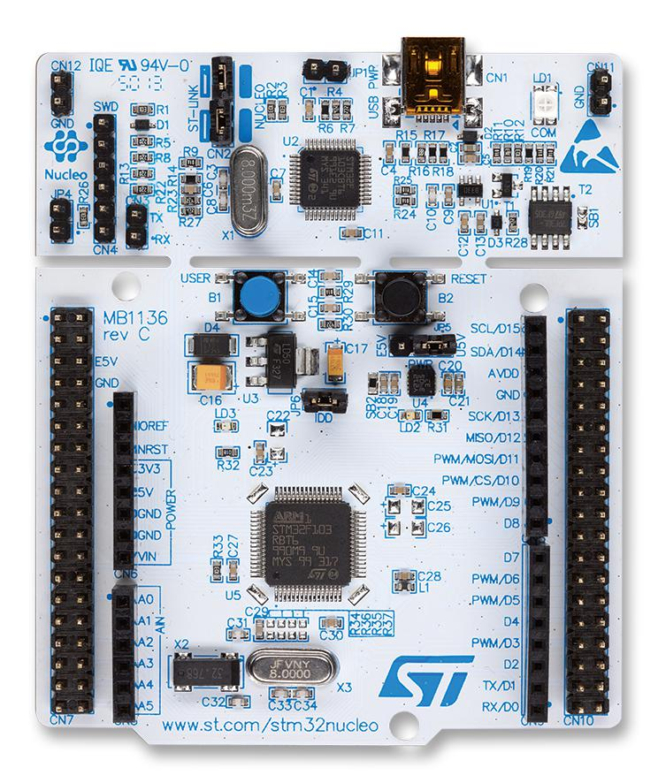
Microcontroller
ARM Cortex M3
STM32F103RBT6 on the Nucleo board
Price 10chf on Digi-Key
Community
Very fast microcontroller with many periphals – 2xADC 16 channels each
HAL Library, no CUBE MX code generation
C++
Few words about logic
ADC readout using DMA every second
Average of 20 readouts
Transfer data by UART using DMA

Slide 18
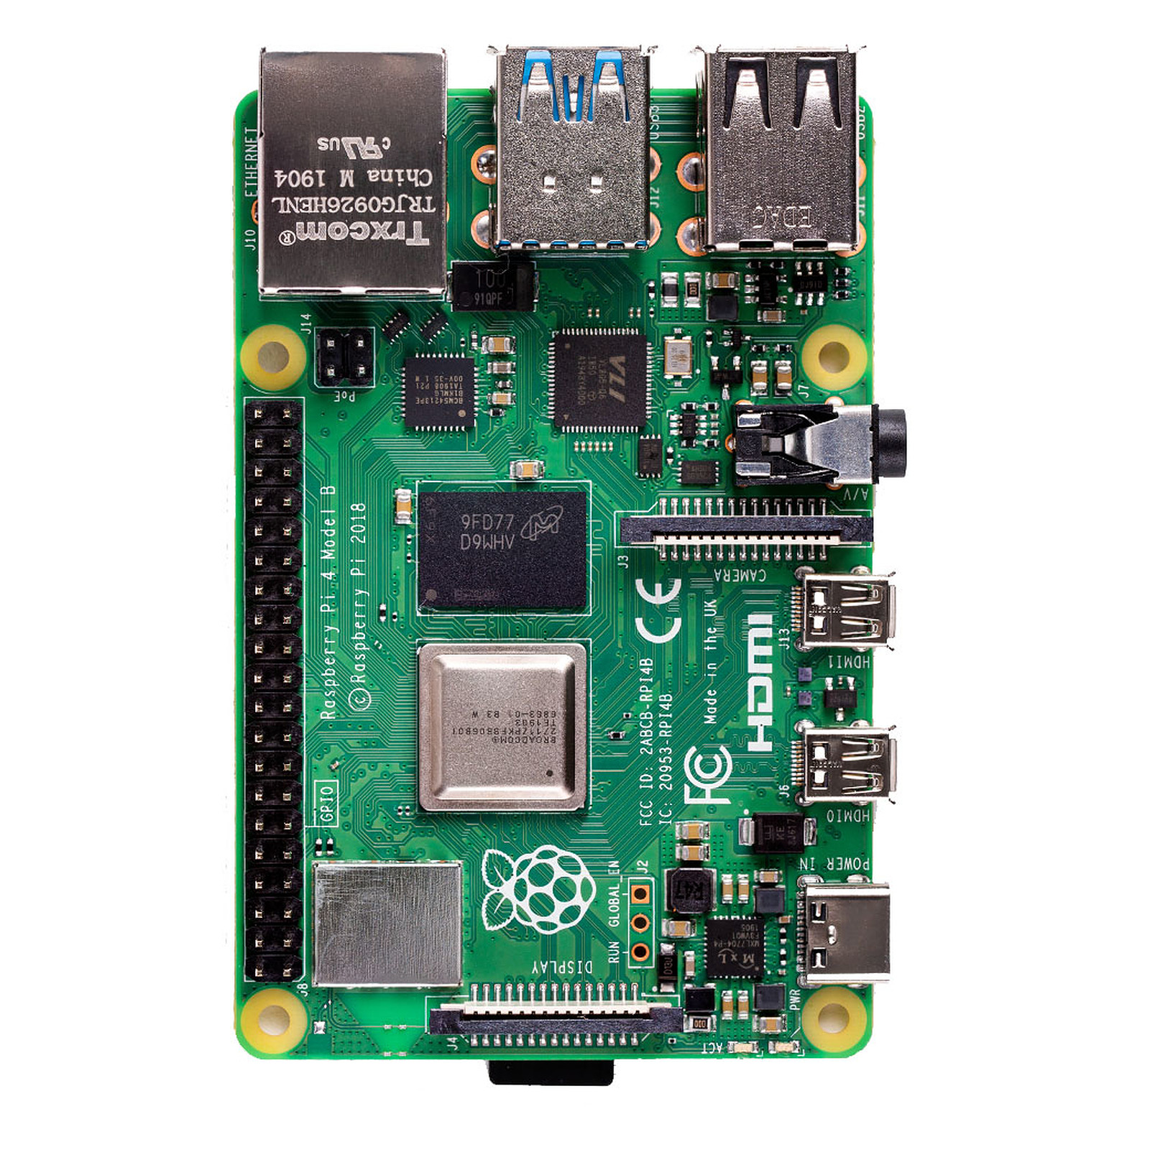
Raspberry OPC UA Server
Raspberry PI 4
Ubuntu Docker image
docker-compose
Very easy to configure and run server – one comand
OPC UA Server
Generic industrial protocol
Easy to transfer data to SCADA
Python 3.7 implementation using opcua library
Why raspberry?
Impossible to deploy OPC Server on microcontroller

Slide 19
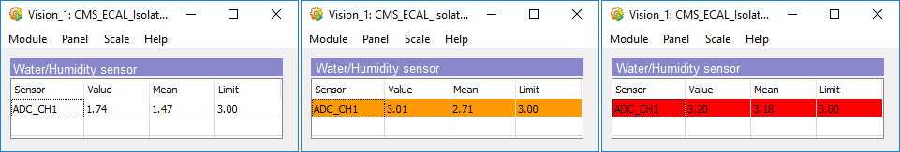
SCADA
Front-end part of the system
Panel (widget) to visualize data
Alarms
WinCC OA 3.16 Patch 15, JCOP 8.4.0 Beta
Simple instalation of the component
Adding managers
Configuring addresses
Establishing connection with OPC UA Server

Slide 20
Project outcome

Slide 21
Future work
Test system in real operational environment
Adapt to the new conditions – change resistors, change thresholds
Add more set of needles and measure over a whole length

Slide 22
https://gitlab.cern.ch/jawieczo/isolationverifier
jakub.lukasz.wieczorek@cern.ch

