Slide 1

German Census
Week 8 Report
Andrei Staradubets
Bai Li
Erblina Jakupi
Priya Arumugam

Slide 2
Outline
Classification
Comparing Logistic Regression, Ridge Classifier, and SVC
Optimizing Regularization parameter
Comparing PCA and Forward Feature Selection
Analysis of errors, done by classifier
Regression
Predict University degree holders
Predict Divorced female (between 25-29 years)

Slide 3
Classification – North/South/East
Split trainval : test 80 : 20 and train : val 80 : 20 with stratification policy
Optimum PCA on 31 Components
Optimum SVC on 7 features:
Ownership of the dwelling: Private individual(s)
Type of in-commuters: Int. commuters within t. municipality of t. workp.
Migration experience (decade of arrival): 1980 – 1989
Religion (in detail): Not a member of a public-law religious society
Religion (in detail): Roman Catholic Church
Type of heating: Single- or multi-room stoves
Type of use of the dwelling/Type of the building (construction): Occupied by owner/Terraced house

Slide 4
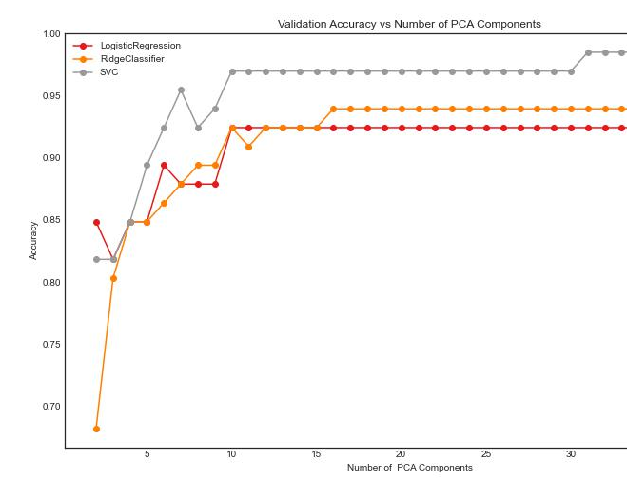
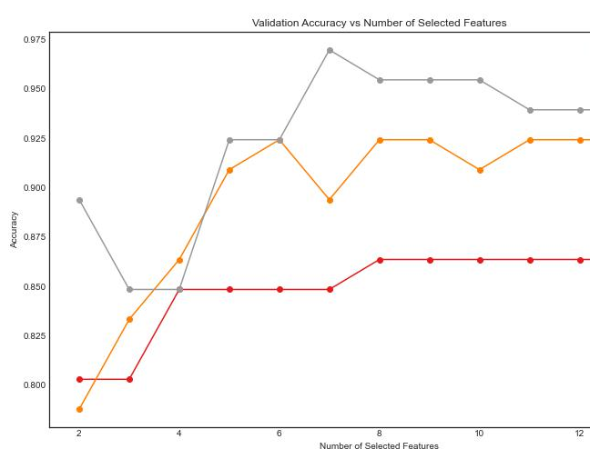
Classification – North/South/East
PCA Best C = 14.1
FFS Best C = 10.9
4

Slide 5
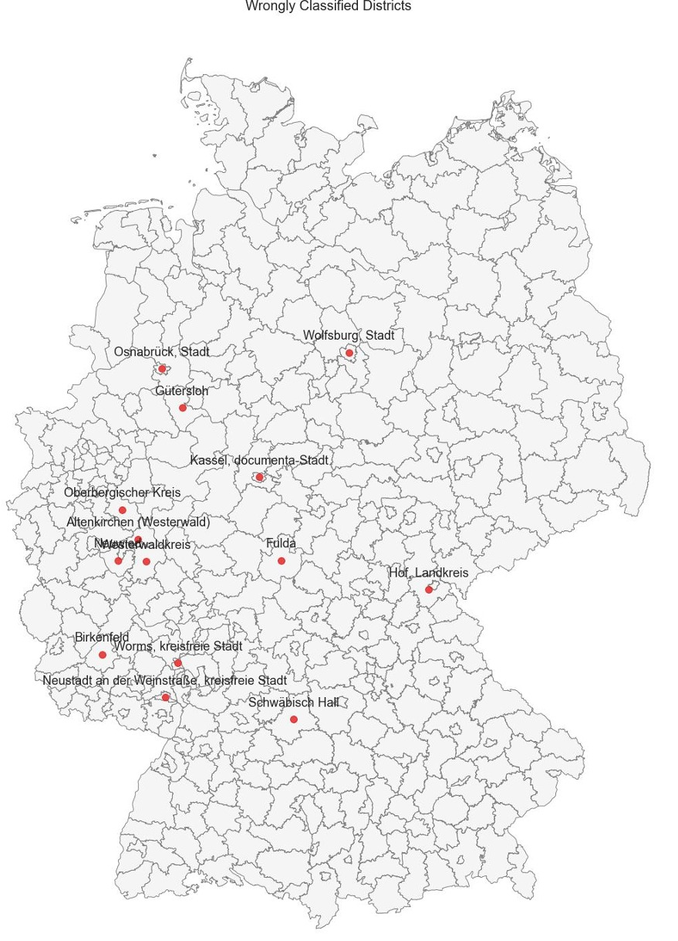
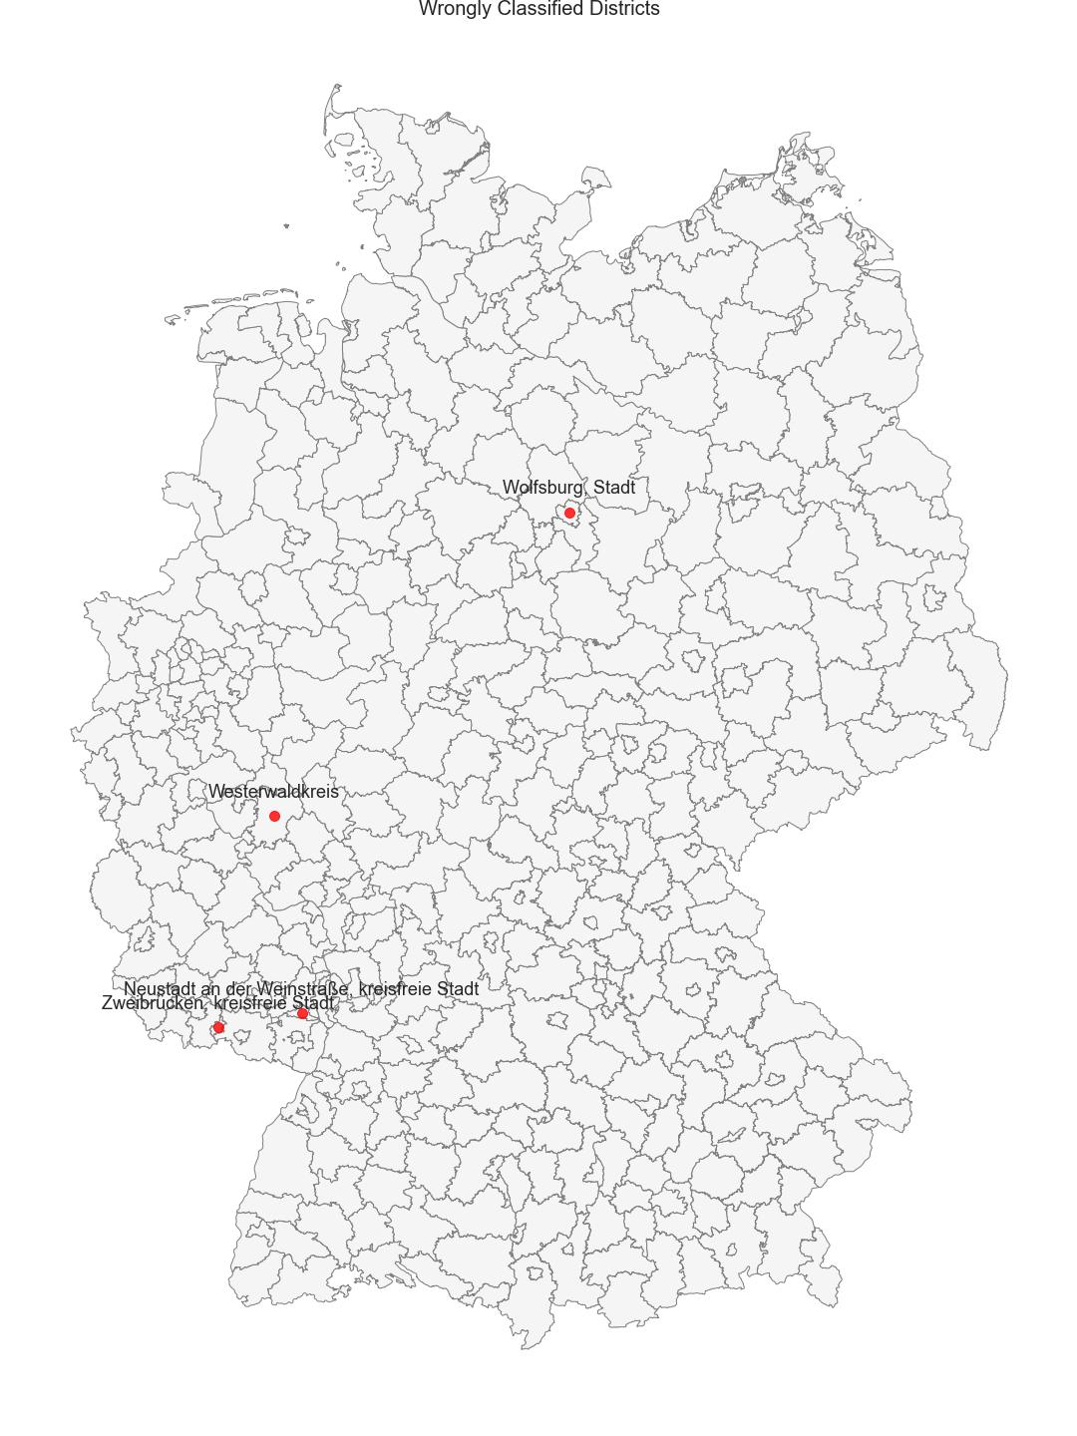
Classification – N/S/E
PCA on left
FFS on right

Slide 6
Results of Classification – North/South/East
Accuracy/Method | PCA | Forward Feature Selection
Training | 0.996 | 0.973
Validation | 1.0 | 0.955
Test | 0.964 | 0.952
Conclusion: For North-South-East Classification PCA shows almost absolute accuracy, but Forward Feature Selection still has more then acceptable results with much better transparency of what data has been used for district analysis. Both methods may do few mistakes with urbanized districts, due to intra-similarity of that cluster.

Slide 7
Classification – Urban vs Rural
Split trainval : test 80 : 20 and train : val 80 : 20 with stratification policy
Optimum PCA on 9 Components
Optimum SVC on 8 features:
Ownership of the dwelling: Private individual(s),
Age (eleven classes of years)/Size of private household:
15 to 17 years/1 person; /2 persons; /5 persons; 3 to 5 years/1 person; 6 to 14 years/1 person; 65 to 74 years/5 persons
Activity status (detailed): Unemployed, never having worked
Occupation (areas by KldB 2010)/Citizenship (selected countries)/Sex: Agriculture, forestry, horticulture/Total/Male
Dwellings in a building: 2 dwellings

Slide 8
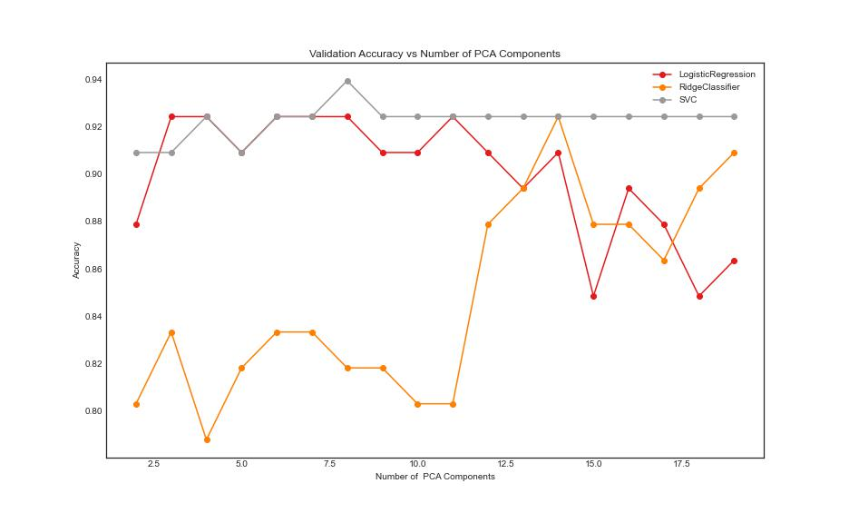
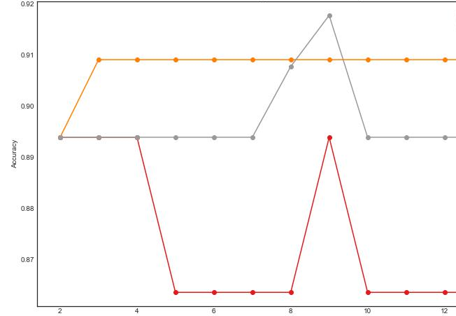
Classification – Urban vs Rural
PCA Best C = 38.8
FFS Best C = 7.6
8

Slide 9
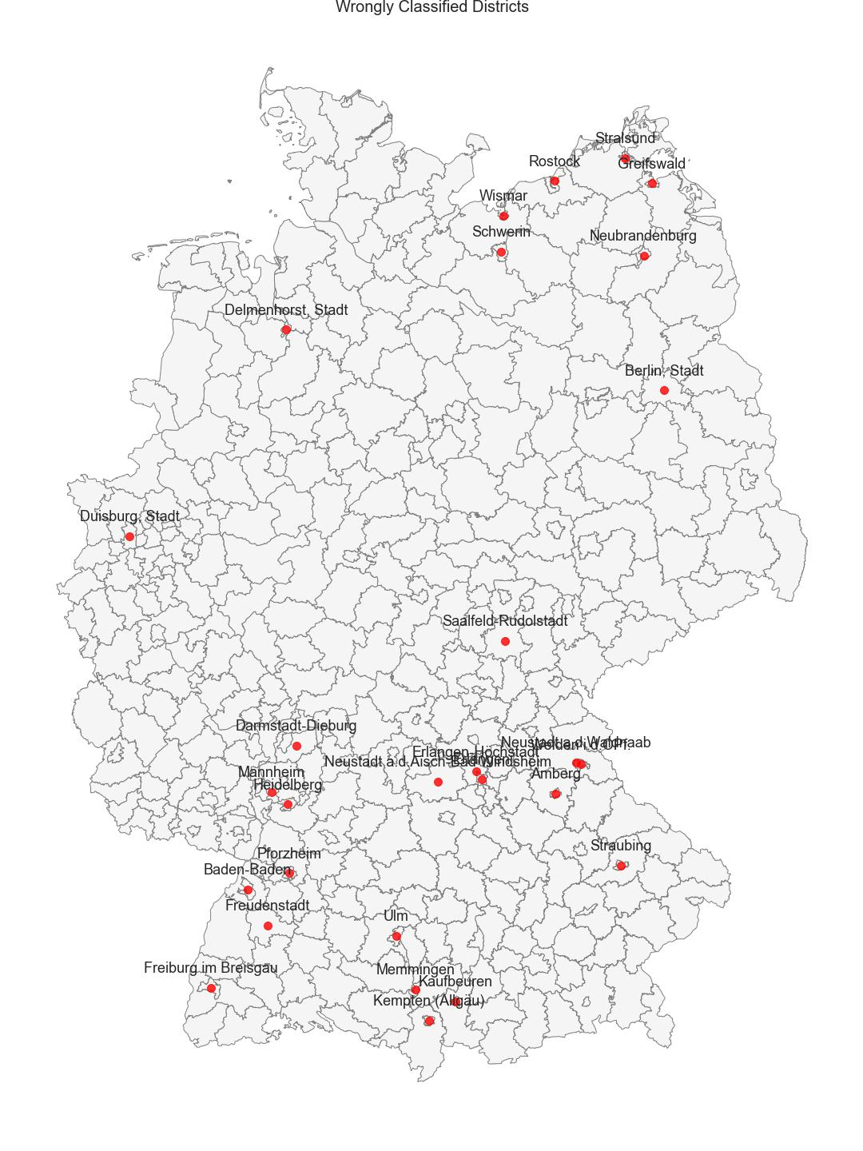
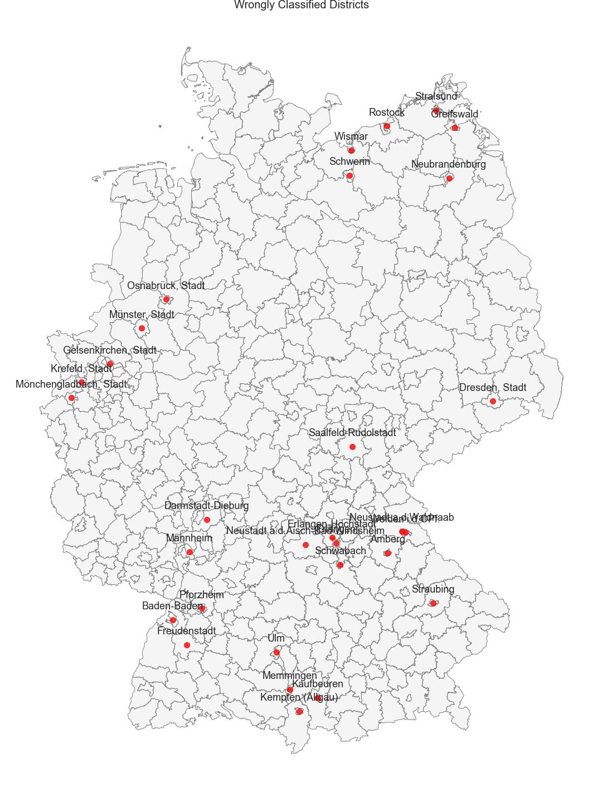
Classification – Urban vs Rural
PCA on left
FFS on right

Slide 10
Results of Classification – Urban vs Rural
Accuracy/Method | PCA | Forward Feature Selection
Training | 0.935 | 0.939
Validation | 0.909 | 0.939
Test | 0.916 | 0.904
Conclusion: For Urban-Rural Classification both PCA and Forward Feature Selection performs quite similar. The errors in the result could mostly be explained by not ideal original labels assignment and not ideal correspondence between administrative borders of districts with Urban centers.

Slide 11
Regression
Dataset: Proportional version
Split: trainval/test 80/20 and train/val 80/20 with stratification policy.
Dropped columns: All non-correlated columns like construction year, roomsize, building type, etc.
Objective: Using PCA and regularization, find best regressor for 2 features:
University degree holders
Divorced Female between 25-29 years of age.
Regression Algorithm: Linear and Ridge Regression

Slide 12
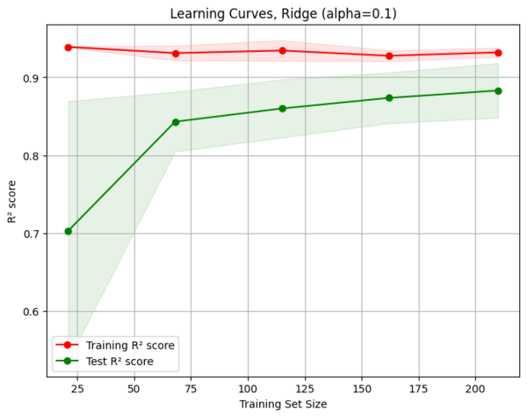
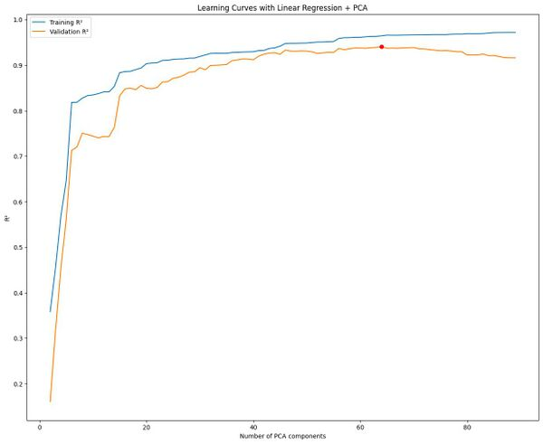
Regression – University degree holders

Slide 13
Regression – University degree holders
 | Training MSE | Training R2 | Validation MSE | Validation R2 | Test MSE | Test R2
Ridge (L2 α=0.1) | 7.26e-05 | 0.92 | 7.59e-05 | 0.87
Ridge + PCA | 7.15e-05 | 0.93 | 7.25e-05 | 0.91
Linear | 3.92e-05 | 0.96 | 6.89e-05 | 0.89 | 8.50e-05 | 0.92

Slide 14
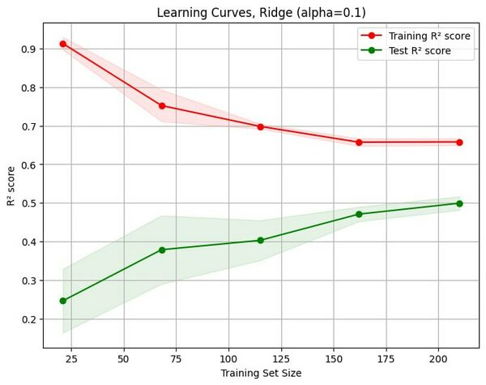
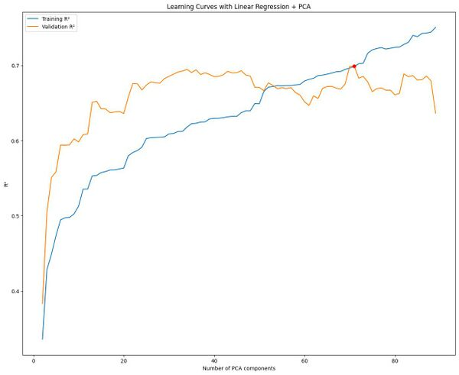
Regression – Divorced female between 25-29 years of age

Slide 15
Regression – Divorced female between 25-29 years of age
 | Training MSE | Training R2 | Validation MSE | Validation R2 | Test MSE | Test R2
Ridge (L2 α=0.1) | 1.87e-08 | 0.64 | 2.80e-08 | 0.68
Ridge + PCA | 1.91e-08 | 0.63 | 2.82e-08 | 0.68
Linear | 1.16e-08 | 0.69 | 2.73e-08 | 0.69 | 3.51e-08 | 0.60

Slide 16
Next step
Prepare Final Presentation

Slide 17
Thank you!
German Census Team

