Slide 1

German Census
Week 3 Report
Andrey Staradubets
Bai Li
Erblina Jakupi
Priya Arumugam

Slide 2
Outline
Correlation features
Data distribution and Outliers
Next step and Issues
Questionnaires

Slide 3
Correlation features
Correlation charts
The correlation between features is calculated, and the top 100 pairs of features with the greatest correlation are selected.

Slide 4
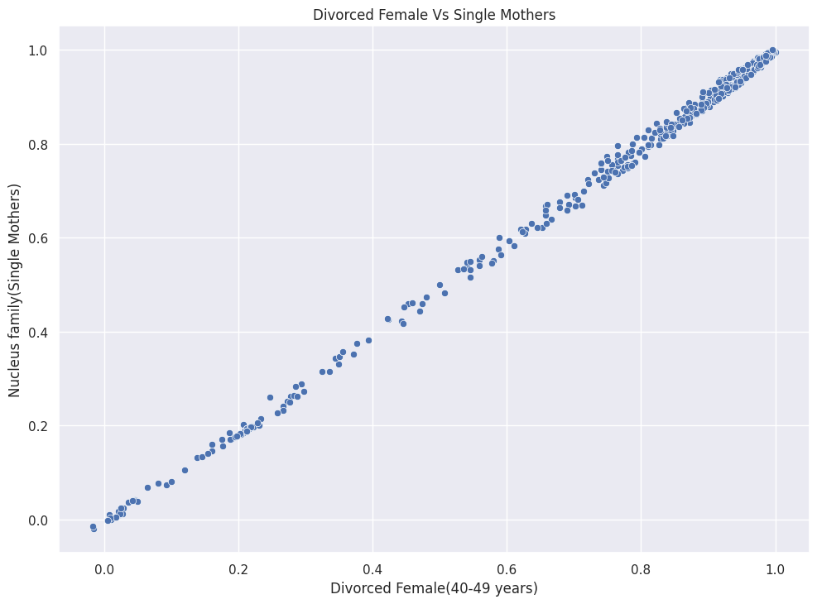
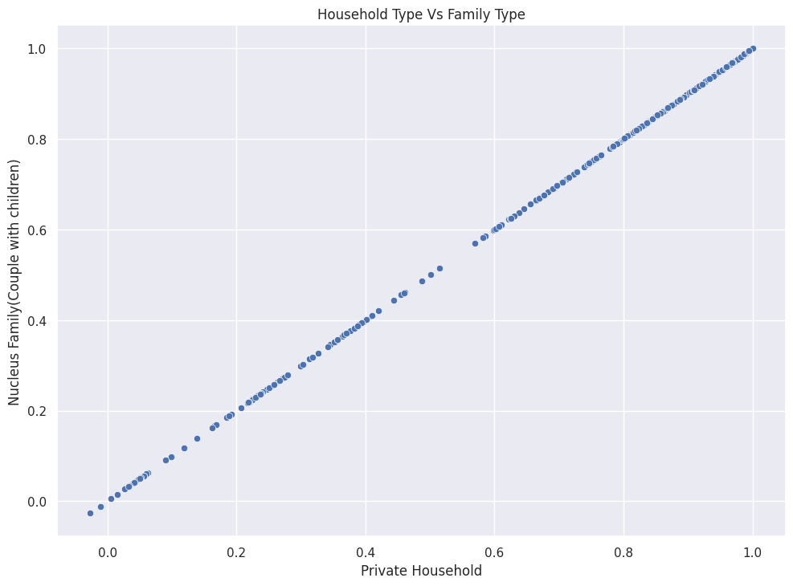
Correlation features
Correlation charts
2 examples: what the chart should look like if 2 different features are correlated. Almost a line!

Slide 5
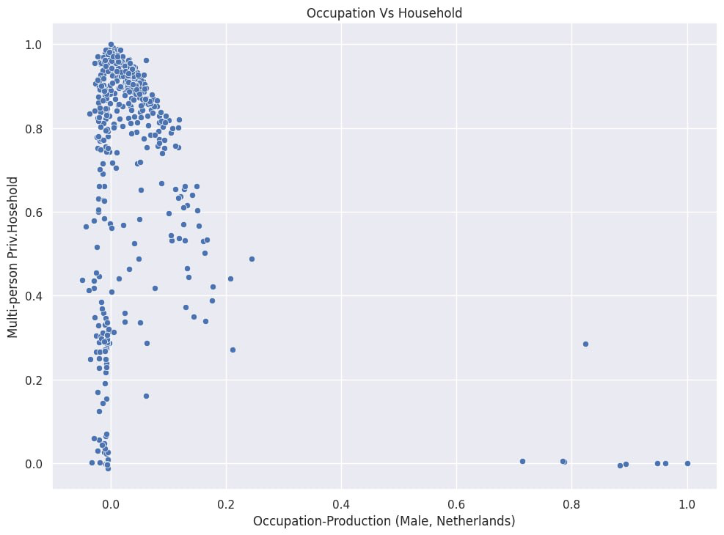
Correlation features
Correlation charts
1 example: what the chart should look like if 2 different features are not correlated.
It is difficult to find any linear or other relationship directly from the chart.

Slide 6
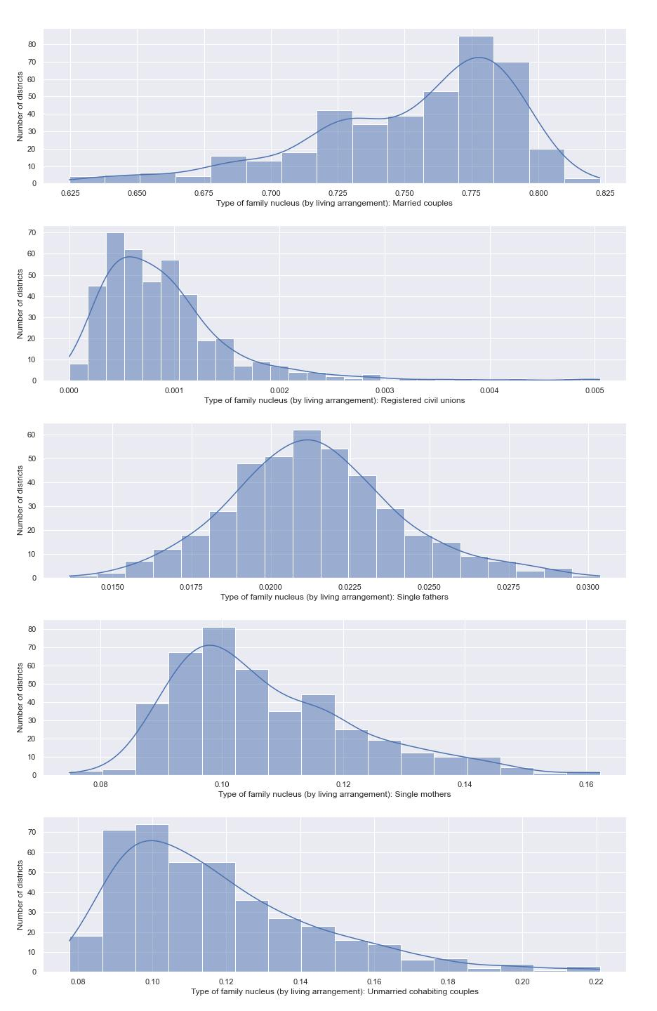
Data distribution and Outliers
Data distribution-Type of family nucleus (by living arrangement)
Skewed Right
Skewed Left

Slide 7
Data distribution and Outliers
Data distribution-Type of family nucleus (by living arrangement)
Normal
Distribution
Skewed Left

Slide 8
Data distribution and Outliers
Data distribution-Type of family nucleus (by living arrangement)
Skewed Left
Skewed Left

Slide 9
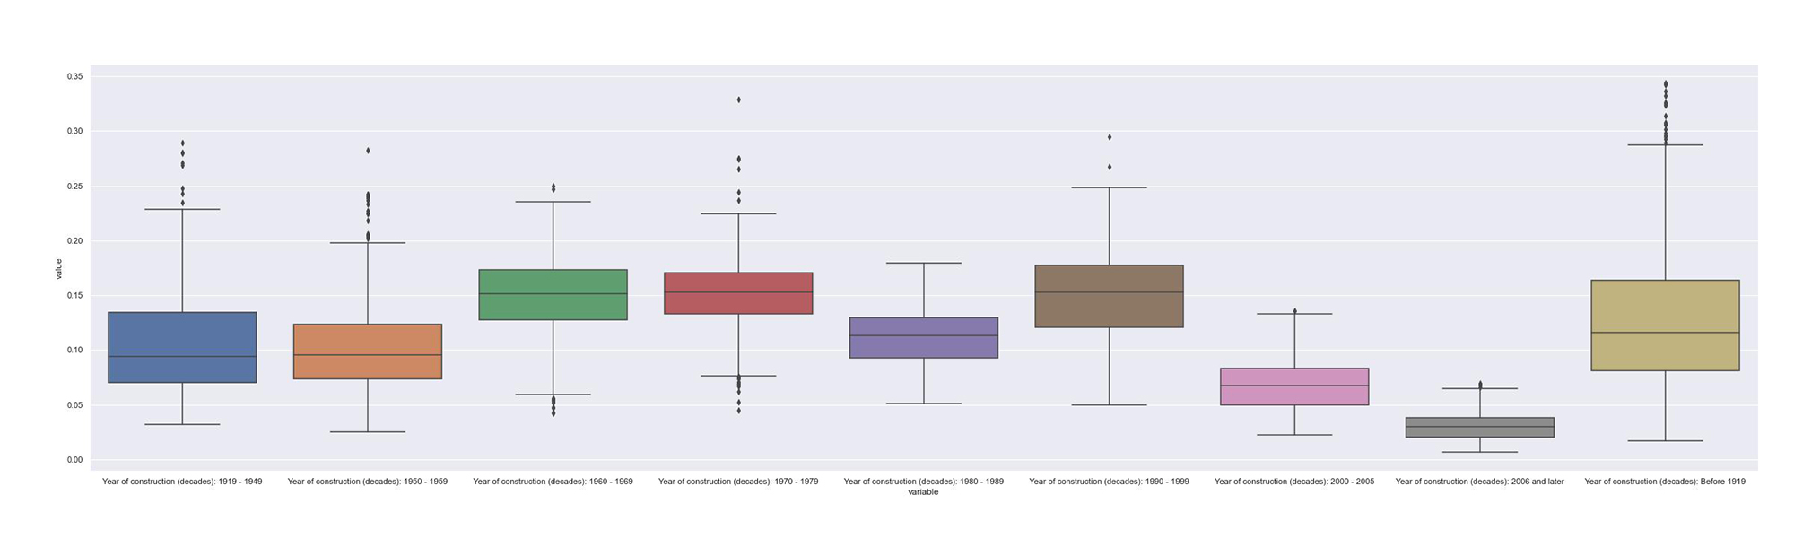
Data distribution and Outliers
Outliers
Boxplot example: A chart about the outlier in this feature. A lot of outliers in these features.

Slide 10
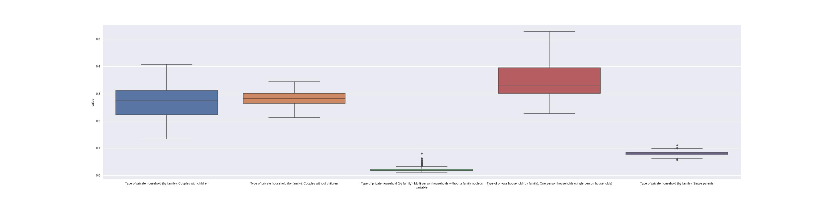
Data distribution and Outliers
Outliers
Boxplot example: A chart about the outlier in this feature. Not each feature has outliers.

Slide 11
Next step and Issues
Spurious correlation
A considerable amount of correlation comes between features with no clear relationship. This association may be due to randomness or other unknown variables. It reminds us that the correlations found so far do not always indicate true causation, but may be due to shared randomness or other external factors.
Inconsistent scales
The correlation of some features are more meaningful comparing absolut values, and which were better based on normalised to the total population of the district.

Slide 12
Next step and Issues
Now we analyzed the correlation of the features in the dataset and created charts to describe the distribution of the features in the dataset, we would like to proceed with the below tasks for next week.
Further analyze the correlation of features to exclude Spurious correlation.
Normalize the data to remove outliers and scale inconsistencies.

Slide 13
Questionnaire
Questionnaire
How housing construction changed due to population?
How construction changed due to economic growth/employment growth?
Which age group prefer which type of building?
Which type of family(based on size) prefer which building type?

Slide 14
Thank you for your listening!
Looking forward to your questions and suggestions!

