Slide 1

German Census
Week 4 Report
Andrey Staradubets
Bai Li
Erblina Jakupi
Priya Arumugam

Slide 2
Outline
Modifying/Organizing Dataset
Trend Charts
Regional Distribution
Next step and Issues

Slide 3
Modifying/Organizing Data
Dropped +300 features
Added features
coordinates
urban/countyside type were added to the districts

Slide 4
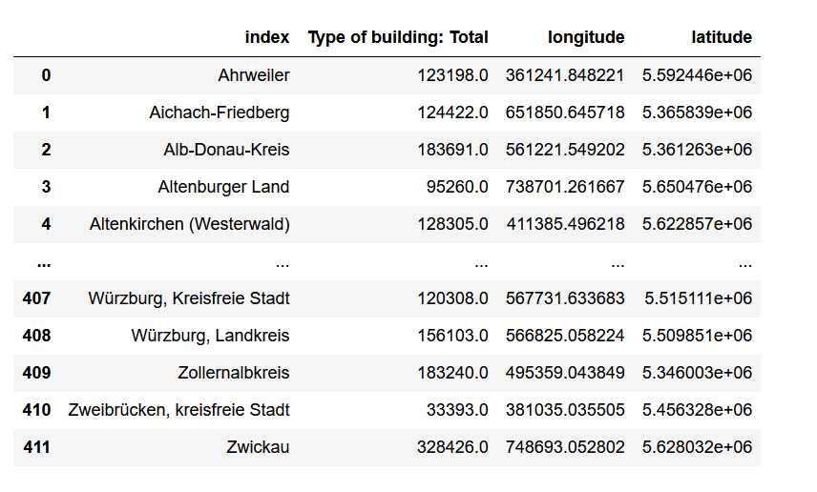
Modifying/Organizing Data
We have a rich collection of
+300 features with
(Total category)
Features could be combined
Education vs Empolyment Status
Household vs Equipment

Slide 5
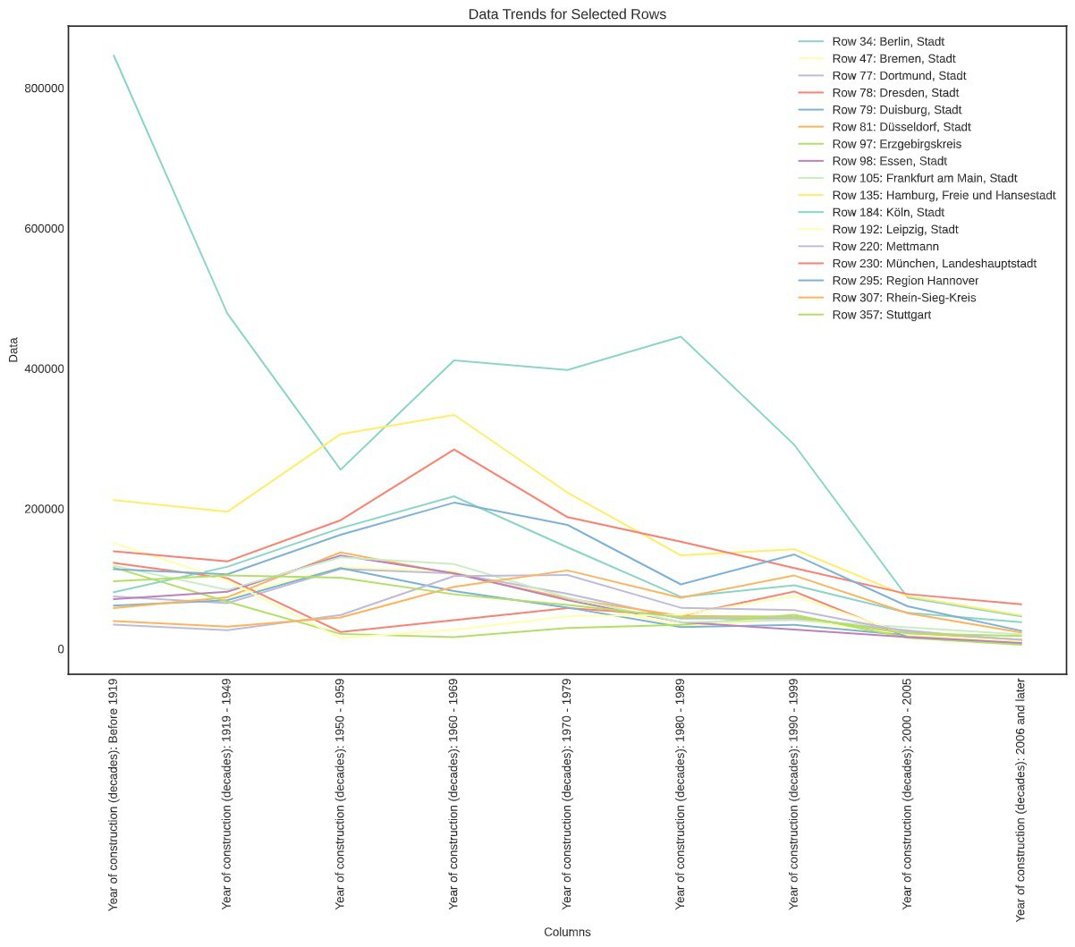
Trend Charts
Data trend for constructions
over years for different regions

Slide 6
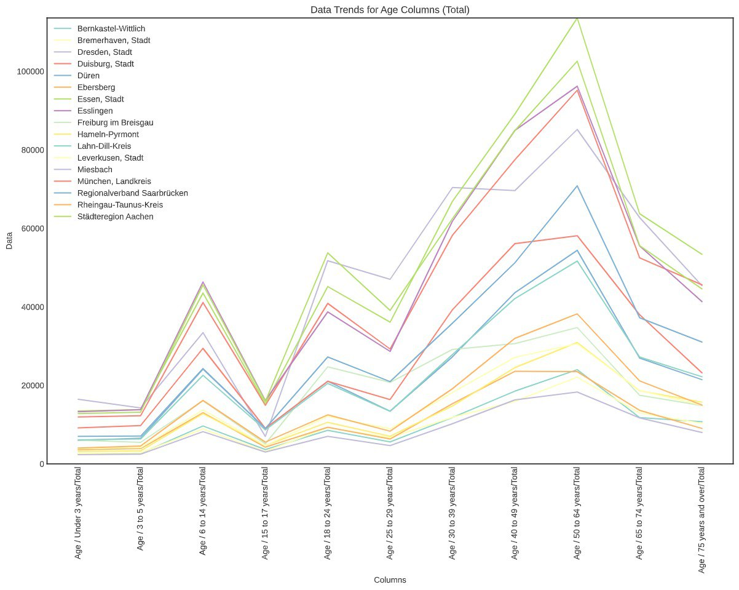
Trend Charts
Data trend for group age for different regions

Slide 7
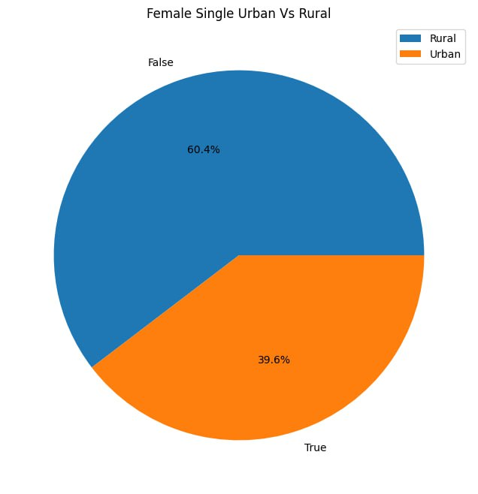
Regional Distribution
Examining regional distribution for females

Slide 8
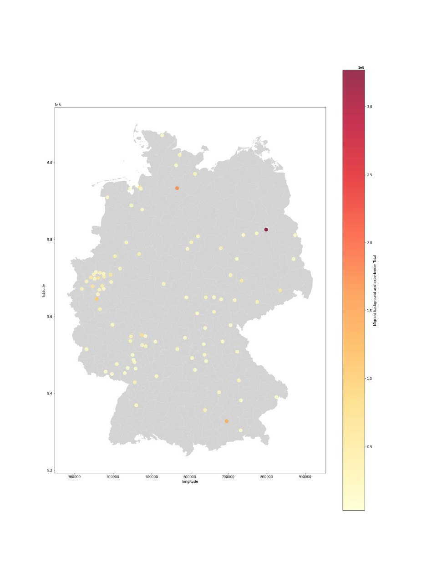
Regional Distribution
Map showing
Migration Experience for Urban places

Slide 9
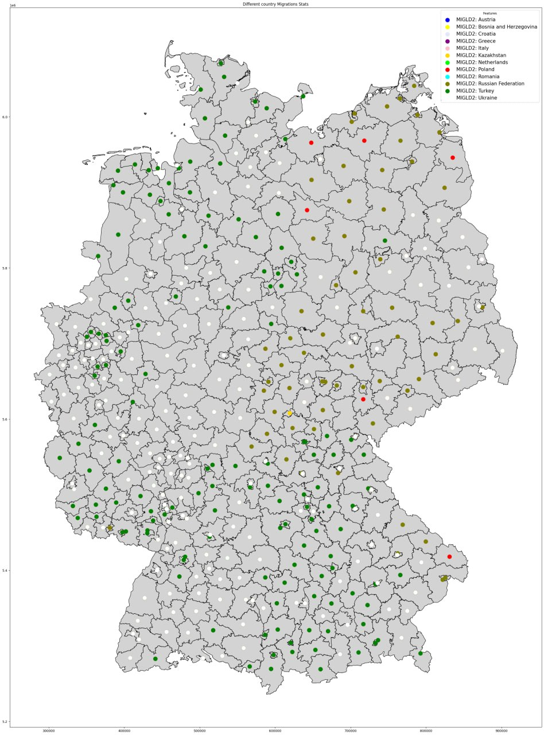
Regional Distribution
Map showing
Migration nationality

Slide 10
Questionnaire?
- How many of migrants has higher education such as University Collage?
- What is the Employment Status of migrants before year of 2000 and after year of 2000?
What distribution are the family sizes in Urban vs Regional places?
What is the trend between family type, like couples without kids, couples with kids, single mothers, single fathers etc.

Slide 11
Next step and Issues
Now we analyzed the correlation of the features in the dataset and created charts to describe the distribution of the features in the dataset, we would like to proceed with the below tasks for next week.
Further analyze the data set by checking outliers
Check most correlating features
Filter the dataset by reducing the count features and using only the meaningful ones

Slide 12
Thank you!
German Census Team

