Slide 1

German Census
Week 6 Report
Andrey Staradubets
Bai Li
Erblina Jakupi
Priya Arumugam

Slide 2
Contents
Prediction Tasks
Classification
Regression
Next Steps

Slide 3
Prediction Tasks
Prediction tasks identified for overall dataset:
Classification: 1. Predict, if the region is urbanized 2. Predict the North vs South vs East vs West location
Regression: 1. Predict construction trend and/or aging 2. Predict percentage of migrants in each region

Slide 4
Dataset
790 features out of 1099(initial)
All steps related to data pre-processing like finding correlating features, removal of NULL values, data cleaning (removing '-', '/', etc..), visualizing trends, etc. were identified and implemented in previous weeks.
Included latitude and longitude values (absolute), Urban and Clusters based on historical data from dataset.

Slide 5
Classification – Location
Manipulated the location feature.
Used cluster values from last week to complete the above step.
Train, Test split = 80: 20
Created the dataframe with selective features for building independent variables/input features.
Used location as class label.
RandomForest classification was implemented
Accuracy achieved was: 83% (approx)

Slide 6
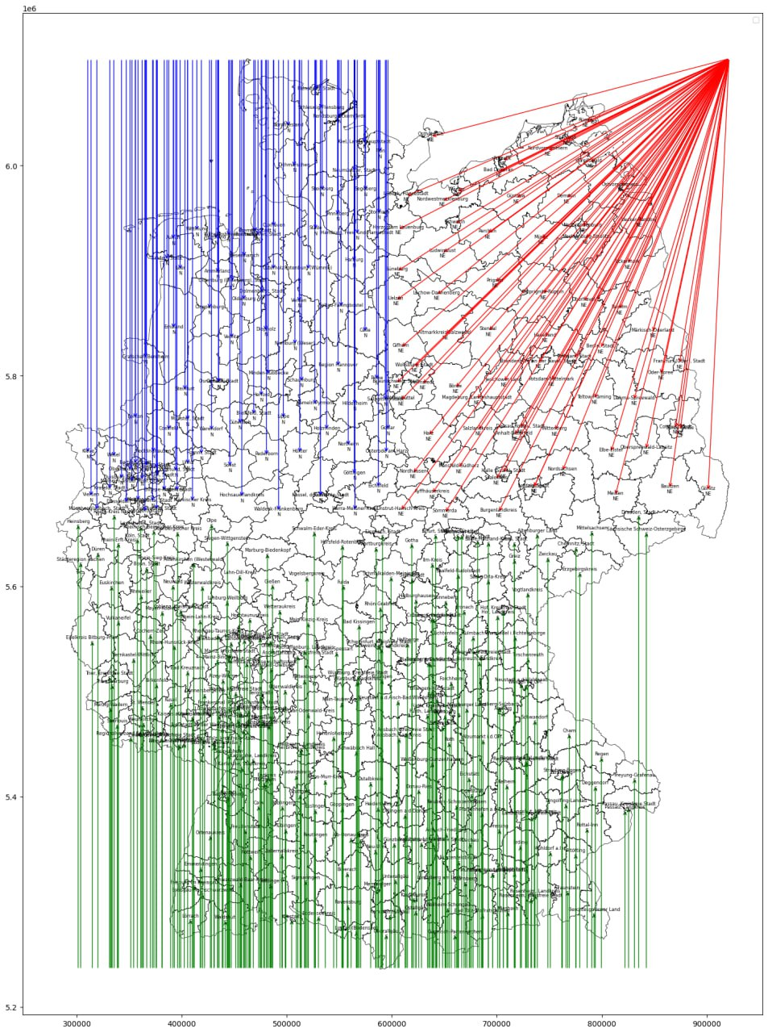
Location Split

Slide 7
Classification – Urban/Rural
Imported the tidy dataset, which includes all regions except Urban.
Train, Test split = 80: 20
Used Urban feature as class label
Applied PCA dimensionality reduction technic to avoid overfitting.
Choose 400 as target dimension value.
Used SVM classification (this week) for analysis.
Adjusted regularization param C of SVM to achieve better accuracy.
Current accuracy obtained is above 90%.

Slide 8
Regression – Construction Trend
Prepared the input features by selecting relevant features and dropping irrelevant data.
Train, Test split = 80: 20
Calculated target label by taking the proportion of ‘Construction for 2006 and later’ compared to Total construction.
Used basic LinearRegression to fit the model
Error metrics used - MSE, RMSE and R-square
The prediction score with R-square metric is:
Training R² score: 0.9638274736432375 and
Test R² score: -45.064106536658144.
The model is currently overfitting.

Slide 9
Regression – Migrant distribution
Identify the list of irrelevant features to be dropped.
Created the input features with relevant list.
Created a target column as a proportion of migrant with to without migration background.
Data Normalized with StandardScalar.
Model fit on train dataset using GLM (Generalized Linear Model).
Results:
Fit score on train data is 0.97
on test data -1.53 with mean absolute error 0.119

Slide 10
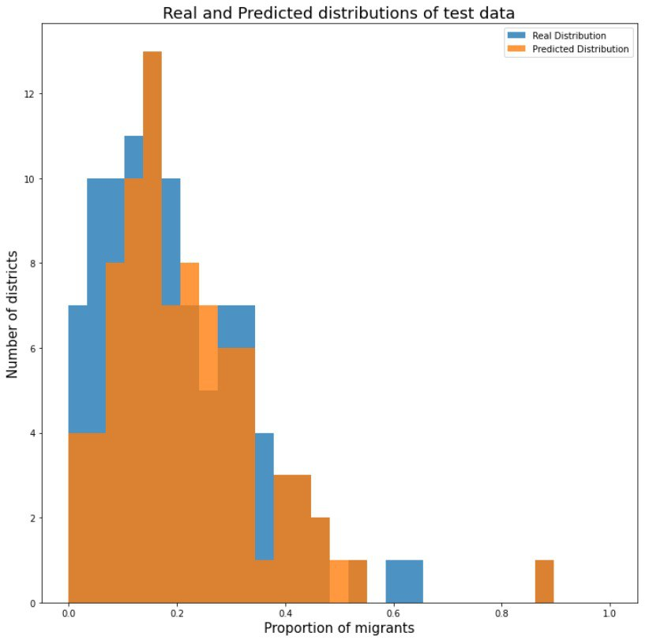
Real vs Predicted
The real and predicted migrated distribution can be visualized as below.

Slide 11
Next step
Overall, we observe that our models overfits and performs worse than model with null deviance. So, we are aiming to do the below: 1. To find alternate methods for avoiding overfitting. 2. To modify feature selection, so that model can generalize.
3. Identify right regularization for better accuracy.

Slide 12
Thank you for your listening!
Looking forward to your questions and suggestions!

