Slide 1

German Census
Week 7 Report
Andrey Staradubets
Bai Li
Erblina Jakupi
Priya Arumugam

Slide 2
Contents
Prediction Tasks
Optimize Classification
Optimize Regression
Next Steps

Slide 3
Prediction Tasks
Prediction tasks identified for overall dataset:
Classification: 1. Predict, if the region is urbanized 2. Predict the North vs South vs East vs West location
Regression: 1. Predict percentage of construction after 2006
2. Predict percentage of migrants in each region
And on the algorithm optimization level!

Slide 4
Classification – Location
Classify all regions based on the dataset, dividing East, North and South Germany.
The data set is divided into training set validation set and test set.
Apply PCA dimensionality reduction on the data set to find the optimal feature column for subsequent training.
After finding the optimal dimension, the SVM algorithm is applied to classify the dataset.
Accuracy: 0.97

Slide 5
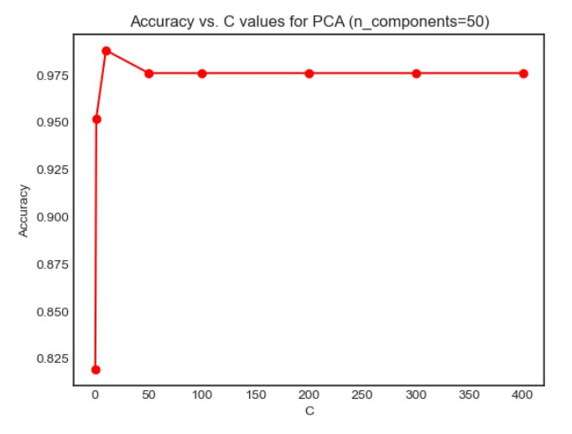
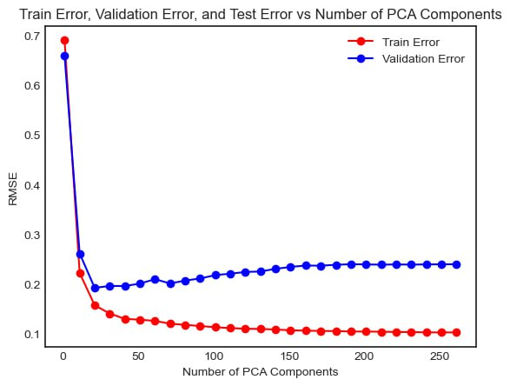
Model Curve
C Value: 25
PCA Component: 20

Slide 6
Classification – Urban/Rural
Imported the tidy dataset, which includes all regions except Urban.
Train Validation Test split
Used Urban feature as class label
Applied PCA dimensionality reduction technic to avoid overfitting with the best parameter.
Choose 50 as target dimension value.
Finding the best C value = 50 for the best SVM under the best dimension of PCA.

Slide 7
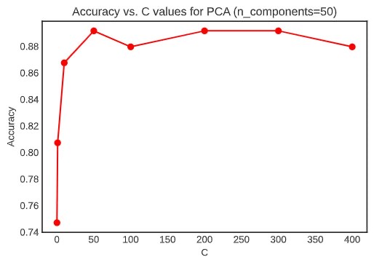
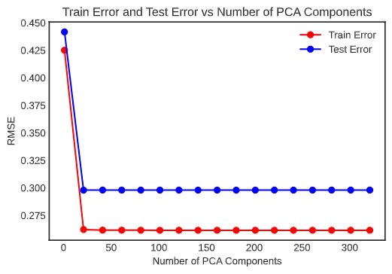
Classification – Urban/Rural
Training accuracy: 0.96
Testing accuracy: 0.88

Slide 8
Regression – Construction Trend
Train Validation Test split
Calculated target label by taking the proportion of ‘Construction for 2006 and later’ compared to Total construction.
The sampling was randomized by stratify sampling
Used basic Linear Regression to fit the model
Started 5 experiments. Below we show the MSE error plots for training using stratified sampling and without stratification.

Slide 9
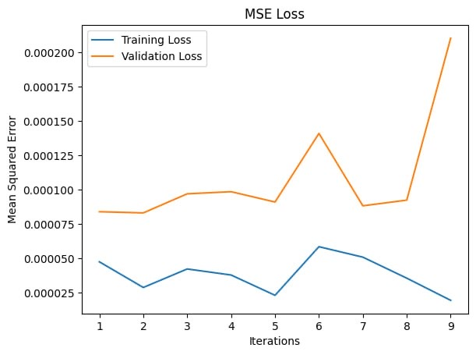
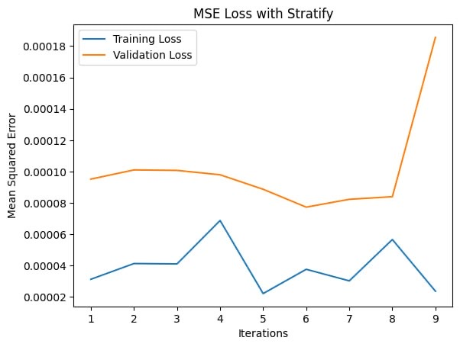
Regression – Construction Trend
Analyze a simple Linear regression with PCA (by changing no of components) and used L2 regularization to observe for optimal results.
But the validation set produced almost similar results. The learning curves and loss curves are presented as below.

Slide 10
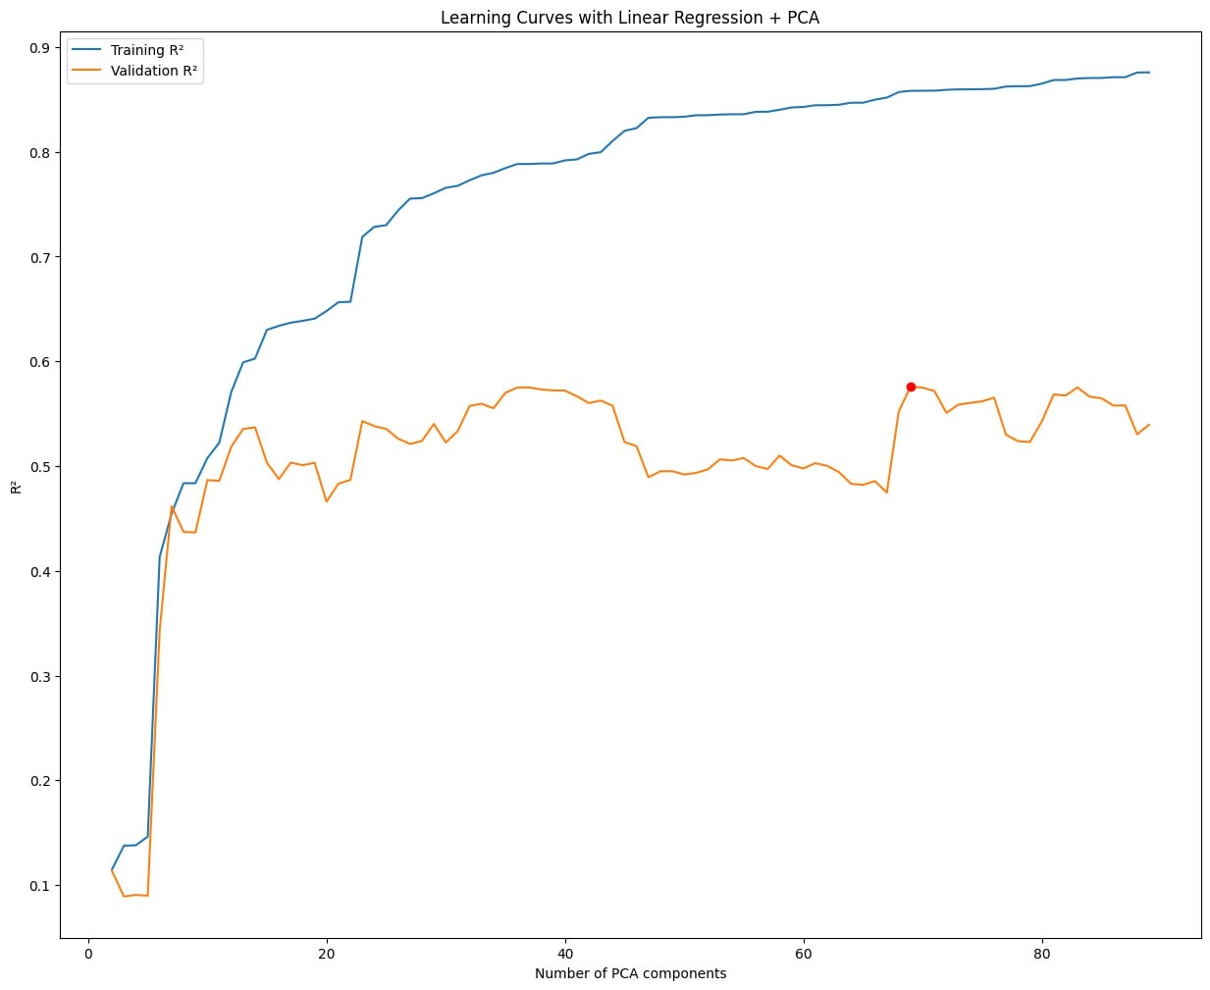
Regression – Construction Trend
Experiment 1. PCA(90 components)+Lin Reg:(best scores obtained at 69th iteration)
Experiment 2: PCA (best component-70) on Lin reg model
Experiment 3: PCA (best component-90) on Lin reg model

Slide 11
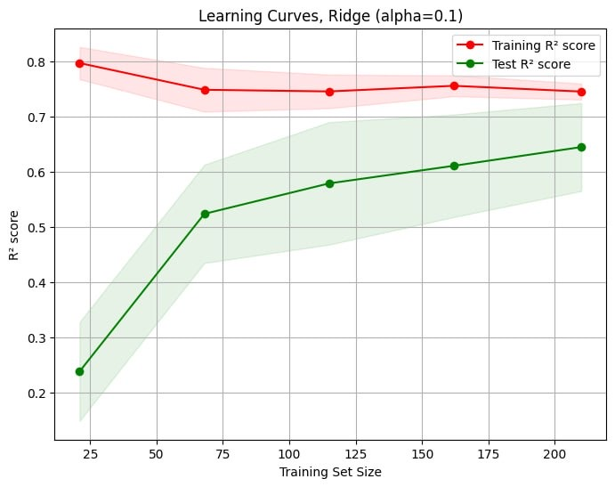
Regression – Construction Trend
Experiment 4: Ridge regression with alpha(0.1) and got below results, similar to PCA + Linear Regression for validation set.
Parameter | Value
Training MSE | 3.84e-05
Training R-squared | 0.74
Validation MSE | 5.86e-05
Validation R-squared | 0.58
Test MSE | 3.71e-05
Test R-squared | 0.76

Slide 12
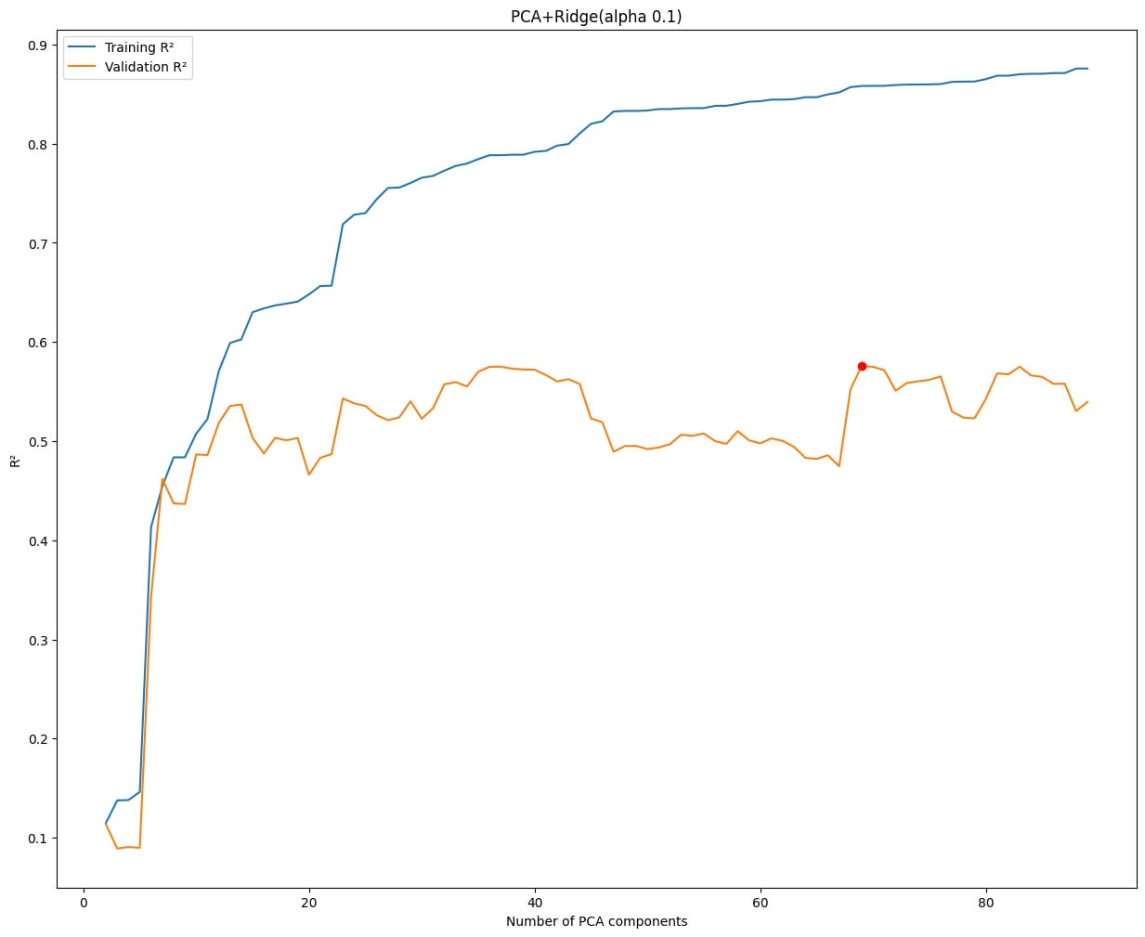
Regression – Construction Trend
Experiment 5:. PCA(70 components)+Ridge, got following results. Still not a better one than PCA + Linear Regression
Parameter | Value
Training MSE | 3.84e-05
Training R-squared | 0.74
Validation MSE | 5.86e-05
Validation R-squared | 0.58
Test MSE | 3.71e-05
Test R-squared | 0.76

Slide 13
Regression – Migrant distribution
Splitting into train, validation and test datasets was improved by introducing stratify policy.
Train Validation Test split
Train dataset includes 263 district instances
Dropping irrelevant columns or columns with data snooping, there were 426 features.
The optimization objective was to find optimal PCA components numbers.

Slide 14
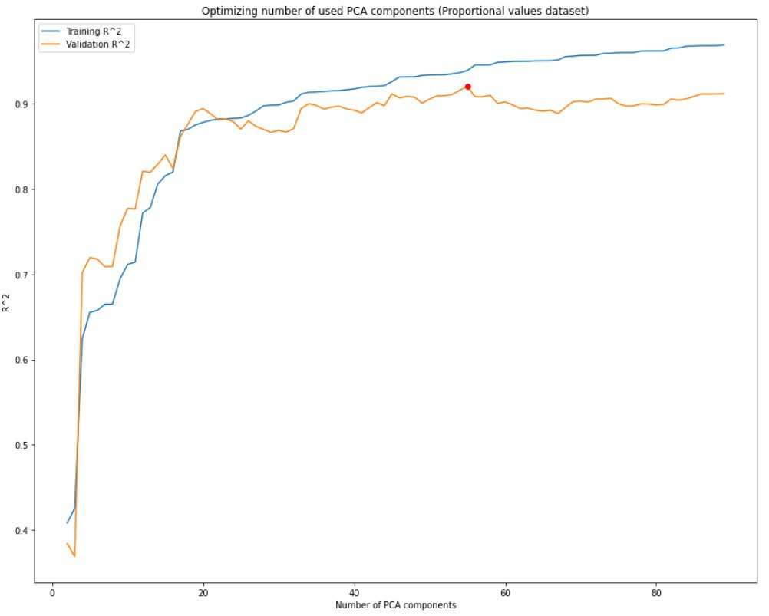
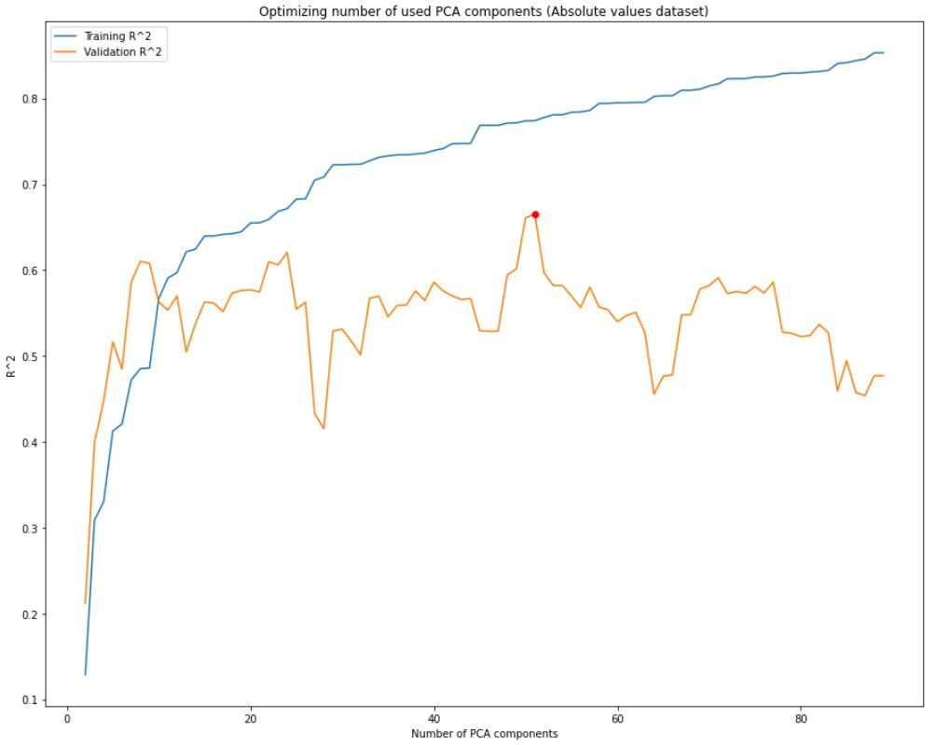
Regression – Migrant distribution
Conducted experiment on two versions of our dataset: with absolute values and proportional data.

Slide 15
Regression – Migrant distribution
Conducted experiment on two versions of our dataset: with absolute values and proportional data.
Absolute value
Parameter | Value
Training MSE | 5.6e-03
Training R-squared | 0.76
Validation MSE | 6.97e-03
Validation R-squared | 0.63
Test MSE | 8.06e-03
Test R-squared | 0.62
Proportional data
Parameter | Value
Training MSE | 1.48e-03
Training R-squared | 0.93
Validation MSE | 1.52e-03
Validation R-squared | 0.92
Test MSE | 2.33e-03
Test R-squared | 0.89

Slide 16
Next step
explore more approaches to improve the model's predictive power
predicting other relevant features, such as age groups, for migrants from different countries, education level.

Slide 17
Thank you for your listening!
Looking forward to your questions and suggestions!

