Slide 1
Transformative Technology Commercial Banking Coverage & Credit Strategy
Executive portfolio simulation for a technology-focused middle-market banking team
Flagship client: AetherGrid Systems
Portfolio prioritization • Financial statement analysis • Credit screening • Treasury & FX • Relationship review
All companies and financial data are fictional and created for portfolio demonstration.
Independent synthetic portfolio simulation

Slide 2
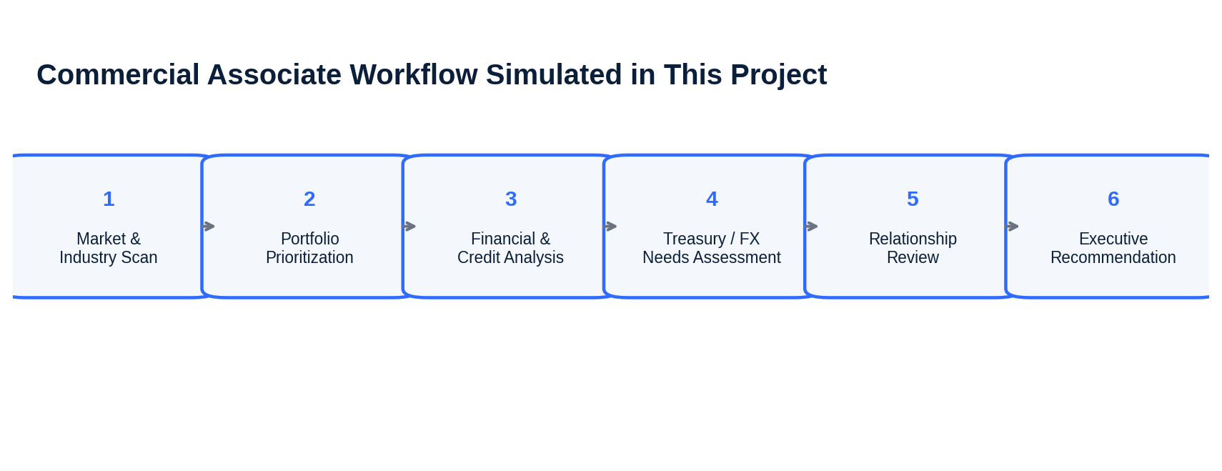
What the Project Simulates
Designed around the responsibilities of a technology commercial-banking associate
• Coverage-level prioritization across clients and prospects
• Company-level financial, credit, treasury, and relationship analysis
• Executive recommendation translated into a relationship-manager workplan
Independent synthetic portfolio simulation | Not Bank of America work product

Slide 3
Market & Coverage Context
Public context informs the simulation; all model data remain synthetic
GCB client revenue range
Fed funds target
Portfolio companies
Synthetic portfolio revenue
$50MM–$2B
3.50%–3.75%
12
$5.6B
• Technology coverage requires combining company analysis with access to Credit, Treasury, FX, Investment Banking, Merchant Services, and other partners.
• The model uses a 3.65% illustrative reference rate for the base case, inside the current Federal Reserve target range.
• Portfolio companies span cloud, cybersecurity, fintech infrastructure, AI data, SaaS, healthcare technology, and network software.
• The portfolio score separates credit strength from relationship opportunity.
• The flagship case tests whether growth, margin expansion, and cash generation remain sufficient under a slower-growth / higher-rate downside.
• Treasury analysis focuses on collections, payments, liquidity, and international FX needs.
Sources: Bank of America Global Commercial Banking public pages; Federal Reserve FOMC statement, July 29 2026.
Independent synthetic portfolio simulation | Not Bank of America work product

Slide 4
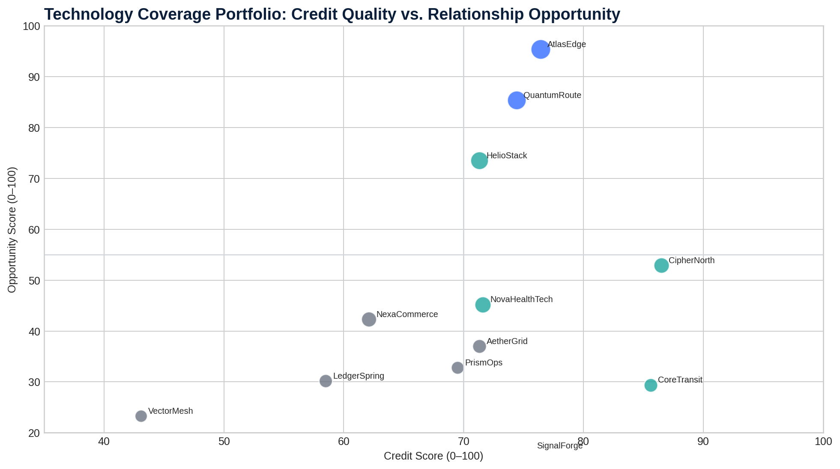
Technology Portfolio Prioritization
Credit quality and relationship opportunity are evaluated separately before combining into coverage priority
Coverage Takeaways
• AtlasEdge and QuantumRoute rank highest overall because of strong financial profiles and larger relationship wallets.
• CipherNorth screens as the strongest high-growth prospect from a credit perspective.
• VectorMesh AI demonstrates why exceptional growth does not automatically equal bankable credit quality.
• AetherGrid is an existing client with a solid credit screen but meaningful room to deepen the wallet.
Independent synthetic portfolio simulation | Not Bank of America work product

Slide 5
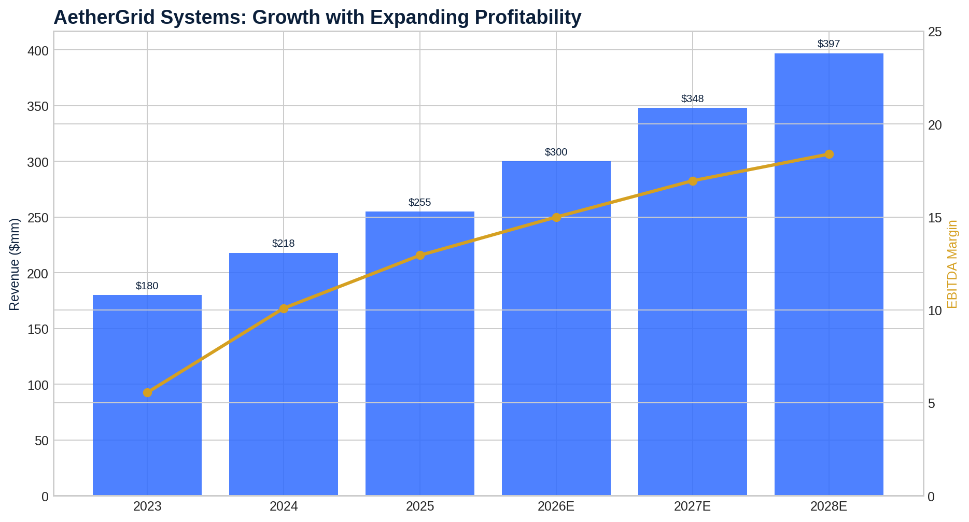
Flagship Client: AetherGrid Systems
Existing cloud / AI observability client selected for full relationship review
2025 Revenue
2025 EBITDA Margin
2025 Cash
2025 Debt
2025 Net Leverage
NRR
$255MM
12.9%
$48MM
$80MM
1.0x
112%
• Revenue expands while EBITDA margin improves, creating stronger internal cash generation.
• Debt declines and cash increases, reducing net leverage.
• Recurring-revenue retention remains strong, though the forecast assumes gradual normalization.
• International revenue increases, expanding treasury and FX complexity.
Independent synthetic portfolio simulation | Not Bank of America work product

Slide 6
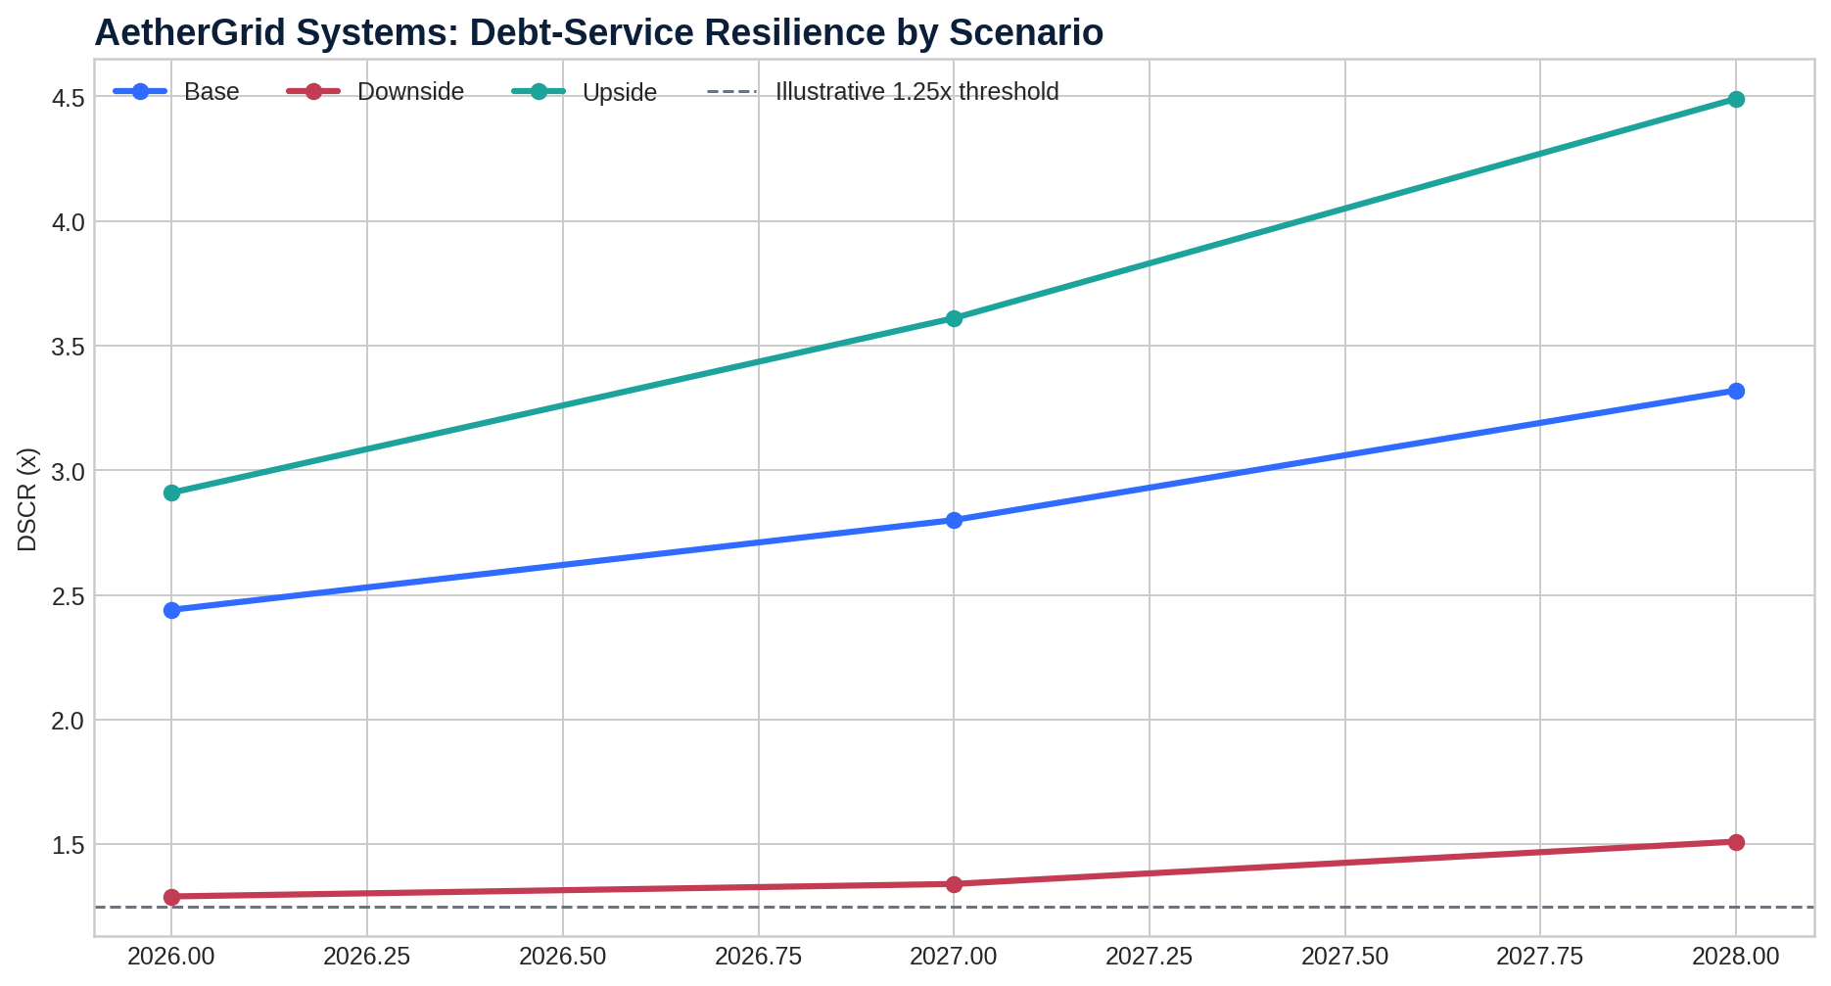
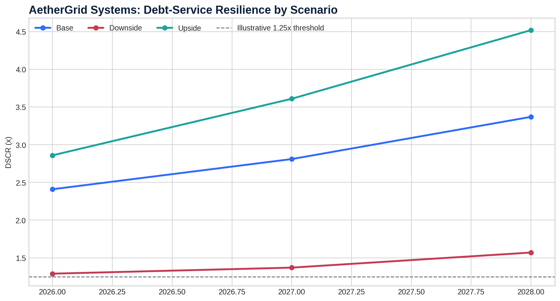
Credit Analysis & Downside Resilience
The key question is not whether AetherGrid grows—it is whether cash flow can service debt when growth slows
2026E Base DSCR
2026E Downside DSCR
Illustrative monitor
Base Net Leverage
2.41x
1.29x
1.25x
0.71x
• Base case shows comfortable coverage and continued deleveraging.
• Downside 2026E is the critical watch point: 1.29x DSCR leaves only modest cushion.
• Higher rates and margin compression matter more than revenue growth alone.
• Preliminary view: maintain revolver flexibility, but avoid aggressive incremental term leverage.
Independent synthetic portfolio simulation | Not Bank of America work product

Slide 7
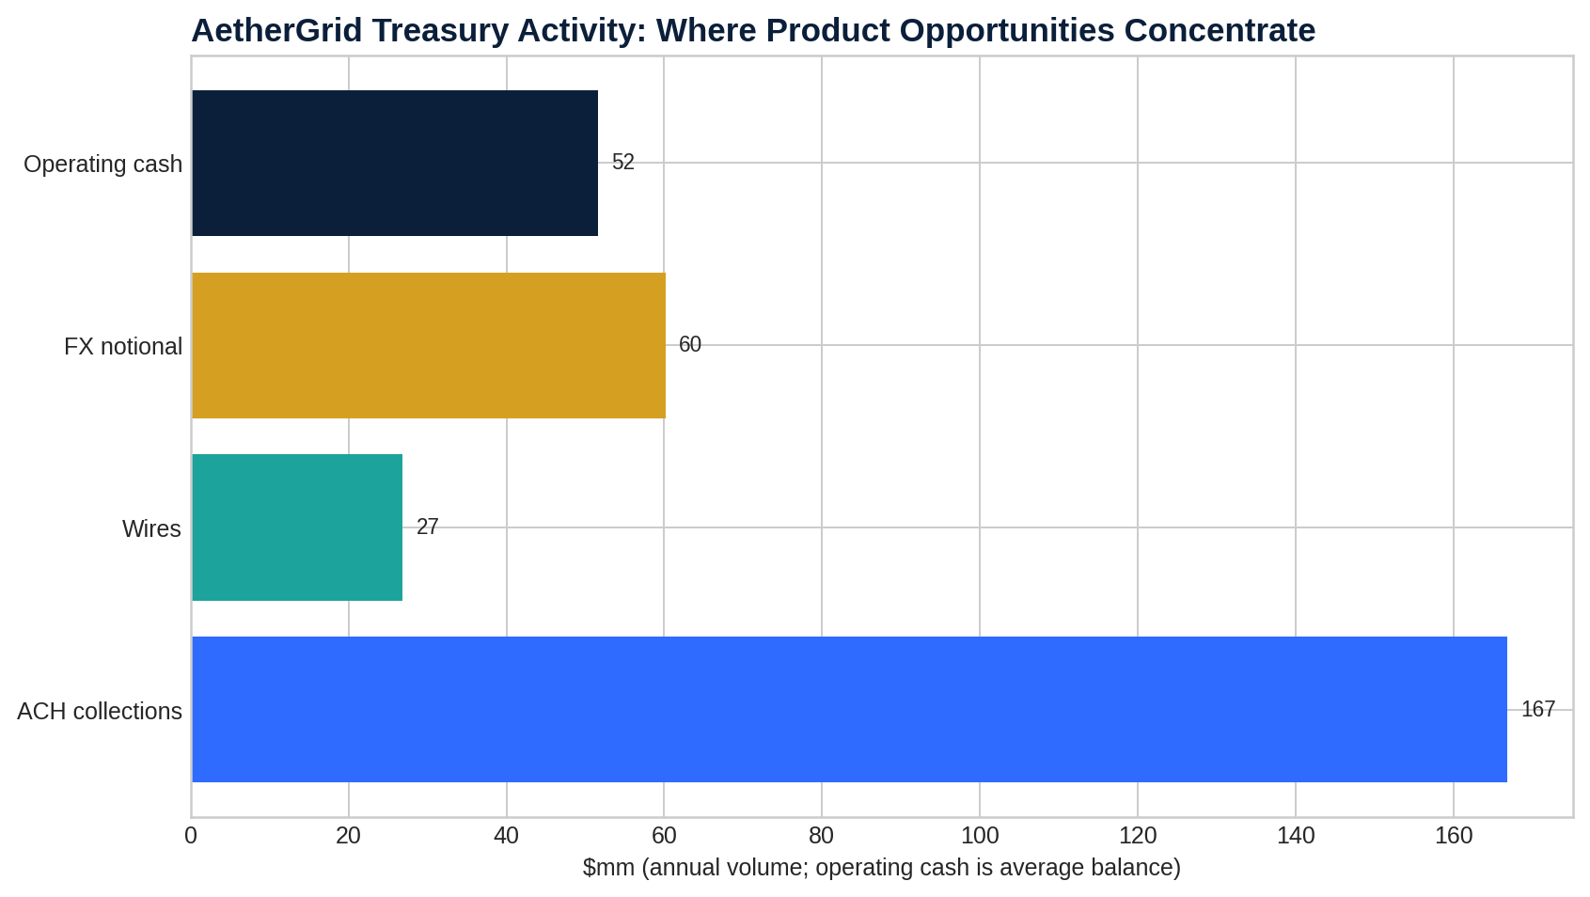
Treasury, Payments & FX Opportunity
A commercial relationship should be evaluated as more than a loan
Priority Solution Areas
• Receivables / ACH automation as collections scale
• Operating deposits and liquidity structure as cash balances rise
• Global payment visibility as international revenue expands
• FX exposure review and hedging discussion
• Payment controls for growing vendor disbursements
• Commercial card / expense management for a scaling workforce
Commercial thesis: deepen operating flows and visibility before adding material leverage.
Independent synthetic portfolio simulation | Not Bank of America work product

Slide 8
Executive Relationship Review
Translate analysis into coordinated actions across coverage and product partners
Finding
Implication
Action
Improving leverage & cash flow
Credit is supportive but still sensitive to downside
Maintain revolver; limit incremental term debt
Rising collections & cash
Treasury wallet is underpenetrated
Map receivables, payments, liquidity and controls
International revenue rising
FX complexity increases with growth
Conduct exposure review by currency / market
Strong NRR but normalizing
Renewal quality remains a key risk indicator
Review customer concentration and renewal pipeline
Potential future M&A
Strategic-capital needs may emerge
Keep Investment Banking informed
Independent synthetic portfolio simulation | Not Bank of America work product

Slide 9
Recommended Coverage Plan
The recommendation balances growth support, risk discipline, and relationship expansion
Preliminary Recommendation
Support continued access to an illustrative $50MM revolving facility, subject to formal underwriting and approval; prioritize treasury, liquidity, and FX expansion before adding aggressive incremental term leverage.
1
CFO / Treasurer Review
2
Credit Refresh
3
Treasury / FX Mapping
4
Quarterly Monitoring
Validate 2026 plan, cash priorities, renewal quality, and capital needs.
Update downside sensitivities, customer concentration, debt schedule, and liquidity.
Map collections, payments, deposits, international flows, and policy gaps.
Track DSCR, NRR, cash, leverage, margin execution, and wallet penetration.
Independent synthetic portfolio simulation | Not Bank of America work product

Slide 10
What This Project Demonstrates
Financial Analysis
Commercial Credit
Three-year forecast, margins, working capital, liquidity and cash flow
Net leverage, DSCR, interest-rate sensitivity and downside screening
Technology Coverage
Treasury & FX
SaaS / recurring revenue, NRR, growth and operating leverage
Collections, payments, deposits, liquidity and international exposure
Client Strategy
Executive Communication
Relationship prioritization, needs assessment and product opportunity mapping
Dashboard, credit screening memo, relationship review and pitch deck
Portfolio-ready • GitHub-ready • Interview-ready

