Slide 1
MySQL- DBMS

Slide 2
Over All Objective
To understand fundamental of database
To create ,drop and alter tables in MySQL Database using DDL commands
To insert, update and delete data in to the table in MySQL Database using DML commands
To retrieve data from tables in Database using DQL commands

Slide 3
Session Objective
To understand DBMS and Normalization

Slide 4
Normalization
Normalization

Slide 5
Normalization
Process of decomposing relations with anomalies to produce smaller, well-structured relations
Primarily a tool to validate and improve a logical design so that it satisfies certain constraints that avoid unnecessary duplication of data
A well-structured relations is a relation, which contains minimal data redundancy and allows users to insert, delete, and update rows without causing data inconsistencies

Slide 6
Need for Normalization
To avoid Anomalies
Insertion Anomaly–adding new rows forces user to create duplicate data
Deletion Anomaly–deleting rows may cause a loss of data that would be needed for other future rows
Modification Anomaly–changing data in a row forces changes to other rows because of duplication

Slide 7
Need for Normalization contd…
CNo | CName | PNo | PAddress | RentStart | RentFinish | Rent | ONo | OName
CR76 | John | PG4 | 6 lawrence St,Glasgow | 1-Jul-00 | 31-Aug-01 | 350 | CO40 | Tina Murphy
 |  | PG16 | 5 Novar Dr, Glasgow | 1-Sep-02 | 1-Sep-02 | 450 | CO93 | Tony Shaw
CR56 | Aline | PG4 | 6 lawrenceSt,Glasgow | 1-Sep-99 | 10-Jun-00 | 350 | CO40 | Tina Murphy
 |  | PG36 | 2 Manor Rd, Glasgow | 10-Oct-00 | 1-Dec-01 | 370 | CO93 | Tony Shaw
 |  | PG16 | 5 Novar Dr,Glasgow | 1-Nov-02 | 1-Aug-03 | 450 | CO93 | Tony Shaw
The above table, has multiple values on 2nd record, and fourth record which violates 1NF

Slide 8


1NF- First Normal Form
A table/relation have the following,
No multi-valued attributes
Every attribute value is atomic
For Example, The table in the previous slide is not fall under 1NF
How to make it in INF

Slide 9
1NF- First Normal Form
CNo | CName | PNo | PAddress | RentStart | RentFinish | Rent | ONo | OName
CR76 | John | PG4 | 6 lawrence St,Glasgow | 1-Jul-00 | 31-Aug-01 | 350 | CO40 | Tina Murphy
 |  | PG16 | 5 Novar Dr, Glasgow | 1-Sep-02 | 1-Sep-02 | 450 | CO93 | Tony Shaw
CR56 | Aline | PG4 | 6 lawrenceSt,Glasgow | 1-Sep-99 | 10-Jun-00 | 350 | CO40 | Tina Murphy
 |  | PG36 | 2 Manor Rd, Glasgow | 10-Oct-00 | 1-Dec-01 | 370 | CO93 | Tony Shaw
 |  | PG16 | 5 Novar Dr,Glasgow | 1-Nov-02 | 1-Aug-03 | 450 | CO93 | Tony Shaw
CNo | CName
CR76 | John
CR76 | John
CR56 | Aline
CR56 | Aline
CR56 | Aline
CNo | PNo | PAddress | RentStart | RentFinish | rent | ONo | OName
CR76 | PG4 | 6 lawrence St,Glasgow | 1-Jul-00 | 31-Aug-01 | 350 | CO40 | Tina Murphy
CR76 | PG16 | 5 Novar Dr, Glasgow | 1-Sep-02 | 1-Sep-02 | 450 | CO93 | Tony Shaw
CR56 | PG4 | 6 lawrenceSt,Glasgow | 1-Sep-99 | 10-Jun-00 | 350 | CO40 | Tina Murphy
CR56 | PG36 | 2 Manor Rd, Glasgow | 10-Oct-00 | 1-Dec-01 | 370 | CO93 | Tony Shaw
CR56 | PG16 | 5 Novar Dr,Glasgow | 1-Nov-02 | 1-Aug-03 | 450 | CO93 | Tony Shaw

Slide 10
1NF- First Normal Form
Now the table is in 1st Normal form
CNo | CName
CR76 | John
CR76 | John
CR56 | Aline
CR56 | Aline
CR56 | Aline
CNo | PNo | PAddress | RentStart | RentFinish | Rent | ONo | OName
CR76 | PG4 | 6 lawrence St,Glasgow | 1-Jul-00 | 31-Aug-01 | 350 | CO40 | Tina Murphy
CR76 | PG16 | 5 Novar Dr, Glasgow | 1-Sep-02 | 1-Sep-02 | 450 | CO93 | Tony Shaw
CR56 | PG4 | 6 lawrenceSt,Glasgow | 1-Sep-99 | 10-Jun-00 | 350 | CO40 | Tina Murphy
CR56 | PG36 | 2 Manor Rd, Glasgow | 10-Oct-00 | 1-Dec-01 | 370 | CO93 | Tony Shaw
CR56 | PG16 | 5 Novar Dr,Glasgow | 1-Nov-02 | 1-Aug-03 | 450 | CO93 | Tony Shaw
Though the above table in 1NF, but it has various anomalies, such as Insertion, deletion and update.

Slide 11
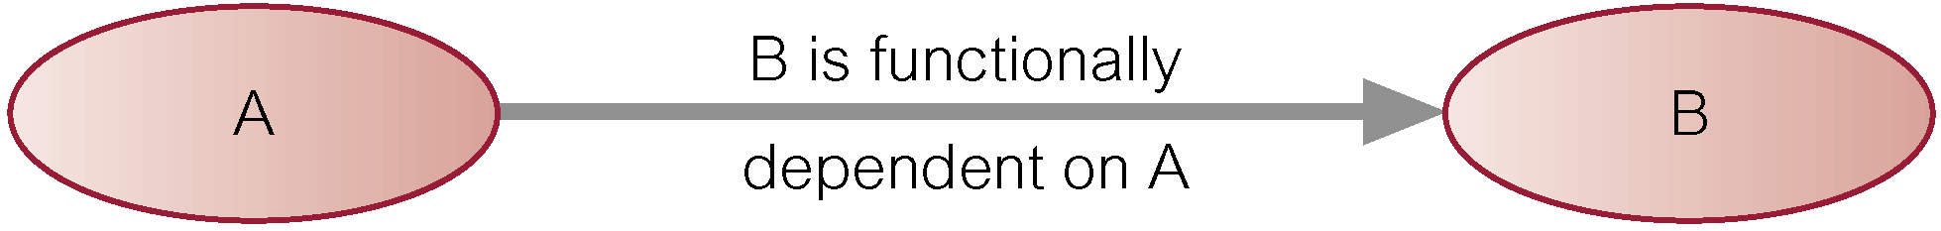
Functional Dependency (FD)
Functional dependency describes relationship between attributes
2nd Normal Form and 3rd Normal Form are based on Functional dependency
Functional dependency (FD) definition:
if A and B are attributes of relation R, B is functionally dependent on A (denoted A → B), if each value of A in R is associated with exactly one value of B in R
Diagrammatic representation
The determinant of a functional dependency refers to the attribute or group of attributes on the left-hand side of the arrow

Slide 12
Functional Dependency contd…
FD 1 | CNo, PNo ➔ RentStart, RentFinish | (Primary Key)
FD 2 | CNo ➔ CName | (Partial dependency)
FD 3 | PNo ➔ PAddress, Rent, ONo, OName | (Partial dependency)
FD 4 | ONo ➔ OName | (Transitive Dependency)
FD 5 | CNo, RentStart ➔ PNo, PAddress, RentFinish,Rent,Ono,OName | (Candidate key)
FD 6 | PNo, RentStart ➔ clientNo, cName, rentFinish | (Candidate key)

Slide 13
2NF- Second Normal Form
2NF Definition:
A relation that is in 1NF and every non-primary-key attribute is fully functionally dependent on the primary key
For Example, The below table is not in 2NF
CNo | PNo | PAddress | RentStart | RentFinish | Rent | ONo | OName
CR76 | PG4 | 6 lawrence St,Glasgow | 1-Jul-00 | 31-Aug-01 | 350 | CO40 | Tina Murphy
CR76 | PG16 | 5 Novar Dr, Glasgow | 1-Sep-02 | 1-Sep-02 | 450 | CO93 | Tony Shaw
CR56 | PG4 | 6 lawrenceSt,Glasgow | 1-Sep-99 | 10-Jun-00 | 350 | CO40 | Tina Murphy
CR56 | PG36 | 2 Manor Rd, Glasgow | 10-Oct-00 | 1-Dec-01 | 370 | CO93 | Tony Shaw
CR56 | PG16 | 5 Novar Dr,Glasgow | 1-Nov-02 | 1-Aug-03 | 450 | CO93 | Tony Shaw
In the above CNp, Pno, Ono are primary key attribute. Though it determines every other non-primary key attributes ( Paddress,RentStart,RentFinish,Rent,OName), the part of primary key CNo is enough to determine CNAME. Similarly Pno is enough to determine Paddress,Rent which is part of primary key. This is violation of 2NF.

Slide 14
Second Normal Form
Now the table is in 2nd Normal form
After removing the violation,
CNo | CName
CR76 | John
CR76 | John
CR56 | Aline
CR56 | Aline
CR56 | Aline
CNo | PNo | RentStart | RentFinish
CR76 | PG4 | 1-Jul-00 | 31-Aug-01
CR76 | PG16 | 1-Sep-02 | 1-Sep-02
CR56 | PG4 | 1-Sep-99 | 10-Jun-00
CR56 | PG36 | 10-Oct-00 | 1-Dec-01
CR56 | PG16 | 1-Nov-02 | 1-Aug-03
PNo | PAddress | Rent | ONo | OName
PG4 | 6 lawrence St,Glasgow | 350 | CO40 | Tina Murphy
PG16 | 5 Novar Dr, Glasgow | 450 | CO93 | Tony Shaw
PG36 | 2 Manor Rd, Glasgow | 370 | CO93 | Tony Shaw

Slide 15
3NF- Third Normal Form
3NF Definition:
A relation that is in 2NF and in which none of the non-key fields determine another non-key field.
Example,
PNo | PAddress | Rent | ONo | OName
PG4 | 6 lawrence St,Glasgow | 350 | CO40 | Tina Murphy
PG16 | 5 Novar Dr, Glasgow | 450 | CO93 | Tony Shaw
PG36 | 2 Manor Rd, Glasgow | 370 | CO93 | Tony Shaw
In the above table, PNO is the primary key.
The non-key attributes ONo determines OName. This is the violation of 3NF

Slide 16
Third Normal Form
Now the table is in 3rd Normal form
After removing the violation,
CNo | PNo | RentStart | RentFinish
CR76 | PG4 | 1-Jul-00 | 31-Aug-01
CR76 | PG16 | 1-Sep-02 | 1-Sep-02
CR56 | PG4 | 1-Sep-99 | 10-Jun-00
CR56 | PG36 | 10-Oct-00 | 1-Dec-01
CR56 | PG16 | 1-Nov-02 | 1-Aug-03
CNo | CName
CR76 | John
CR76 | John
CR56 | Aline
CR56 | Aline
CR56 | Aline
PNo | PAddress | Rent | ONo
PG4 | 6 lawrence St,Glasgow | 350 | CO40
PG16 | 5 Novar Dr, Glasgow | 450 | CO93
PG36 | 2 Manor Rd, Glasgow | 370 | CO93
ONo | OName
CO40 | Tina Murphy
CO93 | Tony Shaw
CO93 | Tony Shaw

Slide 17
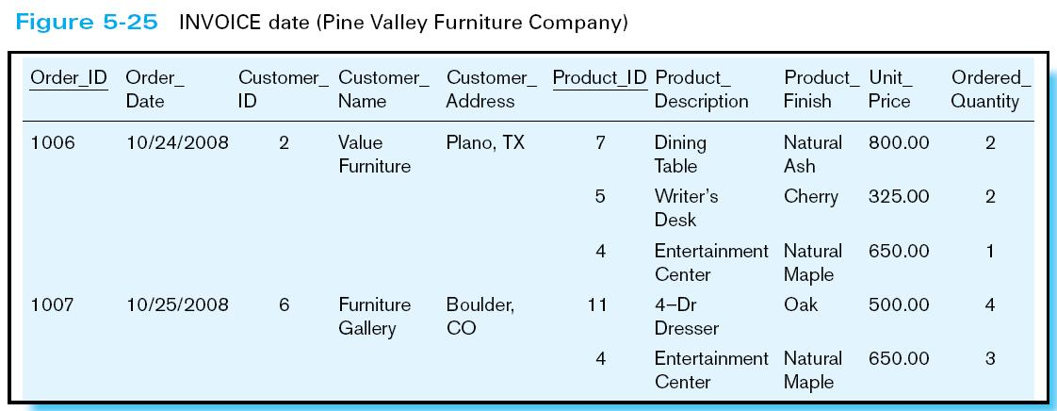
Case Study on Normalization
Consider the relation INVOICE,
The above relation is in Un-normalized state.

Slide 18
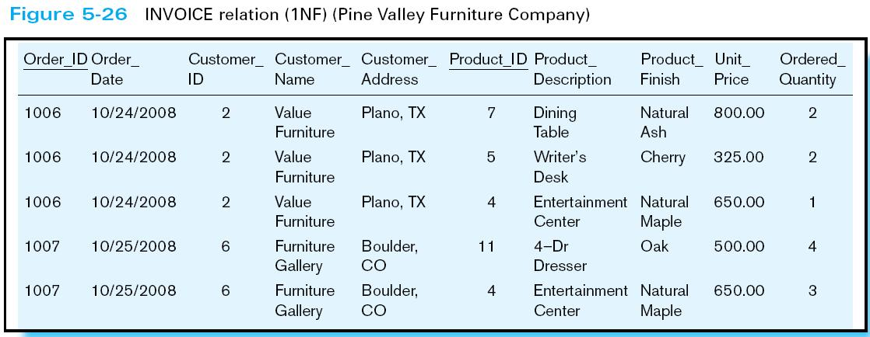
Case Study on Normalization contd…
After 1NF, ( multiple values are present, which violates 1NF)
The above table in 1NF, because no multi-value attributes.

Slide 19
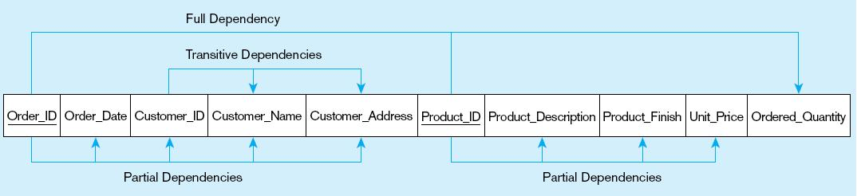
Case Study on Normalization contd…
Based on the information (table) details, list all the FDs
The FDs, which violates 2NF and 3NF are mentioned
Order_ID ➔ Order_Date, Customer_ID, Customer_Name, Customer_Address
Customer_ID ➔ Customer_Name, Customer_Address
Product_ID ➔ Product_Description, Product_Finish, Unit_Price
Order_ID, Product_ID ➔ Order_Quantity

Slide 20
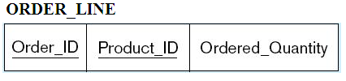



Case Study on Normalization contd…
After removing the partial and transitive dependencies,
The above relations are in 3NF

Slide 21


Data Base Keys

Slide 22
Keys
A key is a one or more attributes, used to identify a record in a relation/table
Relation model support different types of keys
Candidate key
Super key
Foreign key
Alternate key
Primary key

Slide 23
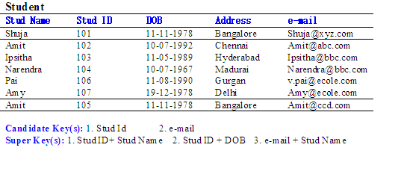
Keys contd…
Candidate Key
One or more attributes, which is used to uniquely identify a record in a relation
Super key
One or more attributes, which is used to uniquely identify a record in a relation
super set of candidate key i.e.,Candidate key + non key attributes

Slide 24
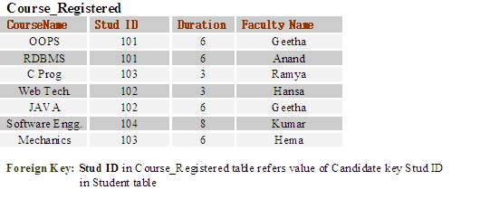
Keys contd…
Foreign Key
Used to relate one or more relations/tables
One or more attributes, which is used to refer value of a candidate key in the same relation or a different relation
Alternate Key
Candidate keys that are not selected to be primary key

Slide 25
Keys contd…
Primary Key
One or more attributes, which is used to uniquely identify a record in a relation
Used in table creation
If a relation has several candidate keys, one is chosen arbitrarily to be the primary key
Example: Primary key: Stud ID

Slide 26

Video on Keys
Objective:
To make the Trainee understand the concept of Database keys.
Video Path:
https://www.youtube.com/watch?v=JkwbhFUftSc

