Slide 1
House Sales Project
Data Visualization Project Using Tableau, Extracting House Sales Data in King County, Washington 2014-2015
By Jalal Haider

Slide 2
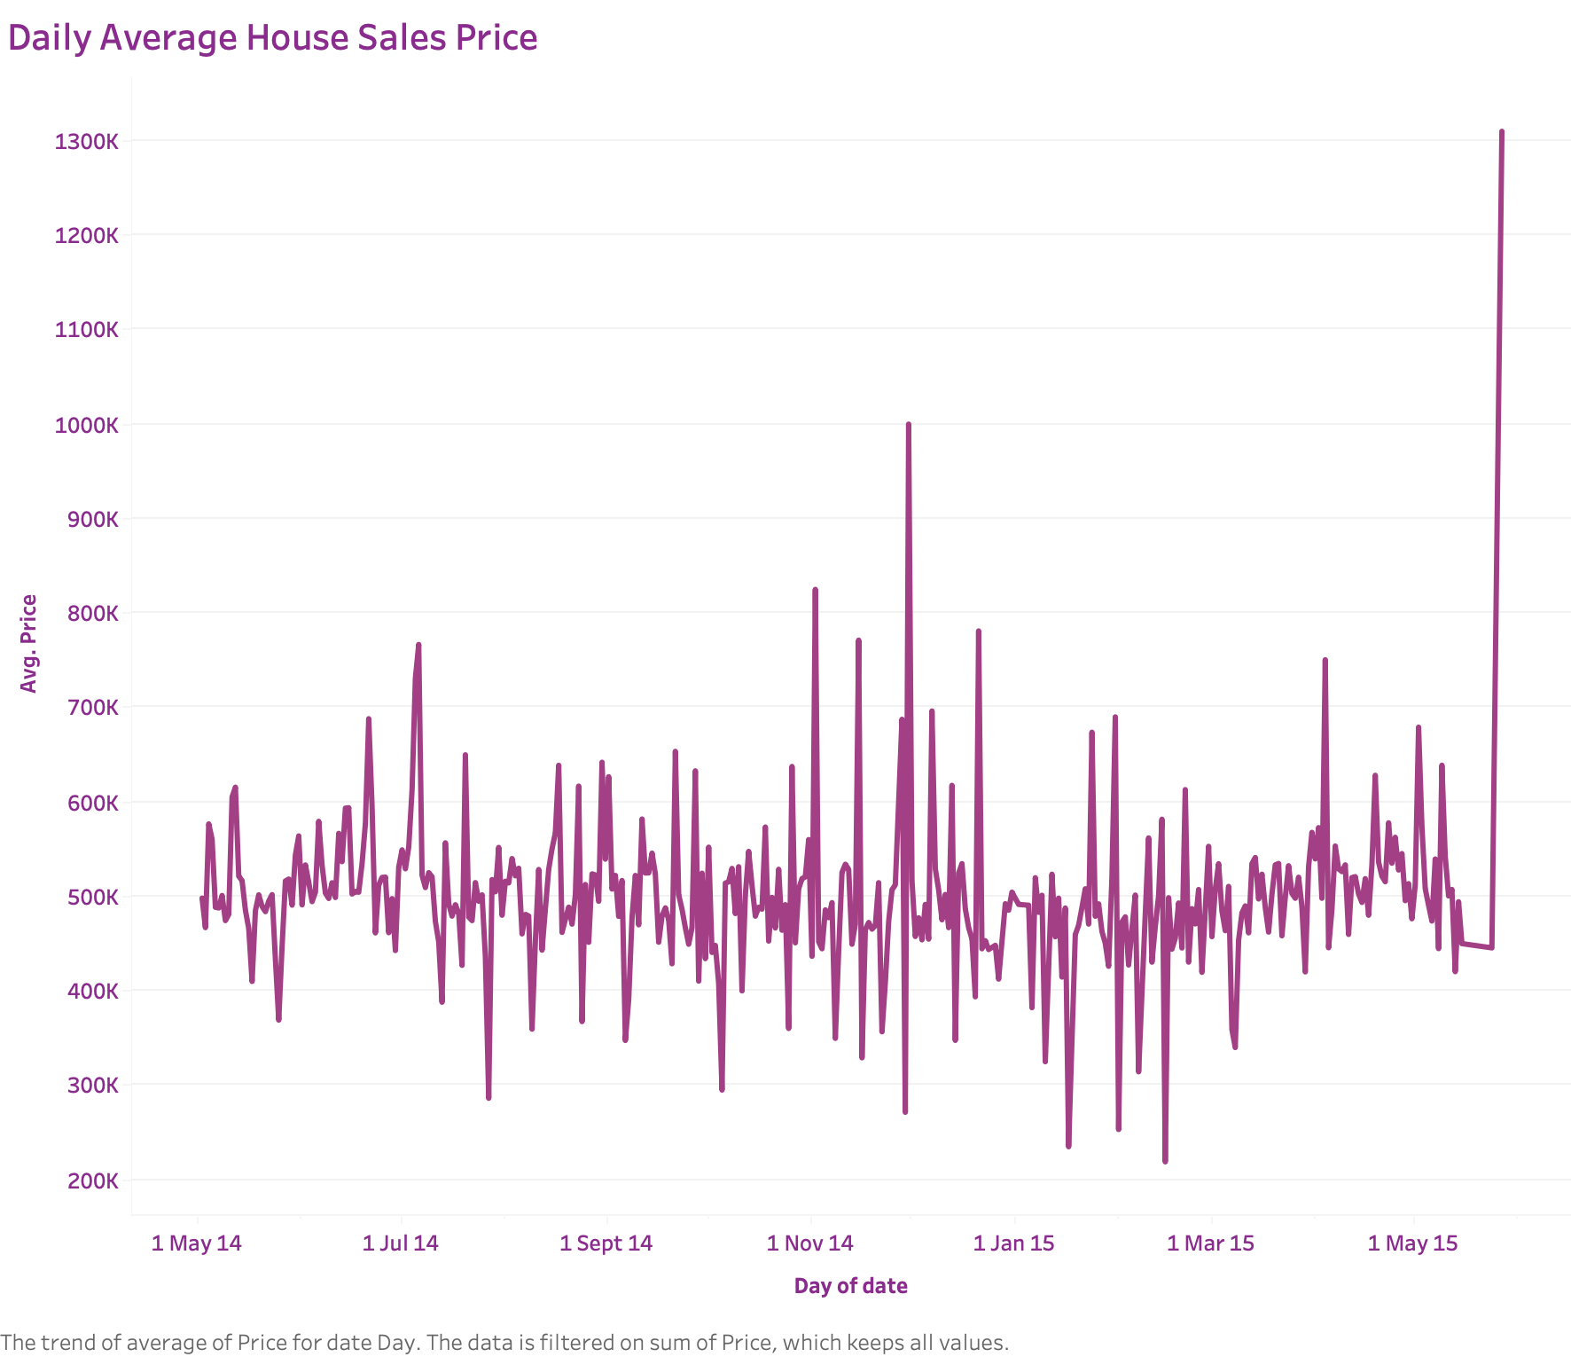

Slide 3
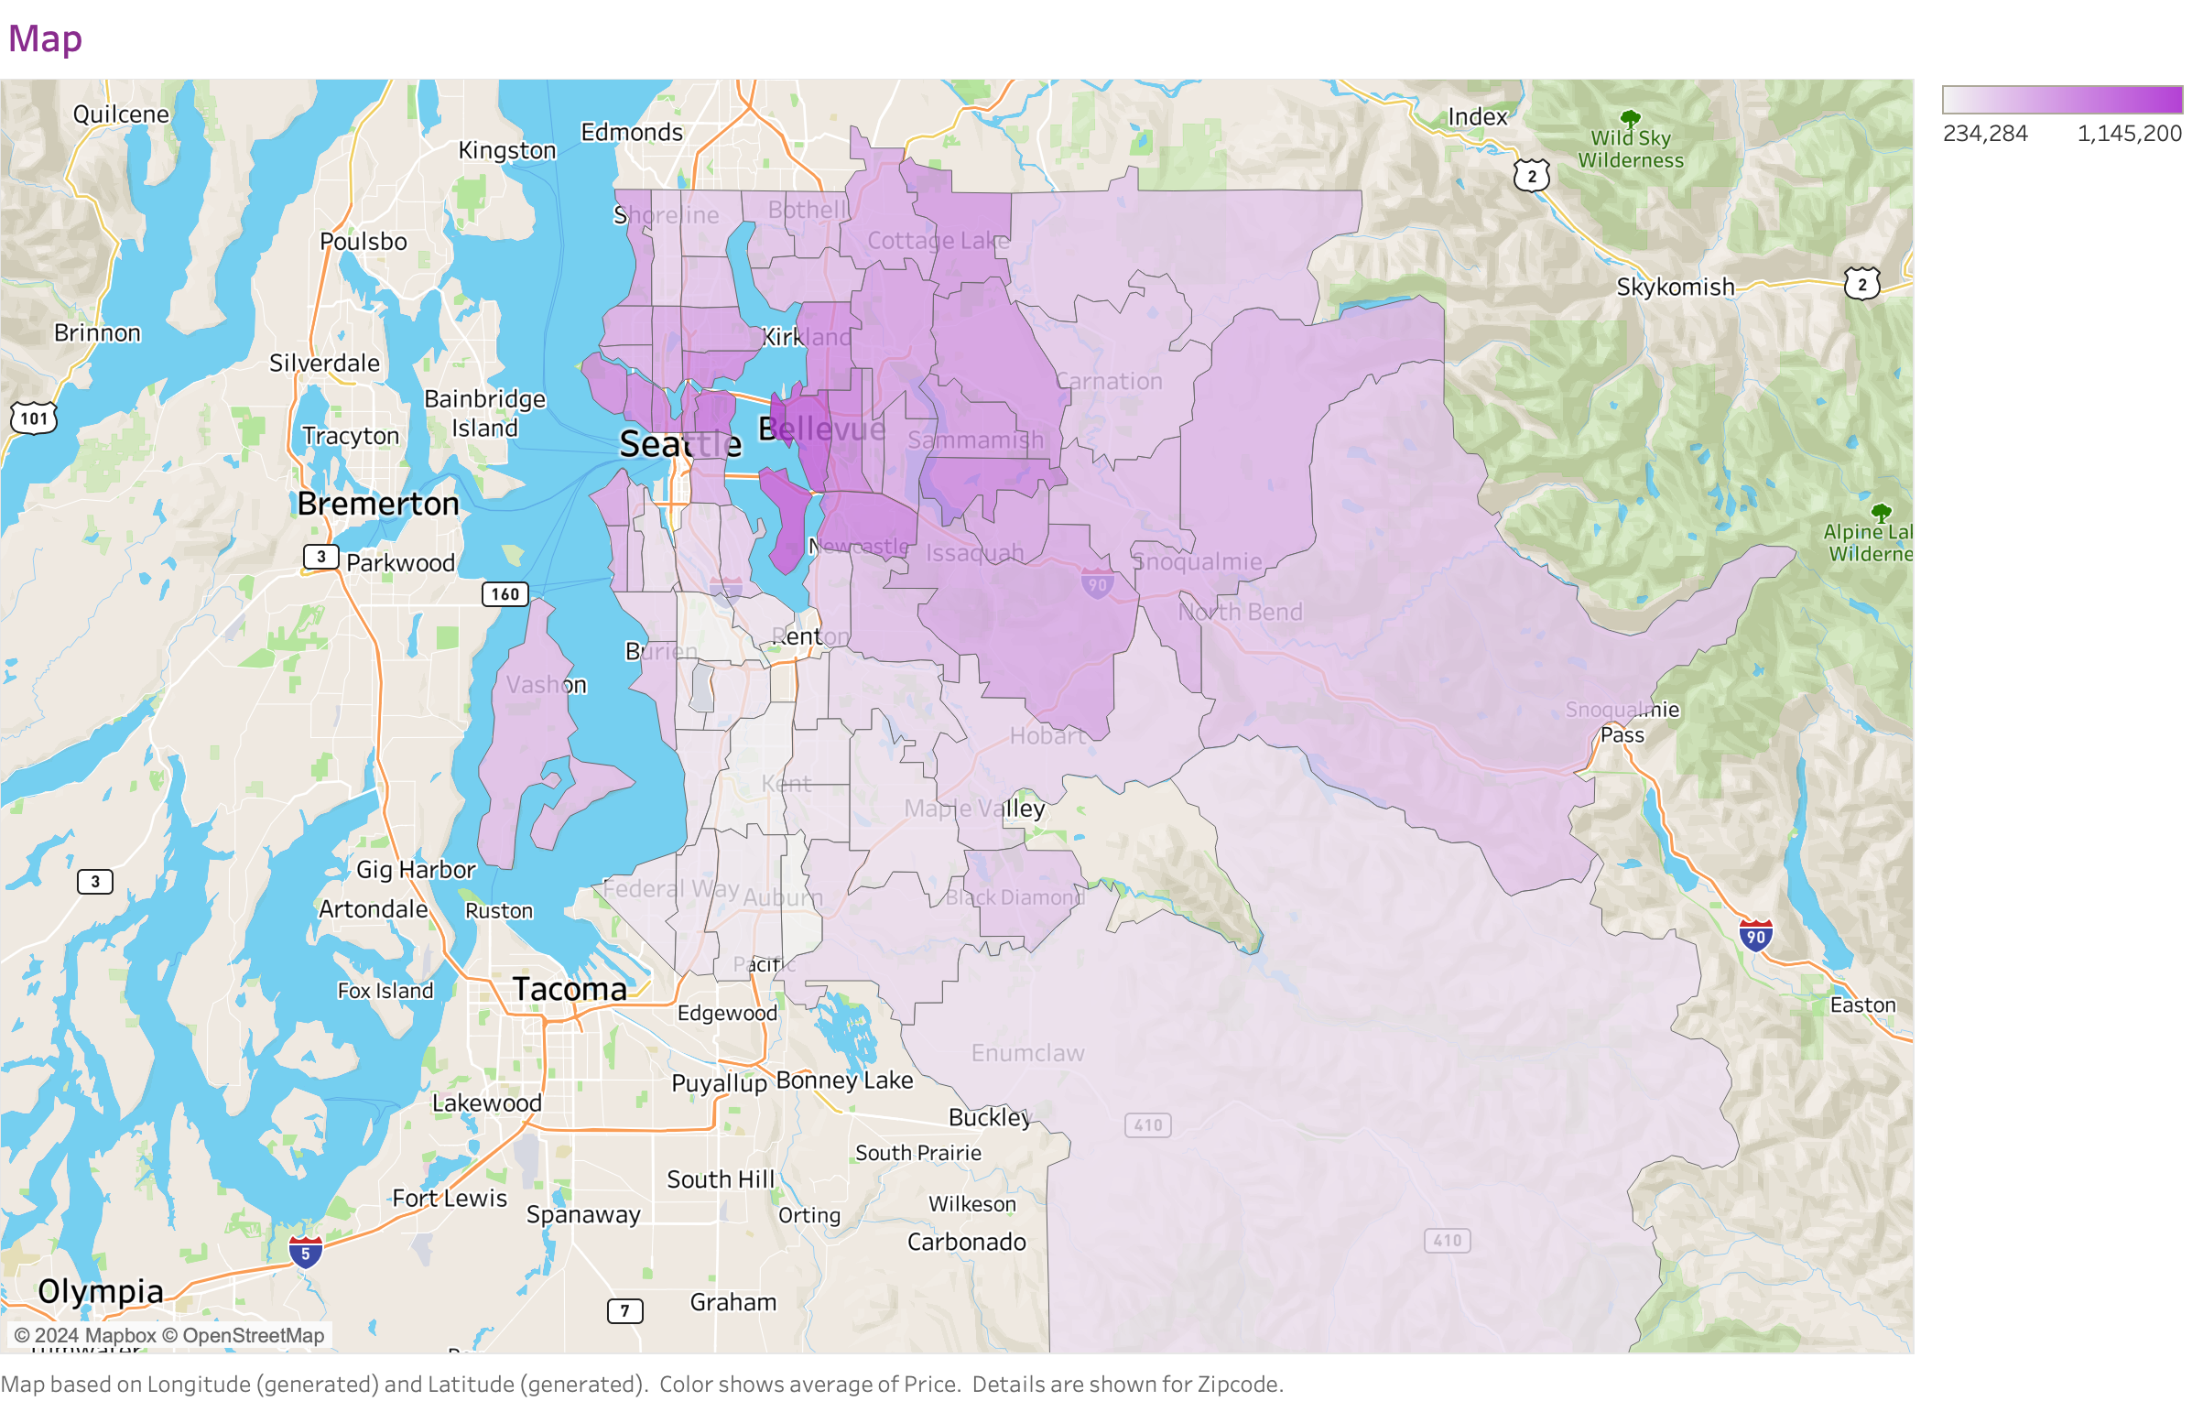

Slide 4
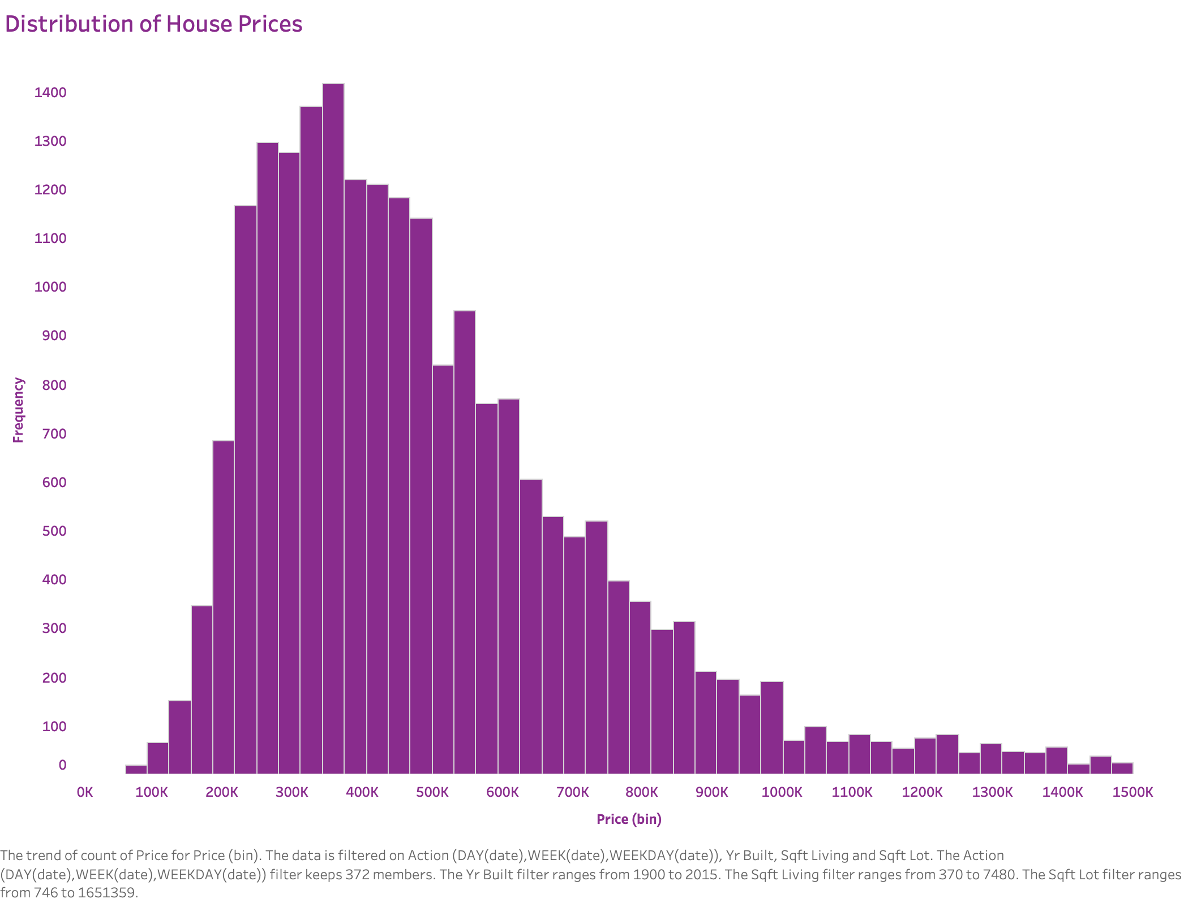

Slide 5
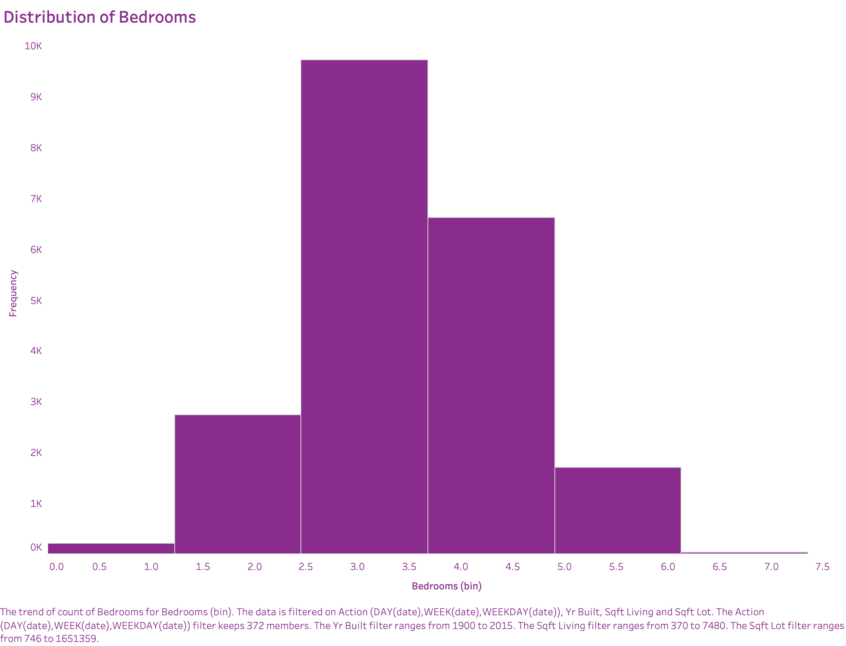

Slide 6
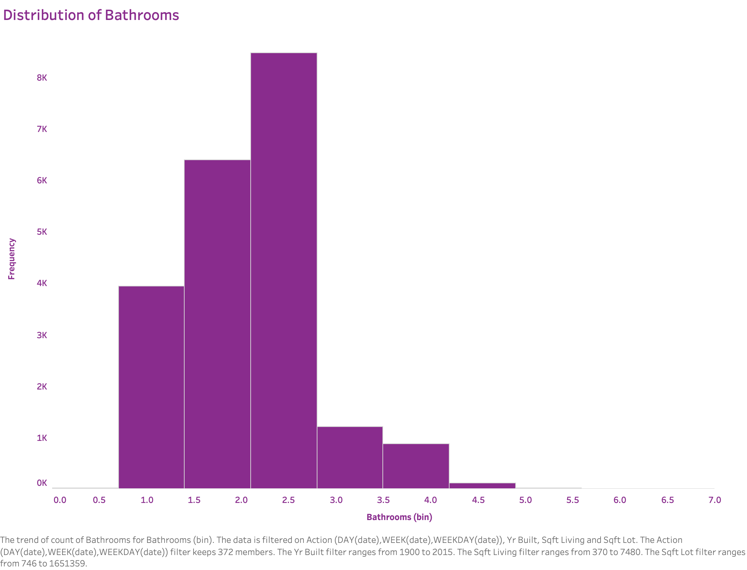

Slide 7
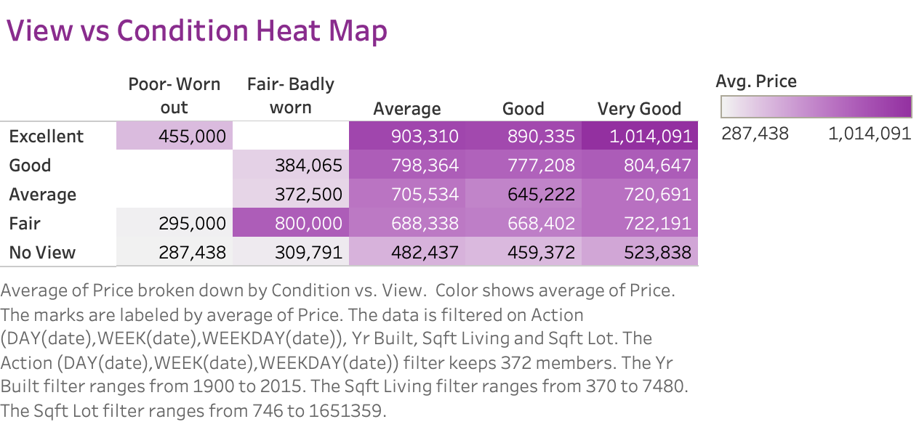

Slide 8
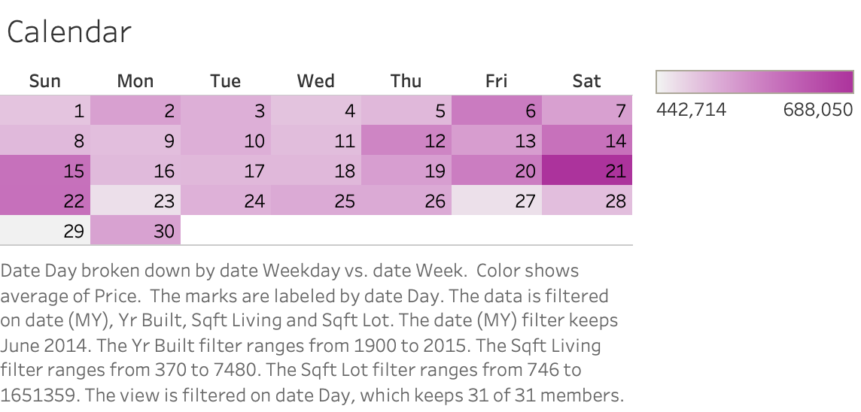

Slide 9
