Slide 1
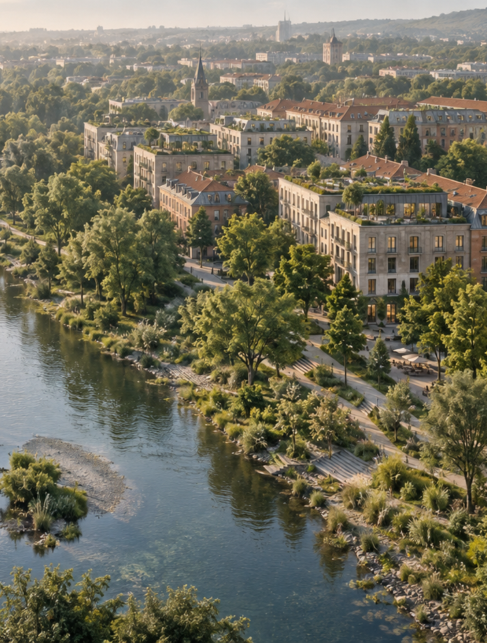

Applied Sustainability in Business and Management
Lecture 1 — Foundations of Sustainability, Environmental Challenges and Green Infrastructure
Ing,Arch.Jenan Hussein.Msc.PhD.
jenanhussein83@gmail.com
Notes:
AI-generated conceptual artwork created with OpenAI image generation, September 2026. Decorative illustration; not a photograph of a documented location or case study.

Slide 2

Learning Objectives
By the end of this lecture you will be able to:
01
Define sustainability and sustainable development.
05
Explain why sustainability is becoming a strategic business issue.
02
Explain the three pillars of sustainability (Triple Bottom Line).
06
Understand the major environmental challenges of the 21st century.
03
Understand the relationship between business and ecosystems.
07
Analyze the impacts of urbanization on natural systems & Green Infrastructure.
04
Identify sustainability challenges facing modern organizations.
www.newton.university
02

Slide 3
Today's Lecture Agenda
Before the break
After the break
Part 1 — Why Sustainability Matters
Part 4 — Planetary Challenges
Part 2 — Sustainability and Business
Part 5 — Urban Development and Nature
Part 3 — Green Infrastructure in Business
Part 6 — Green Infrastructure as a Solution
Prague Focus — the City as a Living Laboratory
Prague Case Study — the Vltava River Corridor
Case Study — Singapore: City in Nature
Workshop and Preparation for Seminar 1
Discussion
Key Messages and Reading
Break
www.newton.university
03

Slide 4
Part 1
01
Why Sustainability
Matters
www.newton.university
04

Slide 5
Opening Discussion
Class brainstorming exercise
What does sustainability mean to you?
Can a company be profitable and sustainable at the same time?
Should businesses be responsible for environmental protection?
www.newton.university
05

Slide 6
What is Sustainability?
Brundtland Definition (1987)
“Sustainable development is development that meets the needs of the present without compromising the ability of future generations to meet their own needs.”
Three ideas behind the definition
Long-term thinking
Responsible resource management
Intergenerational responsibility
www.newton.university
06

Slide 7
The Triple Bottom Line
Sustainability balances three dimensions of value:
People
Planet
Profit
Social
Environmental
Economic
Human rights
Carbon emissions
Financial performance
Fair wages
Biodiversity
Innovation
Community wellbeing
Water management
Competitiveness
www.newton.university
07

Slide 8
Evolution of Corporate Sustainability
1970s
1990s
Today
Compliance
Corporate Responsibility
ESG and Sustainable Business
Environmental regulations set the minimum standard
Voluntary CSR programmes and reporting
Sustainability as core strategy: Microsoft, Unilever, Patagonia, IKEA
www.newton.university
08

Slide 9
02
Part 2
Sustainability
and Business
www.newton.university
09

Slide 10
Why Companies Care About Sustainability
Four drivers push sustainability onto the management agenda:
Regulation
Investors
European Green Deal · CSRD · ESG requirements
ESG investing · e.g. BlackRock
Customers
Employees
Demand for greener products
Preference for sustainable employers
www.newton.university
10

Slide 11
Business Risks of Unsustainability
01
02
03
Environmental risks
Economic risks
Reputational risks
Flooding
Resource scarcity
Greenwashing accusations
Drought
Rising costs
Brand damage
Heat waves
www.newton.university
11

Slide 12
Case Study: Unilever
Sustainability strategy focus
01
Sustainable sourcing of raw materials
Discussion
How does sustainability create business value?
02
Water use reduction
03
Carbon reduction across the value chain
www.newton.university
12

Slide 13

Part 3
Green Infrastructure
in Business
www.newton.university
13
Notes:
AI-generated conceptual artwork created with OpenAI image generation, September 2026. Decorative illustration; not a photograph of a documented location or case study.

Slide 14
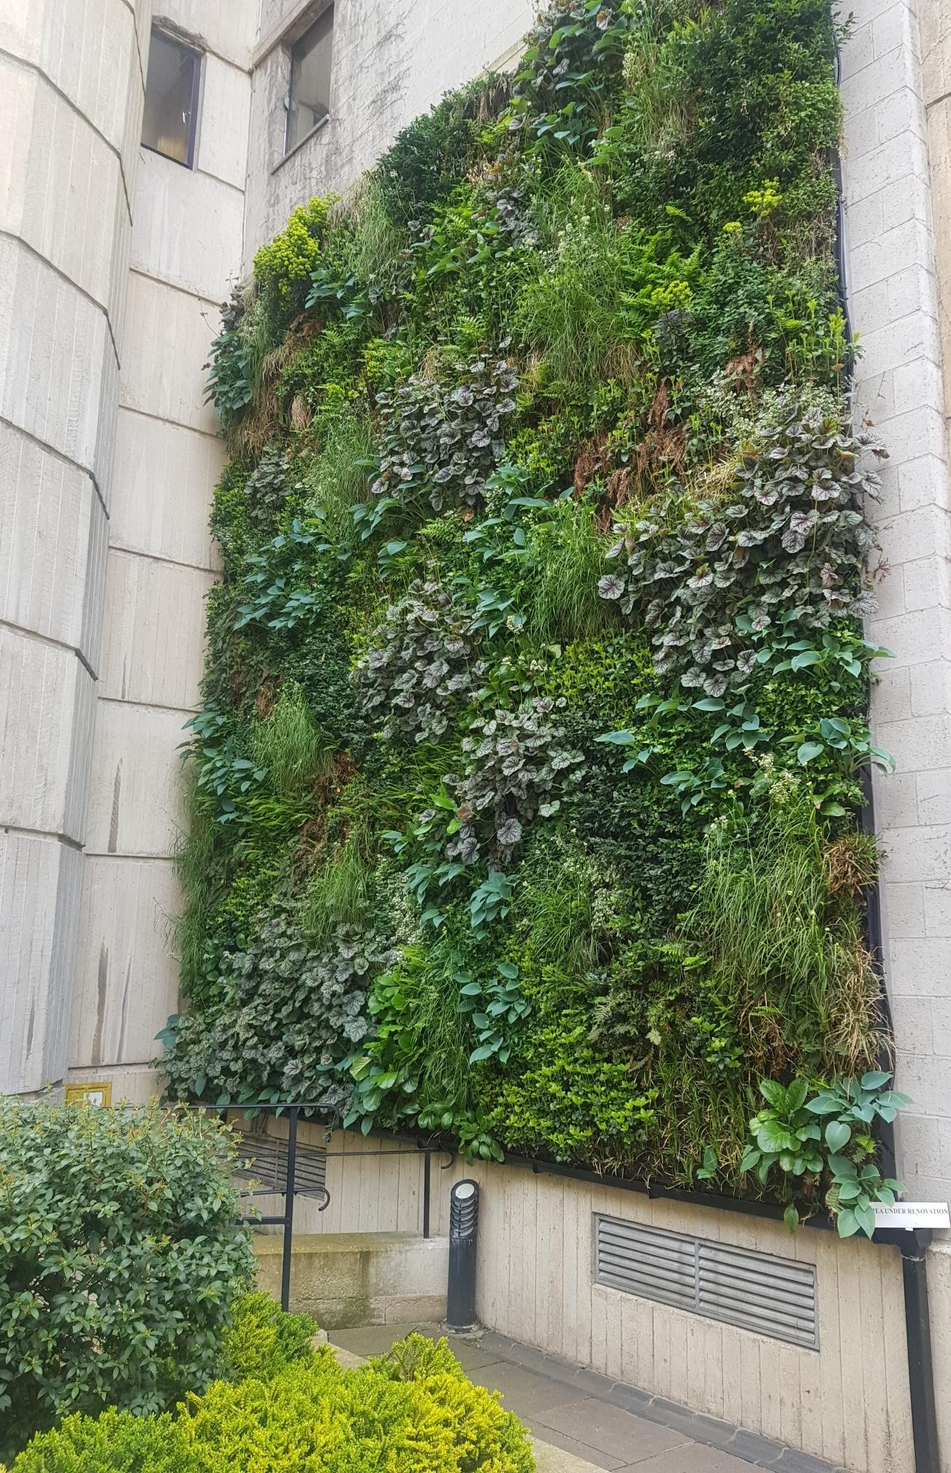
What is Green Infrastructure?
Definition
A strategically planned network of natural and semi-natural areas, designed and managed to provide ecosystem services and improve environmental quality.
For a company, Green Infrastructure means using nature as a business asset — green roofs, living walls, rain gardens or trees on site — to cut operating costs, manage risk and deliver services it would otherwise pay for.
Living wall at St Edmund Hall: nature integrated into the built environment
www.newton.university
14
Notes:
St Edmund Hall Living Wall.jpg — CC BY-SA 4.0, Wikimedia Commons
https://commons.wikimedia.org/wiki/File:St_Edmund_Hall_Living_Wall.jpg
Source photograph retained from original deck; cropped for layout.
Caption clarified: the source image identifies St Edmund Hall, rather than an office building.

Slide 15
Green Infrastructure a Company Can Use
Green roofs
Living walls
Lower cooling bills
Cooler buildings
Longer roof life
Cleaner air
Lower stormwater fees
Brand image
Rain gardens
Trees on site
Flood protection
Shade and cooling
Lower drainage costs
Staff well-being
Regulatory compliance
Carbon absorption
www.newton.university
15

Slide 16
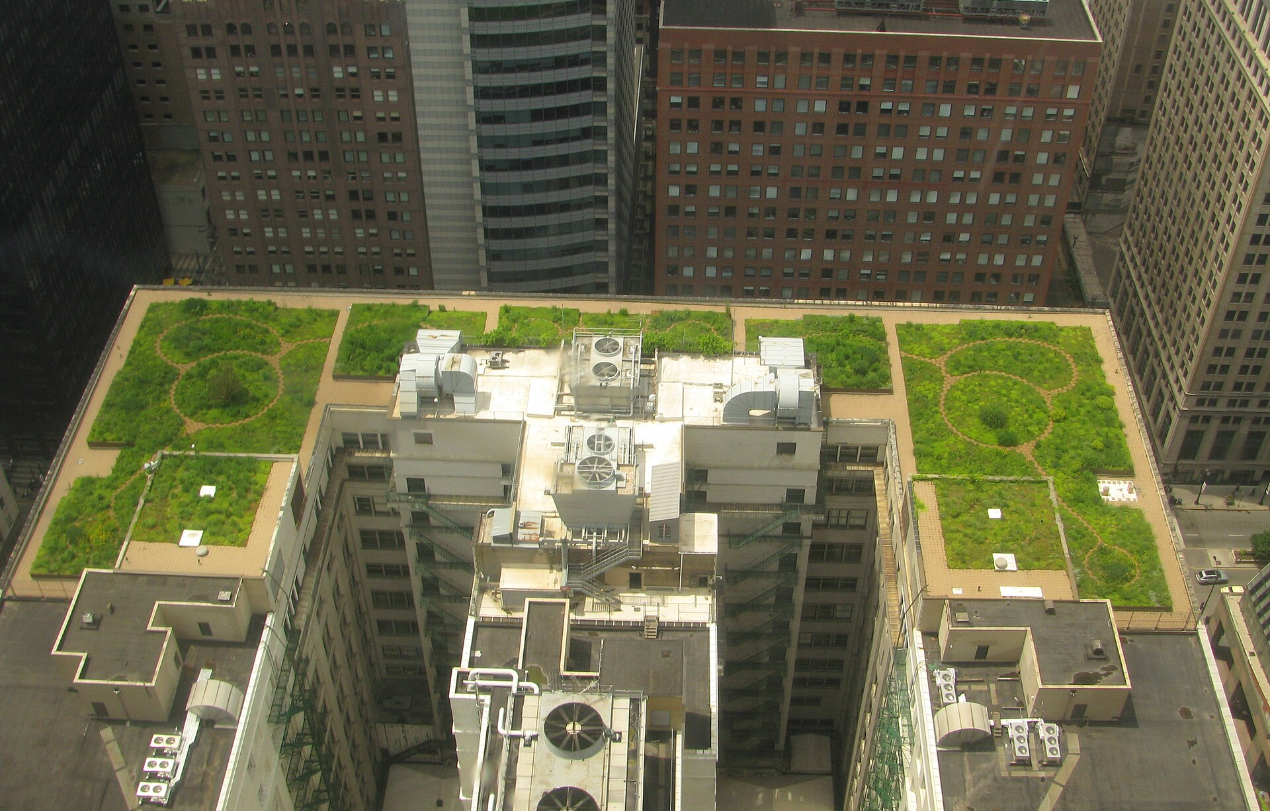
Green Roofs as a Business Investment
Green roof, Chicago — for the building owner it lowers cooling costs, extends the life of the roof and reduces stormwater charges. Companies make the same case for their own offices, warehouses and factories.
www.newton.university
16
Notes:
20080708 Chicago City Hall Green Roof.JPG — CC BY-SA 3.0, Wikimedia Commons
https://commons.wikimedia.org/wiki/File:20080708_Chicago_City_Hall_Green_Roof.JPG
Source photograph retained from original deck; cropped for layout.

Slide 17
Natural Capital and Ecosystem Services
Nature provides four categories of services with measurable economic value:
Provisioning
Regulating
Cultural
Supporting
Food
Flood control
Recreation
Soil formation
Water
Climate regulation
Tourism
Nutrient cycling
Raw materials
Pollination
What this means for a company
Provisioning services are the raw materials and water in its supply chain. Regulating services protect its sites from floods and heat. Cultural and supporting services underpin the reputation and licence to operate that come from protecting nature.
www.newton.university
17

Slide 18
Prague
Focus
www.newton.university
18

Slide 19
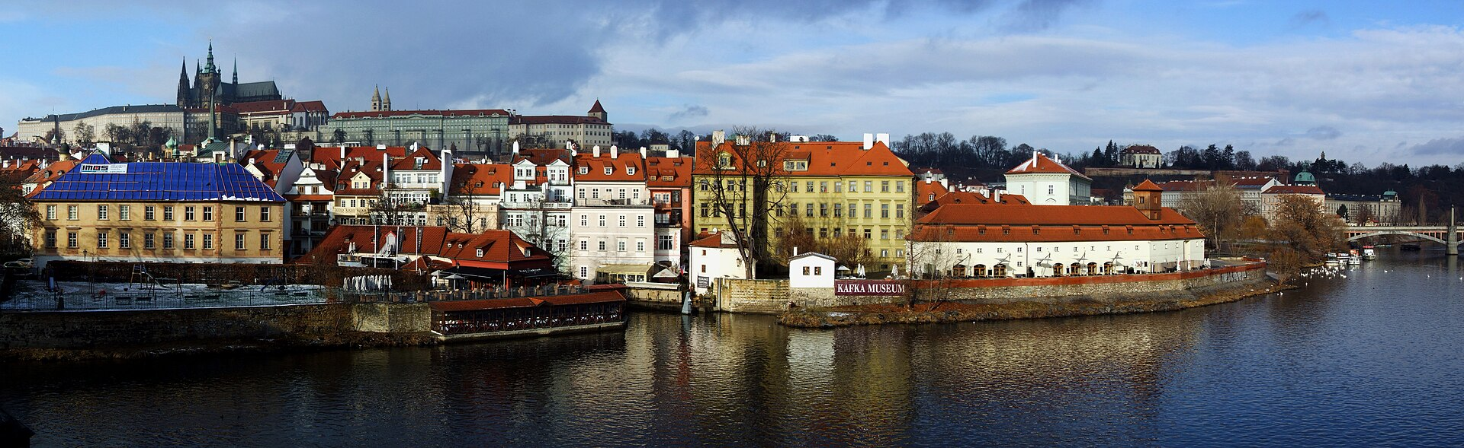
Prague — a City Built Around its River
The Vltava River corridor: the city's blue-green spine
www.newton.university
19
Notes:
Prague - view from Charles Bridge (by Pudelek).jpg — CC BY-SA 3.0, Wikimedia Commons
https://commons.wikimedia.org/wiki/File:Prague_-_view_from_Charles_Bridge_(by_Pudelek).jpg
Source photograph retained from original deck; cropped for layout.

Slide 20
Prague as a Living Laboratory
Natural assets of the city
01
Stromovka Park — historic urban park and recreation area
Discussion
How do these areas support the city — environmentally, socially, economically?
02
Divoká Šárka — nature reserve inside the city
03
Prokopské údolí — protected valley landscape
04
Vltava River corridor — the city's blue-green spine
www.newton.university
20

Slide 21
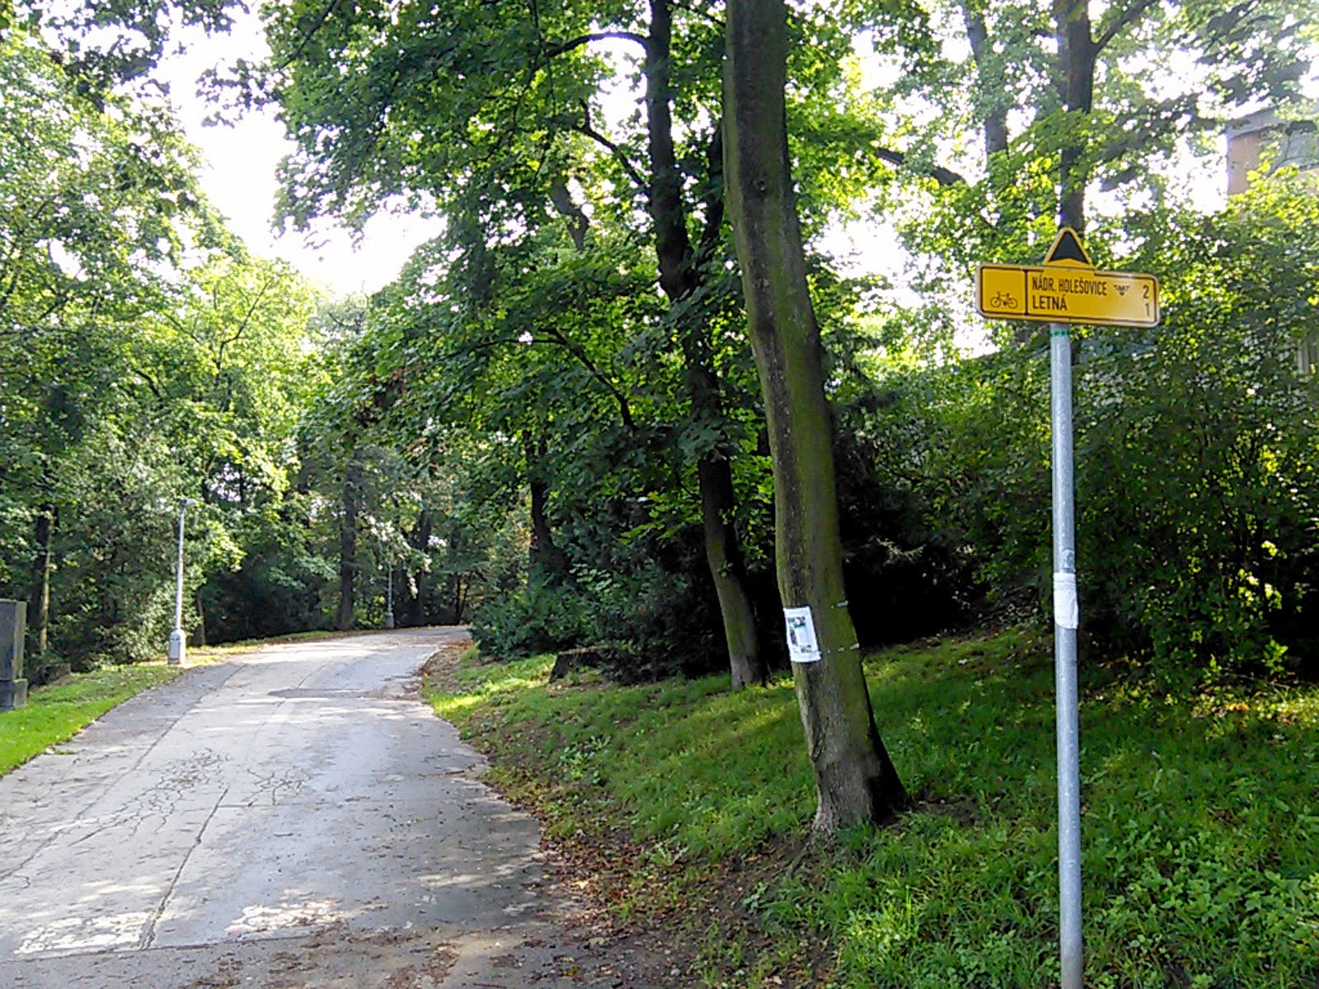
Human–Nature Interaction
Why are people attracted to green spaces?
How do green areas affect property values?
How do businesses benefit from nearby parks?
Stromovka — Prague's royal park
www.newton.university
21
Notes:
Královská obora (Stromovka) park in Prague, Czech Republic. - panoramio.jpg — CC BY-SA 3.0, Wikimedia Commons
https://commons.wikimedia.org/wiki/File:Kr%C3%A1lovsk%C3%A1_obora_(Stromovka)_park_in_Prague%2C_Czech_Republic._-_panoramio.jpg
Source photograph retained from original deck; cropped for layout.

Slide 22
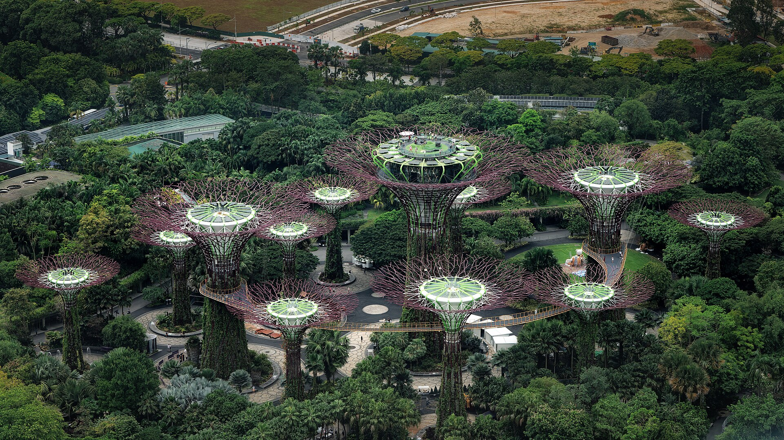
Case Study: Singapore — City in Nature
Key themes
Urban biodiversity
Vertical greenery and green roofs
Urban resilience
Lesson
Nature can be integrated even into very dense urban environments.
Supertree Grove, Gardens by the Bay
www.newton.university
22
Notes:
Supertree Grove, Gardens by the Bay, Singapore1.jpg — CC0, Wikimedia Commons
https://commons.wikimedia.org/wiki/File:Supertree_Grove%2C_Gardens_by_the_Bay%2C_Singapore1.jpg
Source photograph retained from original deck; cropped for layout.

Slide 23
Mid-Lecture Discussion
01
Is sustainability a cost or an investment?
02
Why should business managers understand ecology?
03
Could Prague become a greener city?
www.newton.university
23

Slide 24
Break
Second half — Environmental Challenges, Urban Expansion and Green Infrastructure
www.newton.university
24

Slide 25
Part 4
Planetary
Challenges
04
www.newton.university
25

Slide 26
The Planetary Boundaries Framework
Key boundaries under pressure
01
Climate change
Discussion
02
Biodiversity loss
What happens when planetary boundaries are exceeded?
03
Freshwater use
04
Land-system change
05
Pollution (novel entities)
www.newton.university
26

Slide 27
Climate Change
Causes
Consequences
Fossil fuel combustion
Extreme heat
Deforestation
Floods
Industrialization
Droughts
www.newton.university
27

Slide 28
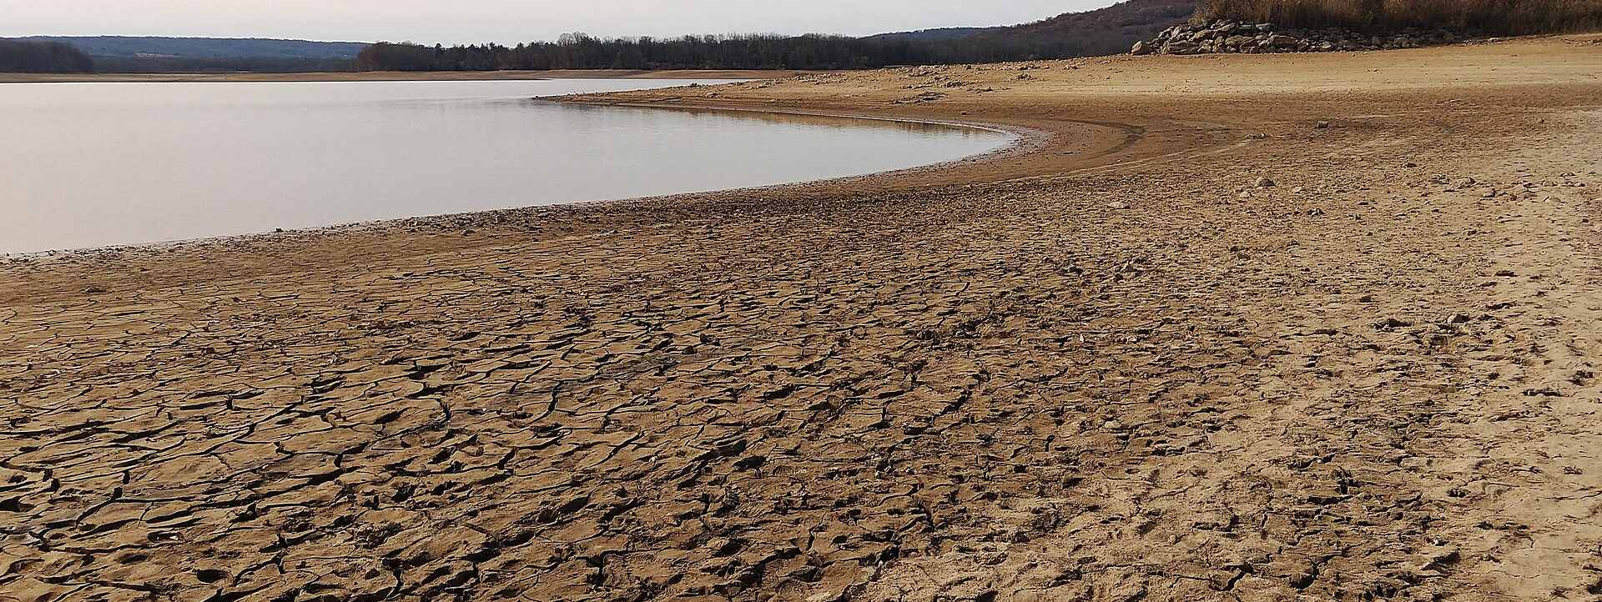
Drought: a Growing European Risk
Illustrative drought photograph: Spruce Run Reservoir, New Jersey, November 2024.
www.newton.university
28
Notes:
Spruce Run Reservoir drought from beach (2), Nov. 2024.jpg — CC BY-SA 4.0, Wikimedia Commons
https://commons.wikimedia.org/wiki/File:Spruce_Run_Reservoir_drought_from_beach_(2)%2C_Nov._2024.jpg
Source photograph retained from original deck; cropped for layout.
Photograph location verified: New Jersey. https://commons.wikimedia.org/wiki/Category:Drought_in_New_Jersey

Slide 29
The Biodiversity Crisis
Current pressures
Why biodiversity matters
Habitat destruction
Food production
Urban expansion
Water regulation
Pollution
Pollination
Invasive species
Climate stability
www.newton.university
29

Slide 30
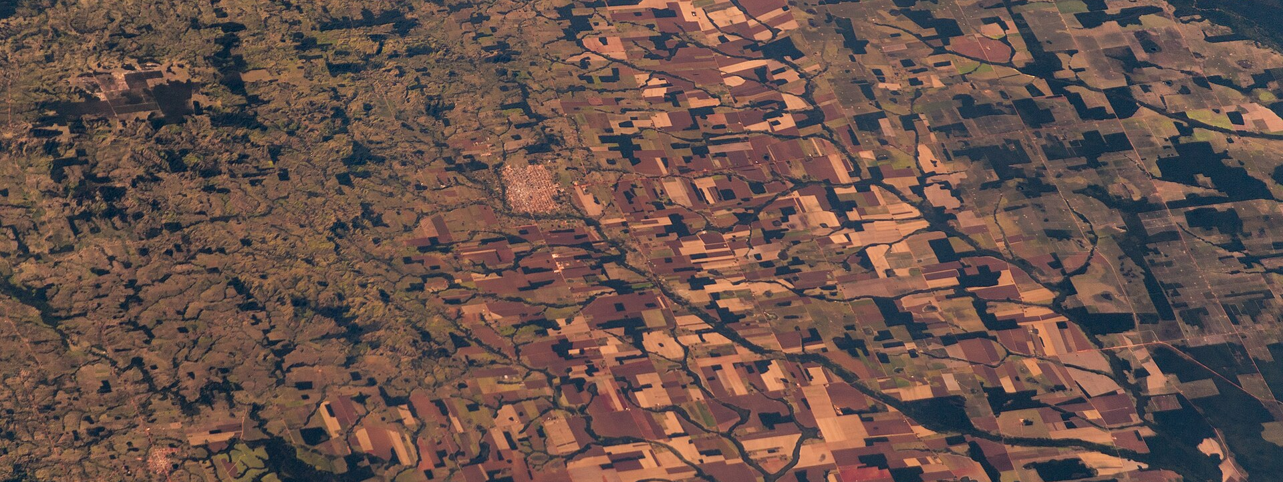
Land-Use Change Seen from Above
Satellite view of deforestation — land-system change is a planetary boundary under pressure
www.newton.university
30
Notes:
Amazon rainforest (Satellite picture).jpg — CC BY-SA 2.0, Wikimedia Commons
https://commons.wikimedia.org/wiki/File:Amazon_rainforest_(Satellite_picture).jpg
Source photograph retained from original deck; cropped for layout.

Slide 31
Part 5
Urban Development
and Nature
05
www.newton.university
31

Slide 32
Urbanization Trends
Global reality
Resulting challenges
More than half of humanity now lives in cities.
Housing demand
Transportation pressure
Future population growth will occur mainly in urban areas.
Reduction of green space
www.newton.university
32

Slide 33
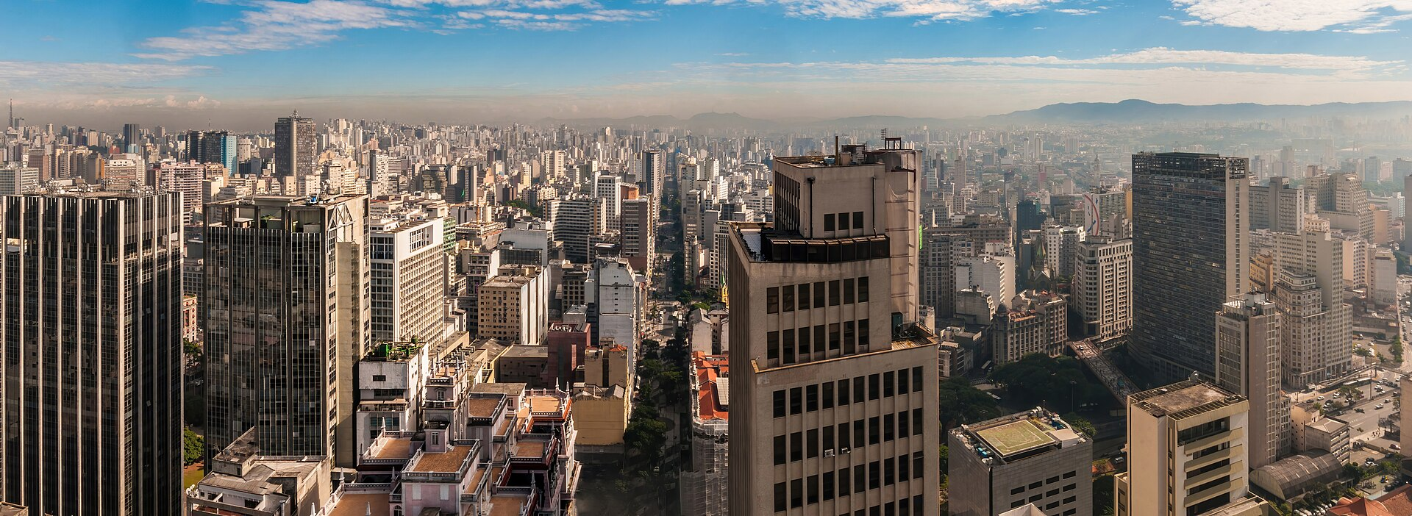
Urban Heat Islands
Definition
Cities become significantly hotter than their surroundings.
Dense, sealed surfaces trap heat and pollution
Main causes
Asphalt and concrete surfaces absorbing heat
Lack of vegetation and shade
Waste heat from buildings and traffic
www.newton.university
33
Notes:
Panoramic view of air pollution in São Paulo city, Brazil.jpg — CC0, Wikimedia Commons
https://commons.wikimedia.org/wiki/File:Panoramic_view_of_air_pollution_in_S%C3%A3o_Paulo_city%2C_Brazil.jpg
Source photograph retained from original deck; cropped for layout.

Slide 34
Prague Example: Green vs Dense Urban Areas
Discussion: how does vegetation affect temperature in the city?
Historic green area
Dense urban area
Stromovka Park
Prague city centre
Tree canopy and water features
Sealed surfaces, little vegetation
Noticeably cooler microclimate
Strong heat-island effect
www.newton.university
34

Slide 35
Part 6
Green Infrastructure
as a Solution
www.newton.university
35
Notes:
AI-generated conceptual artwork created with OpenAI image generation, September 2026. Decorative illustration; not a photograph of a documented location or case study.

Slide 36
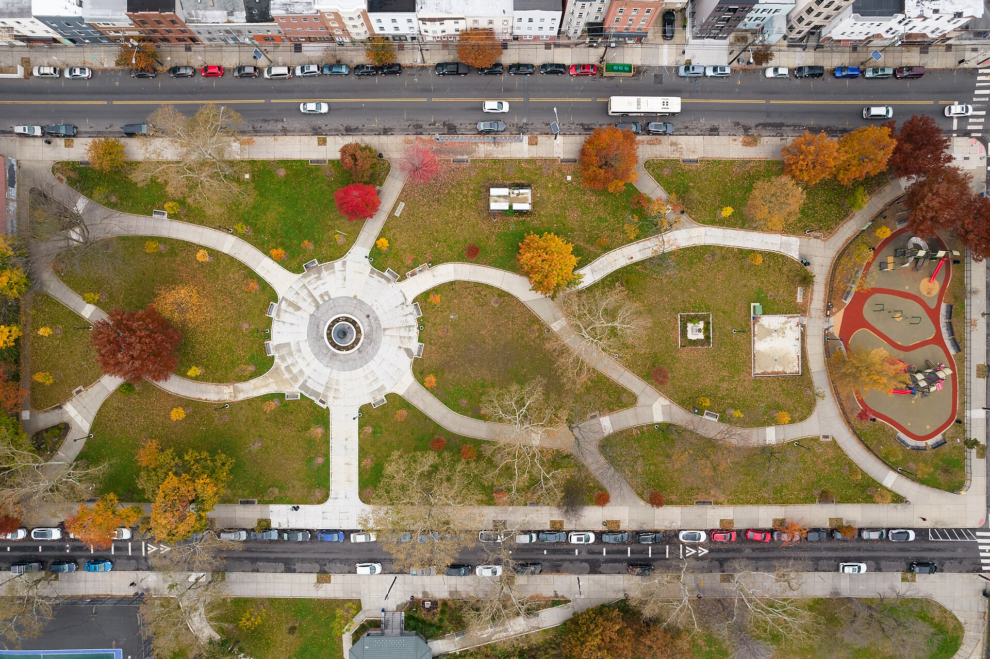
Nature-Based Solutions
Definition
Infrastructure inspired by, and working with, natural processes.
Examples
Urban forests
Green roofs
Wetlands
Urban parks cool and connect the city
www.newton.university
36
Notes:
Riverview-Fisk Park Jersey City November 2021 001.jpg — CC BY-SA 4.0, Wikimedia Commons
https://commons.wikimedia.org/wiki/File:Riverview-Fisk_Park_Jersey_City_November_2021_001.jpg
Source photograph retained from original deck; cropped for layout.

Slide 37
Flood Management: Grey vs Green
Traditional infrastructure
Green infrastructure
Pipes
Wetlands
Concrete channels
Rain gardens
Single purpose
Water-retention landscapes
High maintenance cost
Multiple co-benefits: cooling, recreation, biodiversity
www.newton.university
37

Slide 38
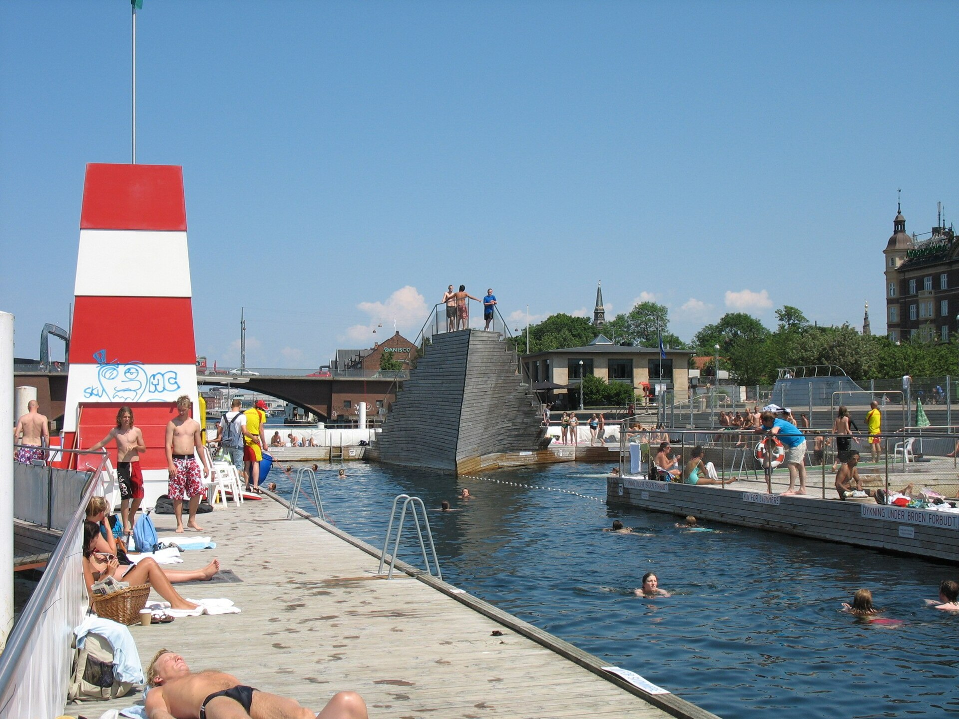
Smart City Example: Copenhagen
Cloudburst Management Plan
Parks designed to flood safely during storms
Water-retention areas and green streets
Benefits
Flood protection
Improved public spaces
Copenhagen harbour bath — clean water as public space
www.newton.university
38
Notes:
Harbour Bath, Islands Brygge.jpg — CC BY 2.0, Wikimedia Commons
https://commons.wikimedia.org/wiki/File:Harbour_Bath%2C_Islands_Brygge.jpg
Source photograph retained from original deck; cropped for layout.

Slide 39
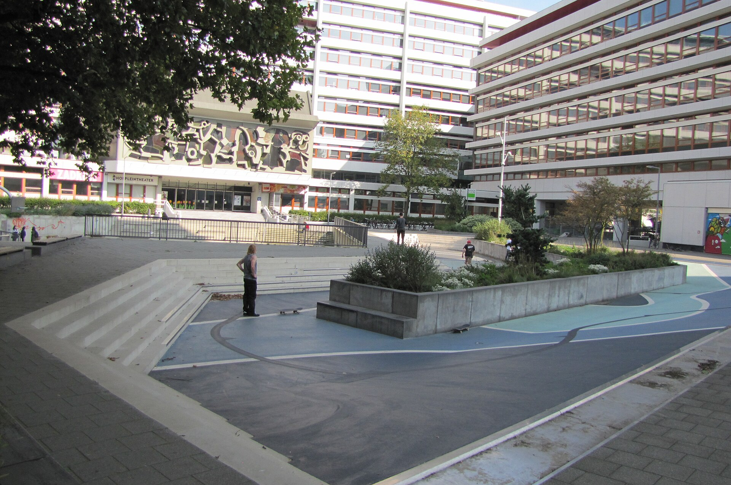
Smart City Example: Rotterdam
Water Squares
Public squares designed to store water during storms — playgrounds and sports courts in dry weather, retention basins in heavy rain.
Discussion
Can infrastructure serve more than one purpose?
Benthemplein water square in dry mode
www.newton.university
39
Notes:
Benthemplein terrain skate gestion eau.jpg — CC BY-SA 4.0, Wikimedia Commons
https://commons.wikimedia.org/wiki/File:Benthemplein_terrain_skate_gestion_eau.jpg
Source photograph retained from original deck; cropped for layout.

Slide 40
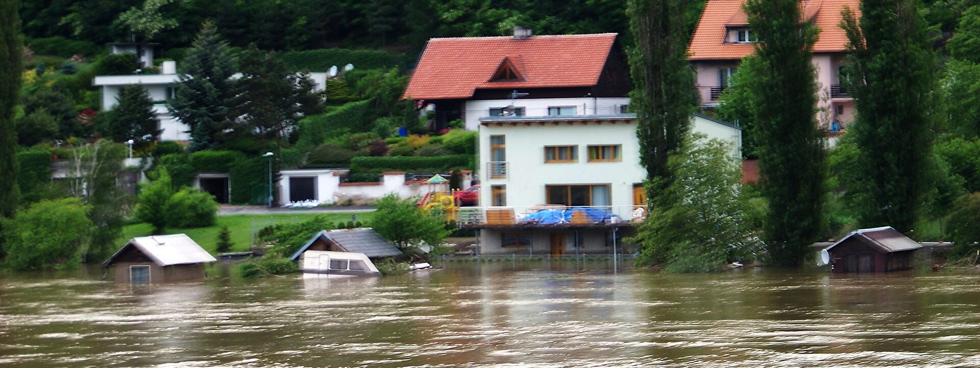
When the River Rises
Vltava flood, 2013 — why flood resilience is a Prague business issue
www.newton.university
40
Notes:
Husinec (Praha-východ), od Žalova, povodeň 2013-06-05.jpg — CC BY-SA 3.0, Wikimedia Commons
https://commons.wikimedia.org/wiki/File:Husinec_(Praha-v%C3%BDchod)%2C_od_%C5%BDalova%2C_povode%C5%88_2013-06-05.jpg
Source photograph retained from original deck; cropped for layout.

Slide 41
Prague Case Study: Vltava River Corridor
What ecosystem services does the river corridor provide?
Environmental
Social
Economic
Flood management
Tourism
Property value
Habitat corridor
Recreation
City attractiveness
www.newton.university
41

Slide 42
Classroom Workshop
20
Analyze one Prague location and identify its:
Environmental benefits
Social benefits
minutes
Economic benefits
In groups
Sustainability challenges
www.newton.university
42

Slide 43
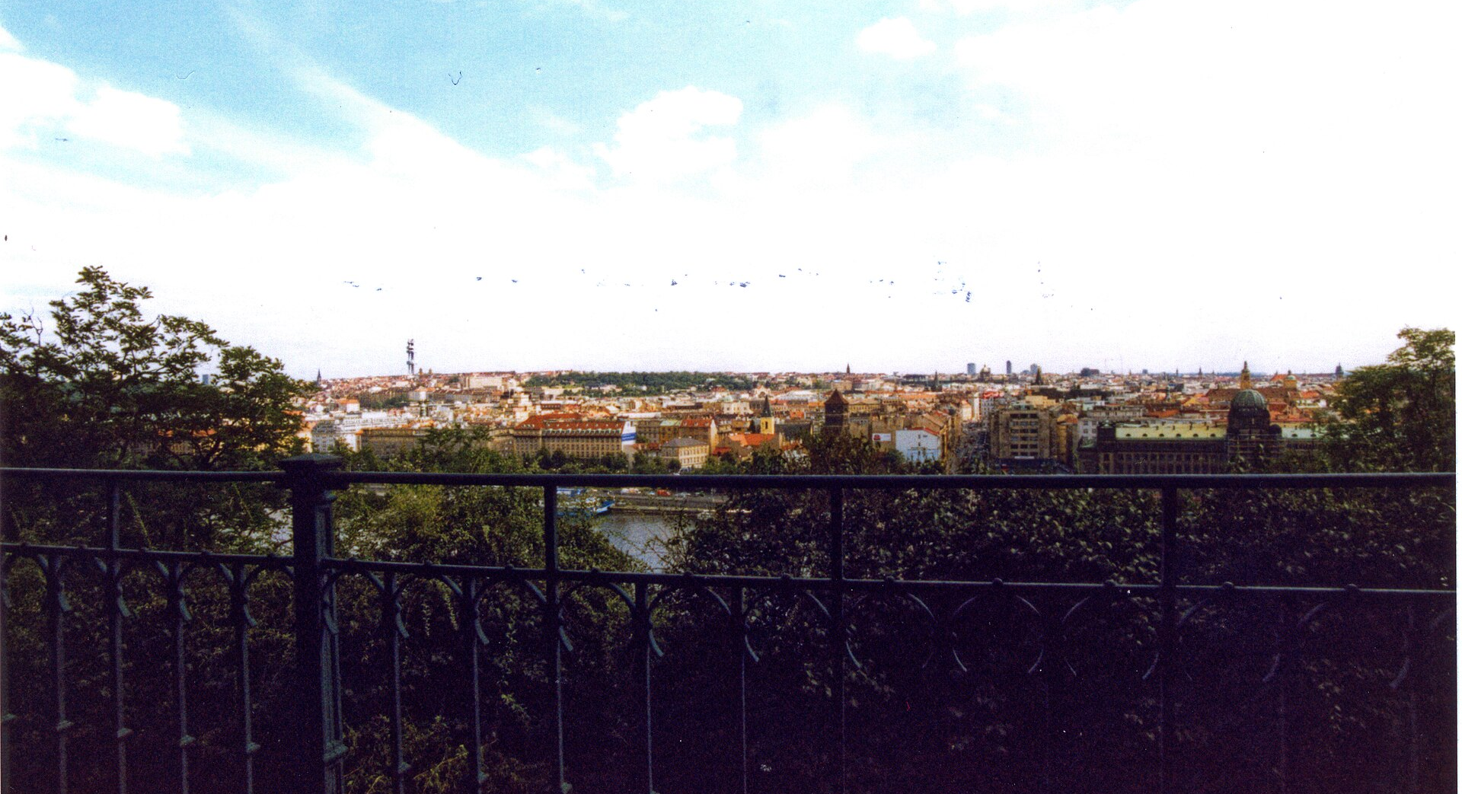
Preparing for Seminar 1
Choose your Prague case-study area — you will work with it all semester.
Stromovka Park
Letná Park
Vltava River Corridor
Divoká Šárka
Prokopské údolí
Hostivař Reservoir
Troja landscape
View from Letná over the city
www.newton.university
43
Notes:
Praha - Letná Park - View South.jpg — CC BY-SA 4.0, Wikimedia Commons
https://commons.wikimedia.org/wiki/File:Praha_-_Letn%C3%A1_Park_-_View_South.jpg
Source photograph retained from original deck; cropped for layout.

Slide 44
Key Messages
01
Sustainability is a business issue.
05
Environmental challenges are business challenges.
02
Nature provides measurable economic value.
06
Urbanization creates pressure on natural systems.
03
Green Infrastructure creates social, environmental and business benefits.
07
Green Infrastructure improves urban resilience.
08
Prague provides excellent real-life sustainability case studies.
04
Urban development and natural systems must coexist.
www.newton.university
44

Slide 45
Recommended Reading
Blackburn, W. R. (2007). The Sustainability Handbook. Earthscan.
Next lecture
Porter, M. & Kramer, M. (2011). Creating Shared Value. Harvard Business Review.
Pollution, Climate Resilience and the Circular Economy.
Freeman, R. E. (1984). Strategic Management: A Stakeholder Approach.
Business in the Community Ireland — Sustainability Handbook (course compulsory reading).
www.newton.university
45

Slide 46
Any
questions?
www.newton.university
46
Notes:
AI-generated conceptual artwork created with OpenAI image generation, September 2026. Decorative illustration; not a photograph of a documented location or case study.

Slide 47
Image credits
St Edmund Hall Living Wall.jpg — CC BY-SA 4.0, Wikimedia Commons
Panoramic view of air pollution in São Paulo city, Brazil.jpg — CC0, Wikimedia Commons
20080708 Chicago City Hall Green Roof.JPG — CC BY-SA 3.0, Wikimedia Commons
Riverview-Fisk Park Jersey City November 2021 001.jpg — CC BY-SA 4.0, Wikimedia Commons
Prague - view from Charles Bridge (by Pudelek).jpg — CC BY-SA 3.0, Wikimedia Commons
Harbour Bath, Islands Brygge.jpg — CC BY 2.0, Wikimedia Commons
Královská obora (Stromovka) park in Prague, Czech Republic. - panoramio.jpg — CC BY-SA 3.0, Wikimedia Commons
Benthemplein terrain skate gestion eau.jpg — CC BY-SA 4.0, Wikimedia Commons
Supertree Grove, Gardens by the Bay, Singapore1.jpg — CC0, Wikimedia Commons
Husinec (Praha-východ), od Žalova, povodeň 2013-06-05.jpg — CC BY-SA 3.0, Wikimedia Commons
Spruce Run Reservoir drought from beach (2), Nov. 2024.jpg — CC BY-SA 4.0, Wikimedia Commons
Praha - Letná Park - View South.jpg — CC BY-SA 4.0, Wikimedia Commons
Amazon rainforest (Satellite picture).jpg — CC BY-SA 2.0, Wikimedia Commons
Conceptual cover and leaf artwork: AI-generated with OpenAI, September 2026.
www.newton.university
47

