Slide 1
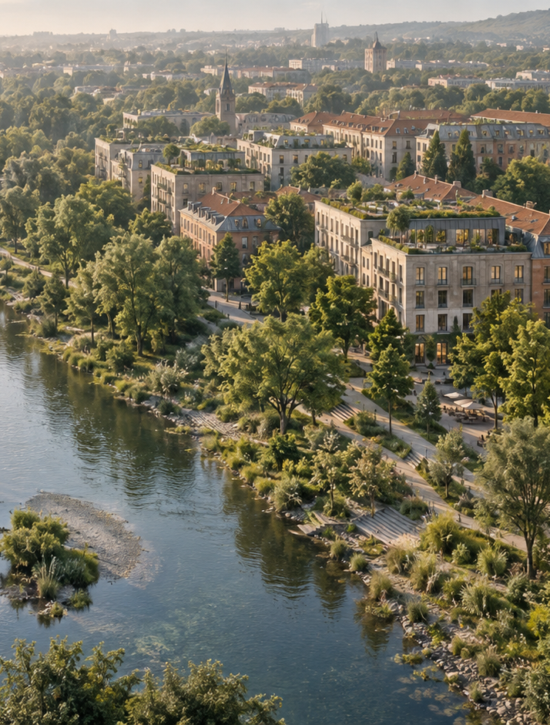

Applied Sustainability
in Business and
Management
Lecture 2 — Pollution, Climate
Resilience and the Circular Economy
Ing. Arch. Jenan Hussein, MSc, PhD
jenanhussein83@gmail.com
Notes:
Lecture 2, slide 1: Applied Sustainability in Business and Management
Suggested time: 1 min
Say: Welcome back. Remind students: last time we saw why sustainability matters and what Green Infrastructure is. Today we look at the damage cities cause and two ways to fix it.
Decorative artwork reused from the approved Lecture 1 design. AI-generated with OpenAI, September 2026; not a photograph of a documented place.

Slide 2

Learning Objectives
By the end of this lecture you will be able to:
01
Explain how pollution and emission
scopes affect business decisions.
05
Use the R-ladder to preserve
product and material value.
02
Identify climate risks to operations,
workers and suppliers.
06
Evaluate circular practices in
company and city cases.
03
Compare nature-based and
engineered adaptation options.
07
Design a resource loop with a payer,
owner and measure of success.
04
Distinguish linear and circular
business models.
www.newton.university
02
Notes:
Lecture 2, slide 2: Learning Objectives
Suggested time: 3 min
Say: Read the seven objectives. Connect each to a decision a manager needs to make. The first half introduces the tools and business problem; the second half applies them to the cases and activities. Students will use the same tools for their Prague semester site.

Slide 3
Today's Lecture Agenda
Before the break
After the break
Part 1 — Pollution in the Urban Environment
Part 4 — From Linear to Circular
Part 2 — Climate Change and Urban
Resilience
Part 5 — Circular Economy in Business
Practice
Part 3 — Nature-Based Adaptation for
Business
Part 6 — Green Infrastructure and Urban
Circularity
Prague Case Study — Heat Islands and
Mitigation
Case Studies — LEGO and Amsterdam
Activity
Discussion
Key Messages and Reading
www.newton.university
03
Notes:
Lecture 2, slide 3: Today's Lecture Agenda
Suggested time: 2 min
Say: Show the six parts. Say there are two short activities today — one before the break and one at the end.

Slide 4
Part 1
Pollution in the Urban
Environment
01
www.newton.university
04
Notes:
Lecture 2, slide 4: Part 1 — Pollution in the Urban Environment
Suggested time: 1 min
Say: Announce the part.

Slide 5
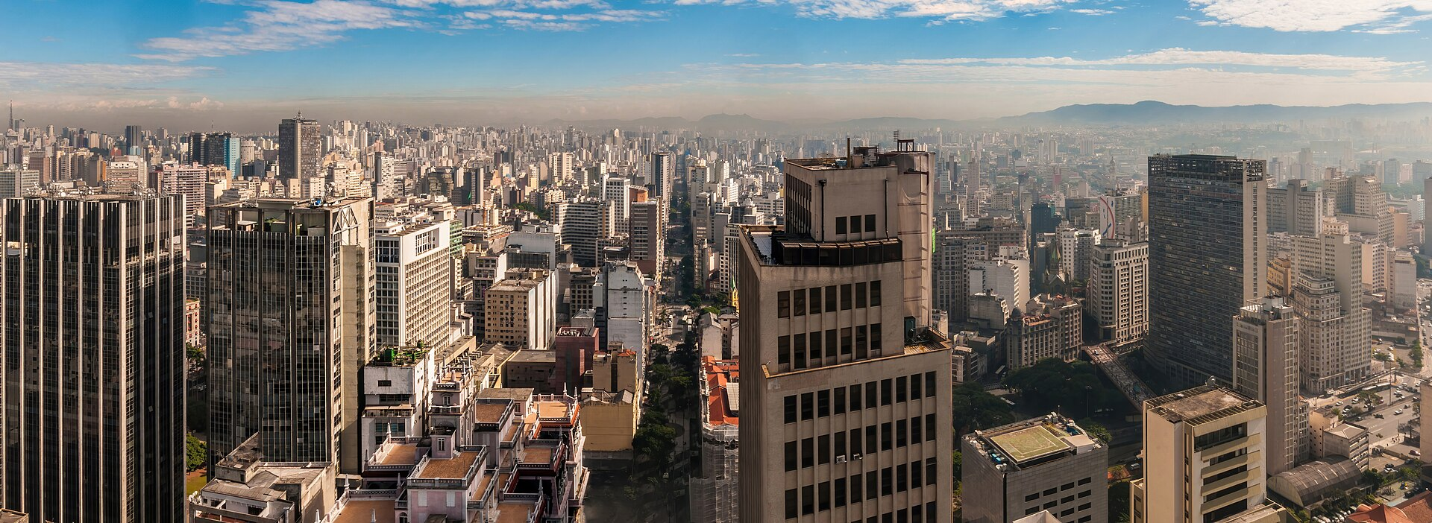
Air Pollution
Main urban sources
Road transport
Heating and energy production
Industry and construction
Impacts
Respiratory and cardiovascular disease
Lost productivity and healthcare costs
Smog over a dense city — a health and
business cost
www.newton.university
05
Notes:
Lecture 2, slide 5: Air Pollution
Suggested time: 5 min
Say: The photo shows smog over a big city. The main sources in a city are cars, heating and industry. Air pollution causes breathing and heart disease, which costs money in sick days and healthcare. For a manager the point is: this is a cost, not only a health topic.
Ask: Where does Prague's winter smog come from? (Mostly heating and traffic.)
Image credit: Panoramic view of air pollution in São Paulo city, Brazil.jpg — CC0, Wikimedia Commons
https://commons.wikimedia.org/wiki/File:Panoramic_view_of_air_pollution_in_S%C3%A3o_Paulo_city%2C_Brazil.jpg
Source image retained from the original lecture.

Slide 6
Water Pollution
Urban pressures on water
Why managers should care
Untreated stormwater runoff carrying
oil, metals and microplastics
Water quality drives regulation,
operating permits and reputation.
Combined sewer overflows during
heavy rain
Clean rivers create recreation, tourism
and property value.
Industrial discharge and agricultural
nutrients upstream
www.newton.university
06
Notes:
Lecture 2, slide 6: Water Pollution
Suggested time: 4 min
Say: Rainwater running off streets carries oil, metals and tiny plastics into the river. In heavy rain, old sewers overflow untreated. Why should managers care? Because water quality decides permits and reputation, and because a clean river creates tourism and property value.

Slide 7
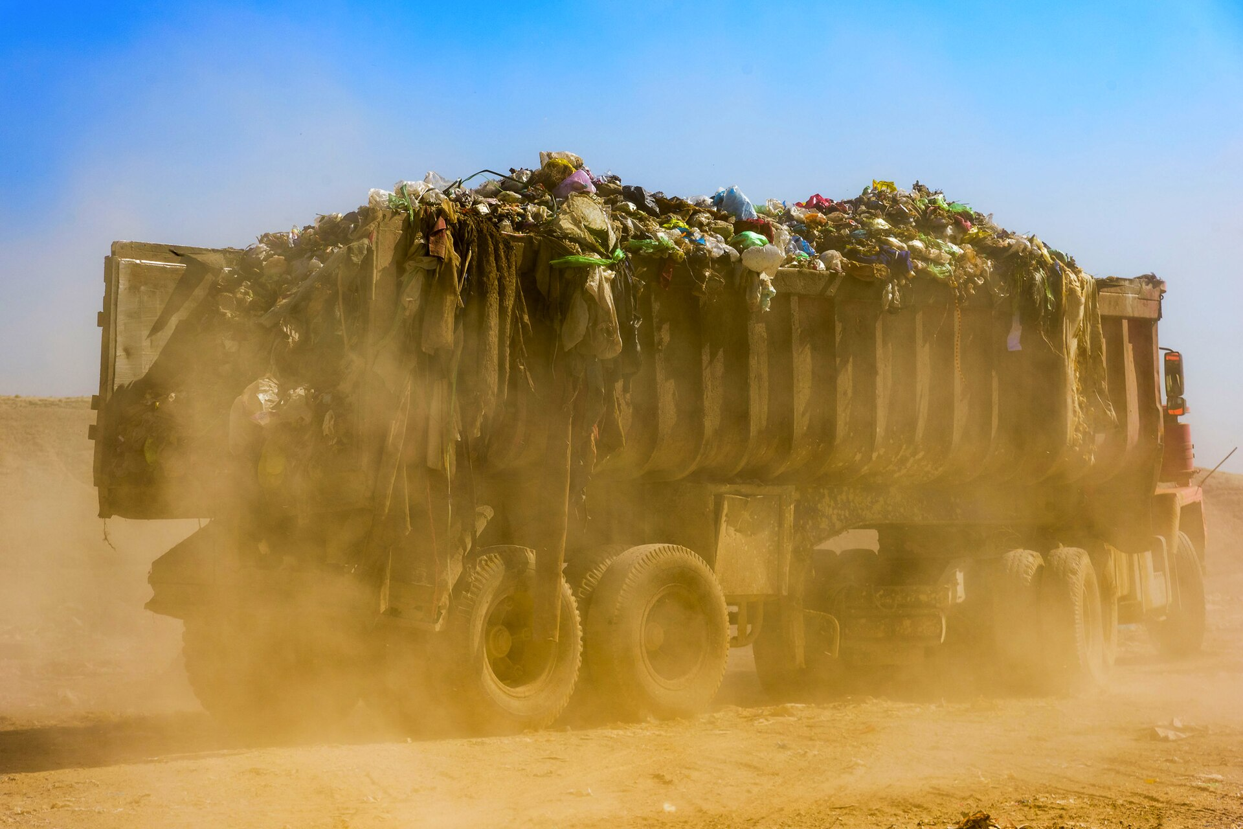
Waste Generation
The urban waste challenge
Cities concentrate consumption — and therefore
waste.
Landfilling releases methane and pollutes soil and
groundwater.
The waste hierarchy
Prevent → Reuse → Recycle → Recover → Dispose
Preview: Part 4 of this lecture explores the circular
economy in depth.
Waste disposal loses materials that a business
could keep in use
www.newton.university
07
Notes:
Lecture 2, slide 7: Waste Generation
Suggested time: 4 min
Say: Cities concentrate people, so they concentrate waste. Landfills leak methane (a strong greenhouse gas) into the air and pollutants into the ground. Introduce the waste hierarchy: prevent, reuse, recycle, recover, dispose — the best option is at the top. Say this is the bridge to the second half of the lecture.
Image credit: Milad jafari (28).jpg — CC BY-SA 4.0, Wikimedia Commons
https://commons.wikimedia.org/wiki/File:Milad_jafari_(28).jpg
Source image retained from the original lecture.

Slide 8
Carbon Emissions and Business
Emission scopes (GHG Protocol)
Discussion
Scope 1 — direct emissions from owned or
controlled sources
Which scope is
hardest for a
company to reduce —
and why?
Scope 2 — purchased energy
Scope 3 — value chain (usually the largest
share)
www.newton.university
08
Notes:
Lecture 2, slide 8: Carbon Emissions and Business
Suggested time: 6 min
Say: Scope 1 covers direct emissions from sources the company owns or controls, including fuel use, industrial processes and refrigerant leaks. Scope 2 covers purchased electricity, heat, steam and cooling. Scope 3 covers other value-chain emissions, from suppliers to product use and disposal. Its importance varies by business.
Ask: Which scope is hardest for this particular company to reduce, and what purchasing or design decision could help?

Slide 9
Part 2
Climate Change and Urban
Resilience
02
www.newton.university
09
Notes:
Lecture 2, slide 9: Part 2 — Climate Change and Urban Resilience
Suggested time: 1 min
Say: Announce the part: from pollution we move to climate.

Slide 10
How Climate Change Hits Cities
Heat
Water
Economy
More frequent heat
waves
Flash floods and river
floods
Damaged infrastructure
Business interruption
Urban heat island
amplification
Drought and water
scarcity
Rising insurance costs
Health risks for
vulnerable groups
Aging drainage
overloaded
www.newton.university
10
Notes:
Lecture 2, slide 10: How Climate Change Hits Cities
Suggested time: 5 min
Say: Three columns: heat (heat waves, hotter city centres, health risks), water (flash floods, river floods, drought, old drains that cannot cope) and economy (broken infrastructure, closed businesses, higher insurance). Ask students which of these they have seen in Prague. Most will remember a flood or a heat wave.

Slide 11
What is Urban Resilience?
Definition
Resilience thinking for managers
The capacity of a city — its people,
businesses and systems — to survive,
adapt and grow in the face of chronic
stresses and acute shocks.
Redundancy: more than one way to
deliver a critical service.
Flexibility: systems that bend rather
than break.
Nature as a buffer: vegetation and
water storage can complement
engineered protection.
www.newton.university
11
Notes:
Lecture 2, slide 11: What is Urban Resilience?
Suggested time: 5 min
Say: Resilience means a business and its surrounding systems can keep essential functions working during stress or recover after a shock. Use redundancy, flexibility and nature as a buffer. Wetlands and trees can help manage heat and runoff, alongside drainage and engineered protection; none is unlimited.

Slide 12

Part 3
Nature-Based
Adaptation for
Business
www.newton.university
12
Notes:
Lecture 2, slide 12: Part 3 — Nature-Based Adaptation for Business
Suggested time: 1 min
Say: Move from city-level climate risks to what a company can do on its own buildings and sites, then show how those measures connect to city infrastructure.
Decorative artwork reused from the approved Lecture 1 design. AI-generated with OpenAI, September 2026; not a photograph of a documented place.

Slide 13
Nature-Based Adaptation on Company Sites
Green roofs
Trees and shade
Reduce heat entering buildings
Cool entrances and outdoor work areas
Retain rainfall before it reaches drains
Plan space, species and long-term care
Rain gardens
Ponds and wetlands
Slow and filter runoff from hard surfaces
Store water where space and design allow
Check soil, contamination and overflow
routes
Assign inspection and maintenance duties
www.newton.university
13
Notes:
Lecture 2, slide 13: Nature-Based Adaptation on Company Sites
Suggested time: 5 min
Say: Use an office, shop or warehouse as the example. A roof can retain rain, trees can shade entrances, and a rain garden can slow runoff. The manager must check the building structure, ground conditions, drainage and maintenance budget. These measures can reduce exposure, but their capacity is limited and overflow routes still matter.
Ask: Who owns the problem, who pays for installation, and who maintains the system?
Sources checked 5 October 2026:
https://www.epa.gov/green-infrastructure/economic-benefits-green-infrastructure

Slide 14
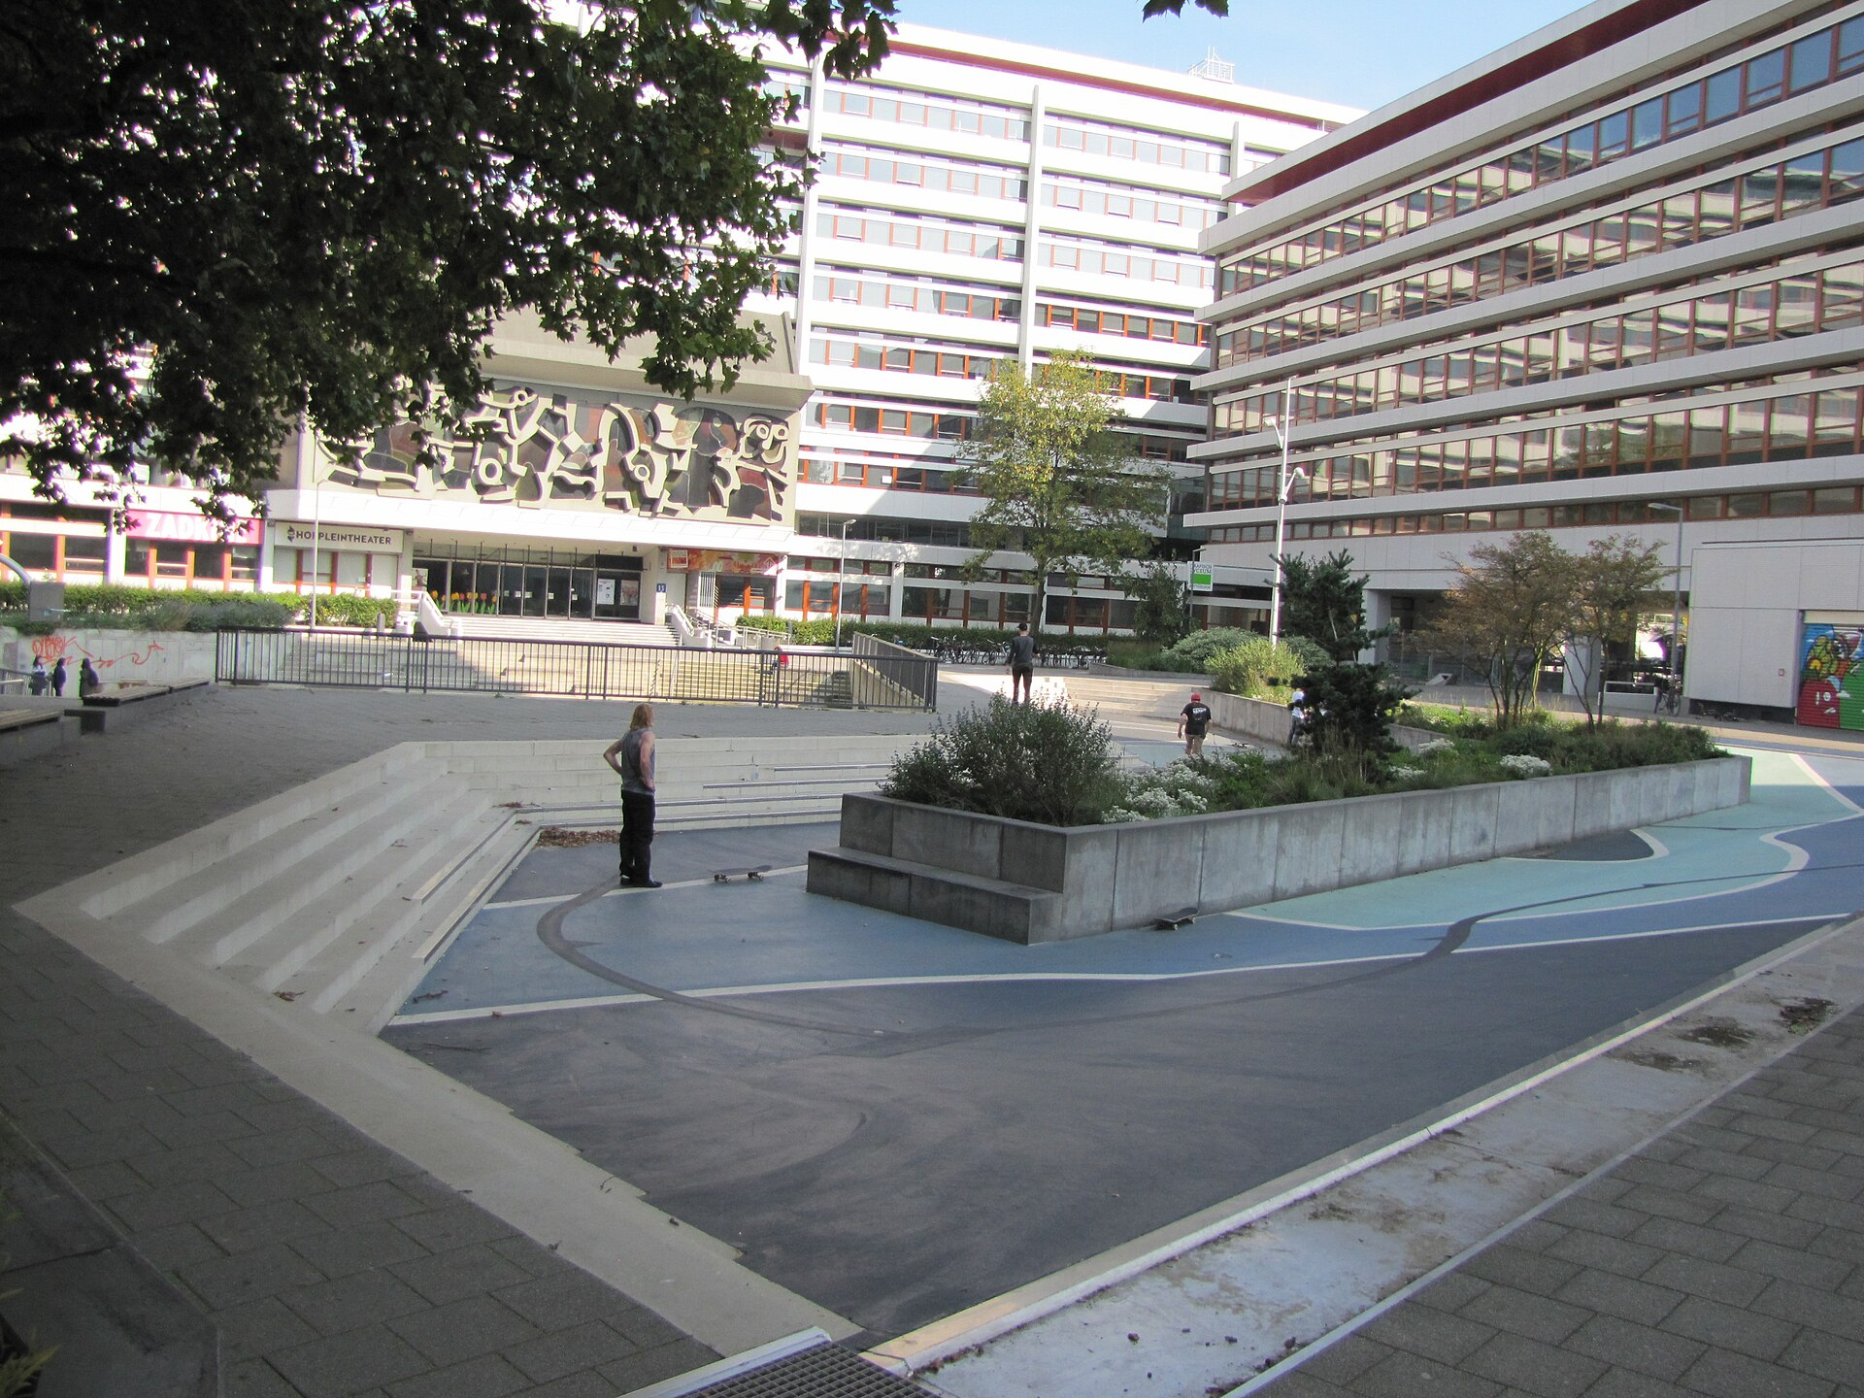
Working with Water, not Against It
Rotterdam's Benthemplein water square — sports court in dry weather, retention basin in storms
www.newton.university
14
Notes:
Lecture 2, slide 14: Working with Water, not Against It
Suggested time: 3 min
Say: Benthemplein remains the city-scale case. It shows how one space serves sport in dry weather and water storage during storms. A business can apply that principle to a courtyard or car park if an engineer confirms capacity, safe access and overflow routes. This is a design analogy, not a claim that any car park can flood safely.
Image credit: Benthemplein terrain skate gestion eau.jpg — CC BY-SA 4.0, Wikimedia Commons
https://commons.wikimedia.org/wiki/File:Benthemplein_terrain_skate_gestion_eau.jpg
Source image retained from the original lecture.

Slide 15
Grey and Green: a Manager's Comparison
Compare the same service level over the same time period.
Engineered protection
Nature-based measures
Defined drainage or protection capacity
Water management plus cooling and
habitat
Capital, energy and maintenance costs
Performance depends on site and
maintenance
Useful where space or extreme loads
constrain planting
May work best alongside engineered
systems
www.newton.university
15
Notes:
Lecture 2, slide 15: Grey and Green: a Manager's Comparison
Suggested time: 5 min
Say: Neither category is automatically cheaper or better. Compare the same flood or heat problem over the same period. Include installation, maintenance, performance limits and wider benefits. A combined system may provide the strongest case.
Ask: Which benefit does the company receive, which goes to the public, and how should that affect cost sharing?
Sources checked 5 October 2026:
https://www.epa.gov/green-infrastructure/economic-benefits-green-infrastructure

Slide 16
Prague Case Study — Heat
Islands
www.newton.university
16
Notes:
Lecture 2, slide 16: Prague Case Study — Heat Islands
Suggested time: 1 min
Say: Announce the case.

Slide 17
Heat Islands in Prague Neighborhoods
The pattern
Mitigation through Green
Infrastructure
Dense, sealed districts can be hotter
than shaded green areas.
Street trees and shading of public spaces
Compare local measurements before
assigning a temperature difference.
Green roofs and facades on new
development
Water elements and permeable surfaces
Prague's Climate Plan 2030 and
Adaptation Strategy both prioritize these
measures.
www.newton.university
17
Notes:
Lecture 2, slide 17: Heat Islands in Prague Neighborhoods
Suggested time: 5 min
Say: Use the Prague case to compare paved and shaded places, then relate heat to staff comfort, cooling demand and opening hours. A measured temperature difference depends on time, weather, shade and the sensor position. The city plans provide context; students should verify the current local project and site data before proposing an investment.

Slide 18
Classroom Activity: Cooling One Street
Pick a street or square in Prague you both know.
Propose three nature-based measures to cool it, and
note:
15
Who pays, who maintains it, and which business risk
does it reduce?
Who benefits, and how could the benefit be measured?
minutes
In pairs
www.newton.university
18
Notes:
Lecture 2, slide 18: Classroom Activity: Cooling One Street
Suggested time: 15 min
Say: Pairs choose a familiar Prague street or square and propose three nature-based measures. For each, name the payer, the maintenance owner, the business or community benefit, and one measure of success. Keep the 15-minute structure in section 3.

Slide 19
Break
Second half — Circular Economy and Green Infrastructure
www.newton.university
19
Notes:
Lecture 2, slide 19: Break
Suggested time: 15–20 min
Say: Say that after the break we change topic: from pollution and climate to materials and waste — the circular economy.

Slide 20
Part 4
From Linear to Circular
04
www.newton.university
20
Notes:
Lecture 2, slide 20: Part 4 — From Linear to Circular
Suggested time: 1 min
Say: Announce the part.

Slide 21
The Linear Economy
Take → Make → Waste
Why it fails
Extract raw materials
Assumes infinite resources and infinite
space for waste.
Manufacture and distribute products
Value created once, then destroyed.
Use — often briefly
Dispose to landfill or incineration
www.newton.university
21
Notes:
Lecture 2, slide 21: The Linear Economy
Suggested time: 5 min
Say: Take, make, waste. Hold up an everyday object and trace it: raw material, factory, shop, short use, bin. The linear economy assumes endless resources and endless space for waste — both are false. Value is created once and then destroyed.

Slide 22
The Circular Economy
Definition
An approach that aims to eliminate waste and regenerate nature:
products and materials are kept in use through maintenance, reuse,
repair, remanufacturing and — as a last resort — recycling.
Look at how nature works
Nature illustrates how outputs can become inputs. Businesses apply this
idea through design, maintenance and recovery, while accounting for
real material and energy losses.
www.newton.university
22
Notes:
Lecture 2, slide 22: The Circular Economy
Suggested time: 5 min
Say: Circularity is a design ambition to keep materials and products useful and regenerate nature. Real systems still have losses and need energy. Use the forest analogy to explain loops, then ask what collection, repair or quality-control system a company would need.

Slide 23
Circular Strategies (the R-Ladder)
The higher on the ladder, the more value is preserved:
Highest value
Middle
Last resort
Refuse and rethink
Refurbish
Recycle materials
Reduce material use
Remanufacture
Recover energy
Reuse and repair
Repurpose
www.newton.university
23
Notes:
Lecture 2, slide 23: Circular Strategies (the R-Ladder)
Suggested time: 6 min
Say: The ladder ranks strategies. At the top: refuse, rethink, reduce, reuse, repair — these keep almost all the value. In the middle: refurbish, remanufacture, repurpose. At the bottom: recycle and recover energy. The higher you act, the more value you keep. Ask students where 'buying a second-hand phone' sits (reuse — high) and where 'putting a bottle in the yellow bin' sits (recycle — low).

Slide 24
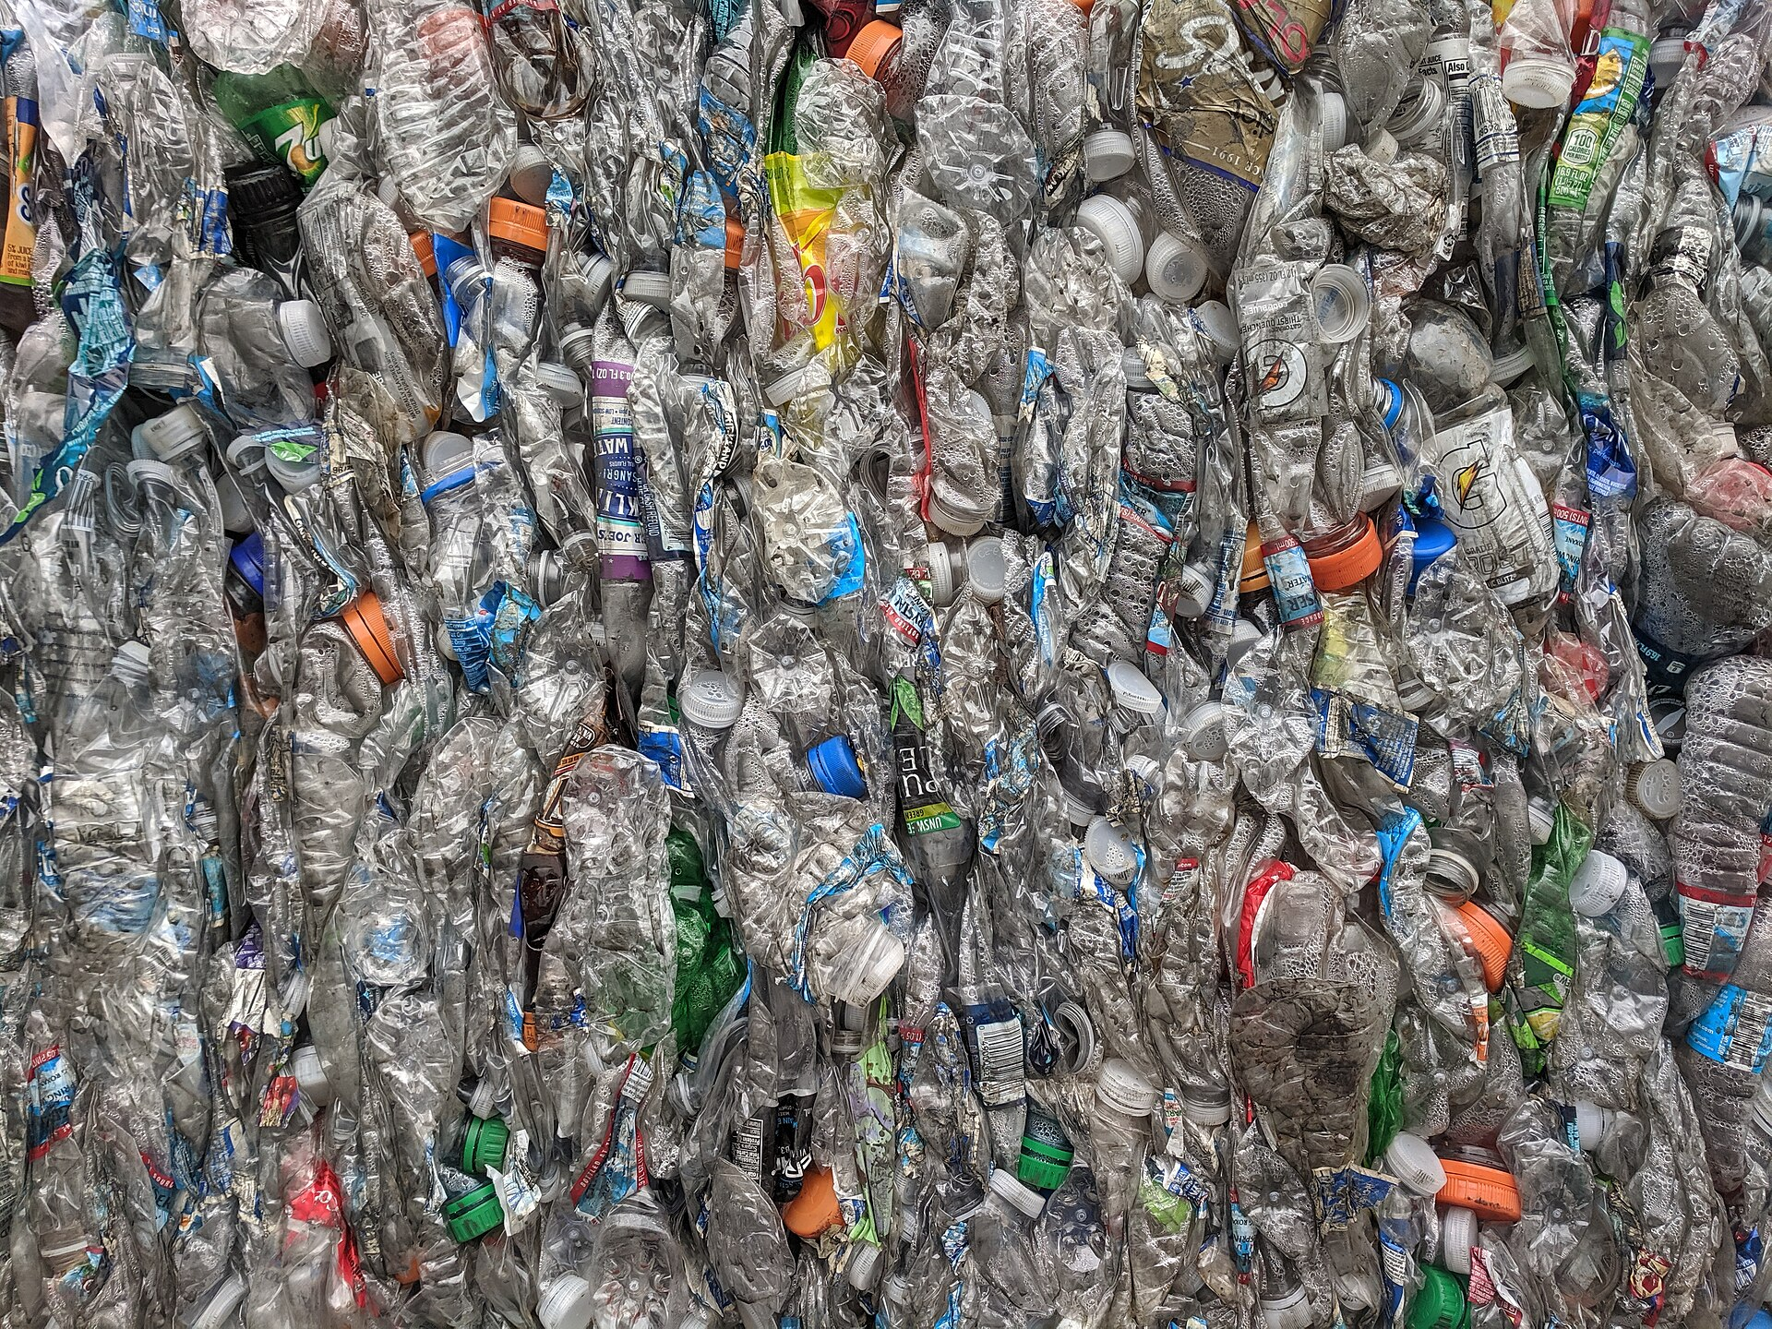
Reuse, Repair and Then Recycling
Baled PET bottles: recycling recovers material; reuse can also preserve the product and its manufacture
www.newton.university
24
Notes:
Lecture 2, slide 24: Reuse, Repair and Then Recycling
Suggested time: 3 min
Say: The PET-bale image shows material recovery. Recycling remains useful, but viable reuse or repair can preserve the product as well as its material. Avoid claiming a fixed loss of embedded value across all materials. Ask students to explain which option works for this product and context.
Image credit: Bales of PET bottles closeup.jpg — CC BY-SA 4.0, Wikimedia Commons
https://commons.wikimedia.org/wiki/File:Bales_of_PET_bottles_closeup.jpg
Source image retained from the original lecture.

Slide 25
Part 5
Circular Economy in Business
Practice
05
www.newton.university
25
Notes:
Lecture 2, slide 25: Part 5 — Circular Economy in Business Practice
Suggested time: 1 min
Say: Announce the part: two real examples, one company and one city.

Slide 26
Case Study: LEGO Circular Design
What the company does
Discussion
Durable product designed for decades of reuse
and resale.
LEGO bricks last
generations. Is
durability itself a
circular strategy?
Testing and purchasing recycled and renewable
material inputs.
Take-back and donation programmes (Replay).
Working with businesses, experts and
policymakers to inspire circular design across
the toy industry.
www.newton.university
26
Notes:
Lecture 2, slide 26: Case Study: LEGO Circular Design
Suggested time: 6 min
Say: LEGO illustrates durable design and repeated use. It also tests alternative materials and uses both physical recycled or renewable inputs and mass-balance sourcing. Those are different claims: a sourcing allocation does not establish the physical renewable content of an individual brick. Replay supports reuse where the programme operates.
Ask: Is durability itself a circular strategy? Yes, when products remain useful and replace the need for new ones.
Sources checked 5 October 2026:
https://www.lego.com/en-us/sustainability/materials
https://www.lego.com/en-us/sustainability/mass-balance

Slide 27
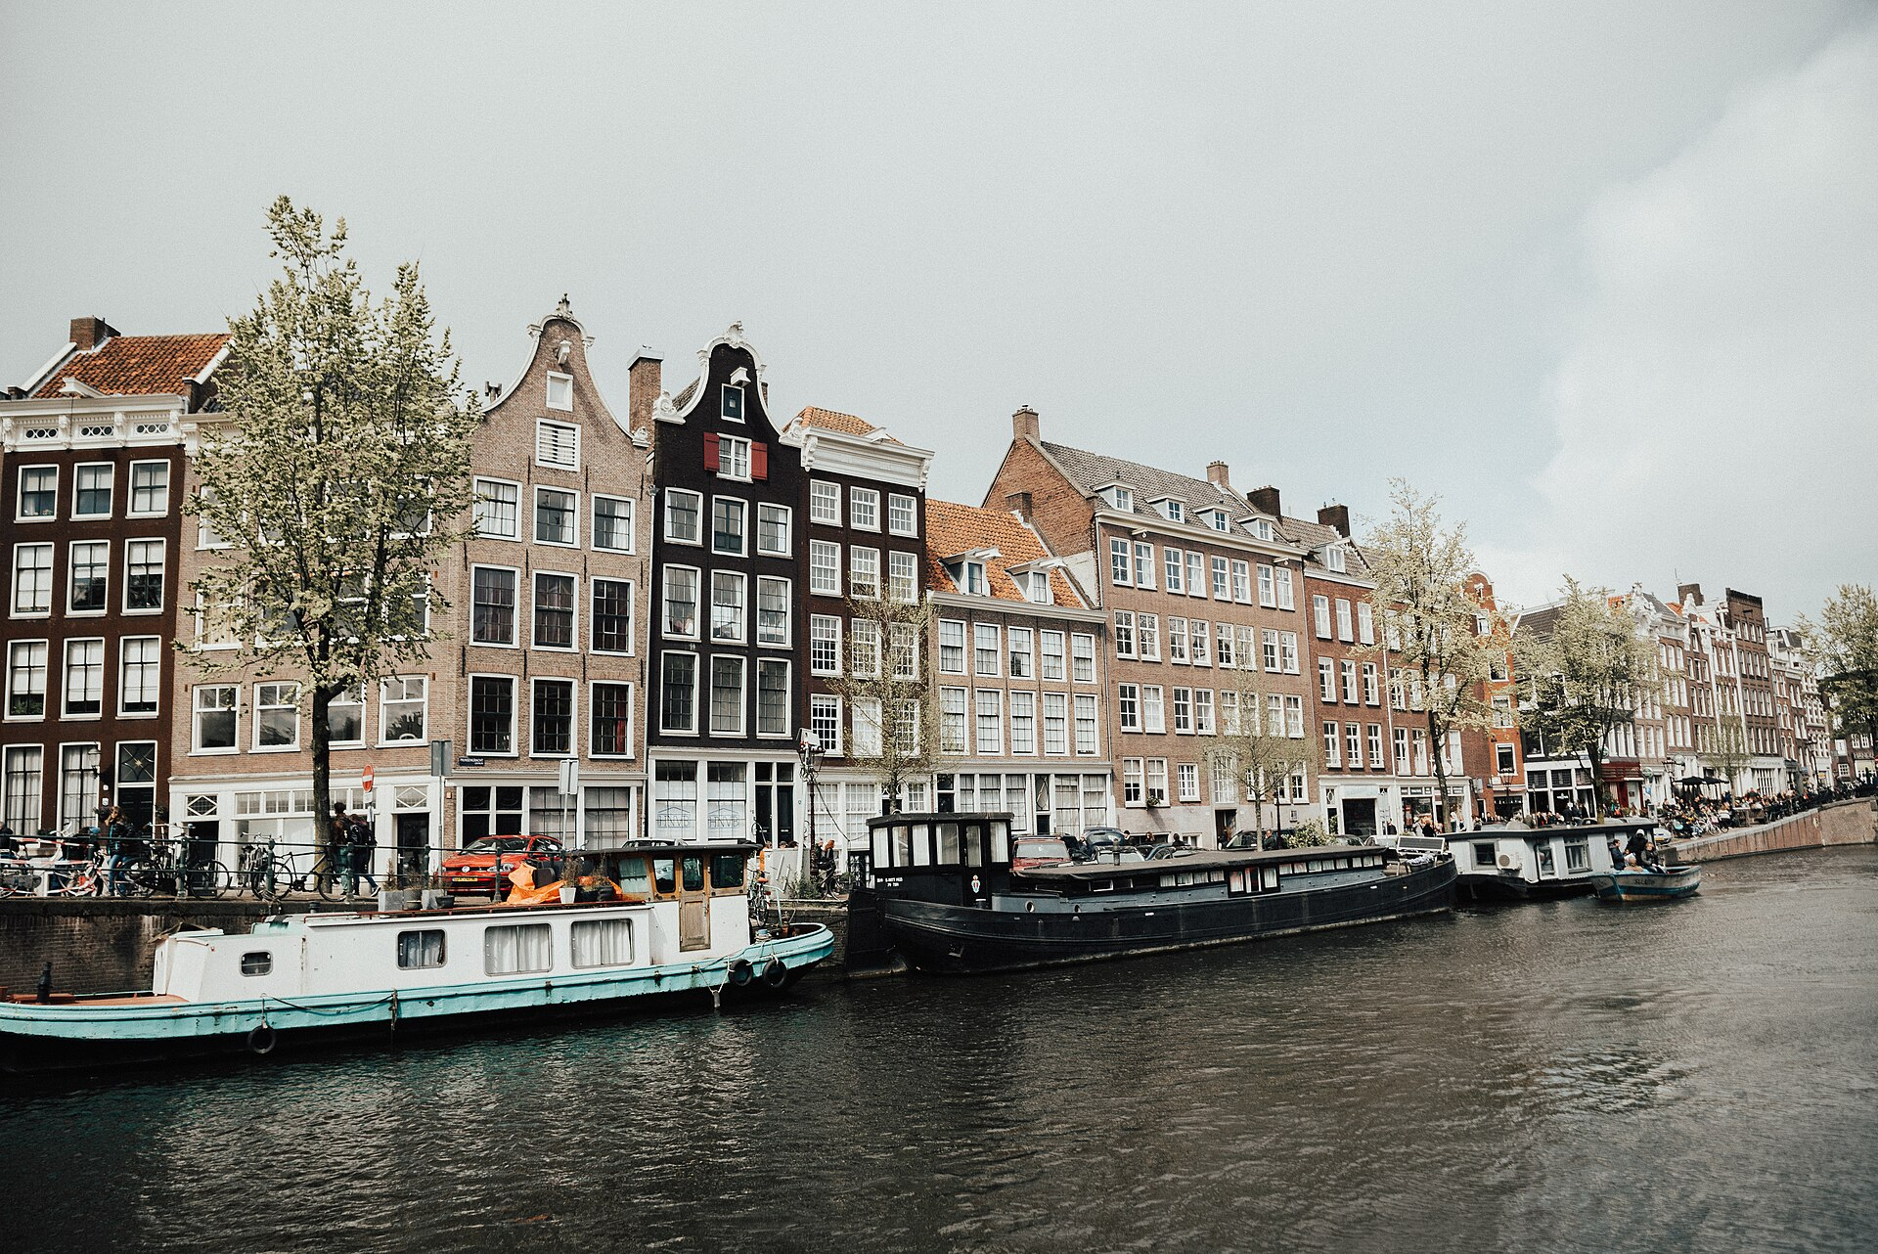
Case Study: Amsterdam Circular Strategy
City-scale circularity
Circular construction and demolition rules
Food and organic waste streams closed locally
Doughnut Economics as the guiding framework
Lesson
Circularity works best when city policy and
business models align.
Amsterdam aims to halve new raw material use
by 2030
www.newton.university
27
Notes:
Lecture 2, slide 27: Case Study: Amsterdam Circular Strategy
Suggested time: 5 min
Say: A whole city can be circular. Amsterdam wants to halve its use of new raw materials by 2030. It has rules for circular construction and demolition, closes food and organic waste loops locally, and uses Doughnut Economics as its guiding picture. Lesson: circularity works best when city policy and business models push in the same direction.
Image credit: Amsterdam Canal Houses (Unsplash).jpg — CC0, Wikimedia Commons
https://commons.wikimedia.org/wiki/File:Amsterdam_Canal_Houses_(Unsplash).jpg
Source image retained from the original lecture.
Sources checked 5 October 2026:
https://www.amsterdam.nl/en/policy/circular-economy/

Slide 28
Part 6
Green Infrastructure
and Urban Circularity
www.newton.university
28
Notes:
Lecture 2, slide 28: Part 6 — Green Infrastructure and Urban Circularity
Suggested time: 1 min
Say: Announce the part: how GI and the circular economy meet.
Decorative artwork reused from the approved Lecture 1 design. AI-generated with OpenAI, September 2026; not a photograph of a documented place.

Slide 29
Resource Loops for Companies and Cities
Water reuse
Urban agriculture
Soil regeneration
Collect rainwater for
suitable on-site uses
Connect growers to local
cafés, staff or residents
Turn suitable, separated
organic waste into
compost
Use treated greywater
only where quality and
rules allow
Shorter supply chains
Healthy soil stores water
and carbon
www.newton.university
29
Notes:
Lecture 2, slide 29: Resource Loops for Companies and Cities
Suggested time: 5 min
Say: Follow each loop from an input to a useful output. A company can collect rainwater, buy local produce or send suitable separated food waste for composting. Each loop needs a contract or owner, a quality requirement and a measurable benefit. Reused water and compost must meet the applicable quality and use requirements.

Slide 30
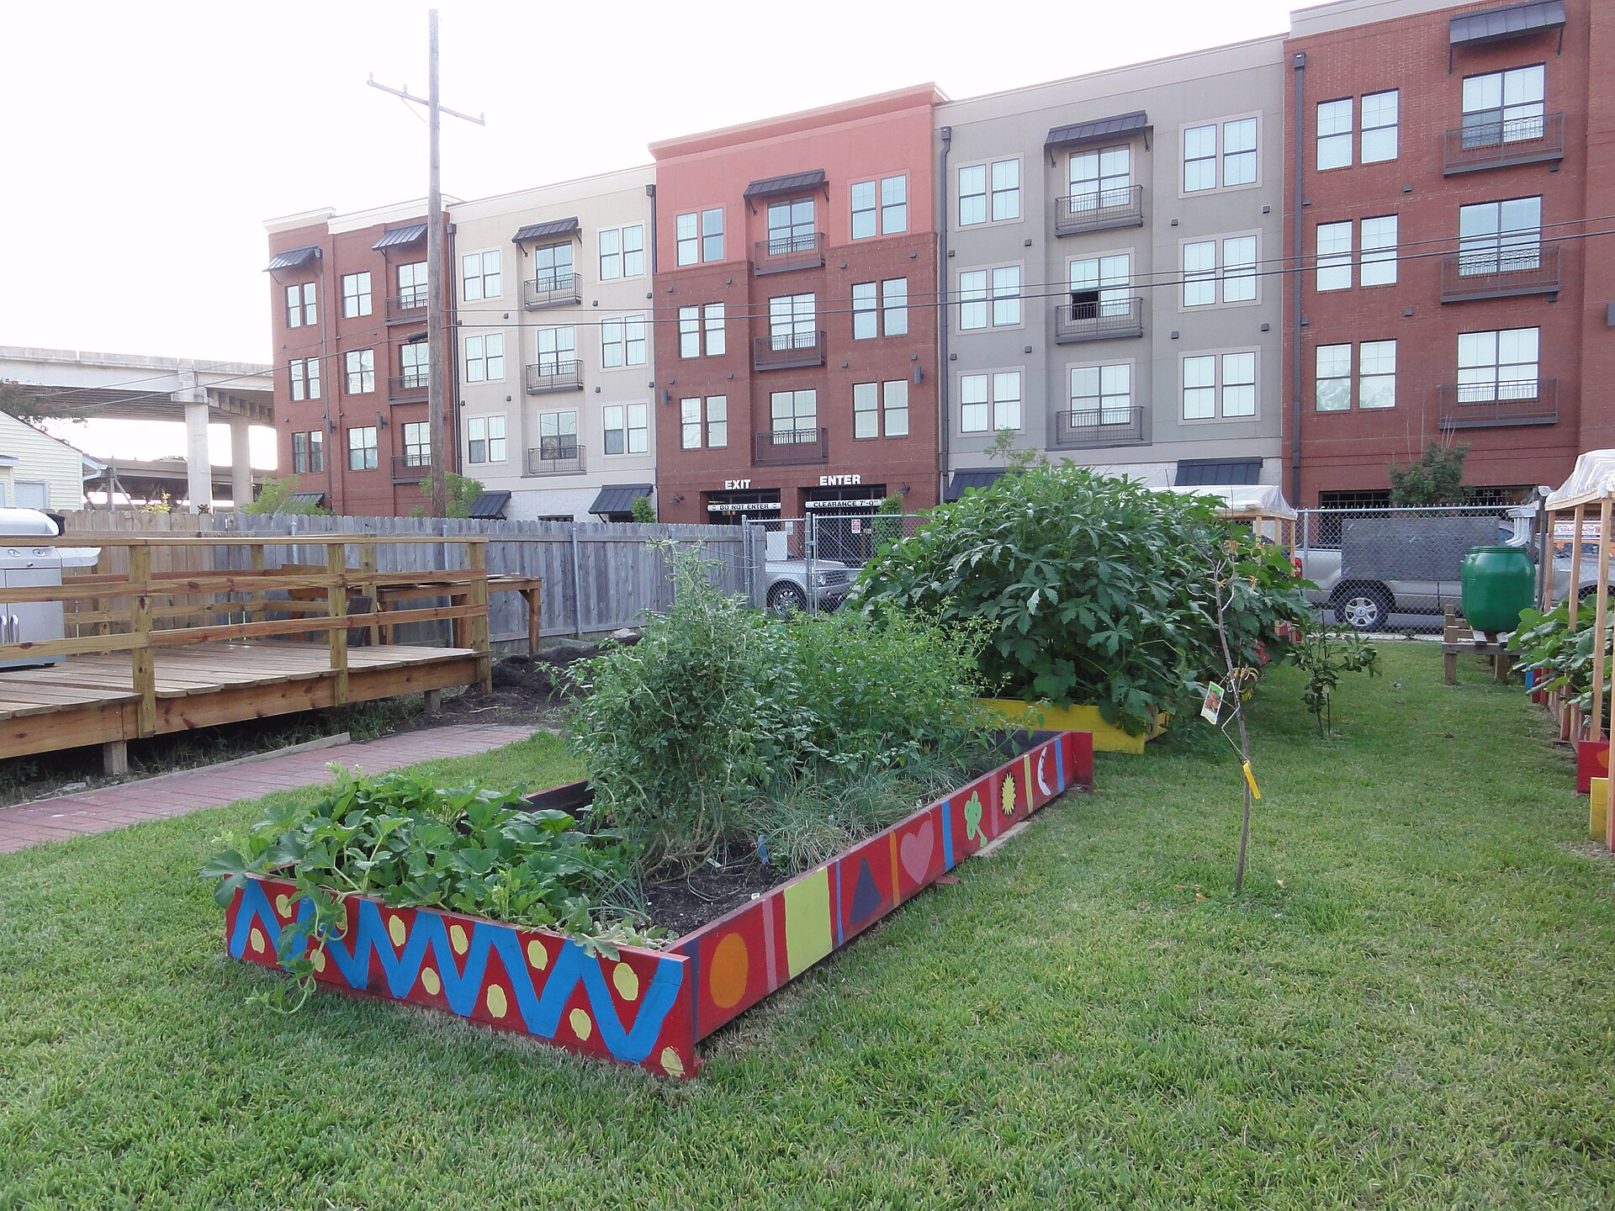
Urban Farming as Circular Infrastructure
One garden, several loops
Bio-waste becomes compost, compost
becomes food.
Rainwater is captured and used on site.
Residents gain skills, food and community ties.
Prague connection
Use a local garden to explore supply,
composting and maintenance partnerships.
Community garden — food, compost and
community in one loop
www.newton.university
30
Notes:
Lecture 2, slide 30: Urban Farming as Circular Infrastructure
Suggested time: 4 min
Say: The photo is a community garden in New Orleans, used to illustrate food, compost, rainwater and community connections. For Prague, ask students to identify a real local garden and verify its activities. A café or employer could be a buyer, contributor or maintenance partner; these are ideas to test, not existing contracts.
Image credit: 2010 WiseWords community garden NewOrleans 4855100893.jpg — CC BY 2.0, Wikimedia Commons
https://commons.wikimedia.org/wiki/File:2010_WiseWords_community_garden_NewOrleans_4855100893.jpg
Source image retained from the original lecture.

Slide 31
Classroom Activity: Redesign for Circularity
Choose an everyday product or an urban space.
Redesign it so that:
20
Material losses are identified and minimized.
At least one input comes from a local 'waste' stream.
Nature is regenerated, not just less damaged.
minutes
Present the loop, payer and maintenance owner in one
minute.
In groups
www.newton.university
31
Notes:
Lecture 2, slide 31: Classroom Activity: Redesign for Circularity
Suggested time: 20 min
Say: Groups choose a product or urban space and redesign its material flows. Keep the original 20-minute activity plan: 12 minutes to design and 8 minutes to share. They should identify losses, use one suitable local recovered input, and explain how the idea could restore nature. The pitch must include a payer and an operating owner.

Slide 32
Key Messages
01
Pollution and carbon emissions are
management problems with
management solutions.
05
The linear economy destroys value;
the circular economy preserves it.
02
Climate change hits cities through
heat, water and economic disruption.
06
Circularity starts at the design stage.
03
Resilient cities use nature as a buffer
against shocks.
07
GI can support water, food and soil
loops when someone owns and
maintains them.
04
One green investment can deliver
many services at once.
08
Policy and business models must
align, as Amsterdam shows.
www.newton.university
32
Notes:
Lecture 2, slide 32: Key Messages
Suggested time: 4 min
Say: Work through the eight messages. Ask students to connect each to a decision, example or tool from this lecture. Distinguish potential benefits from measured results.

Slide 33
Recommended Reading
IPCC (2023). AR6 Synthesis Report — Summary for
Policymakers.
Next lecture
European Environment Agency — Urban adaptation reports.
Sustainable Business
Models and Corporate
Strategy.
Prague Climate Plan 2030 (klima.praha.eu).
Ellen MacArthur Foundation — Towards the Circular
Economy.
European Commission — Circular Economy Action Plan.
Amsterdam Circular 2020–2025 Strategy.
www.newton.university
33
Notes:
Lecture 2, slide 33: Recommended Reading
Suggested time: 2 min
Say: Point to the Ellen MacArthur Foundation report — it is short and free online. Say the next lecture is about sustainable business models and corporate strategy.

Slide 34
Any
questions?
www.newton.university
34
Notes:
Lecture 2, slide 34: Any questions?
Suggested time: 5 min
Say: Take questions. If none, use a question from section 5.
Decorative artwork reused from the approved Lecture 1 design. AI-generated with OpenAI, September 2026; not a photograph of a documented place.

Slide 35
Image credits
Panoramic view of air pollution in São Paulo city, Brazil.jpg — CC0, Wikimedia Commons
Milad jafari (28).jpg — CC BY-SA 4.0, Wikimedia Commons
Benthemplein terrain skate gestion eau.jpg — CC BY-SA 4.0, Wikimedia Commons
Bales of PET bottles closeup.jpg — CC BY-SA 4.0, Wikimedia Commons
Amsterdam Canal Houses (Unsplash).jpg — CC0, Wikimedia Commons
2010 WiseWords community garden NewOrleans 4855100893.jpg — CC BY 2.0, Wikimedia Commons
Conceptual cover and leaf artwork: OpenAI image generation, September 2026. Reused from approved Lecture 1.
www.newton.university
35
Notes:
Lecture 2, slide 35: Image credits
Say: No need to show. Keep it in the file.

