Slide 1
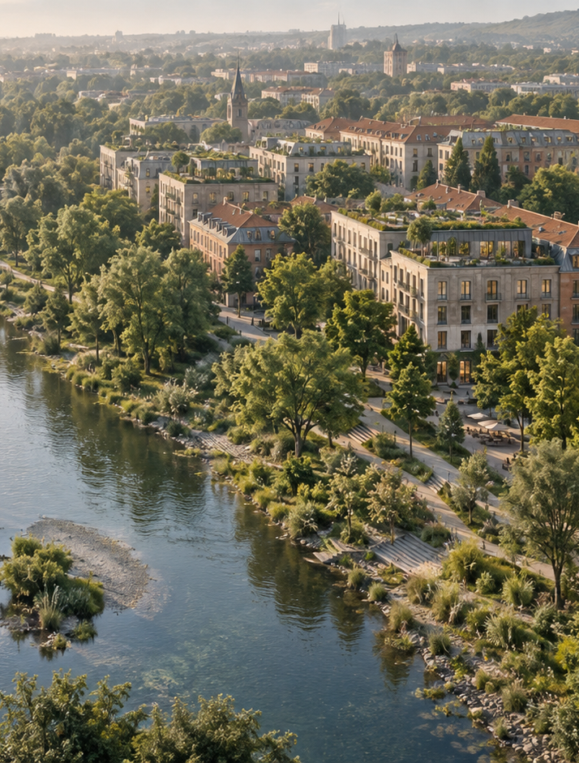

Applied Sustainability
in Business and
Management
Lecture 3 — Sustainable Business
Models and Corporate Strategy
Ing. Arch. Jenan Hussein, MSc, PhD
jenanhussein83@gmail.com
Notes:
Lecture 3, slide 1: Applied Sustainability in Business and Management
Suggested time: 1 min
Say: Welcome. Say that so far we looked at problems and tools; today we look at how companies actually make money with sustainability, and how they plan it.
Decorative artwork reused from the approved Lecture 1 design. AI-generated with OpenAI, September 2026; not a photograph of a documented place.

Slide 2

Learning Objectives
By the end of this lecture you will be able to:
01
Compare efficient, circular and
regenerative business models.
05
Connect SDGs and credible net-zero
plans to company actions.
02
Explain shared value and how a
company captures it.
06
Assess partnerships between
companies and cities.
03
Assess a GI investment using
benefits, costs and risks.
07
Pitch and defend a nature-based
business model.
04
Turn sustainability priorities into
targets and responsibilities.
www.newton.university
02
Notes:
Lecture 3, slide 2: Learning Objectives
Suggested time: 3 min
Say: Read the seven objectives. Connect each to a decision a manager needs to make. The first half introduces the tools and business problem; the second half applies them to the cases and activities. Students will use the same tools for their Prague semester site.

Slide 3
Today's Lecture Agenda
Before the break
After the break
Part 1 — What Makes a Business Model
Sustainable?
Part 4 — Building a Sustainability Strategy
Part 5 — SDGs and Net-Zero
Commitments
Part 2 — Shared Value and Regenerative
Business
Part 6 — GI in Corporate and City Strategy
Part 3 — Nature-Based Value Creation
Group Debate — Should Business Fund
Public GI?
Case Studies — Bosco Verticale,
Microsoft, Singapore
Key Messages and Reading
Activity
www.newton.university
03
Notes:
Lecture 3, slide 3: Today's Lecture Agenda
Suggested time: 2 min
Say: Six parts, a pitch activity before the break, a debate at the end.

Slide 4
Part 1
What Makes a Business Model
Sustainable?
01
www.newton.university
04
Notes:
Lecture 3, slide 4: Part 1 — What Makes a Business Model Sustainable?
Suggested time: 1 min
Say: Announce the part.

Slide 5
Business Models, Revisited
A business model answers three
questions
The sustainable version adds
What value do we create — or destroy
— for society and nature?
What value do we create, and for
whom?
Who are the non-paying stakeholders
affected by our model?
How do we deliver it?
How do we capture part of that value
as revenue?
www.newton.university
05
Notes:
Lecture 3, slide 5: Business Models, Revisited
Suggested time: 6 min
Say: A business model answers three questions: what value do we create and for whom, how do we deliver it, and how do we keep part of it as revenue. Use a simple example — a café: value is good coffee and a place to sit, delivered in a shop, paid per cup. The sustainable version adds two questions: what value do we create or destroy for society and nature, and who is affected but does not pay — for example the neighbours who get the noise and the waste.
Ask: For a café: who is affected by the business but never pays it anything?

Slide 6
Types of Sustainable Business Models
Efficiency-based
Circular
Regenerative
Do more with less
Product-as-a-service
Leave systems better
than found
Energy and material
savings
Take-back and
remanufacture
Restore ecosystems and
communities
Example: logistics
optimization
Example: equipment
leasing
Example: regenerative
agriculture
www.newton.university
06
Notes:
Lecture 3, slide 6: Types of Sustainable Business Models
Suggested time: 8 min
Say: Three types, from easy to ambitious. Efficiency-based: do the same with less — a logistics company that plans routes to save fuel. Circular: product as a service, take- back, leasing — a company that rents washing machines and repairs them. Regenerative: leave things better than you found them — regenerative farming that builds soil. Most companies start with efficiency; the course argues for moving right.

Slide 7
Part 2
Shared Value and
Regenerative Business
02
www.newton.university
07
Notes:
Lecture 3, slide 7: Part 2 — Shared Value and Regenerative Business
Suggested time: 1 min
Say: Announce the part.

Slide 8
Creating Shared Value (Porter & Kramer, 2011)
Core idea
Three routes
Discussion
Companies can create
economic value in ways
that also create value for
society — not as
philanthropy, but as
strategy.
Reconceive products and
markets.
Is a city park part of a
company's 'cluster'?
Redefine productivity in
the value chain.
Build supportive industry
clusters — including
healthy local
environments.
www.newton.university
08
Notes:
Lecture 3, slide 8: Creating Shared Value (Porter & Kramer, 2011)
Suggested time: 7 min
Say: This is a classic Harvard Business Review article; students should remember the names. The idea: a company can earn money by solving a social or environmental problem — not as charity on the side, but as the core strategy. Three routes: new products for unmet needs; a more productive value chain (less waste, healthier workers); and building strong local 'clusters' — suppliers, skills, and a healthy local environment. Ask the question on the slide.
Ask: Is a city park part of a company's cluster? Guide them to: yes, if it makes the location attractive for workers and customers.

Slide 9
Sustainable and Regenerative Business
Sustainable
Regenerative
The management test
Reduce harm while
maintaining social and
economic value.
Aim to restore soil, water,
habitat or community
capacity.
GI can support
regeneration when the
design, baseline and
maintenance plan show
real improvement.
Planting alone is not
proof.
www.newton.university
09
Notes:
Lecture 3, slide 9: Sustainable and Regenerative Business
Suggested time: 4 min
Say: Reducing harm and restoring damaged systems are different ambitions. A planted site only supports a regenerative claim when its condition improves against a baseline and that improvement lasts. Include water demand, species choice, survival and maintenance. A company should measure the outcome rather than assume all greenery is regenerative.

Slide 10

Part 3
Nature-Based Value
Creation
www.newton.university
10
Notes:
Lecture 3, slide 10: Part 3 — Nature-Based Value Creation
Suggested time: 1 min
Say: Announce the part: now the money.
Decorative artwork reused from the approved Lecture 1 design. AI-generated with OpenAI, September 2026; not a photograph of a documented place.

Slide 11
How Organizations Capture Value from GI
Operating costs
Resilience
Potential cooling and drainage savings
Reduce exposure to heat and runoff
Compare installation and upkeep costs
Check residual risks and insurance terms
People
Assets
Comfortable, accessible workplaces
Tenant appeal and site quality
Measure use and employee feedback
Test rental or planning assumptions
www.newton.university
11
Notes:
Lecture 3, slide 11: How Organizations Capture Value from GI
Suggested time: 7 min
Say: These are possible sources of value, not guaranteed returns. A building owner needs a baseline, installation and maintenance costs, and evidence for the benefits it expects to capture. Fee reductions depend on local tariffs. Insurance savings, rent premiums and faster approvals need specific evidence.
Ask: Which benefit goes to the company, and which goes to neighbours or the city?
Sources checked 5 October 2026:
https://www.epa.gov/green-infrastructure/economic-benefits-green-infrastructure
https://www.epa.gov/heatislands/using-green-roofs-reduce-heat-islands

Slide 12
Case Study: Bosco Verticale, Milan
The 'Vertical Forest' residential towers
Business lesson
About 800 trees and 20,000 plants on two
towers.
Nature on the building
became the brand of
the building.
Vegetation shades apartments, filters air and
dampens noise.
Its distinctive planted facade forms a clear part
of the property identity.
www.newton.university
12
Notes:
Lecture 3, slide 12: Case Study: Bosco Verticale, Milan
Suggested time: 5 min
Say: The architect describes Bosco Verticale as two planted residential towers with around 800 trees and thousands of shrubs and plants. The business lesson is differentiation through building design. Do not infer a rental premium from the photograph or identity alone. A Prague proposal still needs structural checks, irrigation, maintenance costs and evidence of tenant demand.
Sources checked 5 October 2026:
https://www.stefanoboeriarchitetti.net/en/project/vertical-forest/

Slide 13
Case Study: Microsoft and Nature on Site
Company-reported approach
Management lesson
A carbon-negative ambition for 2030
Separate a company
commitment from a
measured result. A
campus project
cannot establish
whole-company
sustainability.
Investment in environmental projects and
nature on sites
Campus design can support employee
experience
www.newton.university
13
Notes:
Lecture 3, slide 13: Case Study: Microsoft and Nature on Site
Suggested time: 4 min
Say: Use Microsoft as a company-reported strategy example. Its 2025 environmental report restated the carbon-negative 2030 ambition and the need to reduce value-chain emissions. Nature on a campus can be part of the workplace and site strategy, but it does not prove a whole-company outcome or a quantified productivity gain.
Ask: What evidence would you request before repeating a company benefit claim?
Sources checked 5 October 2026:
https://blogs.microsoft.com/on-the-issues/2025/05/29/environmental-sustainability-report/

Slide 14
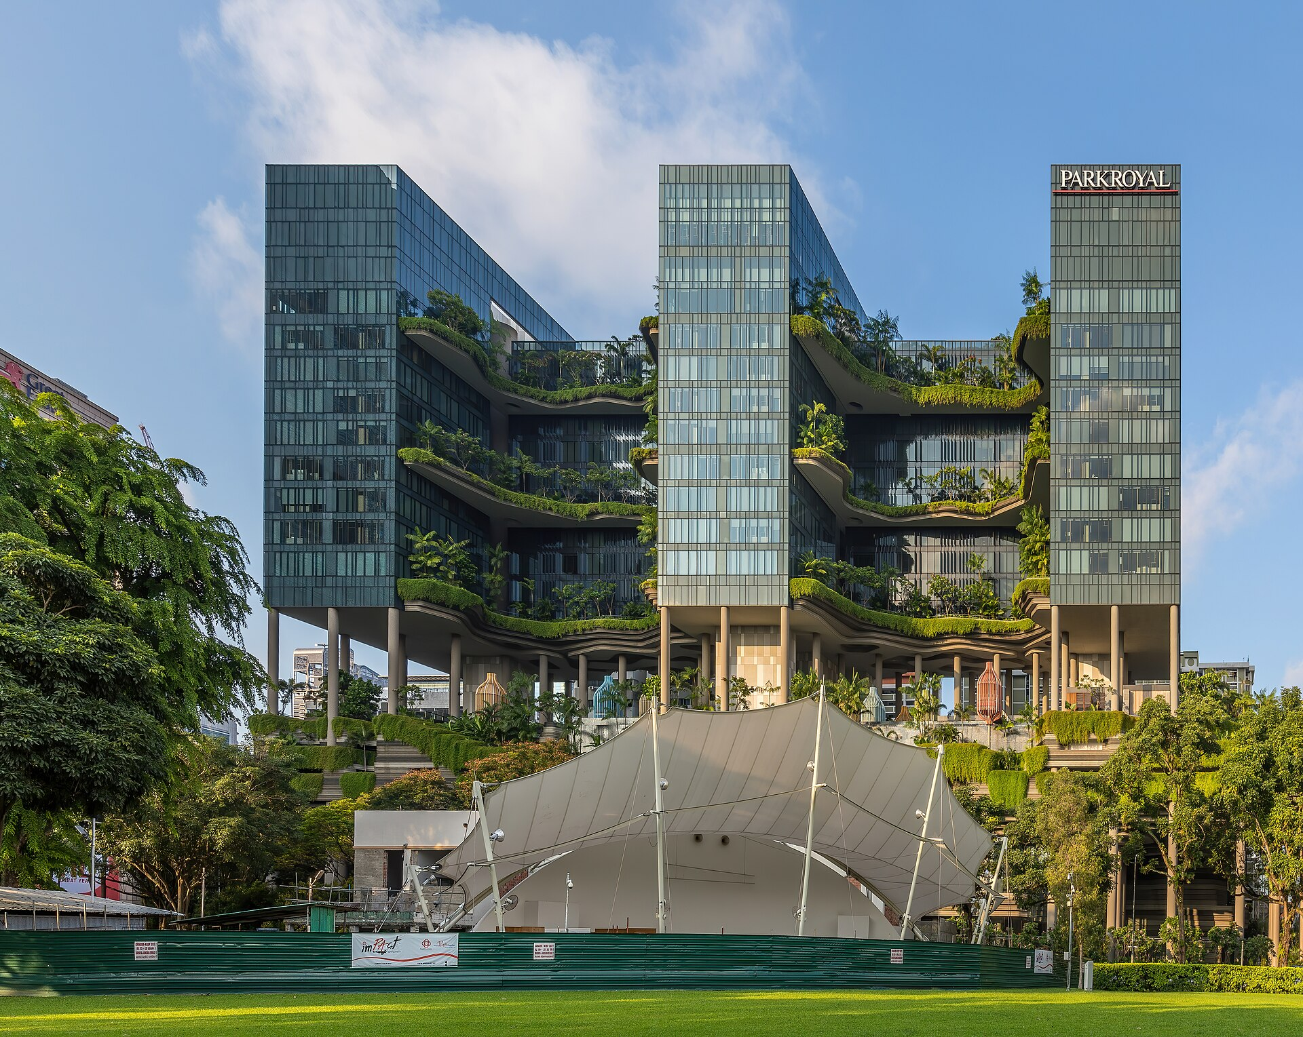
Case Study: Singapore Green Buildings
Business decisions
How does greenery support the guest experience?
What are the structure, irrigation and upkeep costs?
Which planning and certification requirements
apply?
Lesson
Assess the business case for this building instead of
assuming every green building earns a premium.
Parkroyal Collection Pickering: the building's
planting is part of its identity
www.newton.university
14
Notes:
Lecture 3, slide 14: Case Study: Singapore Green Buildings
Suggested time: 4 min
Say: Retain Parkroyal as the visual case. Ask how its landscape affects customer experience and operating costs. Singapore has planning and green-building frameworks, but requirements depend on the development. Do not claim that all new buildings face the same landscape obligation or that a price premium is guaranteed.
Image credit: Hotel Park Royal on Pickering from Hong Lim Park in Singapore.jpg — CC BY-SA 4.0, Wikimedia Commons
https://commons.wikimedia.org/wiki/File:Hotel_Park_Royal_on_Pickering_from_Hong_Lim_Park_in_Singapore.jpg
Source image retained from the original lecture.

Slide 15
Classroom Activity: Pitch a Nature-Based Model
Design a business model for Prague that earns
revenue from Green Infrastructure:
20
Green roof installation and maintenance service
Biodiversity consulting for developers
Urban farming subscription
minutes
— or your own idea.
In groups
Pitch: value proposition, customer, revenue stream, and
the ecosystem service behind it.
www.newton.university
15
Notes:
Lecture 3, slide 15: Classroom Activity: Pitch a Nature-Based Model
Suggested time: 20 min
Say: Groups design a business for Prague that earns money from Green Infrastructure and pitch it: value proposition, customer, revenue stream, and the ecosystem service behind it. Details in section 3.

Slide 16
Break
Second half — Sustainable Corporate Strategy and Urban
Sustainability
www.newton.university
16
Notes:
Lecture 3, slide 16: Break
Suggested time: 15–20 min
Say: After the break: from single business models to whole-company strategy, then the debate.

Slide 17
Part 4
Building a Sustainability
Strategy
04
www.newton.university
17
Notes:
Lecture 3, slide 17: Part 4 — Building a Sustainability Strategy
Suggested time: 1 min
Say: Announce the part.

Slide 18
From Ambition to Strategy
The strategy pyramid
Purpose — why sustainability matters to this organization.
Materiality — which issues matter most to the business and its
stakeholders.
Targets — measurable, time-bound commitments.
Programmes — the projects that deliver the targets.
Governance — who is accountable, how progress is reported.
www.newton.university
18
Notes:
Lecture 3, slide 18: From Ambition to Strategy
Suggested time: 6 min
Say: A strategy pyramid with five levels. Purpose: why sustainability matters to this company. Materiality: which issues matter most. Targets: measurable and with a date. Programmes: the projects that deliver the targets. Governance: who is responsible and how progress is reported. Say that many companies have a purpose statement and nothing below it — that is the gap.

Slide 19
Materiality: Priorities for a Business
Two perspectives
Example: a Prague
developer
Decision
Consider significant
impacts on people and
nature, and sustainability
risks or opportunities for
the business. An issue
may matter under either
perspective.
Use evidence to rank
priorities and record the
reasoning. Lecture 6
develops the ESRS
approach.
Energy use and climate
resilience of buildings
Habitat and green-space
impacts
Office paper may be a
lower priority, depending
on scale
www.newton.university
19
Notes:
Lecture 3, slide 19: Materiality: Priorities for a Business
Suggested time: 6 min
Say: A simple ranking can help strategy, but a top-right-only grid is not an adequate double-materiality test. An issue may be significant because of the company’s impact, its financial effects, or both. For a developer, check buildings, land, people and supply chains. Treat office paper as a possible lower priority, not automatically immaterial.
Ask: Could a serious habitat impact matter even before it affects the company’s profits?
Sources checked 5 October 2026:
https://knowledgehub.efrag.org/eng/interactive/ig/ig1/09-2025/75

Slide 20
Part 5
SDGs and Net-Zero
Commitments
05
www.newton.university
20
Notes:
Lecture 3, slide 20: Part 5 — SDGs and Net-Zero Commitments
Suggested time: 1 min
Say: Announce the part.

Slide 21
Integrating the SDGs
Most relevant goals for this
course
How companies use them
Map activities to goals, set indicators,
report contribution.
SDG 11 — Sustainable Cities and
Communities
Avoid 'SDG-washing': claiming goals
without measurable action.
SDG 13 — Climate Action
SDG 15 — Life on Land
SDG 6 — Clean Water; SDG 3 —
Health and Wellbeing
www.newton.university
21
Notes:
Lecture 3, slide 21: Integrating the SDGs
Suggested time: 6 min
Say: The 17 UN goals. The most relevant for this course: 11 sustainable cities, 13 climate action, 15 life on land, plus 6 clean water and 3 health. Companies map their activities to goals, set indicators and report. Warn about 'SDG-washing' — putting colourful SDG icons in a report without any measurable action behind them. Seminar 2 goes deeper into the SDGs and the Green Deal.

Slide 22
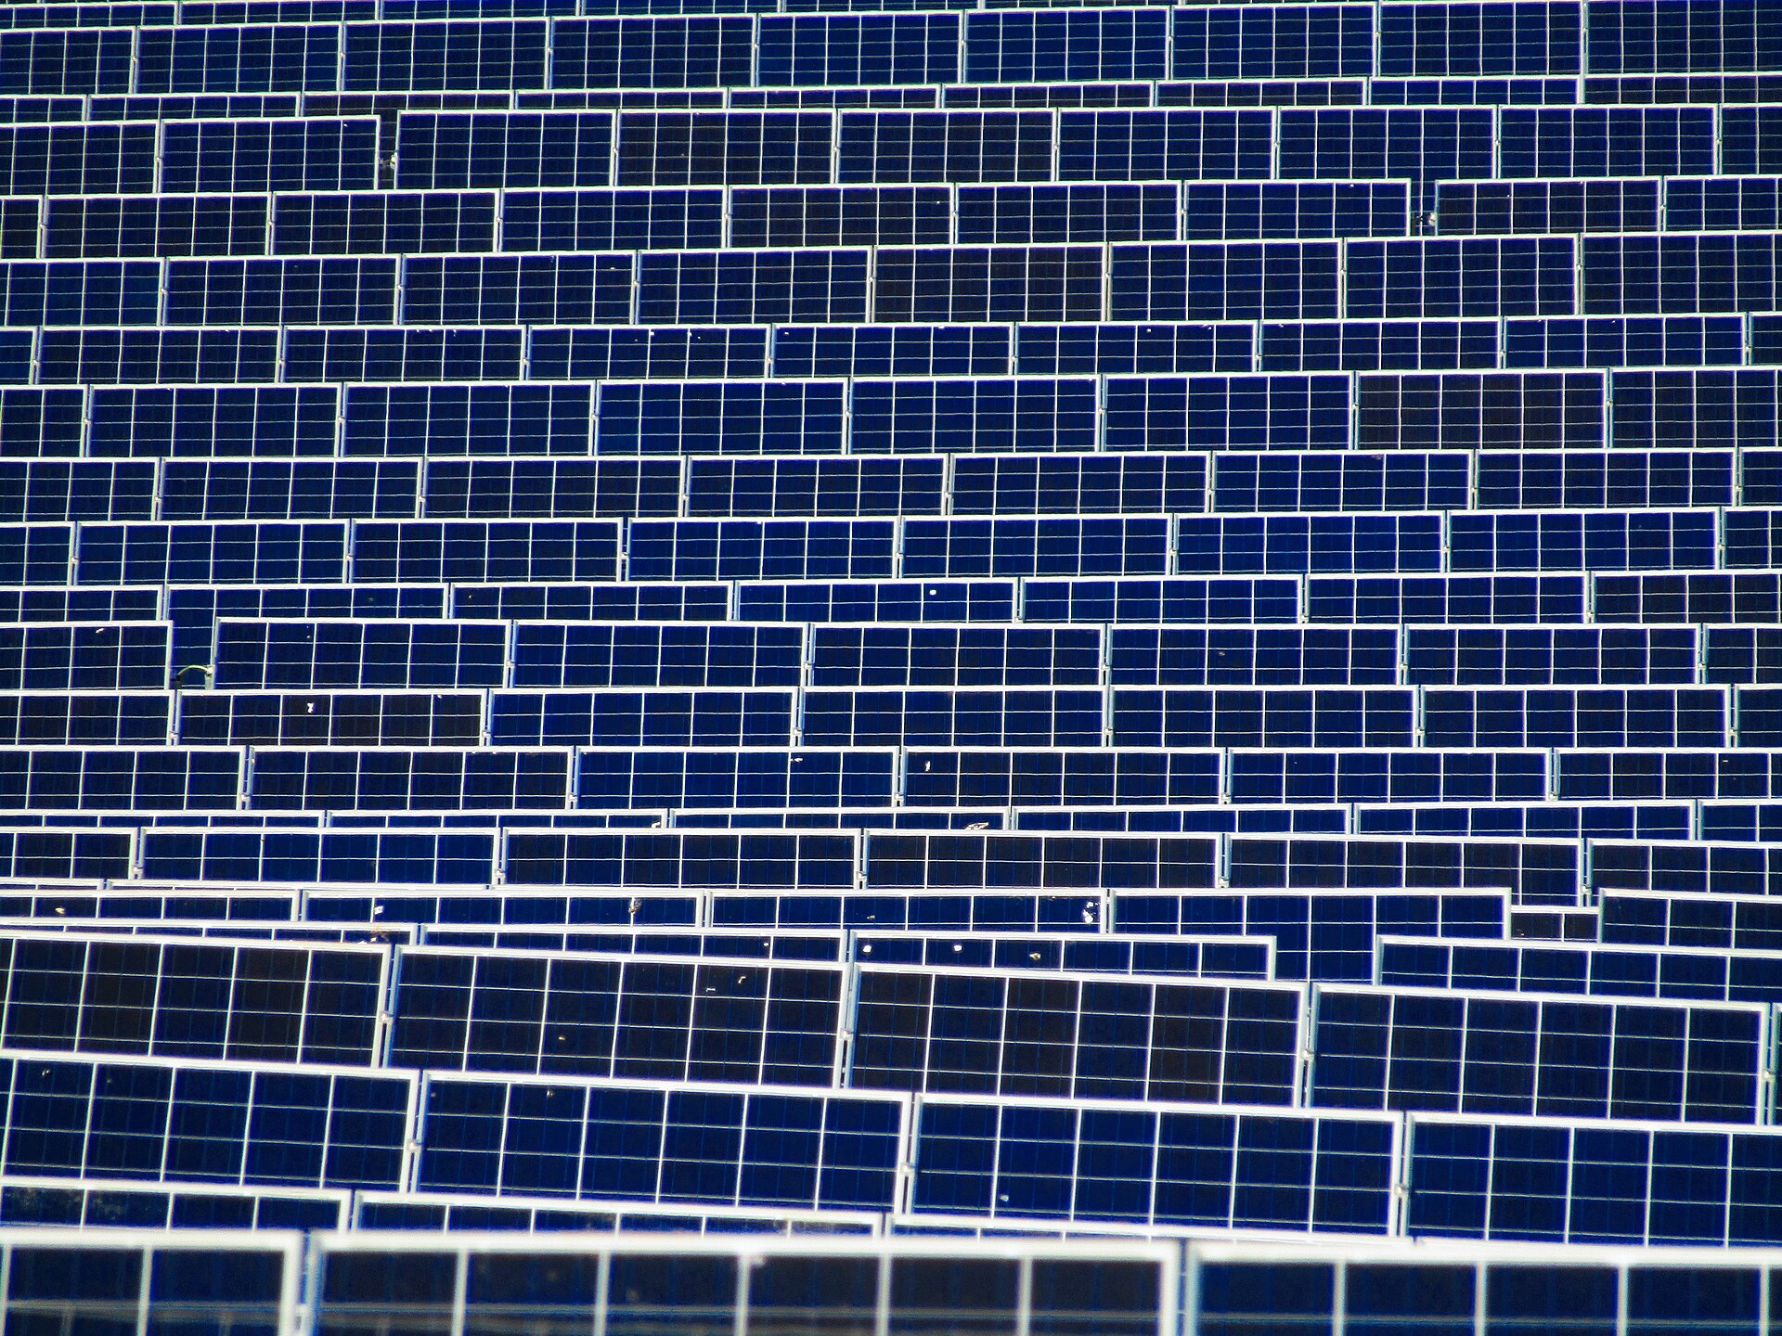
Net-Zero Plans
Credible net-zero plans include
Science-based reduction targets for scopes 1–3.
Deep reductions first; eligible removals address
residual emissions.
Nature projects need credible carbon accounting
and durability evidence.
Discussion
Can a company plant its way to net zero?
Decarbonizing energy is necessary — but not
sufficient
www.newton.university
22
Notes:
Lecture 3, slide 22: Net-Zero Plans
Suggested time: 6 min
Say: A net-zero plan needs a clear boundary, credible reduction targets and evidence of delivery. Residual emissions require eligible removals under the relevant standard; buying arbitrary offsets or planting trees is not enough. Storage duration, reversals and double counting matter. Urban GI can help adaptation and biodiversity without qualifying as neutralization.
Ask: Can a company plant its way to net zero? No. First reduce emissions, then meet the applicable requirements for the remaining emissions.
Image credit: Field of Solar Panels near Ogwell.jpg — CC BY-SA 4.0, Wikimedia Commons
https://commons.wikimedia.org/wiki/File:Field_of_Solar_Panels_near_Ogwell.jpg
Source image retained from the original lecture.
Sources checked 5 October 2026:
https://files.sciencebasedtargets.org/production/files/Corporate-Net-Zero-Standard-version-2.pdf

Slide 23
Part 6
GI in Corporate and
City Strategy
www.newton.university
23
Notes:
Lecture 3, slide 23: Part 6 — GI in Corporate and City Strategy
Suggested time: 1 min
Say: Announce the part.
Decorative artwork reused from the approved Lecture 1 design. AI-generated with OpenAI, September 2026; not a photograph of a documented place.

Slide 24
Where GI Enters Corporate Plans
Operations
Strategy
Brand & people
Green roofs on facilities
Climate adaptation of
assets
Green workplaces
Site biodiversity plans
Community green
projects
Nature-related risk
assessment
Stormwater management
Employer attractiveness
Nature and carbon plans
with separate accounting
www.newton.university
24
Notes:
Lecture 3, slide 24: Where GI Enters Corporate Plans
Suggested time: 5 min
Say: GI appears in facility operations, adaptation planning and people or community programmes. Give each action an owner, budget and measure of success. Keep climate adaptation and biodiversity benefits distinct from any carbon-removal claim, which requires separate accounting.

Slide 25
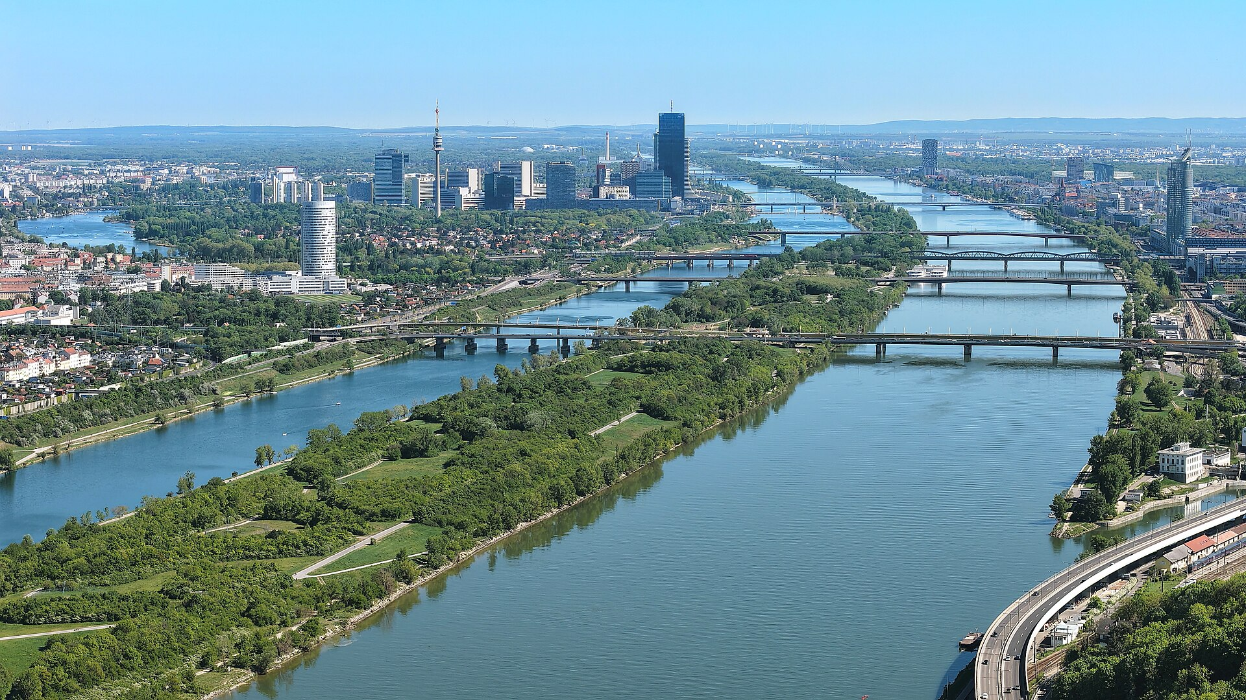
Municipal Strategies: Prague and Vienna
Prague
Climate Plan 2030: emissions, energy, mobility,
adaptation.
Adaptation Strategy: trees, water, permeable surfaces.
Vienna
Green corridors and the Danube Island model:
infrastructure as public space.
For business
City strategies signal where public investment — and
partnership opportunity — will go.
Vienna's Danube Island — flood protection that
became a park
www.newton.university
25
Notes:
Lecture 3, slide 25: Municipal Strategies: Prague and Vienna
Suggested time: 5 min
Say: Prague has a Climate Plan 2030 (emissions, energy, mobility, adaptation) and an Adaptation Strategy (trees, water, permeable surfaces). Vienna's Danube Island in the photo was built as flood protection and became the city's favourite park. For business the message is: city strategies show where public money and partnership opportunities will go in the next years.
Image credit: Wien - Donauinsel mit den Donaubrücken.JPG — CC BY-SA 4.0, Wikimedia Commons
https://commons.wikimedia.org/wiki/File:Wien_-_Donauinsel_mit_den_Donaubr%C3%BCcken.JPG
Source image retained from the original lecture.

Slide 26
Group Debate
Two teams, 10 minutes preparation, structured debate
“Should businesses invest directly in public green
infrastructure?”
Team A argues yes
Team B argues no
Resilience, talent, brand, shared value.
Free-rider problem, core-business
focus, public sector's job.
Finish by looking for the conditions under which both sides agree.
www.newton.university
26
Notes:
Lecture 3, slide 26: Group Debate
Suggested time: 25 min
Say: Two teams. Motion: 'Should businesses invest directly in public green infrastructure?' Team A argues yes (resilience, talent, brand, shared value). Team B argues no (free-rider problem, focus on core business, it is the public sector's job). Ten minutes to prepare, then a structured debate. Finish by finding the conditions where both sides agree. Details in section 3.

Slide 27
Key Messages
01
Sustainable business models account
for value to society and nature, not
only customers.
05
Strategy turns sustainability ambition
into targets, programmes and
accountability.
02
Shared value is strategy, not
philanthropy.
06
Materiality keeps strategy focused
on what matters.
03
GI can create value when benefits
exceed installation and maintenance
costs.
07
Credible net-zero plans reduce
emissions and meet residual-removal
requirements.
04
Regenerative claims need lasting,
measured improvements in natural
systems.
08
City strategies like Prague's Climate
Plan map where business can partner.
www.newton.university
27
Notes:
Lecture 3, slide 27: Key Messages
Suggested time: 4 min
Say: Work through the eight messages. Ask students to connect each to a decision, example or tool from this lecture. Distinguish potential benefits from measured results.

Slide 28
Recommended Reading
Porter, M. & Kramer, M. (2011). Creating Shared Value. HBR.
Next lecture
Comin et al. (2019). Sustainable business models: a literature
review. Benchmarking.
Measuring
Sustainability —
Assessment, KPIs and
Life Cycle Thinking.
Jacobsen et al. (2020). Towards a Typology of Sustainability
Practices. Sustainability 12(12).
Blackburn (2007). The Sustainability Handbook — strategy
chapters.
Science Based Targets initiative — Corporate Net-Zero Standard.
Prague Climate Plan 2030.
www.newton.university
28
Notes:
Lecture 3, slide 28: Recommended Reading
Suggested time: 2 min
Say: Porter and Kramer 2011 is the one to read — it is short. Next lecture: measuring sustainability — KPIs and life cycle assessment.

Slide 29
Any
questions?
www.newton.university
29
Notes:
Lecture 3, slide 29: Any questions?
Suggested time: 5 min
Say: Take questions.
Decorative artwork reused from the approved Lecture 1 design. AI-generated with OpenAI, September 2026; not a photograph of a documented place.

Slide 30
Image credits
Hotel Park Royal on Pickering from Hong Lim Park in Singapore.jpg — CC BY-SA 4.0, Wikimedia Commons
Field of Solar Panels near Ogwell.jpg — CC BY-SA 4.0, Wikimedia Commons
Wien - Donauinsel mit den Donaubrücken.JPG — CC BY-SA 4.0, Wikimedia Commons
Conceptual cover and leaf artwork: OpenAI image generation, September 2026. Reused from approved Lecture 1.
www.newton.university
30
Notes:
Lecture 3, slide 30: Image credits
Say: No need to show.

