Slide 1
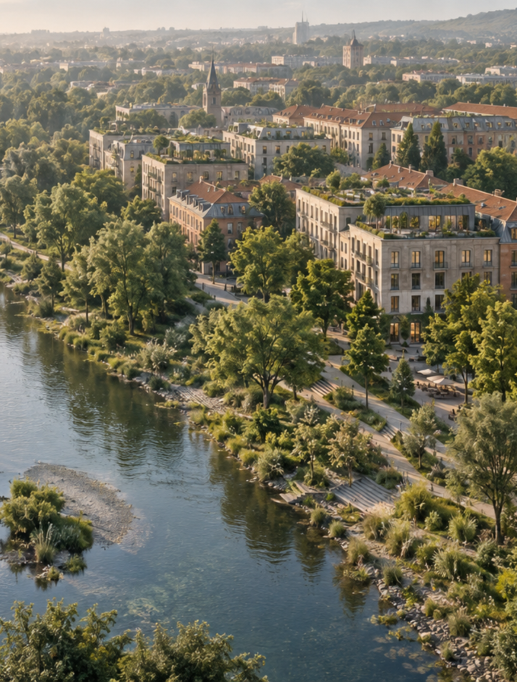

Applied Sustainability
in Business and
Management
Lecture 4 — Measuring Sustainability
— Assessment, KPIs and Life Cycle
Thinking
Ing. Arch. Jenan Hussein, MSc, PhD
jenanhussein83@gmail.com
Notes:
Lecture 4, slide 1: Applied Sustainability in Business and Management
Suggested time: 1 min
Say: Welcome. Say that last time we talked about strategy and targets. A target without a number is a wish — today is about the numbers.
Decorative artwork reused from the approved Lecture 1 design. AI-generated with OpenAI, September 2026; not a photograph of a documented place.

Slide 2

Learning Objectives
By the end of this lecture you will be able to:
01
Explain how measurement supports
management decisions.
05
Use a functional unit to compare
alternatives fairly.
02
Select environmental, economic and
social KPIs for GI.
06
Apply ecodesign to products and
business facilities.
03
Design a dashboard with units, data
sources and owners.
07
Assess roof options using life-cycle
impacts and wider benefits.
04
Explain the four phases of Life Cycle
Assessment.
www.newton.university
02
Notes:
Lecture 4, slide 2: Learning Objectives
Suggested time: 3 min
Say: Read the seven objectives. Connect each to a decision a manager needs to make. The first half introduces the tools and business problem; the second half applies them to the cases and activities. Students will use the same tools for their Prague semester site.

Slide 3
Today's Lecture Agenda
Before the break
After the break
Part 1 — Why and How We Measure
Part 4 — Life Cycle Assessment
Part 2 — KPIs for Green Infrastructure
Part 5 — Ecodesign
Part 3 — Data and Tools
Part 6 — Lifecycle Thinking for Buildings and
Sites
Workshop — Build a GI Dashboard
Case Study — Green Roof vs Conventional
Roof
Activity
Key Messages and Reading
www.newton.university
03
Notes:
Lecture 4, slide 3: Today's Lecture Agenda
Suggested time: 2 min
Say: Six parts; a longer workshop before the break and a short activity at the end.

Slide 4
Part 1
Why and How We Measure
01
www.newton.university
04
Notes:
Lecture 4, slide 4: Part 1 — Why and How We Measure
Suggested time: 1 min
Say: Announce the part.

Slide 5
You Manage What You Measure
Why indicators
matter
The measurement
cycle
Good KPIs are
Relevant, measurable,
comparable over time,
and hard to game.
Targets without indicators
are wishes.
Baseline → Target →
Monitor → Report →
Improve
Investors, regulators and
citizens increasingly
demand evidence.
www.newton.university
05
Notes:
Lecture 4, slide 5: You Manage What You Measure
Suggested time: 10 min
Say: Three blocks. Why indicators matter: targets without indicators are wishes, and investors, regulators and citizens want evidence. The measurement cycle: baseline, target, monitor, report, improve — draw it as a circle on the board. Good KPIs are relevant, measurable, comparable over time, and hard to game. Give an example of a bad KPI: 'number of trees planted' is easy to game (plant cheap saplings that die); 'tree canopy cover in five years' is better.
Ask: Give me one KPI that is easy to game. How would you fix it?

Slide 6
Part 2
KPIs for Green Infrastructure
02
www.newton.university
06
Notes:
Lecture 4, slide 6: Part 2 — KPIs for Green Infrastructure
Suggested time: 1 min
Say: Announce the part.

Slide 7
Three Families of GI Indicators
Environmental
Economic
Social
Carbon sequestration (t
CO2/yr)
Property value uplift (%)
Health and wellbeing
scores
Energy savings (kWh,
CZK)
Biodiversity indicators
(species counts)
Visitor numbers
Avoided flood damage
Community engagement
events
Water retention (m3
stored)
Return on investment
Access within 300 m of
green space
Temperature reduction
(°C)
www.newton.university
07
Notes:
Lecture 4, slide 7: Three Families of GI Indicators
Suggested time: 10 min
Say: Compare environmental, economic and social indicators. Every quantitative KPI needs a unit, boundary, baseline and collection method. Carbon sequestration is a flow per year; carbon stock is the amount stored at a point in time. For green-space access, define the distance and route method explicitly. For a business project, distinguish savings the company captures from public benefits.

Slide 8
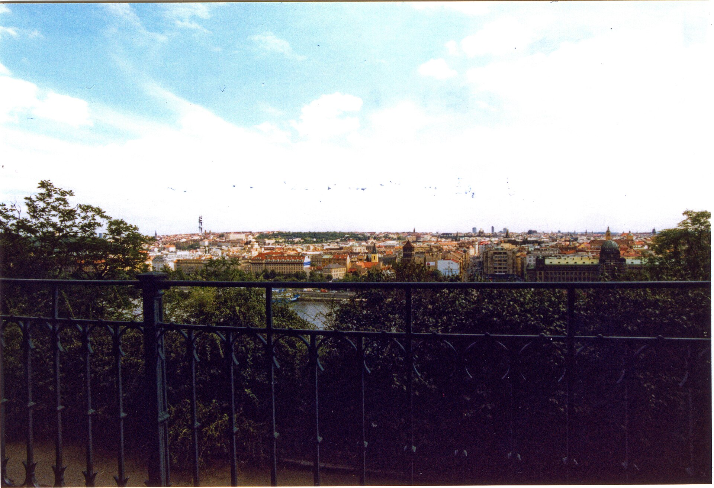
Measuring a Park: Prague Example
Try it now
Name one environmental, one economic and
one social KPI for this park.
Where would the data come from?
Who would use the numbers — and for what
decision?
Letná Park — how would you measure its
value?
www.newton.university
08
Notes:
Lecture 4, slide 8: Measuring a Park: Prague Example
Suggested time: 10 min
Say: Use Letná as the public case, then ask how a nearby café, hotel or employer could use the same evidence. Name one environmental, one economic and one social indicator, its data source, and the decision it supports. Treat an investment amount as a hypothetical classroom example, not a confirmed city budget.
Image credit: Praha - Letná Park - View South.jpg — CC BY-SA 4.0, Wikimedia Commons
https://commons.wikimedia.org/wiki/File:Praha_-_Letn%C3%A1_Park_-_View_South.jpg
Source image retained from the original lecture.

Slide 9

Part 3
Data and Tools
www.newton.university
09
Notes:
Lecture 4, slide 9: Part 3 — Data and Tools
Suggested time: 1 min
Say: Announce the part.
Decorative artwork reused from the approved Lecture 1 design. AI-generated with OpenAI, September 2026; not a photograph of a documented place.

Slide 10
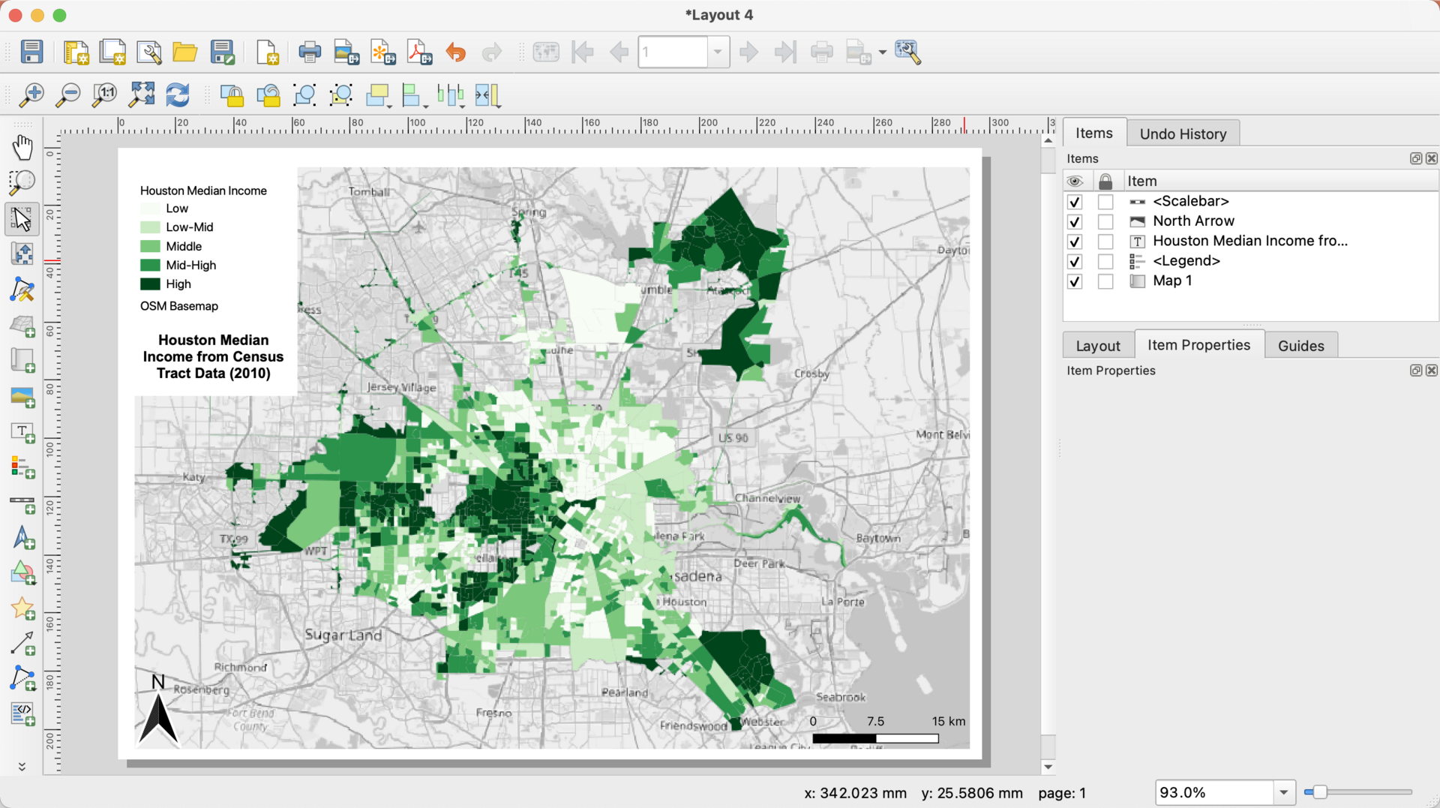
The GI Measurement Toolkit
Spatial analysis
GIS platforms: QGIS (open source), ArcGIS
Field data
IoT sensors: temperature, humidity, water flow
i-Tree: valuing ecosystem services of trees
Reporting
Dashboards: Power BI, digital twins for scenario
testing
Illustrative GIS interface: the source map shows
Houston income, not Prague green cover
www.newton.university
10
Notes:
Lecture 4, slide 10: The GI Measurement Toolkit
Suggested time: 10 min
Say: GIS can map green cover, heat and access, while sensors collect field measurements. i-Tree estimates tree benefits using data and models. Dashboards communicate results; digital twins test scenarios. The screenshot in this slide is only an example of a GIS interface: its map is Houston income, not a sustainability analysis of Prague.
Image credit: QGIS Interface Screenshot with Map of Median Income in Houston (2010).png — CC0, Wikimedia Commons
https://commons.wikimedia.org/wiki/File:QGIS_Interface_Screenshot_with_Map_of_Median_Income_in_Houston_(2010).png
Source image retained from the original lecture.

Slide 11
Workshop: Build a Green Infrastructure Dashboard
Design a one-screen dashboard for your
semester case-study site:
30
Choose 3 environmental, 3 economic and 3 social KPIs.
For each: unit, baseline, data source, update frequency
and owner.
minutes
Sketch the layout: what decision does a site manager,
mayor or investor make?
In groups
Present in 2 minutes per group.
www.newton.university
11
Notes:
Lecture 4, slide 11: Workshop: Build a Green Infrastructure Dashboard
Suggested time: 30 min
Say: Keep the 30-minute group workshop and the nine KPIs. For each, add a baseline and accountable owner to the original unit, source and frequency. The dashboard should help a site manager, mayor or investor decide what to do. Ask groups to separate measured values from estimates or missing data.

Slide 12
Break
Second half — Life Cycle Assessment and Ecodesign
www.newton.university
12
Notes:
Lecture 4, slide 12: Break
Suggested time: 20 min
Say: After the break: from measuring a place to measuring a product — Life Cycle Assessment.

Slide 13
Part 4
Life Cycle Assessment
04
www.newton.university
13
Notes:
Lecture 4, slide 13: Part 4 — Life Cycle Assessment
Suggested time: 1 min
Say: Announce the part. Say the short form: LCA.

Slide 14
What is LCA?
Definition
A standardized method (ISO 14040/14044) for quantifying the
environmental impacts of a product or service across its whole life: raw
materials, production, transport, use and end of life.
Why 'cradle to grave' matters
The dominant stage depends on the product, energy mix, lifetime and
use. LCA helps managers check whether an improvement in one stage
shifts impacts to another.
www.newton.university
14
Notes:
Lecture 4, slide 14: What is LCA?
Suggested time: 8 min
Say: Explain goal and scope, inventory, impact assessment and interpretation. LCA includes a defined function and boundary across life stages. Do not teach a fixed dominant stage for every car, shirt or building: the result depends on the technology, use, lifetime and impact category.

Slide 15
The Four Phases of LCA
1. Goal and scope
2. Inventory analysis (LCI)
What is assessed, for what decision, with
which system boundaries?
Collect inputs and outputs: energy,
materials, emissions, waste.
3. Impact assessment (LCIA)
4. Interpretation
Translate the inventory into impacts:
climate, water, toxicity, land use.
Draw conclusions, test sensitivity, make
recommendations.
www.newton.university
15
Notes:
Lecture 4, slide 15: The Four Phases of LCA
Suggested time: 8 min
Say: Four phases, in order. Goal and scope: what are we assessing, for which decision, and where are the boundaries. Inventory: collect all inputs and outputs — energy, materials, emissions, waste. Impact assessment: translate the inventory into impacts such as climate, water, toxicity, land use. Interpretation: draw conclusions, test how sensitive the result is, recommend. Students should be able to name the four phases in order.

Slide 16
The Functional Unit
The trick that makes comparisons
fair
Discussion
A ceramic mug vs a paper cup: what
functional unit makes this comparison
fair, and how many uses does the mug
need to win?
LCA compares function, not objects: '1
m² of roof kept waterproof for 50 years',
not 'one roof'.
www.newton.university
16
Notes:
Lecture 4, slide 16: The Functional Unit
Suggested time: 8 min
Say: Compare equal service, such as keeping one square metre of roof waterproof for 50 years. For cups, specify a number and volume of drinks plus washing and reuse conditions. There is no universal break-even number for a ceramic mug; it depends on manufacturing, energy, washing and reuse.
Ask: What would you need to measure to make the comparison fair?

Slide 17
Part 5
Ecodesign
05
www.newton.university
17
Notes:
Lecture 4, slide 17: Part 5 — Ecodesign
Suggested time: 1 min
Say: Announce the part.

Slide 18
Ecodesign Principles
Design choices shape impacts across the life cycle:
Materials
Use phase
End of life
Fewer, safer materials
Energy and water
efficiency
Easy separation of parts
Recycled and renewable
inputs
Standardized materials
Durability and
repairability
Take-back systems
Design for disassembly
Upgradeable
components
www.newton.university
18
Notes:
Lecture 4, slide 18: Ecodesign Principles
Suggested time: 10 min
Say: Design affects materials, repair, energy use and recovery. Avoid treating a single percentage as universal. Connect ecodesign to the R-ladder: repair and reuse require durable components, spare parts and a workable service model. Ask which changes a procurement or product manager can specify.

Slide 19
Part 6
Lifecycle Thinking for
Buildings and Sites
www.newton.university
19
Notes:
Lecture 4, slide 19: Part 6 — Lifecycle Thinking for Buildings and Sites
Suggested time: 1 min
Say: Announce the part: LCA is not only for products.
Decorative artwork reused from the approved Lecture 1 design. AI-generated with OpenAI, September 2026; not a photograph of a documented place.

Slide 20
Life-Cycle Thinking for Business Facilities
Applications
The management
test
Buildings: construction, energy, maintenance
and replacement
Account for both
burdens and benefits.
Compare equivalent
service and avoid
assuming vegetation
makes a project
carbon-negative.
Infrastructure: materials, operation and end of
life
GI: planting, irrigation, upkeep and ecosystem
benefits
www.newton.university
20
Notes:
Lecture 4, slide 20: Life-Cycle Thinking for Business Facilities
Suggested time: 5 min
Say: A company can use the same life-cycle approach for a roof, car park or production site. Include materials, transport, irrigation, maintenance, replacement and disposal as relevant. Vegetation may store carbon or reduce cooling needs, but the net result must be calculated. Conventional infrastructure also provides essential services.
Sources checked 5 October 2026:
https://www.epa.gov/heatislands/using-green-roofs-reduce-heat-islands

Slide 21
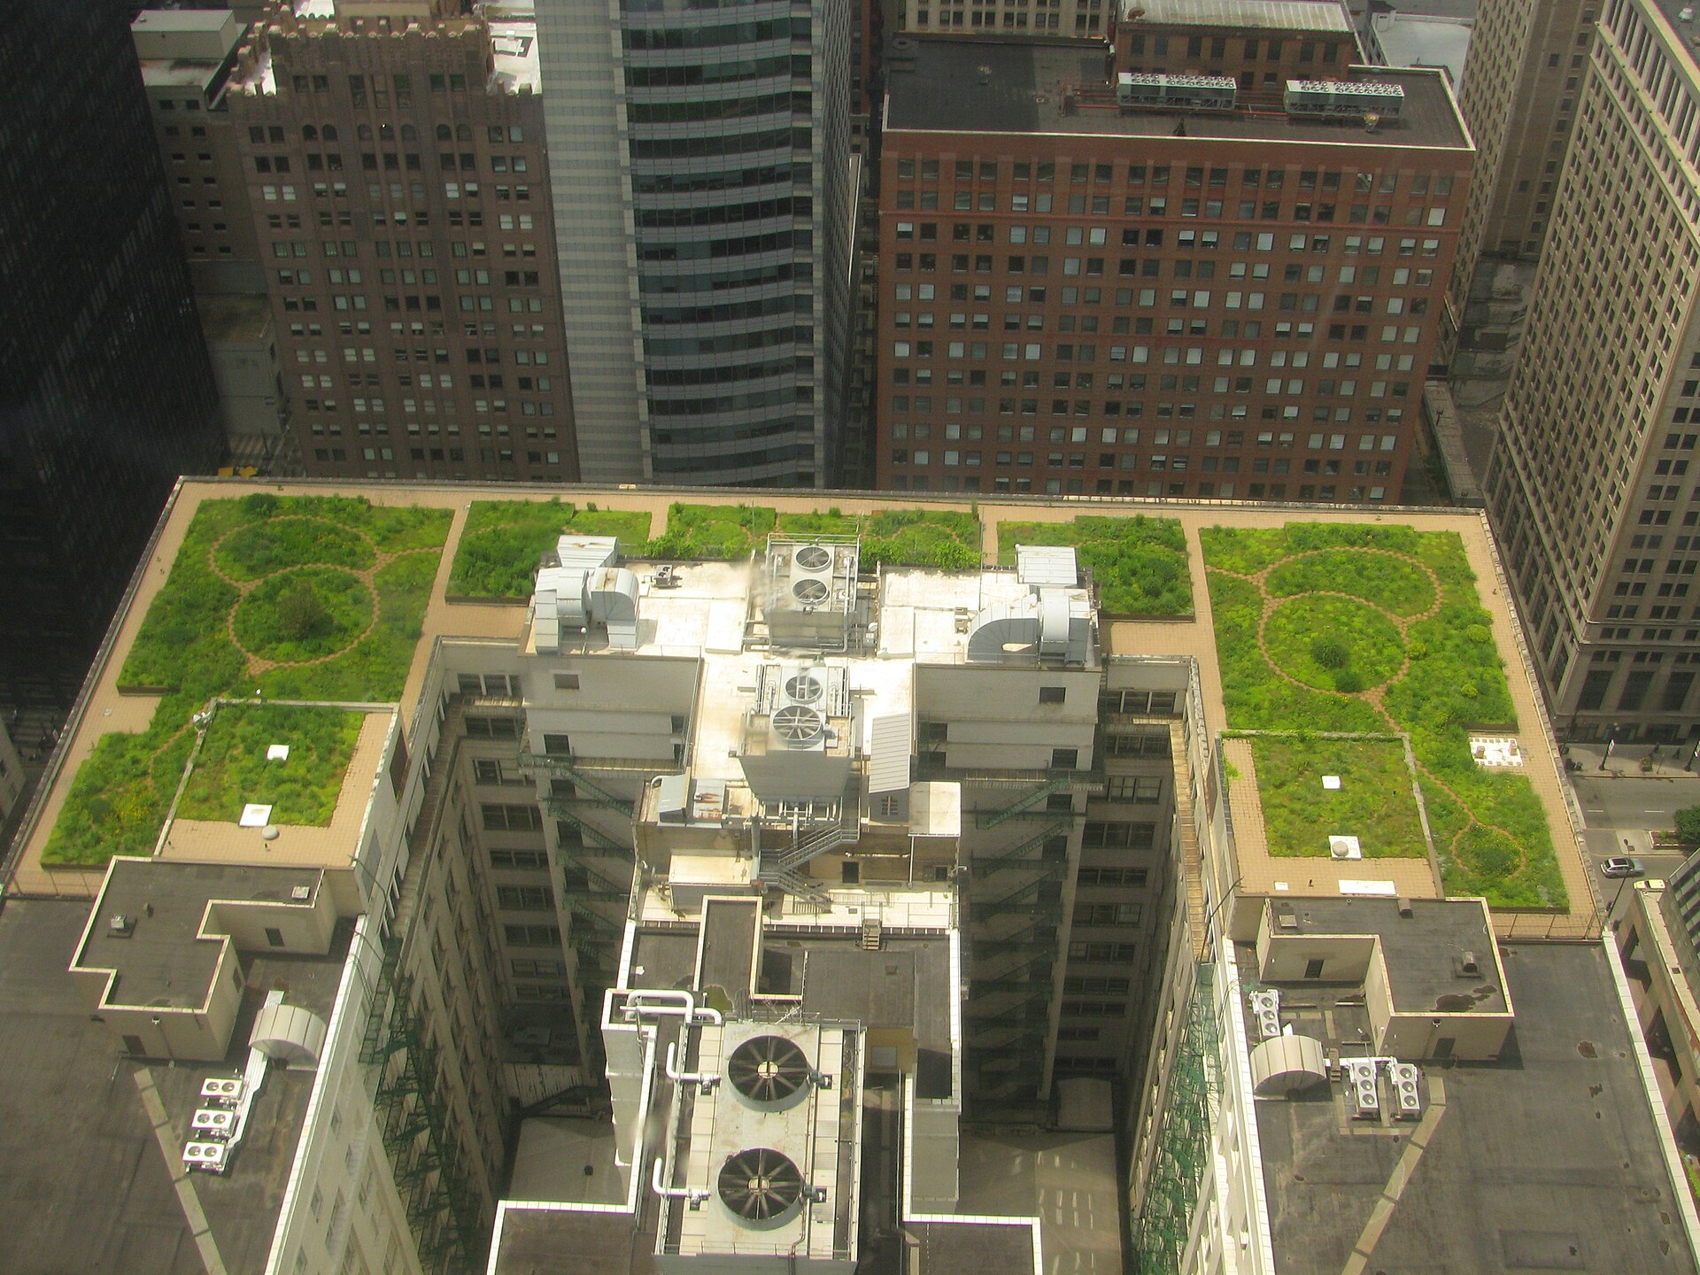
Case Study: the Roof Above Your Head
Chicago City Hall — a working green roof over a hundred-year-old building
www.newton.university
21
Notes:
Lecture 4, slide 21: Case Study: the Roof Above Your Head
Suggested time: 2 min
Say: Chicago City Hall again — a working green roof on a hundred-year-old building. Now we look at it with LCA eyes.
Image credit: 20080708 Chicago City Hall Green Roof.JPG — CC BY-SA 3.0, Wikimedia Commons
https://commons.wikimedia.org/wiki/File:20080708_Chicago_City_Hall_Green_Roof.JPG
Source image retained from the original lecture.

Slide 22
Green Roof and Conventional Roof
Conventional roof
Green roof
Often a lower initial cost
Additional loading and installation
requirements
Useful weather protection with less
added weight
Potential membrane protection and
energy benefits
Performance varies by insulation and
surface design
Rainwater retention, cooling and
habitat
Include maintenance and replacement
Include planting, irrigation and upkeep
www.newton.university
22
Notes:
Lecture 4, slide 22: Green Roof and Conventional Roof
Suggested time: 6 min
Say: Compare the same waterproofing service and study period. Avoid fixed lifetimes as universal facts: actual life depends on the system and maintenance. Green roofs can add benefits but also weight, materials and upkeep. Check the building’s structural suitability before comparing costs.
Sources checked 5 October 2026:
https://www.epa.gov/heatislands/using-green-roofs-reduce-heat-islands

Slide 23
Assessing the Green Roof Business Case
Compare installation, replacement,
maintenance and operating costs.
Discussion
Which benefits enter
the company budget,
and which need a
separate public-value
assessment?
Test climate, irrigation, energy mix and
service-life assumptions.
Report cooling, runoff and habitat outcomes
alongside the LCA.
www.newton.university
23
Notes:
Lecture 4, slide 23: Assessing the Green Roof Business Case
Suggested time: 6 min
Say: Energy savings or a longer membrane life may compensate for added burdens, but the conclusion depends on the site and study. Keep financial appraisal, environmental LCA and wider social or ecological benefits distinct. Use sensitivity checks for uncertain lifetimes and energy savings.
Ask: Would the preferred option change if maintenance costs doubled or the energy mix changed?
Sources checked 5 October 2026:
https://www.epa.gov/heatislands/using-green-roofs-reduce-heat-islands
https://www.epa.gov/green-infrastructure/economic-benefits-green-infrastructure

Slide 24
Classroom Activity: Map a Life Cycle
Choose a product you used today. Sketch its
life cycle:
15
List the main inputs and emissions at each stage.
Mark the stage you think dominates the impact.
Propose one ecodesign change and predict its effect.
minutes
In pairs
www.newton.university
24
Notes:
Lecture 4, slide 24: Classroom Activity: Map a Life Cycle
Suggested time: 15 min
Say: Pairs choose a product they used today, sketch its life cycle, mark the stage with the biggest impact, and propose one ecodesign change. Details in section 3.

Slide 25
Key Messages
01
Measurement turns sustainability
from ambition into management.
05
LCA prevents shifting impacts
between life stages.
02
GI impacts span environmental,
economic and social value — measure
all three.
06
The functional unit makes
comparisons honest.
03
Open tools (QGIS, i-Tree) make
credible measurement affordable.
07
Ecodesign influences materials, use,
repair and end-of-life impacts.
04
A good dashboard answers a
decision, not just displays data.
08
GI decisions need life-cycle burdens,
operating costs and wider benefits.
www.newton.university
25
Notes:
Lecture 4, slide 25: Key Messages
Suggested time: 4 min
Say: Work through the eight messages. Ask students to connect each to a decision, example or tool from this lecture. Distinguish potential benefits from measured results.

Slide 26
Recommended Reading
European Environment Agency — indicators for urban green
space.
Seminar 3 preview
You will apply lifecycle
mapping and ecodesign to
your Prague case-study
site.
i-Tree tools documentation (itreetools.org).
GRI Standards — introduction to sustainability reporting.
ISO 14040:2006 — Environmental management, LCA,
Principles and framework.
Next lecture
Stakeholder Engagement,
Communication and Smart
Cities.
European Commission — Ecodesign for Sustainable
Products Regulation (ESPR).
www.newton.university
26
Notes:
Lecture 4, slide 26: Recommended Reading
Suggested time: 2 min
Say: Point to the Seminar 3 preview: students will apply life cycle mapping and ecodesign to their Prague site. Next lecture: stakeholders, communication and smart cities.

Slide 27
Any
questions?
www.newton.university
27
Notes:
Lecture 4, slide 27: Any questions?
Suggested time: 5 min
Say: Take questions.
Decorative artwork reused from the approved Lecture 1 design. AI-generated with OpenAI, September 2026; not a photograph of a documented place.

Slide 28
Image credits
Praha - Letná Park - View South.jpg — CC BY-SA 4.0, Wikimedia Commons
QGIS Interface Screenshot with Map of Median Income in Houston (2010).png — CC0, Wikimedia Commons
20080708 Chicago City Hall Green Roof.JPG — CC BY-SA 3.0, Wikimedia Commons
Conceptual cover and leaf artwork: OpenAI image generation, September 2026. Reused from approved Lecture 1.
www.newton.university
28
Notes:
Lecture 4, slide 28: Image credits
Say: No need to show.

