Slide 1
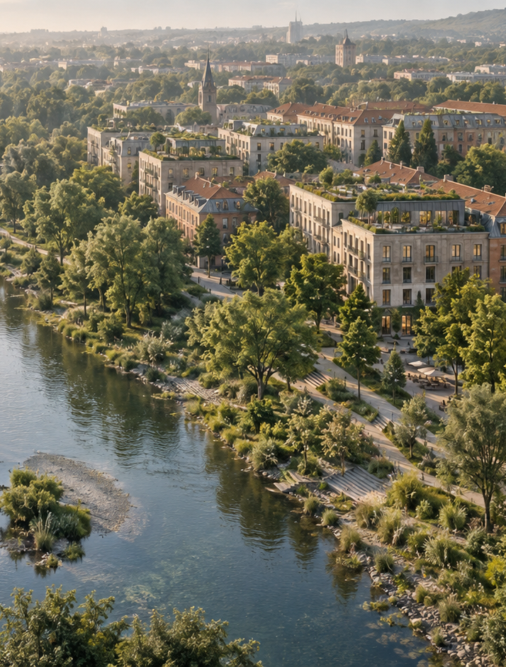

Applied Sustainability
in Business and
Management
Lecture 5 — Stakeholder
Engagement, Communication and
Smart Cities
Ing. Arch. Jenan Hussein, MSc, PhD
jenanhussein83@gmail.com
Notes:
Lecture 5, slide 1: Applied Sustainability in Business and Management
Suggested time: 1 min
Say: Welcome. Say: so far we measured things; today we deal with people — the ones who can stop a project or carry it — and with how we talk to them.
Decorative artwork reused from the approved Lecture 1 design. AI-generated with OpenAI, September 2026; not a photograph of a documented place.

Slide 2

Learning Objectives
By the end of this lecture you will be able to:
01
Identify stakeholders affected by a
business or GI project.
05
Write evidence-based claims and
recognize greenwashing.
02
Use power and interest to plan
engagement.
06
Explain how data supports smart GI
management.
03
Choose an appropriate level of
participation.
07
Propose a Prague pilot with an
owner, budget and outcome.
04
Apply stakeholder mapping to a
Prague development debate.
www.newton.university
02
Notes:
Lecture 5, slide 2: Learning Objectives
Suggested time: 3 min
Say: Read the seven objectives. Connect each to a decision a manager needs to make. The first half introduces the tools and business problem; the second half applies them to the cases and activities. Students will use the same tools for their Prague semester site.

Slide 3
Today's Lecture Agenda
Before the break
After the break
Part 1 — Stakeholder Theory
Part 4 — Communicating Sustainability
Part 2 — Public Participation and
Governance
Part 5 — Greenwashing and How to Avoid It
Part 6 — Smart Cities and Smart Green
Infrastructure
Part 3 — Prague: Development vs Green
Space Debates
City Tour — Singapore, Copenhagen,
Rotterdam, Barcelona, Vienna
Activity — Stakeholder Mapping
Prague Opportunities
Key Messages and Reading
www.newton.university
03
Notes:
Lecture 5, slide 3: Today's Lecture Agenda
Suggested time: 2 min
Say: Six parts. The activity before the break is long (25 minutes) and important for the project.

Slide 4
Part 1
Stakeholder Theory
01
www.newton.university
04
Notes:
Lecture 5, slide 4: Part 1 — Stakeholder Theory
Suggested time: 1 min
Say: Announce the part.

Slide 5
Who is a Stakeholder?
Freeman (1984)
For urban sustainability, that
includes
A stakeholder is any group or individual
who can affect, or is affected by, the
achievement of the organization's
objectives.
Citizens and neighborhood
associations
Municipal government and city districts
Businesses, developers and investors
NGOs, universities — and future
generations
www.newton.university
05
Notes:
Lecture 5, slide 5: Who is a Stakeholder?
Suggested time: 8 min
Say: Freeman's definition from 1984: anyone who can affect, or is affected by, what the organisation does. For a green project in a city that means residents and neighbourhood groups, the city and district offices, businesses, developers and investors, NGOs and universities — and future generations, who cannot speak for themselves. Ask students to name stakeholders of a new park in their district; they will forget some, which is the point.

Slide 6
The Power–Interest Grid
Position determines the engagement strategy:
High power, high interest
High power, low interest
Manage closely
Keep satisfied
e.g. city hall, major developer
e.g. national regulator
Low power, high interest
Low power, low interest
Keep informed, amplify
Monitor
e.g. residents, local NGOs
e.g. occasional visitors
www.newton.university
06
Notes:
Lecture 5, slide 6: The Power–Interest Grid
Suggested time: 10 min
Say: Draw the 2×2 grid on the board. High power and high interest — manage closely: city hall, a major developer. High power, low interest — keep satisfied: a national regulator. Low power, high interest — keep informed and give them a voice: residents, local NGOs. Low power, low interest — just monitor: occasional visitors. The position tells you what to do; that is why the grid is useful. Warn: people move between boxes — residents with low power become high power when they organise.
Ask: Where would you put the local newspaper? (Often high interest, and its power depends on the story.)

Slide 7
Part 2
Public Participation and
Governance
02
www.newton.university
07
Notes:
Lecture 5, slide 7: Part 2 — Public Participation and Governance
Suggested time: 1 min
Say: Announce the part.

Slide 8
Levels of Participation (IAP2 Spectrum)
Increasing public influence on the decision
Discussion
Informing — one-way communication.
Which level can this
project genuinely
offer, and who retains
the final decision?
Consultation — opinions collected, decisions
elsewhere.
Involvement — stakeholders shape options.
Collaboration — shared decisions.
Empowerment — community decides (e.g.
participatory budgeting).
www.newton.university
08
Notes:
Lecture 5, slide 8: Levels of Participation (IAP2 Spectrum)
Suggested time: 8 min
Say: These five levels are the IAP2 Spectrum, distinct from Arnstein’s eight-rung ladder. Inform, consult, involve, collaborate and empower describe different promises to the public. Match the promise to the legal decision-maker and the project. Do not promise a shared decision if the sponsor will only collect opinions.
Ask: Which level is feasible for this company project, and how would you communicate that?
Sources checked 5 October 2026:
https://www.iap2.org/page/pillars

Slide 9
Why Participation Improves Projects
Local knowledge surfaces problems experts
miss.
The cost of skipping
it
Early involvement can reveal concerns and
reduce avoidable delays.
Projects imposed
without engagement
meet petitions,
protests and courts —
often losing years and
budgets.
Shared ownership means better maintenance
and care.
Legitimacy: decisions have a clearer and more
transparent basis.
www.newton.university
09
Notes:
Lecture 5, slide 9: Why Participation Improves Projects
Suggested time: 8 min
Say: Participation can reveal local knowledge, expose concerns and support long-term care. It can reduce avoidable delays, but cannot guarantee agreement or prevent legal challenge. Treat it as part of risk management and a fair decision process. Ask what the project sponsor must do with the feedback received.

Slide 10

Part 3
Prague Debates
www.newton.university
10
Notes:
Lecture 5, slide 10: Part 3 — Prague Debates
Suggested time: 1 min
Say: Announce the part.
Decorative artwork reused from the approved Lecture 1 design. AI-generated with OpenAI, September 2026; not a photograph of a documented place.

Slide 11
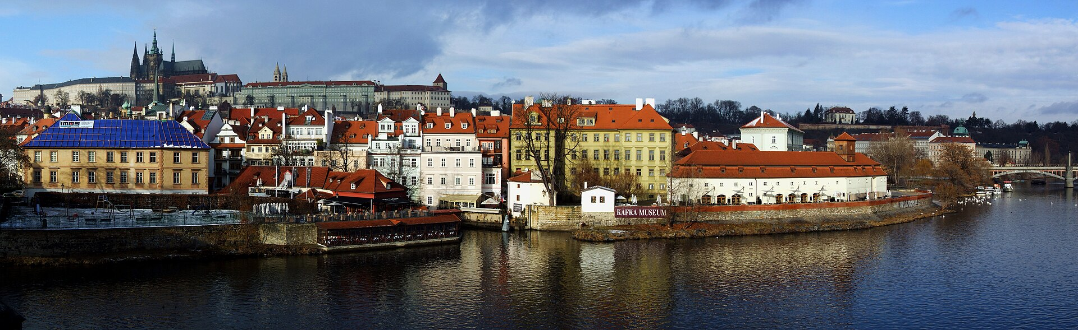
Prague: Where Interests Collide
Recurring public debates
Densification projects near parks and the river.
Protection of green wedges against
construction.
Riverfront redevelopment: recreation vs
commercial use.
Observation
Every debate is a stakeholder map waiting to
be drawn.
Riverfront, parks, development — everyone has
a stake
www.newton.university
11
Notes:
Lecture 5, slide 11: Prague: Where Interests Collide
Suggested time: 8 min
Say: Three recurring Prague debates: building near parks and the river, protecting green wedges from construction, and riverbank redevelopment — recreation versus commercial use. Use the current news story you brought. Ask students to name the stakeholders in it and put two of them on the grid. Observation for them: every public fight is a stakeholder map waiting to be drawn.
Image credit: Prague - view from Charles Bridge (by Pudelek).jpg — CC BY-SA 3.0, Wikimedia Commons
https://commons.wikimedia.org/wiki/File:Prague_-_view_from_Charles_Bridge_(by_Pudelek).jpg
Source image retained from the original lecture.

Slide 12
Activity: Map Your Site's Stakeholders
For your semester case-study site:
25
List every stakeholder: residents, businesses,
municipality, tourists, NGOs.
Place them on the power–interest grid.
For the top three: what do they want, what do they
fear?
minutes
Choose an engagement approach for each.
Project groups
feeds directly into Seminar 4
www.newton.university
12
Notes:
Lecture 5, slide 12: Activity: Map Your Site's Stakeholders
Suggested time: 25 min
Say: Project groups list every stakeholder of their semester site, place them on the grid, and for the top three write what they want, what they fear and how to engage them. This goes straight into Seminar 4 and the paper. Details in section 3.

Slide 13
Break
Second half — Sustainability Communication, Smart Cities
and Green Infrastructure
www.newton.university
13
Notes:
Lecture 5, slide 13: Break
Suggested time: 15–20 min
Say: After the break: how to talk about sustainability without lying, and what smart cities do with data.

Slide 14
Part 4
Communicating Sustainability
04
www.newton.university
14
Notes:
Lecture 5, slide 14: Part 4 — Communicating Sustainability
Suggested time: 1 min
Say: Announce the part.

Slide 15
Principles of Credible Communication
Be specific: a claim needs a metric, boundary,
baseline and period.
Discussion
Find a sustainability
claim in an ad you
have seen recently.
Would it survive these
tests?
Evidence attached: data, methodology,
third-party verification.
Whole picture: report the misses, not only the
wins.
Audience-fit: investors need numbers, citizens
need stories, both need honesty.
www.newton.university
15
Notes:
Lecture 5, slide 15: Principles of Credible Communication
Suggested time: 12 min
Say: A credible claim states what changed, where, over which period and using what evidence. Include limits and missed targets. Tailor the explanation to the audience without changing the facts. Any numerical wording used in this exercise is fictional until supported by real data.
Ask: Take a claim from an advertisement and identify the missing evidence.

Slide 16
Part 5
Greenwashing
05
www.newton.university
16
Notes:
Lecture 5, slide 16: Part 5 — Greenwashing
Suggested time: 1 min
Say: Announce the part.

Slide 17
The Seven Sins of Greenwashing
TerraChoice's teaching taxonomy for recognizing misleading claims:
Common sins
Worse sins
Hidden trade-off
Lesser of two evils
No proof
Fibbing
Vagueness
False labels
Irrelevance
www.newton.university
17
Notes:
Lecture 5, slide 17: The Seven Sins of Greenwashing
Suggested time: 8 min
Say: Use TerraChoice’s seven sins as a teaching checklist, not a legal test. Explain hidden trade-off, no proof, vagueness, irrelevance, lesser of two evils, fibbing and false labels with clearly hypothetical examples. The actual legal requirements come from the applicable rules discussed next.

Slide 18
Environmental Claims and EU Rules
Directive (EU) 2024/825: national measures
apply from 27 September 2026.
Management action
Check the specific
wording, evidence
and applicable
national rules before
publication.
Generic environmental claims require
recognized excellent environmental
performance.
Product climate claims based on offsetting
emissions are prohibited.
www.newton.university
18
Notes:
Lecture 5, slide 18: Environmental Claims and EU Rules
Suggested time: 10 min
Say: Directive (EU) 2024/825 tightens consumer-facing claims. Generic claims need recognized excellent environmental performance relevant to the claim; an arbitrary company document is not enough. It also prohibits claims that a product has neutral, reduced or positive greenhouse-gas impact when based on offsetting. Sustainability labels must meet the directive’s conditions. National measures apply from 27 September 2026. Keep this distinct from CSRD reporting and from the separate Green Claims proposal.
Tip: Check national implementation for a real advertisement or penalty question.
Sources checked 5 October 2026:
https://eur-lex.europa.eu/eli/dir/2024/825/oj/eng

Slide 19
Part 6
Smart Cities and
Smart GI
www.newton.university
19
Notes:
Lecture 5, slide 19: Part 6 — Smart Cities and Smart GI
Suggested time: 1 min
Say: Announce the part.
Decorative artwork reused from the approved Lecture 1 design. AI-generated with OpenAI, September 2026; not a photograph of a documented place.

Slide 20
What Makes a City 'Smart'?
Definition
Smart Green Infrastructure
A city that uses data and technology to
improve services, sustainability and
quality of life.
Sensors monitor soil moisture,
temperature and air quality in real time.
Smart irrigation waters only when
needed.
Digital twins simulate floods, heat and
planting scenarios before investing.
Dashboards show results, methods and
gaps for public scrutiny.
www.newton.university
20
Notes:
Lecture 5, slide 20: What Makes a City 'Smart'?
Suggested time: 6 min
Say: A smart city uses data and technology to run its services better. Smart Green Infrastructure means: sensors measure soil moisture, temperature and air quality live; irrigation runs only when needed; digital twins simulate floods, heat and planting before money is spent; open dashboards let citizens see the results and trust them. Connect to Lecture 4: this is where the KPIs get their data.

Slide 21
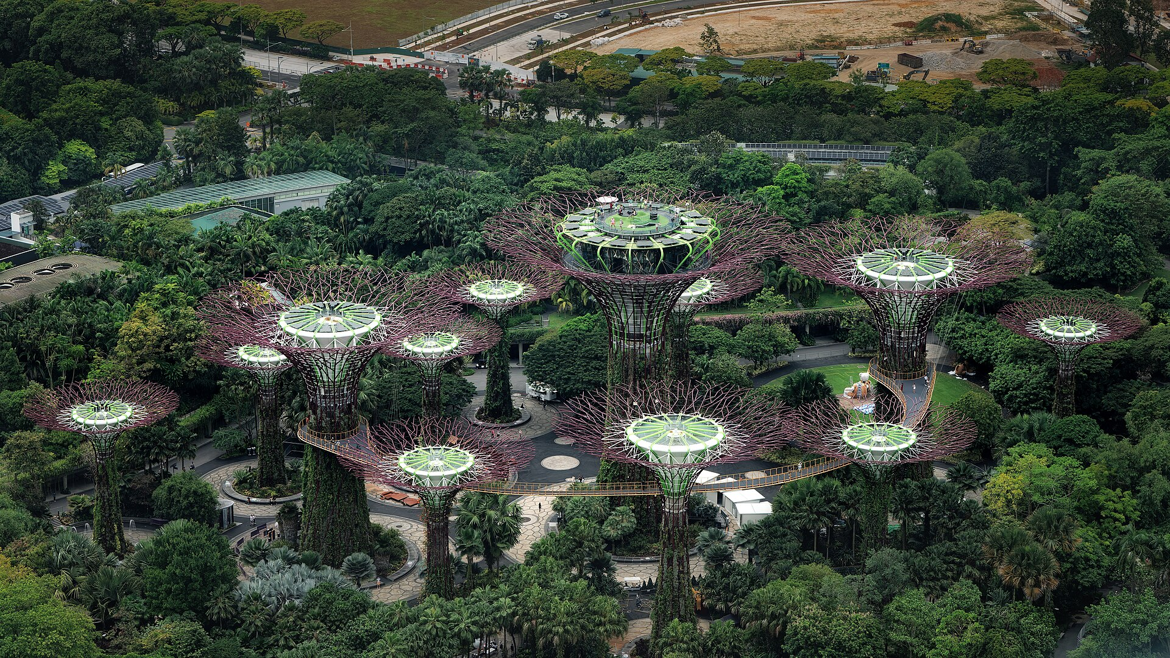
Singapore: Nature and Building Operations
Some Supertrees use photovoltaic cells;
others support ventilation.
Water and energy systems link the
landscape with site operations.
For a business: specify the operating
outcome before buying technology.
Gardens by the Bay: engineered systems and
planting at one site
www.newton.university
21
Notes:
Lecture 5, slide 21: Singapore: Nature and Building Operations
Suggested time: 4 min
Say: Use the documented site functions at Gardens by the Bay. Some Supertrees harvest solar energy; others support conservatory ventilation. This demonstrates integration at a particular site, not an island-wide smart-irrigation system.
Ask: For a Prague hotel or office, would the first priority be water use, cooling or maintenance, and what data would help?
Image credit: Supertree Grove, Gardens by the Bay, Singapore1.jpg — CC0, Wikimedia Commons
https://commons.wikimedia.org/wiki/File:Supertree_Grove%2C_Gardens_by_the_Bay%2C_Singapore1.jpg
Source image retained from the original lecture.
Sources checked 5 October 2026:
https://www.gardensbythebay.com.sg/en/the-gardens/sustainability-efforts.html

Slide 22
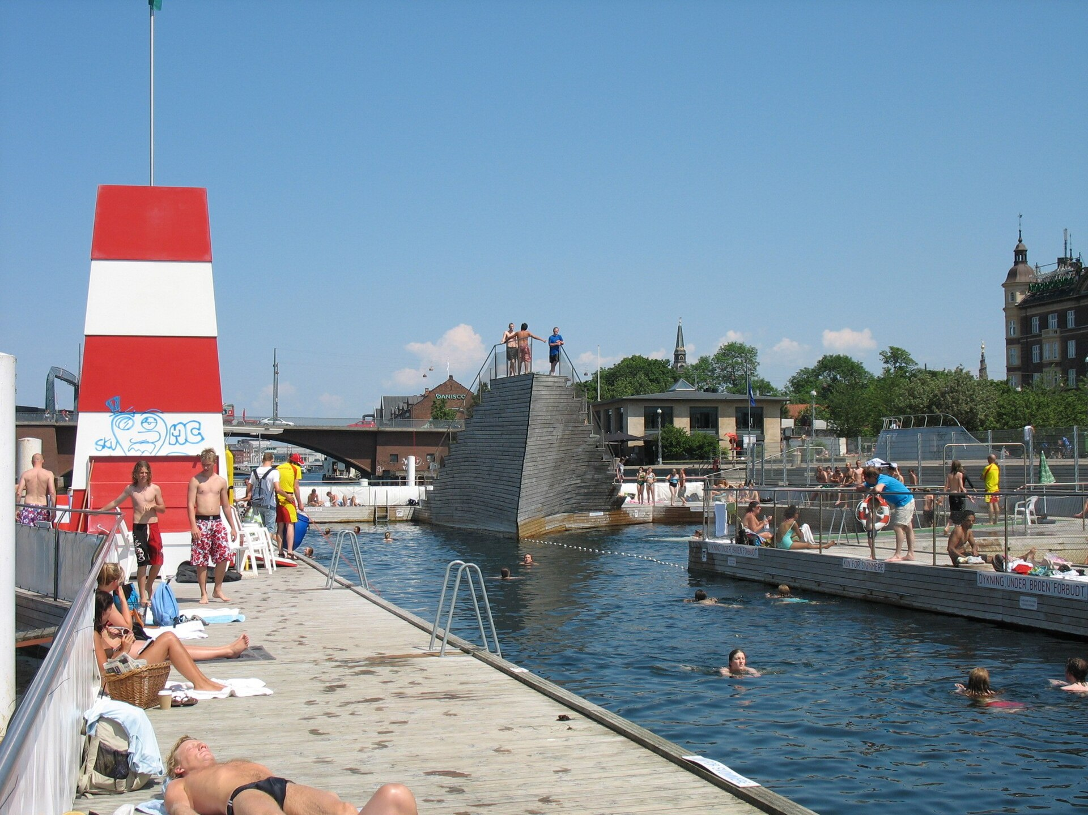
Copenhagen: Managing Cloudburst Risk
The cloudburst plan combines surface
routes, storage and drainage.
Rainfall and flood models help prioritize
investment.
For a company: examine access, drainage
and flood exposure together.
Copenhagen harbour bath: public-waterfront
context, not a cloudburst installation
www.newton.university
22
Notes:
Lecture 5, slide 22: Copenhagen: Managing Cloudburst Risk
Suggested time: 4 min
Say: Revisit Copenhagen through the management and data perspective. Flood modelling helps decide where water should move or be stored. The harbour-bath photograph illustrates waterfront public space, not a particular cloudburst asset. Avoid promising that surface measures are always cheaper than sewers; compare alternatives for the same service level.
Image credit: Harbour Bath, Islands Brygge.jpg — CC BY 2.0, Wikimedia Commons
https://commons.wikimedia.org/wiki/File:Harbour_Bath%2C_Islands_Brygge.jpg
Source image retained from the original lecture.

Slide 23
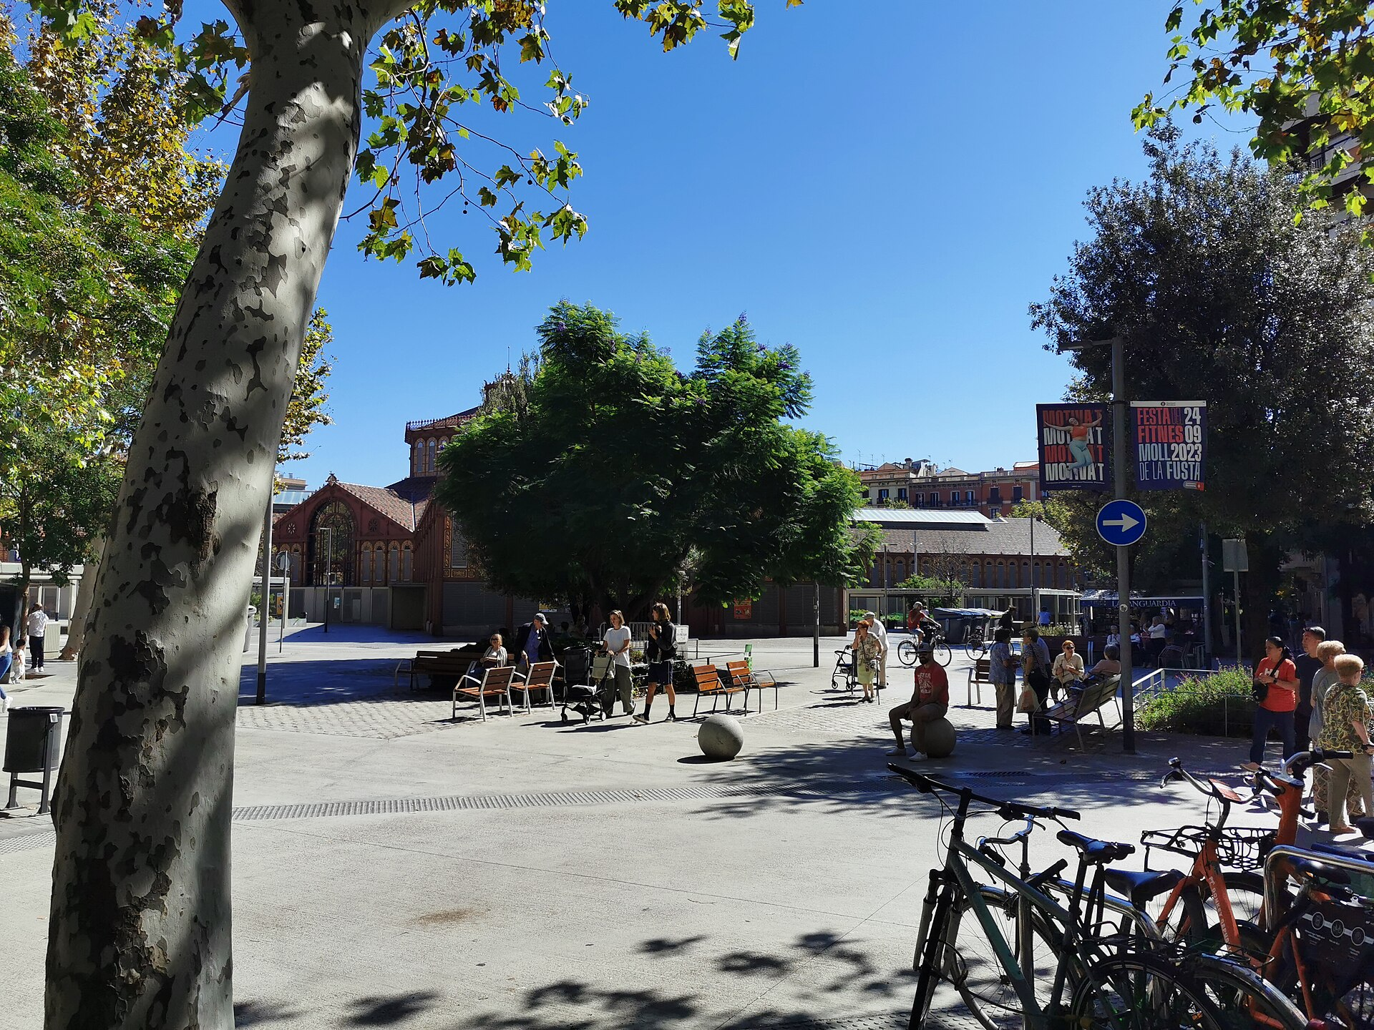
Rotterdam and Barcelona: Decisions to Measure
Rotterdam
Water squares combine public use with stormwater
storage.
Barcelona
Superblocks reduce through-traffic in selected areas.
Management question
How do we test effects on access, trade, comfort and
maintenance? Compare local data before claiming
results.
Barcelona superblock: a public-space and
mobility case
www.newton.university
23
Notes:
Lecture 5, slide 23: Rotterdam and Barcelona: Decisions to Measure
Suggested time: 5 min
Say: Keep both cases, but use this return to ask about decisions and measurement. Rotterdam illustrates shared space and water management; Barcelona illustrates traffic and public-space change. Claims about sales, pollution or walking need a named evaluation and location.
Ask: What baseline would nearby businesses and residents accept?
Image credit: Superilla del barri de Sant Antoni, Barcelona 2.jpg — CC BY-SA 4.0, Wikimedia Commons
https://commons.wikimedia.org/wiki/File:Superilla_del_barri_de_Sant_Antoni%2C_Barcelona_2.jpg
Source image retained from the original lecture.

Slide 24
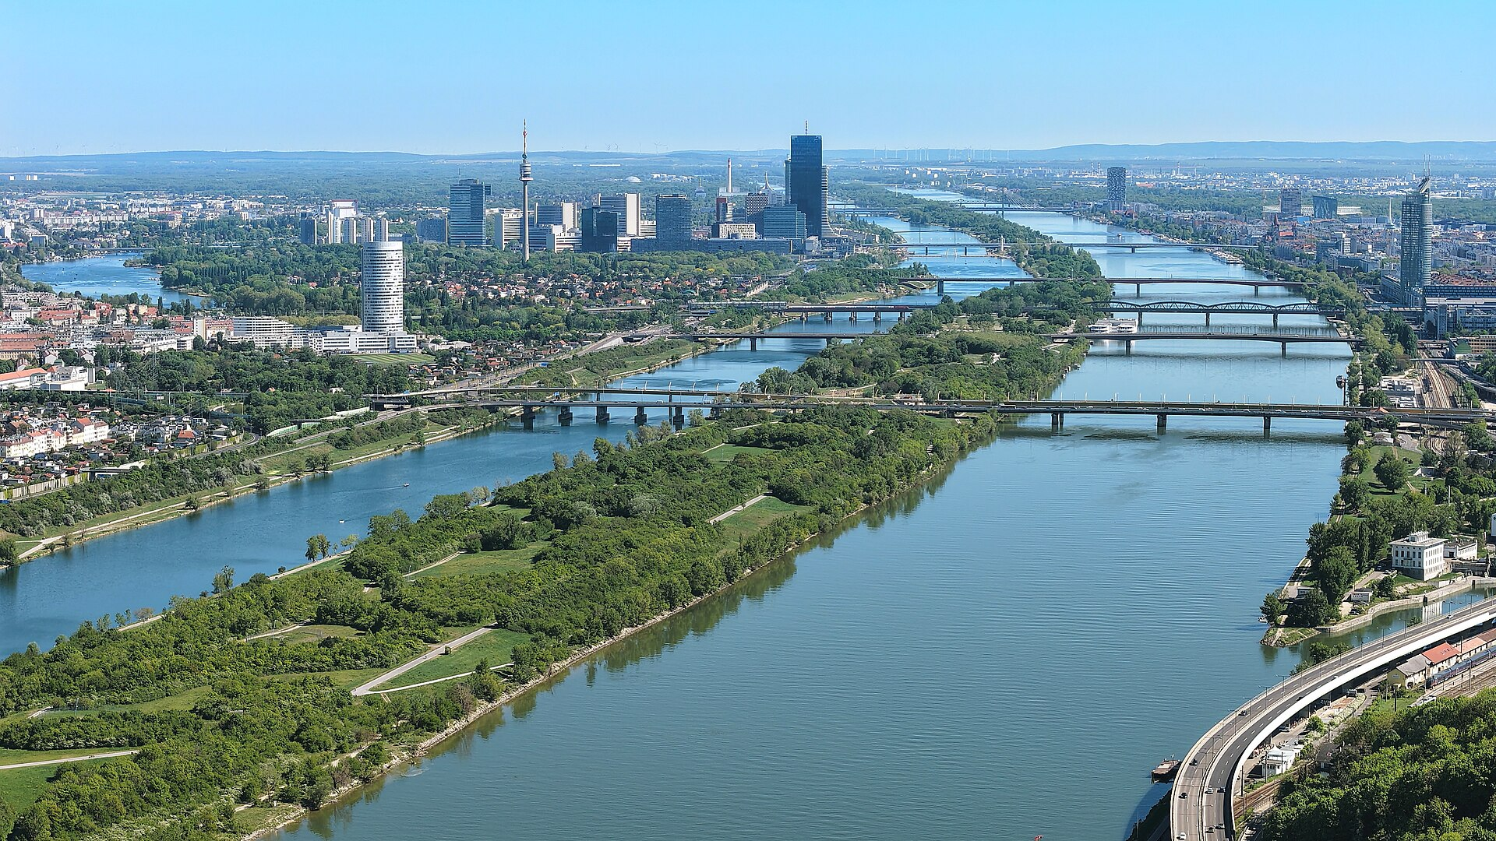
Vienna — and Prague's Opportunity
Vienna
The Danube Island combines flood protection
and public recreation.
Prague's opening
Strong natural assets: river, wooded valleys,
large parks.
Climate Plan 2030 creates the policy frame.
Opportunity to investigate: where would better
data improve site management?
Vienna's Danube Island: green corridor, flood
defence, playground
www.newton.university
24
Notes:
Lecture 5, slide 24: Vienna — and Prague's Opportunity
Suggested time: 6 min
Say: Vienna’s Danube Island shows multiple uses of a green asset. Prague has natural assets and city plans, but do not assume it lacks digital systems. Students should first inspect existing data, responsible teams and operating problems, then propose a pilot only where it fills an evidenced gap.
Ask: Which decision would change because of the proposed sensor or dashboard?
Image credit: Wien - Donauinsel mit den Donaubrücken.JPG — CC BY-SA 4.0, Wikimedia Commons
https://commons.wikimedia.org/wiki/File:Wien_-_Donauinsel_mit_den_Donaubr%C3%BCcken.JPG
Source image retained from the original lecture.

Slide 25
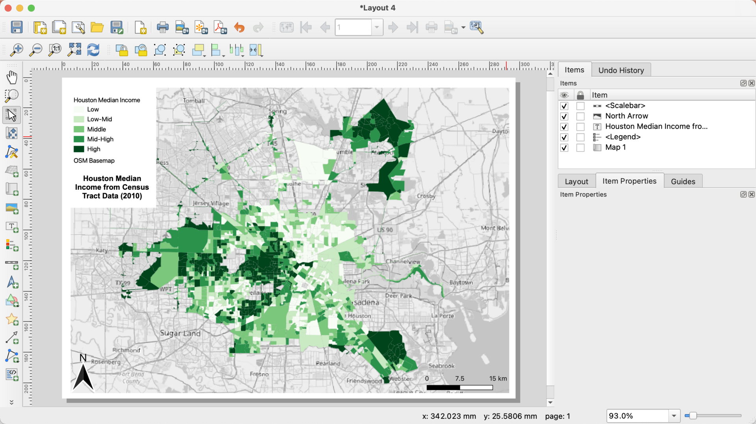
The Technology Stack
GIS: QGIS, ArcGIS — where is the green,
who can reach it?
IoT sensors — what needs action, and who
maintains the devices?
Digital twins — what happens if we change
it?
Power BI dashboards — is the strategy
working?
A useful system connects each data source to
an operating decision
www.newton.university
25
Notes:
Lecture 5, slide 25: The Technology Stack
Suggested time: 5 min
Say: Four layers, from maps to decisions. GIS: where is the green, who can reach it. Sensors: how is it performing right now. Digital twins: what happens if we change it. Dashboards: is the strategy working. Students only need to know the four layers and what question each answers.
Image credit: QGIS Interface Screenshot with Map of Median Income in Houston (2010).png — CC0, Wikimedia Commons
https://commons.wikimedia.org/wiki/File:QGIS_Interface_Screenshot_with_Map_of_Median_Income_in_Houston_(2010).png
Source image retained from the original lecture.

Slide 26
Key Messages
01
Stakeholders can stop a project —
or carry it.
05
Credible communication is specific,
evidenced and complete.
02
The power–interest grid turns a
crowd into a strategy.
06
Greenwashing is now a legal risk,
not just a PR risk.
03
Real participation beats consultation
theatre.
07
Smart cities make Green
Infrastructure measurable and
manageable.
04
Prague's green space debates are
live case material for your project.
08
Prague pilots should fill evidenced
gaps and have an operating owner.
www.newton.university
26
Notes:
Lecture 5, slide 26: Key Messages
Suggested time: 4 min
Say: Work through the eight messages. Ask students to connect each to a decision, example or tool from this lecture. Distinguish potential benefits from measured results.

Slide 27
Recommended Reading
Freeman, R. E. (1984). Strategic Management: A Stakeholder Approach.
Seminar 4 preview
Arnstein, S. (1969). A Ladder of Citizen Participation. JAIP 35(4).
Communicating
sustainability for your
case-study site's
stakeholders.
Institute of Planning and Development Prague (IPR) — participation
manual.
European Commission — Directive (EU) 2024/825 on empowering
consumers for the green transition.
Next lecture
City of Copenhagen — Cloudburst Management Plan.
ESG, Regulation and the
Future of Urban
Development.
Ajuntament de Barcelona — Superblock programme evaluations.
IAP2 — Spectrum of Public Participation (iap2.org).
www.newton.university
27
Notes:
Lecture 5, slide 27: Recommended Reading
Suggested time: 2 min
Say: Point to the Seminar 4 preview: communicating sustainability for their site's stakeholders. Next lecture is the last one: ESG, regulation and the future of urban development.

Slide 28
Any
questions?
www.newton.university
28
Notes:
Lecture 5, slide 28: Any questions?
Suggested time: 5 min
Say: Take questions.
Decorative artwork reused from the approved Lecture 1 design. AI-generated with OpenAI, September 2026; not a photograph of a documented place.

Slide 29
Image credits
Prague - view from Charles Bridge (by Pudelek).jpg — CC BY-SA 3.0, Wikimedia Commons
Supertree Grove, Gardens by the Bay, Singapore1.jpg — CC0, Wikimedia Commons
Harbour Bath, Islands Brygge.jpg — CC BY 2.0, Wikimedia Commons
Superilla del barri de Sant Antoni, Barcelona 2.jpg — CC BY-SA 4.0, Wikimedia Commons
Wien - Donauinsel mit den Donaubrücken.JPG — CC BY-SA 4.0, Wikimedia Commons
QGIS Interface Screenshot with Map of Median Income in Houston (2010).png — CC0, Wikimedia Commons
Conceptual cover and leaf artwork: OpenAI image generation, September 2026. Reused from approved Lecture 1.
www.newton.university
29
Notes:
Lecture 5, slide 29: Image credits
Say: No need to show.

