Slide 1
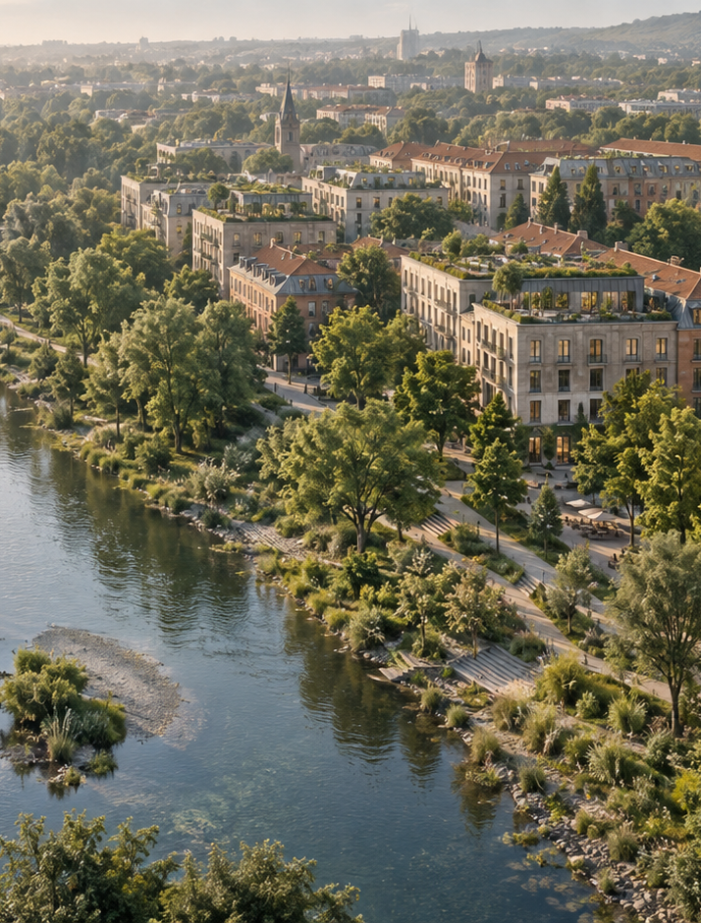

Applied Sustainability
in Business and
Management
Lecture 6 — ESG, Regulation and the
Future of Urban Development
Ing. Arch. Jenan Hussein, MSc, PhD
jenanhussein83@gmail.com
Notes:
Lecture 6, slide 1: Applied Sustainability in Business and Management
Suggested time: 1 min
Say: Welcome to the last lecture. Say that today you connect everything to the two forces that make sustainability compulsory: investors and the law. And you finish with the future of Prague.
Decorative artwork reused from the approved Lecture 1 design. AI-generated with OpenAI, September 2026; not a photograph of a documented place.

Slide 2

Learning Objectives
By the end of this lecture you will be able to:
01
Explain ESG and the limits of
investor ratings.
05
Compare finance options using
eligibility, costs and reporting.
02
Distinguish CSRD, ESRS and
double materiality.
06
Assess nature-positive and smart
development proposals.
03
Design GI indicators with evidence
and accountability.
07
Defend a Prague 2035 proposal
using evidence from the course.
04
Map the EU rules relevant to a
company and its projects.
www.newton.university
02
Notes:
Lecture 6, slide 2: Learning Objectives
Suggested time: 3 min
Say: Read the seven objectives. Connect each to a decision a manager needs to make. The first half introduces the tools and business problem; the second half applies them to the cases and activities. Students will use the same tools for their Prague semester site.

Slide 3
Today's Lecture Agenda
Before the break
After the break
Part 1 — The ESG Framework
Part 4 — The European Regulatory
Landscape
Part 2 — Reporting and Materiality
Part 5 — Sustainable Finance
Part 3 — Green Infrastructure in ESG
Part 6 — Future Trends in Urban Development
Practical Exercise — ESG Indicators for
a Prague GI Project
Final Discussion — Prague 2035
Course Wrap-Up
Key Messages and Reading
www.newton.university
03
Notes:
Lecture 6, slide 3: Today's Lecture Agenda
Suggested time: 2 min
Say: Six parts, an exercise before the break, the Prague 2035 discussion and the course wrap-up at the end.

Slide 4
Part 1
The ESG Framework
01
www.newton.university
04
Notes:
Lecture 6, slide 4: Part 1 — The ESG Framework
Suggested time: 1 min
Say: Announce the part.

Slide 5
What is ESG?
A framework for assessing environmental, social and governance issues, including
their financial effects:
Environmental
Social
Governance
Climate and emissions
Employees and
communities
Board oversight
Water and resources
Transparency and ethics
Health and safety
Biodiversity and land use
Stakeholder rights
Human rights
www.newton.university
05
Notes:
Lecture 6, slide 5: What is ESG?
Suggested time: 8 min
Say: ESG is a lens investors use. Three pillars. Environmental: climate and emissions, water and resources, biodiversity and land use. Social: employees and communities, health and safety, human rights. Governance: board oversight, transparency and ethics, stakeholder rights. Say that ESG is not the same as sustainability — it is sustainability seen from the investor's chair: which of these could cost us money?

Slide 6
Why Investors Care
ESG risks are financial risks: floods
close factories, scandals sink brands.
But note the critique
Ratings disagree with each other;
'ESG' can hide box-ticking.
Investors may use ESG information in
risk and allocation decisions.
Discussion: is a high ESG score the
same thing as being sustainable?
Ratings such as MSCI and
Sustainalytics use different methods.
www.newton.university
06
Notes:
Lecture 6, slide 6: Why Investors Care
Suggested time: 10 min
Say: Environmental and social issues can affect cash flow, disruption and reputation. Investors use different ESG approaches, so a rating is not a universal sustainability verdict or a guaranteed financing discount. Ask students to examine what a rating actually measures.
Ask: Can a company manage its financial risks well while still causing serious harm?

Slide 7
Part 2
Reporting and Materiality
02
www.newton.university
07
Notes:
Lecture 6, slide 7: Part 2 — Reporting and Materiality
Suggested time: 1 min
Say: Announce the part.

Slide 8
CSRD, ESRS and Double Materiality
CSRD scope
ESRS and evidence
Double materiality
2026 EU amendment:
more than 1,000
employees and over
€450m net annual
turnover for the main
EU-company scope.
Standards set the
reporting requirements.
Assess impacts on
people and nature, and
financial risks or
opportunities. Either
perspective can make a
matter material.
Sustainability statements
are subject to limited
assurance.
Check entity, group,
transition and national
application rules.
www.newton.university
08
Notes:
Lecture 6, slide 8: CSRD, ESRS and Double Materiality
Suggested time: 14 min
Say: Separate scope, content and evidence. The 2026 amendment narrows the main EU-company reporting scope, while group, non-EU, transition and national rules need separate checking. ESRS describe the reporting content. Limited assurance on sustainability statements is different from the reasonable assurance normally associated with a financial-statement audit. For materiality, assess both directions; a matter can be material from either one.
Tip: Use the dated official sources below and check the specific company and reporting year before making a compliance judgement.
Sources checked 5 October 2026:
https://www.consilium.europa.eu/en/press/press-releases/2026/02/24/council-signs-off-simplification-of-sustainability-reporting-and-due-diligence-requirements-to-boost-eu-competitiveness/
https://knowledgehub.efrag.org/eng/interactive/ig/ig1/09-2025/75
https://eur-lex.europa.eu/eli/dir/2026/470/oj/eng

Slide 9

Part 3
Green Infrastructure
in ESG
www.newton.university
09
Notes:
Lecture 6, slide 9: Part 3 — Green Infrastructure in ESG
Suggested time: 1 min
Say: Announce the part.
Decorative artwork reused from the approved Lecture 1 design. AI-generated with OpenAI, September 2026; not a photograph of a documented place.

Slide 10
How GI Shows Up in Each Pillar
E
S
G
Carbon sequestration
Community wellbeing
Stakeholder participation
Stormwater management
Employee health
Transparent monitoring
Biodiversity gains (ESRS
E4)
Access to green space
Partnerships with city and
NGOs
Heat protection for
vulnerable groups
Climate adaptation of
assets
www.newton.university
10
Notes:
Lecture 6, slide 10: How GI Shows Up in Each Pillar
Suggested time: 7 min
Say: Take a green roof or a company park and walk through the pillars. E: carbon stored, stormwater managed, biodiversity gains (this is exactly what ESRS E4 asks for), climate adaptation of the asset. S: community wellbeing, employee health, access to green space, heat protection for vulnerable people. G: stakeholder participation, transparent monitoring, partnerships with the city and NGOs. One project, three pillars.

Slide 11
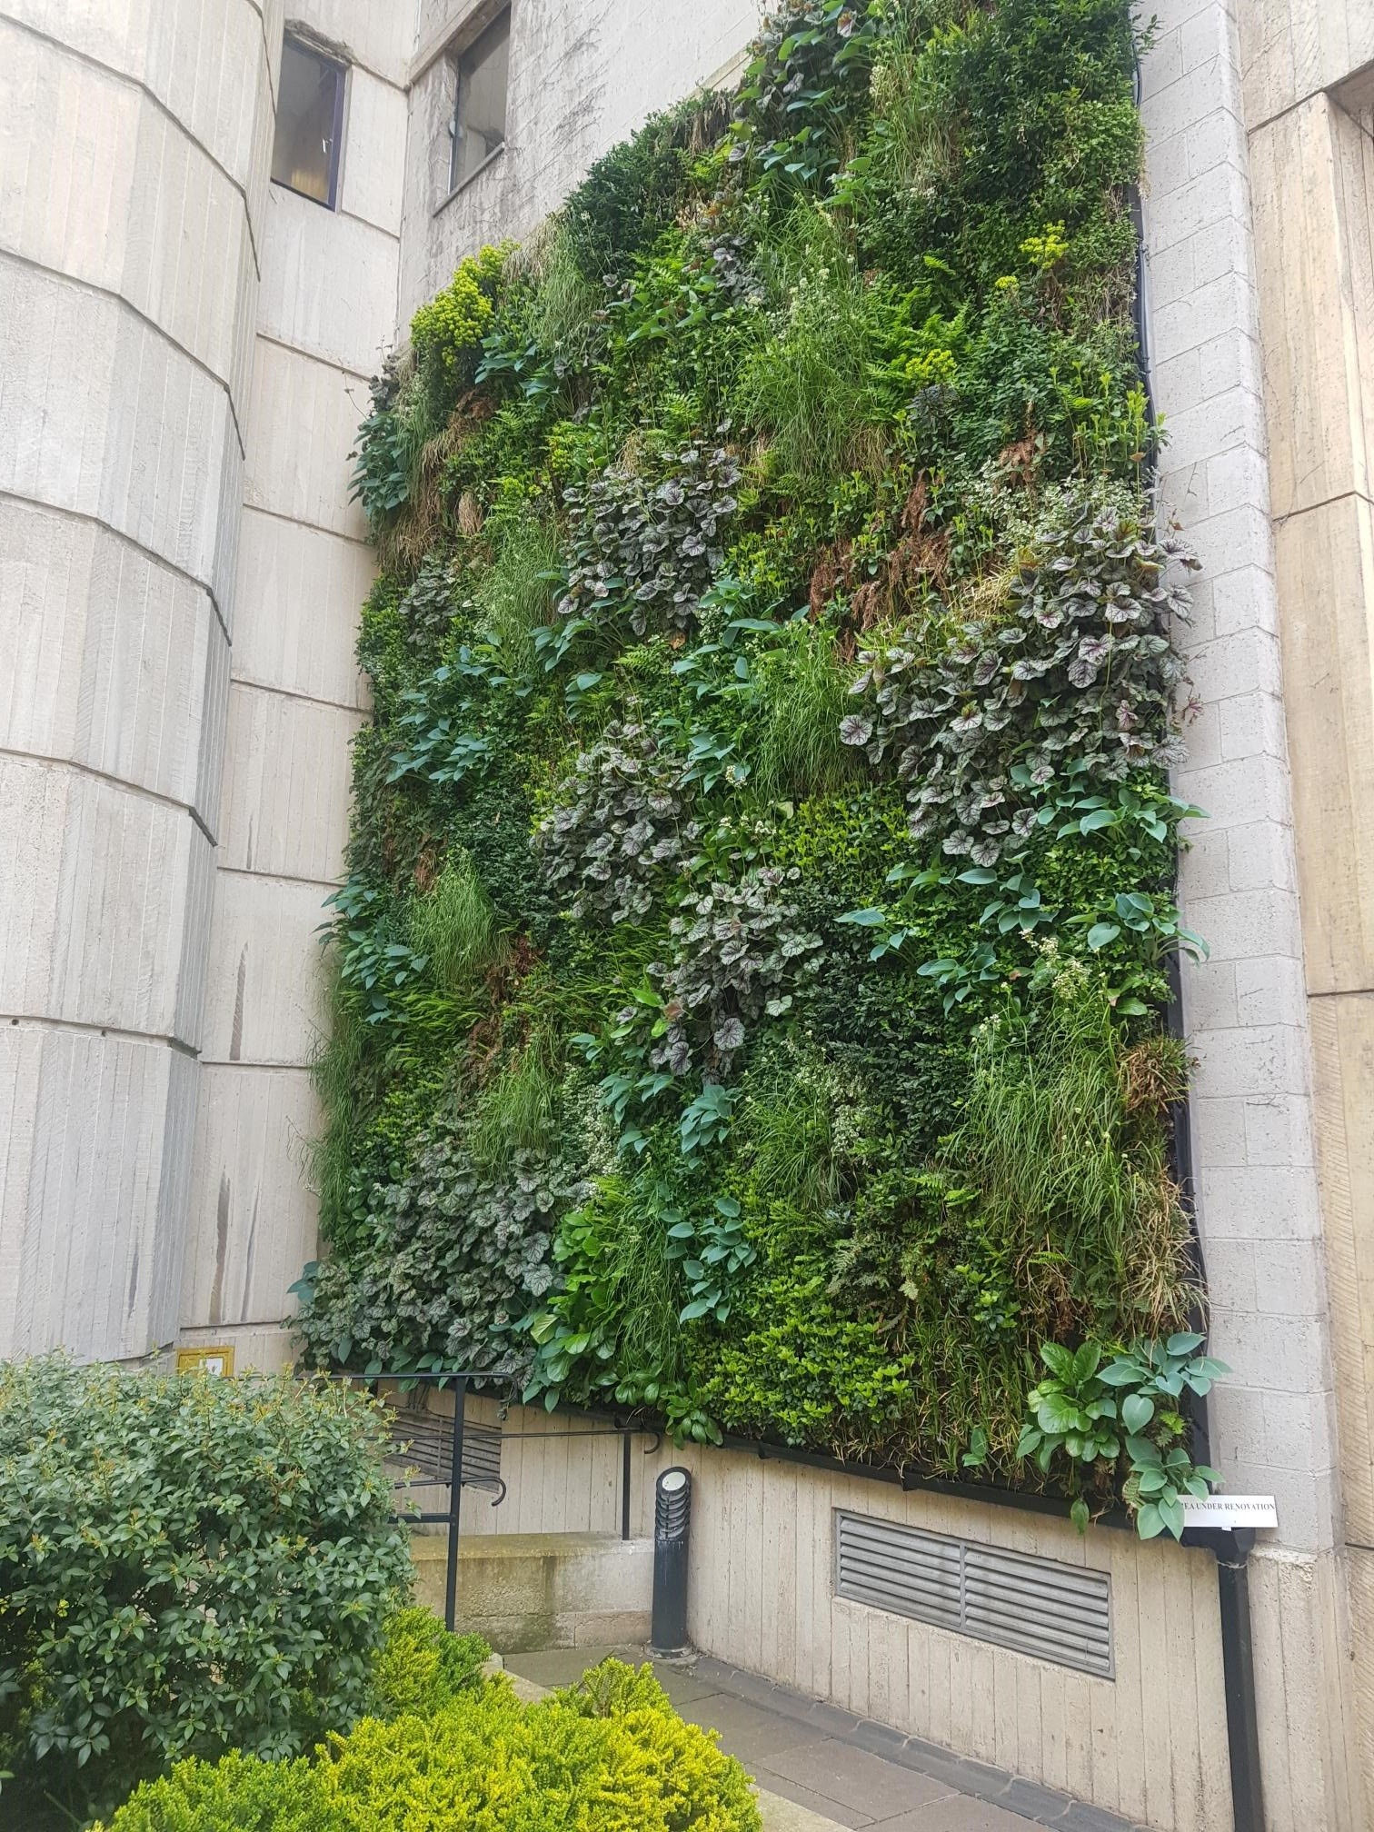
GI in a Company Sustainability Report
Evidence to collect
A baseline, defined boundary and measurement method
Observed outcomes, costs and maintenance records
A named owner and review process
Materiality first
A photograph proves an installation exists. It does not
prove biodiversity gains, carbon removal or a material
improvement across the company.
www.newton.university
11
Notes:
Lecture 6, slide 11: GI in a Company Sustainability Report
Suggested time: 6 min
Say: A photograph is evidence of an asset, not of its impact. The report needs an appropriate baseline, measurements, methods and controls. A project may be relevant to adaptation or biodiversity disclosures when material, but it does not automatically satisfy ESRS or offset unrelated impacts.
Ask: What would an independent reviewer need to verify this claim?
Image credit: St Edmund Hall Living Wall.jpg — CC BY-SA 4.0, Wikimedia Commons
https://commons.wikimedia.org/wiki/File:St_Edmund_Hall_Living_Wall.jpg
Source image retained from the original lecture.
Sources checked 5 October 2026:
https://knowledgehub.efrag.org/eng/interactive/ig/ig1/09-2025/75

Slide 12
Practical Exercise: ESG Indicators
Imagine a company invests in a GI project at
your site. Define:
30
Three E indicators (with units and data sources).
Two S indicators (who benefits, how measured).
Two G indicators (who decides, who verifies).
minutes
One sentence for the annual report — specific,
evidenced, no greenwash.
Project groups
use your semester
case-study site
www.newton.university
12
Notes:
Lecture 6, slide 12: Practical Exercise: ESG Indicators
Suggested time: 30 min
Say: Project groups imagine a company investing in a GI project at their site and define three E indicators, two S, two G, and one honest sentence for the annual report. Details in section 3. This is the last building block of the seminar paper.

Slide 13
Break
Second half — Sustainability Regulation and Future Urban
Development
www.newton.university
13
Notes:
Lecture 6, slide 13: Break
Suggested time: 15–20 min
Say: After the break: the law above the reports, the money, and the future.

Slide 14
Part 4
The European Regulatory
Landscape
04
www.newton.university
14
Notes:
Lecture 6, slide 14: Part 4 — The European Regulatory Landscape
Suggested time: 1 min
Say: Announce the part.

Slide 15
The European Green Deal
Policy framework
Instruments relevant to the course
The EU framework for climate
neutrality, resource efficiency and a fair
transition.
Fit for 55: laws supporting the 2030 climate
target.
Biodiversity Strategy 2030: an EU policy
direction.
Nature Restoration Regulation: binding
restoration targets, including urban
ecosystems.
Adaptation Strategy: resilience policy and
implementation.
www.newton.university
15
Notes:
Lecture 6, slide 15: The European Green Deal
Suggested time: 10 min
Say: Distinguish policy strategies from binding legal acts. The Nature Restoration Regulation sets Member State obligations, including no net loss by 2030 in specified national urban-green-space and tree-cover measures against 2024, with stated exceptions, then increasing trends. Do not translate this into an identical no-net-loss rule for every individual development. A company must check the applicable local and project requirements.
Sources checked 5 October 2026:
https://environment.ec.europa.eu/topics/nature-and-biodiversity/nature-restoration-regulation_en

Slide 16
EU Rules and Company Decisions
CSRD: determine reporting scope and
responsibilities (Part 2).
Management
takeaway
EU Taxonomy: assess activity eligibility and
alignment criteria.
Assign an owner to
each applicable
obligation and keep
evidence of
compliance.
Directive 2024/825: review consumer-facing
environmental claims.
Czech law: check national implementation and
project requirements.
www.newton.university
16
Notes:
Lecture 6, slide 16: EU Rules and Company Decisions
Suggested time: 8 min
Say: The company first determines which obligations apply. Taxonomy eligibility is not the same as alignment, and a taxonomy classification is not an operating permit. CSRD reporting and consumer claims are separate duties. Directives need national transposition; EU regulations generally apply directly, with national enforcement arrangements. The CSRD section earlier in this lecture is Part 2, not Part 1.
Sources checked 5 October 2026:
https://www.consilium.europa.eu/en/press/press-releases/2026/02/24/council-signs-off-simplification-of-sustainability-reporting-and-due-diligence-requirements-to-boost-eu-competitiveness/
https://eur-lex.europa.eu/eli/dir/2024/825/oj/eng
https://finance.ec.europa.eu/sustainable-finance/tools-and-standards/eu-taxonomy-sustainable-activities_en

Slide 17
Part 5
Sustainable Finance
05
www.newton.university
17
Notes:
Lecture 6, slide 17: Part 5 — Sustainable Finance
Suggested time: 1 min
Say: Announce the part: follow the money.

Slide 18
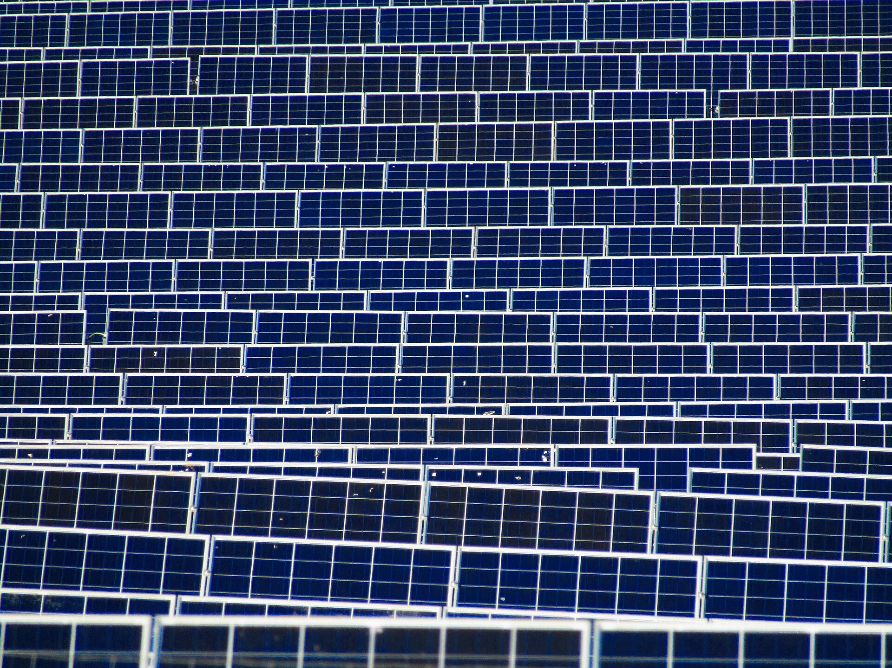
Finance for a GI Investment
Possible instruments
Green bonds: proceeds allocated to eligible
environmental projects.
Sustainability-linked loans: terms linked to agreed
performance targets.
EU programmes: funding subject to the relevant call
and eligibility.
Decision criteria
Compare project eligibility, repayment, borrowing cost,
reporting duties and delivery risk. A green label does
not guarantee cheaper finance.
www.newton.university
18
Notes:
Lecture 6, slide 18: Finance for a GI Investment
Suggested time: 10 min
Say: A green bond directs proceeds to eligible projects and involves allocation and impact reporting. It does not mean every project is automatically verified. A sustainability-linked loan changes agreed terms according to performance; the result can include penalties. Grants and EU programmes depend on current calls, eligibility and timing.
Ask: Who can borrow or apply, how will a park repay debt, and which costs must a business or city cover?
Image credit: Field of Solar Panels near Ogwell.jpg — CC BY-SA 4.0, Wikimedia Commons
https://commons.wikimedia.org/wiki/File:Field_of_Solar_Panels_near_Ogwell.jpg
Source image retained from the original lecture.
Sources checked 5 October 2026:
https://www.icmagroup.org/sustainable-finance/the-principles-guidelines-and-handbooks/green-bond-principles-gbp/

Slide 19
Part 6
Future Trends
www.newton.university
19
Notes:
Lecture 6, slide 19: Part 6 — Future Trends
Suggested time: 1 min
Say: Announce the part.
Decorative artwork reused from the approved Lecture 1 design. AI-generated with OpenAI, September 2026; not a photograph of a documented place.

Slide 20
Where Urban Development is Heading
Nature-positive cities
Regenerative
development
Smart ecosystems
An ambition for
measurable nature
recovery across
development
Sensor-managed urban
nature
Projects that restore soil,
water, habitat
Digital twins for
adaptation
Beyond 'less harm'
Biodiversity as planning
KPI
Biodiversity reporting
(TNFD)
www.newton.university
20
Notes:
Lecture 6, slide 20: Where Urban Development is Heading
Suggested time: 6 min
Say: Present these as approaches and ambitions, not universal legal requirements or guaranteed predictions. Nature-positive proposals need a baseline and evidence of recovery; regenerative projects restore damaged systems; smart management uses data where it improves operations. TNFD is a nature-related disclosure framework, not a biodiversity sensor.

Slide 21
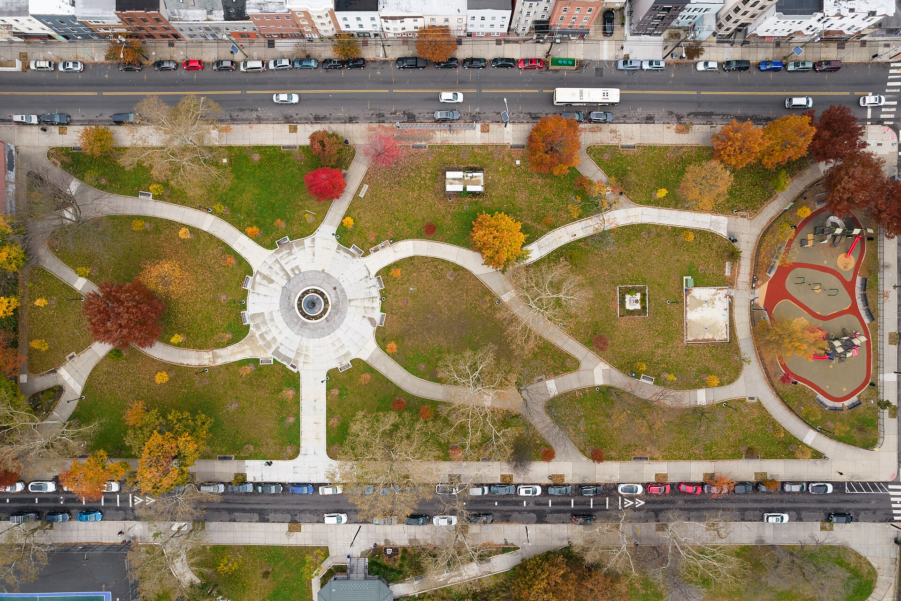
The Decade of Urban Nature
Heat, flood exposure and workforce needs
can affect location decisions.
Regulation (restoration targets) sets the
floor; competition sets the pace.
Businesses will choose locations partly for
climate resilience.
Which European cities will lead — and what
would it take to join them?
A scenario for discussion: resilience may
influence business location choices
www.newton.university
21
Notes:
Lecture 6, slide 21: The Decade of Urban Nature
Suggested time: 6 min
Say: This is a 2035 scenario for debate, not a forecast proven by the course. Ask what evidence would show that climate resilience affects a company’s location choice, and weigh it against costs, infrastructure, customers and skills.
Image credit: Riverview-Fisk Park Jersey City November 2021 001.jpg — CC BY-SA 4.0, Wikimedia Commons
https://commons.wikimedia.org/wiki/File:Riverview-Fisk_Park_Jersey_City_November_2021_001.jpg
Source image retained from the original lecture.

Slide 22
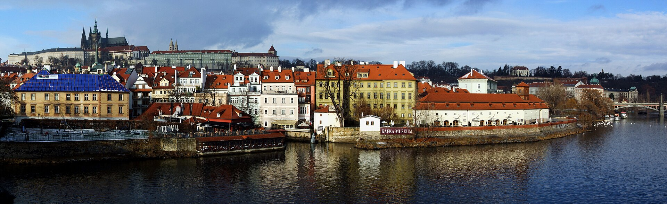
Final Discussion: Prague 2035
Can Prague become one of Europe's leading
Green Infrastructure capitals by 2035?
Argue with evidence from the whole
course
Assets: river corridor, wooded valleys, large
parks.
Frameworks: Climate Plan 2030, Adaptation
Strategy, EU funding.
Questions to test: data gaps, business
engagement and delivery capacity.
The assets are there. Is the ambition?
www.newton.university
22
Notes:
Lecture 6, slide 22: Final Discussion: Prague 2035
Suggested time: 20 min
Say: Groups argue for a Prague 2035 proposal using evidence from the course. Distinguish documented assets and policy frameworks from possible gaps that need investigation. Ask each group to name an action, a responsible organisation, a funding route and a measure of success. Retain the 20-minute discussion format.
Image credit: Prague - view from Charles Bridge (by Pudelek).jpg — CC BY-SA 3.0, Wikimedia Commons
https://commons.wikimedia.org/wiki/File:Prague_-_view_from_Charles_Bridge_(by_Pudelek).jpg
Source image retained from the original lecture.

Slide 23
Course Wrap-Up
What you can now do
Before the exam
Analyze the interaction of business, city
and nature.
Seminar paper due — check the
project brief for structure.
Use SWOT, stakeholder mapping,
KPIs, LCA and ESG as working tools.
Exam: written test + oral part, covering
all six lectures.
Propose GI solutions grounded in real
policy.
www.newton.university
23
Notes:
Lecture 6, slide 23: Course Wrap-Up
Suggested time: 8 min
Say: What students can now do: analyse how business, city and nature interact; use SWOT, stakeholder mapping, KPIs, LCA and ESG as working tools; propose GI solutions grounded in real policy. Before the exam: the seminar paper deadline (check the project brief for the structure) and the exam — a written test plus an oral part covering all six lectures. Say the dates out loud and answer questions about the exam now.

Slide 24
Key Messages
01
ESG translates sustainability into the
language of investors.
05
The Green Deal combines policy
strategies with binding legal
instruments.
02
CSRD and ESRS connect reporting,
double materiality and assurance.
06
Finance choices depend on eligibility,
cost, risk and reporting duties.
03
GI outcomes need environmental,
social and governance evidence.
07
Nature-positive and smart
development are ambitions to test and
measure.
04
Indicators first, claims second.
08
Prague's green future is a choice —
and a business opportunity.
www.newton.university
24
Notes:
Lecture 6, slide 24: Key Messages
Suggested time: 4 min
Say: Work through the eight messages. Ask students to connect each to a decision, example or tool from this lecture. Distinguish potential benefits from measured results.

Slide 25
Recommended Reading
EFRAG — ESRS E4 Biodiversity and Ecosystems standard.
Aghaegbuna et al. (2020). Sustainability in Project Management Practice.
TNFD — Taskforce on Nature-related Financial Disclosures framework.
www.newton.university
25
Notes:
Lecture 6, slide 25: Recommended Reading
Suggested time: 2 min
Say: EFRAG's ESRS E4 is the biodiversity reporting standard; TNFD is the nature-risk framework. Both are free online.

Slide 26
Thank you
Good luck with your projects
www.newton.university
26
Notes:
Lecture 6, slide 26: Thank you — and good luck with your projects!
Suggested time: 5 min
Say: Thank the students. Remind them of Seminar 5 (group plan) and Seminar 6 (presentations). Take final questions.
Decorative artwork reused from the approved Lecture 1 design. AI-generated with OpenAI, September 2026; not a photograph of a documented place.

Slide 27
Image credits
St Edmund Hall Living Wall.jpg — CC BY-SA 4.0, Wikimedia Commons
Field of Solar Panels near Ogwell.jpg — CC BY-SA 4.0, Wikimedia Commons
Riverview-Fisk Park Jersey City November 2021 001.jpg — CC BY-SA 4.0, Wikimedia Commons
Prague - view from Charles Bridge (by Pudelek).jpg — CC BY-SA 3.0, Wikimedia Commons
Conceptual cover and leaf artwork: OpenAI image generation, September 2026. Reused from approved Lecture 1.
www.newton.university
27
Notes:
Lecture 6, slide 27: Image credits
Say: No need to show.

