Slide 1

Optimizing Movie Recommendations: A Collaborative User- Based Approach
BY: JALAL KADERNANI

Slide 2

Collaborative Filtering
Collaborative Filtering is a technique used to make personalized recommendations based on similarities between users.
Collaborative Filtering is the most widely used method for generating recommendations.
It can be user-based or item-based.
User-Based Collaborative Filtering recommends movies to a user based on what similar users have liked.
It involves finding users with similar tastes and recommending movies they have rated highly.

Slide 3
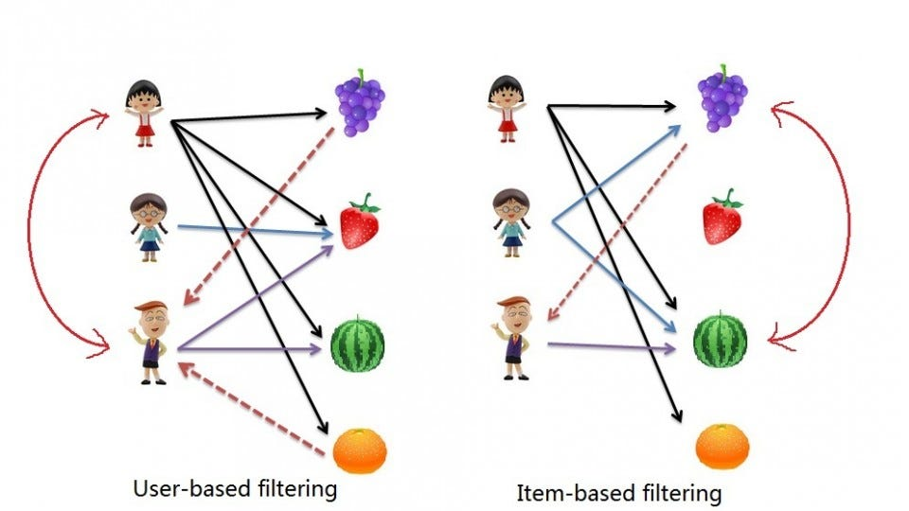

Slide 4

Introduction – Movie Lens
Recommendations are important for user engagement and satisfaction.
The Movielens dataset is a popular benchmark dataset in recommender systems. It contains ratings of movies by users and has been widely used to evaluate recommendation algorithms.
The dataset is available in different sizes, from 100k to 27 million ratings.
We use the 100k dataset, 610 users, 9724 movies

Slide 5

Building the Recommendation System
Building the User – based Recommendation System involves:
Identify and prepare the data
Find Similar users based on interactions with common items
Identify items rated highly by similar users but the target user has not been exposed to or interacted with
Calculate the weighted average score for each item
Rank items based on score and recommend top “n” items
Code walk through of each step and elaborate how Pandas and collaborative filtering are used to optimize movie recommendations.

Slide 6
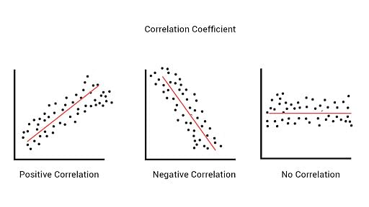
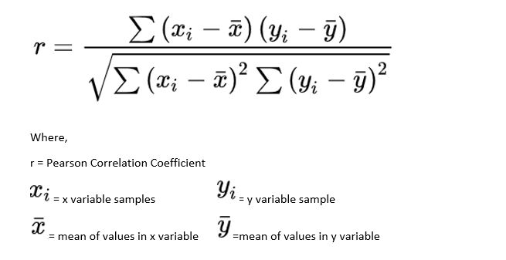
Pearson’s Correlation
Pearson's correlation coefficient is a measure of the strength of a linear association between two variables.
It assigns a value between − 1 and 1, where 0 is no correlation, 1 is total positive correlation, and − 1 is total negative correlation.
Cosine of angle is ~ 100%
Cosine of angle is 0%
Cosine of angle is (-100%)

Slide 7
Pearson’s Correlation
A = [4.0, 5.0, 4.5, NaN, 3.0]
B = [2.5, NaN, 3.0, 3.5, 4.0]
Mean of A = (4.0 + 5.0 + 4.5 + 3.0) / 4 = 4.125
Mean of B = (2.5 + 3.0 + 3.5 + 4.0) / 4 = 3.5
Normalize A: [4.0 - 4.125, 5.0 - 4.125, 4.5 - 4.125, NaN - 4.125, 3.0 - 4.125] = [-0.125, 0.875, 0.375, NaN, -1.125]
Normalize B: [2.5 - 3.5, NaN - 3.5, 3.0 - 3.5, 3.5 - 3.5, 4.0 - 3.5] =
[-1.0, NaN, -0.5, 0.0, 0.5]
Pearson correlation between A and B =
( -0.125 * -1.0 + 0.875 * NaN + 0.375 * -0.5 + -1.125 * 0.0 ) /
( sqrt( (-0.125)^2 + 0.875^2 + 0.375^2 + (-1.125)^2 ) * sqrt( (-1.0)^2 + NaN + (-0.5)^2 + 0.5^2 ) )
= (-0.125) / (sqrt(1.75) * sqrt(1.25))
≈ -0.1787
Cosine of angle is ~ 100%
Cosine of angle is 0%
Cosine of angle is (-100%)

Slide 8
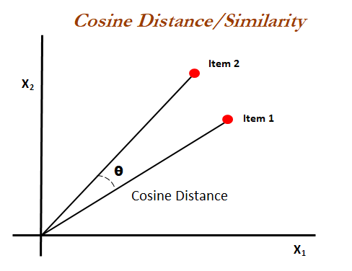
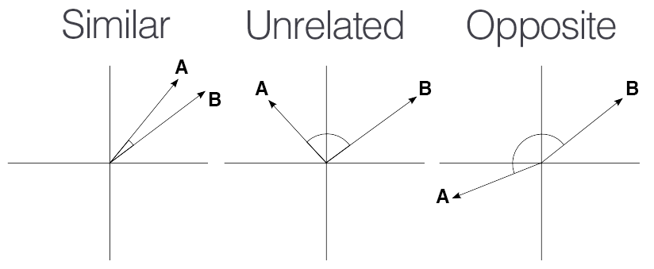
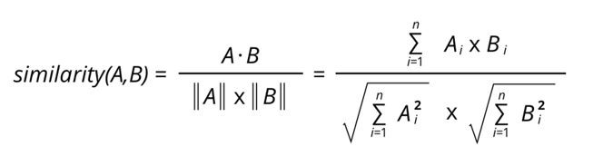
Cosine Similarity
Cosine Similarity is a measure of similarity between two non-zero vectors (measuring distance when the magnitude of the vectors doesn’t matter)
E.G working with Text data represented by word counts
It is widely used in recommendation systems to measure the similarity between items.
Cosine of angle is ~ 100%
Cosine of angle is 0%
Cosine of angle is (-100%)

Slide 9
Conclusion
In this presentation, you have learnt how to optimize movie recommendations using a collaborative user-based approach using Pandas, User-Item Matrix, & Pearsons Correlation or Cosine Similarity to generate recommendations. I hope this presentation has been informative and helpful.

Slide 10
Readings/Research Links
MovieLens Data: https://grouplens.org/datasets/movielens/latest/
Datacamp: https://www.datacamp.com/tutorial/recommender-systems-python
Real Python: https://realpython.com/build-recommendation-engine-collaborative-filtering/
Capital One ML: https://www.capitalone.com/tech/machine-learning/understanding-tf-idf/
Jupyter Widgets: https://ipywidgets.readthedocs.io/en/latest/examples/Widget%20Basics.html

Slide 11
Thanks!

