Slide 1
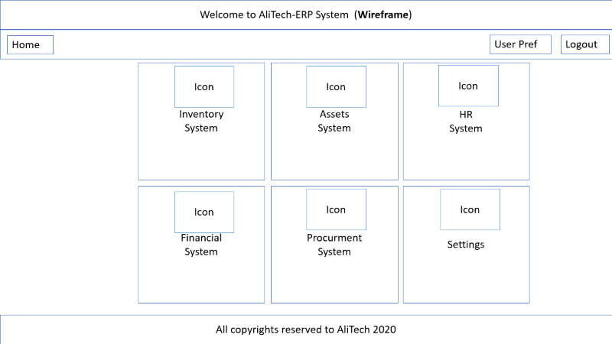
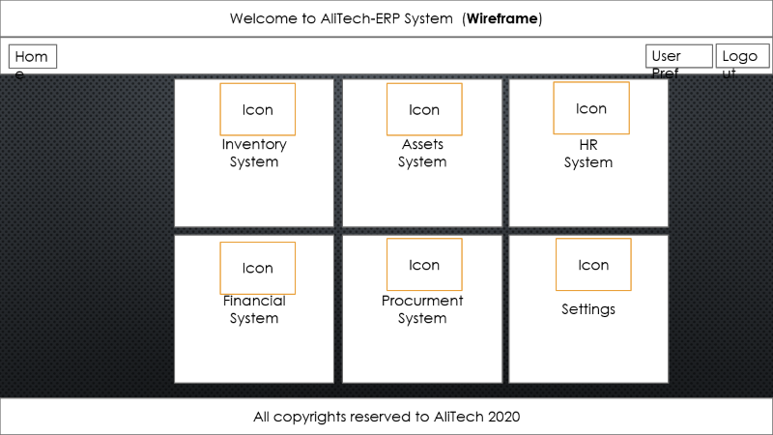
Welcome to AliTech-ERP System (Wireframe)
Home
User Pref
Logout
Inventory
System
Assets
System
HR
System
Icon
Icon
Icon
Financial
System
Procurment
System
Settings
Icon
Icon
Icon
All copyrights reserved to AliTech 2020

Slide 2
Welcome to AliTech-ERP System (Wireframe)
Home
User Pref
Logout
Inventory
System
Invenstory
Assets
System
Assets
System
HR
System
HR
System
Icon
Icon
Icon
Financial
System
Financial
System
Procurement
System
Procurement
System
Settings
Icon
Icon
Icon
All copyrights reserved to AliTech 2020

Slide 3
100%
70%
30%
15%
35%
60^

Slide 4

Login Form
Username
Enter Username / Email
Password
Password
Sing In
Signup
Forget Password

