Slide 1
Lan (Local Area Network)
Hardware:
1- Ethernet
2- Network Cable (RJ45)
3- Hub/Switch
4- Router ()
Software:
1- Protocol (TCP/IP)
2- Each node should have unique IP address
(IP v4, IP v6)
IP: Static / Dynamic (by DHCP server)
Router:
1- Wireless-support
2- Wan (Internet)
3- DHCP Server – Assign Dynamic IP
4- DNS Server (domain-name service), which
Provides DNS name service
PC
192.168.1.20
PC
192.168.1.21
Switch
DNS Table:
192.168.1.25: htu-printer
PC
192.168.1.22
Mobile
192.168.1.23
Router
----
Lan IP
WAN IP
---
Wireless
Wireless
Laptop
192.168.1.24
Wireless
Printer
192.168.1.25
Internet (Wan)

Slide 2
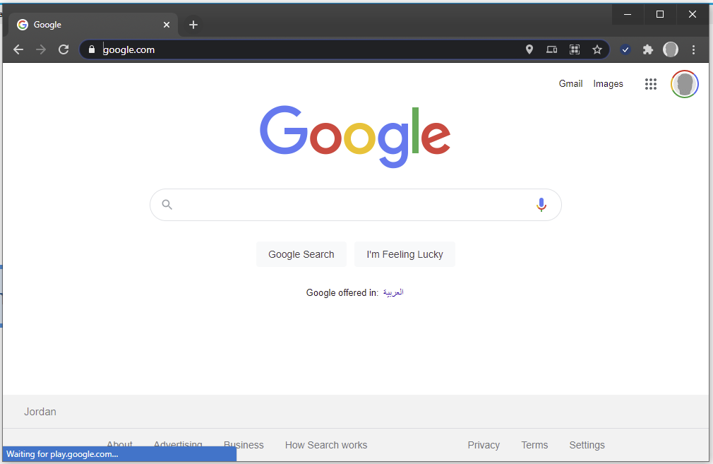
Address bar (domain name)
DNS Lookup (domain name→ IP address)
Title
Page Body

Slide 3
Please give me the IP of google.com
Returns (142.250.186.174)
(DNS Lokup)
DNS Server
Google: 1- Domain Name
2- Hardware Server (hosting)
3- Web Server (Software)
MY PC (Ata)
TCP - IP
Google Server (HW)
HTTP
Web Server
Http Request
Google
Website
Http Response (HTML)
FTP
Windows OS
Linux OS
GitHub - Code

Slide 4

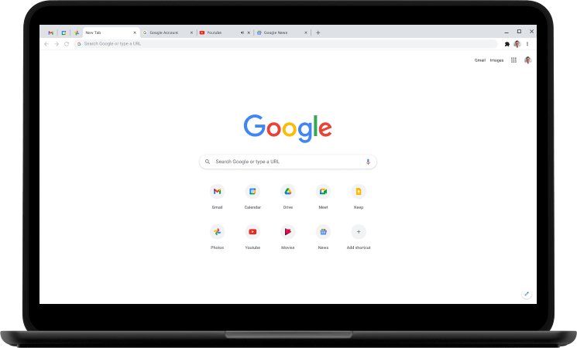
Application
Front-End
Back-End
Generated Code
Generate Dynamic HTML contents
DB
Application
Generate Dynamic HTML contents(e.g, PHP)
Generated Code
DB

