Slide 1
Technical Assignment – Churn Analysis & Prediction
Jalal Mahmud

Slide 2
Data Exploration
The given dataset has 5630 rows – each row for a customer record
Each row has 20 column
CustomerID | Unique customer ID
Churn | Churn Flag
Tenure | Tenure of customer in organization
PreferredLoginDevice | Preferred login device of customer
CityTier | City tier
WarehouseToHome | Distance in between warehouse to home of customer
PreferredPaymentMode | Preferred payment method of customer
Gender | Gender of customer
HourSpendOnApp | Number of hours spend on mobile application or website
NumberOfDeviceRegistered | Total number of deceives is registered on particular customer
PreferedOrderCat | Preferred order category of customer in last month
SatisfactionScore | Satisfactory score of customer on service
MaritalStatus | Marital status of customer
NumberOfAddress | Total number of added added on particular customer
Complain | Any complaint has been raised in last month
OrderAmountHikeFromlastYear | Percentage increases in order from last year
CouponUsed | Total number of coupon has been used in last month
OrderCount | Total number of orders has been places in last month
DaySinceLastOrder | Day Since last order by customer
CashbackAmount | Average cashback in last month

Slide 3
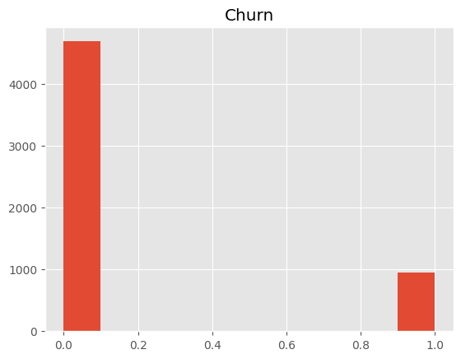
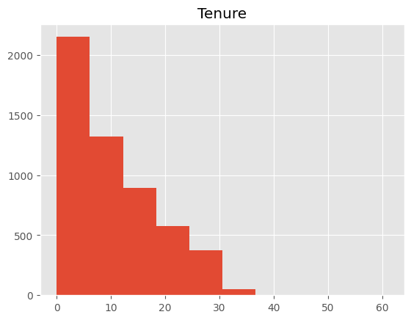
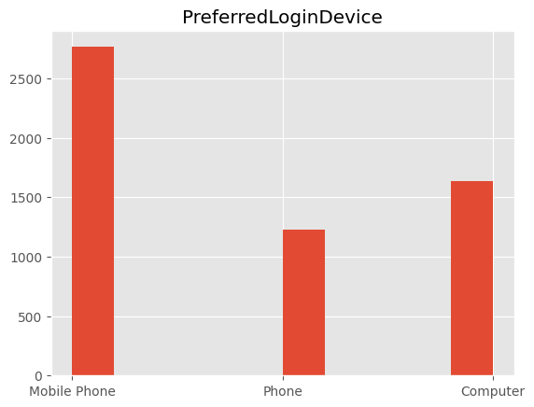
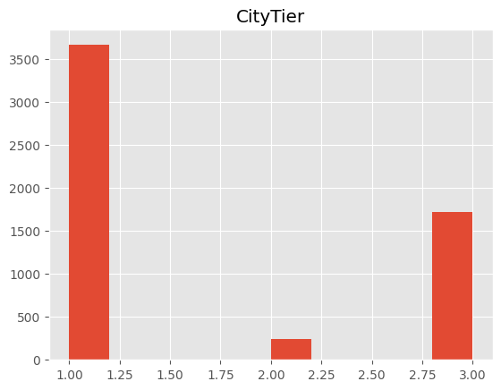
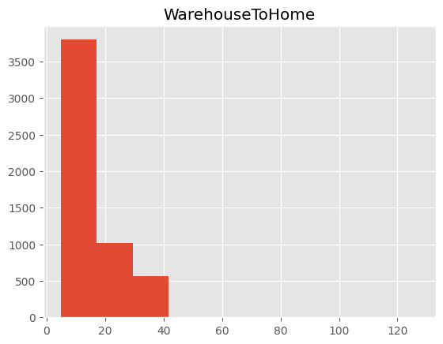
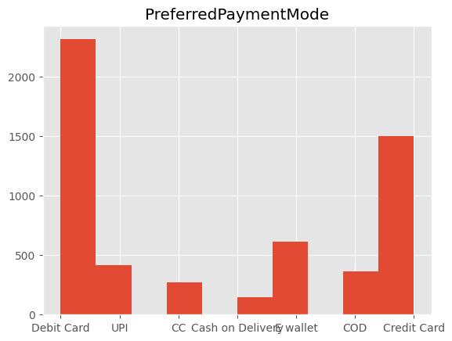
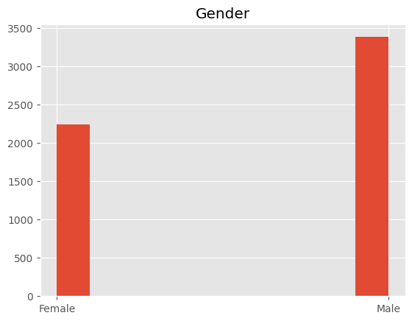
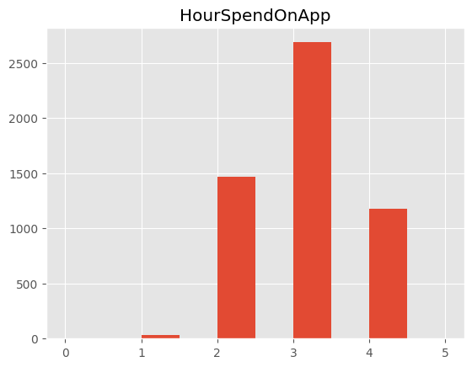
Data Exploration

Slide 4
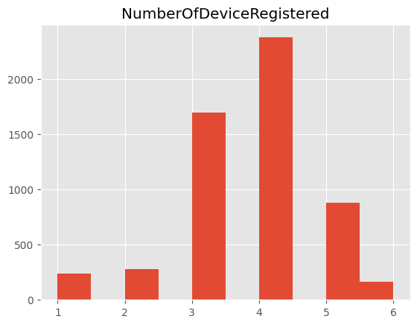
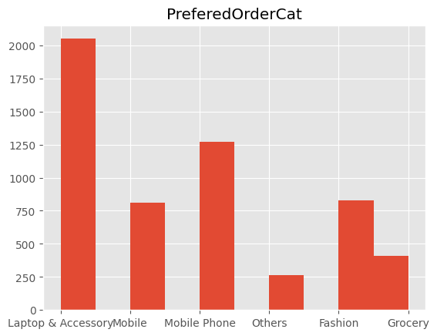
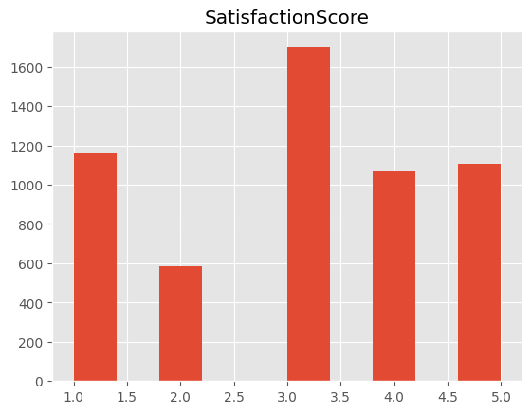
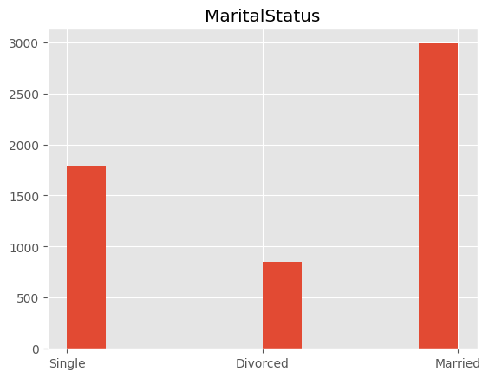
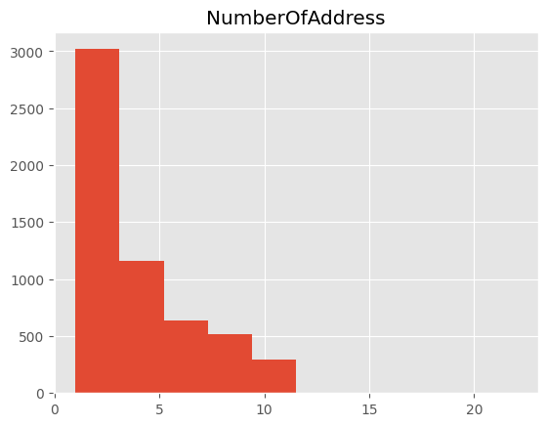
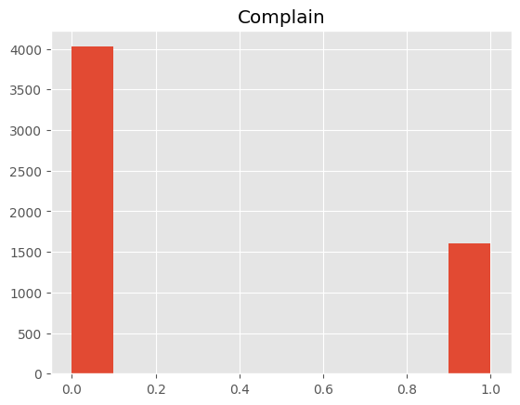
Data Exploration

Slide 5
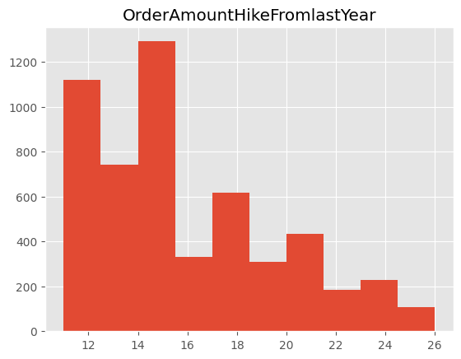
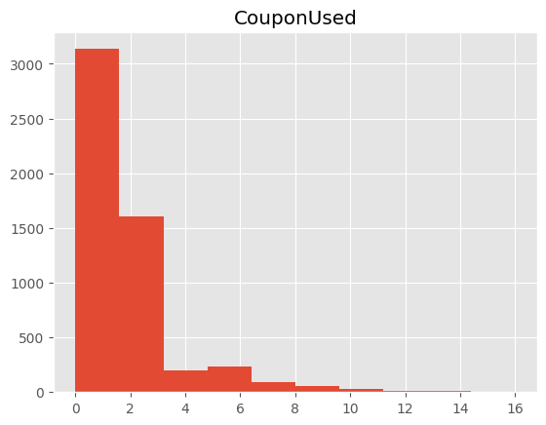
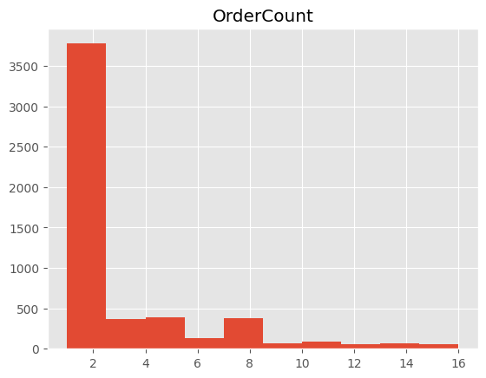
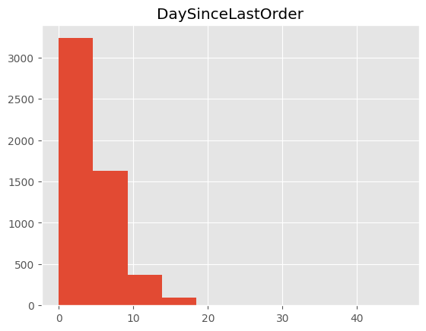
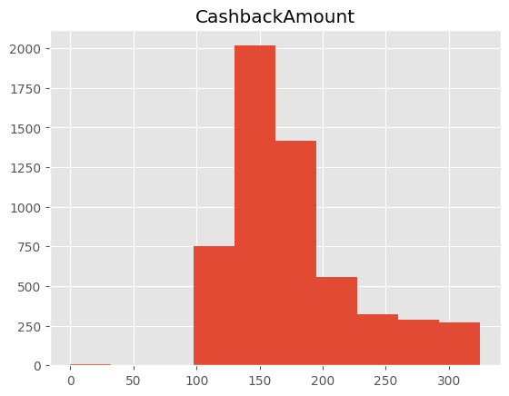
Data Exploration

Slide 6
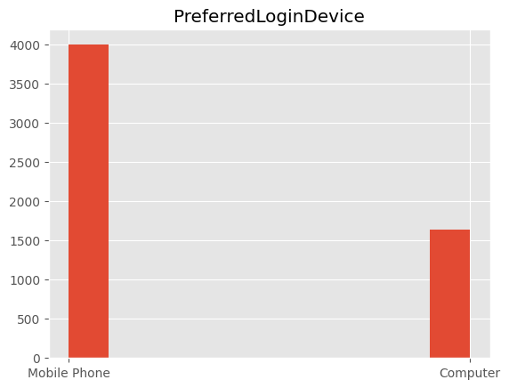
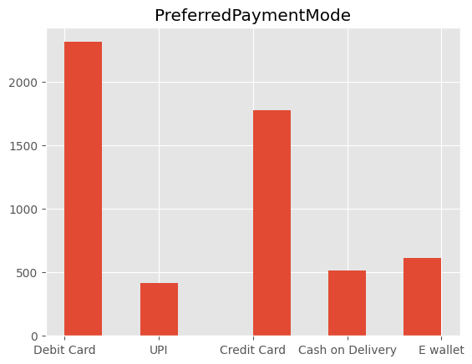
Data Preprocessing – Fix Data Entry Noise
Fixed Data Entry Noise
PreferredLoginDevice column had values Phone and Mobile Phone.
Combined Phone and Mobile
PreferredPaymentMode column had values CC and CreditCard as well as COD and Cash on Delivery
Combined CC and CreditCard
Combined COD and Cash on Delivery

Slide 7
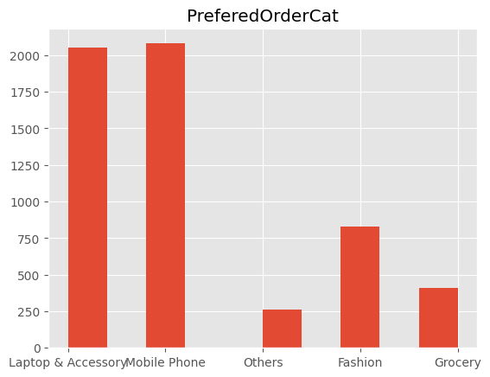
Data Preprocessing – Fix Data Entry Noise
Fixed Data Entry Noise
PreferedOrderCat column had values Mobile and Mobile Phone.
Combined Mobile and Mobile Phone

Slide 8
Data Exploration – Missing Values
Following columns have missing values:
Tenure 264 (4.7%)
WarehouseToHome 251 (4.5%)
HourSpendOnApp 255 (4.5%)
OrderAmountHikeFromlastYear 265 (4.7%)
CouponUsed 256 (4.5%)
OrderCount 258 (4.5%)
DaySinceLastOrder 307 (5.5%)
We process missing values before developing prediction model

Slide 9
Features and Relationships Factors contributing to Customer Churn Actionable Insights
Data Exploration

Slide 10
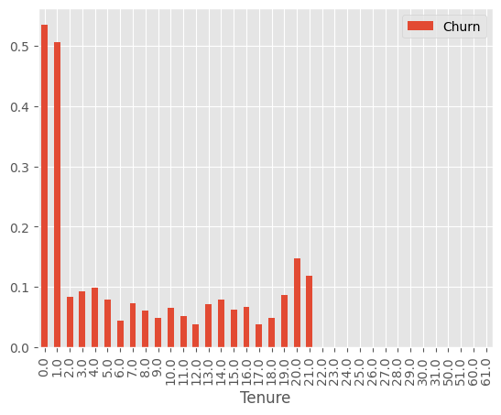
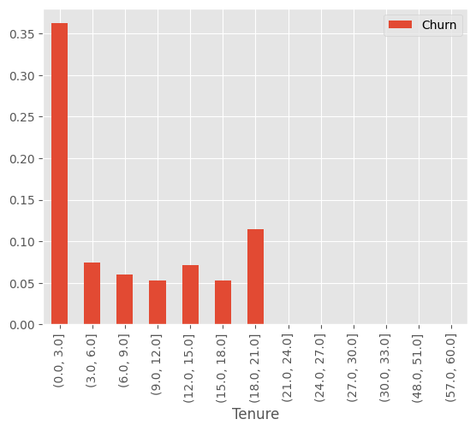
Churn vs. Tenure
Assuming that here Tenure is in months - input file doesn't mention the unit. 50% or more customers Churn within their first month and 35% of customers Churn within their first 3 months.
From CX perspective, we need to focus on retaining new customers. E.g., customers who has not completed their first month or first 3 months. So, they need to be targeted with positive campaign.
Association between Churn and Tenure is statistically significant

Slide 11
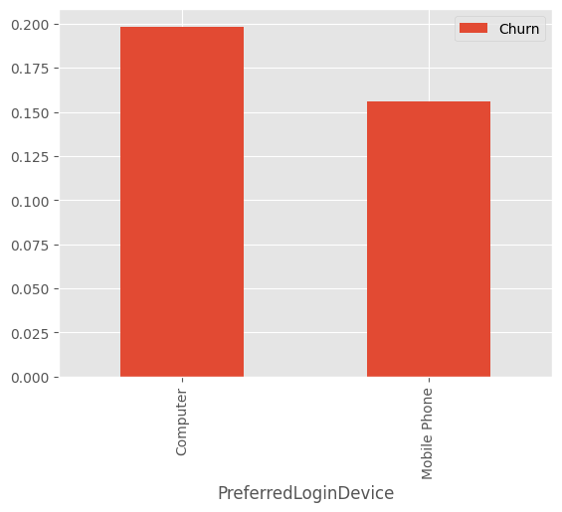
Churn vs. PreferredLoginDevice
Customer who used computer to login to application Churned more than customers who used MobilePhone.
From CX perspective, we may engage with customers who are using Computer to login to application to understand if they are facing any technical issue
Association between Churn and PreferredLoginDevice is statistically significant

Slide 12
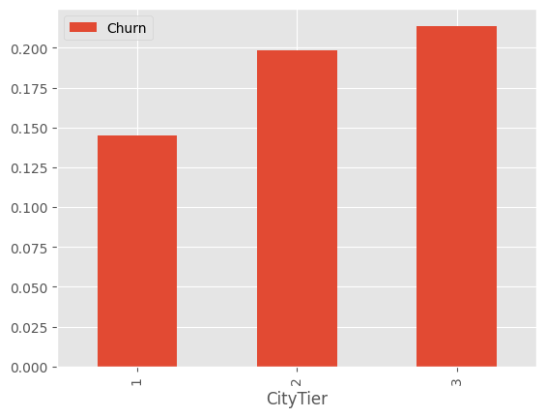
Churn vs. CityTier
CityTier shows a consistent pattern, higher the city tier, higher churn
From CX perspective, it would be good to engage with CityTier 2 and CityTier 3 customers since they are showing 20% or more Churn percentages.
It is noteworthy that CityTier2 and CityTier3 represent smaller group of customers (CityTier2 is only ~5% customers)
Association between Churn and CityTier is statistically significant

Slide 13
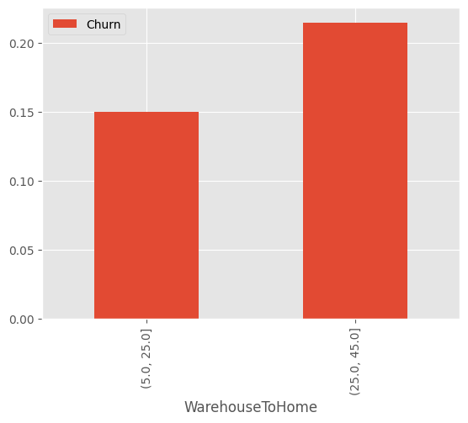
Churn vs. WarehouseToHome
Higher distance from home to warehouse increases churn. 15% of customers for whom Warehouse is within 5 to 25 mile from their home Churned, whereas more than 20% users Churned when the Warehouse is within 25 to 45 miles away from home.
This is intuitive because distance from Warehouse may increase shipping delay/cost.
From CX perspective, users who live far from the warehouse could be incentivized/engaged to prevent their high likelihood of Churn.
Association between Churn and WarehouseToHome is statistically significant

Slide 14
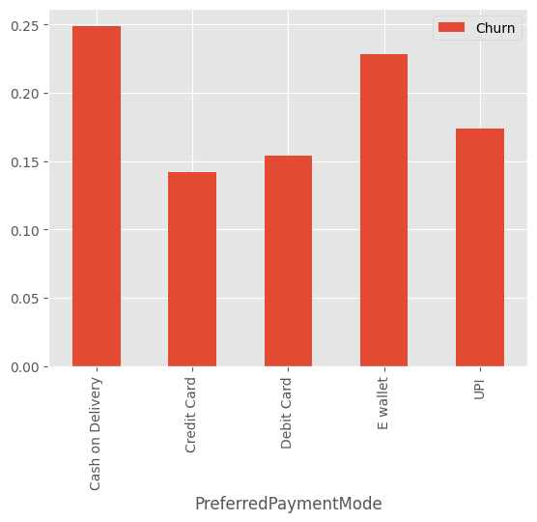
Churn vs. PreferredPaymentMode
PreferredPaymentMode shows variations of Churn behavior. Customers who preferred Cash on Delivery as their payment method Churned more (~25%). E-wallet also show more than 20% Churn.
Association between Churn and PreferredPaymentMode is statistically significant.

Slide 15
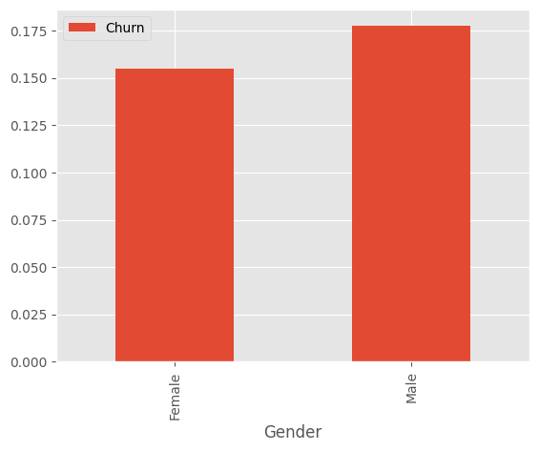
Churn vs. Gender
Data shows that Male customers churned more than Female customers.
Association between Churn and Gender is statistically significant.

Slide 16
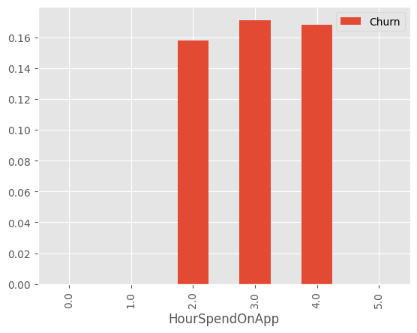
Churn vs. HourSpendOnApp
Intuitively we would expect that higher the number of hrs spend on app, users are less likely to churn, but data doesn't show us that. This is counter intuitive.
Association between Churn and HourSpendOnApp is not statistically significant

Slide 17
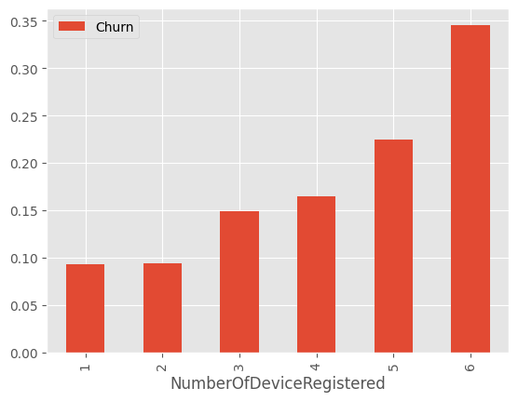
Churn vs. NumberOfDeviceRegistered
Customers churned more as they have registered higher number of devices
Association between Churn and NumberOfDeviceRegistered is statistically significant

Slide 18
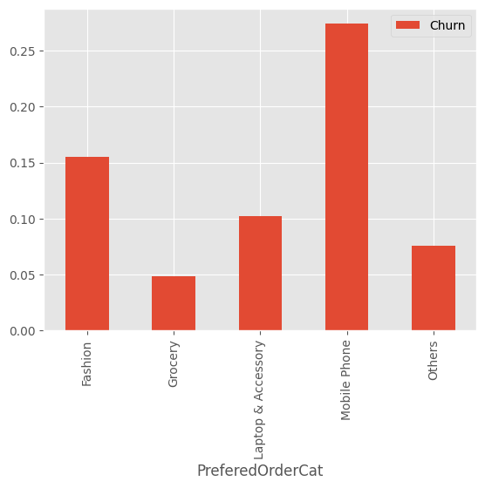
Churn vs. PreferredOrderCat
Customers who ordered mobile phones churned more (more than 25%)
Association between Churn and PreferredOrderCat is statistically significant

Slide 19
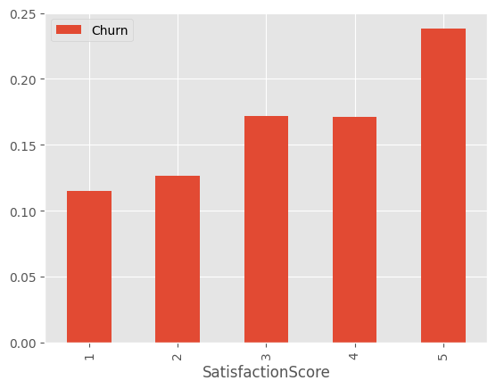
Churn vs. SatisfactionScore
Higher the satisfaction score, higher the churn.
If 5 means most satisfied then it is counter intuitive.
If 1 means most satisfied, then it is intuitive.
From CX perspective, Customers who are least satisfied should be engaged.
Association between Churn and SatisfactionScore is statistically significant

Slide 20
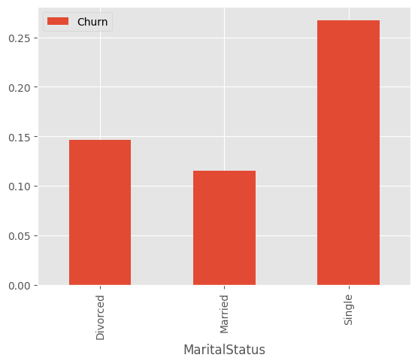
Churn vs. MaritalStatus
Data shows married people are churning less, whereas single individuals are churning more. Perhaps they don't have consistent purchase behaviors.
Association between Churn and MaritalStatus is statistically significant

Slide 21
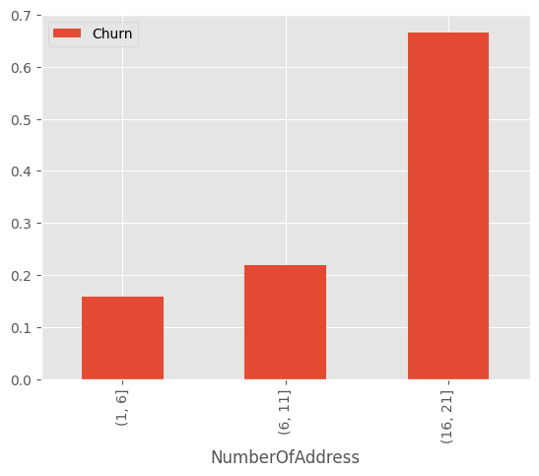
Churn vs NumberOfAddress
Customers who use more number of addresses are churning more.
More than 65% of customers with 16 or more addresses are churning.
This is probably they are not very stable customers.
Association between Churn and NumberOfAddress is statistically significant

Slide 22
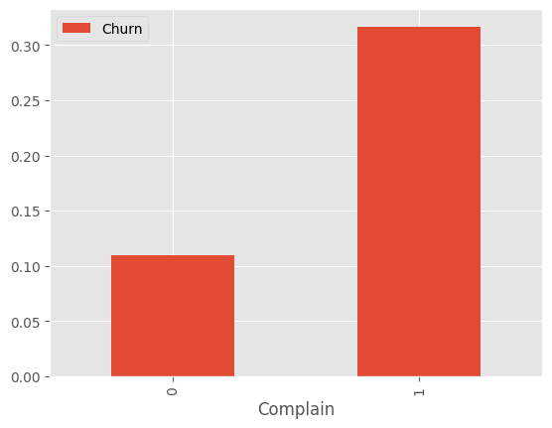
Churn vs. Complain
Customers who raised complain (in last month) churn more. This is intuitive.
From CX standpoint, these customers should be engaged to understand their issue and mitigation should be in place to retain them.
Association between Churn and Complain is statistically significant

Slide 23
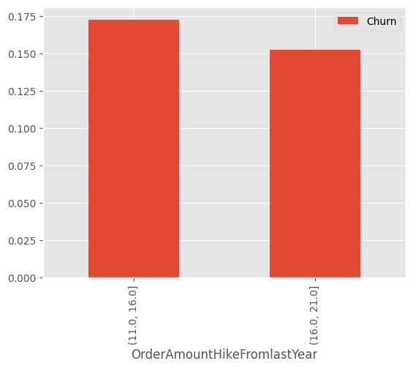
Churn vs. OrderAmountHikeFromLastYear
This shows that people churn less when their order amount hikes more from last year. Order amount hike shows increased engagement with the app, and it is a clear indicator of engagement. So this is intuitive.
Association between Churn and OrderAmountHikeFromLastYear is statistically significant

Slide 24
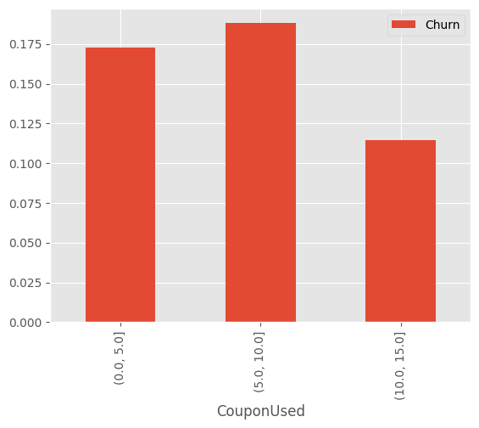
Churn vs. CouponUsed
Customers using more coupons are engaged customers, so we expect them to churn less. However, we don’t see a consistent pattern from the data for this behavior (e.g., middle group who churn more than the first group).
Association between Churn and CouponUsed is not statistically significant

Slide 25
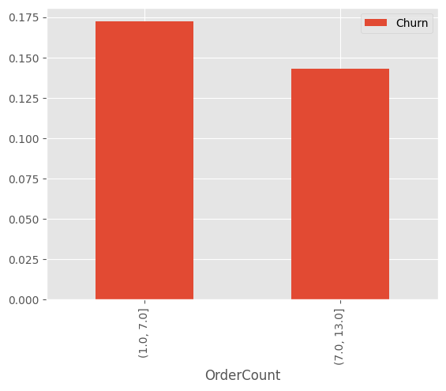
Churn vs. OrderCount
People who placed more orders in the last month churned less. This is intuitive, since placing more orders means engagement with the service.
Association between Churn and OrderCount is statistically significant

Slide 26
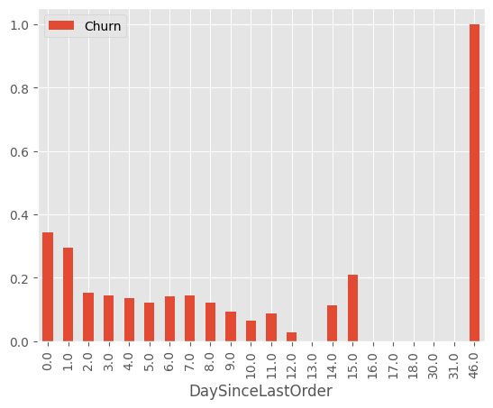
Churn vs. DaySinceLastOrder
Intuitively, customers who did not put any order recently are more likely to churn.
For most of the graph we didn’t see any consistent pattern.
However, association between Churn and DaySinceLastOrder is statistically significant

Slide 27
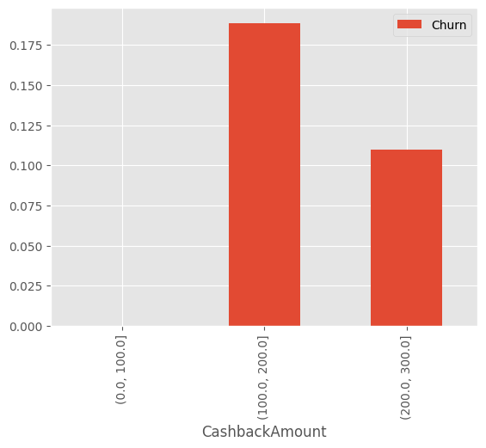
Churn vs. CashbackAmount
People who are getting higher cash back are churning less, this is intuitive
From CX perspective, it is evident that offering customers cashback is a good strategy to retain customers.
Association between Churn and CashbackAmount is statistically significant

Slide 28
Actionable Insights and Recommendations
We found how each factor interacts with Churn – which we would like to reduce from CX perspective
Some ad-hoc strategies can be applied which may reduce churn. E.g.,
We saw that users are more likely to churn in their first 3 months, especially during the first month. So, engage with such customers
Engage with customers who submit low satisfaction score on the app, mitigate their concerns
Engage with customers who complained in the last month, mitigate their concerns
However, we would like to develop a principled approach to predict Churn based on multiple factors
Machine learning models can be trained to predict churn with a reasonable accuracy
Based on the prediction, customers can be engaged for retention
Our choice of ML model is decision tree
Gives explainable rules – appropriate for making business decisions

Slide 29
Significant Factors Contributing to Customer Churn
The following factors were found significant from statistical test:
Tenure, PreferredLoginDevice, CityTier, WarehouseToHome
PreferredPaymentMode, Gender, NumberOfDeviceRegistered, PreferedOrderCat
SatisfactionScore, MaritalStatus, NumberOfAddress, Complain
OrderAmountHikeFromlastYear, OrderCount, DaySinceLastOrder, CashbackAmount
The following factors were not found significant from statistical test:
CouponUsed
HoursSpendOnApp

Slide 30
Developing ML Model to Predict Churn
Use Significant test to select features to predict Churn
16 such features
Handle Missing Values
Replace missing values with mean for the following features
Tenure 264 (4.7%)
WarehouseToHome 251 (4.5%)
OrderAmountHikeFromlastYear 265 (4.7%)
OrderCount 258 (4.5%)
DaySinceLastOrder 307 (5.5%)
Encode Categorical Features to Numerical
['Gender', 'PreferredLoginDevice', 'PreferredPaymentMode' 'PreferedOrderCat', 'MaritalStatus’]
Train/Test Split – 80% for training, 20% for testing
1126 test samples, 941 no-churn and 185 churn
ML Algorithm
Decision Tree which gives explainable rules
Max Depth of the Tree controls trade off between accuracy and simpler tree
Overall Accuracy
Macro F1 – 76% - when max depth is set to 3
Macro F1 – 78% - when max depth is set to 5
Macro F1 – 83% - when max depth is set to 7
Macro F1 – 88% - when max depth is set to 9
Macro F1 – 94% - when max depth is set to 15

Slide 31
Actionable Insights and Recommendations
Example Decision Rules to predict churn:
From a decision tree built with 16 significant factors, but max depth is kept to 3. So, the resultant tree is very simple (but not the most accurate, macro average F1 is 0.76).
If Tenure <= 1 and Complain = 1
If Tenure <= 1 and Complain = 0 and NumberOfAddress > 4
If Tenure > 1 and CashbackAmount <= 124.38 and Complain = 1
This tree has only 3 rules to detect churn
From a decision tree built with 16 significant factors, but max depth is kept to 5. So, the resultant tree is still very simple (but not the most accurate, macro average F1 is 0.78).
Tenure <= 1 and Complain = 0 and NumberOfAddress <= 4 and DaySinceLastOrder <= 1 and WarehouseToHome > 22.50
Tenure <= 1 and Complain = 0 and NumberOfAddress <= 4 and DaySinceLastOrder > 8.50
Tenure <= 1 and Complain = 0 and NumberOfAddress > 4.5 and OrderAmountHikeFromLastYear <= 18.50 and NumberOfDeviceRegister > 2
… and more rules

Slide 32
Summary
Data analysis demonstrates how each of the factors are related to customer churn
We can compute significant factors through statistical analysis
Decision tree modeling is a useful tool to predict customer churn
Rules are explainable
We can balance between size of the decision tree and accuracy based on preference

