Slide 1
Technical Assignment – Churn
Jalal Mahmud

Slide 2
Data Exploration
The given dataset has 5630 rows – each row for a customer record
Each row has 20 column
CustomerID | Unique customer ID
Churn | Churn Flag
Tenure | Tenure of customer in organization
PreferredLoginDevice | Preferred login device of customer
CityTier | City tier
WarehouseToHome | Distance in between warehouse to home of customer
PreferredPaymentMode | Preferred payment method of customer
Gender | Gender of customer
HourSpendOnApp | Number of hours spend on mobile application or website
NumberOfDeviceRegistered | Total number of deceives is registered on particular customer
PreferedOrderCat | Preferred order category of customer in last month
SatisfactionScore | Satisfactory score of customer on service
MaritalStatus | Marital status of customer
NumberOfAddress | Total number of added added on particular customer
Complain | Any complaint has been raised in last month
OrderAmountHikeFromlastYear | Percentage increases in order from last year
CouponUsed | Total number of coupon has been used in last month
OrderCount | Total number of orders has been places in last month
DaySinceLastOrder | Day Since last order by customer
CashbackAmount | Average cashback in last month

Slide 3
Data Exploration – Python Code
print(data.head())
print(data.shape)
print(data.info())
print(data.describe())
Output of these operations are included in the notebook

Slide 4
Data Exploration – Missing Values
print(data.isnull().sum())
Following columns have missing values:
Tenure 264 (4.7%)
WarehouseToHome 251 (4.5%)
HourSpendOnApp 255 (4.5%)
OrderAmountHikeFromlastYear 265 (4.7%)
CouponUsed 256 (4.5%)
OrderCount 258 (4.5%)
DaySinceLastOrder 307 (5.5%)

Slide 5
Features and Relationships
We

Slide 6
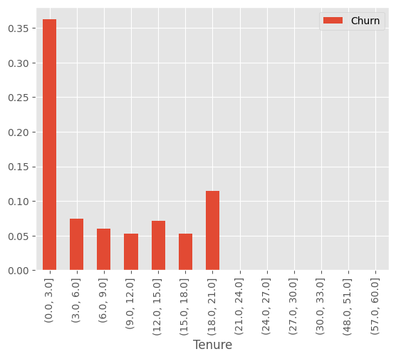
Churn vs. Tenure
Assuming that here Tenure is in months - input file doesn't mention the unit.
35% of users Churn within their first 3 months.
From CX perspective, we need to focus on retaining new customers. E.g., customers who has not completed their first 3 months. So, they need to be targeted with positive campaign.
Association between Churn and Tenure is statistically significant as per Chi-square test

Slide 7
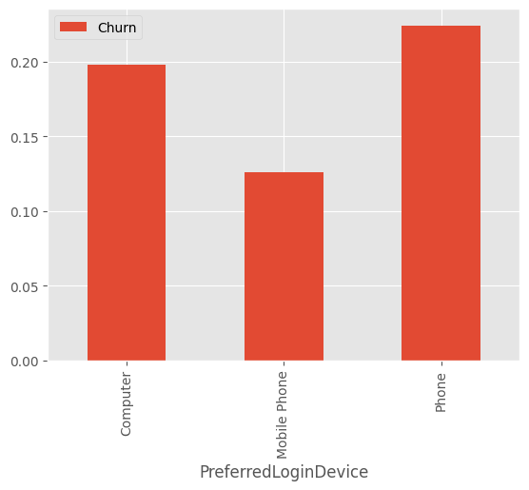
Churn vs. PreferredLoginDevice
Customer who use phone to login to application Churned More than customers who used Computer or MobilePhone.
20% or more customers who used Computer or Phone Churned.
From CX perspective, we need to engage with users who are using Phone or Computer to login to application to understand if they are facing any technical issue
Association between Churn and PreferredLoginDevice is statistically significant as per Chi-square test

Slide 8
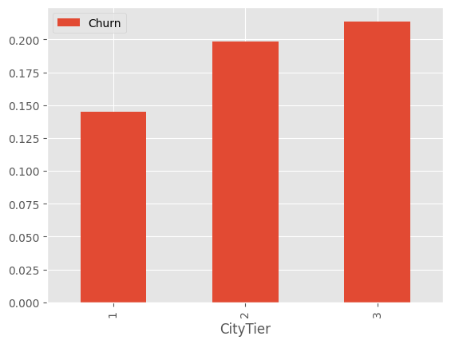
Churn vs. CityTier
CityTier shows a consistent pattern, higher the city tier, higher churn
From CX perspective, it would be good to engage more with CityTier 2 and CityTier 3 customers since they are showing 20% or more Churn percentages.
Association between Churn and CityTier is statistically significant as per Chi-square test

Slide 9
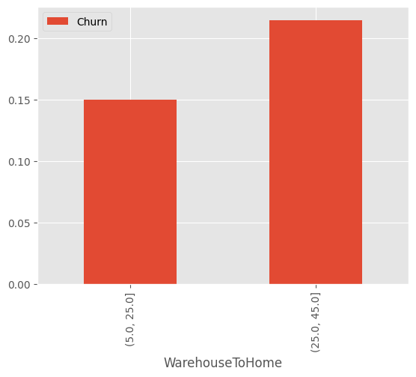
Churn vs. WarehouseToHome
Higher distance from home to warehouse increases churn. 15% of users for whom Warehouse is within 5 to 25 mile from their home Churned, whereas more than 20% users Churned when the Warehouse is within 25 to 45 miles away from home.
This is intuitive because distance from Warehouse may increase shipping delay/cost.
From CX perspective, users who live far from the warehouse could be incentivized/engaged to prevent their high likelihood of Churn
Association between Churn and WarehouseToHome is statistically significant as per Chi-square test

Slide 10
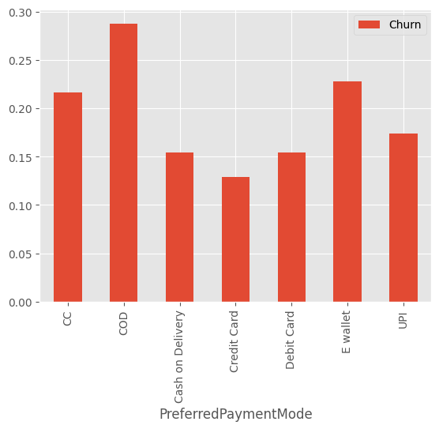
Churn vs. PreferredPaymentMode
PreferredPaymentMode shows variations of Churn behavior. Users who preferred COD as their payment method Churned more (~28%). CC and E-wallet also show more than 20% Churn.
This should be further investigated to see if those customers face any specific problem with these payment methods (CC, COD and E-wallet) using the application, so those customers should be engaged to learn more.
Association between Churn and PreferredPaymentMode is statistically significant as per Chi-square test

Slide 11
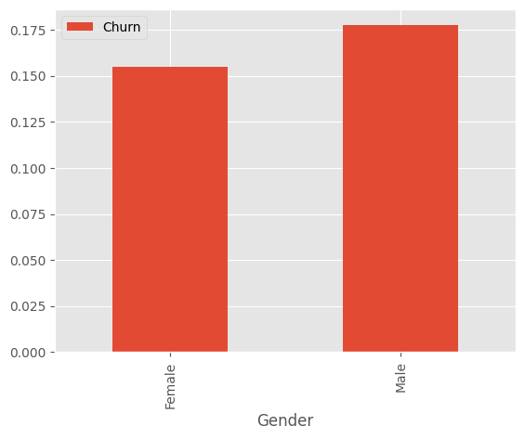
Churn vs. Gender
Data shows that Male customers churned more than Female customers.
Association between Churn and Gender is statistically significant as per Chi-square test

Slide 12
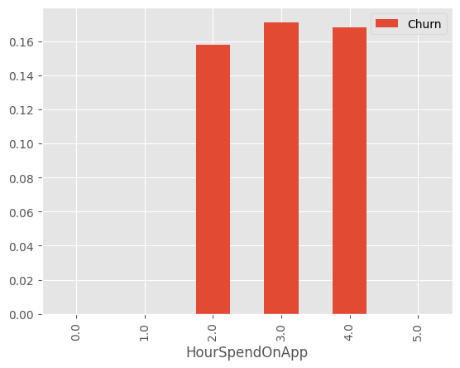
Churn vs. HourSpendOnApp
Intuitively we would expect that higher the number of hrs spend on app, users are less likely to churn, but data doesn't show us that. This is counter intuitive.
Association between Churn and HourSpendOnApp is not statistically significant as per Chi-square test (p value 0.09)

Slide 13
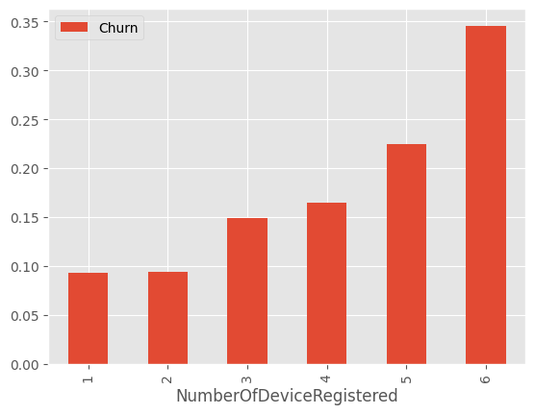
Churn vs. NumberOfDeviceRegistered
Customers churned more as they have registered higher number of devices
From CX point of view, users with more registered devices should be engaged.
Association between Churn and NumberOfDeviceRegistered is statistically significant as per Chi-square test

Slide 14
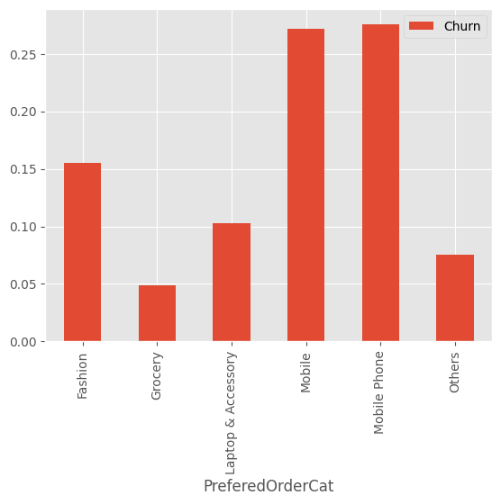
Churn vs. PreferredOrderCat
Custoemers who ordered mobile and mobile phones churned more (more than 25%)
Association between Churn and PreferredOrderCat is statistically significant as per Chi-square test

