Slide 1
Python Crash Course Outline
Python Setup
Python Object and Data Structure Basics
Python Comparison and logical Operators
Python Statements (loops)
File Input/output in Python
Python Methods and Functions
Errors and Exceptions Handling in Python
Object Oriented Programming in Python
Modules and Package in Python

Slide 2
Python Crash Course
Lecture 1

Slide 3
Lecture 1 Material
Command Prompt basics
Install Anaconda/Jupyter notebook
Access course material (Github)
Python object and data structure basics
Integers
Floating point
Strings
Lists
Dictionaries
Tuples
Sets
Booleans

Slide 4
Lecture 1 Material
Command Prompt basics
Install Anaconda/Jupyter notebook
Access course material (Github)
Python object and data structure basics
Integers
Floating point
Strings
Lists
Dictionaries
Tuples
Sets
Booleans

Slide 5
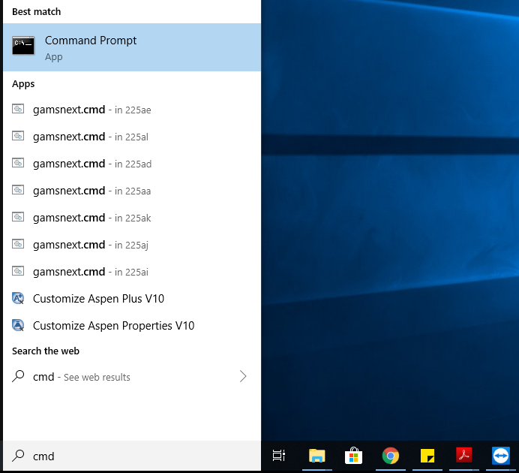
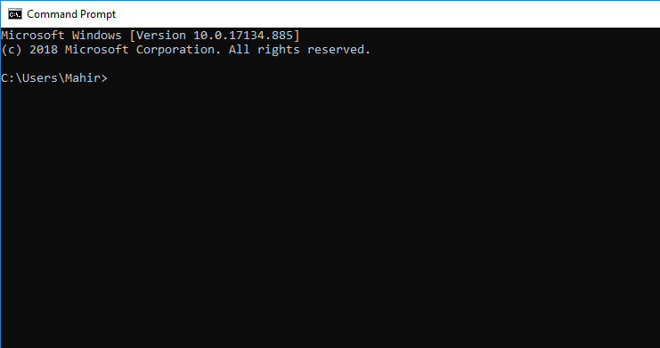
Command Prompt Basics
Command Prompts is a command line interface used to execute commands in your operating system (Windows, MacOS).
From the Command Prompts, you can navigate through files and folders on your computer, just as you would do with your mouse. The difference is that the Command Prompts is fully text-based.
Windows users: To get to the command prompt go to Start -> Search -> type ‘cmd’ and click on command prompt.
MacOS: To get to the command prompt (called terminal) go to Search -> type ‘terminal’ and click on terminal.

Slide 6
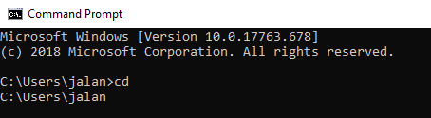
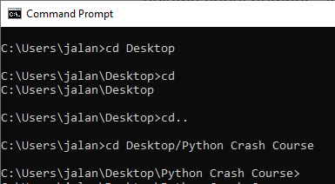
Command Prompt Basics
Display current directory
cd (Windows)
pwd (MacOS)
Show all the files and folder located at the current directory
dir (Windows)
ls (MacOS)
Move to a folder in your current directory
cd Desktop
Go back up a directory
cd ..
Clean the command line screen
cls (Windows)
clear (MacOS)

Slide 7
Lecture 1 Material
Command Prompt basics
Install Anaconda/Jupyter notebook
Access course material (Github)
Python object and data structure basics
Integers
Floating point
Strings
Lists
Dictionaries
Tuples
Sets
Booleans

Slide 9
Python Installation
Install Python using Anaconda distribution.
Anaconda distribution includes Python and other useful libraries, including Jupyter notebook.
In this course, we will use Jupyter notebook mostly to write and run our code.
To Install Anaconda go to www.anaconda.com/downloads

Slide 10
Jupyter Notebook
Notebook environment that is great for learning
The inputs and outputs are next to each other
Special file formats that have the extension .ipnyb not regular python extension .py
These notebooks can be lunched using Jupyter notebook only and cannot be opened by double-clicking on the file in your computer
Let’s start working with Jupyter Notebook

Slide 11
Lecture 1 Material
Command Prompt basics
Install Anaconda/Jupyter notebook
Access course material
Python object and data structure basics
Integers
Floating point
Strings
Lists
Dictionaries
Tuples
Sets
Booleans

Slide 12
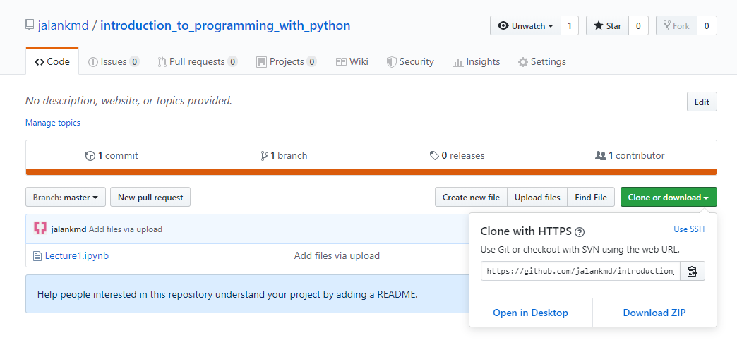
Access Course Material (Github)
Go to https://github.com/jalankmd/introduction_to_programming_with_python
Click on clone or download
Download ZIP

Slide 13
Lecture 1 Material
Command Prompt basics
Install Anaconda/Jupyter notebook
Access course material (Github)
Python object and data structure basics
Integers
Floating point
Strings
Lists
Dictionaries
Tuples
Sets
Booleans

Slide 14
Data types in Python
Name | Type | Description
Integers | int | Whole numbers, such as: 3 200 1000
Floating point | float | Numbers with a decimal point: 2.5 3.64 200.0
Strings | str | Ordered sequence of characters: “hello” ‘Magic’ “2000”
Lists | list | Ordered sequence of objects: [3,”hello”,10.2]
Dictionaries | dict | Unordered (key:value) pairs: {“key1” : “value1”, “key2” : “value2”}
Tuples | tup | Ordered immutable sequence of object: (3,”hello”,10.2)
Sets | set | Unordered collection of unique object: {“a”,”b”}
Booleans | bool | Logical value: True or False

Slide 15
Lecture 2 Material
Comparison Operators
Logical Operators
Python Statements
If, elif, and else
For Loops and While Loops
Python Useful Built-in Functions and Operators
Range(), enumerate(), zip(), min(), max(), input(), in
List Comprehensions
Import and Export files/data

Slide 16
Comparison Operators
Comparison operators are used to compare value and evaluate down to a single a Boolean value of either True or False
Operator | Meaning | Example | Result
== | Equal | 5 == 2 | False
!= | Not equal | 5 != 2 | True
> | Strictly greater than | 3 > 3 | False
< | Strictly less than | 3 < 5 | True
>= | Greater than or equal | 3 >= 3 | True
<= | Less than or equal | 4 <= 2 | False

Slide 17
Logical Operators
Logical operators are used to evaluate whether two ore more expressions are True or False
Operator | Meaning | Example
and | True if both are true | x and y
or | True if at least one is true | x or y
not | True only if false | not x

Slide 18
Truth Tables
EQUAL Truth Table
x | == | y | Result
True | == | True | True
True | == | False | False
False | == | True | False
False | == | False | True
AND Truth Table
x | and | y | Result
True | and | True | True
True | and | False | False
False | and | True | False
False | and | False | False
OR Truth Table
x | or | y | Result
True | or | True | True
True | or | False | True
False | or | True | True
False | or | False | False
NOT Truth Table
not | x | Result
not | True | False
not | False | True

Slide 19
Control Flow/code blocks in Python
Control flow statements in Python allow us to control the stream and outcome of a program.
When writing a program, we might want some certain code blocks to be executed only when a particular condition has been met.
Python uses of colon (:) and white space (indentation) to define a block of code, some other languages like C, C++, Java use { }.
A code block (body of a function, loop, etc.) starts with indentation and ends with the first unindented line.
Generally four whitespaces are used for indentation and is preferred over tabs.

Slide 20
Control Flow Statements in Python
There are three control flow statements in Python:
Conditional statements (if – elif – else)
Executes the code block depending on if some condition is met
for statement
Looping statement that repeatedly executes the block code for specific number of times
while statement
Looping statement that repeatedly executes the block code while some condition remains True

Slide 21
Conditional Statements Syntax (if – elif – else)
Executes the code block depending on if some condition is met
Syntax of an if/else statement
if <condition>:
<statements(s)>
else:
<statements(s)>
Syntax of an if/elif/else statement
if <condition>:
<statements(s)>
elif <other_condition>:
<statements(s)>
else:
<statements(s)>

Slide 22
Iterable Objects in Python
Most objects in python are “iterable”, meaning we can iterate over every element in the objects.
Lists, strings, dictionaries, tuples, and sets are example of iterable objects.
We can iterate over every item in a list, iterate over every character in a string, iterate over every key in a dictionary...etc
For loops can be used to execute a block of code for every iteration.

Slide 23
For Loop Statement Syntax
Looping statement that repeatedly executes the block code for specific number of times
Syntax of a for loop statement
for <variable> in <iterable object>:
<statements(s)>

Slide 24
While Loop Statement Syntax
Looping statement that repeatedly executes the block code while some condition remains True
Syntax of while loop statement
while <condition>:
<statements(s)>
Syntax of while loop statement with else
while <condition>:
<statements(s)>
else:
<statements(s)>

Slide 25
List Comprehensions (for loop)
It provides a concise way to create lists.
Starts with a [‘and’], to help you remember that the result is going to be a list.
Syntax with for loop
<list> = [ ]
for <item> in <iterable object>:
<list>.append(<expression(item)>)
Syntax with list comprehensions
<list> = [<expression(item)> for <item> in <iterable object>]

Slide 26
List Comprehensions (for loop with condition inside “if”)
Syntax with for loop and if
<list> = [ ]
for <item> in <iterable object>:
if <condition(item)>
<list>.append(<expression(item)>)
Syntax with list comprehensions
<list> = [<expression(item)> for <item> in <iterable object> if <condition(item)>]

Slide 27
Lecture 3 Material
Methods
Functions
Nested Functions
Names and Namespaces
Python Variable Scope
Syntax Errors and Exceptions
Exceptions Handling

Slide 28
Python methods
Method is called by its name and it is associated to an object
Can access the data within the object and may alter an object's state
With methods, the idea is the object is acted upon by the function, where the focus is on the object
Methods syntax
<object>.<method>(<arguments>)
There are many built-in methods for different objects in Python (list, tuples, dictionary…etc)
To check all available methods for an object in Jupyter notebook type:
<object>.
then press tab

Slide 29
Python functions
Function is a block of code used to carry out a specific task.
Functions are called without any object, so it doesn't alter the object’s state
With functions, the idea is the function acts on the arguments, where the focus in on the function.
Define function syntax
def <function name> (<arguments>):
<function body>
return <value>
Calling function syntax
function name(<arguments>)

Slide 30
Python Names and Namespaces
Name is simply a name given to object (everything in Python is an object).
Example: a = 2, here 2 is an object stored in memory and a is the name associated it with.
Namespace is a collection of names (mapping of every name you have defined to corresponding object).
Namespace is a system to have a unique name for every object in Python.
Python implements namespaces as dictionary; there is a name-to-object mapping, with the names as keys and the objects as values.
Lifetime of a name space depends upon the scope of objects, if the scope of the object ends, the lifetime of that namespace comes to an end.
Notes:
https://www.programiz.com/python-programming/namespace
https://www.geeksforgeeks.org/namespaces-and-scope-in-python/

Slide 31
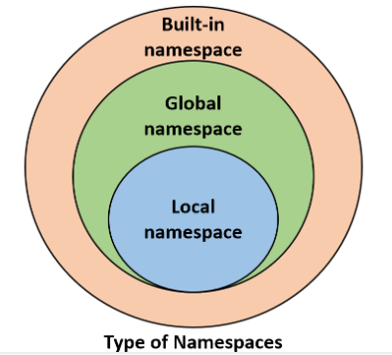
Python Namespaces
Types of namespaces:
Built-in namespace: includes Python built-in functions and is created when we start the Python interpreter (ie: print(), list,.. Etc).
Global namespace: includes names from various imported modules that are being used in a project and is created when the module is imported in the project and lasts until the script ends.
Local namespace: Include local names inside a function and is created when a function is called, and it only lasts until the function returns.

Slide 32

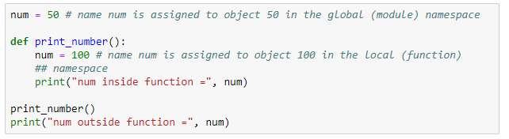
Python Namespaces
Multiple namespaces can exist independently from each other and they can contain the same variable name.
This means a name num can be assigned to object 50 in the global (module) namespace, and the same name num can be assigned to object 100 in the local (function) namespace without overwriting it
If we tried to access the object of the name num, what do we get?
To understand the answer, we need to learn the concept of scope

Slide 33
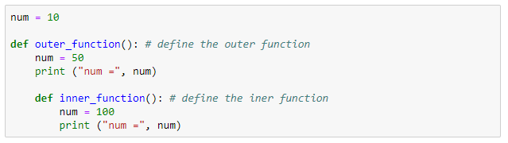
Python Scope
A scope is code region form which a particular object is accessible.
A name has a scope that defines the parts of the program where we could access that name.
We cannot access any particular object from anywhere from the code.
Question: “In which order does Python search the different levels of namespaces before it finds the name-to-object’ mapping?”
Answer: It uses the LEGB-rule which stand for
Local -> Enclosed -> Global -> Built-in
Global Scope
Enclosed Scope
Local Scope

Slide 34
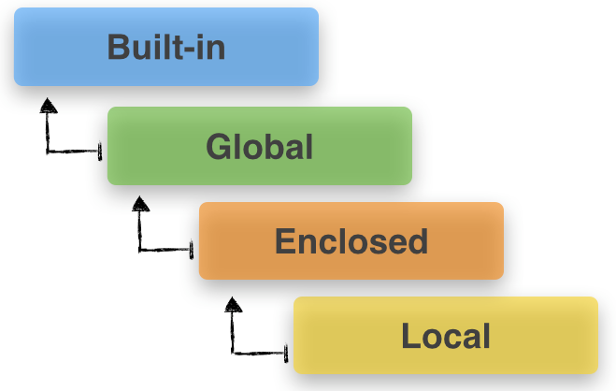
LEGB Rule
Local scope – innermost scope which is the scope of the current function (search for a name inside the current function)
Enclosed scope – scope of all enclosing function, when the current function is inside another function “enclosing function” (search for a name starts from the nearest enclosing scope and move outwards)
Global scope – scope of the module file (search for all global names from the current module)
Built-in – outermost scope (search for built-in names in Python)

Slide 35
Python Variable Scope
Scope refers to the code region from which a specific Python object is accessible.
We cannot access any specific object from anywhere from the code
There are multiple scopes in a program:
Local scope
Enclosed scope
Global scope
Built-in scope
Notes:
https://sebastianraschka.com/Articles/2014_python_scope_and_namespaces.html

Slide 36
Syntax Errors and Exceptions
A Python program terminate as soon as it encounters an error.
There are two types of errors in Python:
Syntax errors:
Mistakes in the use of the Python language (similar to spelling or grammar mistakes in English language).
Python find syntax errors when it tries to parse (analyze the syntax) your program and exit with an error message without running anything.
Exceptions:
Errors detected during executions (The sentence flap your arms and fly to China, is correct but impossible to execute)
These errors are normally detected if there is no syntax errors in the code.

Slide 37
Syntax Errors
Common Python syntax errors include:
Leaving out or misspelling a keyword
Putting a keyword in the wrong place
Leaving out a symbol, such as colon, comma or brackets
Incorrect indentation
Empty block

Slide 38
Exceptions
Common Python exceptions include:
Division by zero
Performing an operation on incompatible types
Using and identifier which has not been defined
Accessing a list element, dictionary value or object attributes which doesn’t exist
Trying to call a function which is not defined

Slide 39
Handling Exceptions
All the programs we have wrote so far ignored the fact that things can go wrong (program might crash because of exceptions)
A program which crashes whenever it encounters an easily foreseeable exception is not very pleasant to use.
Most users expect programs to be robust enough to deal with easily foreseeable exceptions.
If we know that a particular section of our program is likely to cause an exception, we can use handling exceptions to tell Python what to do if the exception does happen, instead of letting that exception crash our program.
Handling exceptions let the script continues with the rest of the code and report the exception if it exist.

Slide 40
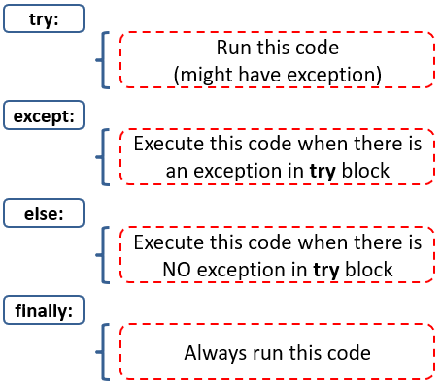
Handling Exceptions
Four keywords used for handling exceptions:

Slide 41
Lecture 4 Material
Object Oriented Programming
Classes
Inheritances
Modules and Packages
Python built-in modules
Install open-source packages
Create modules and packages
numpy
Pandas
Matplotlib

Slide 42
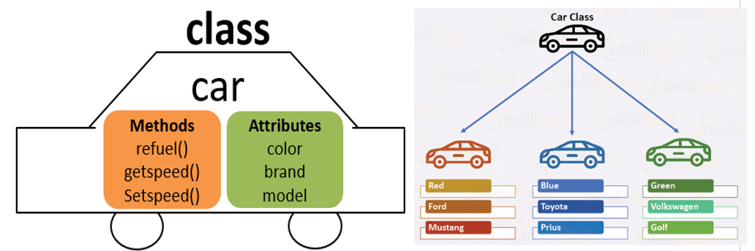
Object-Oriented Programming
Python is an object-oriented programming (OOP) language.
Object oriented programming is a programming paradigm that uses the concept of classes and objects
OBB allows programmers to create their own objects that have attributes and methods.
Classes define the structure of object and serve as a templates “blueprint” for creating them.
Objects are instances of classes; they are entities that contain data members called attributes (characteristics they possess) and procedures called methods (actions they perform).

Slide 43
Object-Oriented Programming
Define a class syntax
class NameOfClass():
def __init__(self,param1,param2):
self.param1 = param1
self.param2 = param2
def some_method(self):
# perform some action
The function inside the class are called methods when it is inside a class
__init__ is a method that allows you to create an instance of the actual object
param1 and param2 are parameters that you should pass when creating an instance of this object and they get assigned to an attribute of function.

Slide 44
Object-Oriented Programming
class NameOfClass():
def __init__(self,param1,param2):
self.param1 = param1
self.param2 = param2
def some_method(self):
# perform some action

Slide 45
Inheritances
Inheritances is a way to form new classes using classes that have already been defined.
The new class is called derived (or child) class and the one from which it inherits is called base (or parent) class
Inheritances syntax:
class BaseClass():
body of base class
class DerivedClass(BaseClass):
body of derived class

Slide 46
Python Modules and Packages
Modules are any text file containing python definition and statements with the .py extension and are called by another .py script.
Modules can define different Python objects such as functions, classes, variables, constants, etc.
A module objects can be made available to another Python script by using the import statement.
Packages are a collection of modules.
Python interpreter has number of built-in functions that are loaded automatically as the interpreter starts and are always available such as print(), int().
Python has several built-in modules that contain functions, classes, variables, and constants that can be used once the module is imported, such as the math module.

Slide 47
Python Modules and Packages
There are many other packages available that people have open-sourced and shared on PyPI.
Python Package Index (PyPI) is a repository of open-source Python packages supplied by the worldwide community of Python developers.
We can use pip install at the command line to install the packages available in PyPI.
pip is the package installer for python, which gets installed with Anaconda distribution (You already have it).
To install a package through command line:
> pip install package_name

Slide 48
Create Modules and Packages
We learnt how to import python built-in modules, and how to install modules/packages available in PyPI, but how do we create our own modules and packages and why we do that?
Modules allow us to split a large piece of code written in one script into several files (modules) for easier maintenance and reusability of the code
We can create modules (.py files) using Notepad for Windows users and TextEdit for Mac users.
We can create packages with these three step:
Create a directory and give it your package’s name
Put your modules in it.
Create a __init__.py file in the directory which makes Python know that this directory is a Python package directory.

Slide 49
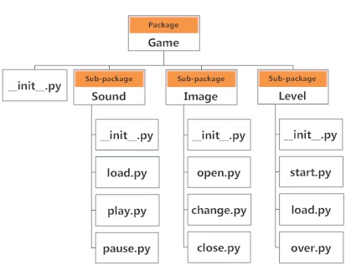
Packages and Sub-packages

Slide 50
https://en.wikiversity.org/wiki/Python_Programming

Slide 51
Lecture 5
Project I
Project II
Project III

Slide 52
Handling Exceptions
try:
Run this code (might have exception)
except:
Execute this code when there is an exception in try block
else:
Execute this code when there is NO exception in try block
finally:
Always run this code

