Slide 1
Lecture 4/5 Material
Object Oriented Programming
Classes
Inheritances
Modules and Packages
Python built-in modules
Install open-source packages
Create modules and packages
Input/output Python
Important libraries
NumPy
Pandas
Matplotlib

Slide 2
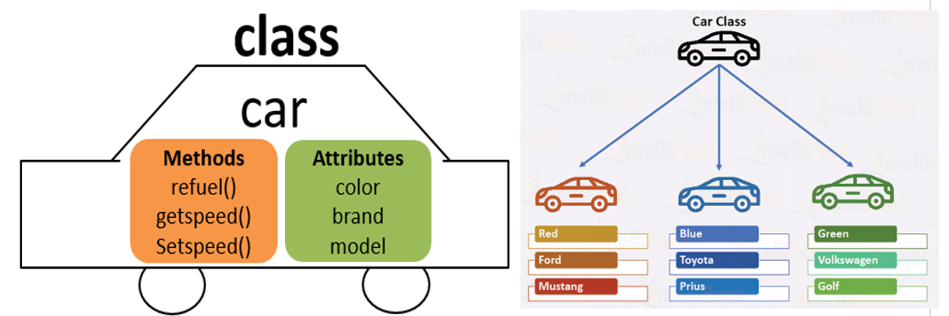
Object-Oriented Programming
Python is an object-oriented programming (OOP) language.
Object oriented programming is a programming paradigm that uses the concept of classes and objects
OOP allows programmers to create their own objects that have attributes and methods.
Classes define the structure of object and serve as a templates “blueprint” for creating them.
Objects are instances of classes; they are entities that contain data members called attributes (characteristics they possess) and procedures called methods (actions they perform).

Slide 3
Object-Oriented Programming
Define a class syntax
class NameOfClass():
def __init__(self,param1,param2):
self.param1 = param1
self.param2 = param2
def some_method(self):
# perform some action
The function inside the class are called methods when it is inside a class
__init__ is a method that allows you to create an instance of the actual object
param1 and param2 are parameters that you should pass when creating an instance of this object and they get assigned to an attribute of function.

Slide 4
Object-Oriented Programming
class NameOfClass():
def __init__(self,param1,param2):
self.param1 = param1
self.param2 = param2
def some_method(self):
# perform some action

Slide 5
Inheritances
Inheritances is a way to form new classes using classes that have already been defined.
The new class is called derived (or child) class and the one from which it inherits is called base (or parent) class
Inheritances syntax:
class BaseClass():
body of base class
class DerivedClass(BaseClass):
body of derived class

Slide 6
Python Modules and Packages
Modules are any text file containing python definition and statements with the .py extension and are called by another .py script.
Modules can define different Python objects such as functions, classes, variables, constants, etc.
A module objects can be made available to another Python script by using the import statement.
Packages are a collection of modules.
Python interpreter has number of built-in functions that are loaded automatically as the interpreter starts and are always available such as print(), int().
Python has several built-in modules that contain functions, classes, variables, and constants that can be used once the module is imported, such as the math module.

Slide 7
Python Modules and Packages
There are many other packages available that people have open-sourced and shared on PyPI.
Python Package Index (PyPI) is a repository of open-source Python packages supplied by the worldwide community of Python developers.
We can use pip install at the command line to install the packages available in PyPI.
pip is the package installer for python, which gets installed with Anaconda distribution (You already have it).
To install a package through command line:
> pip install package_name

Slide 8
Create Modules and Packages
We learnt how to import python built-in modules, and how to install modules/packages available in PyPI, but how do we create our own modules and packages and why we do that?
Modules allow us to split a large piece of code written in one script into several files (modules) for easier maintenance and reusability of the code
We can create modules (.py files) using Notepad for Windows users and TextEdit for Mac users.
We can create packages with these three step:
Create a directory and give it your package’s name
Put your modules in it.
Create a __init__.py file in the directory which makes Python know that this directory is a Python package directory.

Slide 9
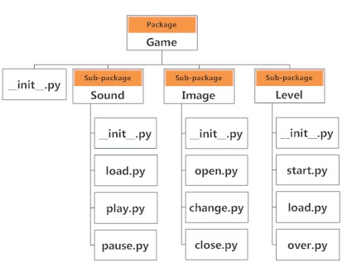
Packages and Sub-packages

Slide 10
NumPy Library
NumPy (stand for Numerical Python) is the core library for scientific computing in Python.
It provides a high-performance multidimensional array object and tools for working with these arrays.
NumPy provides the excellent ndarray objects, short for n-dimensional arrays.
In a ‘ndarray’ object, you can store multiple items of the same data type.
The key difference between an array and a list is, arrays are designed to handle vectorized operations while python list is not.
If you apply a function on an array, the function will perform on every item in the array, rather than on the whole array.
Cheat sheet
https://www.datacamp.com/community/data-science-cheatsheets?page=3

Slide 11
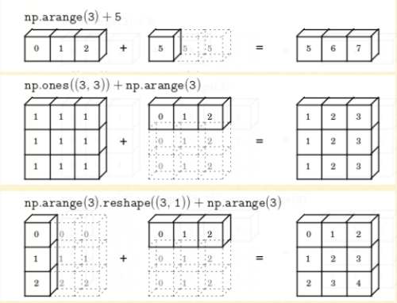
NumPy Broadcasting

Slide 12
Pandas Library
Pandas is an open source Python library that provides performance, easy to use data structure and data analysis tools.
Pandas runs on top of NumPy library (uses NumPy)
NumPy provides objects for multi-dimensional arrays, while Pandas provides 2d table objects called Dataframe.
These Datafream are like a spreadsheet with column names and row labels.
Cheat sheet
https://github.com/pandas-dev/pandas/blob/master/doc/cheatsheet/Pandas_Cheat_Sheet.pdf

