Slide 1
Python Crash Course
Lecture 3

Slide 2
Lecture 3 Material
Methods
Functions
Nested Functions
Names and Namespaces
Python Variable Scope
Syntax Errors and Exceptions
Exceptions Handling

Slide 3
Python methods
Method is called by its name and it is associated to an object
Can access the data within the object and may alter an object's state
With methods, the idea is the object is acted upon by the function, where the focus is on the object
Methods syntax
<object>.<method>(<arguments>)
There are many built-in methods for different objects in Python (list, tuples, dictionary…etc)
To check all available methods for an object in Jupyter notebook type:
<object>.
then press tab

Slide 4
Python functions
Function is a block of code used to carry out a specific task.
Functions are called without any object, so it doesn't alter the object’s state
With functions, the idea is the function acts on the arguments, where the focus in on the function.
Define function syntax
def <function name> (<arguments>):
<function body>
return <value>
Calling function syntax
function name(<arguments>)

Slide 5
Python Names and Namespaces
Name is simply a name given to object (everything in Python is an object).
Example: a = 2, here 2 is an object stored in memory and a is the name associated it with.
Namespace is a collection of names (mapping of every name you have defined to corresponding object).
Namespace is a system to have a unique name for every object in Python.
Python implements namespaces as dictionary; there is a name-to-object mapping, with the names as keys and the objects as values.
Lifetime of a name space depends upon the scope of objects, if the scope of the object ends, the lifetime of that namespace comes to an end.
Notes:
https://www.programiz.com/python-programming/namespace
https://www.geeksforgeeks.org/namespaces-and-scope-in-python/

Slide 6
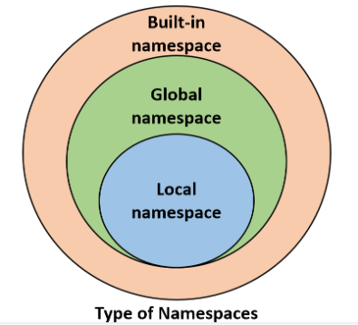
Python Namespaces
Types of namespaces:
Built-in namespace: includes Python built-in functions and is created when we start the Python interpreter (ie: print(), list,.. Etc).
Global namespace: includes names from various imported modules that are being used in a project and is created when the module is imported in the project and lasts until the script ends.
Local namespace: Include local names inside a function and is created when a function is called, and it only lasts until the function returns.

Slide 7

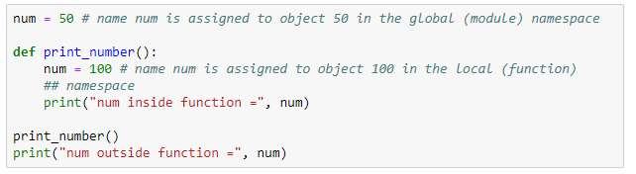
Python Namespaces
Multiple namespaces can exist independently from each other and they can contain the same variable name.
This means a name num can be assigned to object 50 in the global (module) namespace, and the same name num can be assigned to object 100 in the local (function) namespace without overwriting it
If we tried to access the object of the name num, what do we get?
To understand the answer, we need to learn the concept of scope

Slide 8
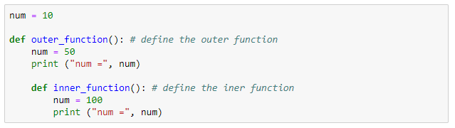
Python Scope
A scope is code region form which a particular object is accessible.
A name has a scope that defines the parts of the program where we could access that name.
We cannot access any particular object from anywhere from the code.
Question: “In which order does Python search the different levels of namespaces before it finds the name-to-object’ mapping?”
Answer: It uses the LEGB-rule which stand for
Local -> Enclosed -> Global -> Built-in
Global Scope
Enclosed Scope
Local Scope

Slide 9
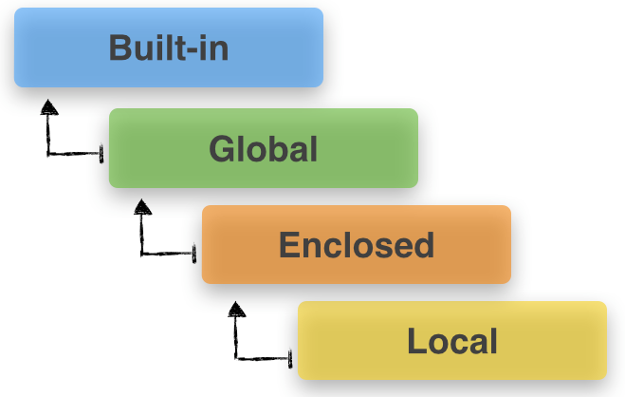
LEGB Rule
Local scope – innermost scope which is the scope of the current function (search for a name inside the current function)
Enclosed scope – scope of all enclosing function, when the current function is inside another function “enclosing function” (search for a name starts from the nearest enclosing scope and move outwards)
Global scope – scope of the module file (search for all global names from the current module)
Built-in – outermost scope (search for built-in names in Python)

Slide 10
Python Variable Scope
Scope refers to the code region from which a specific Python object is accessible.
We cannot access any specific object from anywhere from the code
There are multiple scopes in a program:
Local scope
Enclosed scope
Global scope
Built-in scope
Notes:
https://sebastianraschka.com/Articles/2014_python_scope_and_namespaces.html

Slide 11
Syntax Errors and Exceptions
A Python program terminate as soon as it encounters an error.
There are two types of errors in Python:
Syntax errors:
Mistakes in the use of the Python language (similar to spelling or grammar mistakes in English language).
Python find syntax errors when it tries to parse (analyze the syntax) your program and exit with an error message without running anything.
Exceptions:
Errors detected during executions (The sentence flap your arms and fly to China, is correct but impossible to execute)
These errors are normally detected if there is no syntax errors in the code.

Slide 12
Syntax Errors
Common Python syntax errors include:
Leaving out or misspelling a keyword
Putting a keyword in the wrong place
Leaving out a symbol, such as colon, comma or brackets
Incorrect indentation
Empty block

Slide 13
Exceptions
Common Python exceptions include:
Division by zero
Performing an operation on incompatible types
Using and identifier which has not been defined
Accessing a list element, dictionary value or object attributes which doesn’t exist
Trying to call a function which is not defined

Slide 14
Handling Exceptions
All the programs we have wrote so far ignored the fact that things can go wrong (program might crash because of exceptions)
A program which crashes whenever it encounters an easily foreseeable exception is not very pleasant to use.
Most users expect programs to be robust enough to deal with easily foreseeable exceptions.
If we know that a particular section of our program is likely to cause an exception, we can use handling exceptions to tell Python what to do if the exception does happen, instead of letting that exception crash our program.
Handling exceptions let the script continues with the rest of the code and report the exception if it exist.

Slide 15
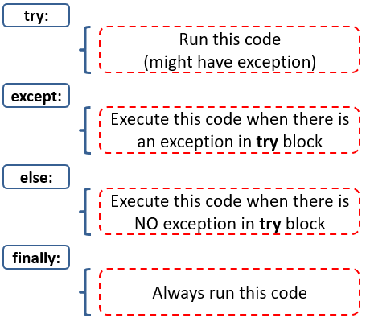
Handling Exceptions
Four keywords used for handling exceptions:

