Slide 1
Python Crash Course
Course Objectives:
Introduce the fundamentals of programming with Python.
Give the required programming background to take machine learning, neural networks and deep learning courses.
Instructor:
Mahir Jalanko
Ph.D. Candidate – Chemical Engineering department
Bachelor of Chemical Engineering and Management (McMaster 2016)
Email : jalankmd@mcmaster.ca

Slide 2
Python Crash Course Outline
Python Setup
Python Object and Data Structure Basics
Python Comparison and logical Operators
Python Statements (loops)
File Input/output in Python
Python Methods and Functions
Errors and Exceptions Handling in Python
Object Oriented Programming in Python
Modules and Package in Python

Slide 3
Python Crash Course
Lecture 1

Slide 4
Lecture 1 Material
Command Prompt basics
Install Anaconda/Jupyter notebook
Access course material (Github)
Python object and data structure basics
Integers
Floating point
Strings
Lists
Dictionaries
Tuples
Sets
Booleans

Slide 5
Lecture 1 Material
Command Prompt basics
Install Anaconda/Jupyter notebook
Access course material (Github)
Python object and data structure basics
Integers
Floating point
Strings
Lists
Dictionaries
Tuples
Sets
Booleans

Slide 6
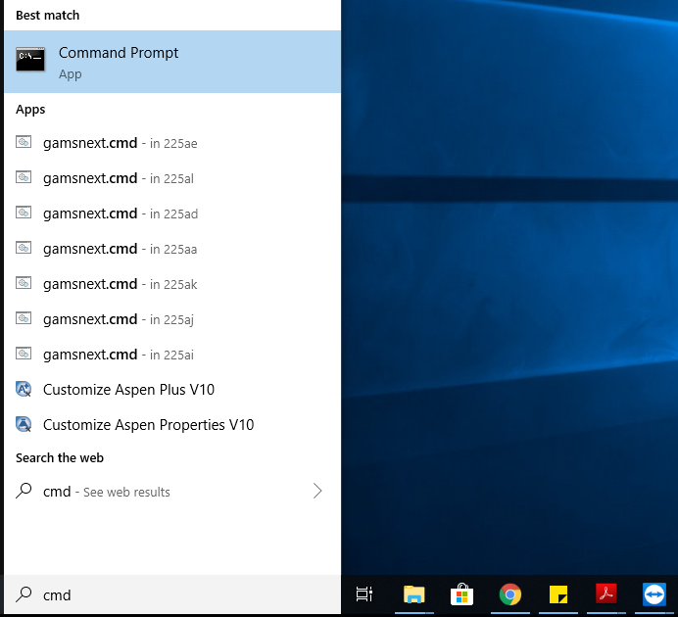
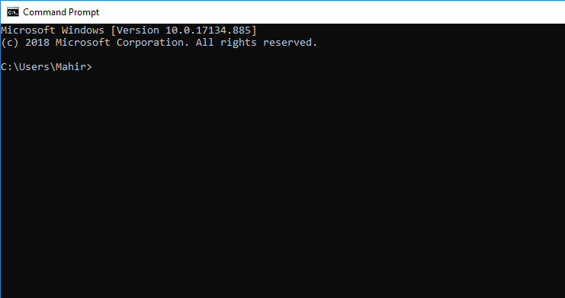
Command Prompt Basics
Command Prompts is a command line interface used to execute commands in your operating system (Windows, MacOS).
From the Command Prompts, you can navigate through files and folders on your computer, just as you would do with your mouse. The difference is that the Command Prompts is fully text-based.
Windows users: To get to the command prompt go to Start -> Search -> type ‘cmd’ and click on command prompt.
MacOS: To get to the command prompt (called terminal) go to Search -> type ‘terminal’ and click on terminal.

Slide 7
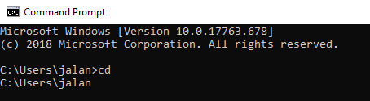
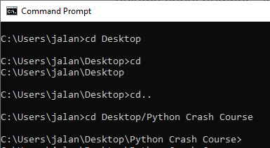
Command Prompt Basics
Display current directory
cd (Windows)
pwd (MacOS)
Show all the files and folder located at the current directory
dir (Windows)
ls (MacOS)
Move to a folder in your current directory
cd Desktop
Go back up a directory
cd ..
Clean the command line screen
cls (Windows)
clear (MacOS)

Slide 8
Lecture 1 Material
Command Prompt basics
Install Anaconda/Jupyter notebook
Access course material (Github)
Python object and data structure basics
Integers
Floating point
Strings
Lists
Dictionaries
Tuples
Sets
Booleans

Slide 9
Python Installation
Install Python using Anaconda distribution.
Anaconda distribution includes Python and other useful programming languages, including Jupyter notebook.
In this course, we will use Jupyter notebook mostly to write and run our code.
To Install Anaconda go to www.anaconda.com/downloads

Slide 10
Jupyter Notebook
Jupyter Notebook is an application that allows editing and running notebook documents via a web browser.
Jupyter Notebook can be executed on a local desktop requiring no internet access
Jupyter Notebook is great for learning, because the inputs and outputs can be displayed next to each other.
Special file formats that have the extension .ipnyb not regular python extension .py
These notebooks can be lunched using Jupyter notebook only and cannot be opened by double-clicking on the file in your computer
Let’s start working with Jupyter Notebook

Slide 11
Lecture 1 Material
Command Prompt basics
Install Anaconda/Jupyter notebook
Access course material
Python object and data structure basics
Integers
Floating point
Strings
Lists
Dictionaries
Tuples
Sets
Booleans

Slide 12
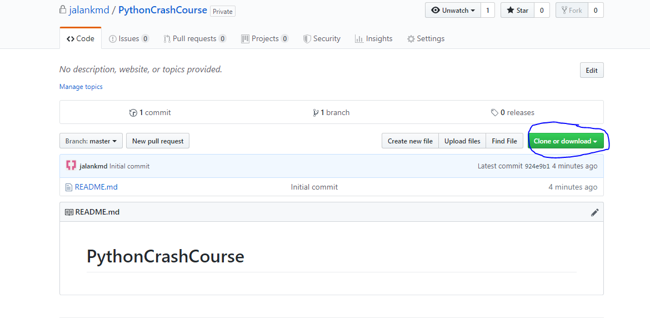
Access Course Material (Github)
Go to https://github.com/jalankmd/PythonCrashCourse
Click on clone or download
Download ZIP

Slide 13
Lecture 1 Material
Command Prompt basics
Install Anaconda/Jupyter notebook
Access course material (Github)
Python object and data structure basics
Integers
Floating point
Strings
Lists
Dictionaries
Tuples
Sets
Booleans

Slide 14
Data types in Python
Name | Type | Description
Integers | int | Whole numbers, such as: 3 200 1000
Floating point | float | Numbers with a decimal point: 2.5 3.64 200.0
Strings | str | Ordered sequence of characters: “hello” ‘Magic’ “2000”
Lists | list | Ordered sequence of objects: [3,”hello”,10.2]
Dictionaries | dict | Unordered (key:value) pairs: {“key1” : “value1”, “key2” : “value2”}
Tuples | tup | Ordered immutable sequence of object: (3,”hello”,10.2)
Sets | set | Unordered collection of unique object: {“a”,”b”}
Booleans | bool | Logical value: True or False

