Slide 1






VPB Game Studio (Group 2)
Vatsal Shukla Prajvin Jalan Baltej Toor

Slide 2
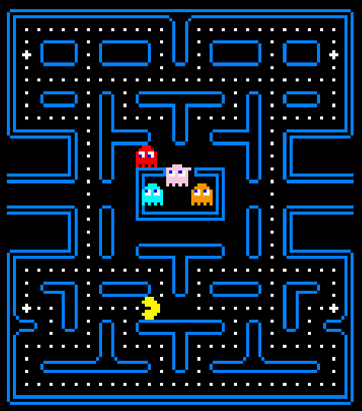
What is NAMCAP?
Redevelopment of the classic-arcade game, Pacman
Purpose:
Develop a simplistic & approachable arcade-style experience
Focus on formal development & documentation practices
Deliver a unique perspective on the arcade classic

Slide 3






Scope
Implement all core game mechanics
Movement
Collision
Enemy AI
Dot & Big Dot
Scoring
Aim to improve usability & learnability wherever possible

Slide 4


Development
The VPB Approach:
Iterative & Traceable Design: Consistent parallel updates to implementation and documentation
Constant Communication: Daily notifications + weekly formalized meetings
User-Focused: Stay true to source material; focus on usability + playability

Slide 5
Technologies
Java
Object-oriented development; following Google Java Standards
Swing + AWT
Graphics libraries used to redevelop the classic-arcade UI
JUnit
Testing suite used for both mechanics & scenario automated testing

Slide 6
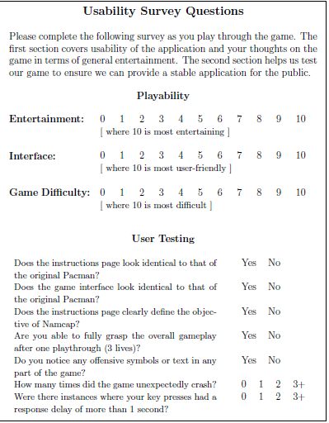
Usability
Google Forms for Usability Survey
Assesses system usability (also learnability)
90% of users gave the game 9/10 (and above) for interface user-friendliness
Difficulty:
30% of users gave 5/10
30% of users gave < 5/10
40% of users gave > 5/10

Slide 7
Learnability
Maintainability & Portability
Usability Survey used to assess learnability as well
100% of users surveyed responded:
Instructions page clearly defines the objective of Namcap
Able to fully grasp the overall gameplay after one play-through
Generic design allows for efficient implementation of future features
Developed character & object (dot, big dot) infrastructure
Game runs on any laptop with the JRE installed
Runs on Windows & Mac/Linux

Slide 8
Demo

Slide 9
Project Retrospective
Namcap was successful in recapturing that classic arcade experience while providing a new, unique perspective on Pacman
Efficient development was achieved through constant communication and iterative design & documentation updates
Future Development:
In-game audio
Additional Power-ups & Levels

