Slide 1






VPB Game Studio (Group 2)
Vatsal Shukla Prajvin Jalan Baltej Toor

Slide 2
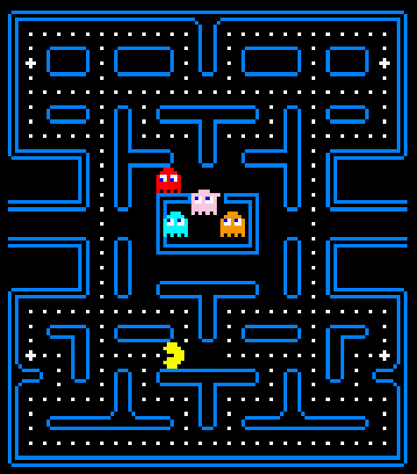
What is NAMCAP?
Redevelopment of the classic-arcade game, Pacman
Purpose:
Develop a simplistic & approachable arcade-style experience
Focus on formal development & documentation practices
Deliver a unique perspective on the arcade classic

Slide 3






Scope
Implement all core game mechanics
Movement
Collision
Enemy AI
Dot & Big Dot
Scoring
Aim to improve usability & learnability wherever possible

Slide 4


Development
The VPB Approach:
Iterative & Traceable Design: Consistent parallel updates to implementation and documentation
Constant Communication: Daily notifications + weekly formalized meetings
User-Focused: Stay true to source material; focus on usability + playability

Slide 5
Technologies
Java
Object-oriented development; following Google Java Standards
Swing + AWT
Graphics libraries used to redevelop the classic-arcade UI
JUnit
Testing suite used for both mechanics & scenario automated testing

Slide 6
Usability

Slide 7
Learnability
Maintainability & Portability

Slide 8
Demo

Slide 9
Project Retrospective
Namcap was successful in recapturing that classic arcade experience while providing a new, unique perspective on Pacman
Efficient development was achieved through constant communication and iterative design & documentation updates
Future Development:
In-game audio
Additional Power-ups & Levels

