Slide 1
Extracting Comparators from Comparable Questions using Data Mining
Presented by
Jalan Macherla
Committee
Dr Zhengxin Chen
Dr Sanjukta Bhowmick
Dr Abhishek Parak

Slide 2
Agenda
Introduction
Objective
Theoretical Concepts
Implementation
Challenges
Conclusion
Future Work
References

Slide 3
Introduction
Decision making
Knowing alternatives
Comparative questions
Comparators
Implementing Bootstrapping algorithm, Nearest neighbor algorithm and Association rules

Slide 4
Objective
Make use of concepts of data mining to develop a system which provides the user with Alternate choices.
Mine comparative entities from comparable questions.
Attain high Precision and Recall
Provide user with alternatives
Integrate Nearest Neighbour Algorithm and Association rules.

Slide 5
Theoretical Concepts
Bootstrapping algorithm
Nearest neighbor algorithm
Association rule mining

Slide 6
Data Mining
Explaining the past and predicting the future.
Analyzing structured/unstructured data
Regression
Classification
Frequency table
Covariance Matrix
Similarity functions
Nearest Neighbor algorithm

Slide 7
Nearest Neighbor Algorithm
Instance based Learning
Stores all available cases and classifies new cases based on a similarity measure.
Instances represented as points in a Euclidean space.
Nearest neighbor are defined in terms of Euclidean distance, dist(X1,X2)

Slide 8
Nearest Neighbor Classifiers
Basic idea:
If it walks like a duck, quacks like a duck, then it’s probably a duck
Basic idea:
If it walks like a duck, quacks like a duck, then it’s probably a duck
Compute Distance
Compute Distance
Test Record
Training Records
Choose k of the “nearest” records

Slide 9
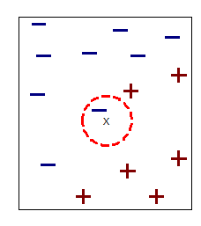
Definition of Nearest Neighbor

Slide 10
Nearest Neighbor Classification
Compute distance between two points:
Euclidean distance

Slide 11
Association Rule Mining
Association rule mining
Finding frequent patterns, associations, correlations against a larger data set.
Item set
A collection of one or more items
Example: {iPhone, charger}
k-item set
An item set that contains k items

Slide 12
Association Rule
Association Rule
X → Y
X and Y are item sets
Rule Evaluation Metrics
Support = frq(X,Y)/N
Confidence = frq(X,Y)/frq(X)

Slide 13
Bootstrapping algorithm
Not an algorithm as such, it’s a process
Two main key steps
Pattern generation
Pattern evaluation

Slide 14
Lexical patterns: These patterns indicate sequential patterns consisting of only words and symbols ($C, #start, and #end).
Example: Which is better, Omaha or Lincoln?
Generalized patterns: A lexical pattern is too specific for matching. Lexical patterns are generalized by replacing one or more words with their POS tags.
Example: Which city is better, Omaha or Lincoln?
Specialized patterns: Pattern specialization by adding POS tags to all comparator slots.
For example, from the lexical pattern “<$C or $C>” and the question “Omaha or Lincoln?”, “<$C=NN or $C=NN?>” will be produced as a specialized pattern.
Example: Omaha or Lincoln?

Slide 15

Pattern Evaluation

Slide 16
Implementation

Slide 17
Development Environment
MySQL database
Eclipse IDE
Java / J2EE ( Web services )
Tomcat 7.0

Slide 18
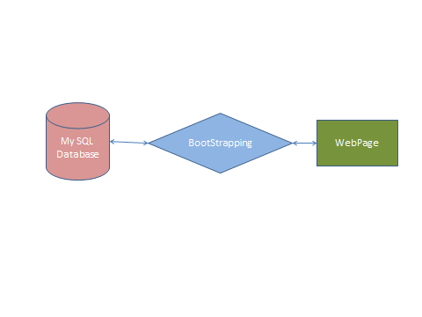
Block Diagram

Slide 19
Comparative questions: A question intended to compare entities of similar types.
Comparators: Entities in the comparative questions which are to be compared

Slide 20
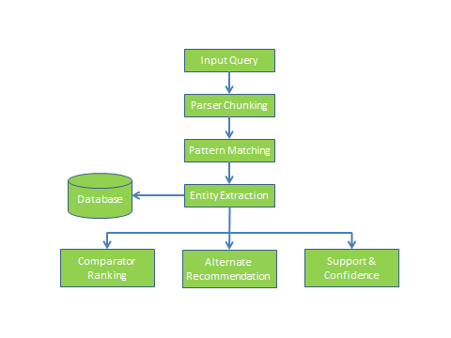
Program Flow

Slide 21
Take input from user.
Check whether the input question is a valid question or not.
If it’s a valid question, then the regular process should follow.
Match the input with the existing question in the database and extract comparators from them.
Extract comparators from the comparative questions.
Suggest user with alternatives for a give input.

Slide 22
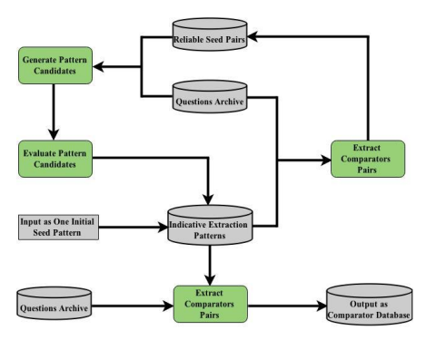
Bootstrapping

Slide 23
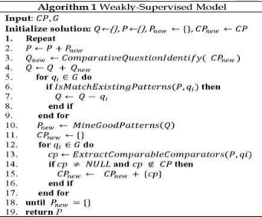
Pseudo code

Slide 24
Weakly supervised method or Comparator Mining
Mining Indicative Extraction Patterns
Comparator Extraction

Slide 25
Bootstrapping starts with a single IEP
Extract initial seed comparator pairs from that single IEP
For each comparator pair all questions that contain the pair are considered as the comparative questions
From comparative questions, all the possible comparators are extracted.
Reliable patterns are added to the IEP repository.

Slide 26
Rules for Phrase Chunker
/* * Heuristic rules
* NP* -> NP
* NN* -> NN
* NN + NNS -> NNS
* NP + NPS -> NPS
* More + ADJ -> JJR
* Most + ADJ -> JJS
* ...
*/

Slide 27

Generate frequent patterns using Association Rules

Slide 28
Nearest neighbor algorithm
Query word
Neighbor

Slide 29
User roles
Admin
Load the dataset, answer the questions, delete the questions
User
Search for alternatives
Answer the questions.
Search for a question
See association rules

Slide 30
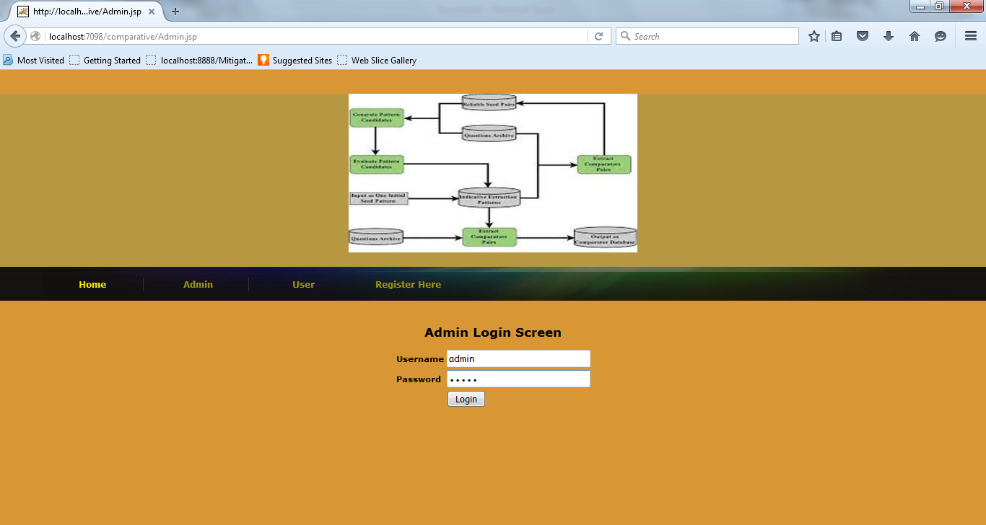

Slide 31
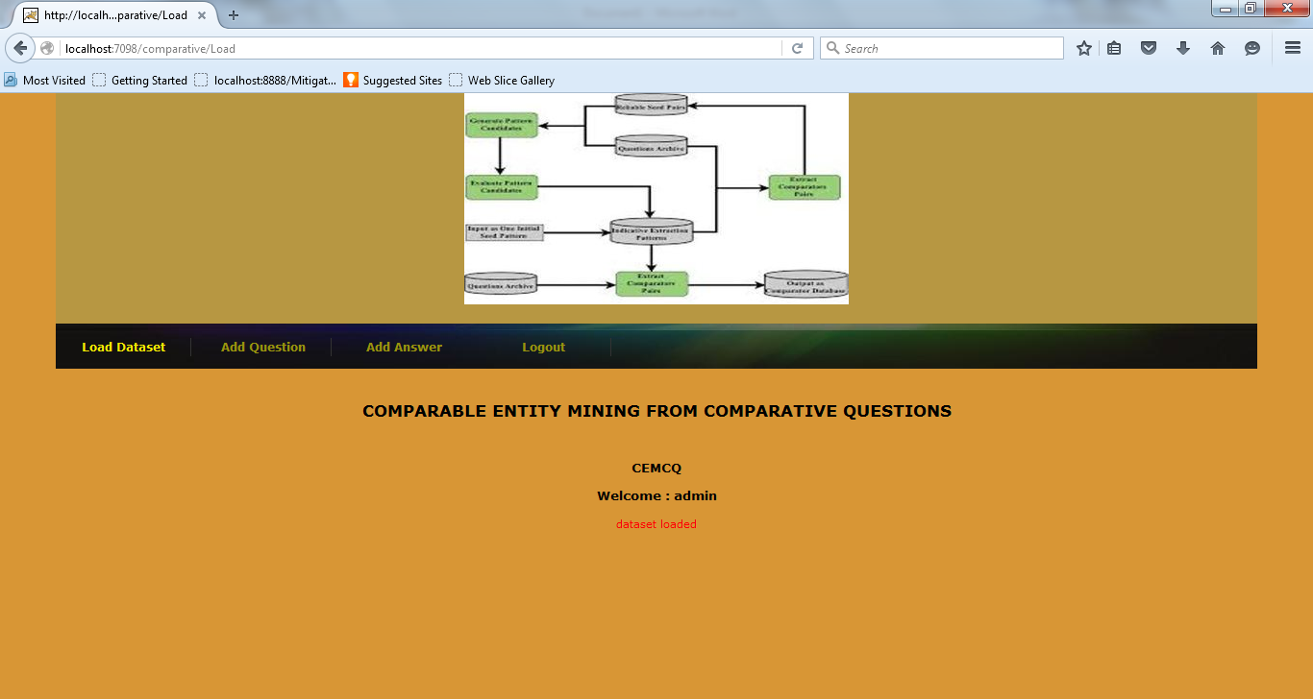

Slide 32
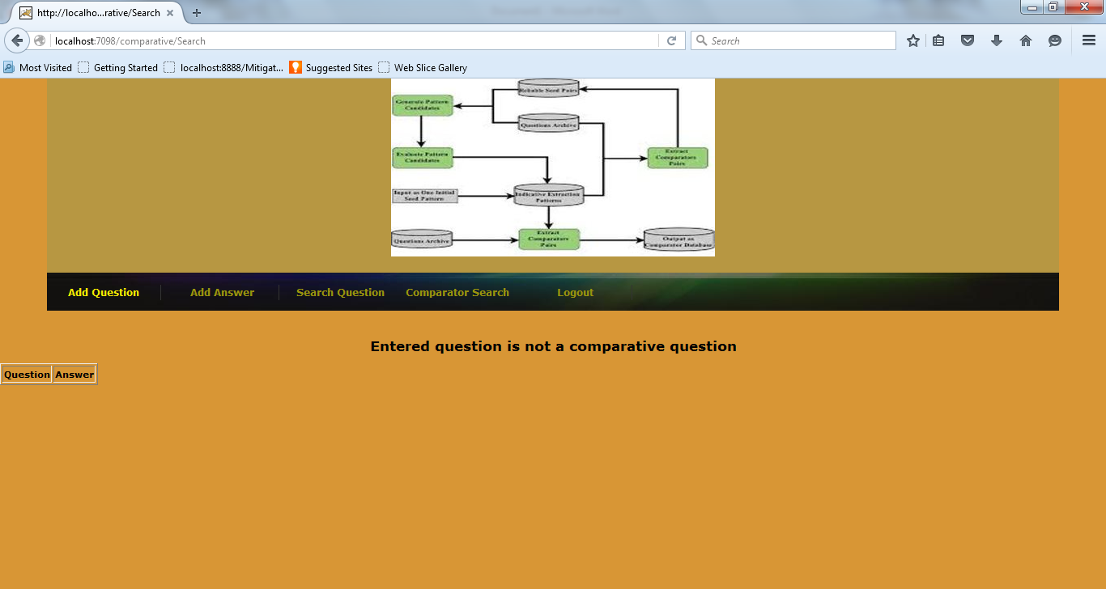

Slide 33
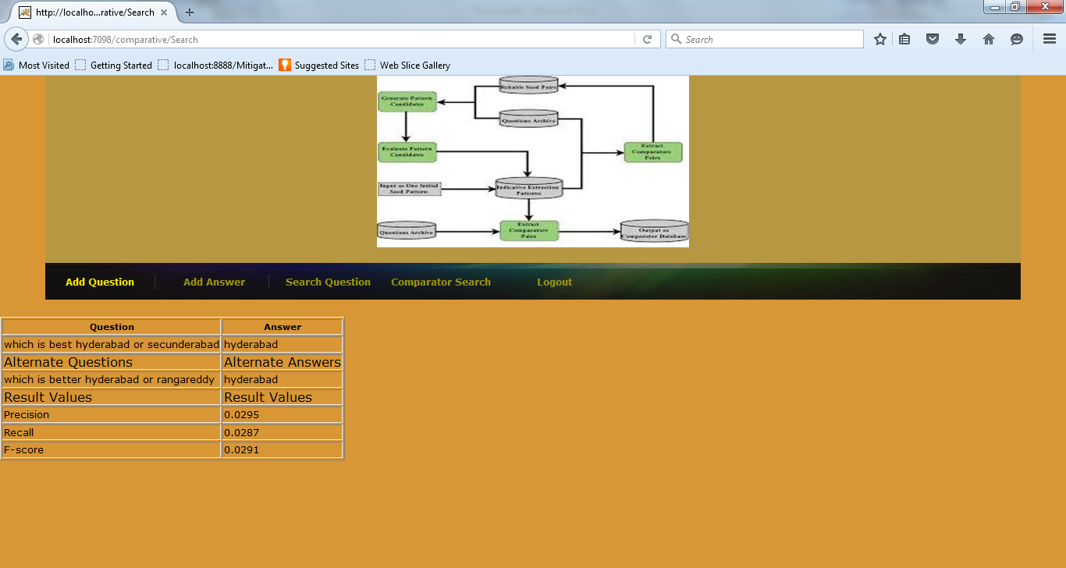

Slide 34
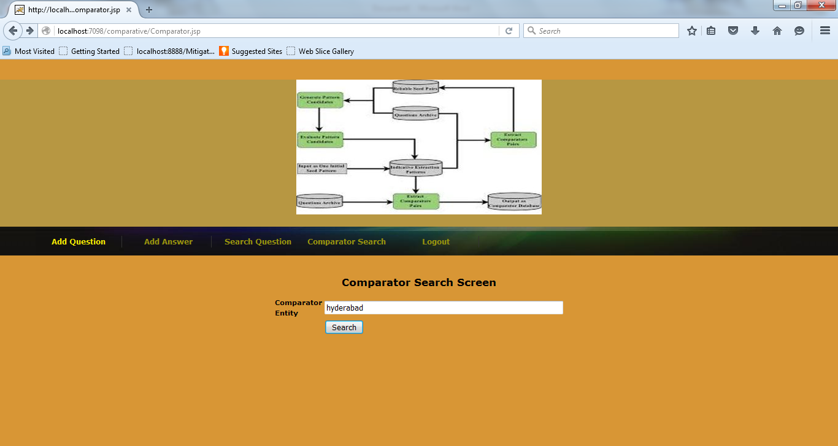

Slide 35
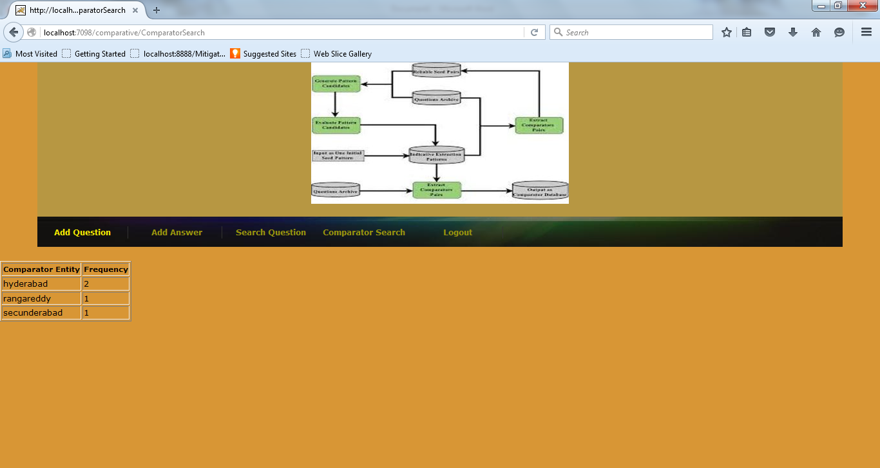

Slide 36
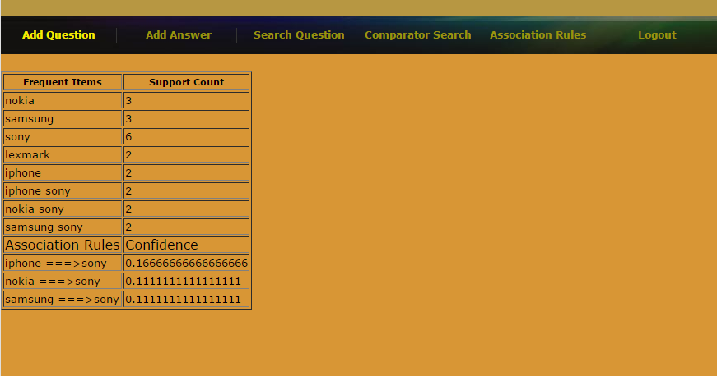

Slide 37
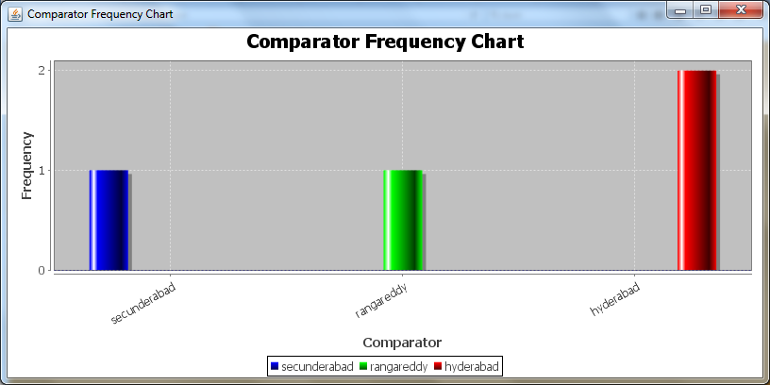

Slide 38
Challenges
Finding online repository of question and answers, and answering them
Implementation of bootstrap algorithm
Integrating the new questions added into the database

Slide 39
Conclusion
Making use of data mining in finding the comparators.
System can be used in decision making process.
Helps the companies in identifying their competitors.

Slide 40
Future work
Pool attributes of similar type into one.
Ambiguity resolution
Performance tuning as and when the database grows.

Slide 41
References
N. Jindal and B. Liu, “Identifying Comparative Sentences in Text Documents,” Proc. 29th Ann. Int’l ACM SIGIR Conf. Research and Development in Information Retrieval (SIGIR ’06), 2006, 244-251.
Li Shasha, Chin-Yew Lin, Young-In Song, and Zhoujun Li, “Comparable Entity Mining from Comparative Questions”, Knowledge and Data Engineering, IEEE Transactions on 25, no. 7, pp. 1498-1509, 2013
https://www.cs.purdue.edu/homes/aref/cs-690d-presentations/MiningAssociationRules.ppt

Slide 42
Thank you

