Slide 1
Variance Based-Clustering with Various Attribute Measures
Supervisory Committee
Presented by
Raghunath Duggi
NUID: 75063575
Email:
RDUGGI@UNOMAHA.EDU
Dr. Zhengxin Chen
Dr. Harvey Siy
Dr. Kenneth Dick

Slide 2
Outline
Systems
Objective
Architecture
Dataset features
Algorithms
Results
Conclusion & Future Work

Slide 3
Real time Systems
System#1
Based on current traffic
No previous data is considered
Relies only on time factor
System#2
Takes historical data
Along with time, frequency factor is considered

Slide 4
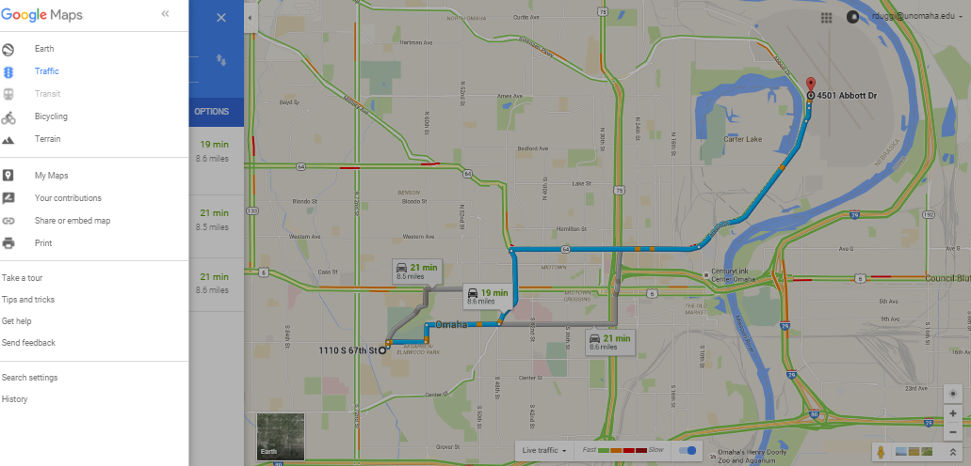
Google Maps – Live Traffic

Slide 5
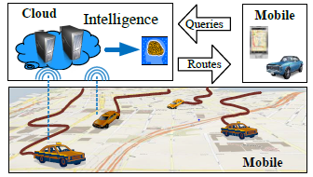
Real time system with Historical data:

Slide 6
Objective
To reduce the query response time by proposing our own unique approach.
Project focus is to perform comparative study between two clustering algorithms (Variance based clustering with Entropy & Variance based clustering with Gini Index).
Time complexity analysis to show comparison results.

Slide 7
Trajectories
When the whole history of a moving object is stored and available for analysis, the sequence of spatial locations visited by the object, together with the time-stamps of such visits, form what is called a trajectory

Slide 8
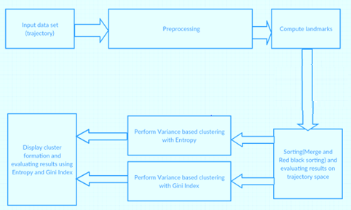
Architecture

Slide 9
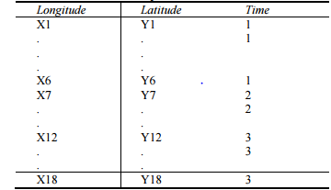
Data dimensions:

Slide 10
Data Set Features:
Feature | Data type | Comment | Example
Latitude | Float | Geographical latitude position | 38.2789
Longitude | Float | Geographical longitude position | 116.3855
Date | String | Date of journey | 2009-10-11
Time | String | Time of journey | 14:04:30

Slide 11
Unique and Duplicate routes
Path#2
Path#1

Slide 12
Continued…
Junction diagram to explain the unique routes
If the Euclidian distance > threshold (width of the lane)
Then treat it as a unique or new route
If the Euclidian distance < threshold (width of the lane)
It is a duplicate route
Increase the frequency counter of this route by 1

Slide 13
Calculating Landmark Edges??
In the given trajectory dataset calculate the distance between relative positions and store all of them in a data structure(array) and see if the all the values are less than a certain threshold say x.
We get the trajectories which are similar in their routes.

Slide 14

Distance Measures (Euclidean)

Slide 15
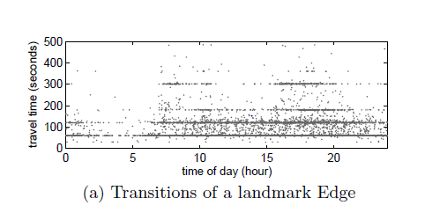
Landmark Edge Transitions:
**The above image is taken from [1] base paper.

Slide 16
Continued…
X:is the particular time slot of the day.
Y:Represents the amount of time a car was there on the particular route

Slide 17
Sorting Time complexity Analysis:
Dataset size | Time taken for Merge sort | Time taken for Red black sort
10k | 12 msec | 10 msec
20k | 18 msec | 15 msec
30k | 22 msec | 20 msec
40k | 25 msec | 23 msec

Slide 18
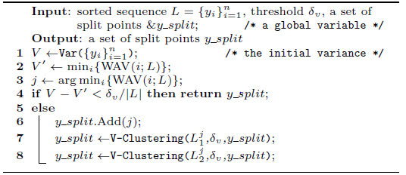
Variance based Clustering:

Slide 19
Implementation details
INPUT: Trajectory Dataset.
Step1: For each landmark say ‘L’ select all the different travel time durations.
Step2: Calculate the total variance of the above Step1 sorted durations.
Step3: Find the best split based on minimal weighted average variance. (WAV)
Step 4: Find the difference between total variance and the WAV.
Step 5: Compare the value in Step 4 with an experimental threshold value.
Step 6: If value in Step 4 is less than the (threshold/data set size) then return split points else continue from Step 3.
OUTPUT: Clusters formation

Slide 20



Variance Calculation:
Variance is calculated as :
Weighted Average Variance:

Slide 21
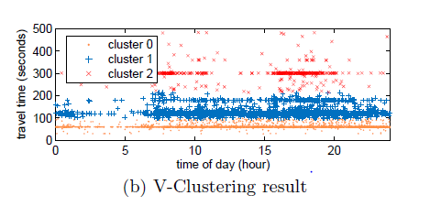
V-Clustering Results:
**The above image is taken from [1] base paper.
The point where the clusters are not overlapped is called the best split point.

Slide 22
Entropy Calculation:
INPUT: Duration Dataset
Step1: Find the cluster ids for the corresponding travel durations from the above V-clustering.
Step2: Calculate the total Entropy of the above Step1 grouped durations.
Step3: Find the best split based on minimal weighted average Entropy. (WAE)
Step 4: Find the difference between total Entropy and the WAE.
Step 5: Compare the value in Step 4 with an experimental threshold value.
Step 6: If value in Step 4 is less than the (threshold/dataset size) then return split points else continue from Step 3.
OUTPUT: Best split points.

Slide 23

Entropy :
Pi : Number of points in a cluster divided by total points in the system.

Slide 24


Weighted Average Entropy Calculation:

Slide 25
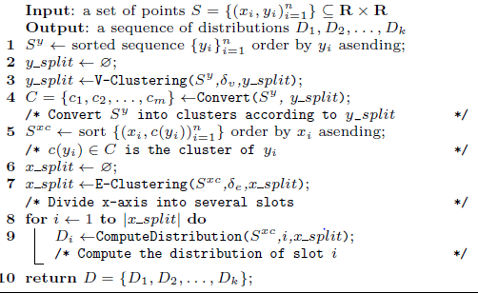
Variance-Entropy Based Clustering

Slide 26
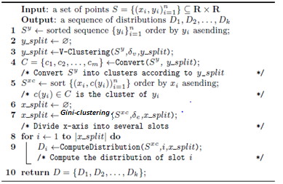
Variance-Gini Based Clustering

Slide 27
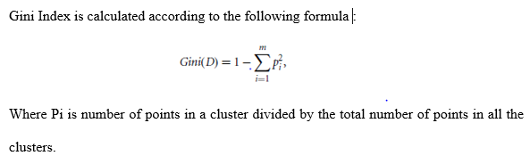
Variance based Clustering with Gini Index

Slide 28
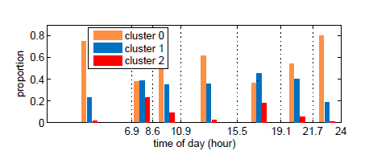
V Clustering with various Entropy attribute measure:
**The above image is taken from [1] base paper.

Slide 29
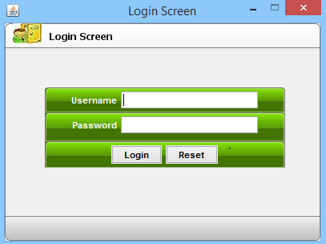
Screenshots: Login

Slide 30
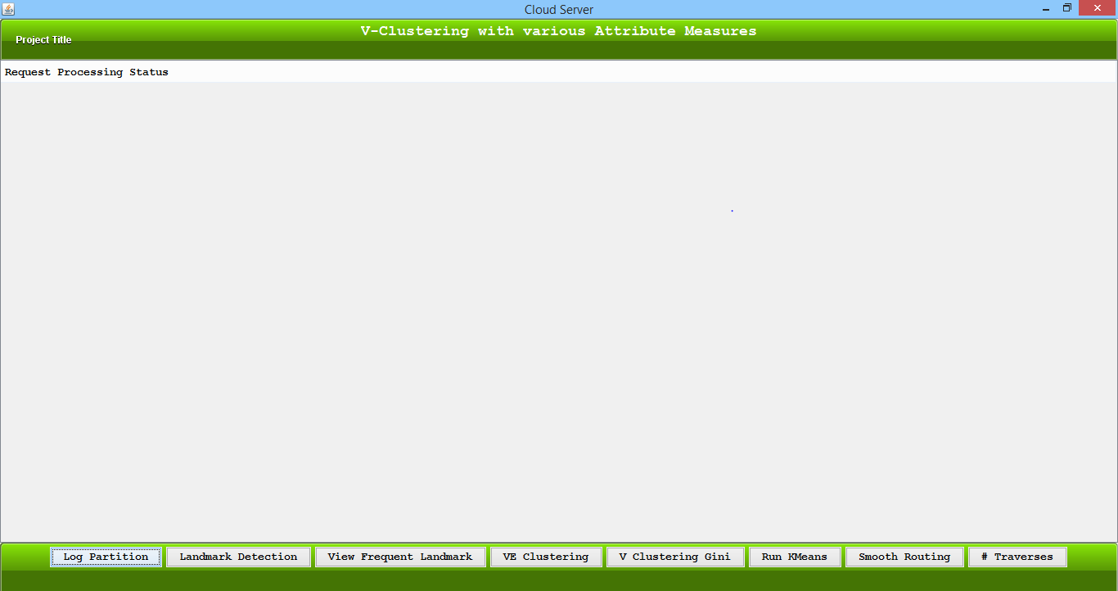
Home Screen:

Slide 31
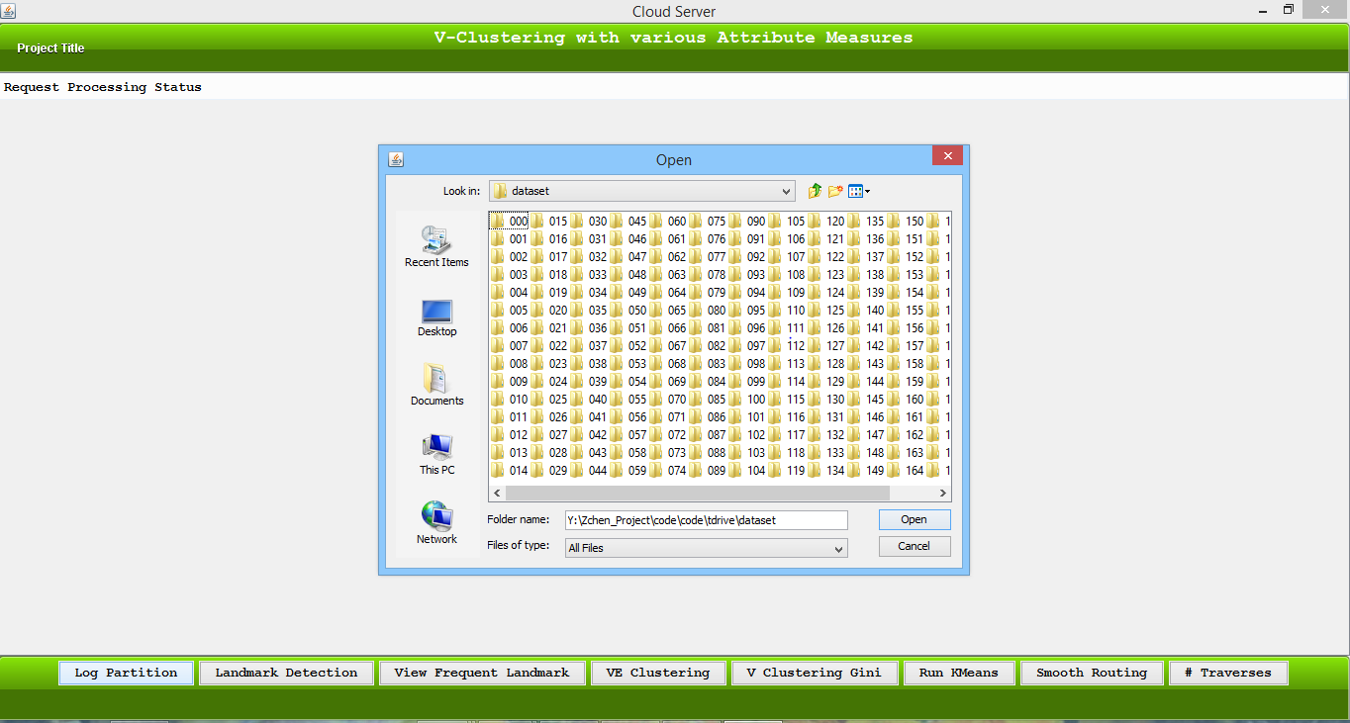
Browse Dataset:

Slide 32
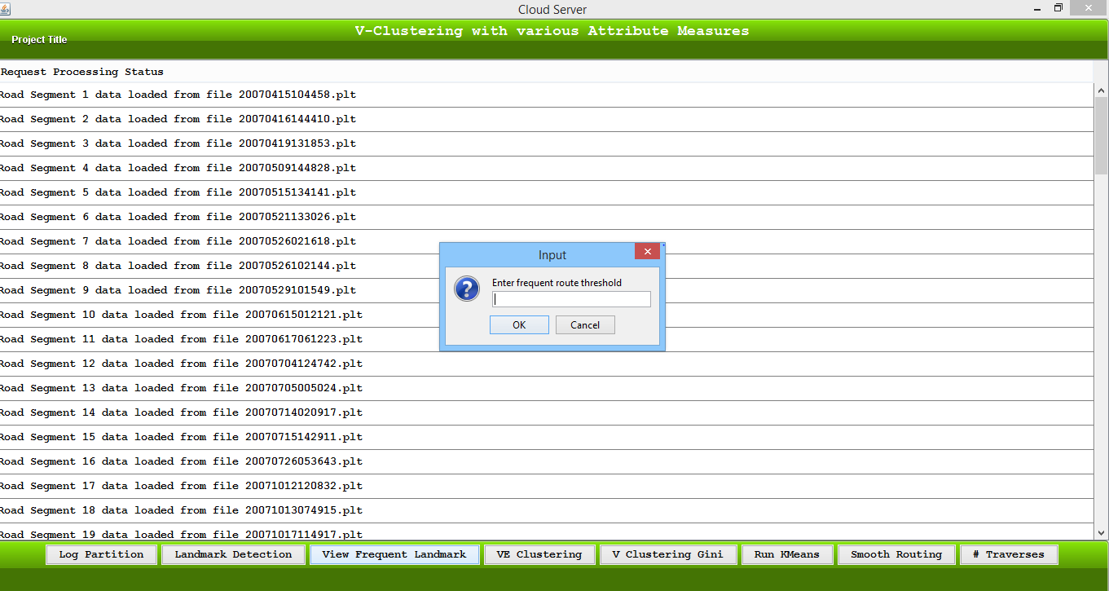
Frequent Routes:

Slide 33
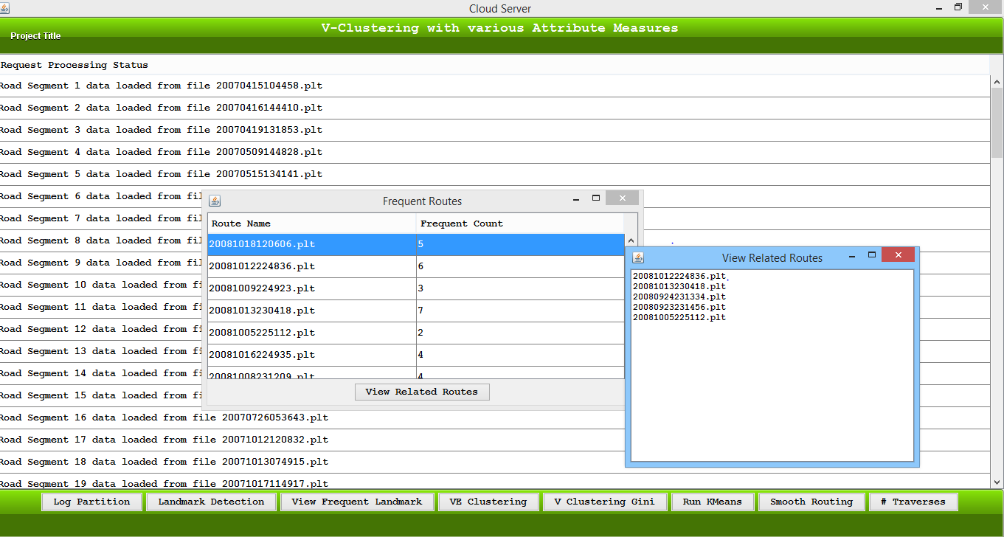
Frequent Routes:

Slide 34
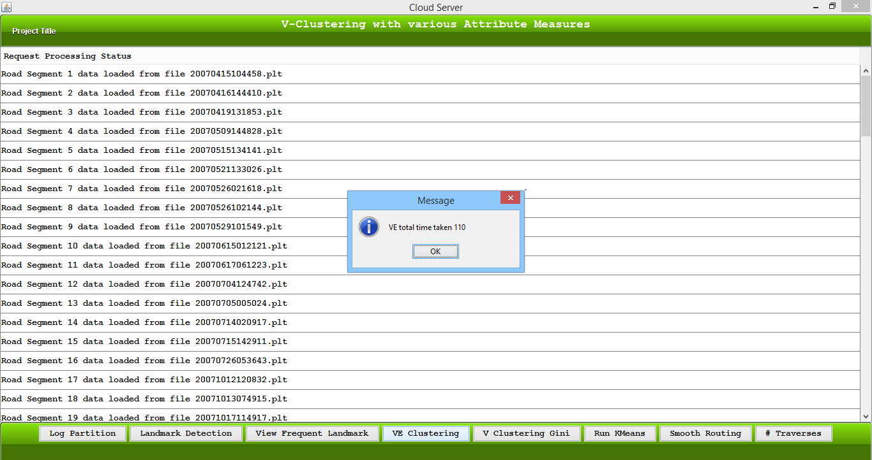
VE Clustering:

Slide 35
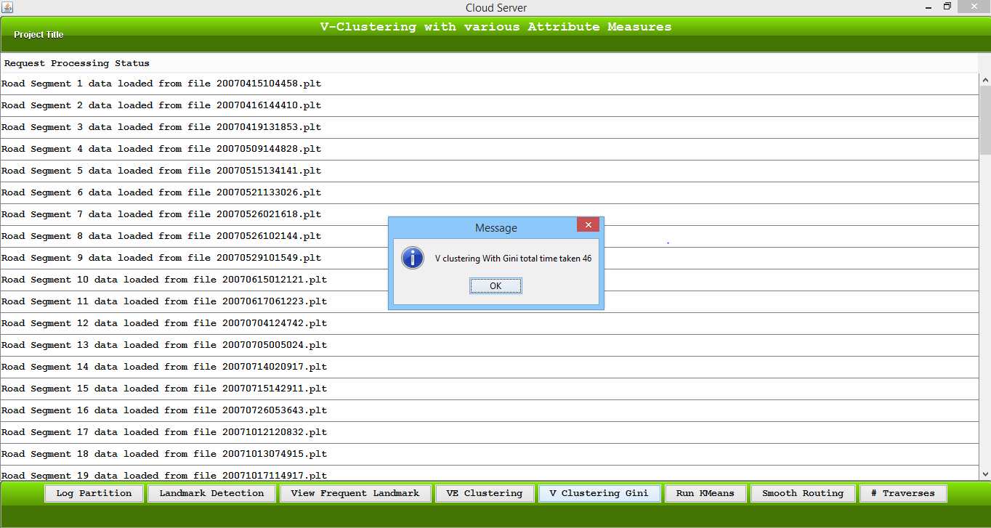
Variance Clustering with Gini Index:

Slide 36
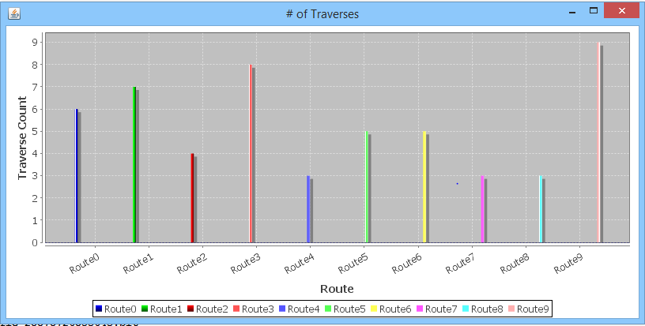
Traversal counts:

Slide 37
Results:
Dataset size | Variance Threshold | Entropy Threshold | Gini Threshold | E step time | G step time
10k | 2055488.00 [220,155,285] | 2.0 Split points :5 | 2.2 Split points:5 | 59 sec | 57 sec
20k | 9555488.00 [220,155,285] | 1.43 Split points:13 | 1.65 Split points 16 | 137 sec | 114 sec
30k | 9555488.00 [220,155,285] | 1.6 Split points :8 | 1.6 Split points:9 | 788 sec | 686 sec
40k | 9555488.00 [220,155,285] | 1.6 Split points:11 | 2.1 Split points:6 | 2230 sec | 1846 sec

Slide 38
Conclusion
Compared two clustering algorithms Variance – Entropy Based Clustering and Variance- Gini Based Clustering.
It can be well observed that Variance based Clustering Algorithm with Gini Index has a better performance when the data set size increased gradually.
Added additional sorting of transitions of landmark edges and compared the time complexities.

Slide 39
Future Work
This work can be enhanced by comparing various other clustering techniques and optimizing the algorithms so that it can be much more efficient.
Algorithms can be optimized and improved to be written more efficiently.
Gather different data sets with various parameters ,properties and can conduct experiments with different clustering techniques.
Can develop a complete application with intelligence that is considering both historical and real time data.

Slide 40
References
[1] J. Yuan, Y. Zheng, C. Zhang, W. Xie, G. Sun, H. Yan and X. Xie, &ldquo,T-Drive: Driving Directions Based on Taxi Trajectories,& rdquo, Proc. 18th SIGSPATIAL Int',l Conf. Advances in Geographic Information Systems (GIS), 2010.
[2] X. Xu, J. Jgerand, H.P. Kriegel. A fast parallel clustering algorithm for large spatial data bases [J]. Data Mining and Knowledge Discovery, 1999, 3(3): 263-290
[3] H.Kargupta, P.Chan. Distributed data mining [J]. AI Magazine, 1999, 20(1):126-130.
[4] S.Kantabutra, A.L.Couch. Parallel k-means clustering algorithm [J]. NECTEC Technical Journal, 2000, 1(6): 243-247.
[5] Loyola, O; Centro de Bioplantas, Ciego de Avila, Cuba; Medina, M.A.; Garcia, M.
[6] T. ZHANG, R. RAMAKRISHNAN and M. LIVNY "BIRSH: an efficient data clustering method for very large databases[C]", Proceedings of the ACM SIGMOD Conference, pp.103 -114

Slide 41


Slide 42
Thank you for your Precious TiM3.....!

