Slide 1
Dominance hierarchies

Slide 2
Some Measures of Dominance Hierarchies
Directional consistency
Laundau’s modifed h’ value
Steepness
Triangle Transitivity
David’s Scores
Bonacich’s Power Centrality / Page-rank
I&SI ranking
Elo/Glicko temporal ranking
Group level
Individual level

Slide 3
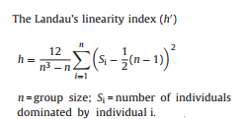

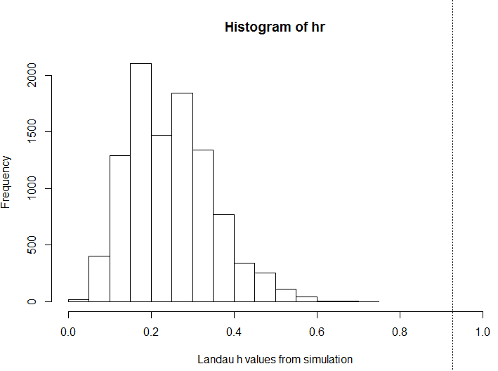
Laundau’s linearity index is a global directional consistency measure - Interaction matrices are permuted 10,000 times and Landau’s h is calculated for each one
(de Vries et al. 1995 Animal Behaviour)

Slide 4
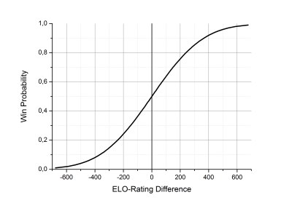
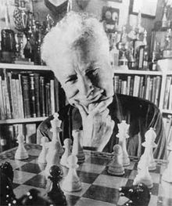
Temporal assessment of Dominance Hierarchy – ELO rating
Arpad Elo
New ELO = Old ELO + ([result - Probability of winning] * K)
e.g. Player A= 1200 wins against Player B=1000 - “A” had a 76% chance of winning
Player A, New ELO = 1200 + ([1-0.76]*100) = 1200 + (0.24*100) = 1224
Player B, New ELO = 1000 + ([0-0.24]*100) = 1200 + (-0.24*100) = 976
[Albers & de Vries 2001 Animal Behaviour]

Slide 5
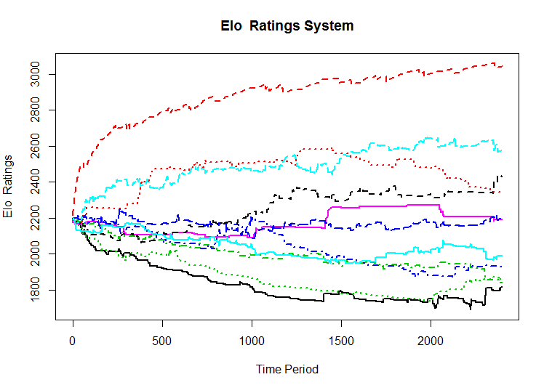

Slide 6

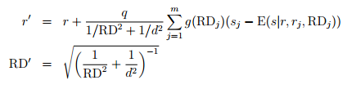

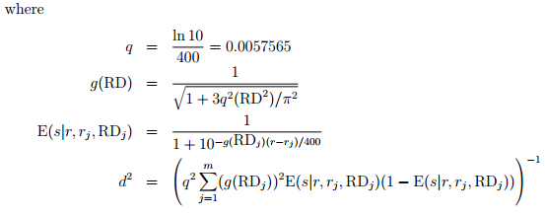
Temporal assessment of Dominance Hierarchy – Glicko rating
→ Added a mechanism for determining the SD of an individual’s rating
→ Built in a decay function in the reliability of ratings with increasing passage of time. i.e. Ratings Standard Deviations become bigger if individuals do not engage in contests
→ The number of points won and lost may not be even between opponents as both individuals rating and SD of their ratings are taken into account
Mark Glickman
r = rating
r‘= new rating
RD = ratings SD
RD’ = new ratings SD
s = result of contest [0, ½, 1]
c = lag constant
t = number of time periods since last contest
Glickman 2001,
J Applied Statistics

Slide 7
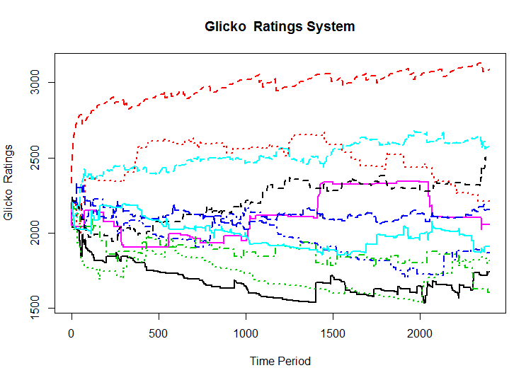

Slide 8
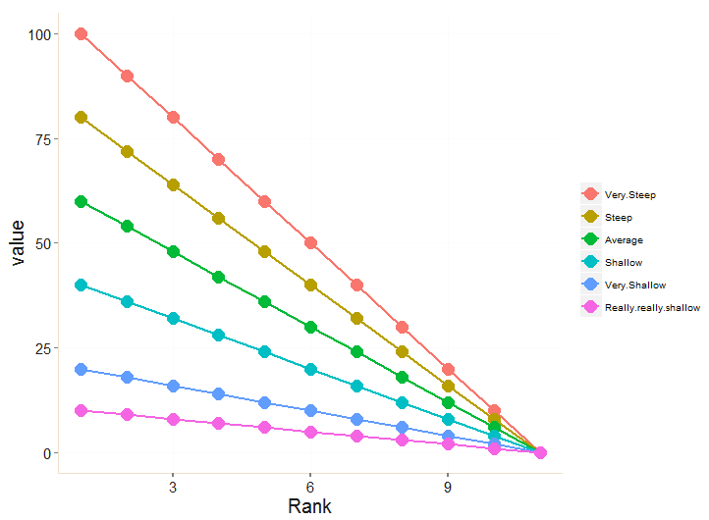
Linearity vs Steepness
All of these lines represent statistically significant linear dominance hierarchies
They vary in steepness: 0 – interactions somewhat unpredictable
1 – dominants always win

Slide 9
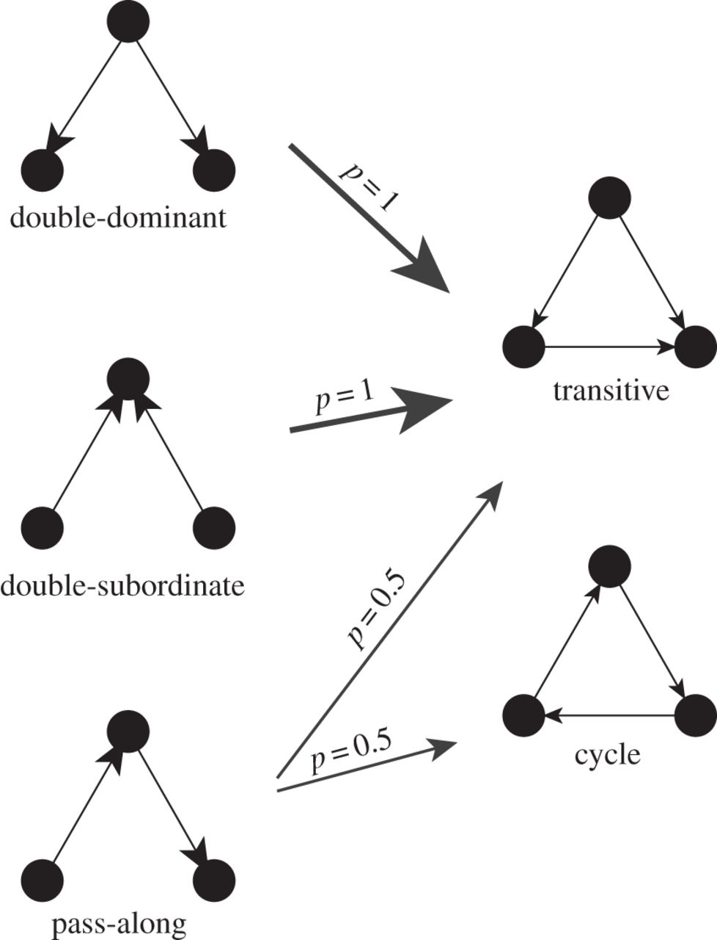
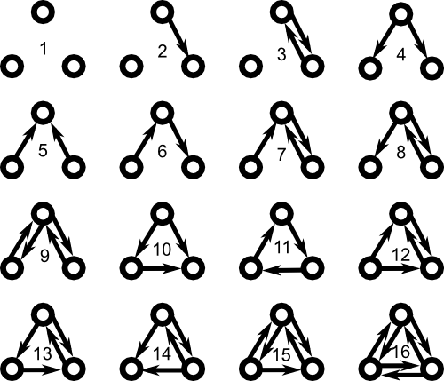
Triangle Transitivity
McDonald & Shizuka 2012
In a directed network, there are 16 possible configurations of triads
In a linear dominance hierarchy we expect to observe that triads should be transitive as this would mean that there are no rank-reversals
Triangle Transitivity (0-1) is an index of what proportion of triads in a network are transitive. This method can also account for missing relationships as triads with two edges also provide information about potential transitivity in the network

Slide 10
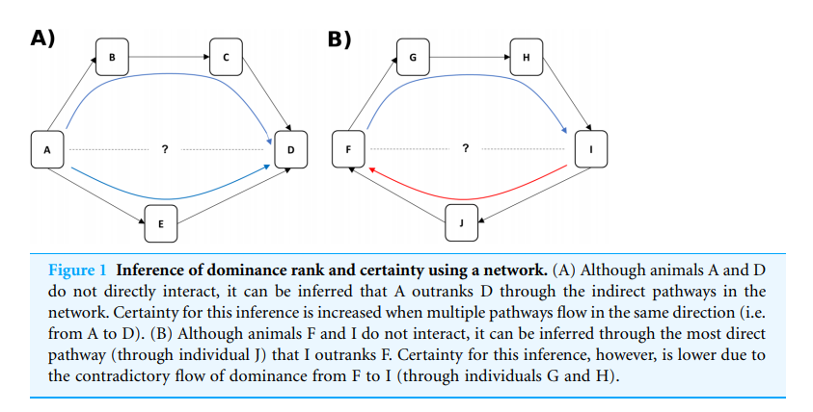
Dominance Certainty
Vandeleest et al 2016 Plos One

Slide 11
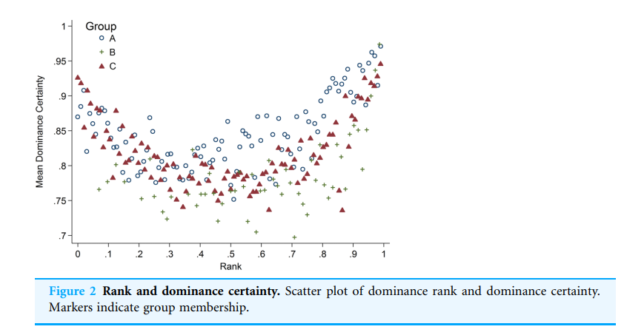
Dominance Certainty
Vandeleest et al 2016 Plos One

Slide 12
Dynamic Networks
Temporal networks –
Time-aggregated networks (aggregations of static networks over discrete time periods, time windows, sliding windows). Comparison of network/node metrics over time.
Time-ordered (edges have start/stop times – may have durations or be time ordered list of complete events).
Temporal stability
Lagged association rate (Whitehead 1995)
- an index of how likely a pair of nodes are likely to be interacting T units of time after previously interacting.

Slide 13
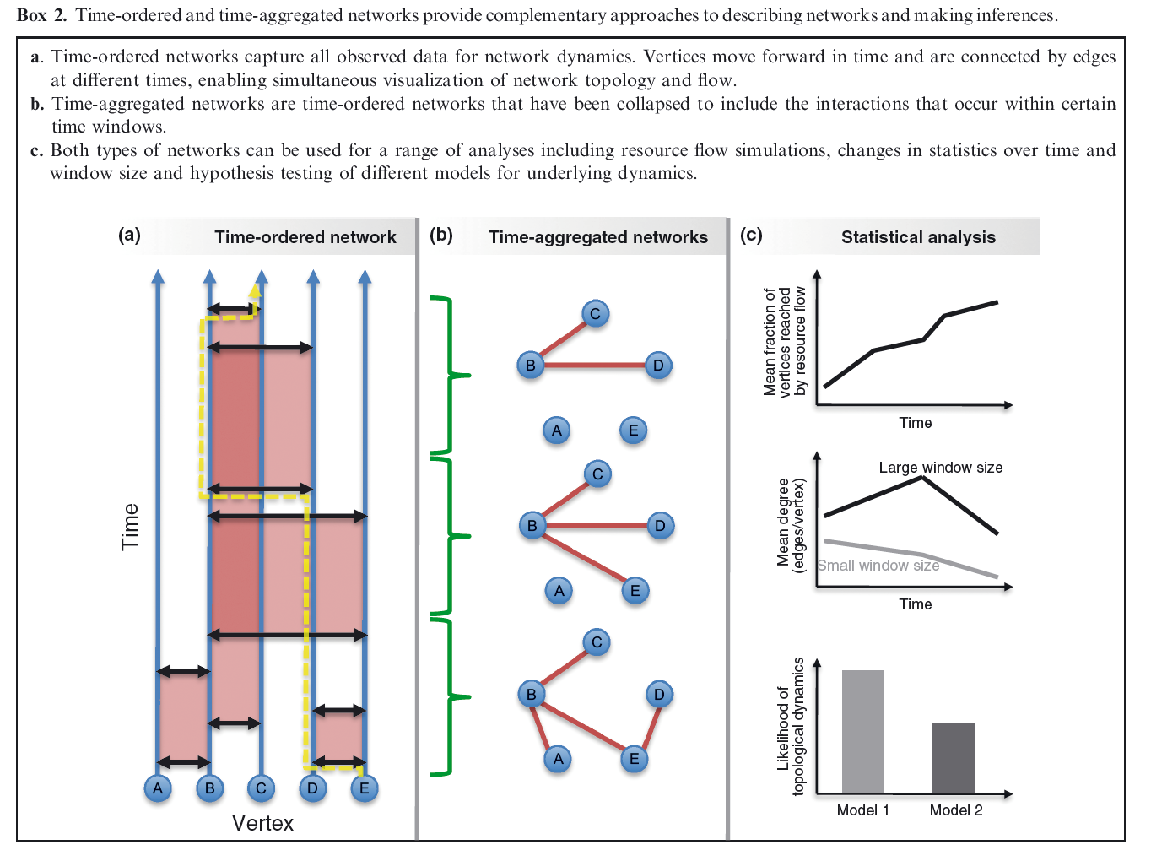
Blonder et al 2012

Slide 14
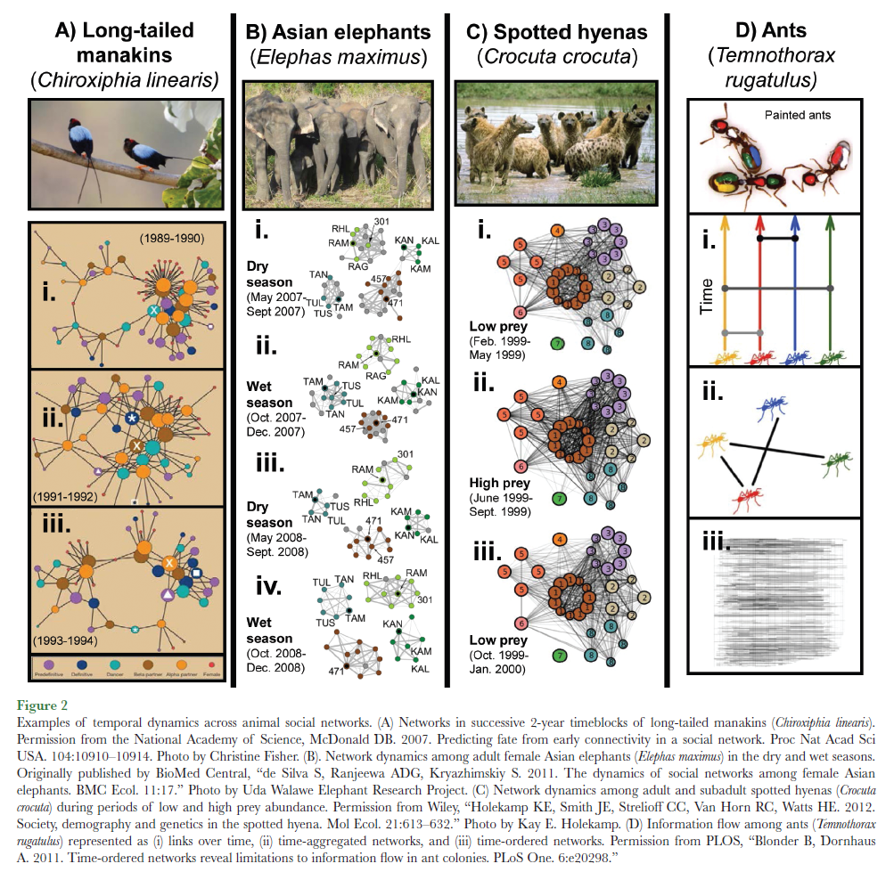
Pinter-Wollman et al 2017

Slide 15
Challenges for Dynamic Network Analysis
Data must be recorded at a time scale that is appropriate for biological questions
Enough data must be collected at each time point to generate robust networks per unit of time – and each should have roughly equivalent sampling effort e.g. if data are only observed once per day, daily aggregated networks may not be suitable.
Generation of a time-ordered network requires highly detailed observation of animals (usually continuous recording of animals where all individuals are observed simultaneously)
The development of robust statistical procedures for analyzing dynamic network data (and generating appropriate null models) is still to occur
Blonder et al 2012
Pinter-Wollman et al 2017

Slide 16
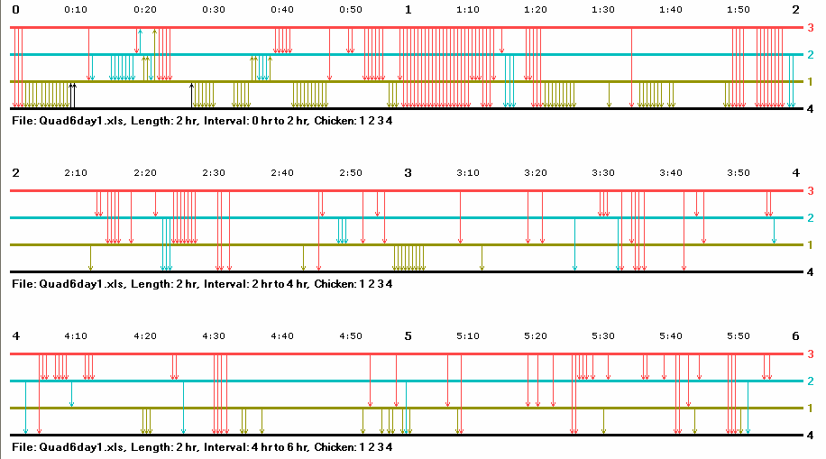
Time‐ordered networks
Complete set of all interactions that occur over time
Provides complete information on the order, duration and timing of events.
Time-ordered networks can be graphically represented as time on the x-axis with nodes on the y-axis. Edges between nodes represented as lines connecting
Ivan Chase
Curley 2016 – “musicnotationR” R package

Slide 17
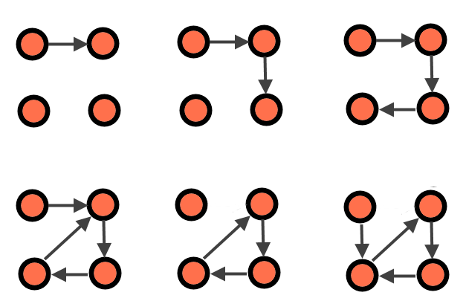
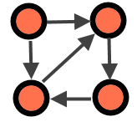
Time‐ordered networks
t1
Time ordered networks can also be represented as the state of the network at each time unit
Analysis of the pattern of temporal edges can reveal information about flow through the network:
e.g. the proportion of nodes that are reached from each node per time unit (the Forward Reachable Set).
e.g. the temporal shortest path from A to C is t = 3 and goes A→B→D→C. However, if the data had been aggregated it would appear that the shortest path was straight from A→C
t2
t3
A
B
C
D
t4
t5
t6
A
B
e.g. short temporal paths between individual nodes may represent common group membership
C
D
Static network

Slide 18
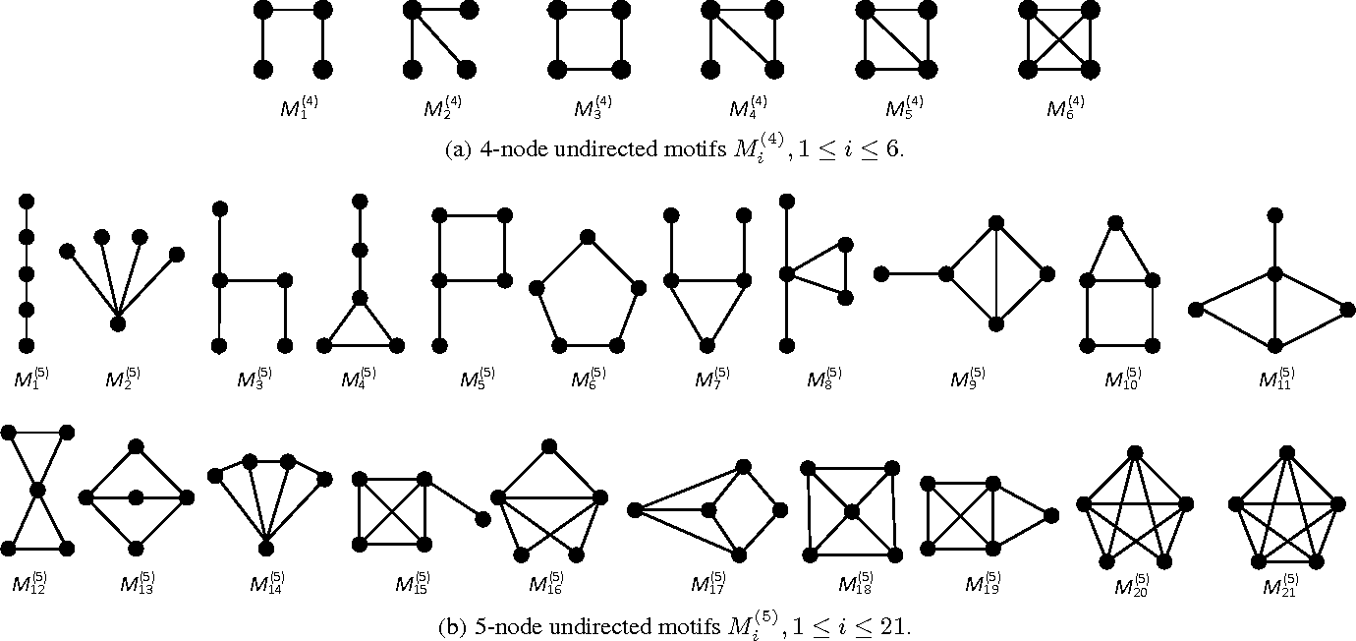
Temporal Motifs
In static network graphs, we can identify structural network motifs for different sets of nodes (e.g. for 3 nodes, 4 nodes, 5 nodes)

Slide 19
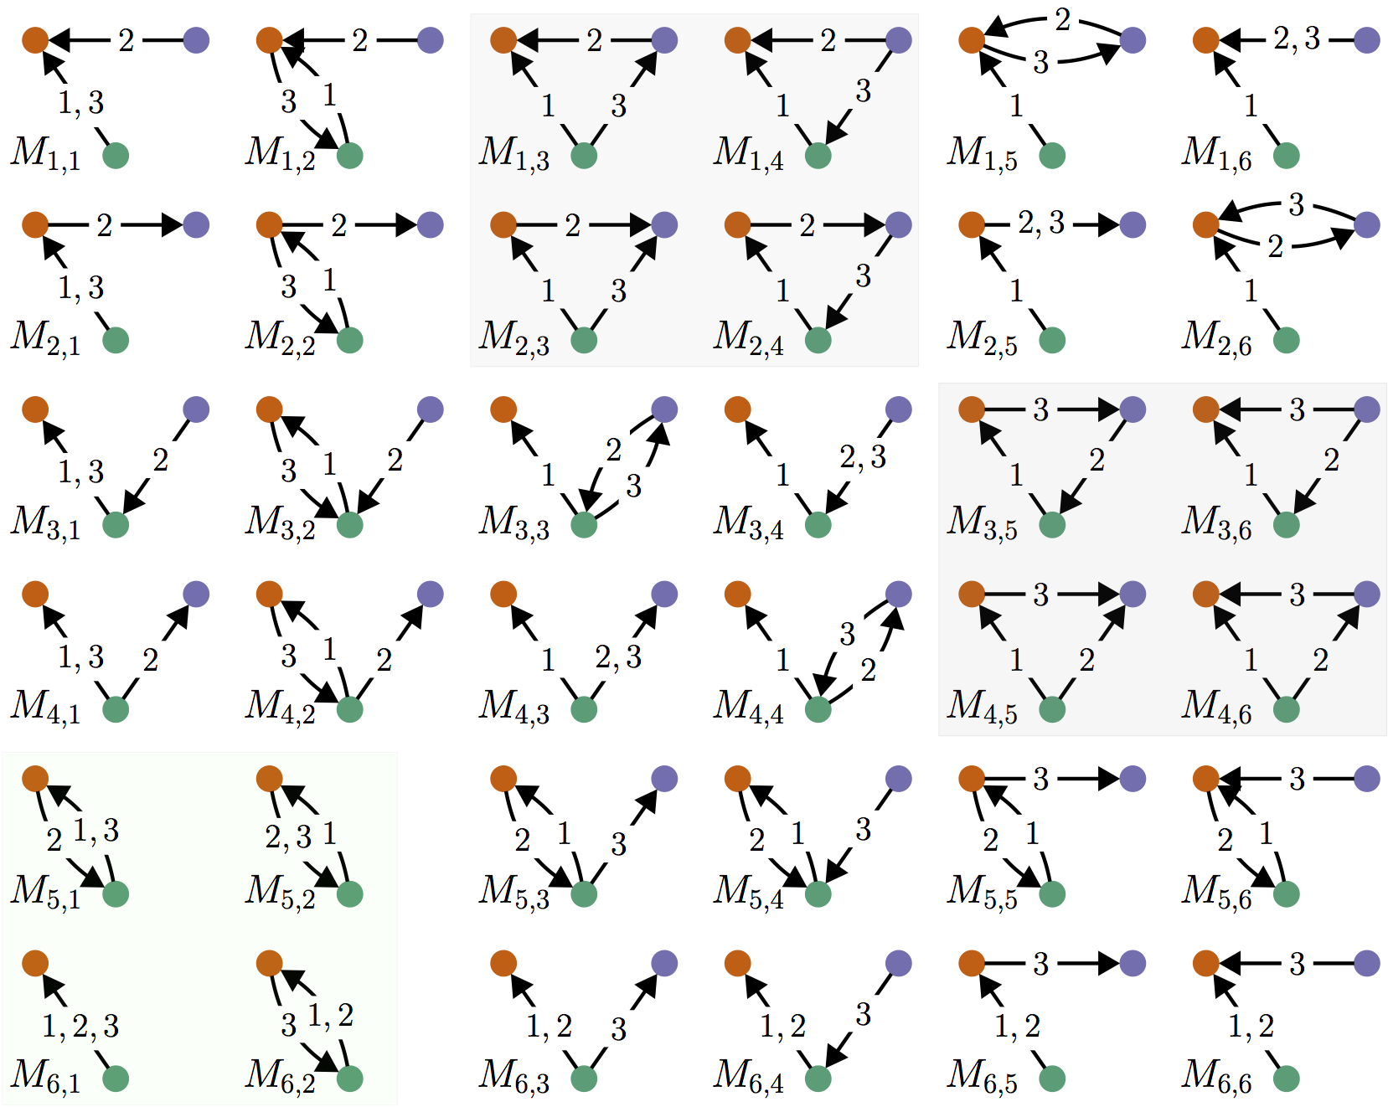
Temporal Motifs
In temporal networks there are potentially many more motifs
e.g. with triads, there are many different ways in which the three successive interactions between three nodes may occur
A question of interest may be whether certain temporal motifs occur more frequently in our observed networks than expected by chance
One method to address this would be to randomize the temporal structure of the original data

Slide 20
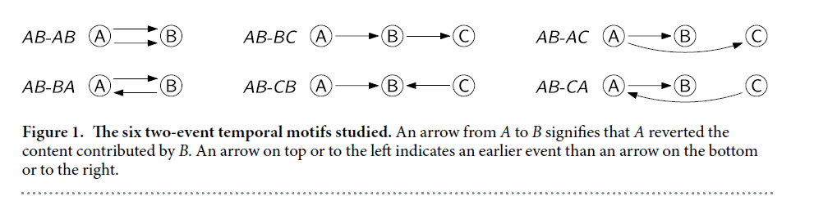
Temporal Motifs
Study of temporal motifs among a network of wikipedia editors
Tsvetkova et al 2016 Sci Reps

Slide 21
Dynamic Community Detection

Slide 22
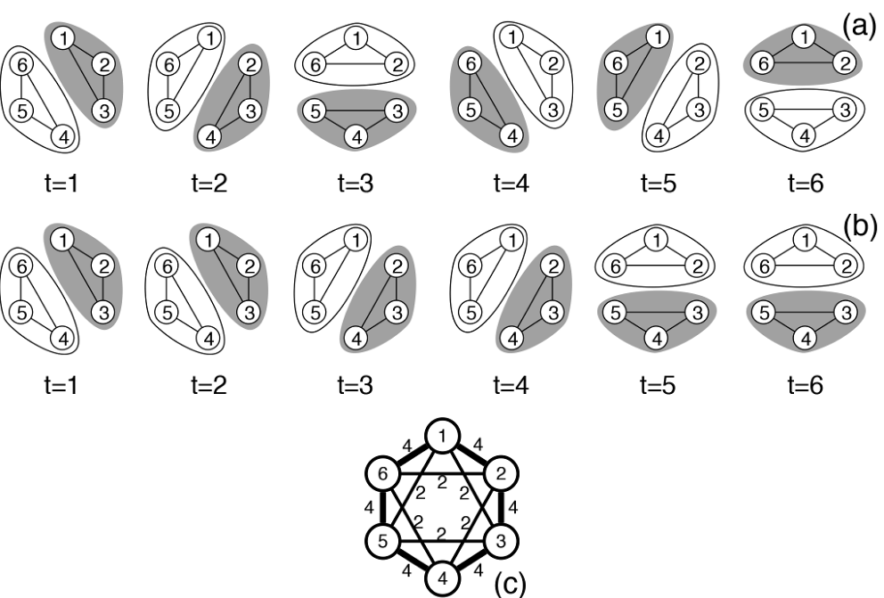
Rubenstein DI, Sundaresan SR, Fischhoff IR, Tantipathananandh C, Berger-Wolf TY (2015) Similar but Different: Dynamic Social Network Analysis Highlights Fundamental Differences between the Fission-Fusion Societies of Two Equid Species, the Onager and Grevy’s Zebra. PLoS ONE 10(10): e0138645.

Slide 23
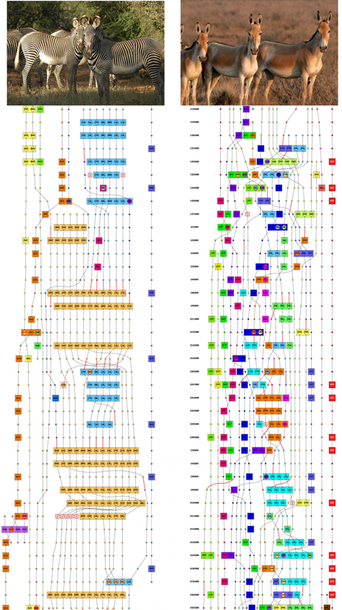
Dan Rubenstein- Princeton
PlosOne 2015
Community membership using CommDy over time in zebras vs onagers

Slide 24
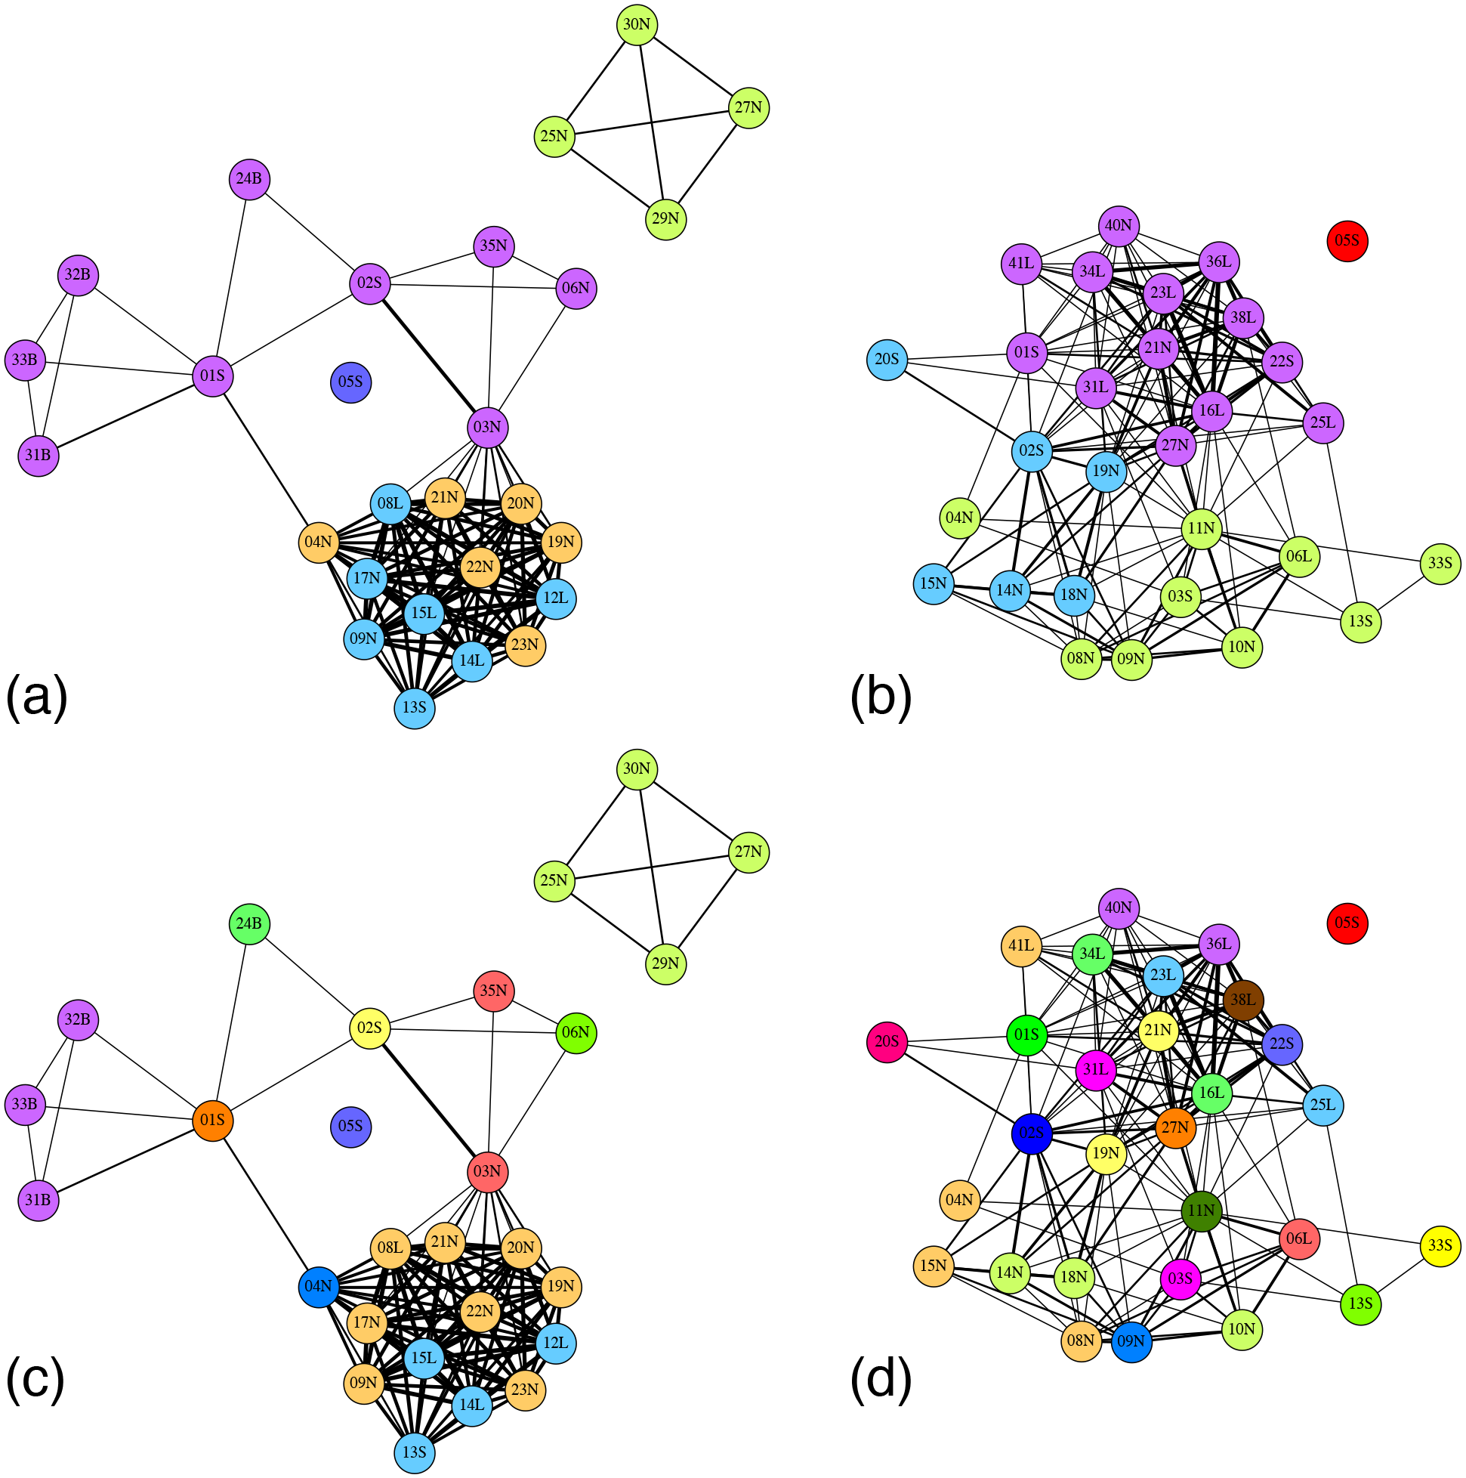
Fig 3. Static communities of Grevy’s zebra and onagers detected using Louvain algorithm ((a) and (b)) and the superimposed dynamic communities, where each node is colored by the majority color of its dynamic communities ((c) and (d)).
Dan Rubenstein- Princeton
PlosOne 2015
Community membership using CommDy over time in zebras vs onagers

