Slide 1
non_groomingNoseVibrissaenose_eyeshead_and_earscheeks_sacksChinHandForelimbAbdomenFlankhindlimbGenitalsBackTailbody
n_gr
N
V
n_ey
h_&_e
cheeks_sacks
Chin
Hand
Forelimb
Abdomen
Flank
Hindlimb
Genitals
Back
Tail
body

Slide 2
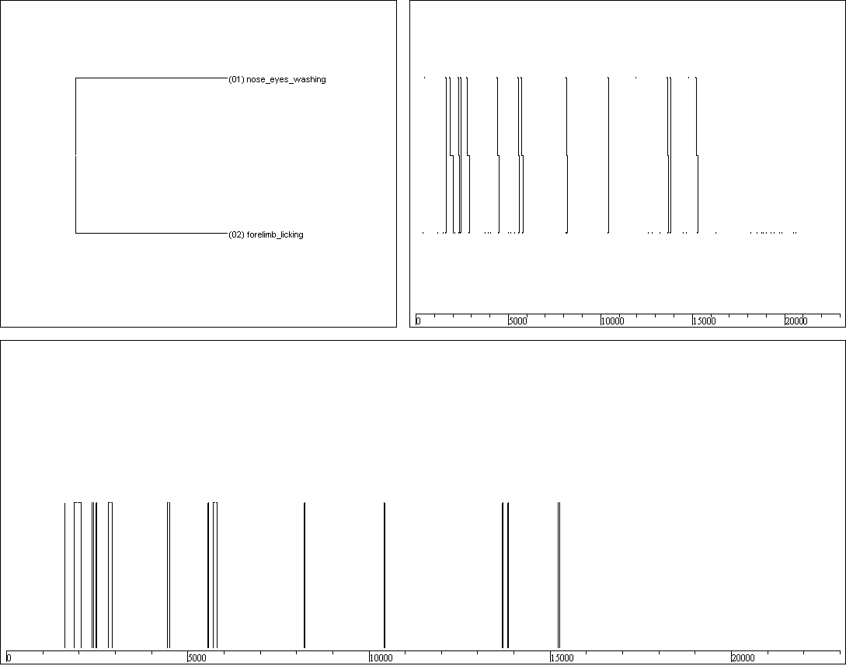
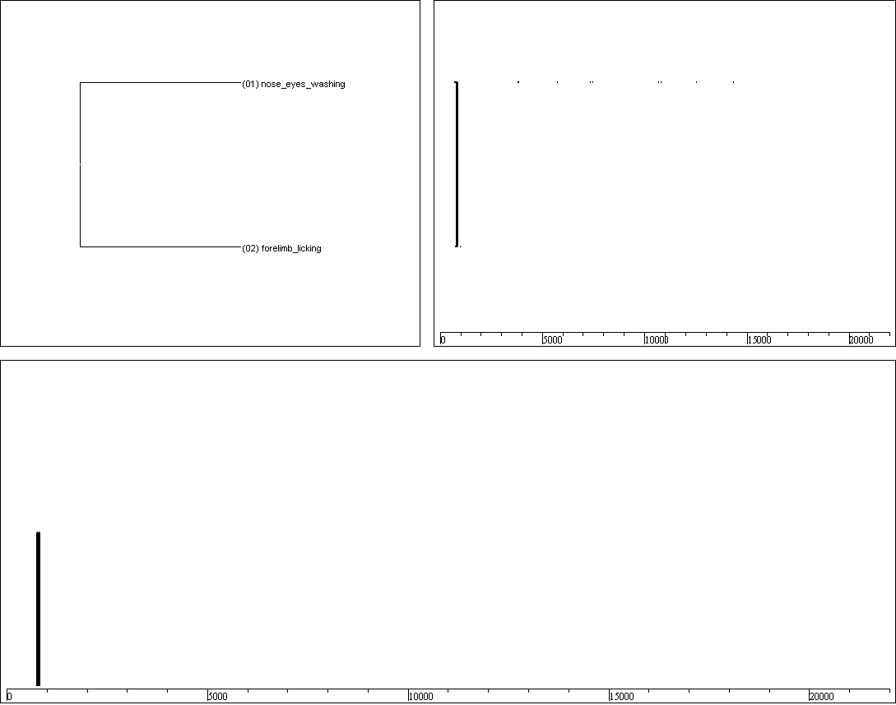
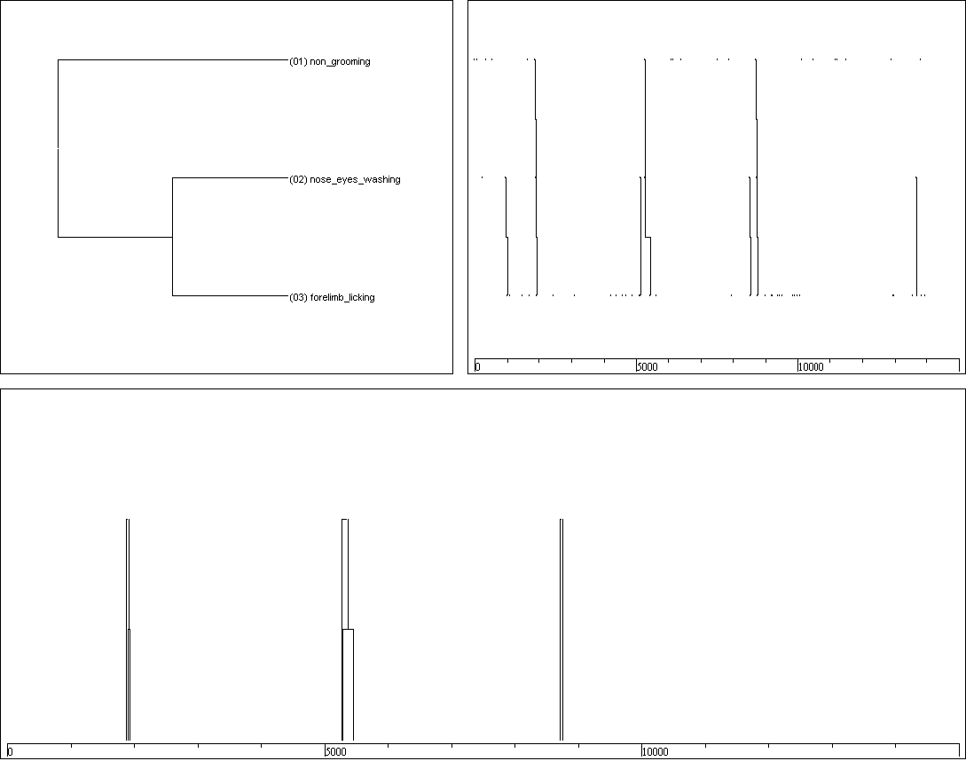
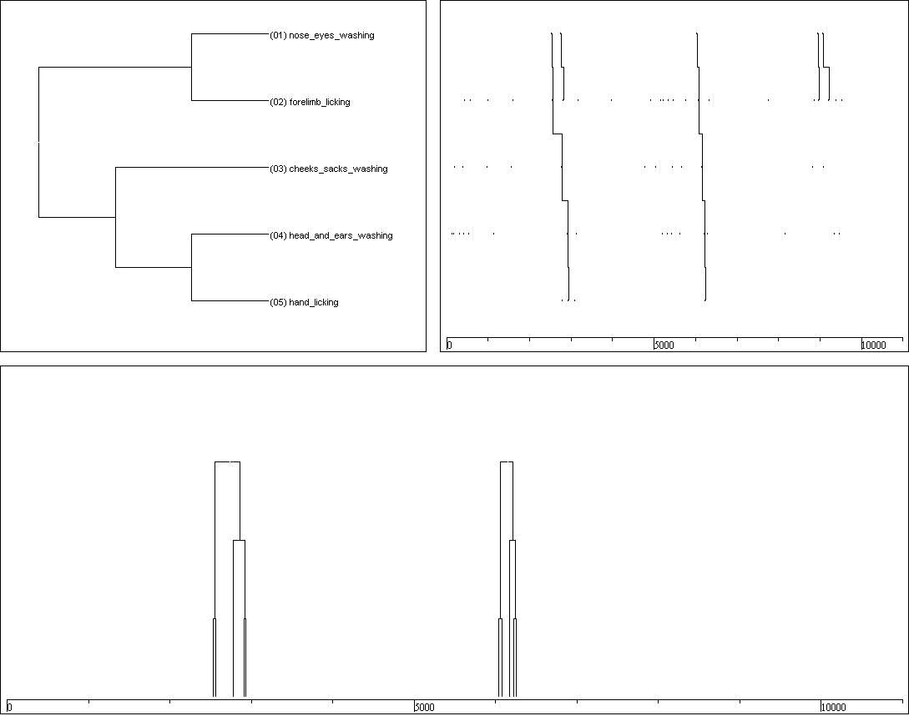
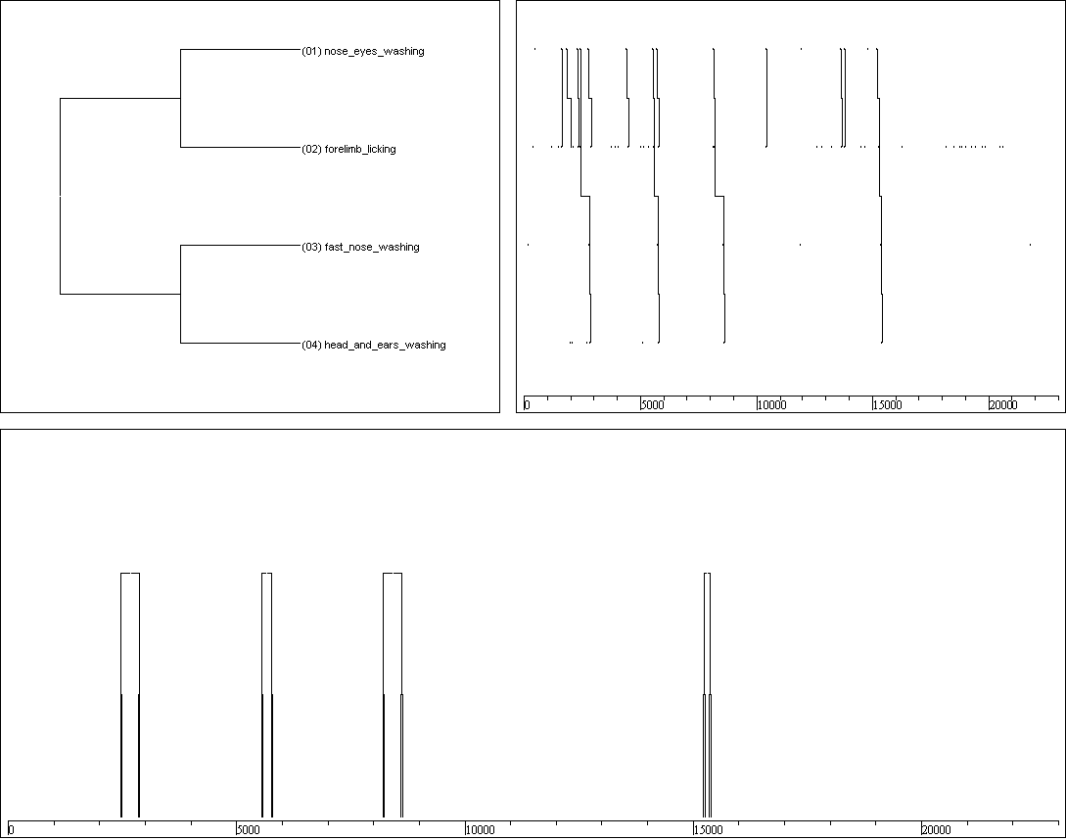
( nose_eyes_washing forelimb_licking )
Auratus (n=5)
n=5.6+5.5
L=40,08+27,72
Dur=1,8+1,5%
n=13 L=54,38+54,53 Dur=3%
Auratus7:
n=3 L=7,37+2,08 Dur=0,1%
Auratus8:
Auratus1
Auratus2
Auratus8
( non_grooming ( nose_eyes_washing forelimb_licking ))
(( nose_eyes_washing forelimb_licking )( fast_nose_washing head_and_ears_washing ))
1type
1type
5types
(( nose_eyes_washing forelimb_licking )( cheeks_sacks_washing ( head_and_ears_washing hand_licking )))

Slide 3
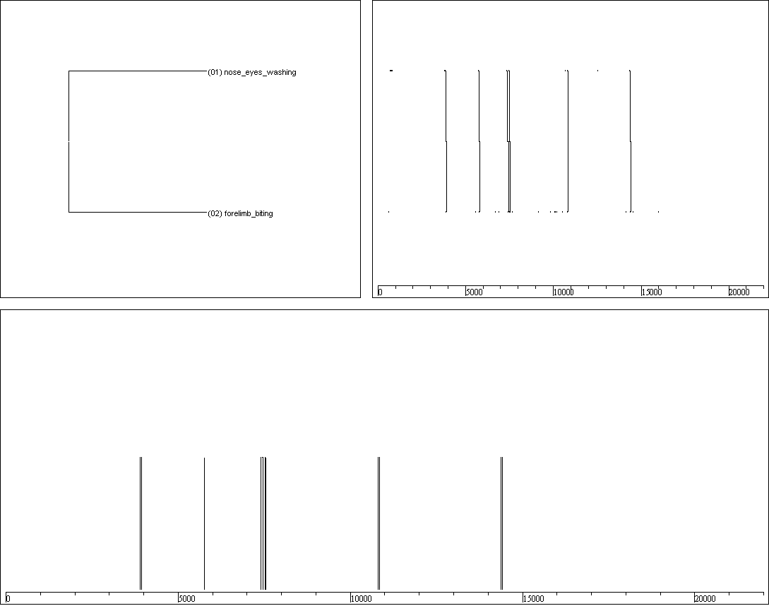
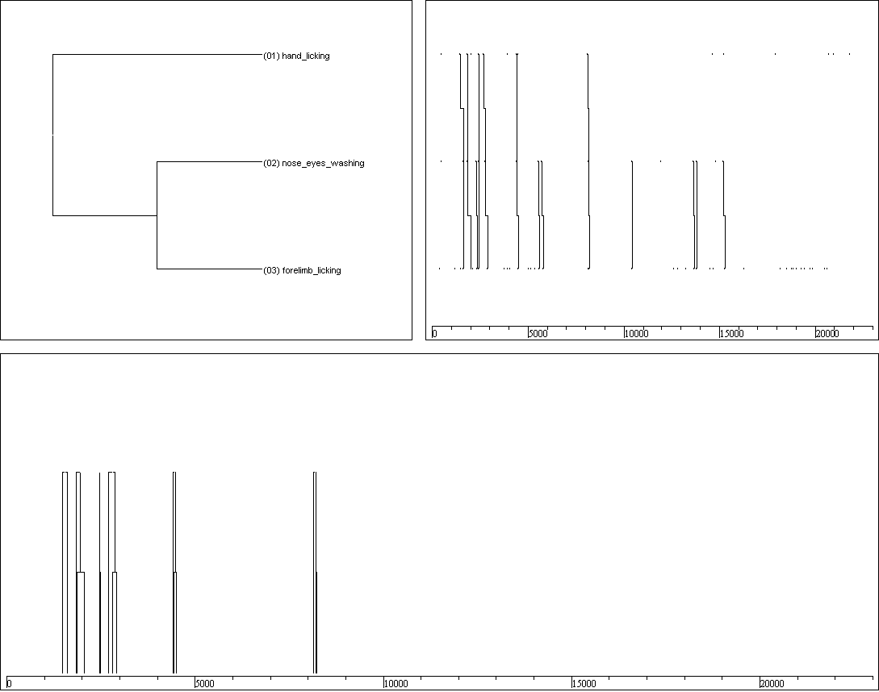
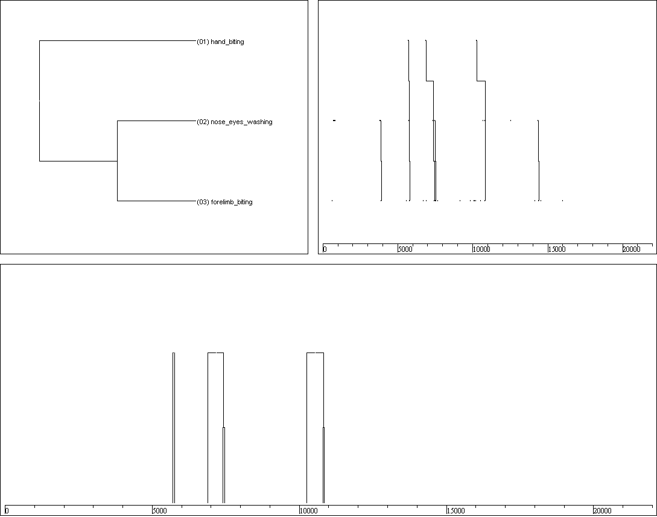
( nose_eyes_washing forelimb_licking )
( nose_eyes_washing forelimb_biting )
Auratus7:
n=3 L=7,37+2,08 Dur=0,1%
Auratus7:
n=6 L=34,33+15,42 Dur=1%
5types
( hand_licking ( nose_eyes_washing forelimb_licking ))
( hand_biting ( nose_eyes_washing forelimb_biting ))
Auratus8:
Auratus7:
( hand_licking ( nose_eyes_washing forelimb_licking ))
campalli: n=3

