Slide 1

2010 Final Budget
The County of York
Adopted:
December 23, 2009

Slide 2

2009 RESULTS
…charting a strategy for recovery

Slide 3

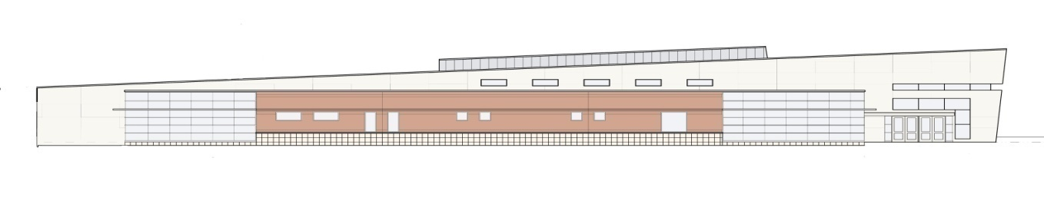
Did we meet our objectives?
911 Strategic plan implementation
  County continues to resolve issues with new radio system
  All police, fire & EMS services cut-over
  to new system
  Staffing and training issues
    persist

Slide 4
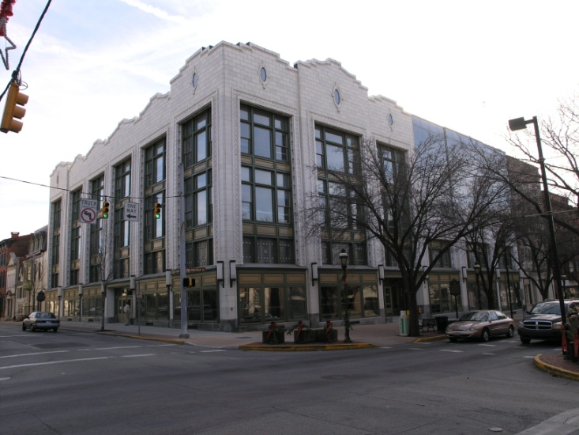
Did we meet our objectives?
Continued Business Continuity Planning program
  Final Phase III in process
  Plans continue to be exercised to ensure compliance
Nursing Home Facility Upgrades
  Project continues; est’d completion
    Mid-year 2010
  Estimated $7.8 million project
  Infrastructure improvements

Slide 5

Did we meet our objectives?
Implemented Jail Diversion program
  Although average daily County population held steady throughout 2009, total impact was mitigated by late-year program ramp-up
Crime Response Unit introduction
  Sheriff’s new community policing
  unit introduced in 2009
  Innovative program puts inmates to work clearing trash and assisting local municipalities with community projects

Slide 6
Notable Achievements in 2009
Implemented cost-reduction and cost containment initiatives aimed at reducing cost of government:
  Cell Phone Stipend program
  Consolidated mail processing
  Business forms standardization
  Labor counsel fee reduction

Slide 7
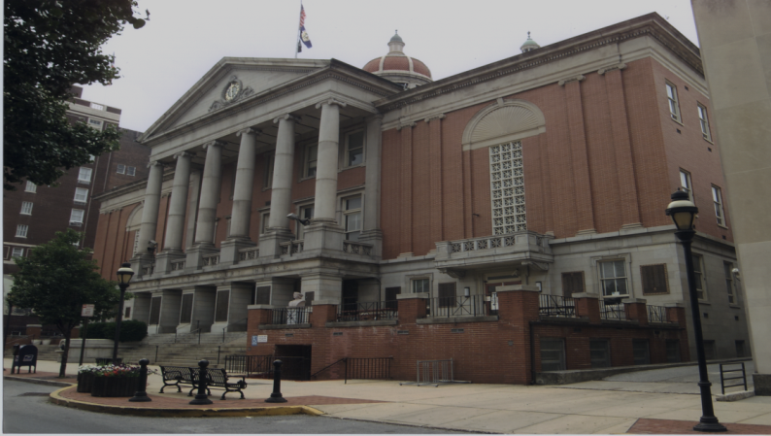
Notable Achievements in 2009
Budget Controls
  Introduced Budget Adjustment policy
  to control spending and improve
  accountability
Facilitated $12.7 million financing package to assist Ag Society
  Collaborative agreement between County, Ag Society and Solid Waste Authority reduced overall cost of capital to maintain sustainability of Expo Center and York Fair operations

Slide 8
Notable Achievements in 2009
Suspended and/or terminated several Swap transactions to generate funds to service LT debt
  Total unbudgeted proceeds exceeded $3.9 million
Procured three new Magisterial District Justice offices, bringing County-owned MDJ facilities to nine
  2009 Additions:
    MDJ Shoemaker – 19-3-07 Dover
    MDJ Reamer – 19-3-04 New Freedom
    MDJ Martin – 19-1-02 Roosevelt Avenue, York

Slide 9

2009 RESULTS
Signs of “green shoots” in 2009…
Estimated $200,000 deficit
Total General Fund spending
was $1.2 million below budget
Tax revenues $1.5 million under plan
ICE revenues fell significantly below plan by $3.4 million
Unplanned revenue sources bolstered income:
  Solid Waste Authority - $3.5 million
  Swap Transaction proceeds - $3.9 million

Slide 10
FAVORABLE TRENDS:
4th Qtr PAN&RC operations study reveals $1 million opportunity for cost reduction and/or revenue increase
Pension Plan assets rebounded with a 20%+ return for 2009
Juvenile placements continue to fall with significant favorable cost impact

Slide 11
UNFAVORABLE TRENDS:
Inability to establish operating reserves could have negative impact on County’s financial ratings in the future
Interim financing plan put in place Dec. 2008 must be restructured in 2010
Impact of Lauxmont and Highpoint acquisition increases County debt service projections
$12.7 million borrowing in 2009 required to provide working capital and refinance general obligation debt

Slide 12
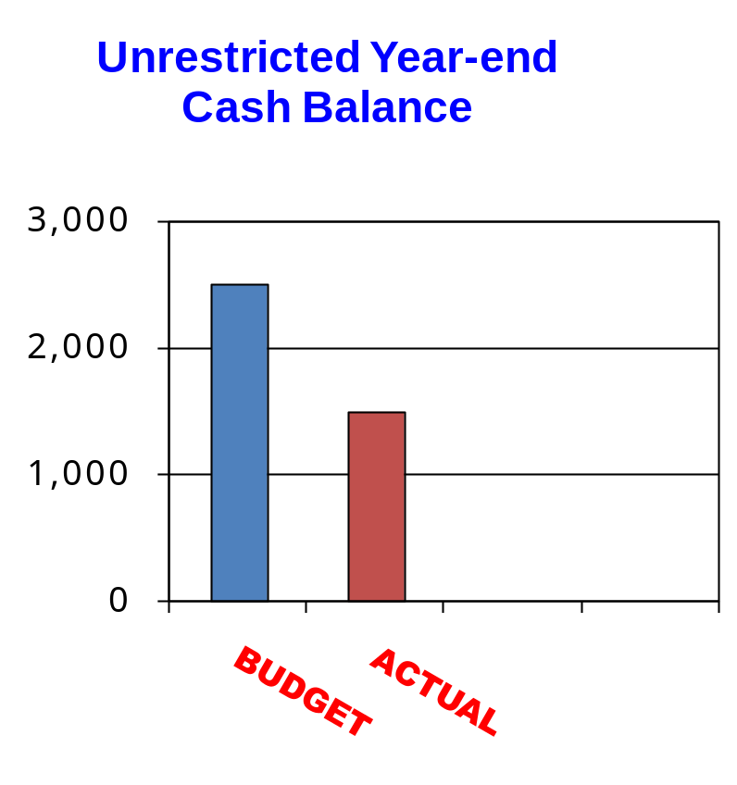

2009 Year End Cash Position
$200,000 deficit anticipated
Year-end cash balance $2.0 M
  Reflects operating deficit
  Includes SWA & Swap proceeds
$25 Million TRAN will be necessary to provide gap financing in 2010
$2.0 M
Dollars in Thousands

Slide 13

The 2010 Budget
Laying the foundation for a better tomorrow….

Slide 14

2010 Budget Objectives
Resolve 911 System deficiencies
Maximize BICE and State inmate
revenue potential
Collaborate with the Courts and DA to
improve efficiency of Court system
Develop Debt Restructuring Strategy
Implement PAN&RC operating
improvement strategy

Slide 15
The Bottom Line…
2009 General Fund Budget
  $182,172,206
  Millage Rate = 4.15
    3.75% increase
  Includes Dedicated Library Tax (.1 Mill)
2010 General Fund Budget
  $167,096,231
  Eliminated 59 positions
    $1.9 million in S&W
  Millage Rate = 4.15
    No change from 2009
  Includes Dedicated Library Tax (.1 Mill)

Slide 16
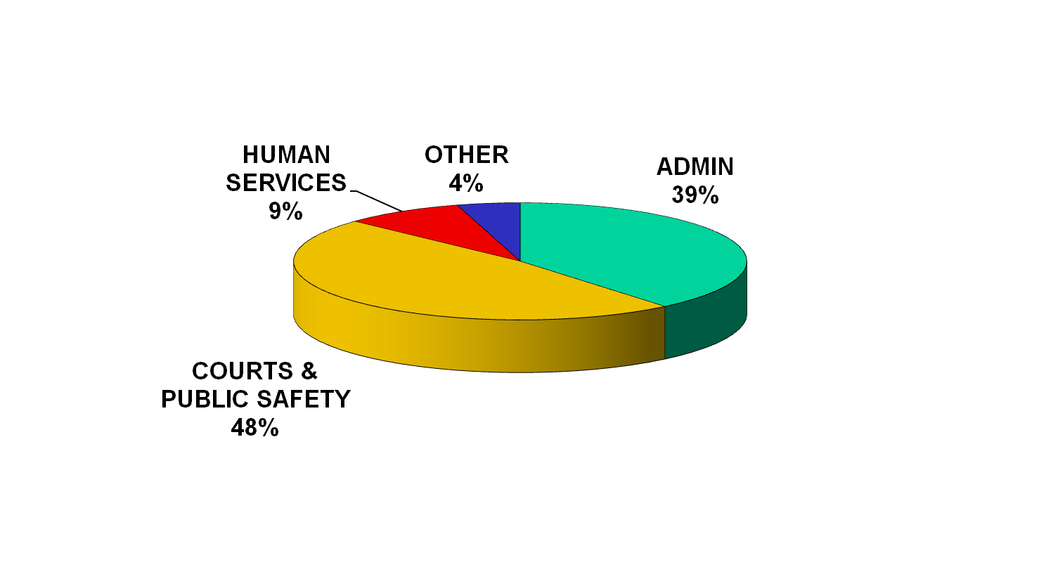
General Fund Expense Summary by Sector
Total General Fund = $167,096,231
Note: Prison operation comprises
46% of total sector costs
How Your Tax Dollars Are Utilized...

Slide 17
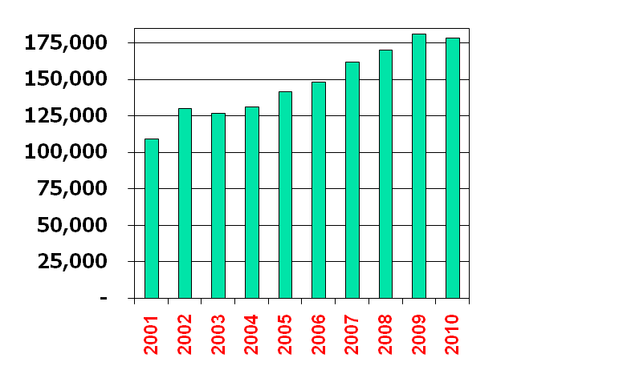
General Fund Growth Trend
2009
2010
Decr.
$182,172,206
$178,207,231
-2.2%
NOTE: 2010 adjusted for change in Juvenile Placement accounting
Average Growth Per Year:
2001 – 2009 +7.1%
2010 -2.2%
Dollars in Thousands

Slide 18
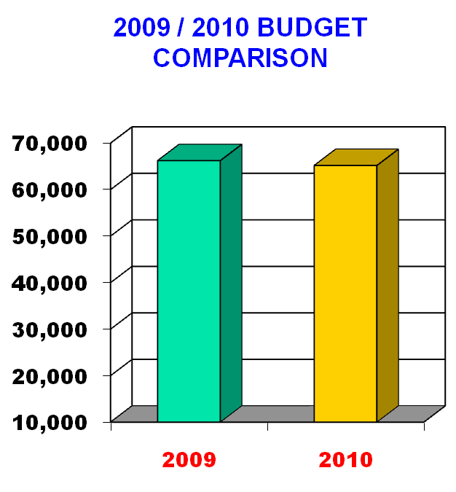
GOVERNMENT ADMINISTRATION
Includes:
  Support functions
  Debt service
  Employee benefits
2010 Budget = $65.2M
Total expenses down $1.0 million or -1.8%
Dollars in Thousands

Slide 19
Government Administration
Major impacts:
  Benefit costs up $2.5 million
    Retirement Plan contribution up $1.0 million
    Health care costs up 9.0%, or $1.5 million
  Debt Service down $2.4 million
    County will restructure $154 million of outstanding debt in 2010
    2010 plan assumes $1.6 million debt reduction related to restructuring

Slide 20
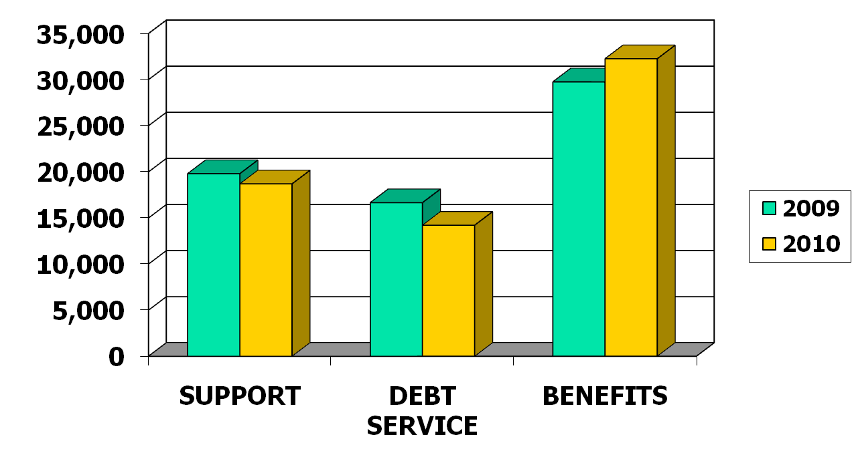
Government Administration
+8%
-6%
-15%
Dollars in Thousands

Slide 21
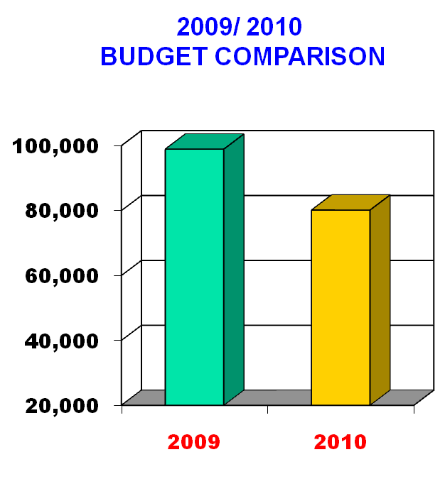
COURT SYSTEM &
PUBLIC SAFETY
Includes:
  Court & Court related functions
  Corrections
  Public Safety
2010 Budget = $80.1M
Total expenses are down $18.8 million or 19%
  Change in accounting for Juvenile placements reduced costs $15.8 M
Dollars in Thousands

Slide 22
Court System & Public Safety
Major Impacts:
  Prison operational costs up $632,000
    S&W costs up $1.7 million
    Telephone commission funds used to offset inmate-related operating expenses
  Prison operating costs offset by increased BICE and state revenue generation
    BICE revenue projected down $1.9 million
    State inmate housing up $2.2 million

Slide 23
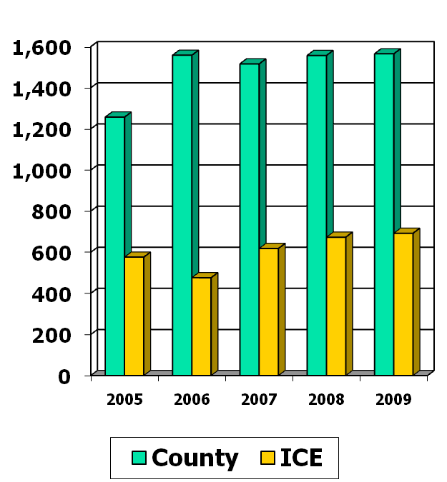
Court System & Public Safety
Average Daily Prison Population
Average York inmate population appears to be leveling off at approx. 1,560
ICE population increased in 2007 & 2008 due to facility expansion
BICE average population projection for 2010 is 745 detainees
  Up slightly from 2009 average of 692 per day
Contract with State will guarantee 100 state inmates per day in 2010

Slide 24
Court System & Public Safety
Major Impacts (Cont’d):
  911 Operations subsidy down $702,000
    Includes Wireless Fund offset of qualifying salaries and wages
  Workforce reduced by 47 positions and $1.5 million in S&W
  Change in state procedures for payment of juvenile placements reduced 2010 County budget $15.8 million
    Placement costs are netted against reimbursements and included in CYS subsidy

Slide 25
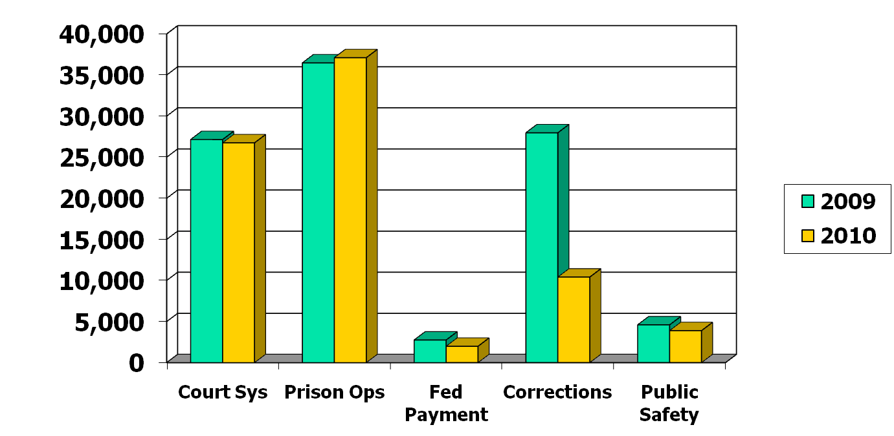
Court System & Public Safety
+2%
-2%
-28%
-15%
Dollars in Thousands

Slide 26
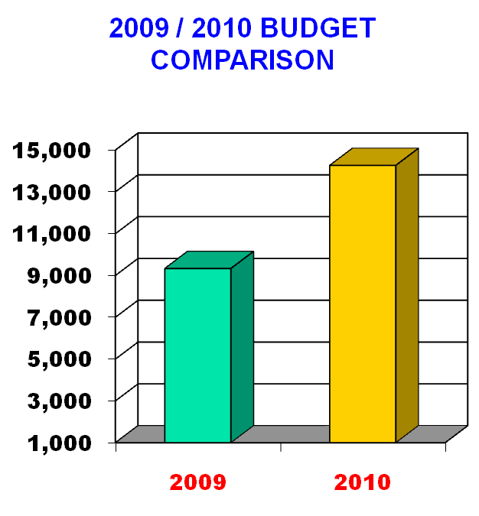
HUMAN SERVICES
Includes:
  C&Y
  MH/MR
  Area Agency on Aging
  YCNH
  Veteran’s Affairs
2010 Budget = $14.3 Million
Total expenses up $4.9 million
  2010 budget includes Juvenile placement net costs of $4.6 million
Dollars in Thousands

Slide 27

Human Services
Major Impacts:
  YCNH subsidy up $1.5 million from 2009
    2010 subsidy is $2.8 million
    Plan includes Therapy services expansion and improved MA revenue generation
    Premier Health Care consultant study
  C&Y costs down $936,000
    Includes Juvenile placement costs
    of $4.6 million
  Area Agency on Aging subsidy
down 297,383

Slide 28
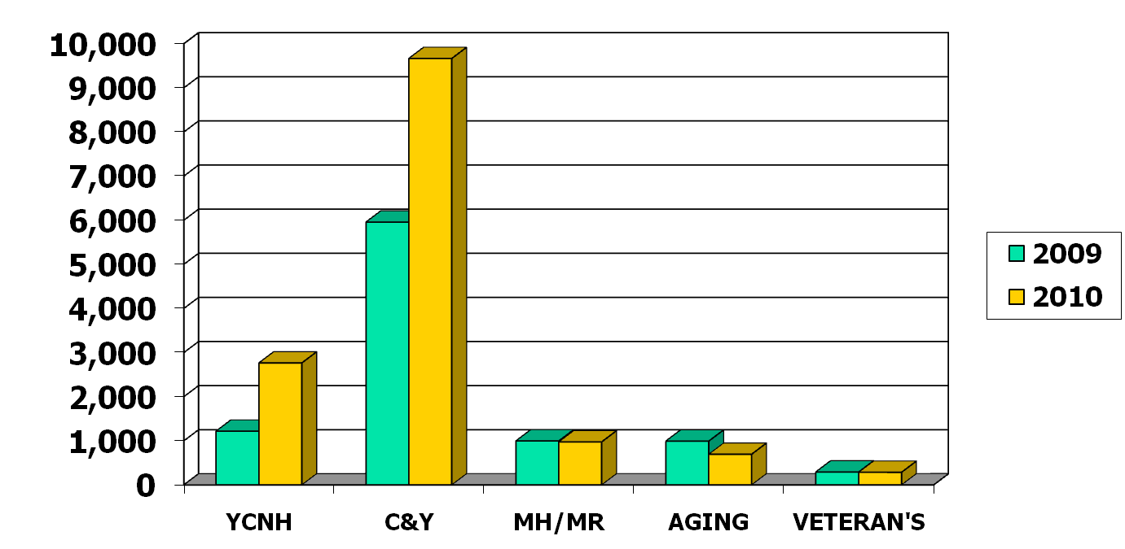
Human Services
+62%
+170%
-2%
-30%
-2%
Dollars in Thousands

Slide 29
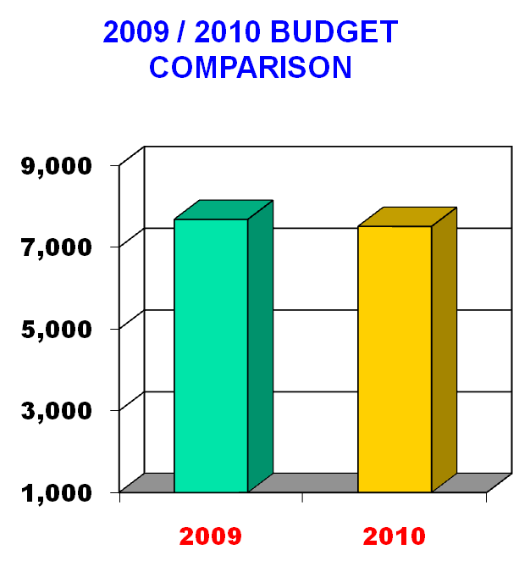
OTHER EXPENSES
Includes:
  Government Services
    Planning Commission
    Farm & Natural Land Trust
    Rabbittransit
    YCEDC
    Library System
  Discretionary allocations
2010 Budget = $7.5 Million
Expenses are down $173,000
or 2%
Dollars in Thousands

Slide 30
Other Expenses
Major Impacts:
  Library funding flat from 2009 level
    Library System contributing$100,000 to General Fund
    Dedicated .1 Mill Library Tax
  All allocations reduced 5%
  Providing $350,000 for Farm & Natural Lands Trust
    Partial funding of $1 million committment

Slide 31
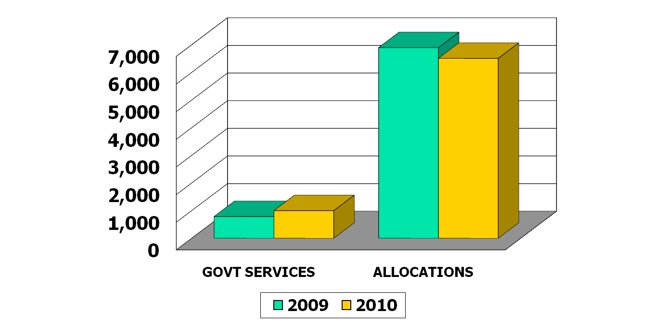
Other Expenses
-6%
+27%
Dollars in Thousands

Slide 32

Millage Rate Distribution
SECTOR
2010 BUDGET (1)
MILL RATE
Govt Admin | $ 51,356,995 | 1.93
Court System & Public Safety | $ 37,469,781 | 1.41
Human Services | $ 14,264,711 | .54
Other Expenses | $ 4,858,513 | .17
Library Tax | $ 2,350,000 | .10
TOTAL | $ 110,300,000 | 4.15
Note (1): Budget expense net of revenue offsets

Slide 33
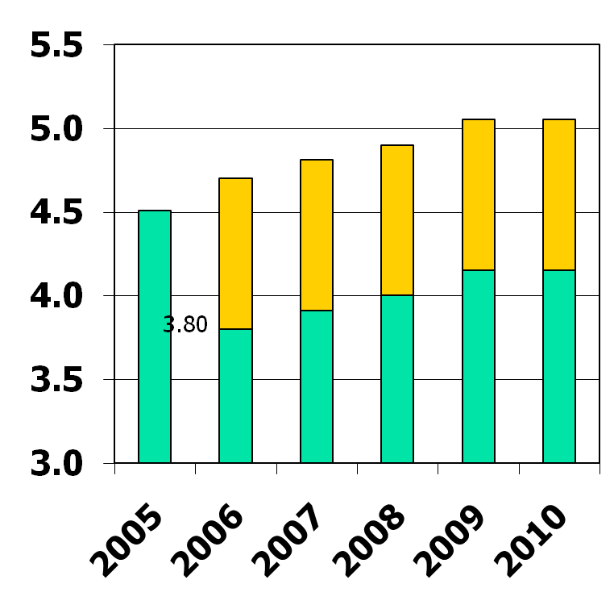
Tax Rate History
Mills
Equalized Tax Rates
County taxes have risen
.64 mills since 2005, or approx. 14%
  Average 2.8% / year
Increases per year:
  2006 4.40%
  2007 2.90%
  2008 2.30%
  2009 3.75%
  2010 -0-
5.15
5.15
4.85
4.71
4.8
1
4.51
4.15
4.15
4.00
3.91

Slide 34

Tax Rate Comparison
For every real estate tax dollar paid in York County…
School Taxes
County
Taxes
Municipal
Taxes
77%
16%
7%
Avg. School Taxes 19.61 mills
Avg. County Taxes 4.15 mills
Avg. Local Taxes 1.73 mills
Total
25.49 mills
Based on 2009 data

Slide 35
Total County Budget
2009
2010
GENERAL FUND
  Principal County Operating Budget $179.8 $164.6
  Dedicated Library Tax 2.4 2.4
  Capital Reserve Fund
PROPRIETARY FUND
  York County Nursing Home 37.9 37.5
  911 County Control 12.5 13.9
SPECIAL REVENUE FUND
  Principal Human Services budget 126.1 97.8
  Domestic Relations budget 5.1 5.0
  Housing, CDBG & Liquid Fuels budget 10.9 10.3
FIDUCIARY FUND
  Retirement Fund 10.7 10.7
  Tax Claim 19.4 19.3
Dollars in Millions
TOTAL BUDGET $ 404.8 $ 361.5

Slide 36
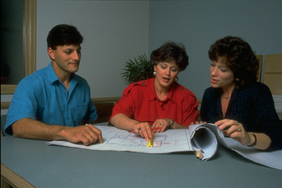
2010 Budget
In summary…
To Recap

Slide 37
2010 Budget Highlights
No G/F tax increase for 2010!
    Millage rate remains at 4.15 mills
    Dedicated Library Tax remains at .1 mills
Holding the line on taxes through:
  Workforce reduction of 59 positions
    S&W reduction of $1.9 million
  Across-the-board 5% operating expense reduction
  Debt restructuring savings of $1.6 million

Slide 38
2010 Budget
The County of York

