Slide 1

2011 Final Budget
The County of York
Adopted:
December 22, 2010

Slide 2

2010 RESULTS
…planning for sustainability

Slide 3

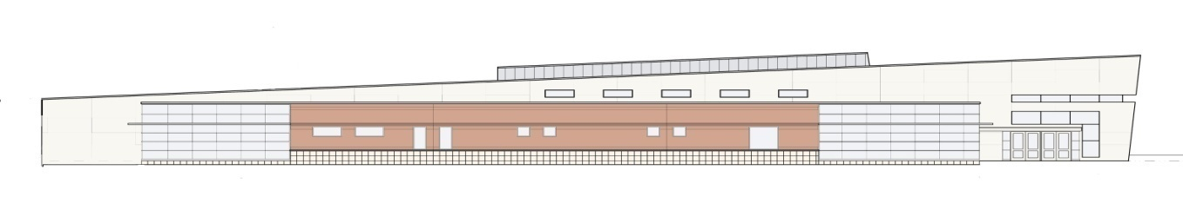
Did we meet our objectives?
911 Strategic plan implementation
  Software and user issues resolved with new radio system
  All police, fire & EMS services using new trunked P-25 technolgoy
  Emphasis on staffing and
  training reduced turnover

Slide 4
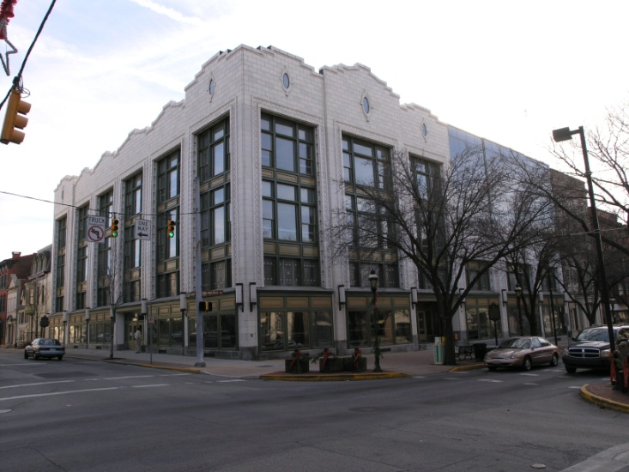
Did we meet our objectives?
Average ICE population expected to exceed plan
  Actual average population expected to be 870 versus budgeted detainee population of 845
  Revenue projections are up $300,000 from plan
Government Center Renovations
  Project approved and commenced
    Mid-year 2010
  Estimated $7.5 million project
  Utilizing $1.6 million DOE grant

Slide 5
Did we meet our objectives?
Implemented debt restructuring strategy
  Re-financed $83 million of variable debt to reduce future interest rate costs
  Issued $52 million of new long-term fixed rate debt to eliminate series of short-term bank notes
  County credit rating improved from AA- to AA Stable
Completed operational review of PAN&RC
  Consulting firm engaged to recommend improvements
  Operational efficiencies incorporated into 2011 budget

Slide 6
Notable Achievements in 2010
Awarded $3.5 million DOE Energy Efficiency Grant
  13 new energy projects identified with annual energy costs savings estimated at $447,000
  ARRA Stimulus grant
Employed aggressive utility hedging and contracting for natural gas and electricity
  Utilized “auction” process for electricity procurement
  Estimated annual savings of $750,000 projected

Slide 7
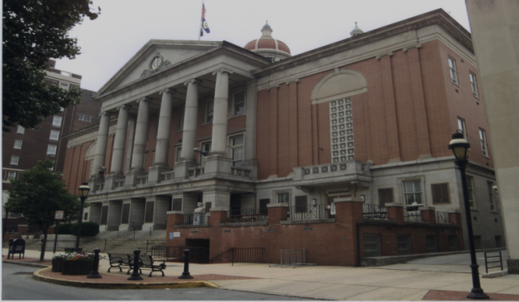
Notable Achievements in 2010
Assessment Revenue Enhancement
  Implemented new 5.5% admin fee
  on collection of delinquent real
  estate accounts
  Estimated $600,000 impact on past-
  due collections
Weights & Measures Registration Fee
  Implemented new registration fee program for all gasoline pump operators and merchants using small scales
  Estimated $200,000 annual revenue

Slide 8
Notable Achievements in 2010
Focused on developing alternative treatment programs to reduce recidivism and reduce County-inmate population
  Applicable to non-violent offenders
  Specialty Courts include: Mental Health, DUI and Drug Courts
  Anticipate an average reduction of 320 inmates

Slide 9

2010 RESULTS
Building financial stability…..
Estimated $3 million surplus
Total General Fund spending
was 4% below budget
Tax revenues on plan despite increased appeals
ICE revenues exceeded plan by $.3 million
PAN&RC subsidy $1 million under plan

Slide 10
FAVORABLE TRENDS:
PAN&RC operations improvement program has positively deduced County subsidy required to operate facility
Pension Plan investment assets continue to rebound with a 10%+ return in 2010
Juvenile placements are down 65% over the past two years, saving taxpayers $5 million in private placement costs

Slide 11
UNFAVORABLE TRENDS:
Court and Court-related costs are expected to continue to grow with two new judges to be elected in 2012
Although bargaining unit increases have moderated, union wages continue to out-pace non-bargaining employee salaries, compressing compensation program
New debt will be required to complete existing capital projects in 2011 and fund proposed new projects

Slide 12
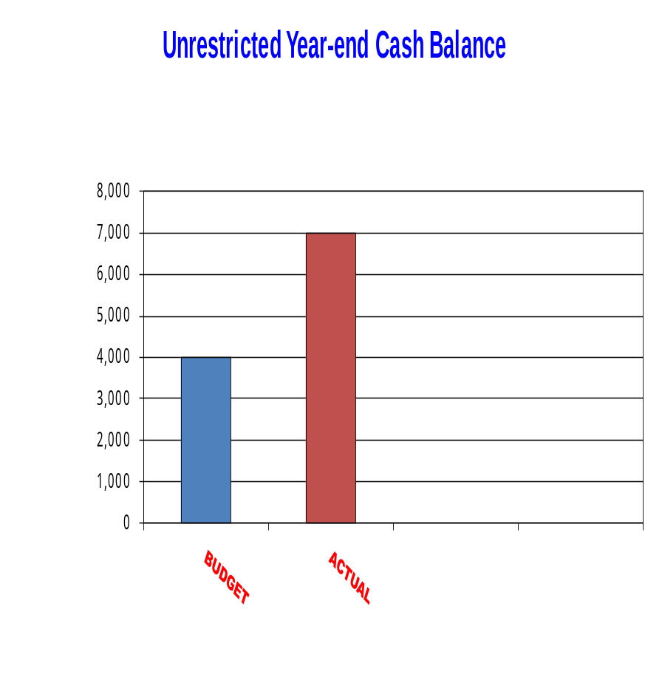

2010 Year End Cash Position
$3.0 million surplus anticipated
Year-end cash balance $7.0 M
  Includes 2009 $4 million cash surplus
  $2.4 million slated to fund 2011 budget
$25 Million TRAN will continue to be required to provide gap financing in 2011
Dollars in Thousands

Slide 13

The 2011 Budget
Holding the line on growth….

Slide 14

2011 Budget Objectives
Close-out 911 Project
Assess ICE proposal for long-term commitment
Collaborate with the Courts and DA to
improve efficiency of Court system
Develop Capital Project Improvement Funding Strategy

Slide 15
The Bottom Line…
2010 General Fund Budget
  $167,096,231
  Millage Rate = 4.15
    No change from 2009
  Includes Dedicated Library Tax (.1 Mill)
2011 General Fund Budget
  $173,970,761
  Millage Rate = 4.15
    No change from 2010
    Second consecutive year
  Includes Dedicated Library Tax (.1 Mill)

Slide 16
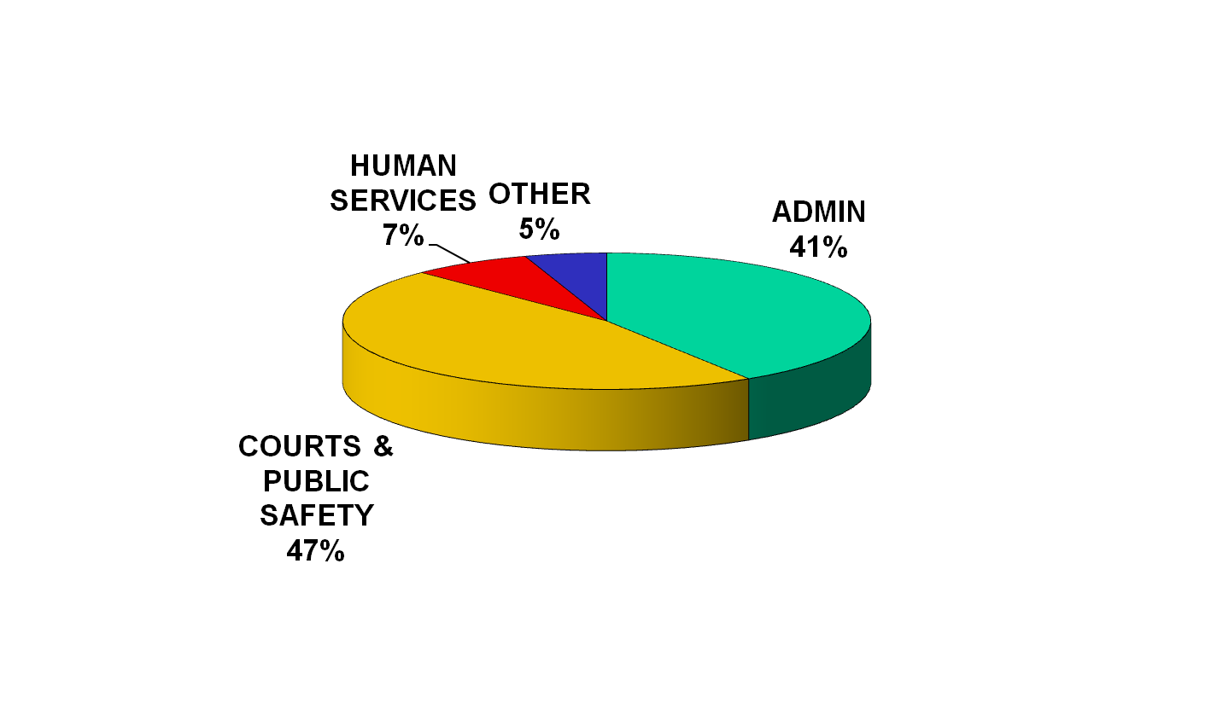
General Fund Expense Summary by Sector
Total General Fund = $173,970,761
Note: Prison operation comprises
47% of total sector costs
How Your Tax Dollars Are Utilized...

Slide 17
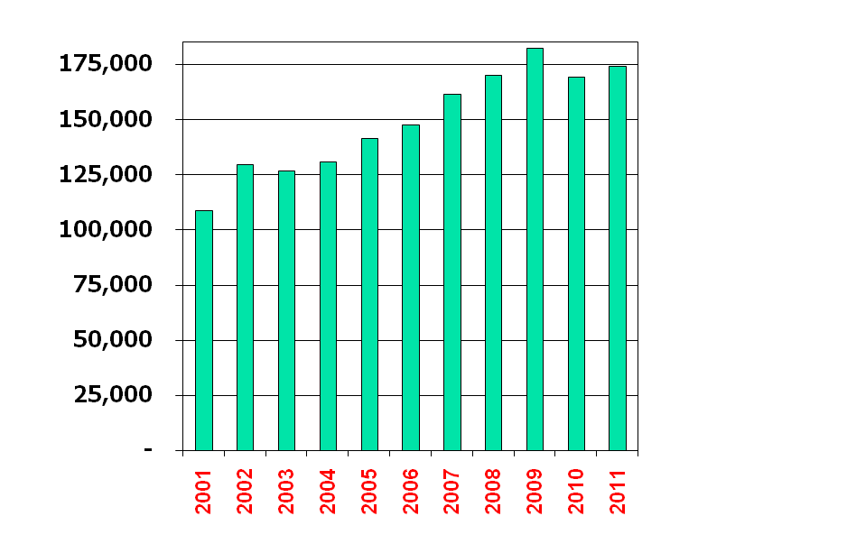
General Fund Growth Trend
2010 Est
2011 Bud
Incr.
$169,453,682
$173,970,761
2.7%
Average Growth Per Year:
2001 – 2010 +4.9%
2011 + 2.7%
Dollars in Thousands

Slide 18
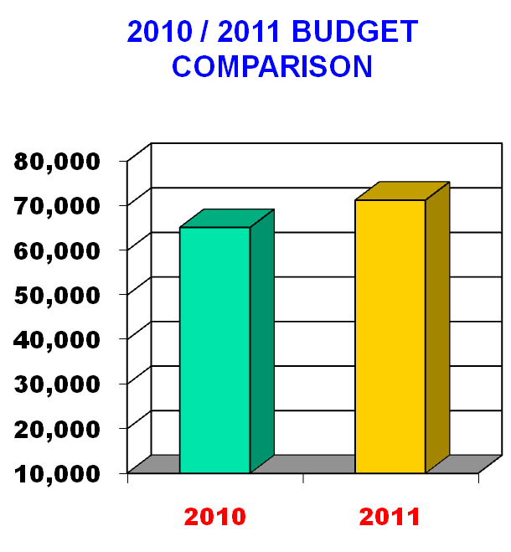
GOVERNMENT ADMINISTRATION
Includes:
  Support functions
  Debt service
  Employee benefits
2011 Budget = $71.3M
Total expenses include $1.6 M DOE Energy Improvement Grant
Expenses up 6.9%
Dollars in Thousands

Slide 19
Government Administration
Major impacts:
  Benefit costs up $2.9 million
    Retirement Plan contribution up $2.0 million
    Health care costs are flat from the 2010 budget
      Projected 2010 costs are 8% below budget
  Debt Service costs are up $2.1 million
    Includes restructuring of $83 million of outstanding variable rate debt
    Includes the refinancing of $52 million of short-term bank notes into long-term fixed rate debt

Slide 20
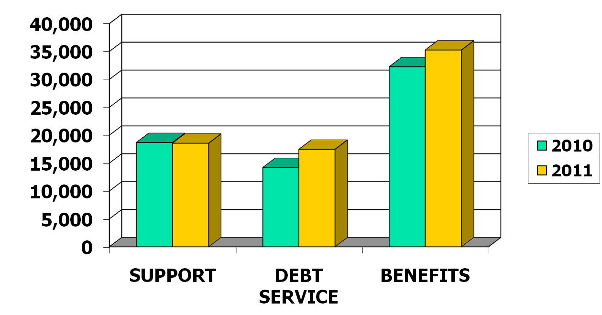
Government Administration
+9%
-1%
+23%
Dollars in Thousands

Slide 21
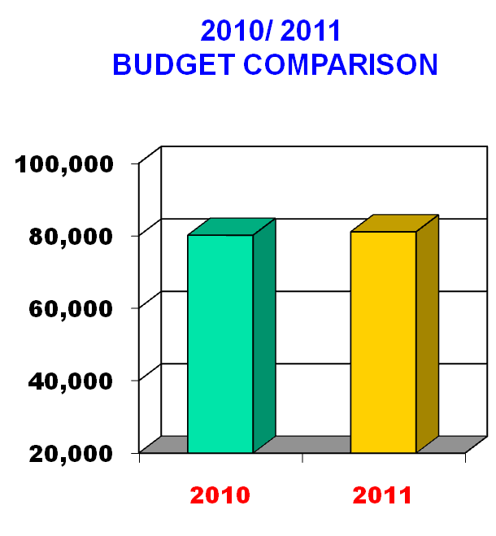
COURT SYSTEM &
PUBLIC SAFETY
Includes:
  Court & Court related functions
  Corrections
  Public Safety
2011 Budget = $81.1M
Total expenses are up .9 million or 1%
911 operations costs are up $1.5 million or 38%
Dollars in Thousands

Slide 22
Court System & Public Safety
Major Impacts:
  Prison operational costs up $643,000
    S&W costs up $610,000 or 2.7%
    Telephone commission funds used to offset inmate-related operating expenses
  Prison operating costs offset by increased ICE and state revenue generation
    ICE revenue projected up $1.9 million
    State inmate housing down $840,000

Slide 23
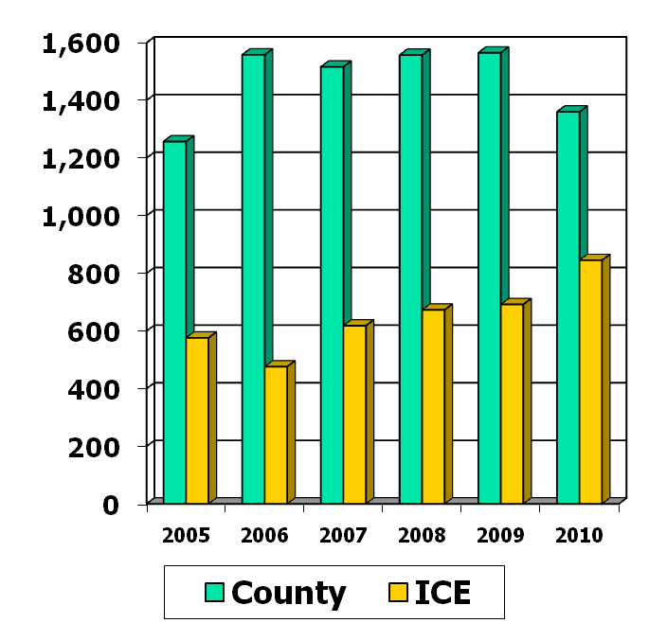
Court System & Public Safety
Average Daily Prison Population
Average York inmate population is decreasing due to alternative sentencing programs
  2010 average is 1,360
ICE population increased in 2010 due to reduction in County inmates
ICE average population projection for 2011 is 860 detainees
  Up from 2010 average of 845 per day

Slide 24
Court System & Public Safety
Major Impacts (Cont’d):
  911 Operations subsidy up $1.5 million
    Reflects new maintenance contracts for radio system
  Court Special Counsel fees reduced $200,000 to reflect impact of Conflict Panel

Slide 25
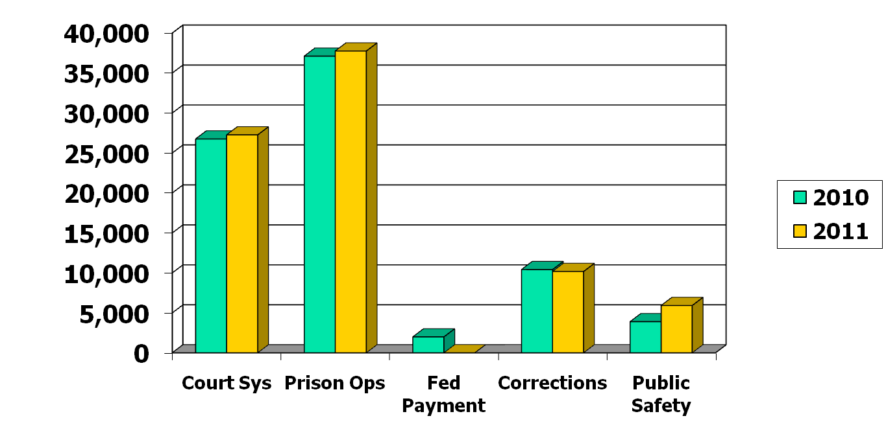
Court System & Public Safety
+2%
2%
-3%
52%
Dollars in Thousands

Slide 26
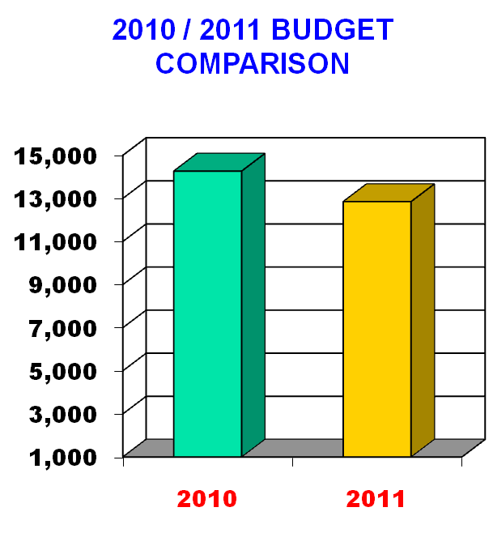
HUMAN SERVICES
Includes:
  C&Y
  MH/MR
  Area Agency on Aging
  PAN&RC
  Veteran’s Affairs
2011 Budget = $12.8 Million
Total expenses down $1.4 million
  PAN&RC subsidy down $1.2 M
Dollars in Thousands

Slide 27

Human Services
Major Impacts:
  PAN&RC subsidy down $1.2 million from 2010
    2011 subsidy is $1.5 million
    Plan includes improved MA revenue generation
    Return of 20 M/A beds to inventory
  C&Y costs flat from 2010
  Area Agency on Aging subsidy
  down $176,000
    2nd consecutive year with a reduction

Slide 28
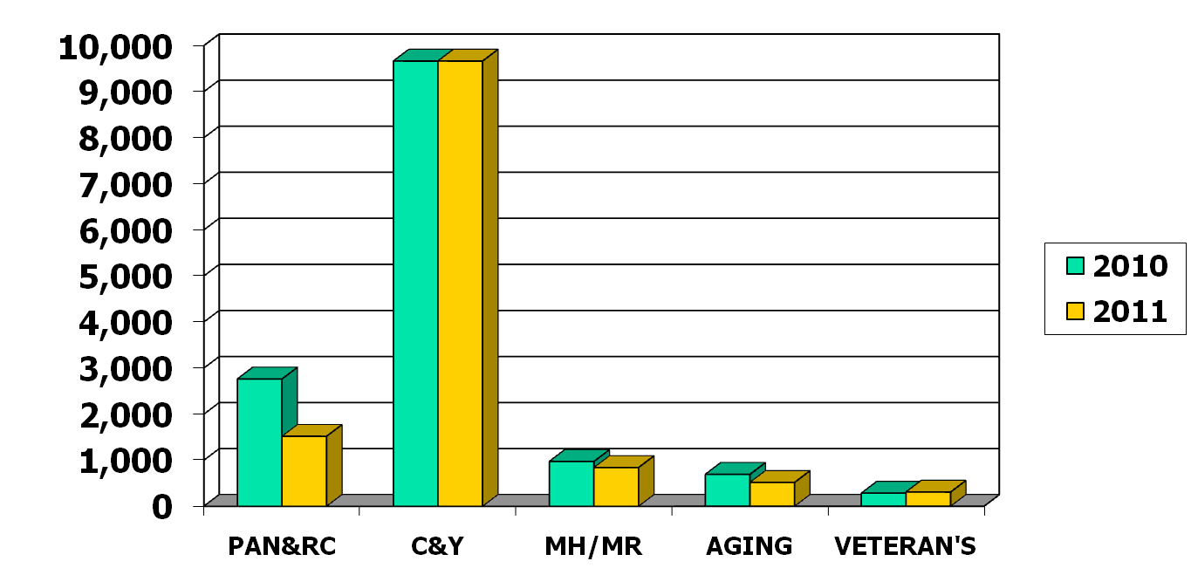
Human Services
0%
-55%
-14%
-25%
+8%
Dollars in Thousands

Slide 29
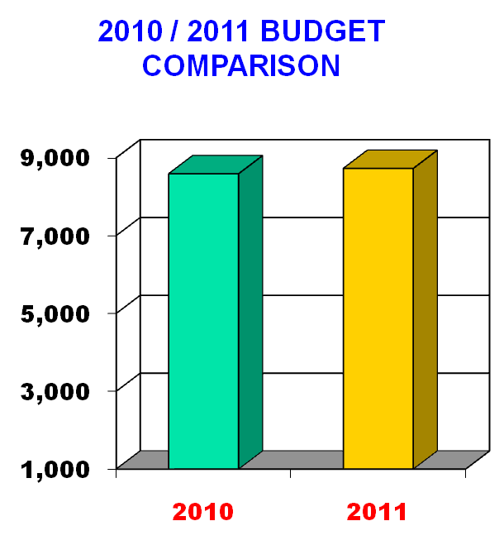
OTHER EXPENSES
Includes:
  Government Services
    Planning Commission
    Farm & Natural Land Trust
    Rabbittransit
    YCEDC
    Library System
  Discretionary allocations
2011 Budget = $8.7 Million
Expenses are up $137,000
or 2%
Dollars in Thousands

Slide 30
Other Expenses
Major Impacts:
  Library funding up $100,000 from 2010 level
    Dedicated .1 Mill Library Tax
  Most allocations held at 2010 levels
  Providing $184,700 for Farm & Natural Lands Trust
    Final installment on $1 million commitment
  Includes $200,000 for City Nuisance Abatement officers
  SPCA funding increased $71,500

Slide 31
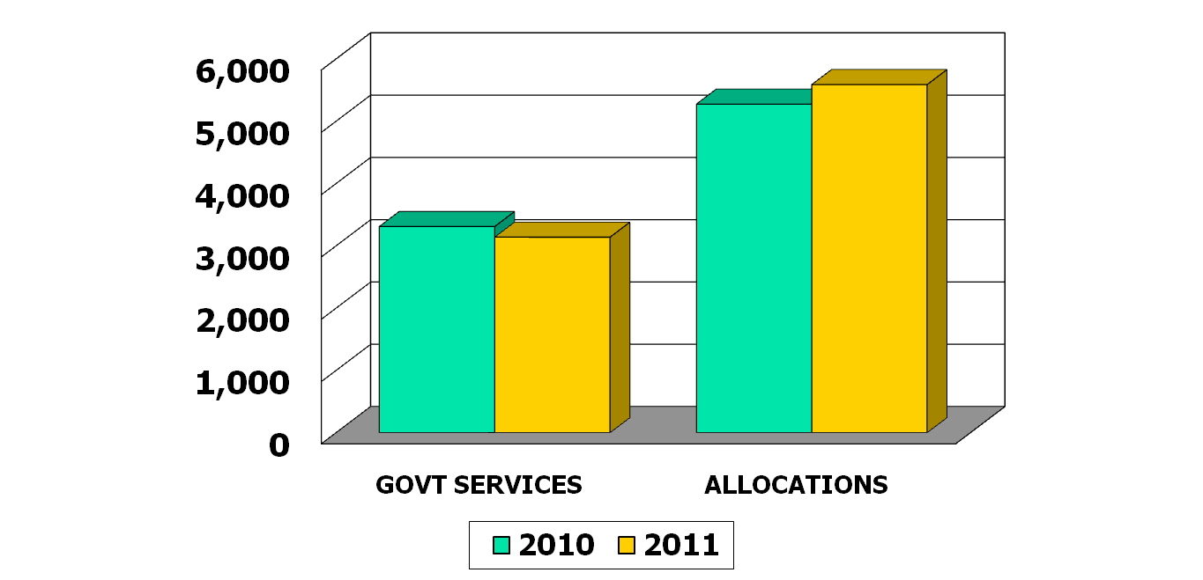
Other Expenses
6%
-5%
Dollars in Thousands

Slide 32

Millage Rate Distribution
SECTOR
2011 BUDGET (1)
MILL RATE
Govt Admin | $ 56,150,872 | 1.99
Court System & Public Safety | $ 40,895,951 | 1.45
Human Services | $ 12,849,819 | .46
Other Expenses | $ 5,075,015 | .15
Library Tax | $ 2,450,000 | .10
TOTAL | $ 110,300,000 | 4.15
Note (1): Budget expense net of revenue offsets

Slide 33
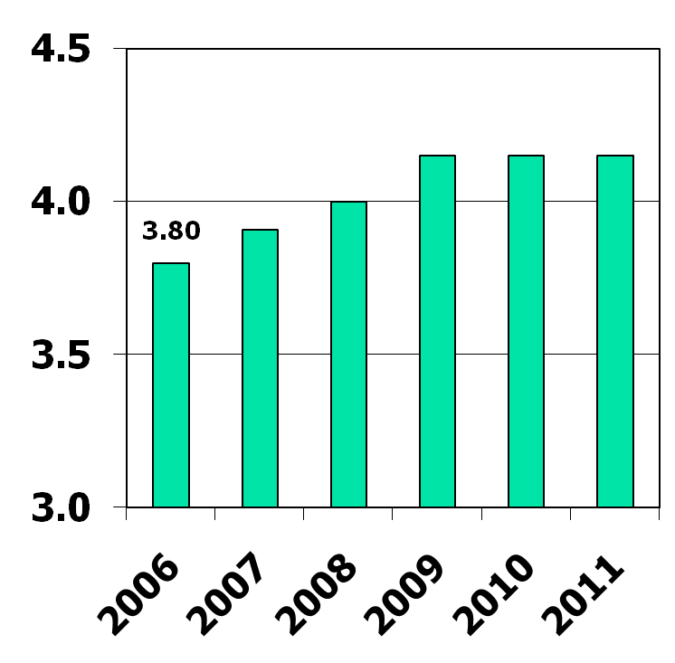
Tax Rate History
Millage Rates
County taxes have risen
.35 mills since 2006, or approx. 9%
  Average 2.0% / year
  No increase since 2009
Increases per year:
  2007 2.90%
  2008 2.30%
  2009 3.75%
  2010 -0-
  2011 -0-
Mills
4.15
4.15
4.15
3.91
4.00

Slide 34

Tax Rate Comparison
For every real estate tax dollar paid in York County…
School Taxes
County
Taxes
Municipal
Taxes
77%
16%
7%
Avg. School Taxes 19.67 mills
Avg. County Taxes 4.15 mills
Avg. Local Taxes 1.76 mills
Total
25.58 mills
Based on 2010 data

Slide 35
Total County Budget
2010
2011
GENERAL FUND
  Principal County Operating Budget $164.6 $171.5
  Dedicated Library Tax 2.4 2.5
  Capital Reserve Fund
PROPRIETARY FUND
  York County Nursing Home 37.5 38.5
  911 County Control 13.9 13.7
SPECIAL REVENUE FUND
  Principal Human Services budget 97.8 88.4
  Domestic Relations budget 5.0 5.0
  Housing, CDBG & Liquid Fuels budget 10.3 93.2
FIDUCIARY FUND
  Retirement Fund 10.7 11.5
  Tax Claim 19.3 20.2
Dollars in Millions
TOTAL BUDGET $ 361.5 $ 444.5

Slide 36
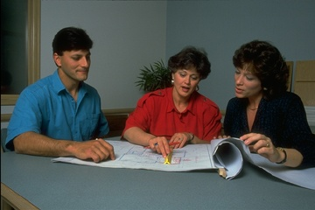
2011 Budget
In summary…
To Recap

Slide 37
2010 Budget Highlights
No G/F tax increase for 2011!
    Millage rate remains at 4.15 mills
    Dedicated Library Tax remains at .1 mills
Holding the line on taxes through:
  ICE revenue maximization
  Aggressive vendor negotiations and expenditure controls
  Operations improvements at PAN&RC

Slide 38
2011 Budget
The County of York

