Slide 1

2012 Final Budget
The County of York
Adopted:
December 21, 2011

Slide 2

2011 RESULTS
…planning for sustainability

Slide 3

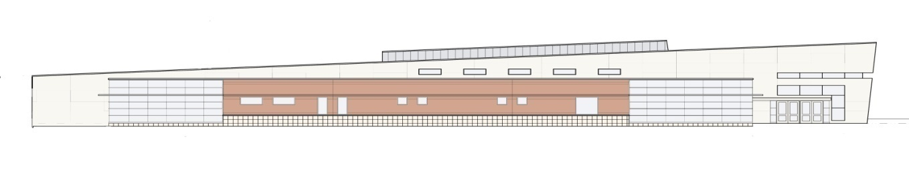
Did we meet our objectives?
911 Strategic plan implementation
  All police, fire & EMS services transitioned to new trunked P-25 technology
  Staff turnover reduced to manageable levels and recruitment increased
  Expanded training component

Slide 4
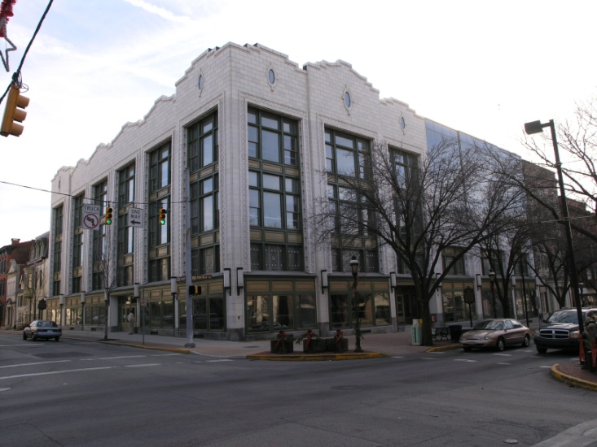
Did we meet our objectives?
Finalized negotiations on new ICE “Fee for Service” contract
  Actual average population was 875, compared to budgeted detainee population of 860
  Revenue projections are up $1.5 million from plan
Government Center Renovations
  Project completed on time and
  $3.1 million under budget
  Completes restructuring plan

Slide 5
Did we meet our objectives?
Implemented capital project funding strategy
  Developed priority list of proposed capital projects
  Obtained $20 million short-term bank note to fund projects
    Provides flexibility on loan drawdown schedule
    Takes advantage of historically low variable loan rates
Hired Public Relations Director
  Provides coordinated approach to public service announcements and media interface
  Responsible for comprehensive County web site overhaul

Slide 6
Notable Achievements in 2011
Completed $3.5 million Energy Efficiency Upgrade
  13 energy projects identified with annual energy cost savings estimated at $447,000
  Facilities include: HSC, Prison, PAN&RC, Parks & YDC
Established Court Appointed Conflict Panel
  Contracted with local attorneys at fixed compensation to handle conflict and indigent cases
  Estimated annual savings of $200,000

Slide 7
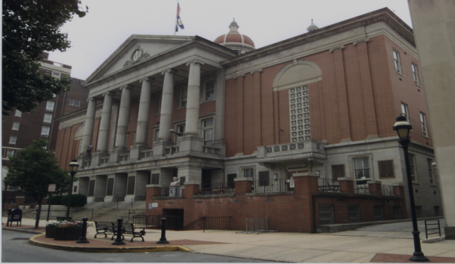
Notable Achievements in 2011
Expanded Electronic Imaging
  Continued program to implement
  electronic imaging to improve efficiency
  Includes: Probation, Archives, Veterans
  Affairs and Human Resources
DUI Court Expansion Initiative
  Judge Kennedy heading up expansion of existing DUI Court
  Project aimed at reducing cost of incarceration and efficient processing of cases through Court system

Slide 8
Notable Achievements in 2011
Obtained $20 million Loan Facility
  Provides short-term funding for approved capital projects
    Human Services Center
    Prison Work Release Facility
    Prison Control Room Upgrade
    YDC Upgrades
Brought “Family Group Decision Making” In-house
  Reduced cost of program and improved service delivery
Renegotiated State & Federal Food Contracts
  Increased amount of food available for local distribution
  Augments traditional local York Food Bank partnership

Slide 9

2011 RESULTS
Building financial stability…..
Estimated $11 million fund balance
Total General Fund spending
on budget
Tax revenues exceeded plan by 1%
ICE revenues exceeded plan by $1.5 million
PAN&RC subsidy exceeded budget by $3.2 million

Slide 10
FAVORABLE TRENDS:
New contract with Bureau of Immigration & Customs Enforcement (BICE) provides stability for program into the future
  Daily rate increased from $67.20 /day to $83 /day
Tax Claim revenues have decreased, reflecting leveling off or reduction in foreclosures
CY&F placements are down 65% over the past two years, saving taxpayers $5 million in private placement costs

Slide 11
UNFAVORABLE TRENDS:
PAN&RC subsidy $3.2 million over budget in 2011
  Reflects lower Medicare reimbursement rates and reduction in billable services provided to residents
Although bargaining unit contract increases have moderated, union wages continue to out-pace non-bargaining employee salaries
  Differential compresses compensation program
2011 Budget requires $1.0 million draw down from Fund Balance
  2012 Budget also anticipates Fund draw down
County continues to “under-fund” Retirement Plan

Slide 12
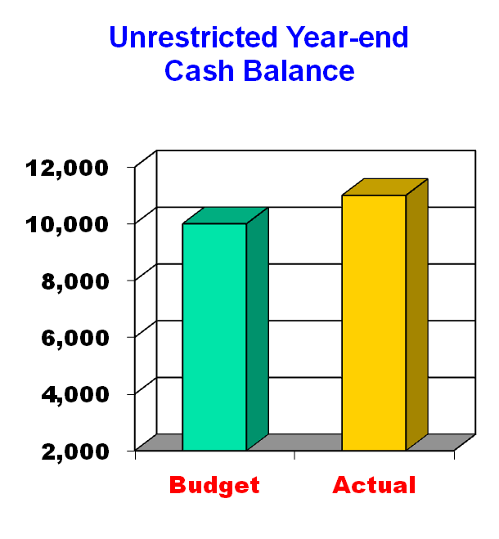

2011 Year End Cash Position
Actual draw down was $1.0M versus planned draw down of $2.4M
Year-end Unrestricted Cash Balance = $11.0 M
$18 Million TRAN will continue to be required to provide gap financing in 2012
Dollars in Thousands

Slide 13

The 2012 Budget
Holding the line on taxes….

Slide 14

2012 Budget Objectives
Court expansion
Magisterial District Justice Restructuring
Develop sustainable strategy for long-term
fiscal stability
Complete planned capital projects & facility improvements

Slide 15
The Bottom Line…
2011 General Fund Budget
  $173,970,761
  Millage Rate = 4.15
    No change from 2010
    Second consecutive year
  Includes Dedicated Library Tax (.1 Mill)
2012 General Fund Budget
  $178,480,163
  Millage Rate = 4.15
    No change from 2011
    Third consecutive year
  Includes Dedicated Library Tax (.1 Mill)

Slide 16
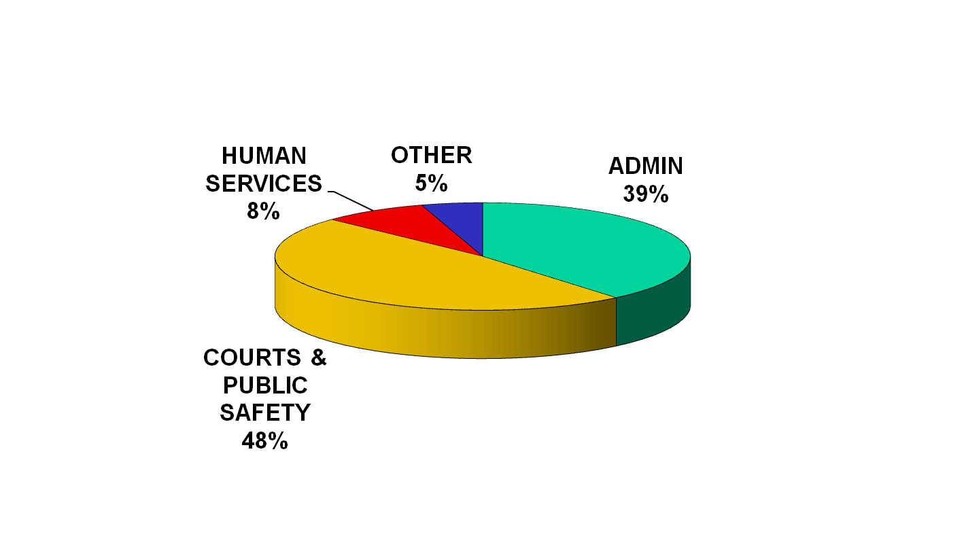
General Fund Expense Summary by Sector
Total General Fund = $178,480,163
Note: Prison operation comprises
48% of total sector costs
How Your Tax Dollars Are Utilized...

Slide 17
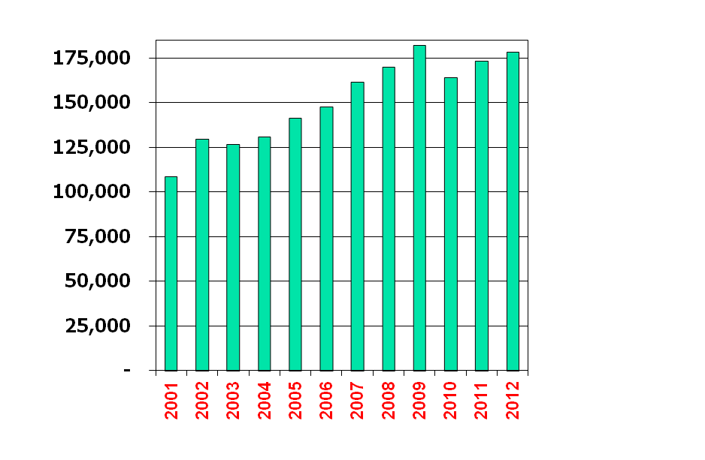
General Fund Growth Trend
2011 Est
2012 Bud
Incr.
$173,650,193
$178,480,163
2.8%
Average Growth Per Year:
2001 – 2011 +4.8%
2012 + 2.8%
Dollars in Thousands

Slide 18
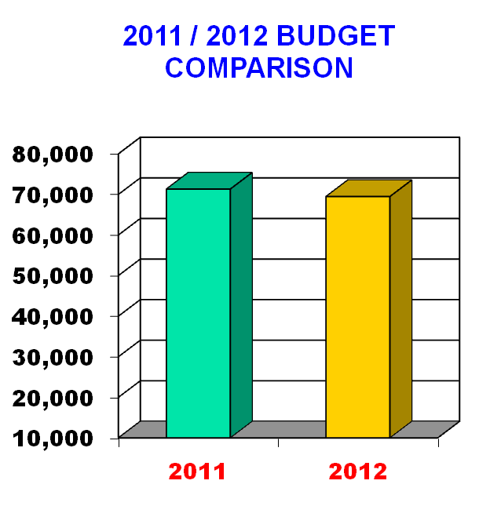
GOVERNMENT ADMINISTRATION
Includes:
  Support functions
  Debt service
  Employee benefits
2012 Budget = $69.5M
2011expense included $1.6 M DOE Energy Improvement Grant
Expenses down 2.5%
Dollars in Thousands

Slide 19
Government Administration
Major impacts:
  Benefit costs up $.3 million
    Retirement Plan contribution (ARC) flat at $10.0 million
    Health care costs are flat from the 2011 budget
      Projected 2011 costs are 5% below budget
  Debt Service costs are flat from 2011
    No new borrowing anticipated for 2012

Slide 20
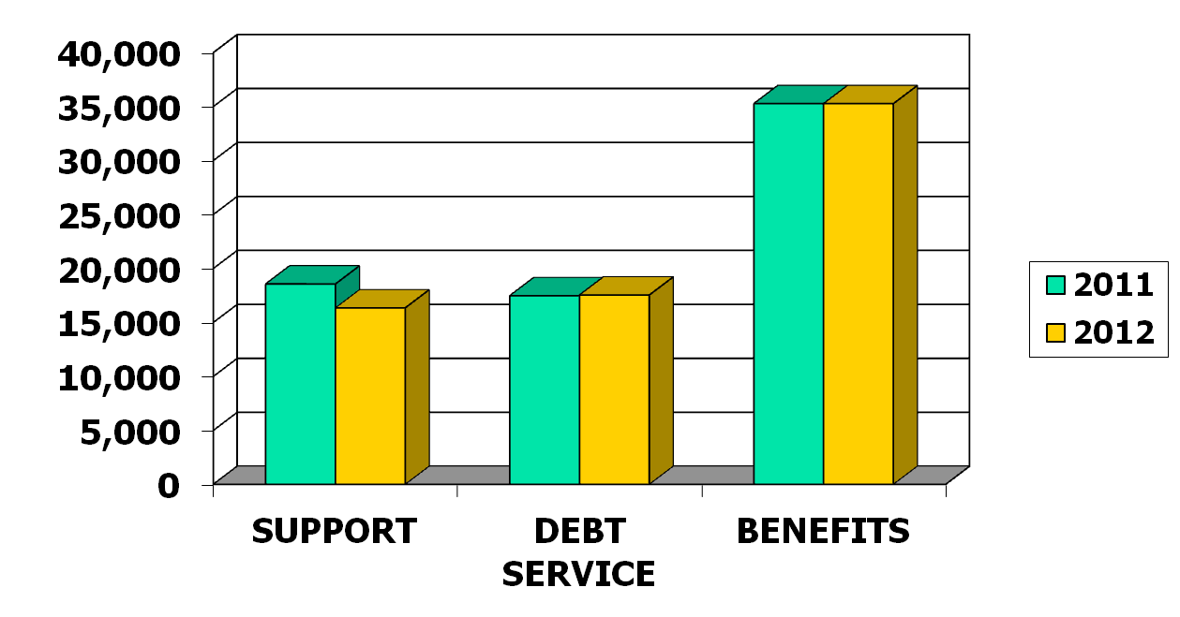
Government Administration
+1%
-12%
0%
Dollars in Thousands

Slide 21
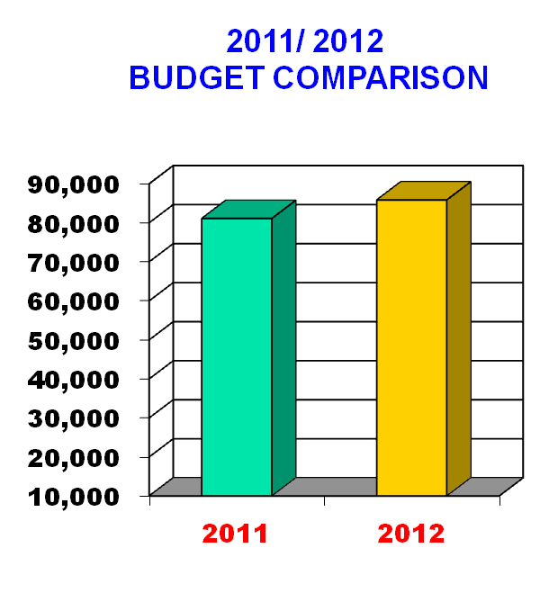
COURT SYSTEM &
PUBLIC SAFETY
Includes:
  Court & Court related functions
  Corrections
  Public Safety
2012 Budget = $85.8M
Total expenses are up 4.8 million or 6%
Prison operations are up $3.8M, or 10%
  Includes 29 new positions
Dollars in Thousands

Slide 22
Court System & Public Safety
Major Impacts:
  Prison operational costs up $3.8 million
    Personnel additions add $1.2 M in S&W costs
    New Work Release facility scheduled to come on line in Sept 2012
  Prison operating costs offset by increased ICE and state revenue generation
    ICE revenue projected up $4.5 million
      Daily rate increased from $67.20/day to $83.00/day effective Oct 2011
    Projected “out-of-county inmate population for 2012 is estimated at 870 per day

Slide 23
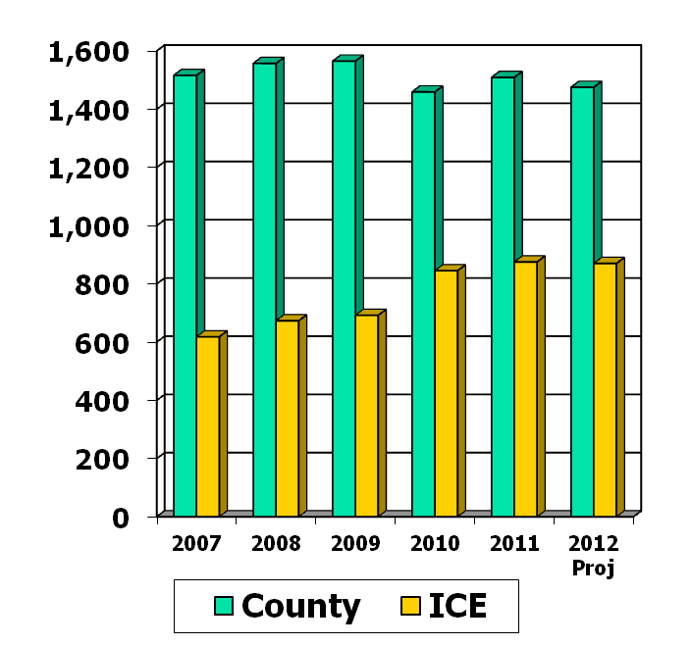
Court System & Public Safety
Average Daily Prison Population
Average York inmate population is decreasing due to alternative sentencing programs
  2011 average is 1,509
ICE population has stabilized at approximately 850 detainees / day
“Out of County” average population projection for 2012 is 870 detainees
  Down from 2011 average of 875 per day

Slide 24
Court System & Public Safety
Major Impacts (Cont’d):
  911 Operations subsidy up $.5 million
    Reflects new maintenance contracts for radio system
  Court Special Counsel fees reduced $330,000 to reflect impact of Conflict Panel
Court Admin budget includes costs for two new Judges
  Includes Law Clerks and Admin. Assts

Slide 25
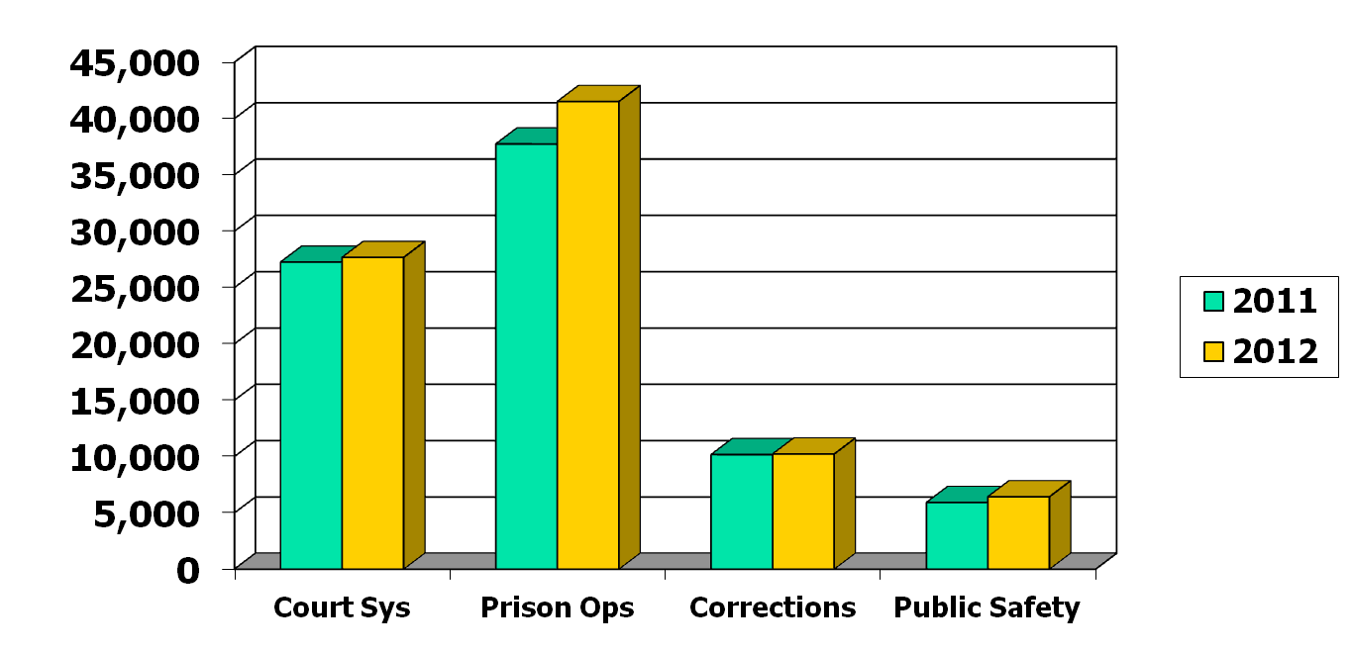
Court System & Public Safety
+10%
+2%
+1%
+9%
Dollars in Thousands

Slide 26
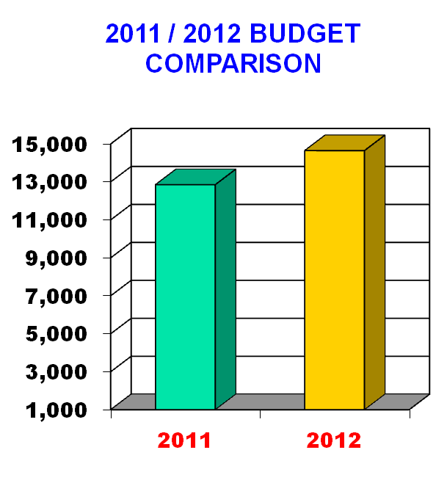
HUMAN SERVICES
Includes:
  C&Y
  MH/MR
  Area Agency on Aging
  PAN&RC
  Veteran’s Affairs
2012 Budget = $14.6 Million
Total expenses up $1.8 million
  PAN&RC subsidy up $1.7 M
Dollars in Thousands

Slide 27

Human Services
Major Impacts:
  PAN&RC subsidy up $1.7 million from 2011
    2012 subsidy is $3.3 million
    Reflects reduced Medicare and Medicaid reimbursement rates
    ARC allocation increased $300,000 from 2011
  CY&F, Aging & MH/MR subsidies flat from 2011

Slide 28
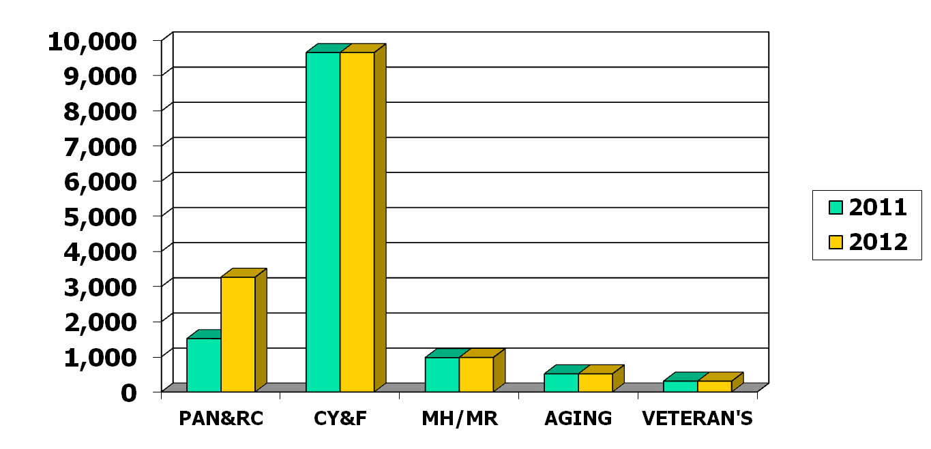
Human Services
0%
+115%
0%
0%
+9%
Dollars in Thousands

Slide 29
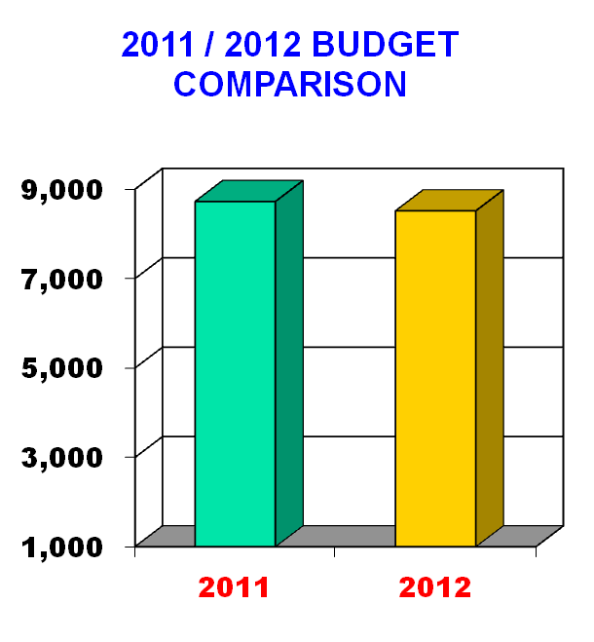
OTHER EXPENSES
Includes:
  Government Services
    Planning Commission
    Farm & Natural Land Trust
    Rabbittransit
    YCEDC
    Library System
  Discretionary allocations
2012 Budget = $8.5 Million
Expenses are down $211,000
or 2%
Dollars in Thousands

Slide 30
Other Expenses
Major Impacts:
  Library funding up $100,000 due to supplemental allocation; total funding is $2.55M
    Includes dedicated .1 Mill Library Tax
  Father’s Workshop program not funded in 2012; in-house program developed to provide alternative services
  Includes $200,000 for City Nuisance Abatement officers
  $75,000 allocated to YWCA for ACCESS and VAC services

Slide 31
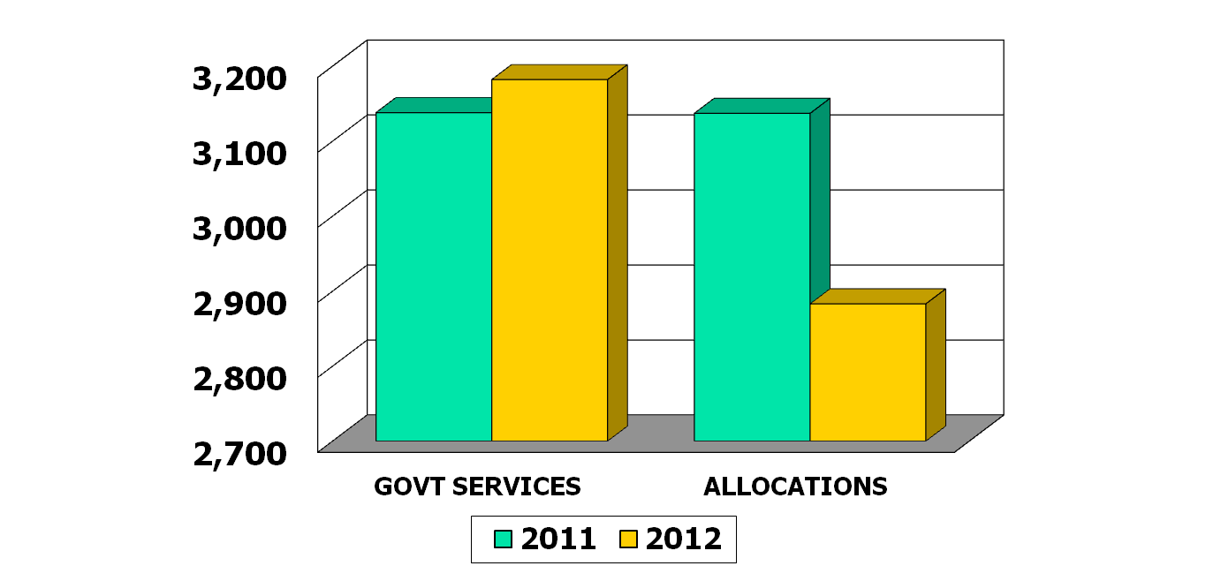
Other Expenses
+1%
-8%
Dollars in Thousands

Slide 32

Millage Rate Distribution
SECTOR
2012 BUDGET (1)
MILL RATE
Govt Admin | $ 53,260,781 | 1.91
Court System & Public Safety | $ 40,621,368 | 1.46
Human Services | $ 14,647,028 | .52
Other Expenses | $ 4,865,422 | .16
Library Tax | $ 2,450,000 | .10
TOTAL | $ 115,844,599 | 4.15
Note (1): Budget expense net of revenue offsets

Slide 33
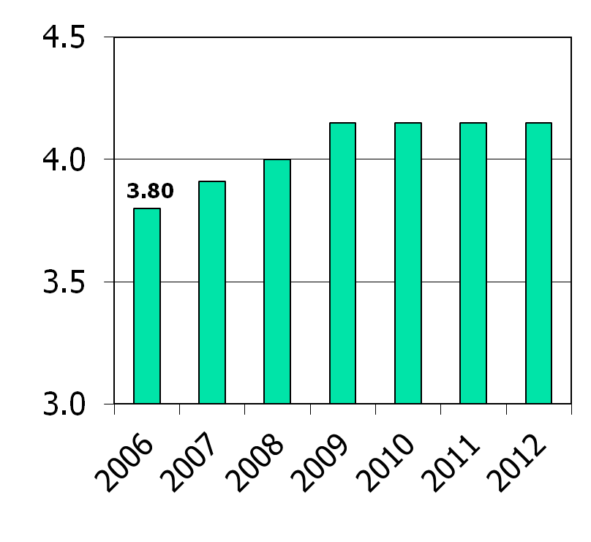
Tax Rate History
County taxes have risen
.35 mills since 2006, or approx. 9%
  Average 1.5% / year
  No increase since 2009
% Increase per year:
  2007 2.90%
  2008 2.30%
  2009 3.75%
  2010 -0-
  2011 -0-
  2012 -0-
Millage Rates
Mills
4.15
4.15
4.15
4.15
3.91
4.00

Slide 34

Tax Rate Comparison
For every real estate tax dollar paid in York County…
School Taxes
County
Taxes
Municipal
Taxes
77%
16%
7%
Avg. School Taxes 19.82 mills
Avg. County Taxes 4.15 mills
Avg. Local Taxes 1.87 mills
Total
25.84 mills
Based on 2011 data

Slide 35
Total County Budget
2011
2012
GENERAL FUND
  Principal County Operating Budget $171.5 $176.0
  Dedicated Library Tax 2.5 2.5
  Capital Reserve Fund
PROPRIETARY FUND
  York County Nursing Home 38.5 39.9
  911 County Control 13.7 15.0
SPECIAL REVENUE FUND
  Principal Human Services budget 88.4 92.5
  Domestic Relations budget 5.0 5.1
  Housing, CDBG & Liquid Fuels budget 93.2 86.7
FIDUCIARY FUND
  Retirement Fund 11.5 12.0
  Tax Claim 20.2 20.8
Dollars in Millions
TOTAL BUDGET $ 444.5 $ 450.5

Slide 36

2012 Budget
In summary…
To Recap

Slide 37
2012 Budget Highlights
No G/F tax increase for 2012!
    Millage rate remains at 4.15 mills
    Dedicated Library Tax remains at .1 mills
Holding the line on taxes through:
  ICE revenue maximization
  $3.4 Million Fund Balance transfer to General Fund
  Aggressive cost controls and spending restraints

Slide 38
2012 Budget
The County of York

