Slide 1

Acting on “Open.”
Heather Joseph
Executive Director, SPARC
SEC Academic Collaboration Award 2015 Workshop
College Station, TX
February 7, 2015

Slide 2
Change is afoot.

Slide 3

The Internet.

Slide 4

New Channels to Share Work.

Slide 5
Digital Everything.

Slide 6


Slide 7
We have a unique opportunity to explore innovative ways to access and use this vast new wealth of digital info.

Slide 8
Oh and by the way – it’s all online, it’s got to be cheaper, right?

Slide 9
Well...no.

Slide 10
Prohibitive Costs Abound.

Slide 11
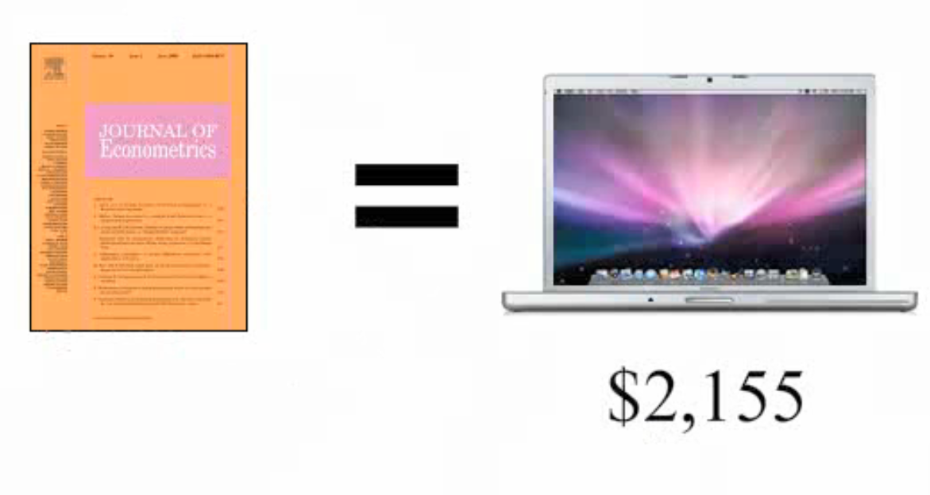
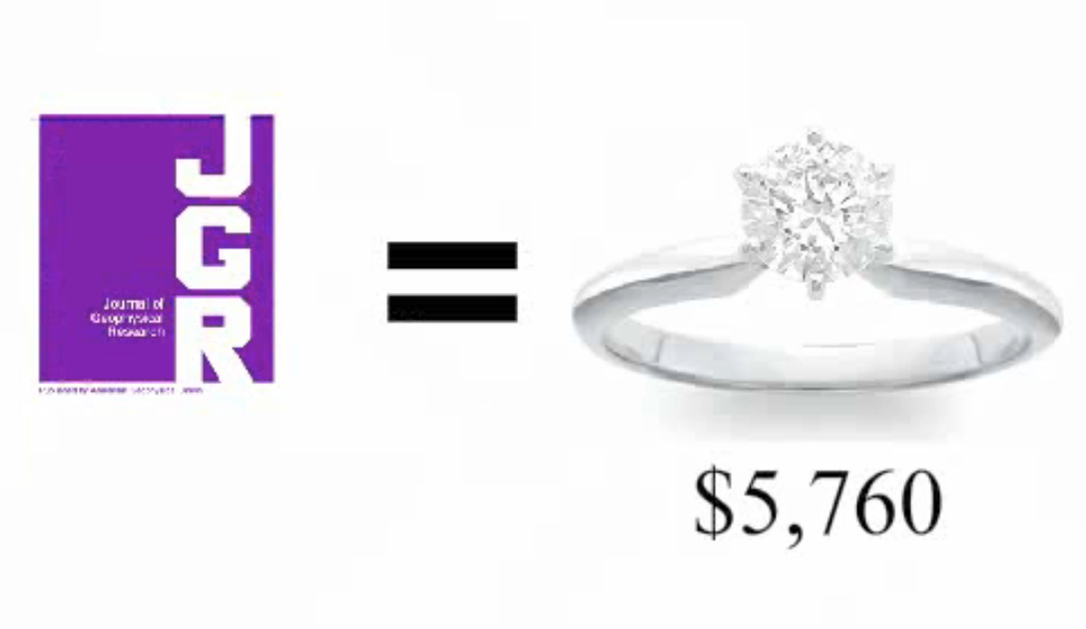
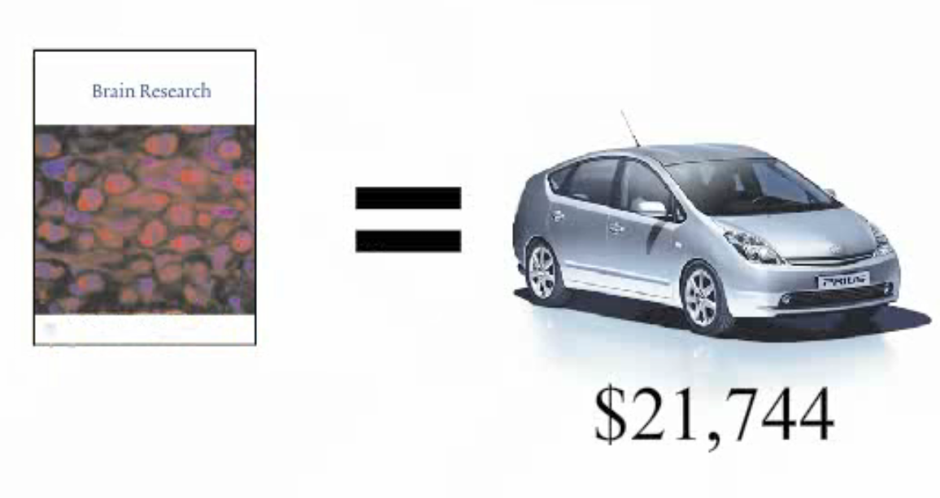
Costs for 1-yr Journal Subscriptions
www.righttoresearch.org
Source: http://web.archive.org/web/20050828210650/libraries.mit.edu/about/scholarly/expensive-titles.html

Slide 12
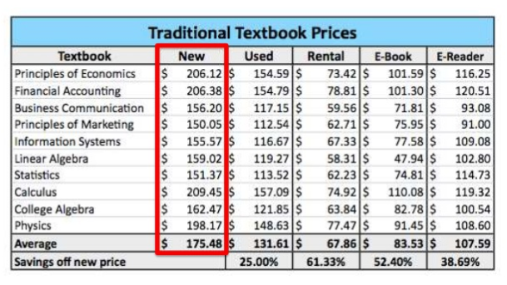
Average Textbook Prices
Source: http://www.studentpirgs.org/sites/student/files/reports/A-Cover-to-Cover-Solution_4pdf

Slide 13
$1,207.
Average budget for student books and supplies for the 2013-2014 academic year.
Source http/:trends.collegeboard.org/college-pricing/figures-tables/average-estimaed-undergraduate-budgets-2013-2014

Slide 14
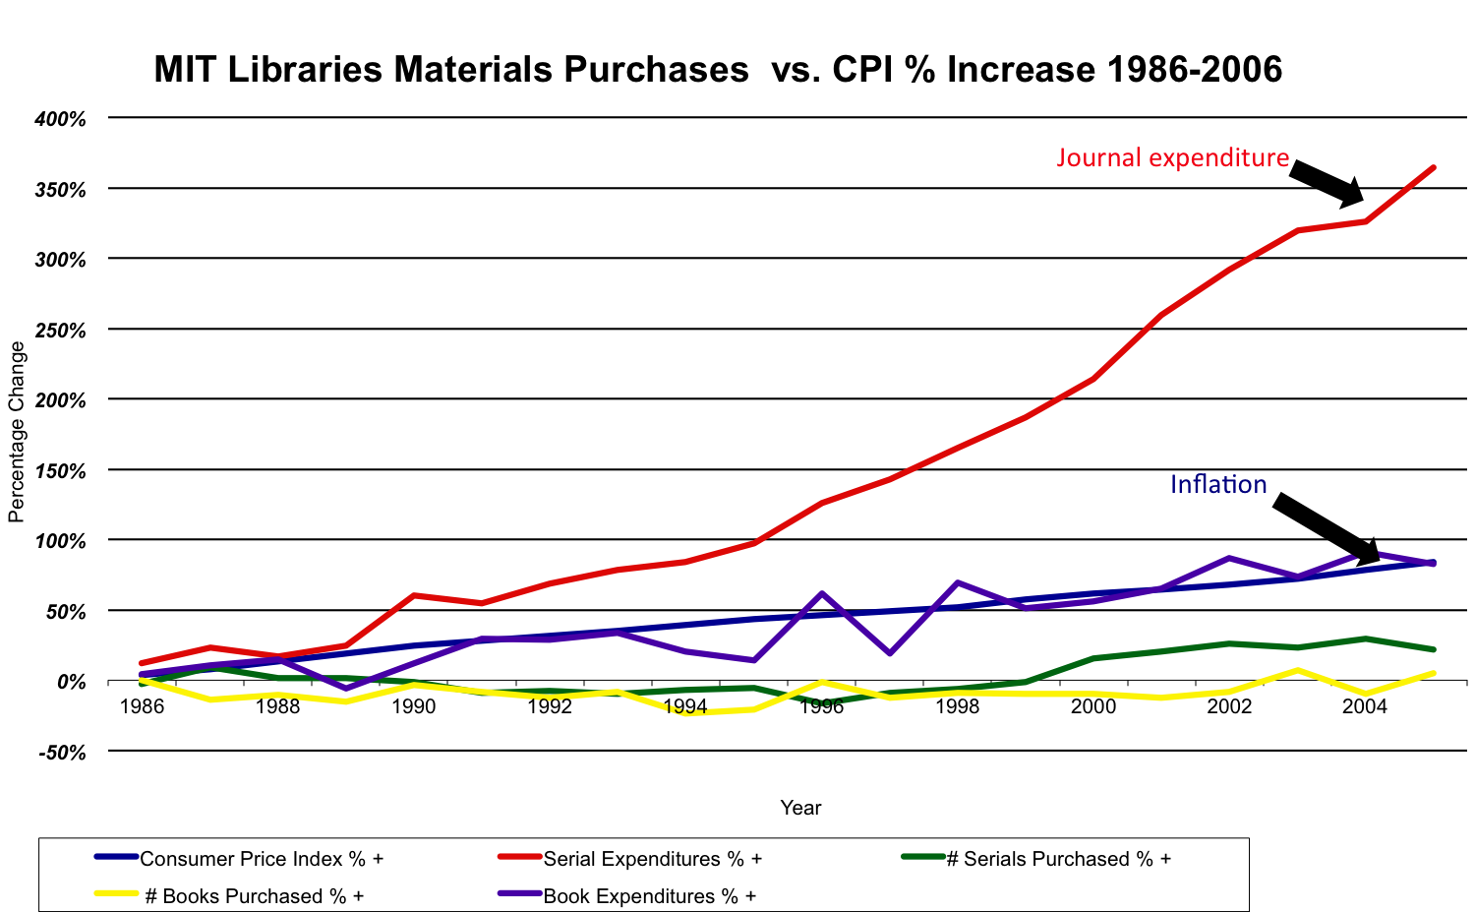
Library budgets & journal prices

Slide 15
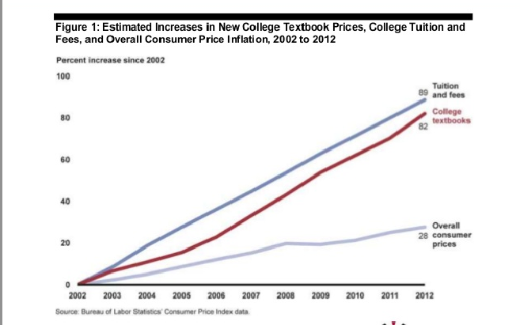
Textbook prices and the CPI
Source: www.goa.gov/products/GAO-13-368
Notes:
Students & family budgets have not kept pace

Slide 16
déjà vu?

Slide 17
Library budgets & journal prices
Notes:
Library budgets have not kept pace

Slide 18
Textbook prices and the CPI
Source: www.goa.gov/products/GAO-13-368

Slide 19
Nope.

Slide 20
Despite the promise of the Internet, the materials we most need the freedom to work with remain largely under restrictive pricing and reuse policies.

Slide 21
We have 20th century policies governing 21st century information.

Slide 22

Source: http://blog.aliyahland.com/2014/02/why-why-why.html

Slide 23
First and easiest answer is, of course, money.

Slide 24
“The annual revenues generated by STM journal publishing were estimated at US $9.4 billion in 2011…”
Source: The STM Report,http://www.stm-assoc.org/2012_12_11_STM_Report_2012.pdf

Slide 25
“During same time period, annual revenues for textbook publishers were estimated at US $8.8 billion …”
Source: http://www.slideshare.net/txtbks/keynote-nercomp?related=1

Slide 26
That’s a lot of revenue…now let’s consider the profits.

Slide 27
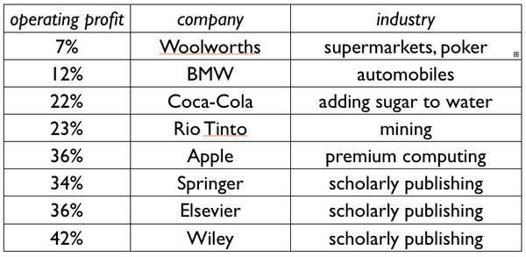
Profit Margins
Source: pic.twitter.com/L3U6GWhM

Slide 28
And we know where that money comes from…

Slide 29
Libraries.
Students & their families.

Slide 30
Prohibitive costs means this information is available to the few – not the many.

Slide 31
We’re forced into living with work-arounds.

Slide 32
Money is only one factor.
Fundamental characteristics set the academic textbook and journal markets apart from others.

Slide 33
Intermediaries blunt price sensitivity.

Slide 34
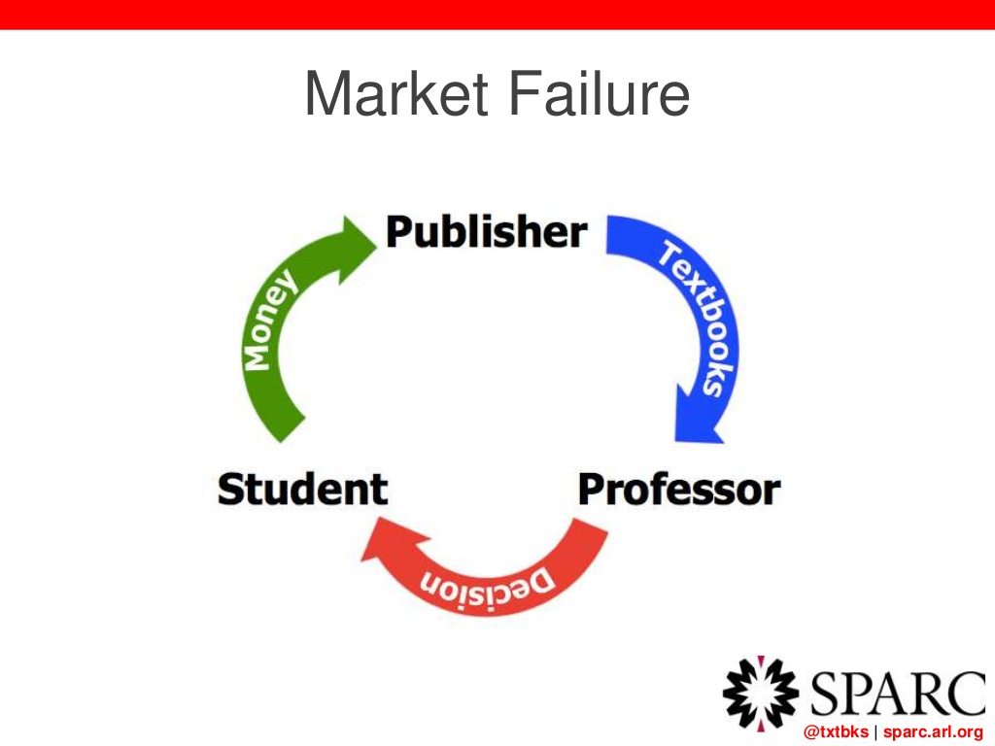

Slide 35
Now look at that slide again, just substitute “Libraries” and “Researchers” for students and professors…

Slide 37
It’s déjà vu all over again…(thanks, Yogi.)

Slide 38
No Substitutions.

Slide 39
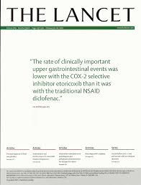
If you need The Lancet…
…You need The Lancet.

Slide 40
No such thing as “The Lancet Lite.”

Slide 41
And one last thing...

Slide 42
Scholars are still largely evaluated on the reputation of the journal titles they publish in, rather than the direct quality of the articles they publish.

Slide 43
Ok. Depressed enough?

Slide 44


Slide 45
No, no, no…hope is not lost. Not by a long shot!

Slide 46
A tale of two “open” movements.

Slide 47



Slide 48
Similar drivers, as we’ve just seen.

Slide 49
But also: similar goals, values, strategies and tactics.

Slide 51
“By open access, we mean the free availability of articles on the public internet, permitting any users to read, download, copy, distribute, print, search or link to the full text of these articles, crawl them for indexing, pass them as data to software or use them for any other lawful purpose…”
- The Budapest Open Access Initiative – February 14, 2002
Notes:
Calls for

Slide 52
Open Access = Immediate Access + Full Reuse

Slide 54
“OER are teaching, learning and research resources that reside in the public domain or released under an intellectual property license that permits their free use and repurposing by others ”
-The Hewlett Foundation Definition of OER

Slide 55
OER = Free Access + Full Reuse Rights

Slide 56
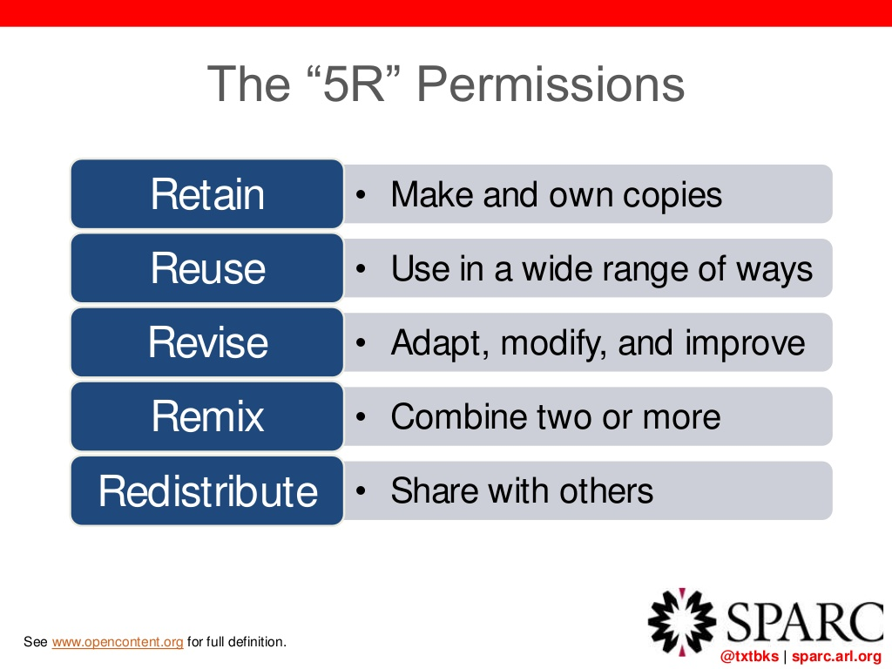

Slide 57
Both OA and OER emphasize the absolute imperative to enable unobstructed digital reuse of these materials, to fully exploit the power - and the value - of the information they contain.

Slide 58
Both movements believe that “Open” provides both a solution to a problem, as well as a lever to create new opportunities.

Slide 59
Ultimate end-game: Set the default to “Open.”

Slide 60
Steady progress being made by both movements to:

Slide 61
1. Create infrastructure.

Slide 62
2. Create Legal Framework.

Slide 63
3. Create Sustainable Business Models.

Slide 64
4. Create Policy Framework

Slide 65
5. Create Collaborations

Slide 66
Challenges are big, but the Opportunities are bigger.

Slide 67
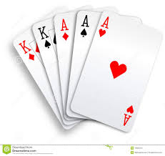
Our community holds powerful cards.

Slide 68
1. We are the content producers.
2. We are the customer base.
3. We have options for individual and collective action.
4. Actions can be small (cancel subscription) or large (collective infrastructure project.

Slide 69
It’s up to us. Let’s get to work!

Slide 70
Thank You for Listening.
Heather Joseph
Executive Director, SPARC heather@arl.org
Thanks to Nicole Allen, Nick Shockey, SPARC NA and Alma Swan, SPARC EU, for sharing slides for this presentation.

