Slide 1
Virginia Energy Resource Issues
Energy Consumption and Supply Trends for Virginia
Presented by Richard F. Spellman
Vice President
GDS Associates, Inc.
October 18, 2006

Slide 2
Topics to Be Discussed
Virginia Energy Consumption and Supply Statistics Trends
Energy consumption by fuel source
  Electricity, petroleum, natural gas, fuel oil, other
Energy consumption by sector
  Residential, commercial, industrial , transportation
Inflows and outflows of energy dollars
The “Gap” between the demand for energy and energy supply sources
Notes:
My presentation builds on the slides presented by Preston Bryant and Patrick Gottschalk, our luncheon speakers.

Slide 3
Virginia Energy Consumption Statistics and Trends

Slide 4
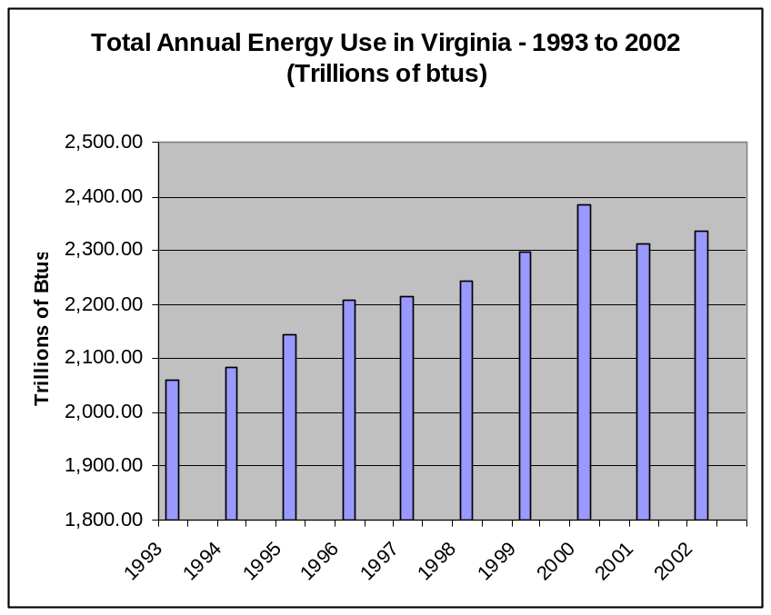
Energy Use in Virginia
Demand in Virginia for electricity, natural gas and other fuels continues to increase
Total energy use in Virginia increased at 1.4 percent a year from 1993 to 2002
Energy prices have increased significantly over the past 24 months for oil, natural gas and gasoline
Notes:
Historically, growth in electricity consumption in Virginia has followed growth in growth domestic product
In the future, growth in energy efficiency programs will cause electricity sales growth to slow.
Demand for electricity in Virginia increased in total, not by year, 24% from 1995 to 2004.
According to the speaker this morning from Dominion, Dominion is projecting that load shedding will be needed by 2011 given their current load forecast.
Part of the reason for the growth in electricity is population growth and the construction of new sophisticated electronic data centers in Virginia.

Slide 5
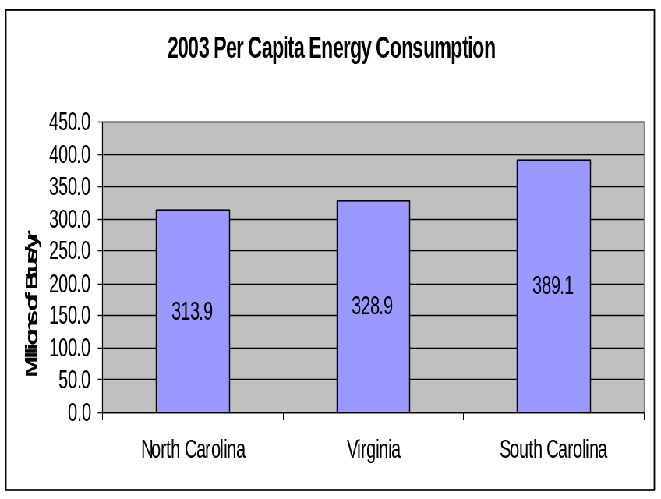
Per Capita Energy Consumption in Virginia
In 2003, Virginia average per capita energy consumption was 313.9 million btus
2003 US average per capita energy consumption was 339.0 million btus
Virginia ranked 30th in 2002

Slide 6
Virginia Energy Consumption By Fuel Source

Slide 7
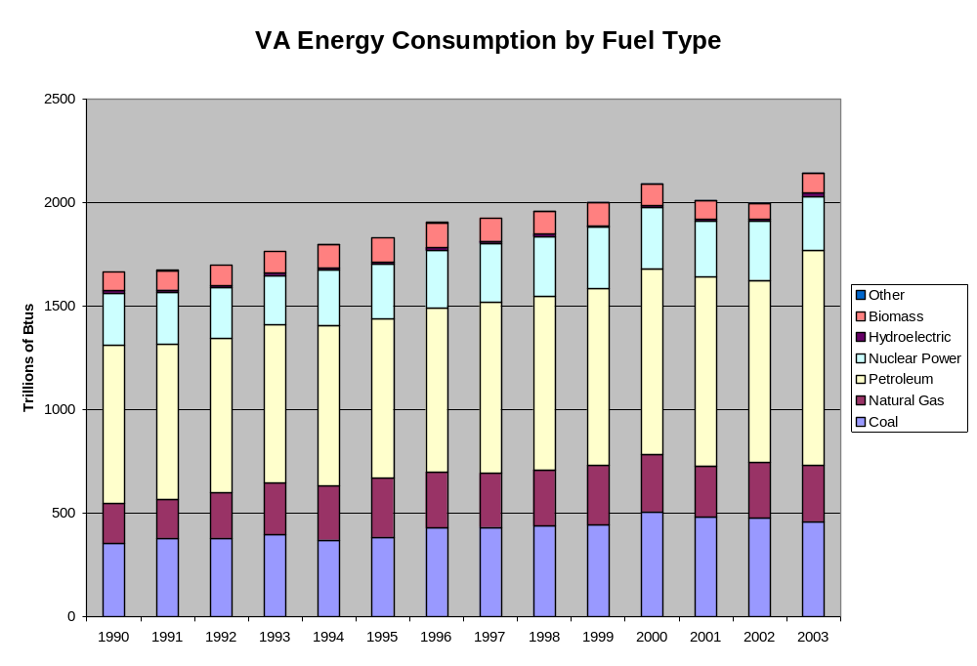
Notes:
49% of the energy consumed in Virginia in 2003 was provided by petroleum products. The State is very reliant on petroleum products.
21% of the energy consumer in Virginia in 2003 was provided by coal and 13% was provided by natural gas. This energy resource percentage mix has remained fairly constant since 1990.
This morning at the 10:30 AM session on the future of coal, Tom Hudson of the Virginia Coal Association noted that the coal reserve base in Virginia is declining and mining costs are increasing. There are several issues that need to be addressed for coal mining in Virginia, such as safety, productivity, and an aging coal work force. The Coal Association supports the examination of a [portfolio of clean coal technologies.
Preston Gottschalk also noted that coal production in Virginia is declining.

Slide 8
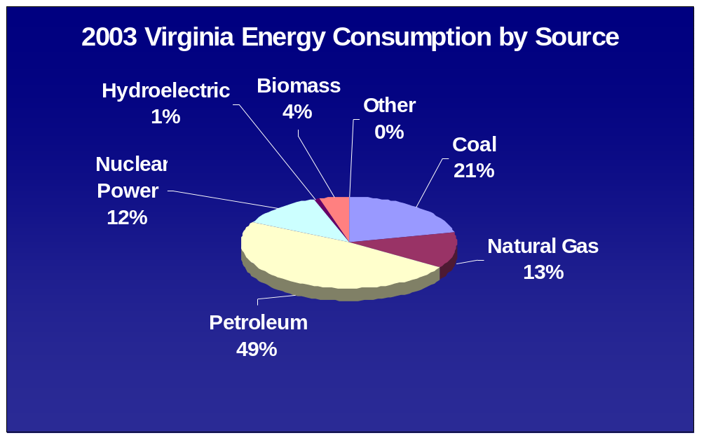

Slide 9
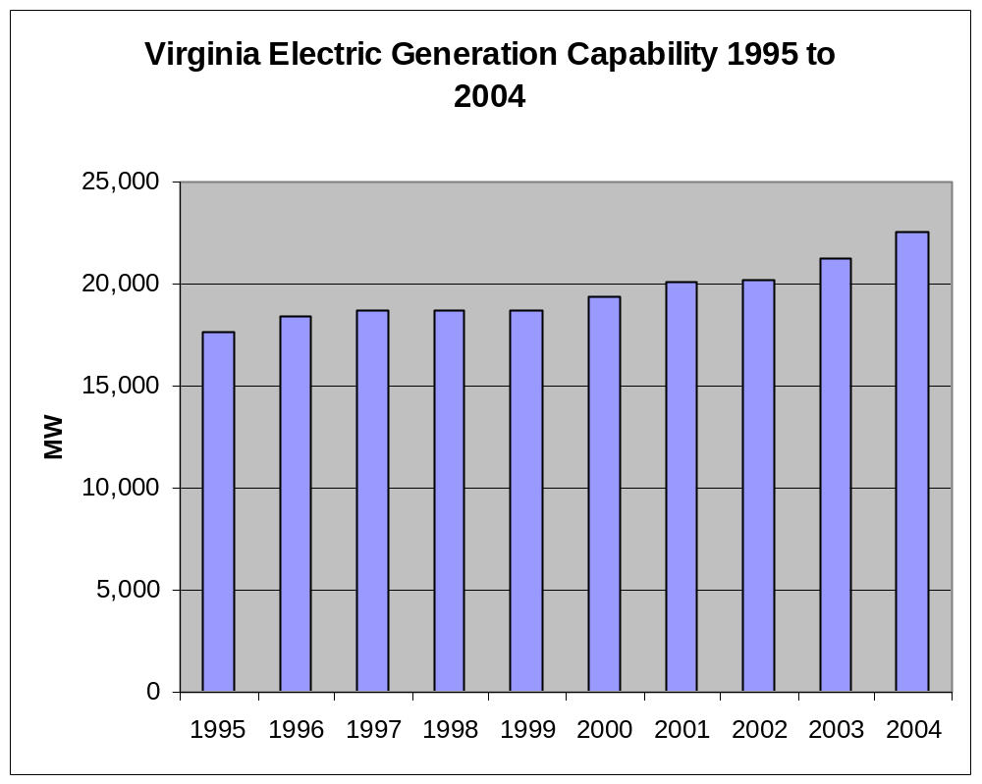
2.7% annual growth in capability from 1995 to 2004
Notes:
Virginia is actively recruiting electronic data centers. Each one has an electric load of 40 to 80 MW.
Virginia population continues to increase
The Governor has just announced a new economic development plan.

Slide 10
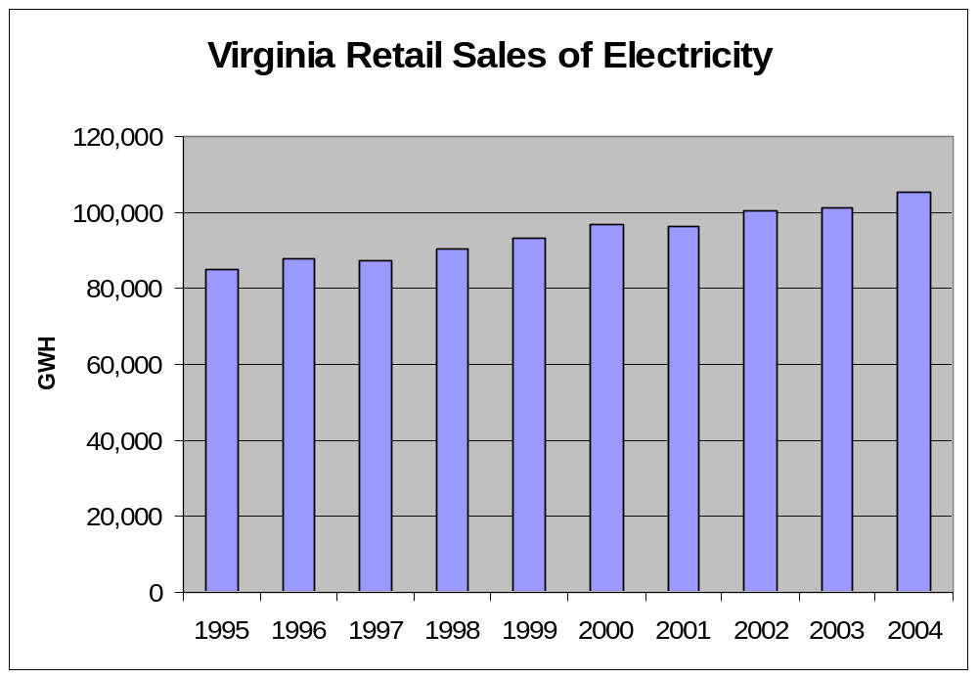
2.4% annual growth in electricity sales 1995 to 2004
Notes:
Electricity sales in Virginia have increased at an average annual rate of 2.4 percent during the period form 1995 to 2004. Overall, during that period, the demand for electricity increased by 24 percent in total.

Slide 11
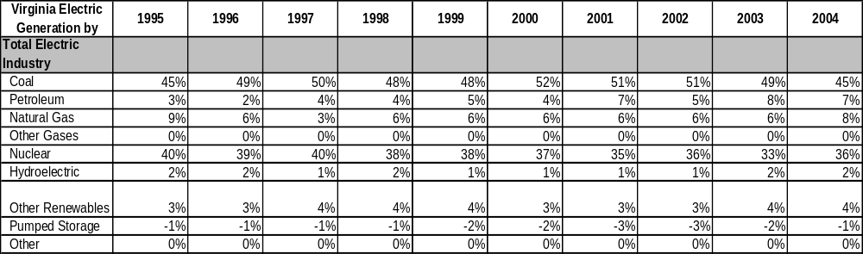
Virginia Electric Generation by Fuel Type – 1995 to 2004
Over the past decade, coal and nuclear power have provided over 80 percent of the State’s electricity generation
Notes:
In 2004 nuclear power provided 36% of the power generated in Virginia, coal provided 45% of the power generation, and natural gas provided 8% of the power generated. As Gene Grecheck of Dominion mentioned in his speech this morning, it is important to have a balanced portfolio of energy supply resources.
Note that in the United States in 2005, nuclear power plants were available and producing power 90 percent of the time.
Mary Quillian, from the Nuclear Energy Institute and a speaker at this morning’s Plenary session, noted that we need to complete the Yucca Mountain fuel storage facility to store spent nuclear fuel.
South Carolina, Idaho and the State of Washington have expressed an interest in having spent nuclear fuel stored in their states.
The Energy Policy Act of 2005 provides policies to get new nuclear plants constructed in the US
Risk insurance for new nuclear plants
Production tax credit (1.8 cents per kWh)
Federal loan guarantee
There are two reactor designs that have been approved by the Nuclear Regulatory Commission
13 companies are looking at building new nuclear power plants – with power coming on line by 2015. Dominion is one of these companies that is considering building a new nuclear plant, but has not made a decision yet. The new plant would cost $3 to $3.5 billion.
The speaker from Dominion noted that Dominion supports reducing carbon dioxide emissions

Slide 12
Virginia Energy Consumption By Residential, Commercial, Industrial and Transportation Sectors

Slide 13
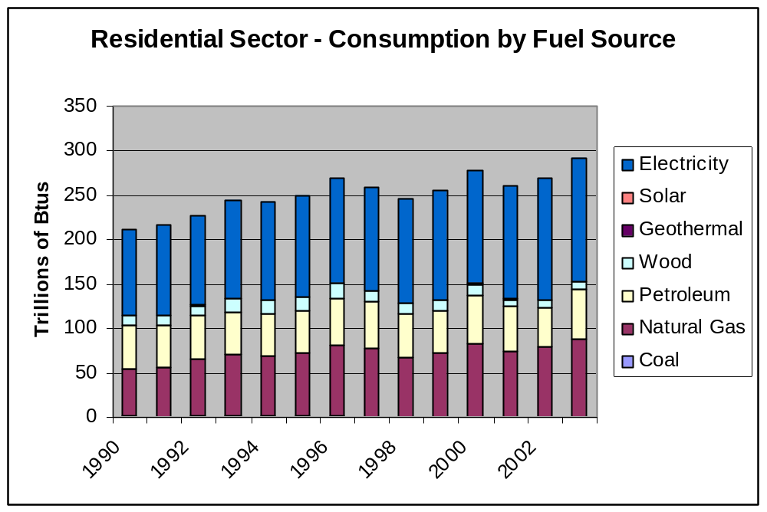
Notes:
48% of the residential sector energy consumption in 2004 was for electricity.

Slide 14
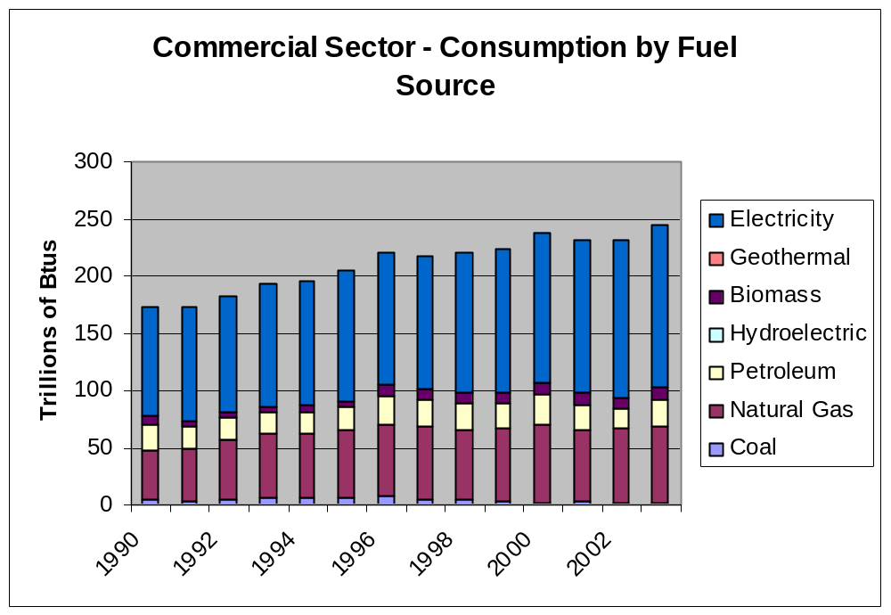
Notes:
59% of the commercial sector energy consumption in 2004 was for electricity.

Slide 15
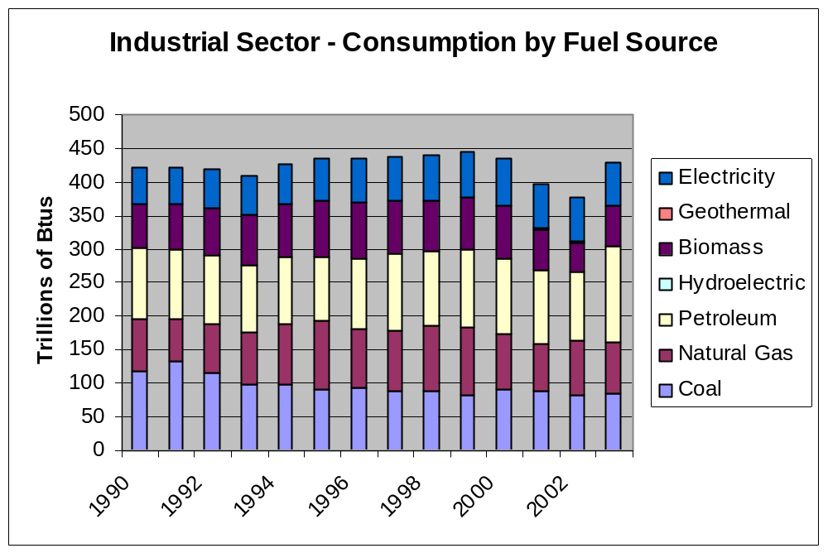
Notes:
34% of the industrial sector energy consumption in 2004 was for electricity, and coal represented 20%.

Slide 16
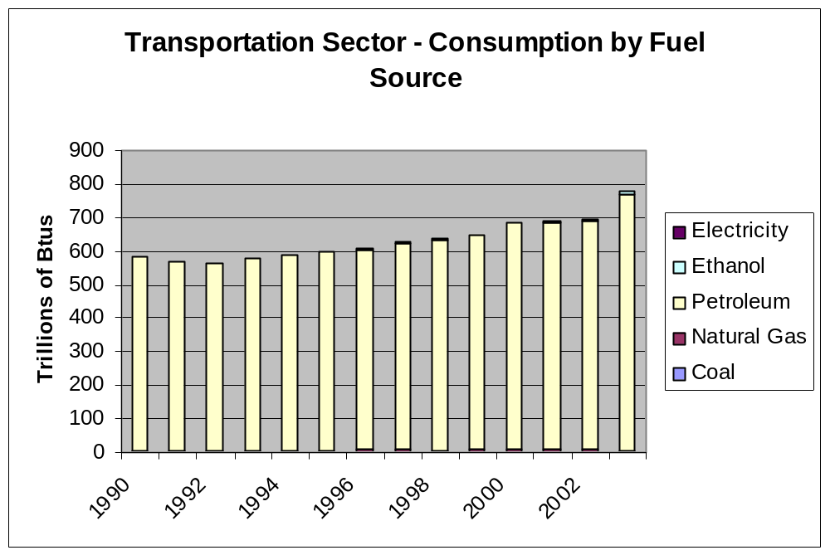
Notes:
In 2004, 98% of the transportation energy sector energy use was for petroleum.

Slide 17
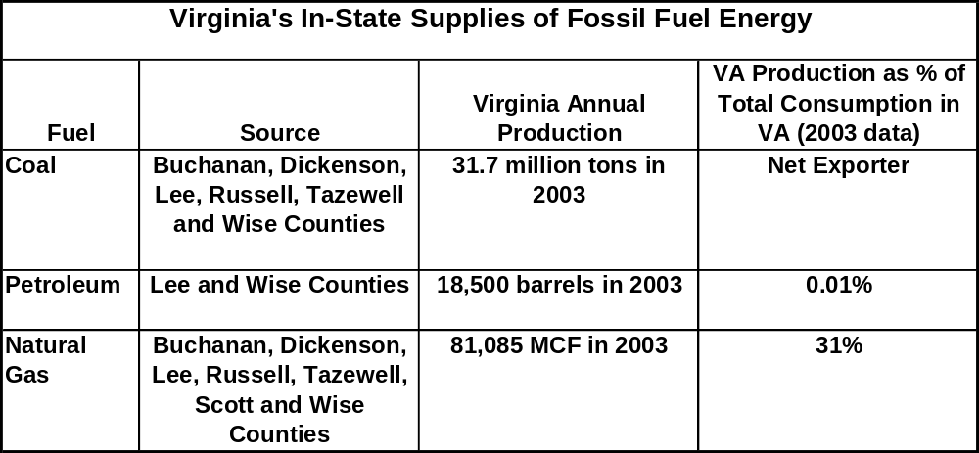
Virginia is a net importer of petroleum and natural gas, and a net exporter of coal.
Notes:
Virginia is a net importer of coal. The State imports the majority of its needs for petroleum and natural gas.

Slide 18
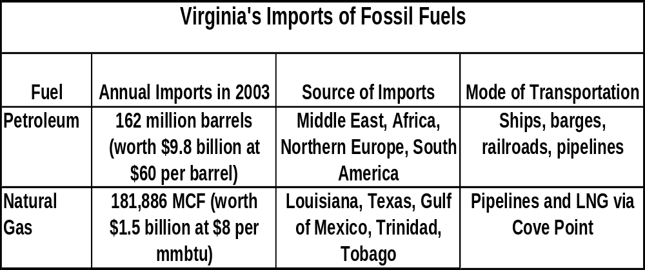

Slide 19
Need for New Energy Resources
Electricity demand is forecast to grow at 2% per year for the next decade
Demand for other fuels is also forecast to increase
Needs to provide a road map for meeting the energy needs of homes and businesses in the State, consistent with the policies and objectives established for this plan

Slide 20
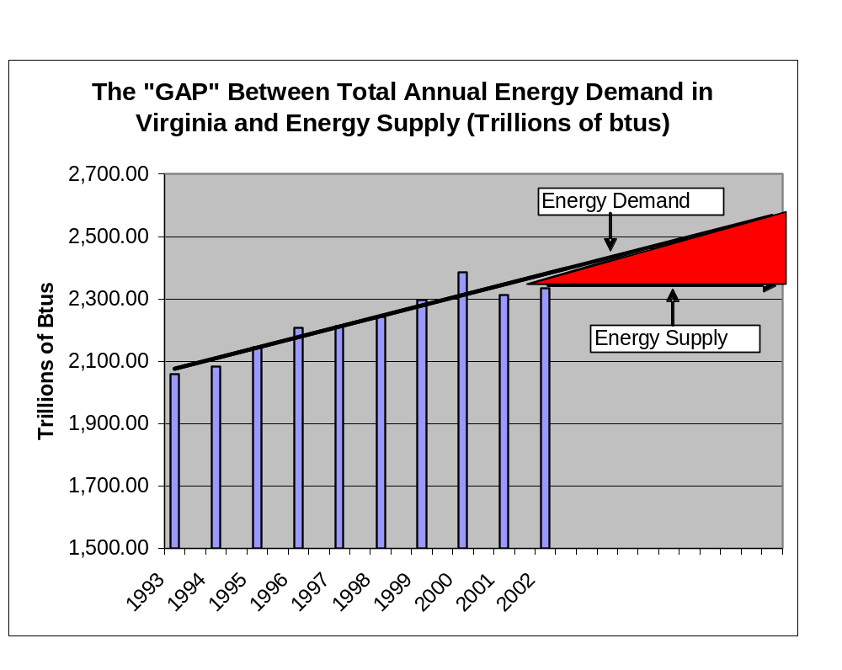

Slide 21
Potential Energy Resource Issues and Options
Reliable, low cost energy supplies to support VA’s economy
Reduce reliance on imports of foreign oil
Increase use of bio-fuels (bio-diesel, ethanol)
Increased emphasis on energy efficiency
Renewable Energy (biomass, solar, landfill, wind, anaerobic digesters, etc.)
Production of natural gas & oil
New nuclear units at North Anna site
Development of off-shore wind generation
LNG imports
R & D Needs
Notes:
The speakers at this morning Plenary session discussed all of these energy resource alternatives.
All agreed that there is a need to reduce emissions of carbon dioxide.
This morning’s speakers noted that it will be very important to weigh several factors when selecting new energy resources to fill the gap:
Electricity demand growth in the future
Construction cost
Operating cost
Future fuel prices
Risk
Portfolio diversification
The length of the licensing process
Safety
Exposure to terrorism
Air Quality, and the ability to reduce emissions
Ability to address climate change
Emerging technologies
Job creation

