Slide 1
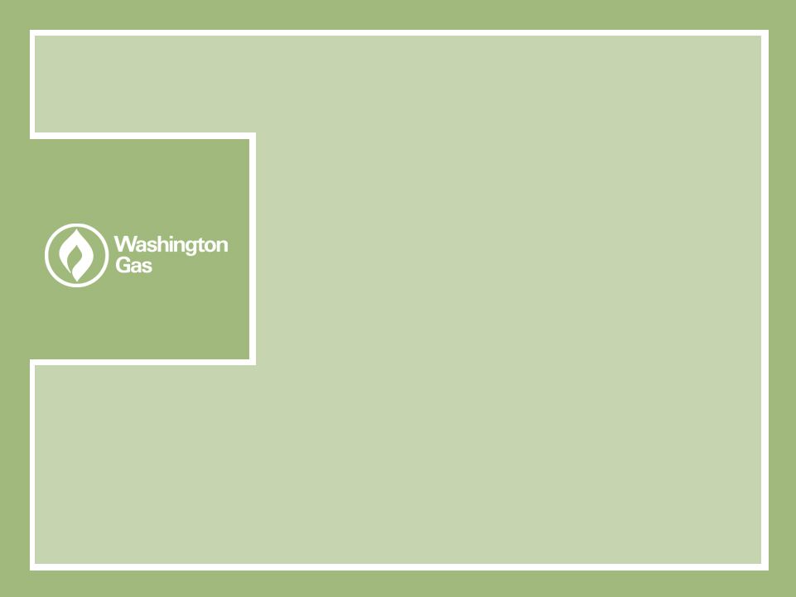
Maryland - District of Columbia Utilities Association Conference
Panel on Conservation and Usage Reduction
James Wagner
Manager – Rates
Washington Gas Light
October 5, 2006

Slide 2

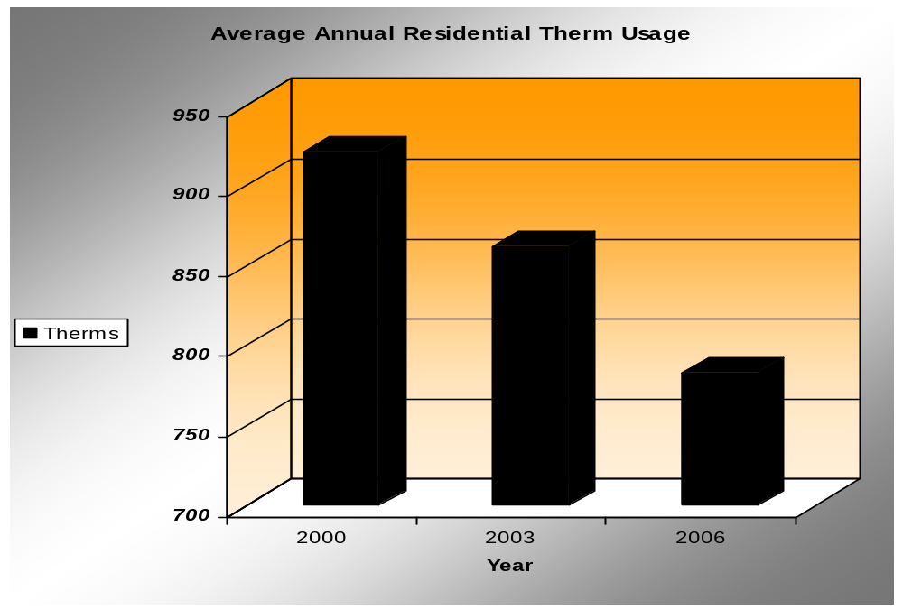
Residential Customer Usage at
Washington Gas
The chart shows the average annual therm usage for a residential customer in 2000, 2003 and 2006

Slide 3
Revenue Collection
Significant mismatch exists between the fixed cost nature of the utility business and the volumetric emphasis of the utility’s rate structure.
Majority of cost are fixed, however over 70% of revenues are collected volumetrically.
An Revenue Normalization Adjustment (RNA) mechanism realigns the collection of revenues to the incurrence of cost.
The RNA can remove the disincentive for utilities to promote conservation by aligning customer and shareholder interests.

Slide 4
Revenue Normalization Adjustments
(RNA) at Washington Gas
Maryland-
RNA in Maryland with an effective date of October 1, 2005.
Virginia-
A proposed RNA filed in Virginia rate case on September 15, 2006.

Slide 5
Maryland Revenue Normalization Adjustment (RNA)
The RNA is a billing adjustment factor computed on a monthly basis that creates a credit or charge to the monthly distribution charge.
RNA adjusts monthly for any variations in revenue per customer from the level that was approved in the last base rate case.
The RNA effectively normalizes revenues for weather, conservation and increased appliance efficiency.

Slide 6
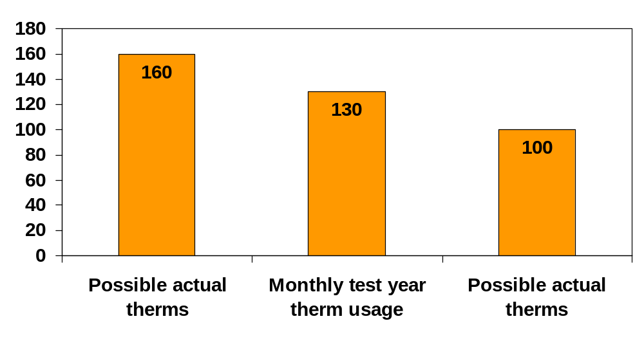
Revenue Normalization Adjustment
(RNA) Example
Credit to Customer
Cold weather
Increased customer usage
New customer usage
Charge to Customer
Warm weather
Conservation
Appliance efficiency

Slide 7
Revenue Normalization Adjustment
(RNA) The Mechanics
The RNA computations are based on the per customer usage levels approved in the last Maryland base rate case.
A level of test year base rate revenues is determined in the last base rate proceeding.
New customer growth is priced at embedded usage levels together with new system charges.
Embedded normal weather rate case revenues plus new customer normal weather revenues are compared to actual revenues.
The RNA amount is either billed or refunded to customers on a two-month lag basis.

Slide 8
For more information, contact:
James Wagner
jwagner@washgas.com
703-750-5261

