Slide 1

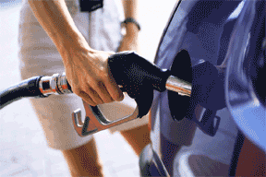

Public Transportation
=
Energy Efficiency & Fuel Conservation
Notes:
Public Transportation Conserves Fuel.
Public Transportation Saves Money.
3. Public Transportation reduces our reliance on foreign oil.

Slide 2
Public Transportation Must Play A More Significant Role In Meeting Virginia’s Transportation Needs
.
Integral to Good Land Use
Reduces Pollution & Congestion
Conserves Fuel - Good for the Wallet, our State
& Nation
Vital Link to Employment
Provides Independence for Growing Elderly
and Disabled Populations

Slide 3
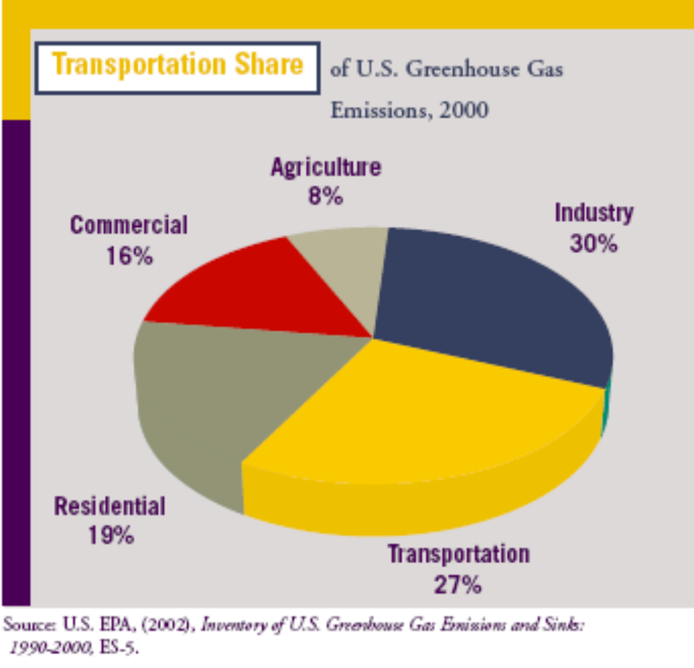
Source: Pew Center on Global Climate Change

Slide 4
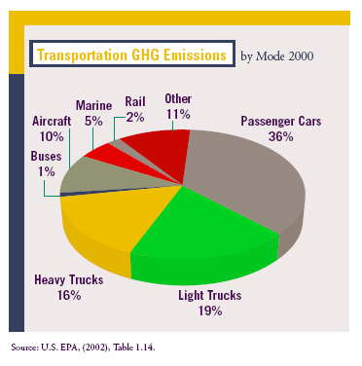
Source: Pew Center on Global Climate Change

Slide 5
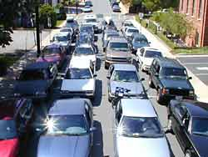
Public Transportation Removes Vehicles from The Road
This many cars=

Slide 6
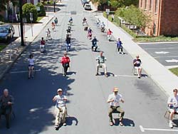
This many people =

Slide 7
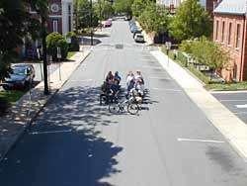
The same number of people “on a bus”.

Slide 8
More Public Transit = Fewer Cars
= Significant Fuel savings
40 SUVs getting 15mpg, 20 mile roundtrip use 53.3 gallons of gas.
1 GRTC bus holding 40 people, traveling the same distance, uses 3.78 gallons of gas.
1 Metro train carrying 650 passengers, traveling the same distance, saves 520 gallons of gas.

Slide 9
Transit Conserves Fuel
More people riding buses and trains =
less reliance on foreign oil
  For every mile traveled, transit carries many more people but uses ½ the fuel of cars and 1/3 the fuel used by SUV’s and light trucks,
  Transit saves over 1.4 billion gallons of gasoline=
    More than 1 month’s oil import from Saudi Arabia
    140,769 service station tanker truck deliveries
    34 supertanker, or a supertanker leaving the Middle
    East every 11 days
    More than 3 months of energy that Americans use to
    heat, cool, and operate their homes
    108 million fill-ups
Source: American Public Transportation Association

Slide 10
Transit Is Essential to Manage Congestion
NOVA Public Transit = 12-15 peak hour freeway lanes of congestion
VRE removes the equivalent of 1 lane of traffic on
I-95 and I-66 every morning and afternoon.
If every Metro rider began driving instead, the daily line of commuter traffic would extend from D.C. to North Carolina (3,250 vehicles per hour)
“If everyone commuting alone in Hampton Roads would carpool or take the bus 1 day in 10, the existing congestion problems in Hampton Roads would disappear”
  Dwight Farmer Transportation Dir., HRPDC

Slide 11
Using Public Transportation
Saves Riders Money
Transportation spending is the #2 highest household expenditure. *
In a “Transit Household” -2 workers/ 1 car, using transit- savings could equal $6,251/year.
- Enough to pay $5,781 annual household spending on food
- Pay most of the $6,848 spent on mortgage interest and fees-
spent each year by the average household
Transit Saves Time
- Extra time spent with family rather than stuck in traffic = priceless
* US Department of Labor, $7.420 in the South.
Source: American Public Transportation Association

Slide 12
More Virginians Are Riding Transit
Major increases by district in just one year (FY05):
Bristol: 65% increase for Mountain Empire Older Citizens
Fredericksburg: 13% increase for Bay Transit
Hampton Roads: 18% increase for HRT
Lynchburg: 23% increase for Farmville Area Bus
Northern VA: 43% increase across region (since 2002)
Richmond: 9% increase for GRTC, over 60% on commuter routes
Staunton: 29% increase for CATS
Statewide: 168 million trips in 2004- a 17% increase from 5 years
ago

Slide 13
A State Energy Plan Should Set Measurable Transportation Goals
Set Goals and Increase Investments and Incentives to:
Increase the % of transit, rideshare, bike and walking trips to manage growth in Vehicle Mile Traveled (VMT).
Extend transit routes so that 75% of Virginians in urban areas live within ¾ miles of a transit stop.
Increase service frequency and convenience.
Encourage efficient land use and transit oriented development.

