Slide 1
Virginia Energy Efficiency and Conservation Savings Potential
Presented by Richard F. Spellman
Vice President
GDS Associates, Inc.
November 2, 2006

Slide 2
Topics to Be Discussed
Cost effective energy efficiency measures
Energy efficiency programs in other states
Virginia energy efficiency savings potential
  By 2012 (five years from now)
  By 2017 (ten years from now)
Energy efficiency potential by sector
Emerging energy efficiency technologies and strategies
Role of consumer education
Savings potential in government facilities
Each year, the top 20 energy efficiency electric utilities are saving 1.4% more of total electric sales

Slide 3

#1 Objective for Appalachian Regional Commission for Economic and Energy Development
“Strategic Objective 1: Promote energy efficiency in Appalachia to enhance the Region’s economic competitiveness.”
Page 12, “Energizing Appalachia, A Regional Blueprint for Economic and Energy Development”, by the Appalachian Regional Commission”, October 2006

Slide 4
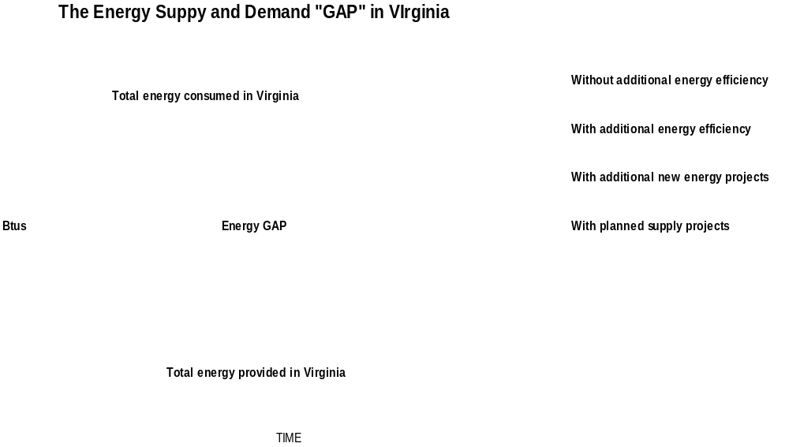

Slide 5
Cost Effective Energy Efficiency Measures

Slide 6
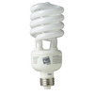
Residential Measure Examples
Energy Star appliances
Energy Star New Homes
Energy Star Windows
High efficiency space and water heating
Insulation and weatherization
Solar space and water heating
Compact fluorescent light bulbs

Slide 7
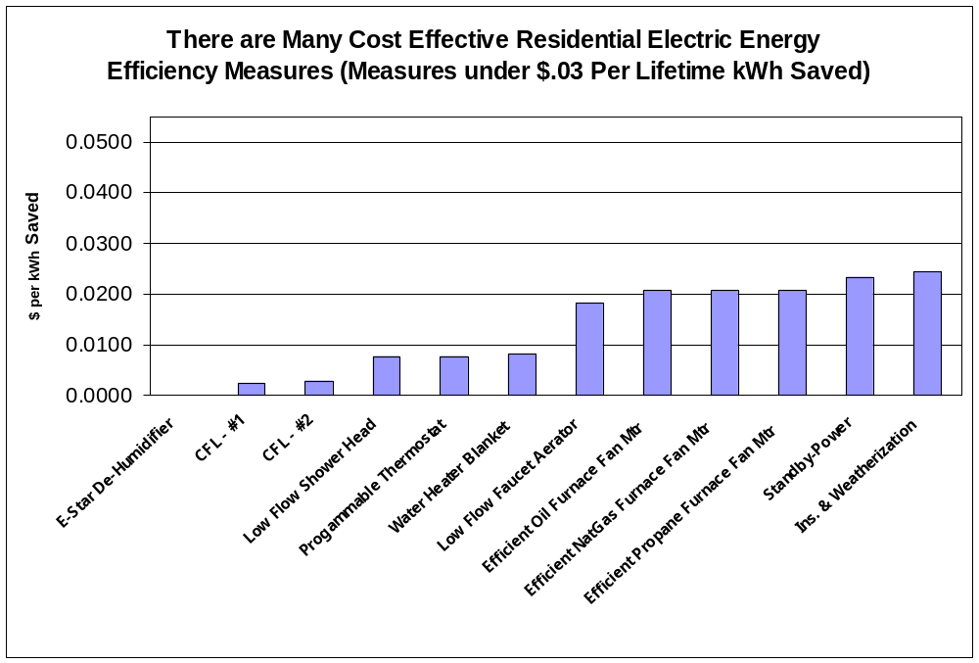

Slide 8
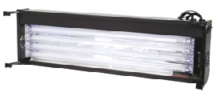
Commercial Measure Examples
Compact fluorescent lighting
Super T-8 lighting
T-5 lighting
Centrifugal chillers
High efficiency motors
Compressed air efficiency measures
Building re-commissioning
Advanced construction practices

Slide 9
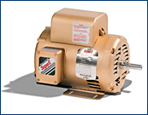
Industrial Measure Examples
Premium efficiency industrial motors
High efficiency transformers
Sensors and controls
Fan system improvements
Air compressor system management

Slide 10
Energy Efficiency Savings and Spending in Virginia

Slide 11
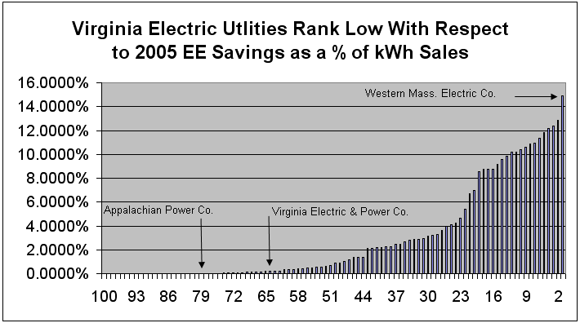
Virginia Utility Energy Efficiency and Conservation Savings
Virginia ranks low on energy efficiency savings originating from utility programs as % of total kWh sales.
The relatively low cost of electricity in Virginia increases payback for efficiency programs and makes them less financially attractive.
VA utilities rank no higher than 64. Western Mass. Electric ranks first.
We shouldn’t wait for higher prices to promote addition efficiency and conservation efforts.

Slide 12
Energy Efficiency and Conservation Spending
On average, the Top 20 energy efficiency utilities spend 2.75% of annual electric utility revenues on energy efficiency programs
Virginia Electric Power Company and Appalachian Power spend about 0% on energy efficiency and conservation programs as a percent of 2005 annual retail revenues
Source: US DOE, Energy Information Administration

Slide 13
Energy Efficiency and Conservation Programs in Other States

Slide 14
Energy Efficiency Program Administrator Types
Electric Utilities
Natural Gas Utilities
Public Benefits Organizations
  Efficiency Maine
  Efficiency Vermont
  NYSERDA
  Wisconsin Focus on Energy
  Midwest Energy Efficiency Alliance (MEEA)
  Northwest Energy Efficiency Alliance (NEEA)
  Southeast Energy Efficiency Alliance (SEEA)
  Southwest Energy Efficiency Project (SWEEP)

Slide 15
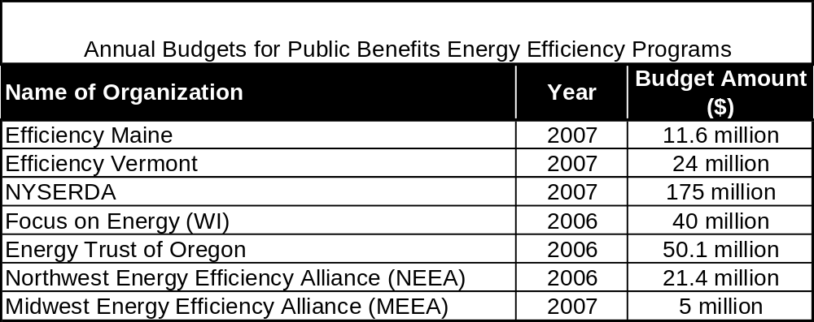

Slide 16
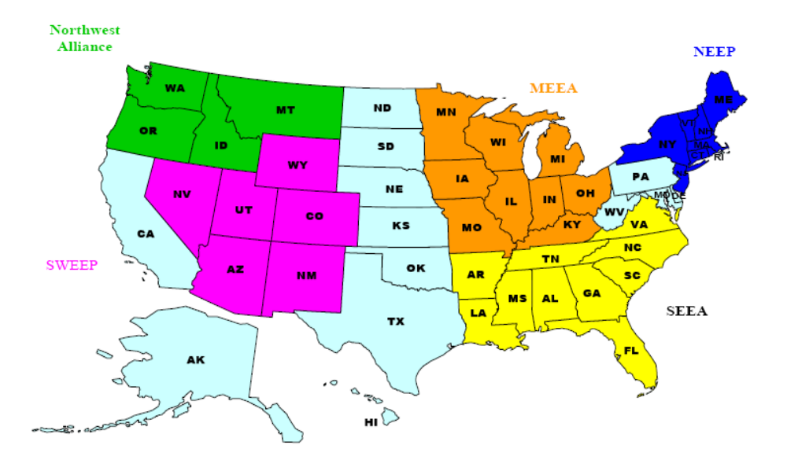
Regional Energy Efficiency Organizations in the United States

Slide 17
What is the Southeast Energy Efficiency Alliance?
Mission: To build regional partnerships in the Southeast to promote and achieve energy efficiency for a cleaner environment, a more prosperous economy, and a higher quality of life
Represents Eleven-State Region: Alabama, Arkansas, Florida, Georgia, Kentucky, Louisiana, Mississippi, North Carolina, South Carolina, Tennessee,Virginia

Slide 18
Energy Efficiency Stats for Top 20 Energy Efficiency Electric Utilities
Each year, the top 20 energy efficiency utilities are saving 1.4% more of total electric sales
On average, the top 20 energy efficiency utilities have already saved 12% of their total electric sales through the end of 2005.

Slide 19
Virginia Energy Efficiency and Conservation Savings Potential and Emerging Technologies

Slide 20
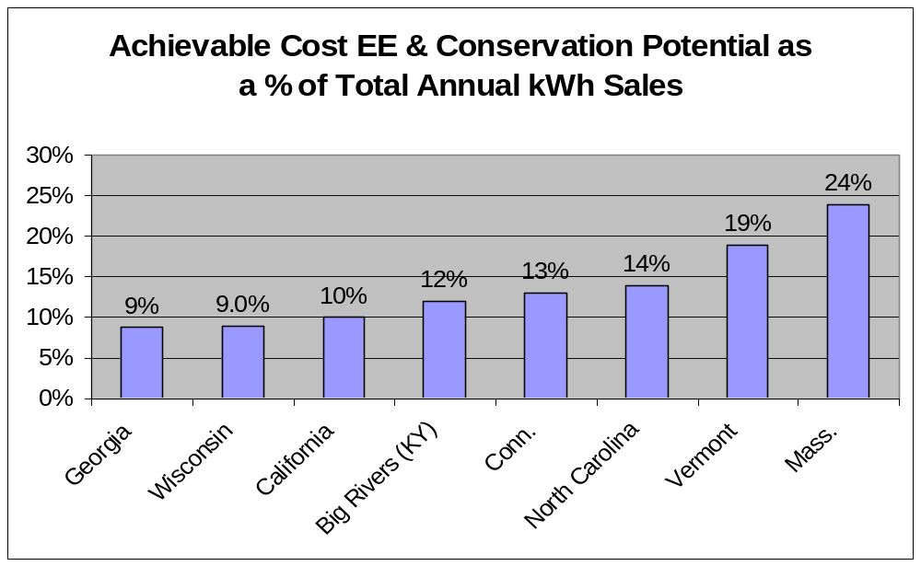
The average achievable cost effective savings potential for these eight studies is 14% of total electricity kWh sales.

Slide 21
Emerging Energy Efficiency and Conservation Technologies
LED Lighting
Residential micro-cogen
Drainwater heat recovery systems
Cool roofs
Zero energy buildings
Advanced refrigerator-freezer

Slide 22
The Call For Demand Response
    The Energy Policy Act of 2005, for the first time, makes it federal policy to endorse demand response and encourage states to pursue this technology. The legislation states:
    “It is the policy of the United States that time-based pricing and other forms of demand response, whereby electricity customers are provided with electricity price signals and the ability to benefit by responding to them, shall be encouraged, the deployment of such technology and devices that enable electricity customers to participate in such pricing and demand response shall be facilitated, and unnecessary barriers to demand response participation in energy capacity and ancillary service markets shall be eliminated.”

Slide 23
Demand Response
      Takes load off the grid during times of peak electrical demand
      Is becoming a popular program option in an evolving electricity market
      Programs are currently offered through PJM
      Programs provide cost savings opportunities to consumer
      Programs face regulatory and institutional challenges
      Technology challenges associated with deployment are being overcome

Slide 24
Role of Consumer Education on Energy Efficiency

Slide 25
Role of Consumer Education
Increase awareness of energy efficiency and Energy Star logo
  TV, radio and newspaper advertising
  Newsletters and bill stuffers
  Web site information
Provide information
  Life-cycle costs, safety, where to purchase energy efficient equipment
Change behaviors
  Purchasing decisions (buy Energy Star)
  Move closer to work

Slide 26
$ Savings from Energy Efficiency and Conservation

Slide 27

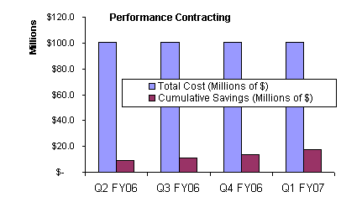
$ Savings from Energy Efficiency and Conservation in State Facilities
Total dollars under contract or in process in Virginia state facilities is at $100,735,732
Projected savings are projected to just over $7 million per year
Simple payback of about 14.4 years per project

