Slide 1
Virginia Energy Plan
Genesis of the Virginia Energy Plan
  Study of Future of Manufacturing in Virginia
    Senator Frank Wagner, Chair
    Gas supply limitations and costs
      High costs of raw material and fuel input
      Largest industrial gas user East of Mississippi in Hopewell
    Reviewed options
      Efficient Use
      Landfill Gas
      LNG
      OCS Gas

Slide 2
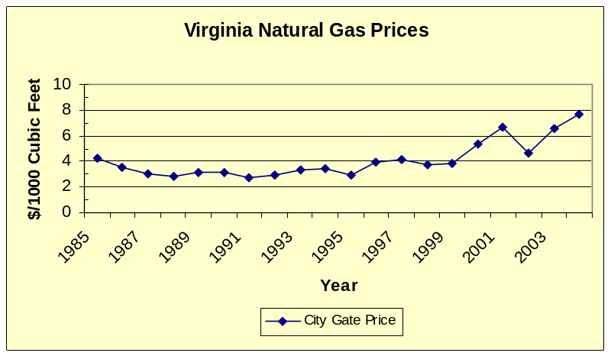
Virginia Energy Plan
Genesis of the Virginia Energy Plan
  Natural Gas Cost
    Eastern Virginia is near the end of supply pipelines & relies heavily on the Gulf of Mexico
    Mid-Atlantic natural gas cost differential

Slide 3
Virginia Energy Plan
Northeast
Rockies
Chicago
15.23
13.25
6.30
11.35
5.695
4.995
Mid Cont Field
Mid Atlantic
Waha
11.52
14.89
11.555
5.04
Henry Hub
6.51
5.16
14.40
Florida Zone 3
S. Texas
Locational Spreads
Rock to Henry
Waha to Henry
MC to Henry
Chicago to Henry
MA to Henry
NE to Henry
STX to Henry
Florida Z3 to Henry
2004
(1.01)
(.85)
(.97)
(.31)
.50
.29
(.35)
.34
2005
(3.05)
(2.84)
(2.88)
(1.15)
.49
.83
(1.55)
1.11
6.01
15.51
12.085
6.355
5.66
Source: AGL Resources

Slide 4
Virginia Energy Policy – SB 262
Major Components of SB 262
  State energy policy statements
  Virginia Energy Plan
  Energy conservation
    Income tax deductions – Efficient equipment & fuel cells
    Renewable electricity production & PV/solar/wind grants
  Landfill/synthetic/waste gas state & local tax exemption
  OCS – Resource study & Atlantic natural gas exploration beyond 50 miles in Minerals Management Service EIS

Slide 5
Virginia Energy Policy – SB 262
Major Components of SB 262
  Dominion Virginia Power electric fuel factor annual recovery
  R&D framework – federal grants
    VCCER Clean Coal
    ODU Coastal Energy Research Consortium
  Coordinated SCC/natural resources permit process study
  State building energy efficiency
  Wind/solar site rating
  Miscellaneous

Slide 6
Virginia Energy Policy – SB 262
Virginia Energy Policy
  Support R&D and promote renewable use
  Ensure supply & conservation support economic growth
  Support R&D of clean coal technologies
  Ensure affordable natural gas
    Transmission & distribution, CBM, methane hydrates, landfill gas, LNG
  Promote electricity through non-greenhouse gas technologies
  Facilitate new/expanded petroleum refining

Slide 7
Virginia Energy Plan
Virginia Energy Policy
  Promote alternate fuel/efficient motor vehicles
  Develop petroleum alternatives such as synthetic and hydrogen-based fuels
  Promote ethanol and biodiesel from agriculture
  Avoid disproportionate impact on economically disadvantaged communities
  Energy generation & distribution systems to minimize impacts to pristine natural areas & significant onshore natural resources

Slide 8
Virginia Energy Plan
DMME to develop
10 year plan, updated every 5 years
Coordinate with Commission on Electric Utility Restructuring & Coal & Energy Commission
  Joint Commission on Technology and Science & Manufacturing Commission interest
Due by June 30, 2007

Slide 9
Virginia Energy Plan
Input into plan
  Advisory Group
  General public
  Assistance from
    State Corporation Commission
    Department of Environmental Quality
    Virginia Center for Coal & Energy Research
  Legislative coordination

Slide 10
Virginia Energy Plan
Schedule
  Consultant research – August to March
    Secondary data gathering
  Advisory Group issue meetings – September to November
  Public listening sessions – with Advisory Group meetings
  Public comment submission – August to March
  State agency & institution input – September to December
  DEQ/SCC/VCCER assistance - ongoing
  Legislative coordination – ongoing
  Drafting & review – March to June

Slide 11
Virginia Energy Plan
Report Outline
    Introduction
    Virginia Energy Sources & Consumption
    Energy Conservation & Efficiency
    Virginia/Regional Energy Infrastructure
    Energy & Environment
    Energy Research & Development
    Conclusions & Recommendations

Slide 12
Virginia Energy Plan
Contact
  www.dmme.virginia.gov/VAEnergyPlan
  Advisory Group Contact
  Stephen Walz
  Department of Mines, Minerals and Energy
  202 North Ninth Street, 8th Floor
  Richmond, VA 23219
  Phone: 804-692-3211
  Stephen.Walz@DMME.Virginia.Gov

