Slide 1
Energy Infrastructure in the
State of Virginia
Presentation for the Virginia Energy Plan
Advisory Group
September 11, 2006
Abington, Virginia

Slide 2
Topics to be Covered
Energy Infrastructure in Virginia
  Electricity
  Petroleum
  Natural Gas and Propane
  Coal
  Renewable Energy (Hydro, Solar, Wind)
  Energy Efficiency

Slide 3
Electricity Infrastructure
Service Areas of electric utilities
Installed generation capacity
Ten largest electric generation plants
Examples of power generation facilities
Historical electric generation mix by fuel type
Nameplate capacity by fuel type
Locations of existing generation plants

Slide 4
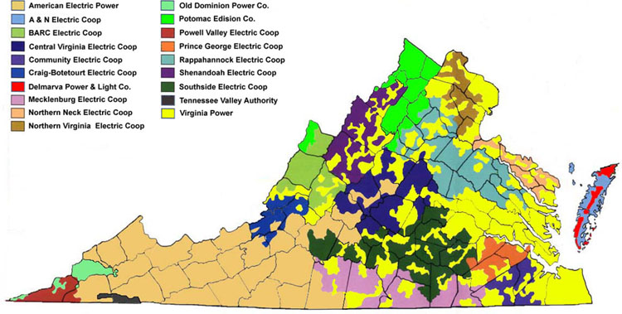
Service Areas of Electric Utilities

Slide 5
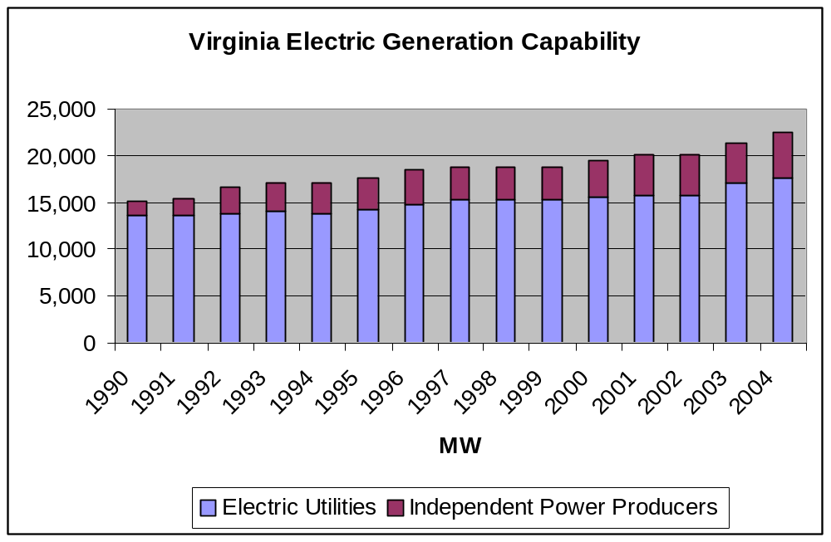

Slide 6
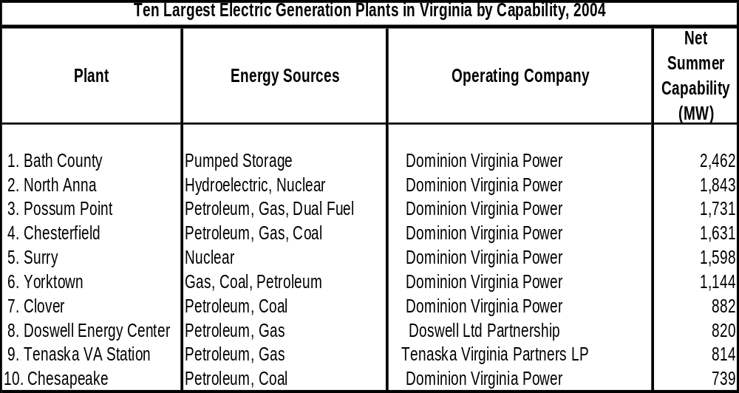

Slide 7
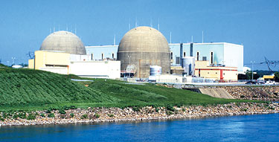
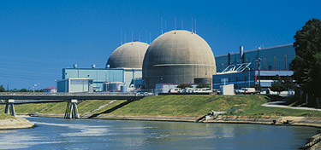
Virginia Nuclear Power Stations
North Anna generates 1,786 megawatts from its two units — enough electricity to power 450,000 homes.
Surry Power Station generates 1,625 megawatts of electric power from its two nuclear reactors — enough electricity to power 400,000 homes.

Slide 8
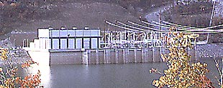
Virginia Pumped Storage Generation
Bath County pumped storage facility has six 350-megawatt turbine generators
The station consists of two large reservoirs — one 1,262 feet (385 meters) higher than the other
Completed in 1985

Slide 9
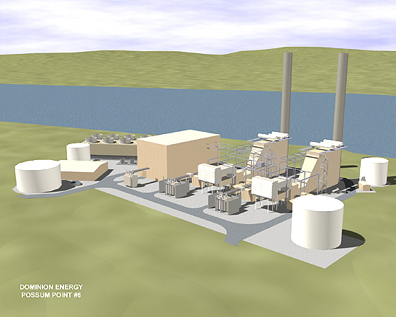
Example of Dual Fuel Generation – Unit #6 at Possum Point
Dominion's Possum Point Unit 6 is a 550 MW combined-cycle unit that went commercial in July of 2003. Unit 6 can use natural gas or #2 fuel oil.

Slide 10
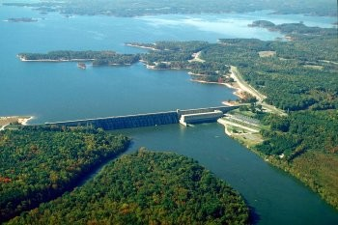
Example of Virginia Hydroelectric Facility – Kerr Dam
Completed in 1953
Summer capacity is 185 MW
Purpose: flood control and hydro power
50,000 acre reservoir

Slide 11
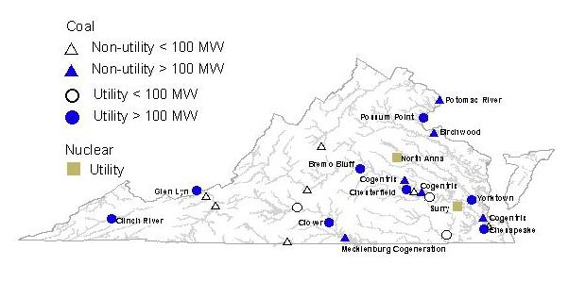
Location of Virginia Coal and Nuclear Electric Generation

Slide 12
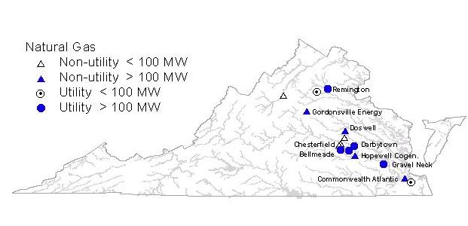
Virginia Natural Gas Generation

Slide 13
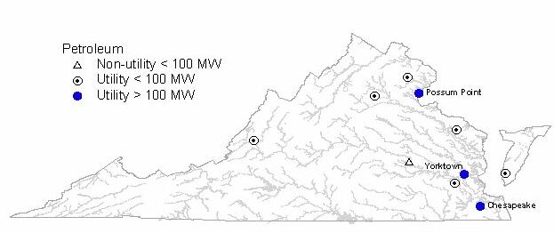
Virginia Oil-Fired Generation
Possum Pt has six units – 1,874 MW
Yorktown has three units – 1,150 MW of capacity

Slide 14
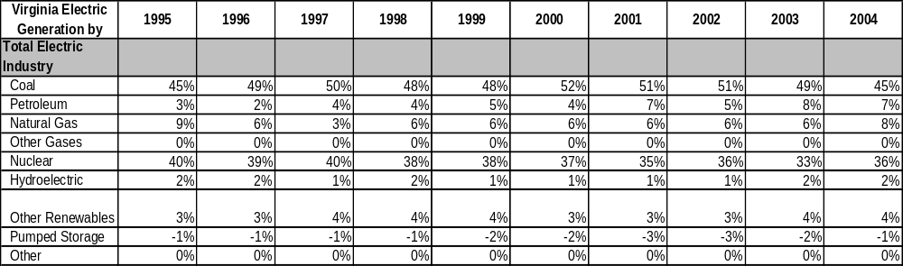
Virginia Electric Generation by Fuel Type – 1995 to 2004
Over the past decade, coal and nuclear power have provided over 80 percent of the State’s electricity generation

Slide 15
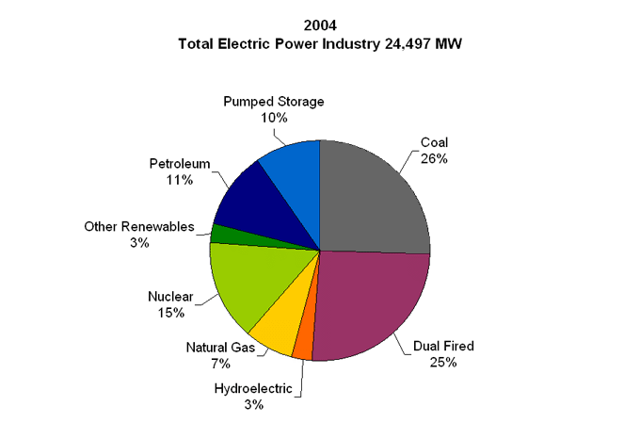
Virginia Electric Generation Nameplate Capacity for 2004

Slide 16
PJM Interconnection
PJM ensures the reliability of the largest centrally dispatched electric grid in the world by coordinating the movement of electricity in all or parts of Delaware, Illinois, Indiana, Kentucky, Maryland, Michigan, New Jersey, North Carolina, Ohio, Pennsylvania, Tennessee, Virginia, West Virginia and the District of Columbia.
PJM, acting neutrally and independently, operates the largest competitive wholesale electricity market in the world.
PJM manages a sophisticated regional planning process for generation and transmission expansion to ensure future electric reliability.
PJM facilitates a collaborative stakeholder process. Stakeholders include participants who produce, buy, sell, move and regulate electricity.

Slide 17
PJM Sets New Peak Demand Record
(Valley Forge, Pa. – Aug. 1, 2006) – PJM Interconnection, the grid operator for 51 million people in 13 states and the District of Columbia, successfully met another new peak demand record for electricity use of 144,000 megawatts (MW) today at 5 p.m. (EDT). PJM’s previous record demand was 139,746 MW set only two weeks ago on July 17, 2006.

Slide 18
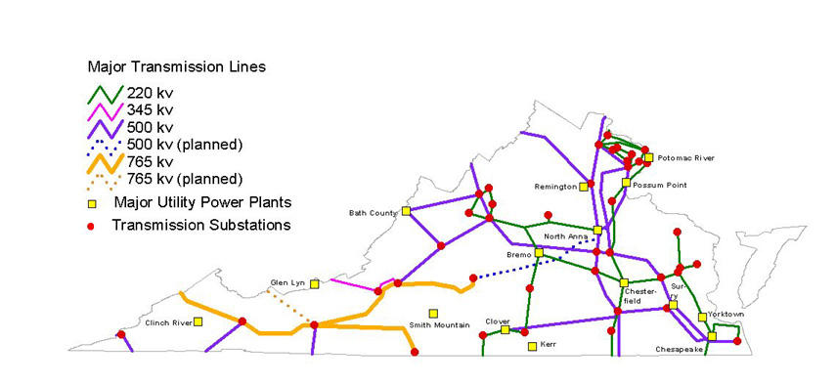
Locations of Major Electric Transmission Lines
This planned 765 KV Line was energized in June 2006.

Slide 19
Dominion Virginia Power Files Application to Build Transmission Line, Substation in Stafford County, Virginia
Thursday August 31, 9:54 am ET
RICHMOND, Va., Aug. 31 /PRNewswire-FirstCall/ -- Dominion Virginia Power on Wednesday applied to the Virginia State Corporation Commission for permission to build a substation and five-mile-long power line in a fast- growing area of Stafford County.
The $13.5 million project needs to be in service by the summer of 2009 to meet the demand for electricity in the Garrisonville, VA area, which is growing by 3 percent to 5 percent each year.

Slide 20
VA Natural Gas Infrastructure
Service areas of natural gas utilities
Annual natural gas production in VA
Existing VA natural gas fields
  Natural gas
  Coal bed methane
Major VA natural gas pipelines
Proposed LNG facilities for VA

Slide 21
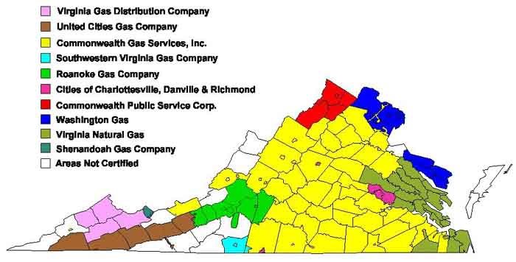
Service Areas of Natural Gas Utilities

Slide 22
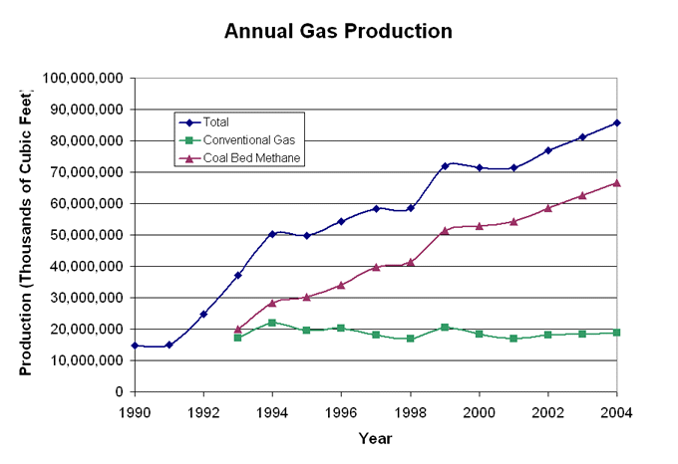

Slide 23
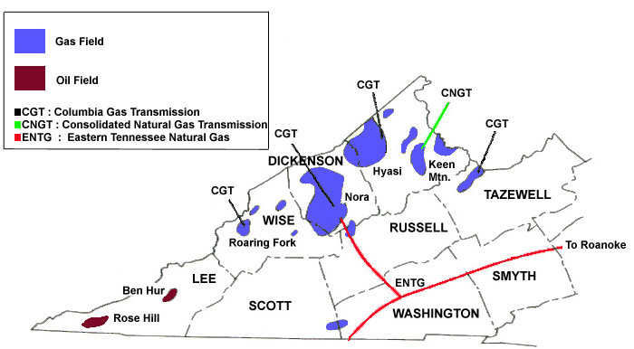
Existing Natural Gas Fields
Buchanan, Dickenson, Wise, Russell, & Tazewell counties have both conventional and CBM gas production
Virginia has over 5,000 producing coalbed methane and conventional wells. Approximately 80% of Virginia’s 2005 production of 86 BCF of gas is produced from coalbed methane wells.

Slide 24
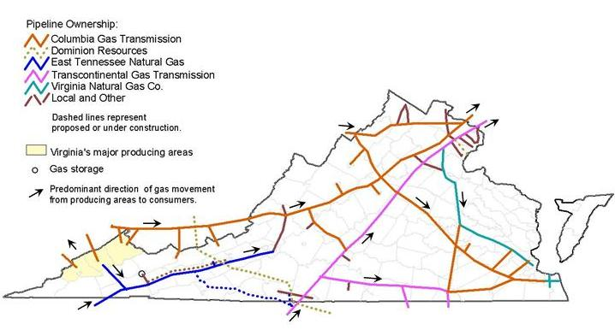
Major Natural Gas Pipelines

Slide 25
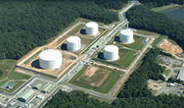
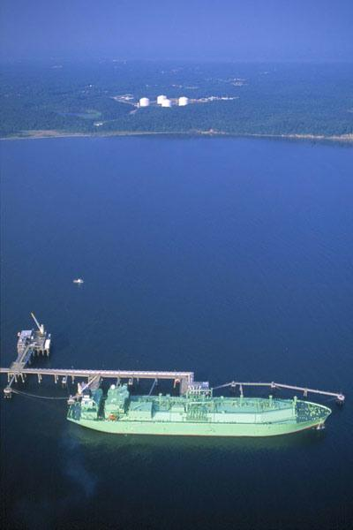
Expansion of Existing LNG Facility at Cove Point
• Need Relatively Deep Water (at least 40 feet of depth)
Takes about 4 years to build
Need over 12 Federal government permits plus state and local government permits
There will need to be pipeline improvements
Dominion has received approval from the Federal Energy Regulatory Commission (FERC) to begin construction activities on expansion facilities at the Cove Point LNG Terminal

Slide 26
Propane Infrastructure
Virginia gets a large percentage of its propane supply from the propane pipeline terminating in North Carolina, with other supplies delivered via rail statewide and via water to the Port of Hampton Roads

Slide 27
VA Petroleum Infrastructure
Annual petroleum production in VA
Existing VA petroleum fields
VA Oil Refinery facility at Yorktown
Major VA oil terminals
Proposed new facilities for VA

Slide 28
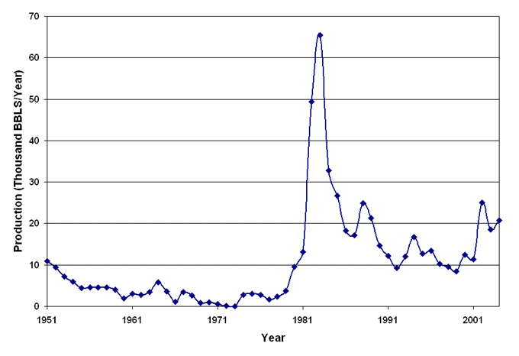
VA Historical Crude Oil Production
1951 to 2004

Slide 29
Existing Oil Fields

Slide 30
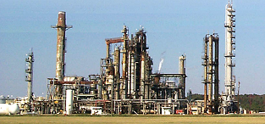
Oil Refineries in Virginia
The state of Virginia has one major oil refinery, at Yorktown, near the mouth of the York River.

Slide 31
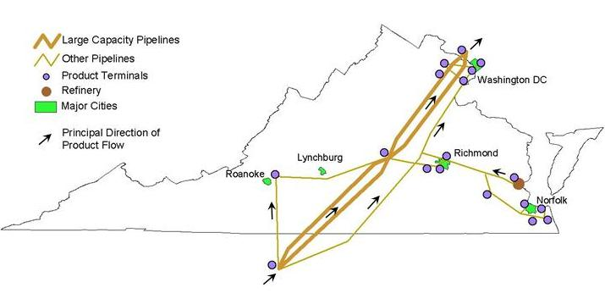
Map of Oil Pipelines and Terminals
VA also gets petroleum products from terminals in Knoxville as well as from Kentucky, West Virginia, Maryland and ocean tanker shipments.

Slide 32
VA Coal Infrastructure
Annual coal production in VA
Existing VA coal fields
Major train transportation routes
Major VA coal export facilities

Slide 33
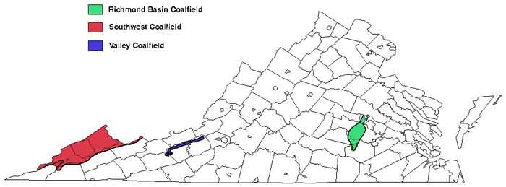
Existing Coal Fields

Slide 34
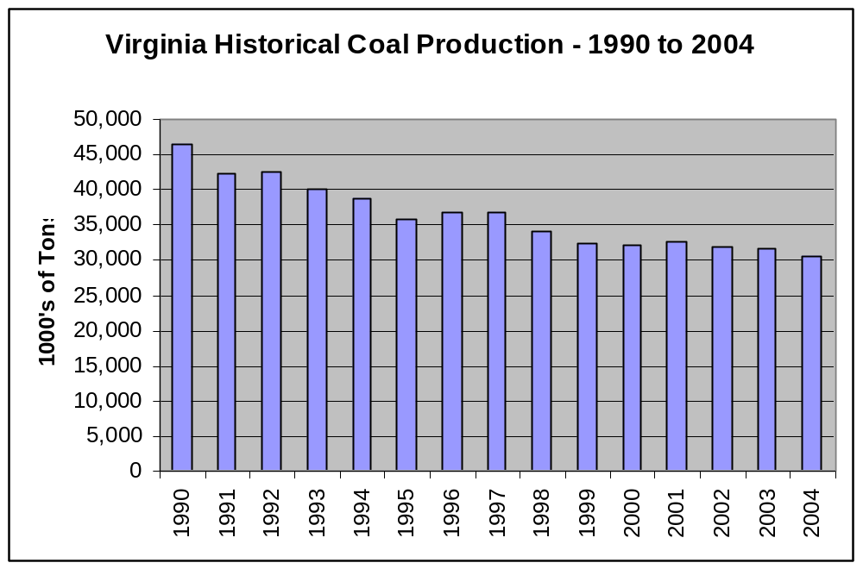

Slide 35
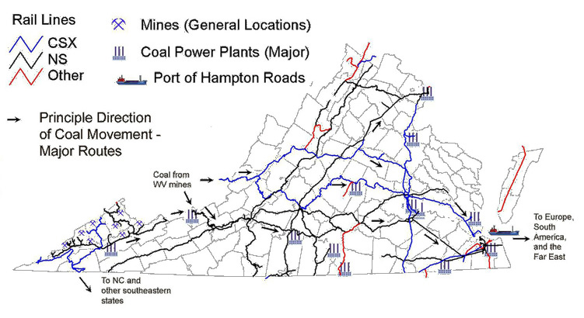
Virginia Coal Transportation

Slide 36
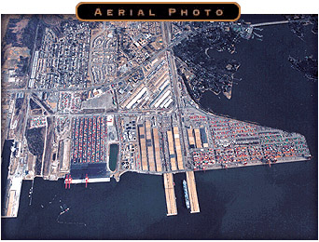
Hampton Roads Export Facilities
The coal loading facilities in the Port of Hampton Roads are able to load in excess of 65 million tons annually, giving the port the largest, most efficient and modern coal loading facilities in the world.

Slide 37
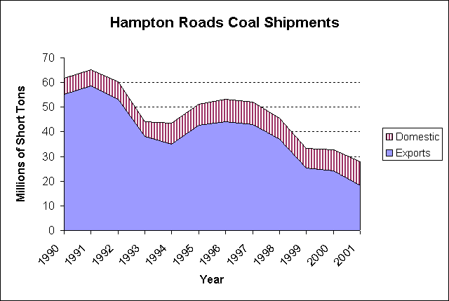

Slide 38
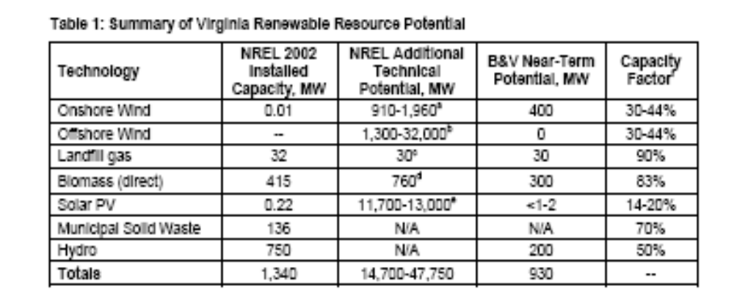
Renewable Energy Potential in Virginia
In 2002, the majority (over 50%) of existing renewable electric generation was hydro, with wood supplying the next largest amount.

Slide 39
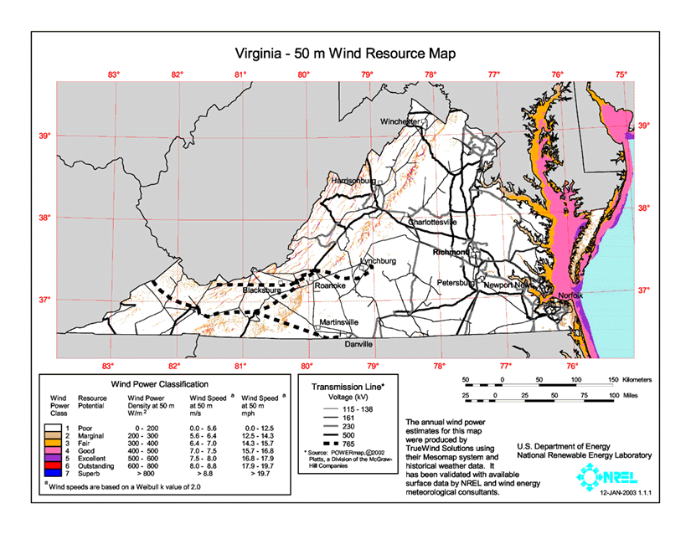
Map of Oil Pipelines and Terminals

Slide 40
Solar Energy Systems
About five years ago Virginia committed to installing 500 solar energy systems on buildings throughout the state by the year 2010. To help meet that goal, the CEAGE combined its resources with the Photovoltaics for Virginia Working Group, an organization created by the Department of Mines, Minerals, and Energy to facilitate the installation of photovoltaics (PV) systems, which convert light energy into electricity.
The Division of Energy supports Virginia's new solar photovoltaic manufacturers with grants and commercialization assistance.

Slide 41
State Energy Efficiency
DMME makes federal funds available to Virginia consumers for innovative uses of biomass and new energy conservation practices
DMME publishes the Virginia Energy Savers Handbook
DHCD makes weatherization assistance available and DSS makes fuel assistance available to low-income families
DEQ offers energy efficiency information as part of its pollution prevention program

Slide 42
For Additional Information, see..
Department of Mines, Minerals and Energy (DMME) (http://www.dmme.virginia.gov)
US DOE Energy Information Administration
(http://www.eia.doe.gov/)
US DOE EIA Virginia data (http://www.eia.doe.gov/emeu/states/state.html?q_state_a=va&q_state=VIRGINIA)
Center for Energy and the Global Environment (CEAGE) at the Alexandria Research Institute of Virginia Tech (http://www.ceage.vt.edu/)
Virginia Energy Patterns and Trends (http://www.energy.vt.edu/vept/index.asp)

