Slide 1




Virginia’s Natural Gas Infrastructure Needs
DMME Energy Plan Working Group
September 11, 2006

Slide 2
Current Natural Gas Infrastructure in Virginia
1 million residential customers
(about 37% of households)
90,000 commercial customers
(about half of non-farm businesses)
1,200 miles of interstate pipelines
22,000 miles of gas pipeline and main
Two LNG storage facilities
Two underground natural gas storage facilities
Sources: EIA, Census, Virginia State Corporation Commission – all data 2004 and later

Slide 3
Advantages of natural gas
Very high efficiency
  About 90% of natural gas produced is delivered to customers as useful energy
  Compare: Less than 30% of the total energy used to generate electricity from coal reaches consumers
  Cleanest fossil fuel
Lowest average cost per Btu – even with recent volatility
Sources: DOE, EIA, AGA

Slide 4
Virginia depends on out of state gas
Current VA gas demand: 278 Bcf/yr*
  Residential 83 Bcf/yr
  Commercial 65 Bcf/yr
  Industrial 72 Bcf/yr
  Electric generation 49 Bcf/yr
  Miscellaneous 9 Bcf/yr
Current VA production: 85 Bcf/yr
Net: -193 Bcf/yr
Sources: EIA, DMME – all data 2004

Slide 5
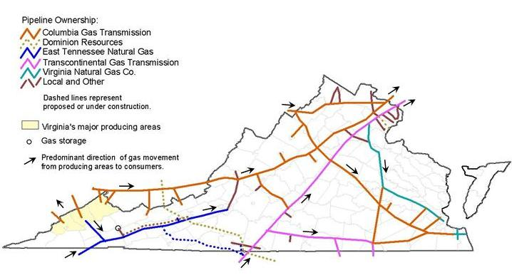
Current VA Gas Flows
Does not depict flows from Cove Point

Slide 6
Changing Market Dynamics
US production flat to declining
  Canadian imports to US also expected to decline
Increasing demand in US, world
  31% US increase 1986-98
  Projected 20% US increase through 2030
    Gap: about 6-7 Tcf/year
  200 GW of US gas-fired electric generation since 1999
    Largest percentage of projected growth through next two decades
  Simultaneous economic expansion in US, Europe, Developing Countries
  Industrial use = about 40% of US demand
Source: INGAA Foundation, FERC, AGA

Slide 7
National Infrastructure Challenge
Difficult environment for infrastructure development
  Protests and interventions have increased 10X in the past decade
  California example shows price of failing to upgrade infrastructure
$60 Billion in US natural gas infrastructure investments needed in next 15-20 years
Source: INGAA Foundation

Slide 8
Benefits of Infrastructure Enhancement
Supply Diversity/Reliability
  80% of East Coast gas is produced in the Gulf of Mexico
Commodity Price Competition
  East Coast has highest US natural gas prices
Peak Day Management
  15-20% of total winter demand is served by storage
  50% or more of peak day demand can be storage gas
Economic Development

Slide 9
Cash Prices & Regional Spreads
Chicago
Northeast
Rockies
5.415
5.850
4.540
10.645
12.420
8.855
Mid Cont Field
Carthage
Mid Atlantic
5.025
Waha
9.460
5.345
5.625
Locational Spreads
Rock to Henry
Waha to Henry
MC to Henry
Chicago to Henry
MA to Henry
NE to Henry
STX to Henry
Florida Z3 to Henry
Carthage to Henry
2005
(2.89)
(2.01)
(2.285)
(1.1)
.35
.675
(1.41)
4.605
(1.54)
2006
(.915)
(.275)
(.43)
(.04)
.17
.395
(.28)
.24
(.11)
5.180
10.205
12.095
9.735
Henry Hub
Fl. Zone 3
S. Texas
5.695
5.175
5.455
16.350
10.335
11.745
**Gas Daily price comparisons are for Sept 6, 2006 & Sept.6, 2005

Slide 10
Essential VA Infrastructure Needs
Additional upstream transportation capacity
  Deliverability options from “conventional” US sources -- Gulf, Appalachian Basin, Rockies
Access to OCS, LNG imports
Additional storage, peak day assets
  Underground
  LNG
  Propane-air
Intrastate deliverability improvements

Slide 11
Concepts for Infrastructure Improvement
Ratemaking Reform
  Forward-looking, rather than historical, test years
  Performance-based and other non-traditional rate concepts to align customer, utility goals
    Decoupling/demand-side management
  Weigh competition for investor, utility capital
Accelerate Siting/Permitting
Reward long-term capacity enhancements

