Slide 1
Energy and the Environment
Discussion of Issues for the Virginia Energy Plan
Presentation for the Virginia Energy Plan
Advisory Group
September 25, 2006
Annandale, Virginia

Slide 2
Topics to be Covered
Environmental impacts of energy production (examine impacts that can be quantified)
    Air impacts (emissions)
    Land impacts (facility siting)
    Water impacts (power plants consume and discharge water)
    Community development (comparable land uses)
Environmental impacts of energy consumption (changes in consumption affect the environment)
Synergies among renewable energy and energy efficiency programs

Slide 3
VIRGINIA ENERGY PLAN OBJECTIVES & POLICIES RELATING TO THE ENVIRONMENT
Objectives:
  Increasing use of less polluting sources of energy
  Researching the efficacy, cost, and benefits of reducing, avoiding, or sequestering the emissions of greenhouse from energy generation
  Increasing use of biofuels
Policy Statements:
  Promote R&D of clean coal technologies
  Promote electric generation from non-greenhouse gas sources
  Promote biodiesel and ethanol from Virginia agricultural crops
  Ensure energy resource development does not have a disproportionate adverse impact on economically disadvantaged or minority communities
  Ensure energy development is located to minimize impacts to pristine natural areas or other significant onshore natural resources, and near compatible development

Slide 4
Environmental Impacts From
Electric Energy Generation and Transmission (quantifiable impacts)
Power plant
  Air Emissions
    SO_{X}
    NO_{X}
    CO2
    Particulates
    Mercury
  Water discharges – heat and other constituents
  Solid waste management
  Water intake and consumption
Hydro and wind
  Hydro – stream blockages, fish kills, wetland impact
  Wind – bird and bat kills
Transmission line siting

Slide 5
US EPA’s Clean Air Interstate Rule (CAIR)
Permanently cap emissions of sulfur dioxide (SO₂) and nitrogen oxides (NOx) in the eastern United States
Reduces air pollution that moves across state boundaries.
When fully implemented, CAIR will reduce SO₂ emissions in these states by over 70 percent and NOx emissions by over 60 percent from 2003 levels.
Virginia DEQ Technical Advisory Group examining Virginia CAIR rules

Slide 6
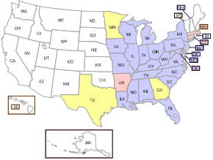

States Covered by CAIR
States Covered by CAIR

Slide 7
State Implementation Plans (SIP)
A SIP is a plan for each state which identifies how the state will meet the National Ambient Air Quality Standards (NAAQS) and certain other requirements of the Clean Air Act.
Virginia's SIP was submitted to EPA in early 1972. The SIP is a living document--more than 100 revisions have been made to the plan since its original submittal.
Virginia must submit SIP revision to address ozone standards
Energy efficiency and renewable energy production are possible control measures in SIPs

Slide 8
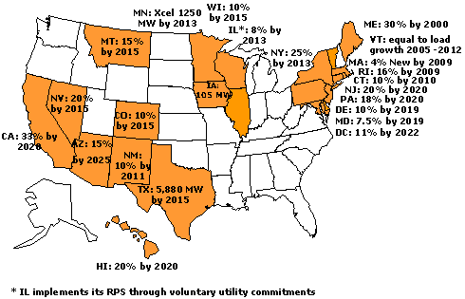
States with Renewable Portfolio Standards, courtesy of Pew Center
Updated May, 2006
Notes:
note that there is a Virginia working group that is examining the RPS issue and what might be needed to develop a robust Virginia renewable energy industry

Slide 9
Debate Over Climate Change
Experts disagree on the causes of global warming
Earth’s temperature projected to increase by 2.5ºF to 10.4ºF by 2100, with warming in the U.S. expected to be even higher.
Global warming is projected to have consequences for the United States and the world
  Sea-level rise
  Changes in precipitation patterns
  Increased risk of droughts and floods
  Threats to biodiversity or flora/fauna ranges

Slide 10
Carbon Sequestration in Virginia
Terrestrial sequestration in unminable coal seams
Agricultural practices
Silvicultural
  Abandoned coal mined lands
  Other lands
Tradable carbon credits
Notes:
The six units at Possum Point can generate over 1,874 MW of Power. This site is on the list of the 100 largest generating stations in the US (number 78).
The largest facility is the Grand Coulee Dam with 7,079 MW of generation capacity.

Slide 11
New and Emerging Electric Generation Technologies
Clean coal technologies
  IGCC
  Fluidized bed
  Supercritical pulverized coal
Nuclear
  New plans for nuclear power plants
    BWXT (Lynchburg)
  Shifting views on nuclear power
  Dominion has applied for site pre-approval at North Anna – could host 2 reactors
  Ongoing waste disposal issues
Renewables
  Wind – Turbine efficiency
  Water – Ocean & Low impact hydro
  Solar PV
  Other
Notes:
There are 32 hydro generation facilities listed on the DMME web site. This is one of the 32.
The John H Kerr Dam is in Mecklenburg County, Virginia; 20 miles downstream from Clarksville, Virginia; 18 miles upstream from the Virginia-North Carolina State line; 80 air miles from Richmond

Slide 12
Environmental Impacts From Oil and Natural Gas Production and Transportation
Oil pipeline spills
Off-shore drilling and production
Siting oil and natural gas pipelines
Siting LNG facilities
Water-based import spills
Waste product disposal
CBM production reduces greenhouse gas
Notes:
The State has two nuclear plants (North Anna and Surry)

Slide 13
Infrastructure and Facility Siting Issues
Siting laws and regulations
  Environmental review and permitting process by Federal, State and local agencies
Land use compatibility
Protecting pristine areas
NIMBY (Not in my backyard), BANANA (Build almost nothing anywhere near anything), SLAPP (Strategic lawsuits against public participation) issues

Slide 14
Synergies Between Energy Efficiency/Alternative Energy Development and the Environment
Energy efficiency measures -- no ongoing fuel costs
Solar thermal, wind, hydro, photovoltaic -- no ongoing fuel costs
Because no fuel is needed and because they have no emissions
Energy efficiency and many types of renewable energy facilities have much less of an environmental footprint
Installed costs of renewable energy facilities are decreasing
As fuel costs increase and installed costs decrease, renewable energy facilities become even more cost effective

Slide 15
Examples of New Conservation Technologies and Their Environmental Benefits
LED lighting
  Lower energy use, long life
High efficiency/Energy Star home appliances (clothes washers, refrigerators, etc.)
  Lower energy and water usage, longer life
Hybrid and plug-in hybrid vehicles
  Higher efficiency, potential for biofuels use
High efficiency motors and controls
Industrial process improvements
Daylighting and lighting controls

Slide 16
Role of State GIS to avoid effects on pristine natural areas and other significant natural resources
To identify appropriate sites for siting of energy facilities and to avoid environmentally sensitive sites
Identify possible environmental conflicts at energy facility sites and develop mitigation actions

Slide 17
Summary
Energy Plan objectives and policy includes many environmental considerations
Energy production and consumption have an environmental impact – may be negative or positive
Need to develop energy resources in an environmentally sound manner

