Slide 1
Climate Change and Buildings 101
John Woody
Business Solutions Fellow
Pew Center on Global Climate Change
Virginia Sustainable Building Network
11th Annual Meeting: Global Change, Local Solutions
June 9, 2006

Slide 2
Climate Change and Buildings 101
Presentation Outline
Overview of Pew Center
Science and Impacts of Climate Change
Pew Center’s report: “Towards a Climate-Friendly Built Environment”
State, Federal, International, and Corporate Developments in Green Buildings
Conclusions

Slide 3
Pew Center on Global Climate Change
Established in 1998 as an independent, non-partisan climate organization
Three-fold mission:
  Research
  Actively advise on policy
  Facilitate business engagement on the climate issue
    Business Environmental Leadership Council
Strict independence earns credibility:
  The Center does not accept any funding from corporations, associations or governments.

Slide 4
Pew’s Business Environmental Leadership Council
40 large corporations active on climate
Primarily Fortune 500 multinationals
Employ nearly 3 million and
represent $2+ trillion in market cap
Most have either large direct GHG emissions or a large GHG “footprint” through their products
Pew engages the BELC in multiple ways

Slide 5






































40 BELC Companies

Slide 6
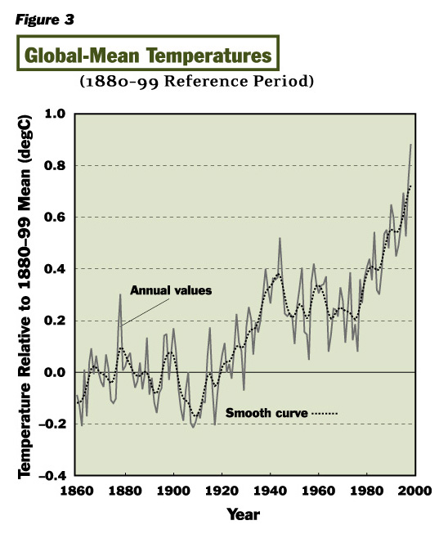
Global Temperatures are Rising
Temperatures have increased…
and are expected to continue to do so.
Warming (1990-2100):
3.6°-8.3°F (2.0°-4.6°C)
Full-range:
2.5°-10.4°F (1.4°-5.8°C)

Slide 7
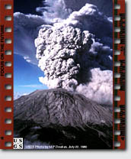

Humans are Influencing Temperature
Why is the Temperature Rising?
Natural variability
Human activities
“There is new and stronger evidence that most of the warming observed over the last 50 years is attributable to human activities” - IPCC, 2001
“GHGs are accumulating in Earth’s Atmosphere as a result of human activities, causing surface air temperatures and subsurface ocean temperatures to rise…” - From the National Academy of Sciences 2001 findings on climate change – research conducted at President Bush’s request

Slide 8
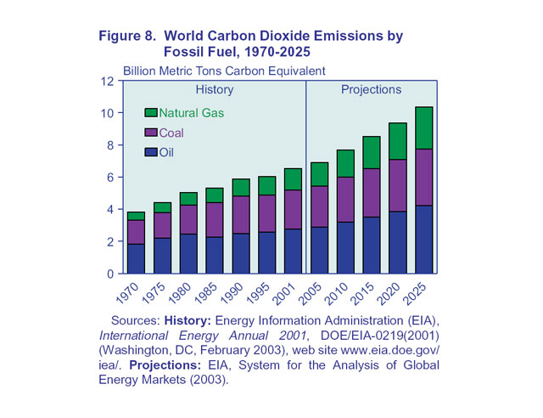
Global Emissions are Rising

Slide 9
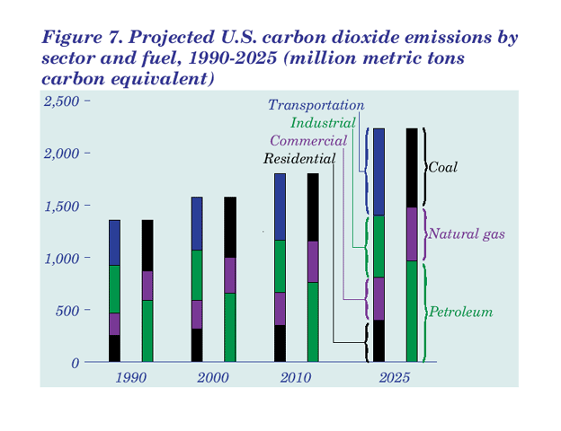
U.S. Emissions are Rising

Slide 10
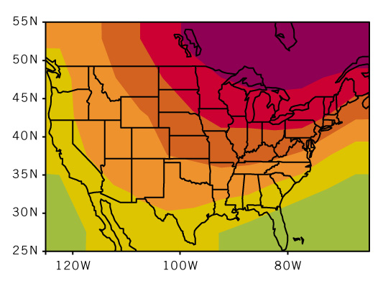
Temperature Changes forecast for U.S.
Ratio of projected change to global-mean change
WINTER (Dec - Jan - Feb)

Slide 11
The Impacts
Multiple impacts:
Weather
Agriculture
Water
Health
Coastal/Aquatic
Ecosystems
  Forest
  Freshwater and wetlands

Slide 12
Public Perception
Globally, the public is becoming more aware of climate change, and some are becoming more concerned
Media attention and headlines are increasing, driven by public interest
Citizens, consumers, and investors will increasingly pressure governments and industry for action
There is some willingness to pay for climate action

Slide 13

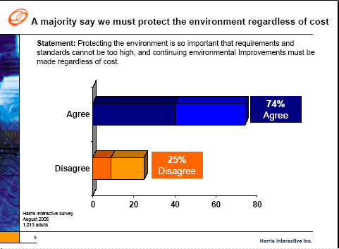
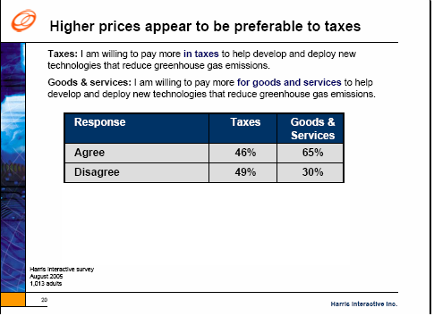
US Public Perception Study Indicates
Greater Awareness…
  *Excerpt from Poll
  Prepared by: HarrisInteractive Study
  Prepared for: Business Roundtable
  Climate RESOLVE
  Date: September 2005

Slide 14






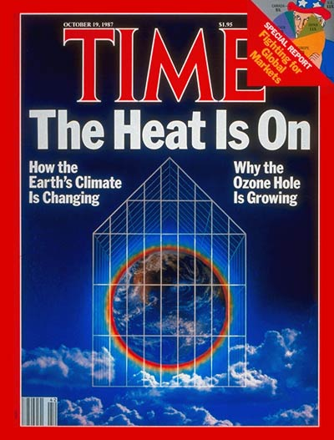


Increased Media Attention

Slide 15

Towards a Climate Friendly Built Environment
Prepared for the
Pew Center on Global Climate Change
by
Marilyn Brown, Frank Southworth and Theresa Stovall

Slide 16
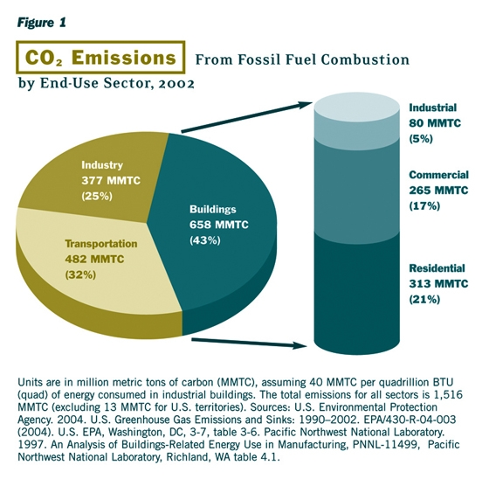
≈ 43% of U.S. CO₂ Emissions come from the Energy Required by Buildings

Slide 17
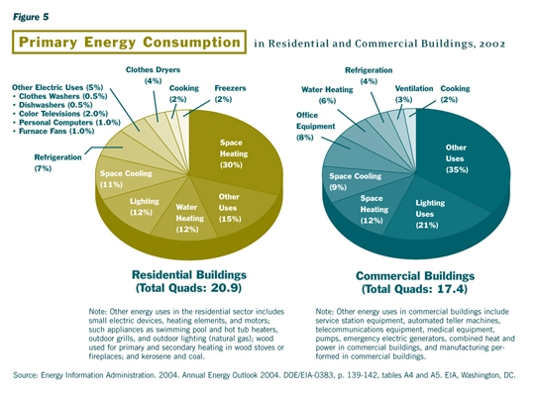
Diverse Sector, Diverse Uses
Energy Used Differently in Homes vs Commercial Buildings

Slide 18
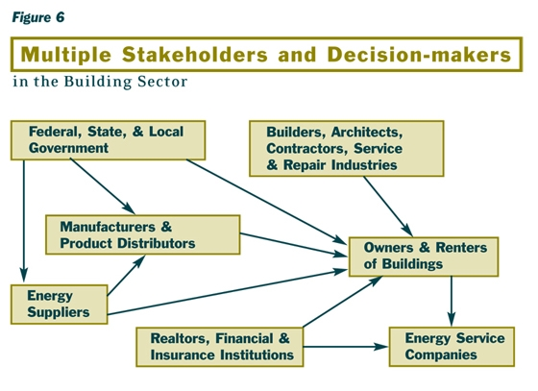
The Fragmented Building Industry Inhibits Innovation and Change

Slide 19
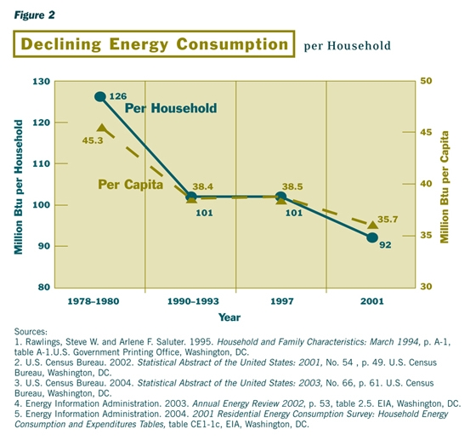
Past Success in Reducing GHG Intensity from the Buildings Sector

Slide 20
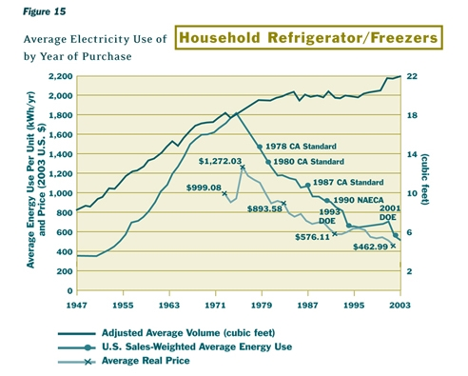
Household Refrigerator Illustrates Potential for Improved Efficiency
Notes:
\

Slide 21
There is no Room for Complacency
In the U.S. over the next 30 years:
  Most of the current stock of buildings will still be occupied
  The built environment will grow by 70%
  New energy services in buildings will continue to expand
  GHG emissions from buildings are expected to increase ~ 1.5% per year

Slide 22
Opportunities for Improvement are Great
The full complement of cost-effective climate-friendly technologies are rarely used (e.g., insulation, low-E glass)
Renewable energy only a small fraction of energy used on-site
Growing interest in reducing sprawl and ever-longer trips
Life cycle issues and interactions among diverse uses suggest the need for an integrated approach
Emerging Energy Technologies Could Make a Big Difference (e.g., Solid state lighting, Thermoelectric materials)

Slide 23
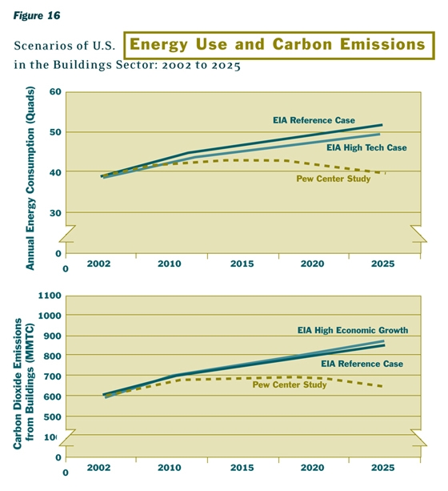
The Potential for Reduced Emissions with 7 Practical Policy Measures

Slide 24
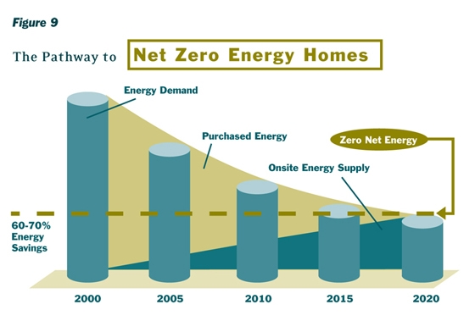
“Net-Zero-Energy” Homes

Slide 25
Good News and Bad News
Emissions are expected to grow in the absence of additional policy intervention.
It is fairly easy, using policies and measures we know about, to keep GHG emissions flat
Change in the building sector depends on aggregation of many small efforts
Over time, more radical changes are needed
In the long term, we’ll need to include widespread use of “zero energy homes” and buildings that are “green” from a climate perspective
But, you can’t keep emissions flat without policy

Slide 26
How do we get there?
Radical GHG reductions from the building sector depends on major advances on two fronts:
  Continued and increased building energy efficiency
  Onsite, low-GHG energy production

Slide 27
State and Local Developments
14 states have adopted LEED standards for government buildings
2 states have adopted Green Globes
New York State Green Building Initiative
California Green Building Initiative
Mayor commitment

Slide 28
Regional and National Initiatives
Public initiatives
  Regional Greenhouse Gas Initiative (RGGI) efficiency incentives
  2005 Energy Policy Act efficiency provisions
  Building America Program
  Department of Defense
Private programs
  American Institute of Architects 2030 Challenge
  Whole buildings standards

Slide 29
GHG Reductions Through Green Building Standards
Leadership in Energy and Environmental Design (LEED)
  Climate is one quarter of overall points
Model Green Homes Building Guidelines
  National Association of Home Builders Research Center (NAHB-RC)
  More emphasis on energy and resource efficiency, less on site selection and preparation
Green Globes - Green Buildings Initiative
Minnesota Sustainable Design Guide
Green Building Initiative

Slide 30
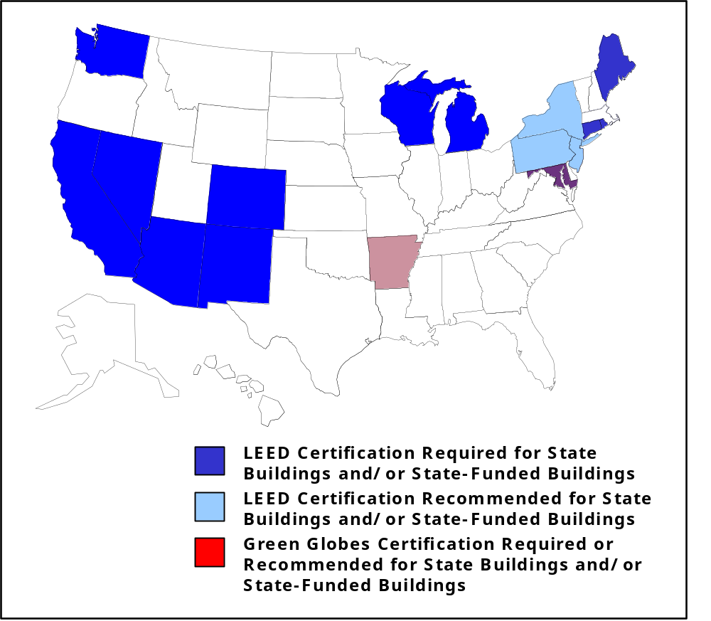
Green Building Standards for State Buildings

Slide 31
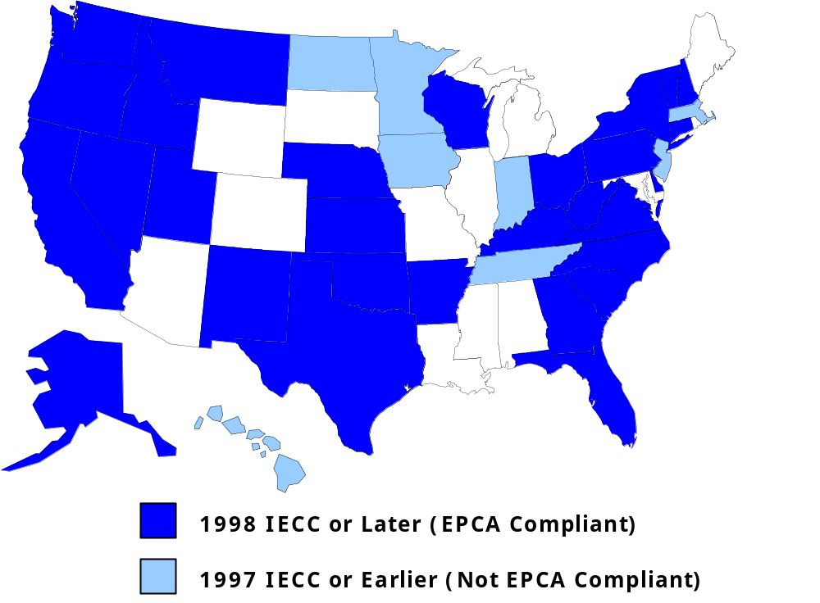
States with Residential Energy Codes

Slide 32
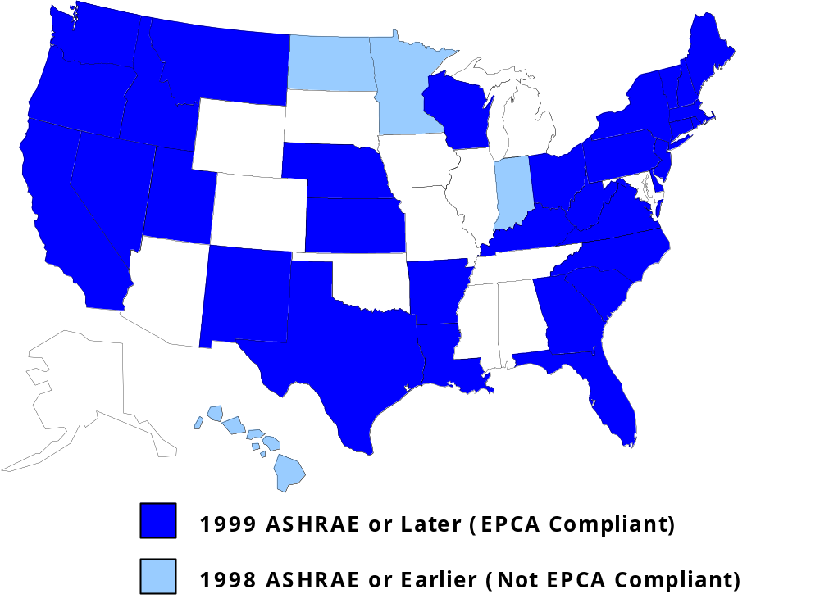
States with Commercial Energy Codes

Slide 33
International Developments
United Nations Environment Programme
  Sustainable Building and Construction Initiative (SBCI)
World Business Council on Sustainable Development’s (WBCSD)
  Green Building Initiative

Slide 34
Corporate Developments
Corporate role in international building initiatives
  UTC, Lafarge, others
Sustainability practices within companies
  Wal-Mart
  Swiss Re
  Bank of America
Growing market for climate-friendly building technologies

Slide 35
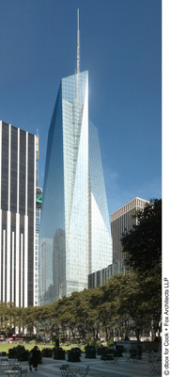
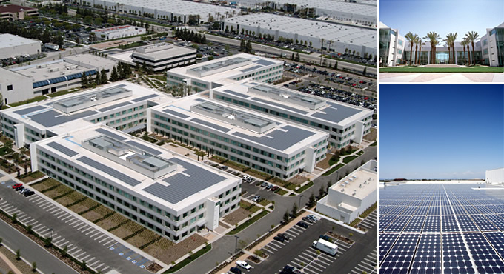
Corporate Headquarters
Bank of America
Toyota

Slide 36
Paths forward
The seven policies
R&D – more money, better focus
Buildings standards for each segment (states, private sector, NPO)
Promote on-site, low-GHG energy production (state and federal incentives)
Studies of lifecycle impacts of different building products
Link smart growth and green buildings efforts
Government buildings are important

Slide 37
Paths forward, (cont’d)
Engagement
  State and local gov’t and MPOs
  All parts of the building sector
  Other corporations
Assessment of progress thus far
  7 yrs ago, LEED had 12 members; now over 6000
  5 yrs ago, little investment in green buildings; now $33 billion
  ½ the market is government, including state and local
  Now 2000 buildings are LEED registered
  What have been the efficiency and GHG benefits?

Slide 38
Conclusions
Climate change is a serious problem
Huge potential for improvement in the building sector
Variety of state, federal, and international green buildings initiative
Technologies and policies available today to decrease GHG from buildings
Radical GHG reductions from the building sector depends on major advances on two fronts
  Continued and increased building energy efficiency
  Onsite, low-GHG energy production

Slide 39
For more information…
www.pewclimate.org

