Slide 1

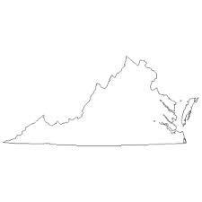
Virginia Comprehensive Services Act
Services for at Risk Youth
Office of the Secretary of Health & Human Resources
Commonwealth of Virginia
www.ehhr.virginia.gov

Slide 2
Virginia Comprehensive Services Act (CSA)
Established a State Pool by consolidating funds that purchased services for individual at-risk children:
Special Education Private Tuition Assistance
Education for Non-educational Placements of Students with Disabilities
State/Local Foster Care Support & Supplemental Services
Mental Health Bed Purchase Funds for Adolescents
Juvenile Justice Special Placement Funds

Slide 3
YOUTH Served by CSA
Youth eligible for foster care services (including prevention of foster care)
Youth requiring special education in private day schools or private residential schools
Youth with emotional/behavioral difficulties requiring services of multiple agencies and/or at risk of residential placement

Slide 4
CSA Details
Established in 1993
Funds are allocated to local interagency teams who assess the needs of youth and families and develop the complement of services necessary to meet their needs
State supervised, locally administered by 130 localities

Slide 5
Questions
Are services available to the children who need them?
Are services being provided in accordance with each child’s needs?
Are funds for services being spent wisely?
To what extent is each program meeting the measurable goals for that program based on the availability of services, each child’s needs and the funds for those services?

Slide 6
The Plan
Following a proof of concept pilot using philanthropic funding
Expand data collection from localities to state
Link clinical, expenditure and provider data
Develop baseline to understand “typical” expenditure for specific services
Perform analytics to identify outliers; both visually and using alerts
Demonstrate success and then go-live

Slide 7
Connecting Connected Facts
To build a more complete picture of an individual child’s experience, we linked assessment, demographic, and payment data from 3 state agencies and 130 localities.
CANS
OASIS
Medicaid payments
CANS – Child and Adolescent Needs and Strengths Assessment
VEMAT – Virginia Enhanced Maintenance Assessment Tool
OASIS – VA foster care case management system
VEMAT
CSA payments
Title IV-E payments

Slide 8
Risk-Adjusted Provider Payment Model
Linear model for expected payment to control for and measure the effects of the following variables simultaneously:
Locality
Month/Year
Service(s) Provided
Number of Children Served
Needs of the Children Served

Slide 9
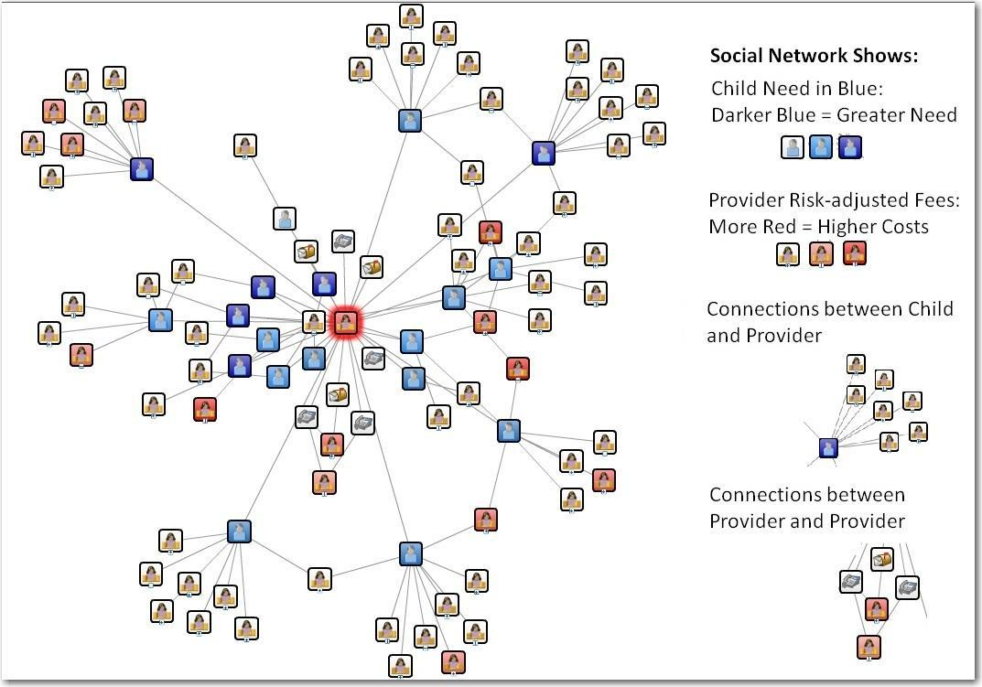
Social Network – visualize cause/effect

Slide 10
Lessons Learned
Technology was a known risk – SAS had good tools to support the effort
Change management is a challenge…achieving stakeholder support. Data can be threatening. Start softly and evolve the business relationship.
Devil in the details – Work through different meta data vocabularies (localization)

Slide 11

Questions?

