Slide 1
Focus on the Southern Piedmont

Slide 2
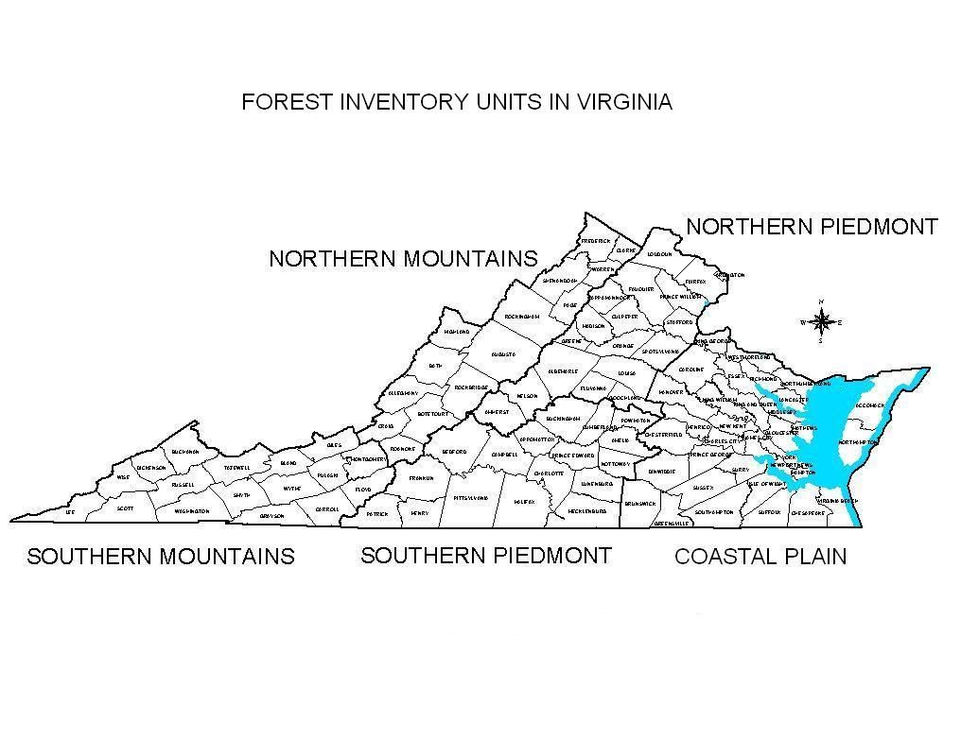
(Unit 3)
(Unit 4)
(Unit 5)
(Unit 2)
(Unit 1)

Slide 3
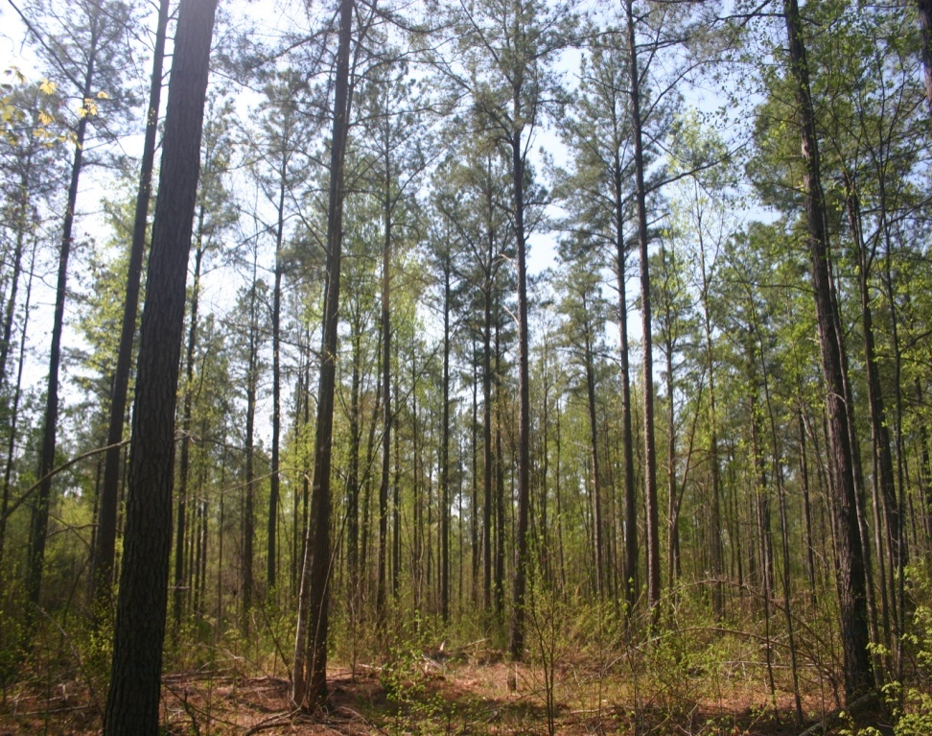
Factors Influencing the Resource
Growth/Removals
Forest land area
Harvesting
Reforestation trends
Cost Share Trends
Climate / Storm Events
Industry Changes
Economy

Slide 4

YEAR | ALL | HARDWOOD | SOFTWOOD
2001 | 1.28 | 1.37 | 1.16
2005 | 1.50 | 1.76 | 1.29
2006 | 1.55 | 1.81 | 1.33
2007 | 1.56 | 1.69 | 1.42
2008 | 1.32 | 1.56 | 1.11
2009 | 1.16 | 1.41 | 0.97
2010 | 1.14 | 1.34 | 0.98
NC Piedmont 2010 | 1.33 | 1.53 | 1.06

Slide 5
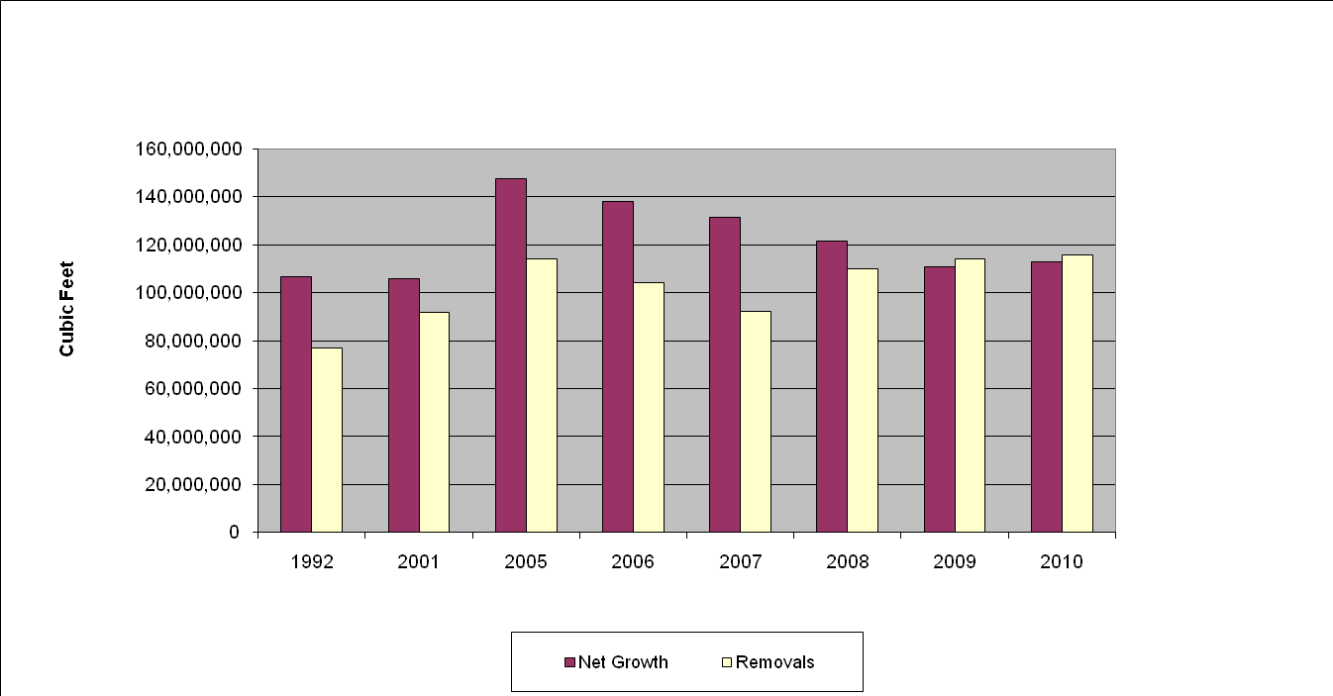
Growth / Removals (S. Piedmont)
Pine Net Growth vs. Removals

Slide 6
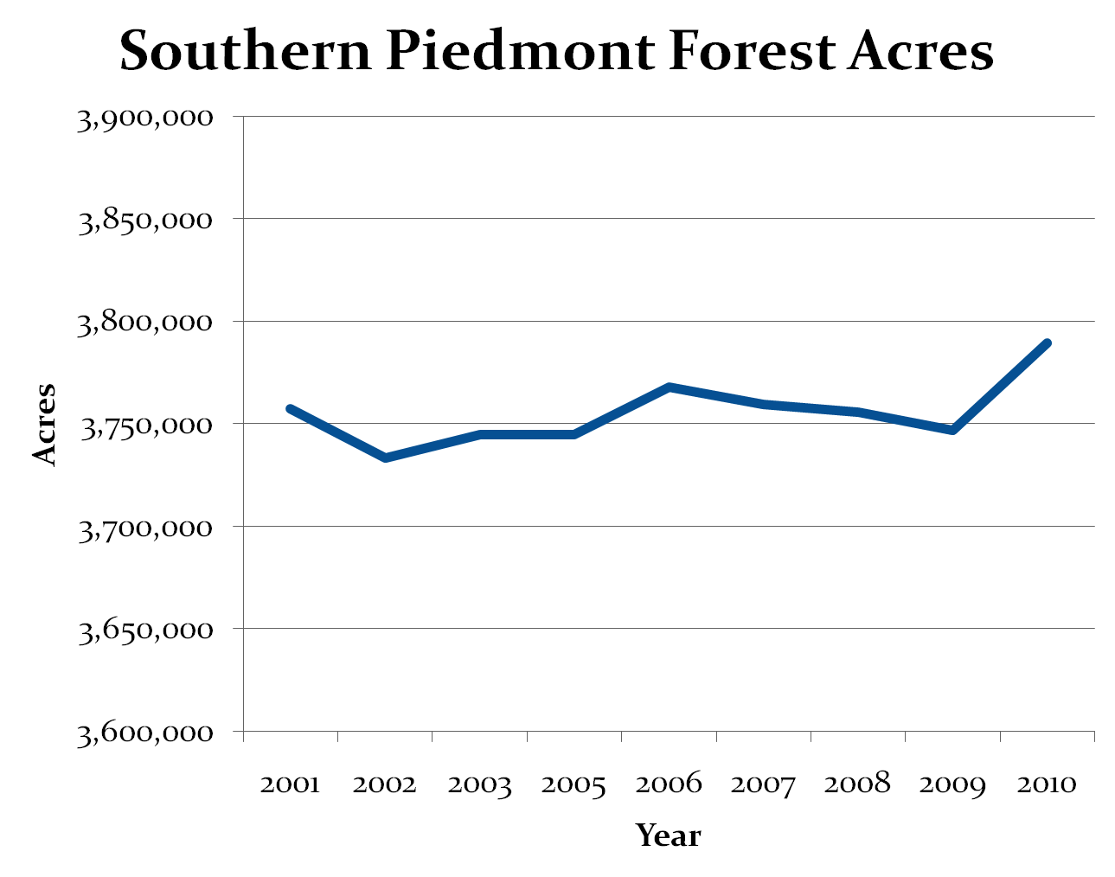

Slide 7
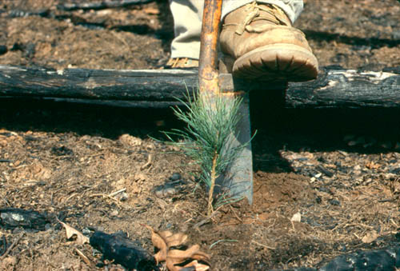
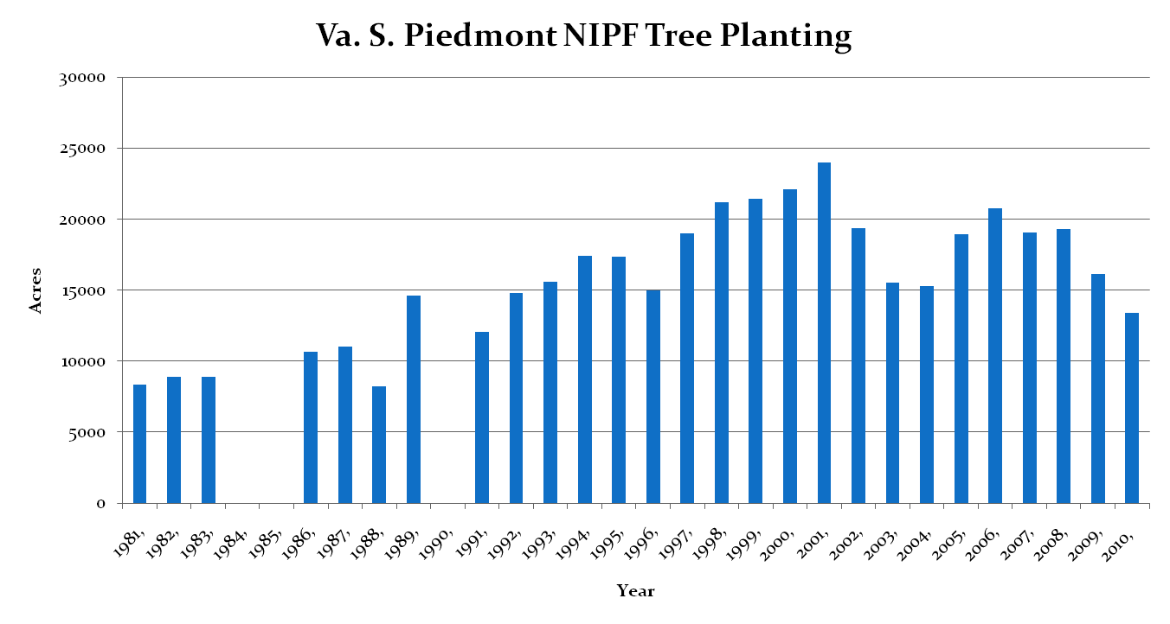
Reforestation Trends

Slide 8
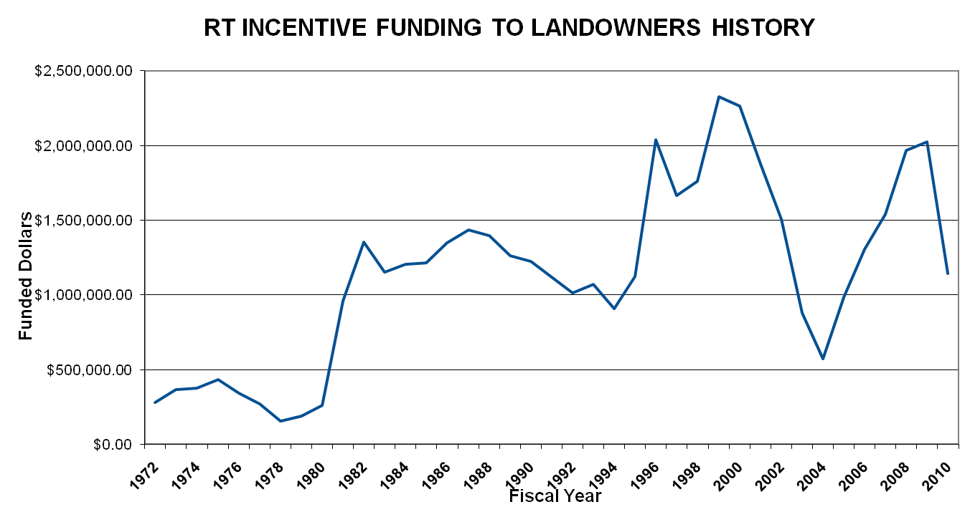
Cost Share Trends

Slide 9
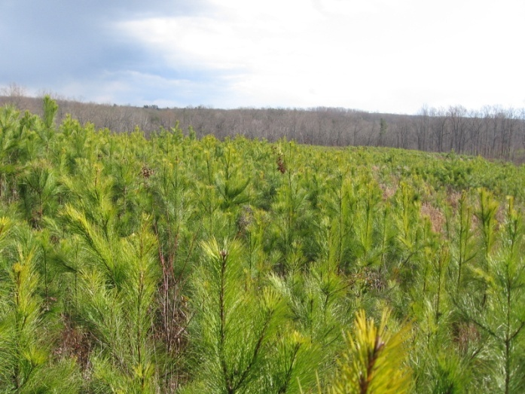
Loblolly Pine Forest Type – Annual Trends – S. Piedmont
Acres converted to Loblolly Pine type +32,550
Acres of Loblolly Pine type lost to other
Forest Types or land use changes -17,692
Net annual gain in loblolly pine forest
type 14,858 ac

Slide 10
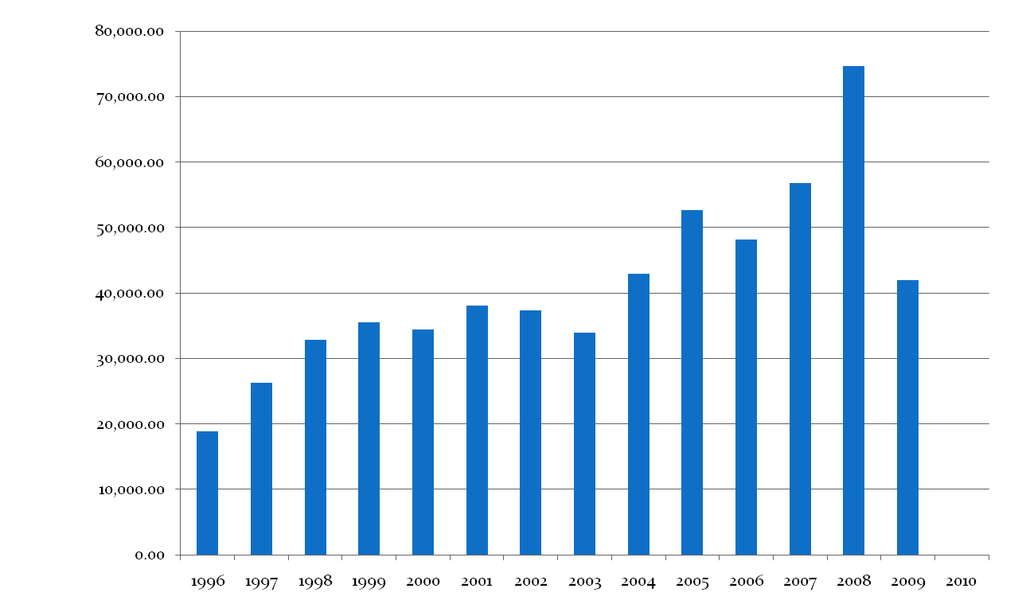
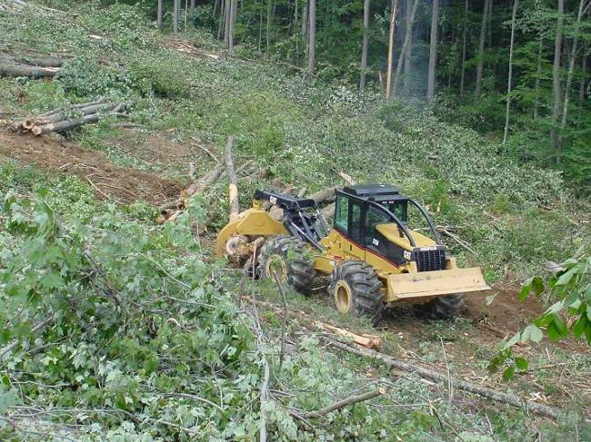
Timber Harvesting (S. Piedmont)

Slide 11
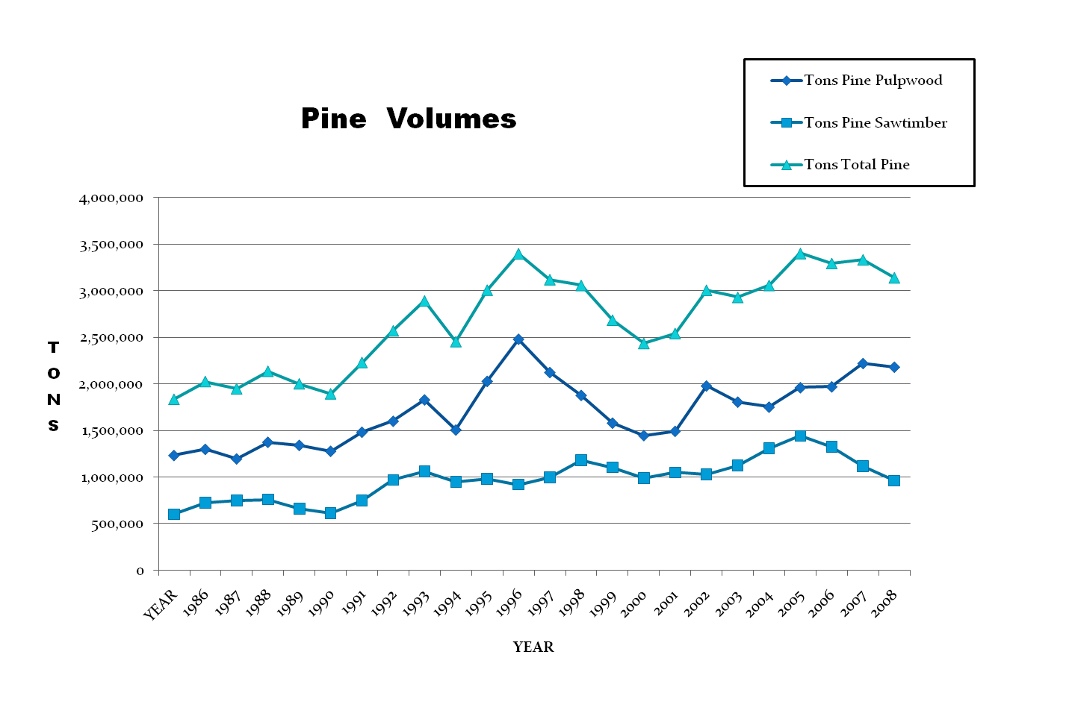
Virginia Southern Piedmont Pine Harvest

Slide 12
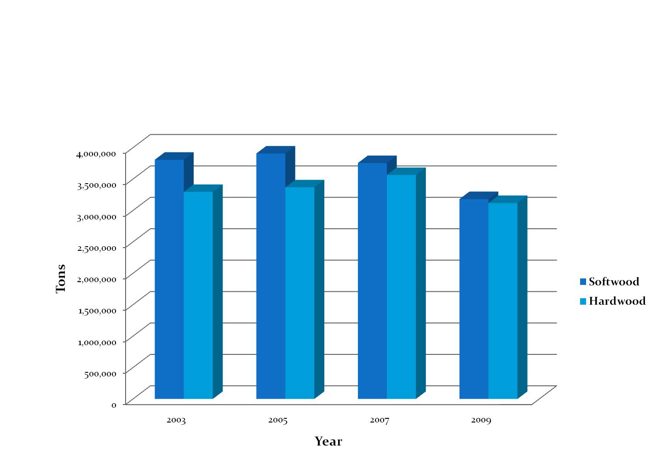
Virginia Southern Piedmont Timber Products Output

Slide 13
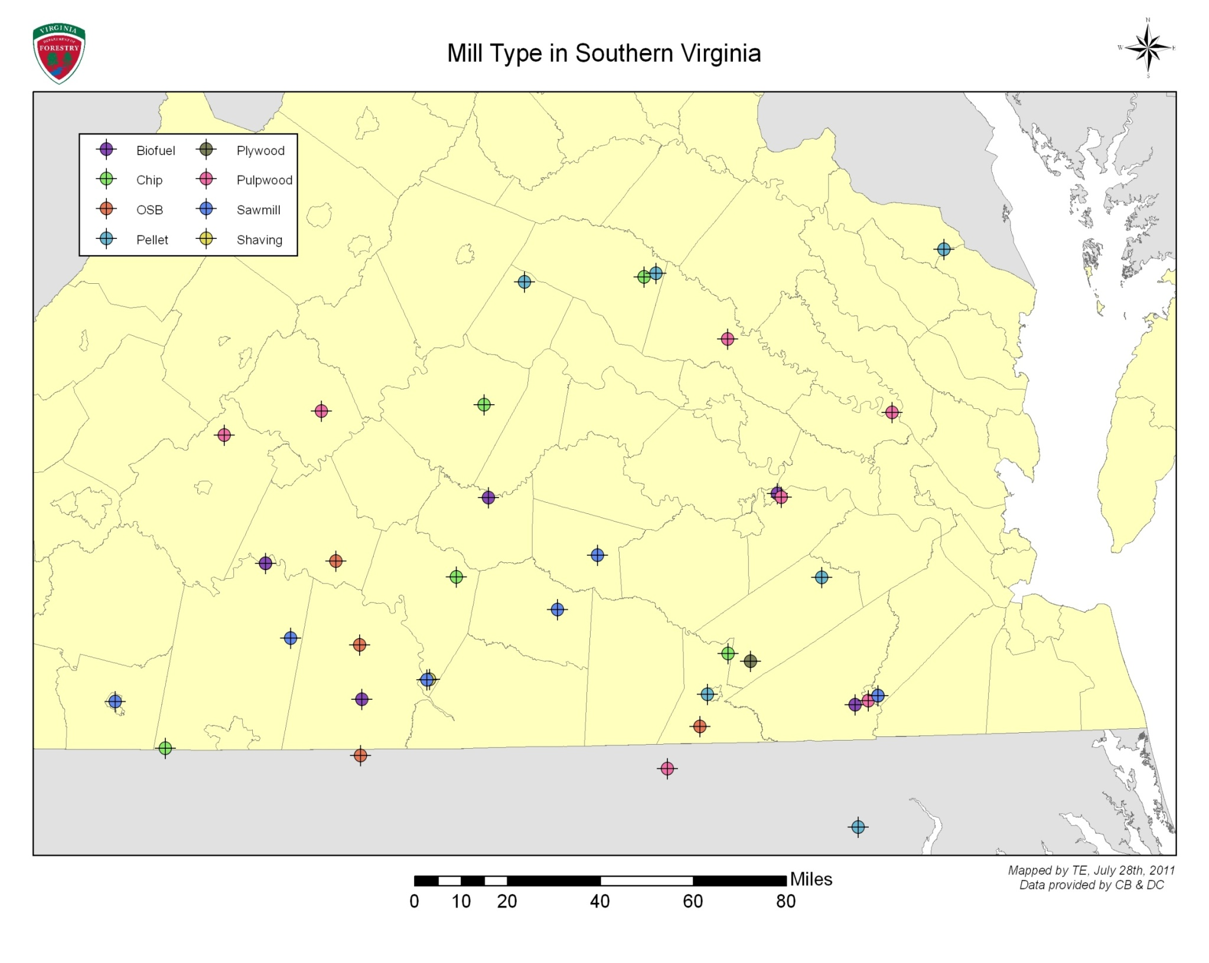

Slide 14
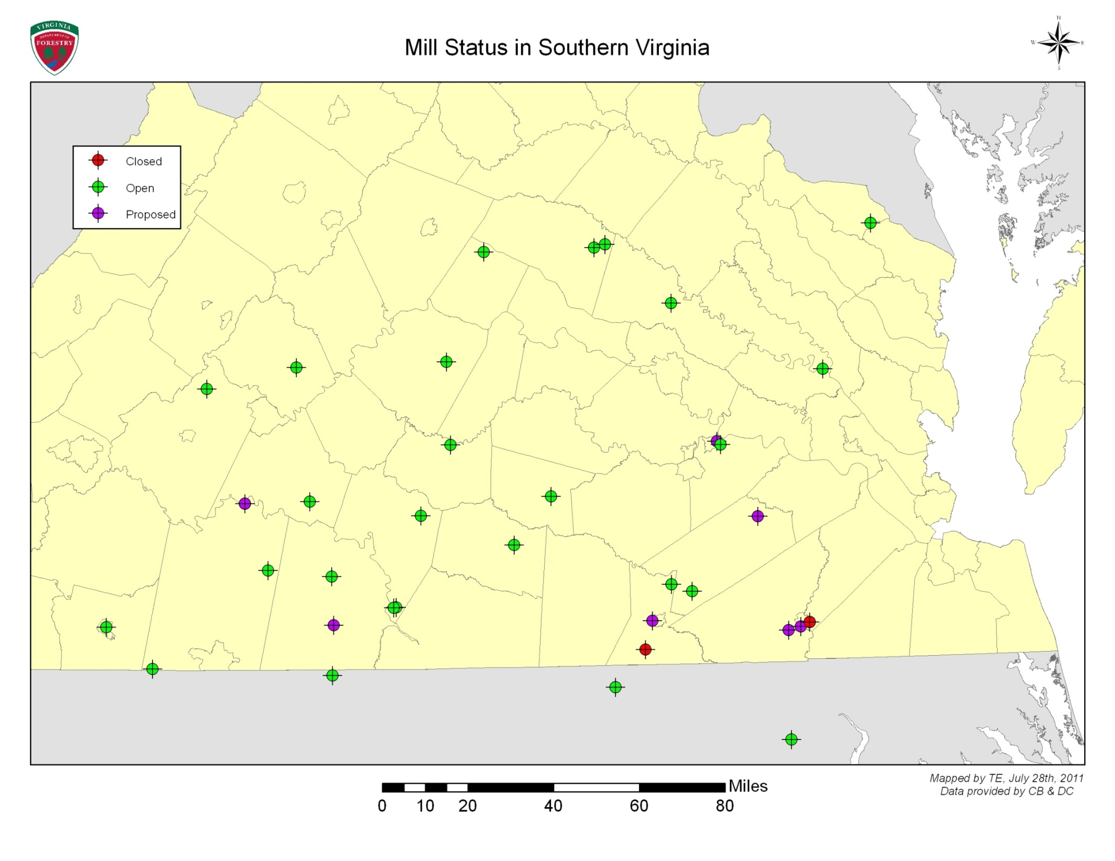

Slide 15
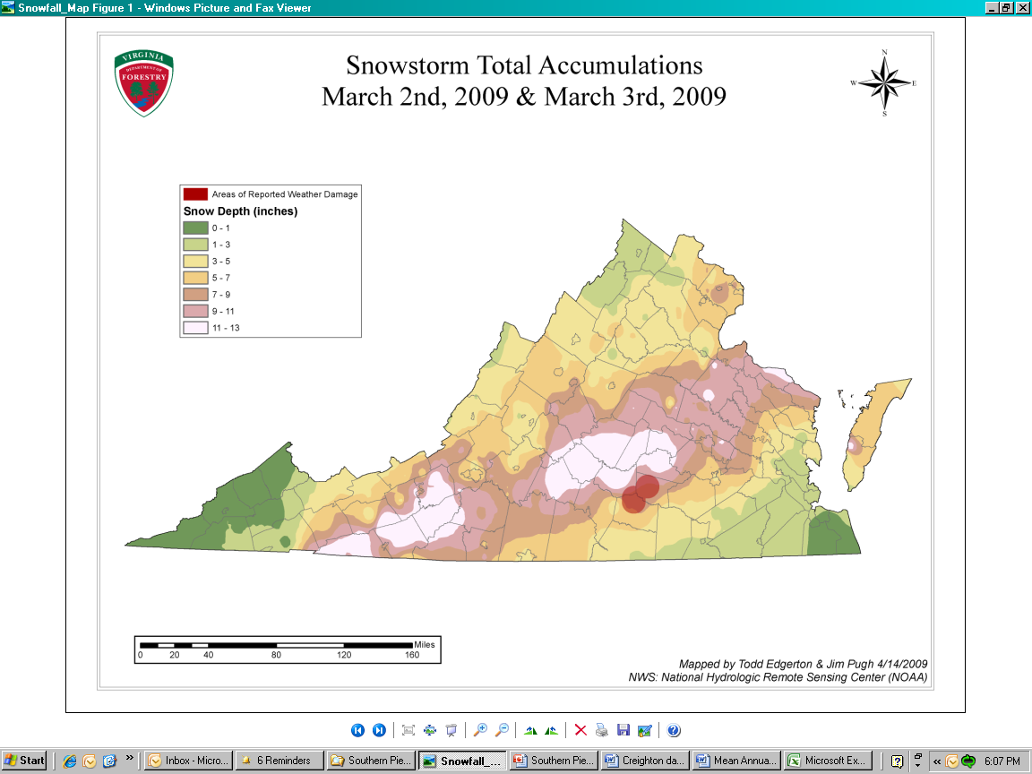
Climate / Storm Events

Slide 16
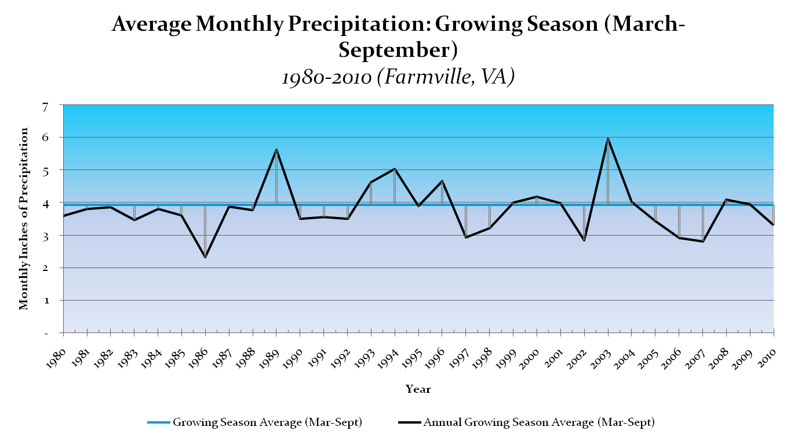
Climate / Storm Events

Slide 17
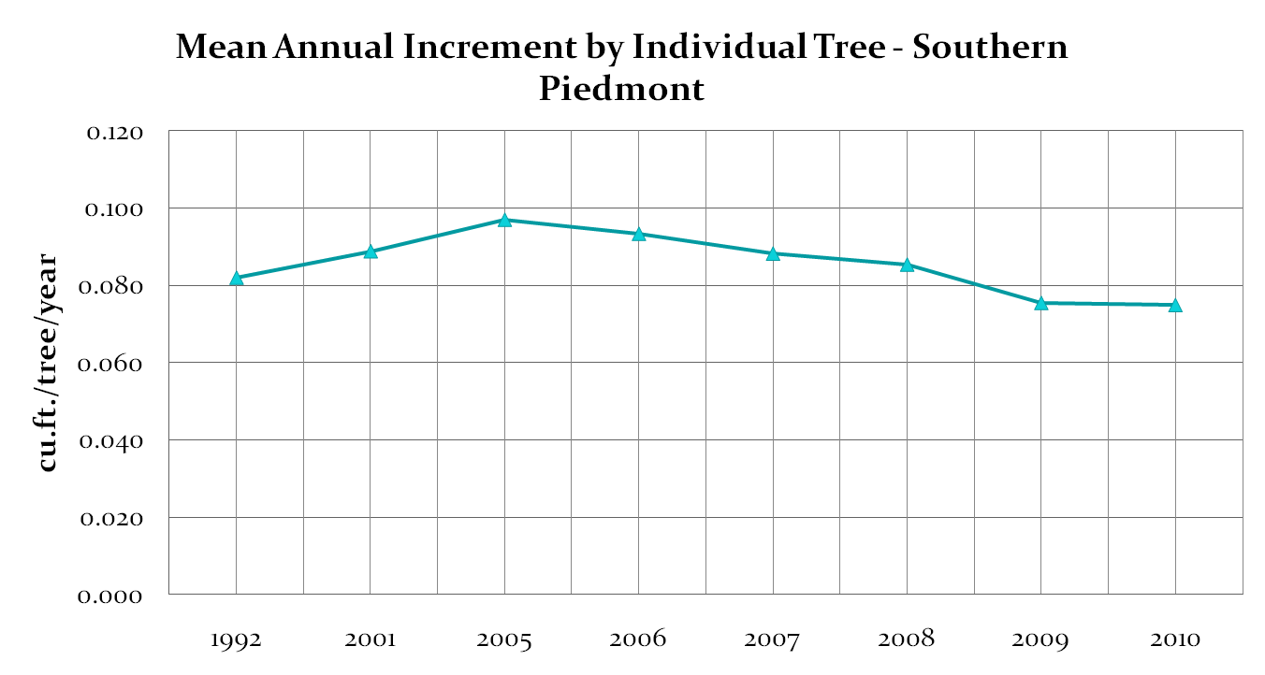
Climate/Storm Events

Slide 18
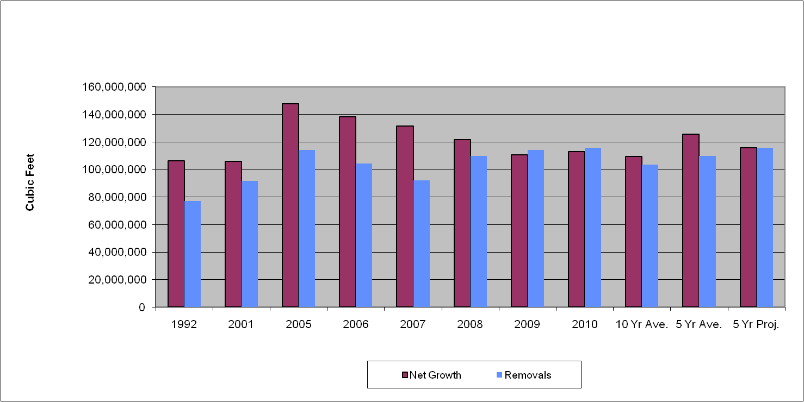
Southern Piedmont Softwood Net Growth vs. Removals - Projection

Slide 19
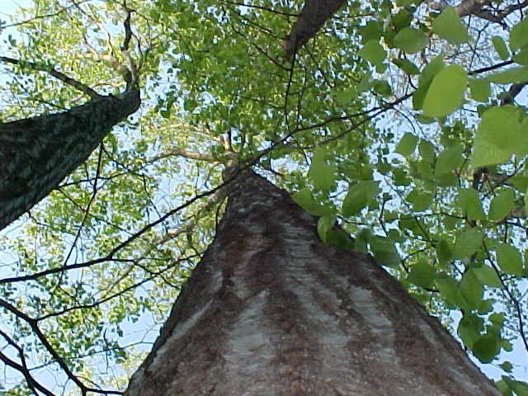

Keeping our Forests Working…and Growing

