Slide 1

Virginia's
Seventh Forest Survey
2001
John Scrivani, Research Forester
John Pemberton, Forest Inventory Manager
Resource Information Team

Slide 2
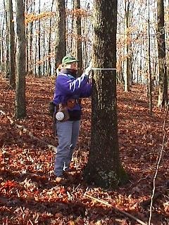
Those Who Made It Possible
Certified Crew Leaders
Trent Badgley
Jennifer Bailey
Onesphore Bitoki
Cesar Carrion
Steve Grayson
Jeffrey Grieco
Kirsten Johnson
Benjamin Koontz
Shannon Lewis
Jean Lorber
Tracy McDonald
Kelly Mezic
Patrick Murphy
Eric Nielsen
Tony Olsen
Ben Parsons
John Pemberton
Scott Siebert
Tom Snoddy
Randall Stamper
Michael Warrillow
Paul Whitehead III
Assistants
Dennis Anderson
Mike Armstrong
Joseph Blaylock
Thomas Callahan
Heather Campbell
Mike Chapman
Aaron Coffey
Chris Corbett
Gerald Crowell
Red Dameron
Greg Degan
Claudine Dunning
Larry Edwards
Patti Fannin
Jennifer Feese
Harold Fisher
Emily Gross
Jones H.F.
G.T. Hughes
Chuck Kuhler
Robert Kurtz
Joe Lehnen
Cindy Levin
Jeffrey Matthews
Robbie May
Seth Miller
Matthew Monaghan
Nan Morgan
Steve Moyer
Rodger Moyers
Rodney Nice
Herb Reynolds
Matthew Sandman
John Scrivani
John Severt
Heather Snead
John Wright
Gary Yew

Slide 3
Some More Details
Loss/gain of forest land varied by across the state
Significant changes in ownership
Growth/removals/mortality varied by unit
Changes in mix of harvest methods
Trend projections, past & future
Fragmentation & parcelization

Slide 4
Rates of Land Conversion,
1992-2001
68,000 acres each year converted from forest to other uses
  168 acres every day
  1 acre every 8 minutes
48,000 acres each year converted or reverted to forest
Net loss = 20,000 acres each year

Slide 5
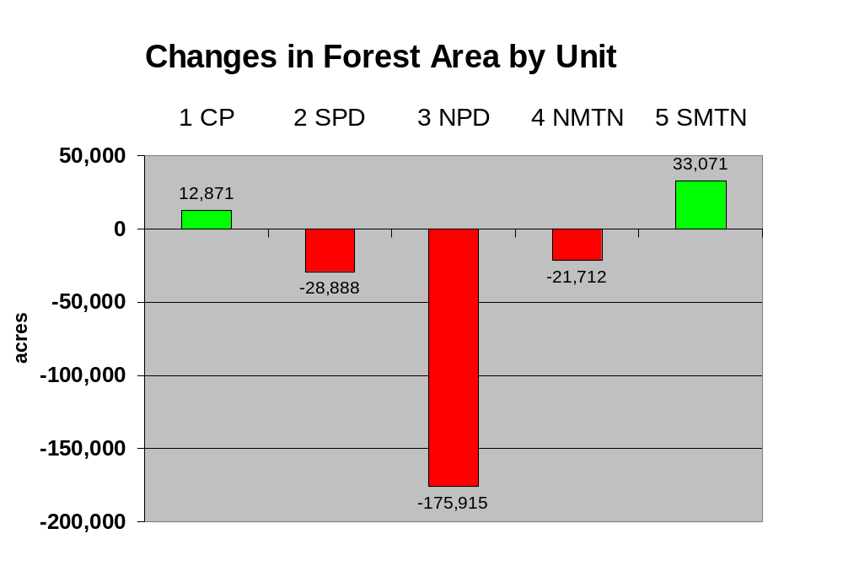

Slide 6
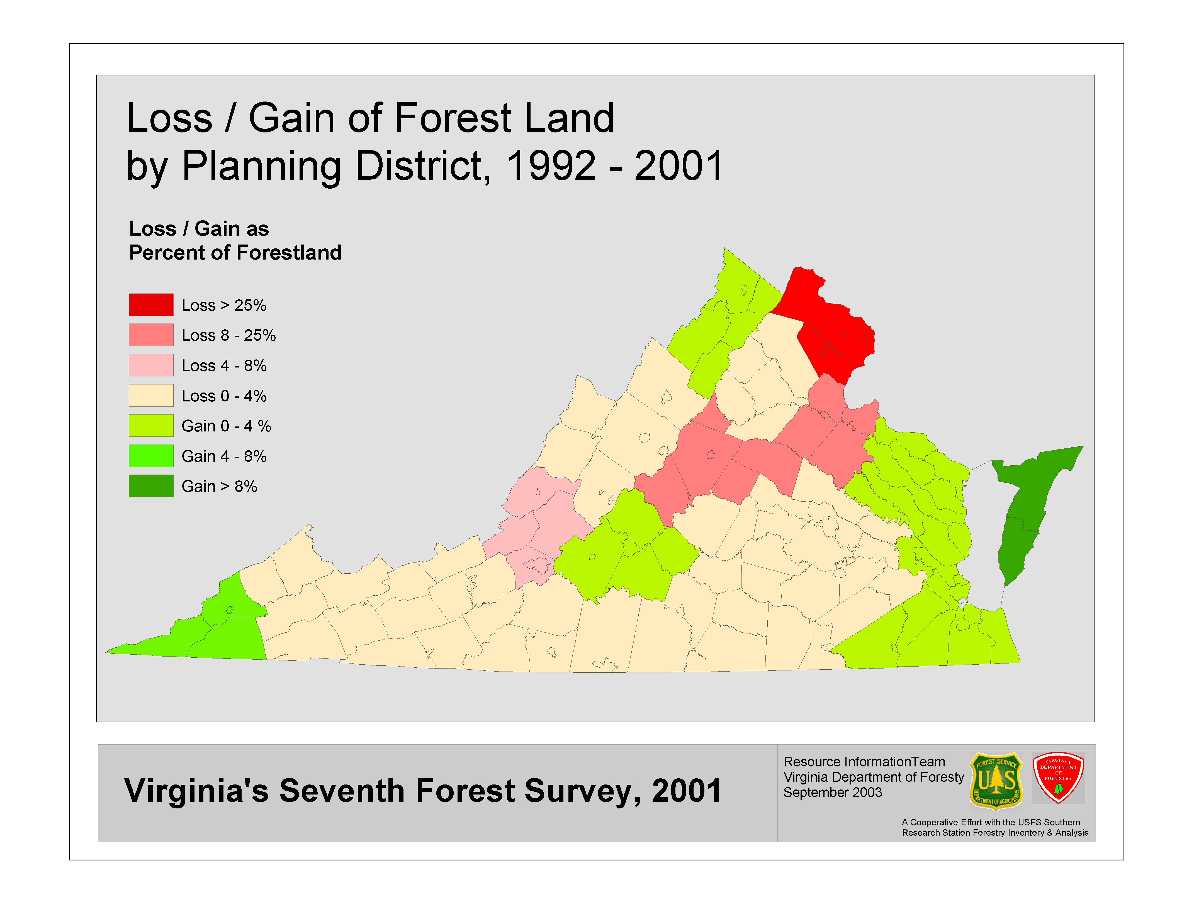

Slide 7
Ownership
Large drop in forest industry ownership
Increase in corporate ownership
Increase in public
Small decrease in private individual ownership

Slide 8
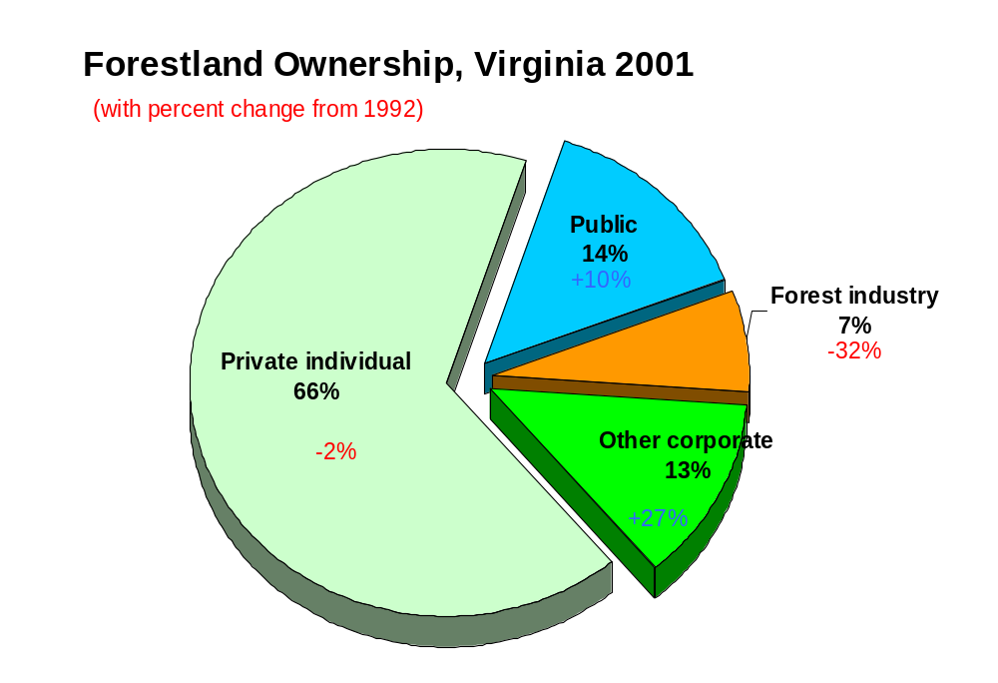

Slide 9
Growth, Removals & Mortality
3.3 % net annual growth all species statewide
1.1 %% annual mortality all species statewide
2.4 % annual removals all species statewide
growth exceeded removals by 271 million cubic feet each year (1% of inventory)
varied by unit and species

Slide 10
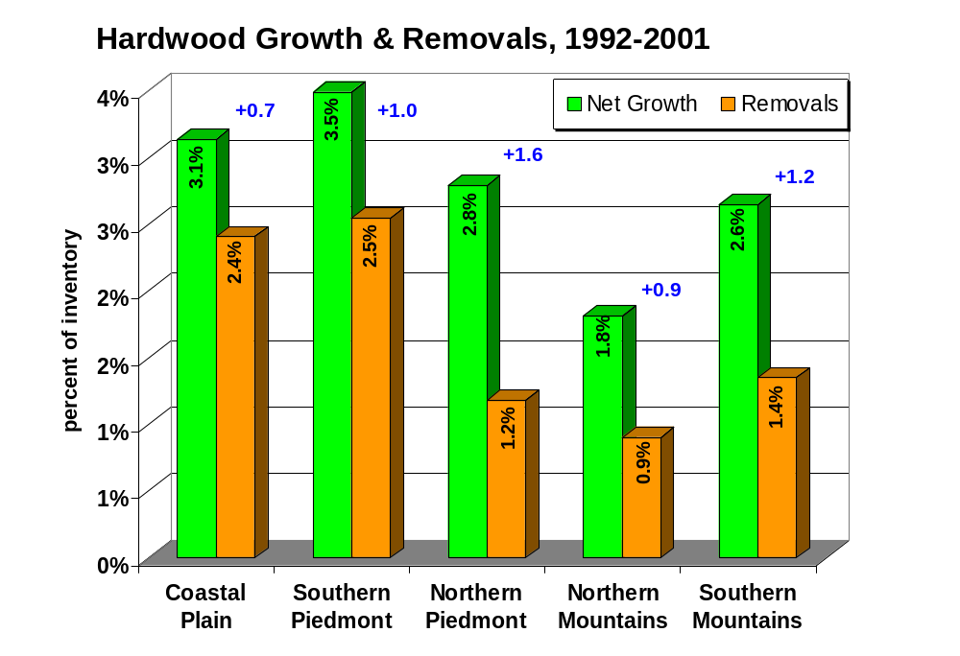

Slide 11
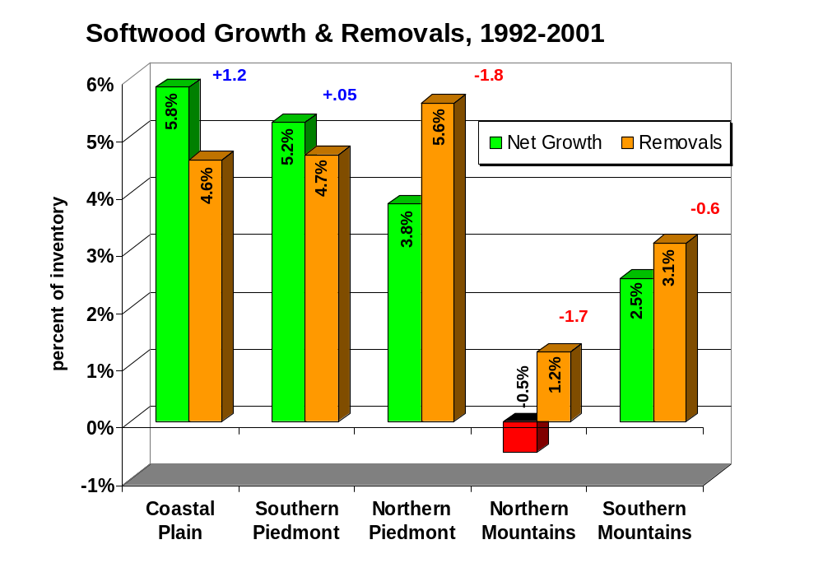

Slide 12
Change in harvesting/regeneration practices
Final harvests (clearcuts) down 16 %
Partial harvest up 154 %
Commercial thinning up 35 %
Natural regeneration up 7%
Artificial regeneration (planting) down 15%

Slide 13
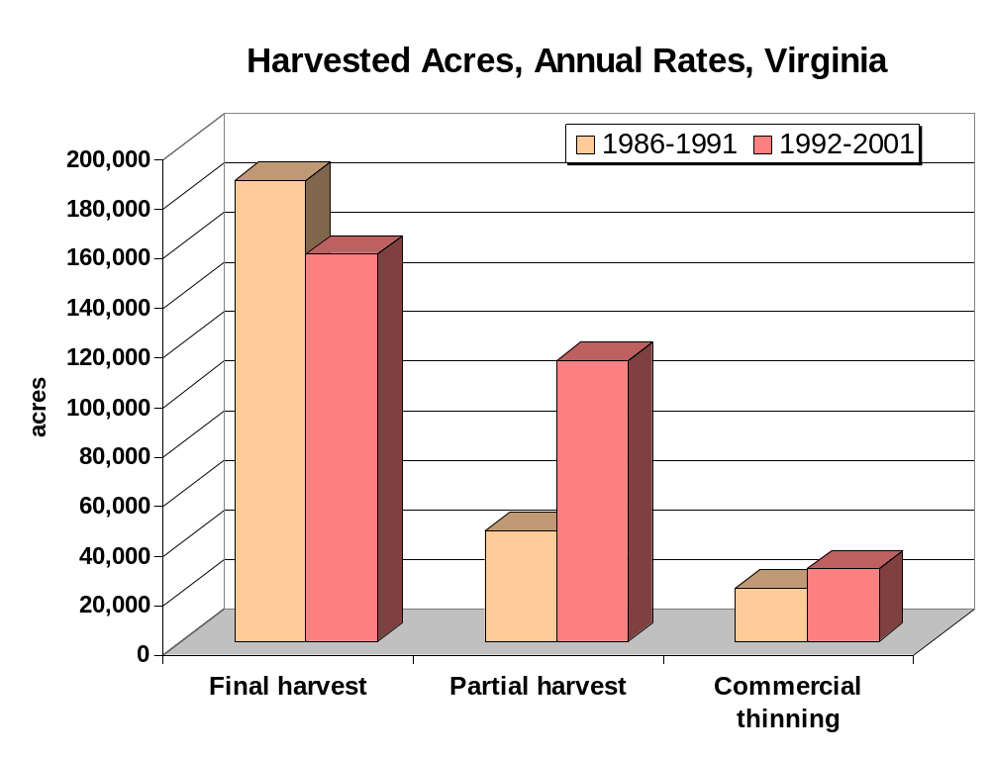

Slide 14
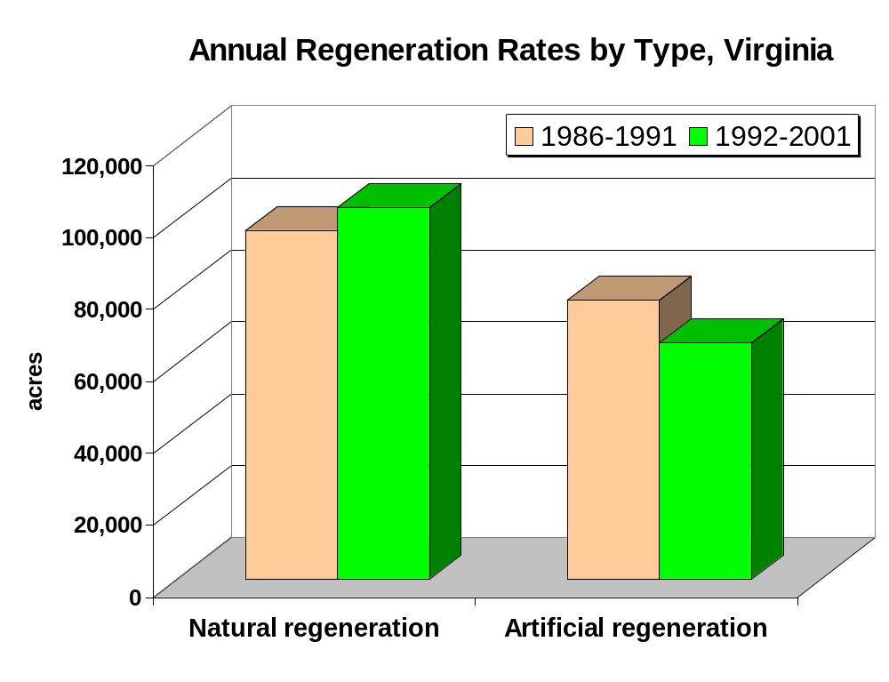

Slide 15
Fourth Forest, 1988: Projections to Year 2030
Subregional Timber Supply Model (SRTS), 2002:
Projections to 2040

Slide 16
Timberland Area
The Fourth Forest projected a decline of timberland area in the year 2000 to 15.04 million acres then stable out to 2030
The SRTS projects a decline to 14 million acres in 2040
The 7th Survey estimates 15.29 million acres
Urban conversion rate, if continued, will consume a million acres by 2040
Will agricultural reversion continue to moderate the decline?

Slide 17
Looking Ahead - Softwood Resources
For the year 2030, the Fourth Forest predicted 3.0 million acres of pine plantations
SRTS predicts about 2.7 million acres in 2040
Based upon increases in both the productivity of management and plantation area, SRTS predicts maintenance of pine ratio > 1.0
The rate of new plantation establishment has slowed in the last few years, making the addition of 900,000 acres questionable.

Slide 18
Looking Ahead - Hardwood Resources
Both the Fourth Forest and the SRTS predict declines in hardwood area, slowing growth and increased removals.
2001 estimates much better than predicted by Fourth Forest
SRTS predicts that hardwood ratio will decrease below 1.0 by 2020
Part of predicted declines in area depend upon predicted pine conversion rates

Slide 19
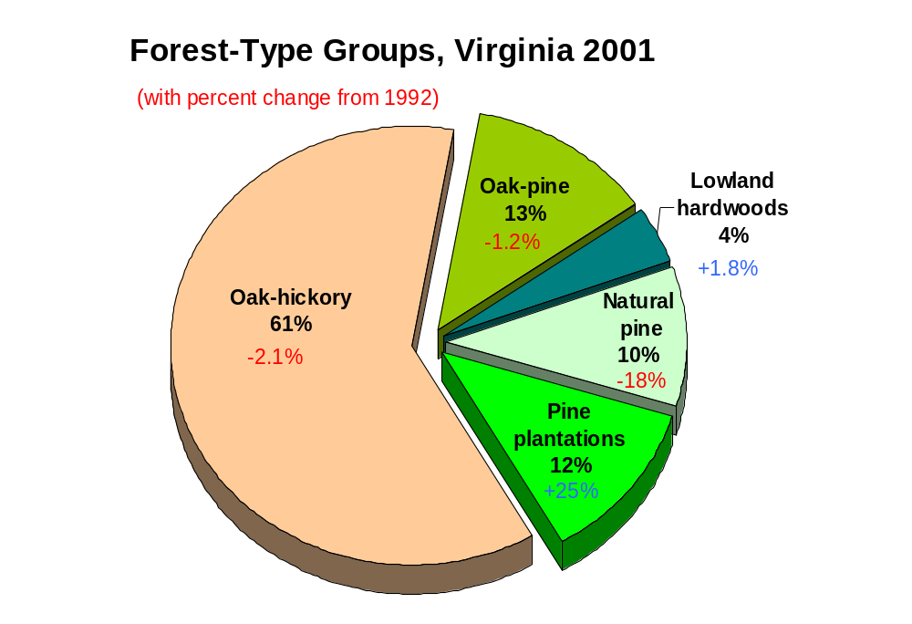

Slide 20
Fragmentation & Parcelization
Urban conversions of forest generally leave surrounding fragmented forests
Agriculture reversions can decrease fragmentation
Subdivision of land increasing parcelization

Slide 21
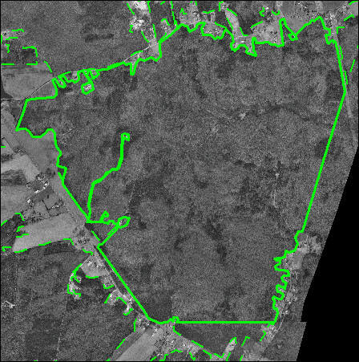
Forest Patch
698 acres

Slide 22
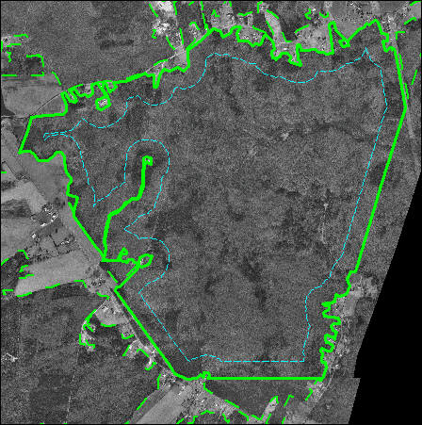
Interior Forest Patch
(100 m)
468 acres

Slide 23
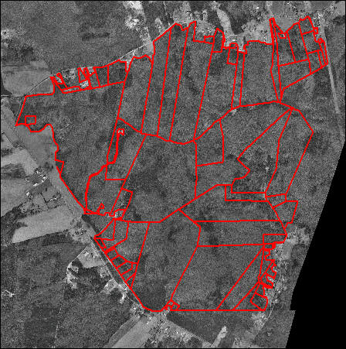
Forest Patch
->
Forest
Parcels
65 parcels
10 ac average
0.1 to 90 ac

Slide 24
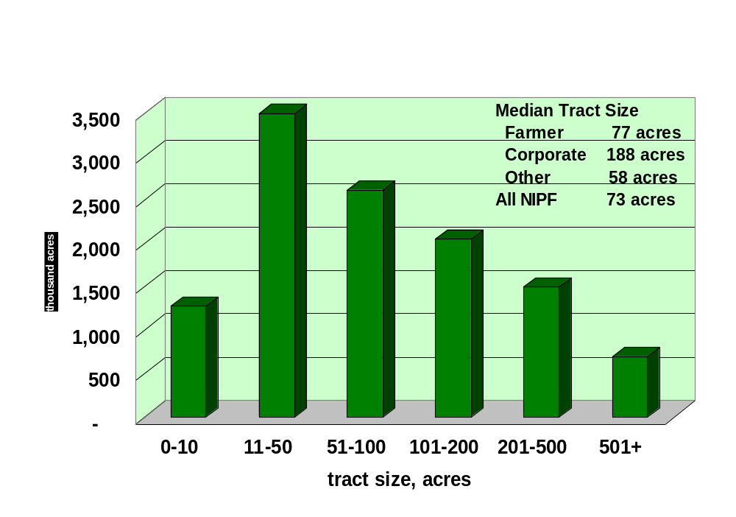
Forested Tract Size Virginia, 1992

Slide 25
Resource Assessments
New data will allow updating of previous assessments (e.g. 1995 study)
Precise plot locations, more and better quality GIS data, including satellite image classifications of forests, will make assessments more spatially accurate

Slide 26
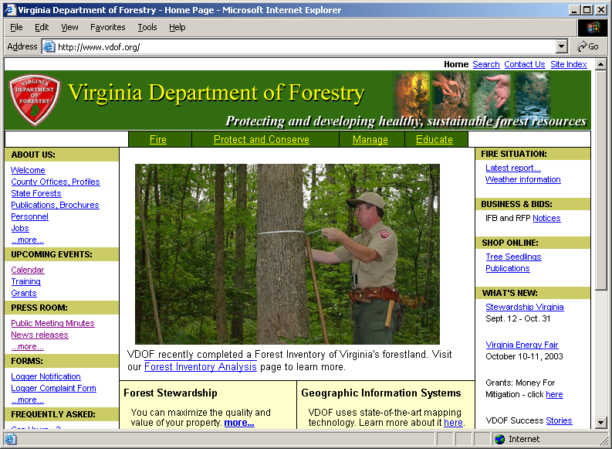
www.vdof.org

Slide 27
Thank you !
Questions?

